Slide 1
Welcome
Fairchild AFB Restoration
Advisory Board (RAB) Meeting
24 March 2022

Slide 2
Fairchild AFB
Restoration Advisory Board Meeting
4:00 p.m., March 24, 2022
RAB Meeting Agenda
4:00 – 4:05 Welcome …………………………………………….. Col. Freeman, RAB Installation Co-Chair
4:05 – 4:15 RAB Business……………………………………… .. Liz Drake, RAB Facilitator
      Ground Rules for Meeting
      Introduce New RAB Members
      Discuss Meeting Minutes from Previous RAB Meeting
4:15 – 4:30 What Do RAB Members Do?.........................................................…... Mark Loucks, AFCEC
4:30 – 4:45 PFOS/PFOA Investigation and Ongoing PFOS/PFOA Projects …... Mark Loucks, AFCEC
4:45 –5:25 Update on Sites Managed Under the Performance Based Contract (SS039, SD037, LF002, WP003, and Voluntary Cleanup Program) + Public Comment Opportunities
………………………………………………………… John Peper, Bay West
………………………………………………………… Kristine Weber, AECOM
5:25 – 5:30 Break
5:30 – 5:40 Public Comment Opportunity………………………. Liz Drake, RAB Facilitator
5:40 – 6:00 Discuss Date and Agenda Items for Next Meeting
Adjourn

Slide 3

RAB Member
Orientation
Mark Loucks,
AFCEC Hill ISS Chief
Air Force Civil Engineer Center

Slide 4
Overview
  CERCLA Process
  Evolution of RAB
  Roles
  Specific duties
  Getting involved
  Discussion

Slide 5
What is CERCLA?
Comprehensive Environmental Response, Compensation and Liability Act
Also called “Superfund”
Passed in 1980. Amended in 1986.
Purpose: To find and clean up old waste disposal sites
Outlines the process that investigations and cleanups will follow

Slide 6
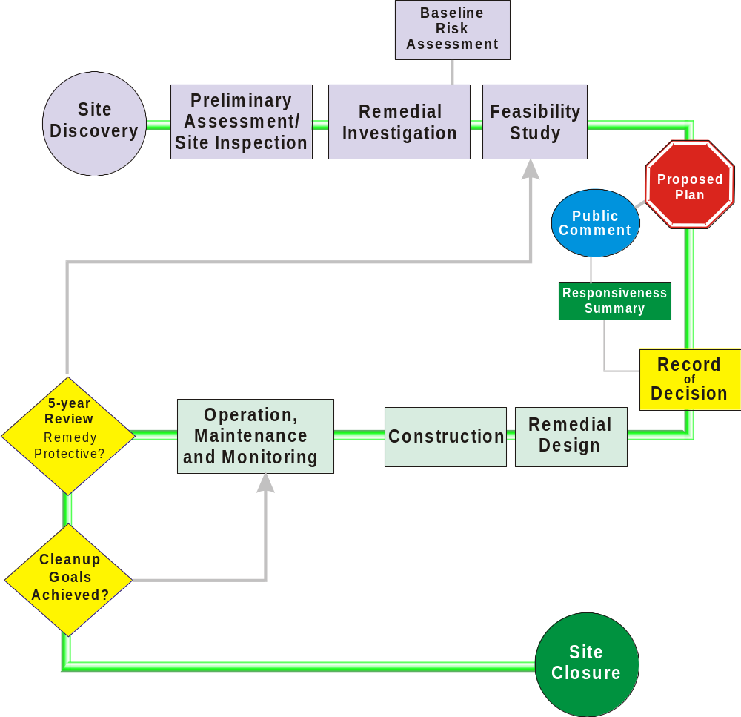
CERCLA Process

Slide 7
According to CERCLA
Must Have Public Involvement
  Requires public to be informed
  Requires public involvement in decisions
  Requires public comment periods
  Administrative Record/Information Repository
  Technical Review Committee – RAB precursor

Slide 8
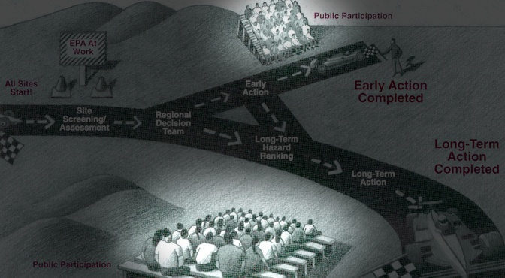
EPA’s Idea of Public Involvement in Early ’90s

Slide 9
Everyone In Agreement Was
Not Really Effective
  Keystone Group formed in early 1990s.
  Wanted more meaningful involvement with federal agencies in cleanup decisions.
  Suggested formation of citizen advisory boards.
  In 1994, DOD adopted the concept of RABs.

Slide 10
RAB Member Job Description
  Provide advice to the Air Force in regards cleanup of sites at Fairchild AFB
  Review and comment on Air Force investigations and cleanup actions
  Act as an advocate for the community
  Help explain cleanup issues to public
  Relay community concerns to the Air Force
  Represent your constituents

Slide 11
RAB Member Job Description (Continued)
  Attend RAB meetings
  Attend training sessions and tours
  Attend information fairs/public meetings
  Read the materials provided to you
  Report back to constituents and/or sponsoring organizations

Slide 12
Other Ways to Be Involved
  Regularly speak to your city or county council about your perspective of the cleanup.
  Speak up. Tell us what you think. Your perspective is important to us.

Slide 13
What the RAB Can’t Do
  Cannot make cleanup decisions
  Cannot set policy or enter into binding agreements
  Has no budget of its own
    AF pays to administer RAB
  Cannot compensate members for time or travel
  *AF provides funds for technical assistance

Slide 14
How the AF Views the RAB
  The RAB does not work for the Air Force
  The RAB is the Air Force’s partner
  An informed RAB gives better advice
  Your opinion is valued - even if it differs from the Air Force’s
  You have a perspective the AF does not have
  The Air Force needs you to speak up
  *AF provides funds for technical assistance

Slide 15
Where to Go for Help
  All documents related to the cleanup are online
  http://afcec.publicadmin-record.us.af.mil/
  Contains all documents related to cleanup in electronic format
  Talk to our team
  Fairchild AFB webpage:
  https://www.fairchild.af.mil/Information/Restoration/

Slide 16
Technical Assistance
  The RAB can request an independent expert to assist them in…
    Interpreting complex documents
    Understanding technical concepts
    Checking the Air Force’s work
  Air Force will pay for the TA
  RAB can interview and choose
  RAB has set rules on how a TA is requested and chosen

Slide 17
Discussion

Slide 18

Air Force Civil Engineer Center
I n t e g r i t y - S e r v i c e - E x c e l l e n c e
March 2022
Restoration Advisory Board (RAB)
Mark Loucks,
AFCEC Hill ISS Chief

Slide 19
Agenda
Background
What have we done so far (mitigation efforts)
Challenges we are dealing with
EE/CA action for City of Airway Heights
New early actions under consideration
Remedial Investigation update

Slide 20
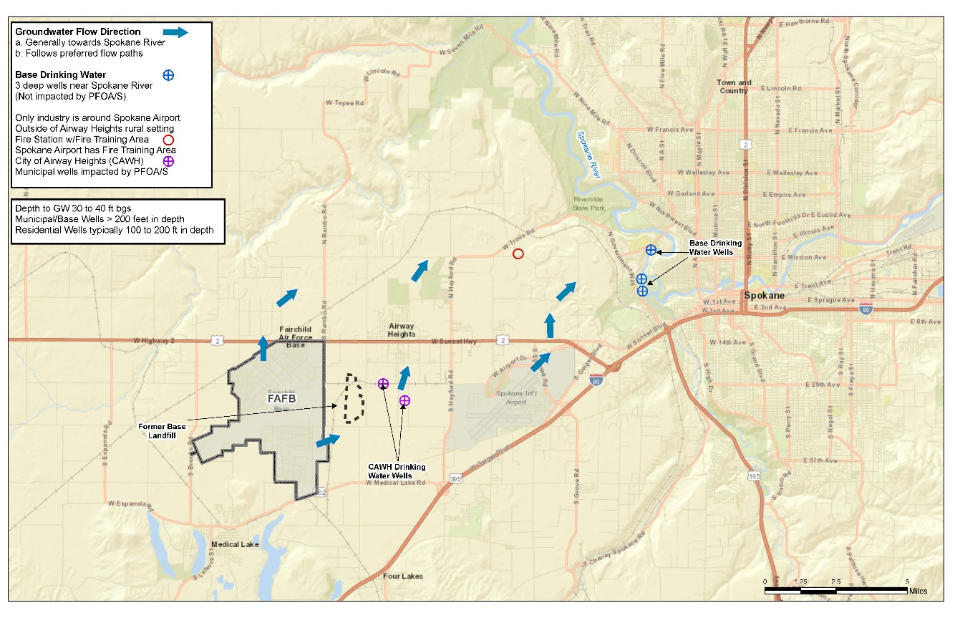
Groundwater Flow

Slide 21
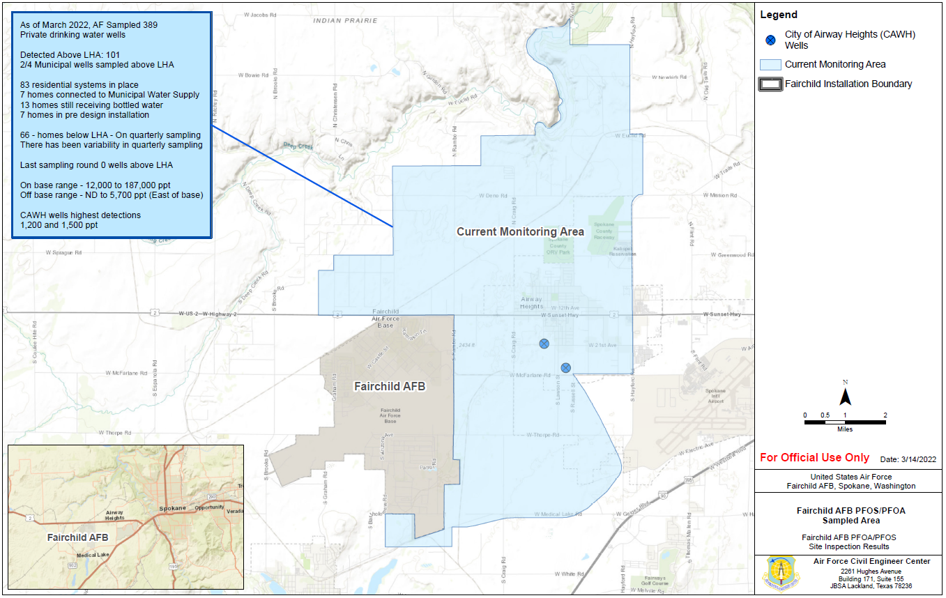
Sampling Area

Slide 22
Response Actions
Actions for residential drinking water wells
  TCRA approved March 2018 installation on-going
  13 homes currently on bottled water
  Individual whole house Granular Activated Carbon (GAC) filtration systems
    83 filtration systems installed
    7 wells with systems pending
    3 wells (6 homes) connected to CAWH water system
    2 wells on hold
      2 homeowners have refused system
    6 wells not currently used (properties with more than one well)
      Wells could not be used as drinking water supply
      Currently not needed to meet home owner requirements

Slide 23
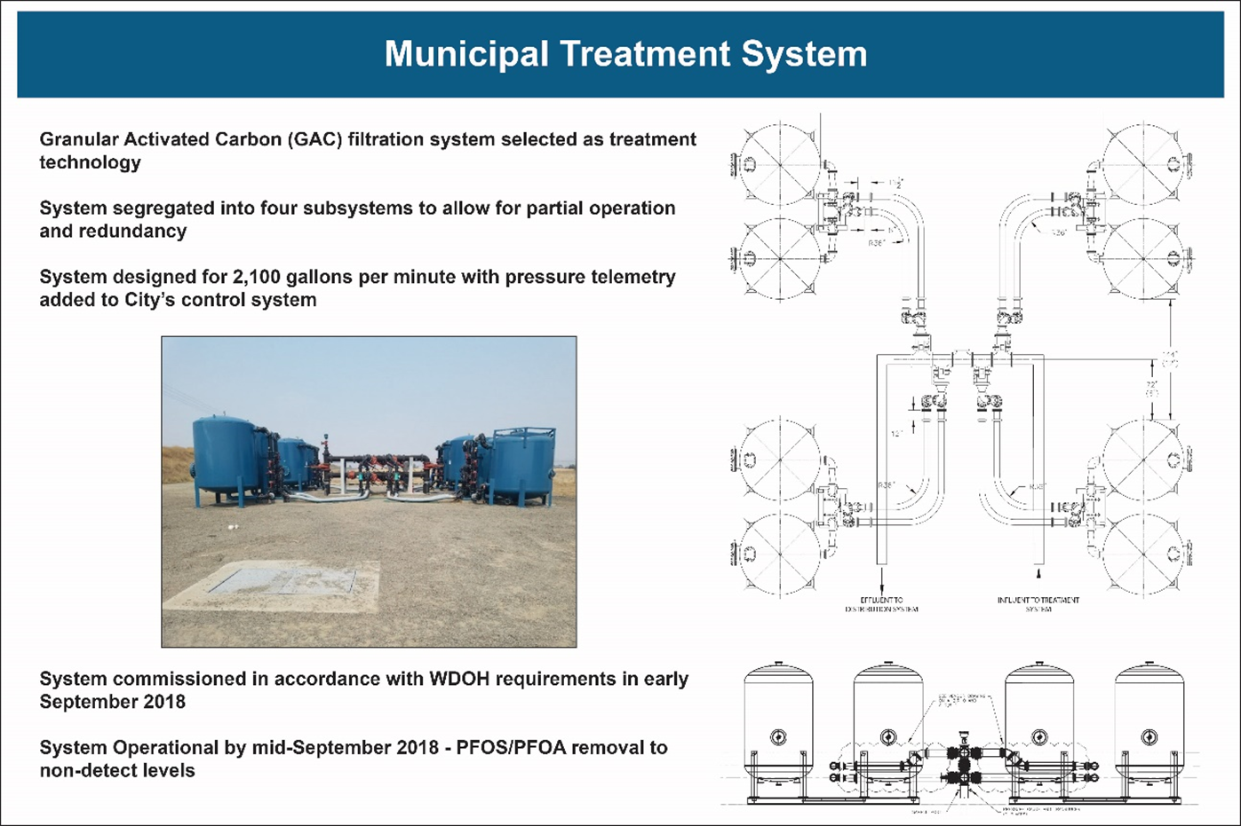
City of Airway Heights
City of Airway Heights (CAWH)
Approximately 6,000 users
Main CAWH Well #9 GAC system installed (temporary solution)
Commissioned on 24 September 2018
Cost $1.5M to install, $180K per yr. to operate (5 month duration)
Back-up municipal well remains shut down
Acquired drinking water from City of Spokane
Environmental Services Agreement (ESA) is about $816k each year based on water usage
TCRA amendment signed Oct 19
7 homes connected to CAWH drinking water system

Slide 24
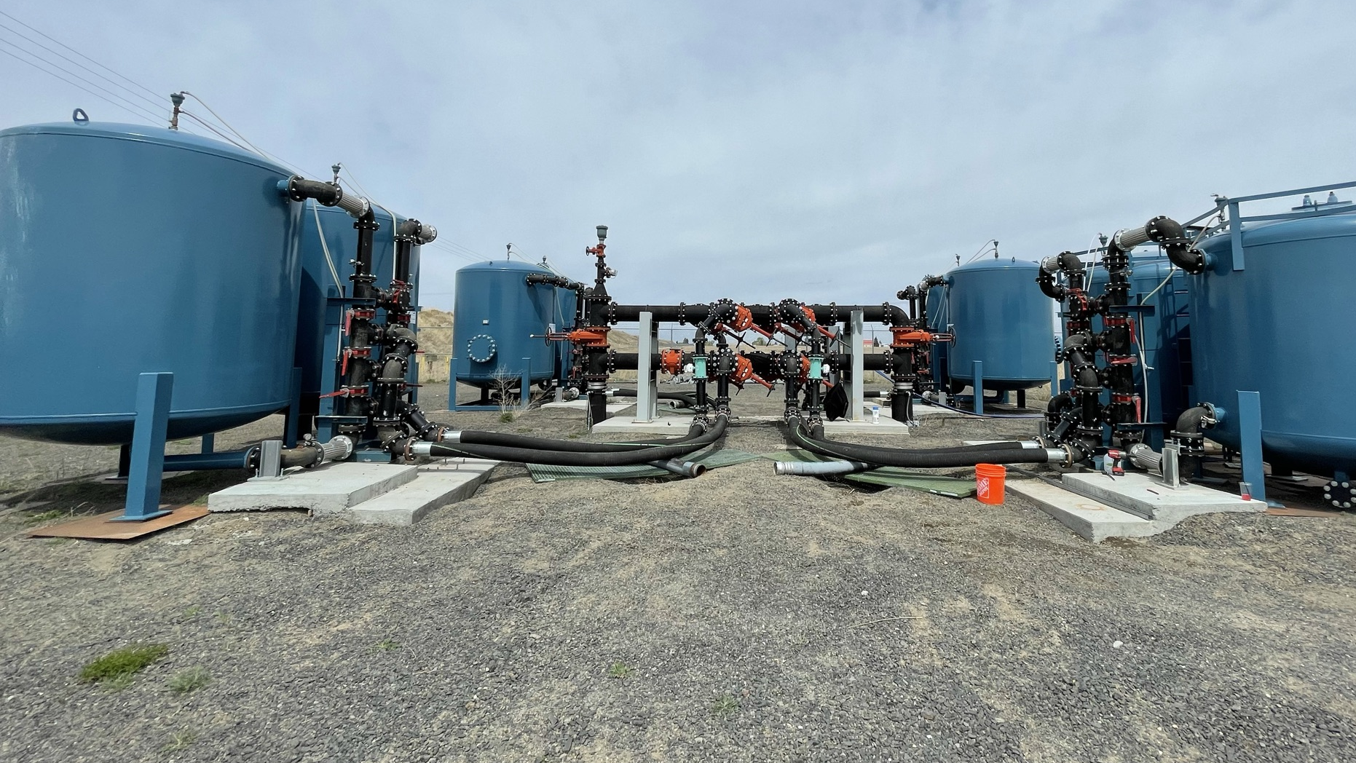
City of airway heights well 9 treatment system
Installed in 2018
Capable of treating up to 1200 gallons per minute (GPM) of drinking water
System is online for summer high demand season – May to October
Sampling is conducted monthly
Winterized and offline during winter months
24

Slide 25
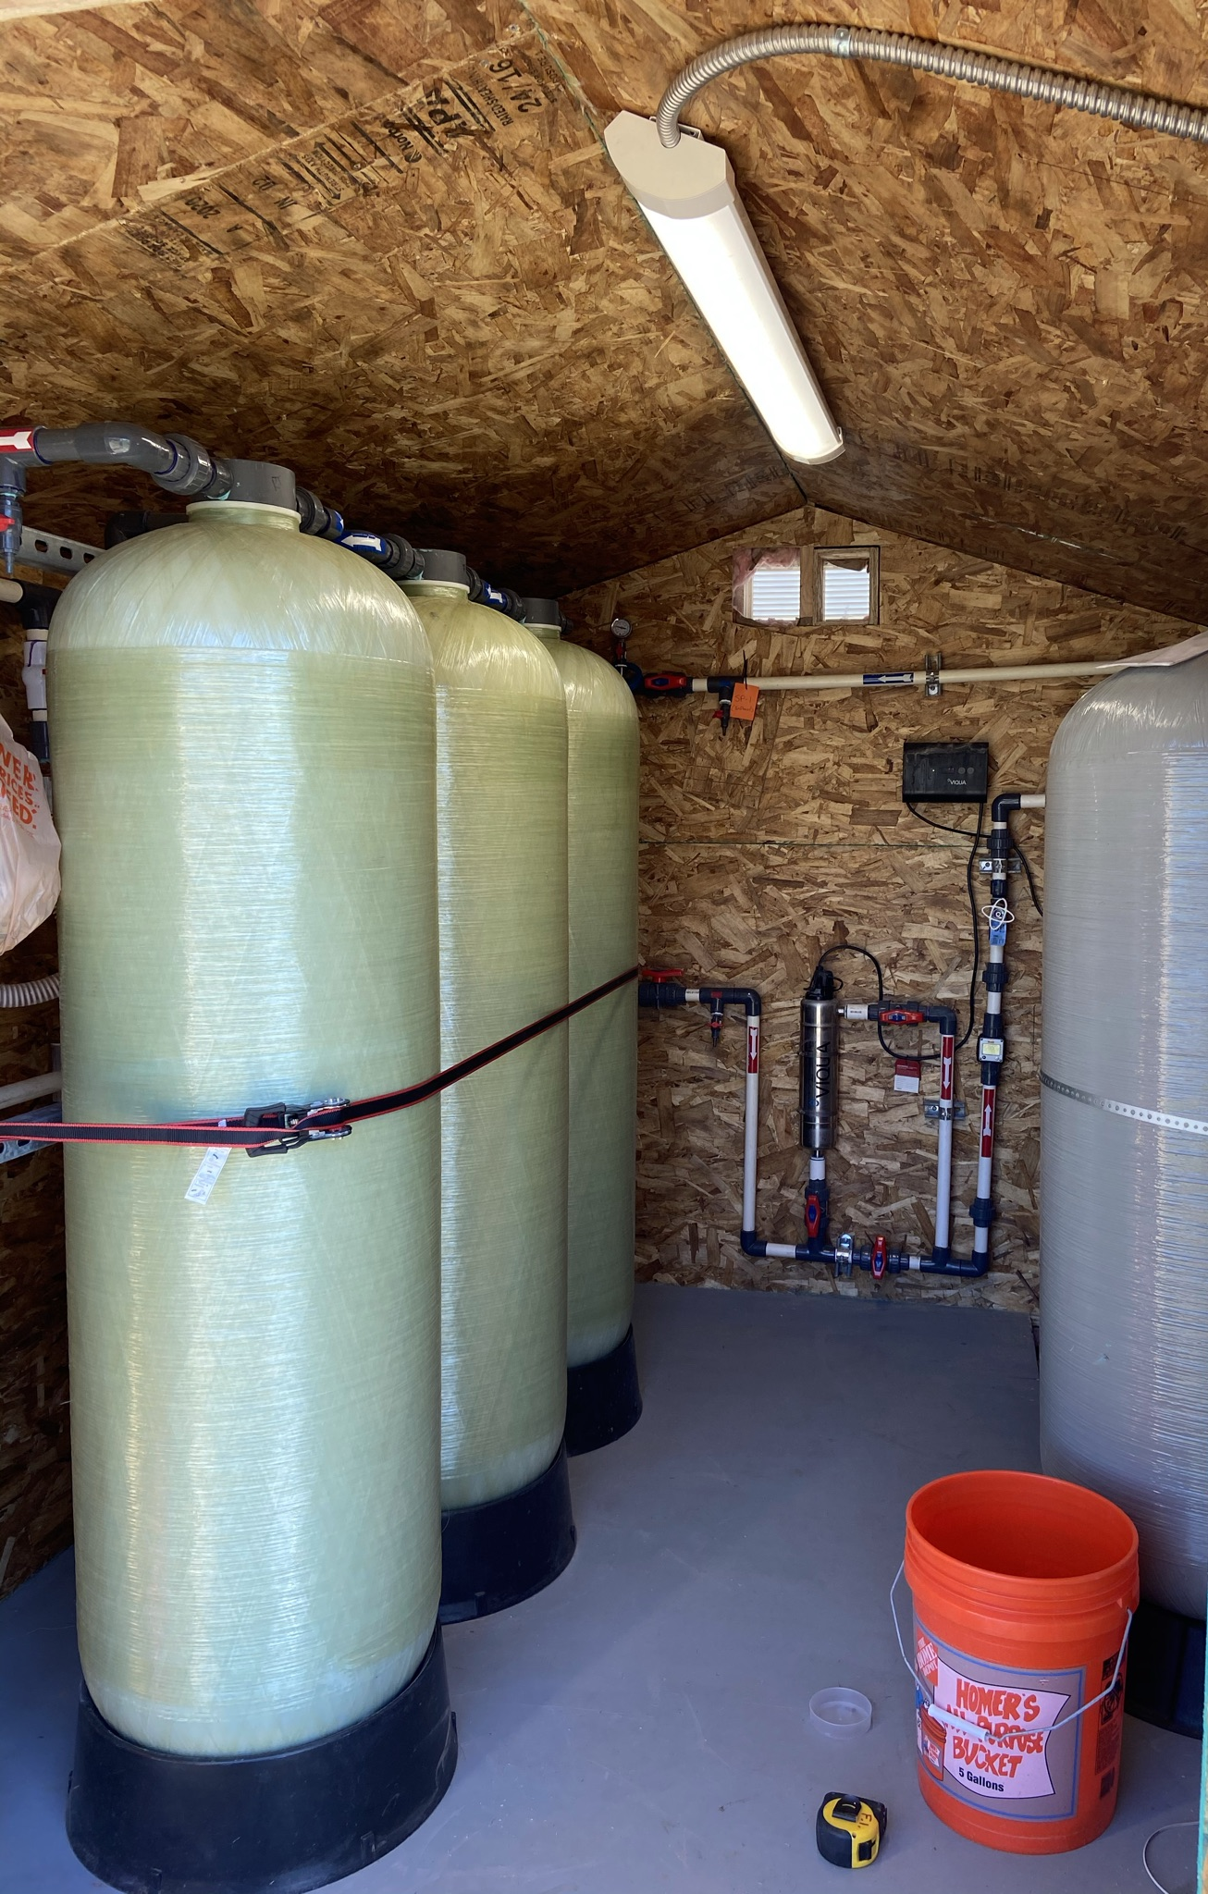
Residential treatment systems
More than 80 treatment systems installed at private residences from 2017 to present
Typical capacity for these systems is 10 GPM, though there are some higher flow systems
System designed with 3 tanks for redundancy and increased safety
Sampling and routine maintenance is conducted quarterly
A 24-hr hotline is available for emergency repairs and response
System also includes:
  Particulate filters to remove any sediment/sands from the well
  UV disinfection system for additional removal of bacteria and microorganisms
25

Slide 26
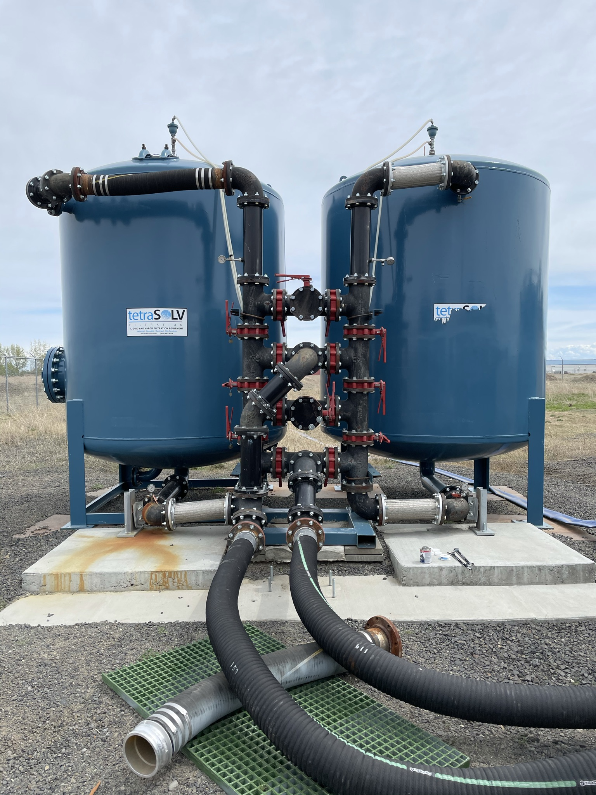
Treatment system design
The water treatment systems are designed with multiple granular activated carbon (GAC) tanks in series (typically 2 or 3 tanks)
GAC removes contaminants, including PFAS compounds, from drinking water through adsorption
At some point, the GAC in the first tank will become “spent” - all available surface area for adsorption will be depleted
Routine sampling is conducted to identify when a GAC tank is no longer working, then the spent GAC can be removed and replaced with new GAC
Additional tanks provide safety and assurance that all PFAS compounds are removed prior to consumption
Removed GAC can be landfilled or regenerated with high temperatures.
26

Slide 27
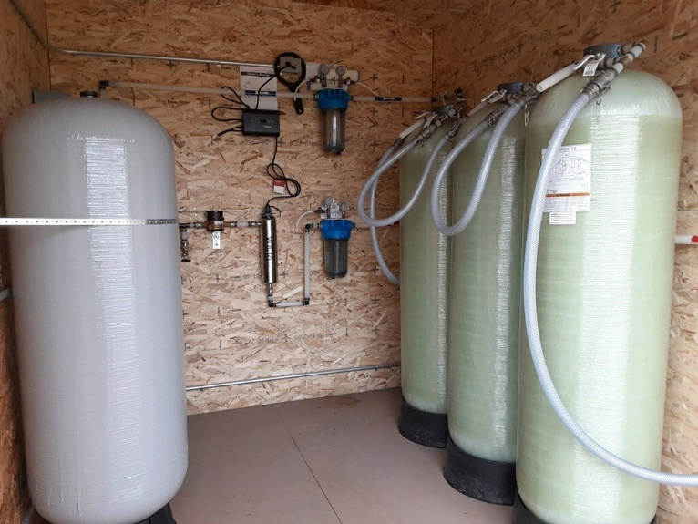
Challenges with O&M
Residential Treatment Systems
Odor issues identified at 1 new home
  Previously identified at 7 homes
  Performed chlorine disinfection of water distribution pipes
  Replaced all 3 GAC canisters for each location
  Performed a 24 hour flush
  At this time, all 7 previous homes with odor issues have been mitigated (due to sulfur/bacteria in well/pipes, emitting hydrogen sulfide gas)
  Odor sampling in progress at newly identified home
Low pressure issues
  Previously identified at 3 homes
  The AF replaced all piping in crawl spaces and under 2 homes
  1 home’s low pressure issues were mitigated upon addressing odor issues
  At this time, all low pressure issues have been mitigated

Slide 28
Summary of Early Action Projects
  Engineering Evaluation/Cost Analysis (EE/CA)
  Final report provided to regulators in September 2021
  Evaluate interim cleanup alternatives for mitigating impacts from PFOS/PFOA for the City of Airway Heights
  Open House held on 23 September 2021
  Currently drafting the Non-Time Critical Removal Action (NTCRA) (on Hold)
    Due to new information supplied by CAWH, the AF is awaiting further documentation prior to selection of a remediation option
  EE/CA Period of Performance (POP) extended 12 months
28

Slide 29
Other Early Actions
Under Consideration
  Critical Process Analysis (CPA)
  AF believes that it is wise to put removal system(s) at Base boundary ASAP
  Need to conduct Pre-Design Investigation (PDI) to support decision
    Data collection will include:
      hydrogeologic data
      bench-scale treatability studies
    The EE/CA and Action Memorandum process will be used to select the remedy
    EE/CA actions include Public Comment Period and Public Meeting
  After final remedy selections process includes
    Design, construction, operation, maintenance, and monitoring

Slide 30
Remedial Investigation (RI)
Phase I
  Goal: Determine nature and extent of soil and groundwater contamination
  Starts with Work Plan/Quality Assurance Project Plan (QAPP)
  Typically takes multiple phases to complete delineation
  Phase I to sample existing wells and install up to 56 new wells
    Many of these are off base (28)
    Working on obtaining permission and rights to install off base wells
  Baseline Risk Assessment (BRA) part of the RI step
  Determine is there are unacceptable risk to human health or the environment

Slide 31
RI Schedules
RI field work to begin Spring 2022
  Soil borings completed 2/3/22
56 monitoring wells to be installed
  28 on base, 28 off base
  Slug testing of each new monitoring well once installed
Phase I Remedial Investigation Report
  Regulatory review and comments due on 7/27/23
  Final Phase I RI Report due on 10/7/23
  Plan for additional RI Phases: October 2023 – April 2024

Slide 32
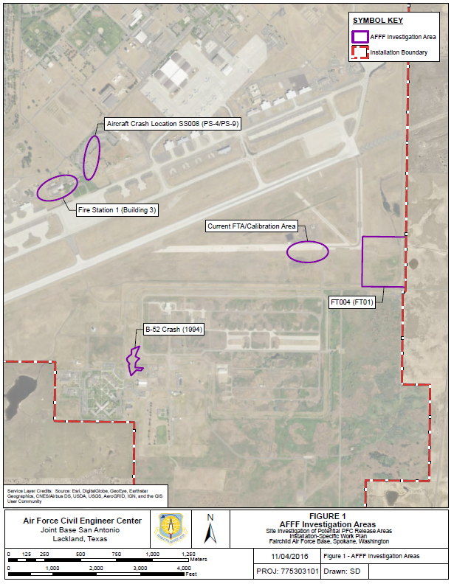
Phase I Remedial Investigation: AFFF Investigation Areas
Aqueous Film -Forming Foam (AFFF) Release Areas 1-5:
AFFF Release Area 1:
  FT004 (FT01)
AFFF Release Area 2:
  Calibration Area
AFFF Release Area 3:
  Aircraft Crash Location SS008 (PS-4/PS-9)
AFFF Release Area 4:
  B-52 Crash (1994)
AFFF Release Area 5:
  Fire Station 1 (Building 1)
3
5
2
1
4
32

Slide 33
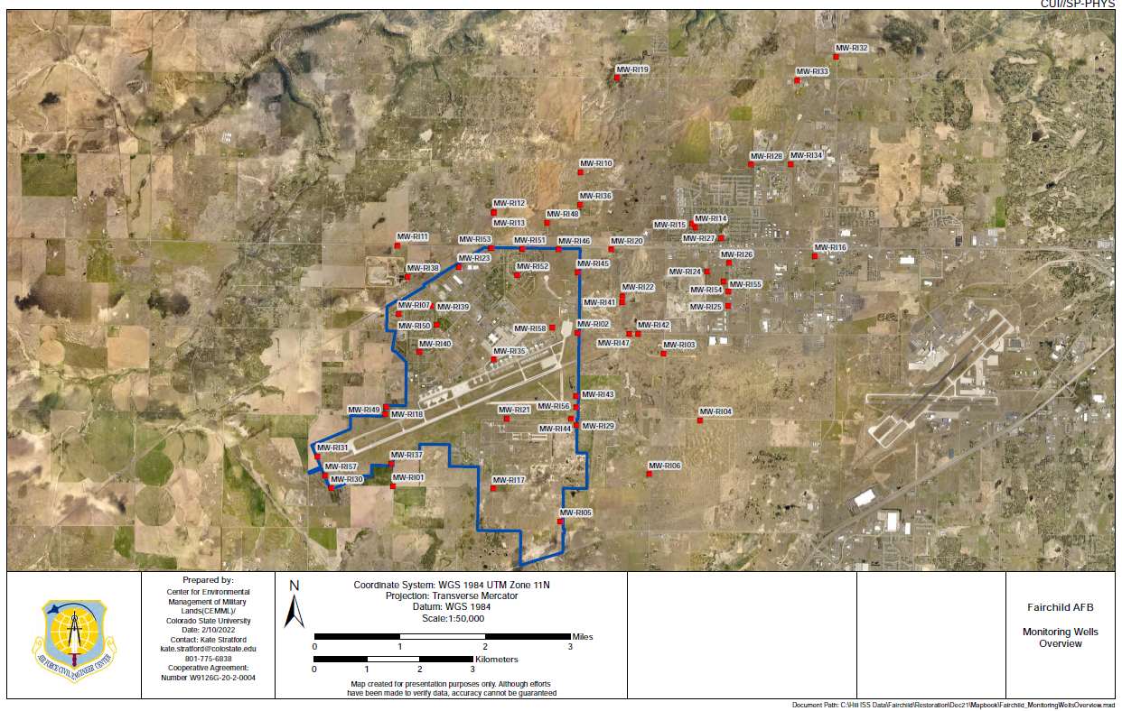
Phase I Remedial Investigation: Monitoring Wells
33

Slide 34
Questions?
34

Slide 35
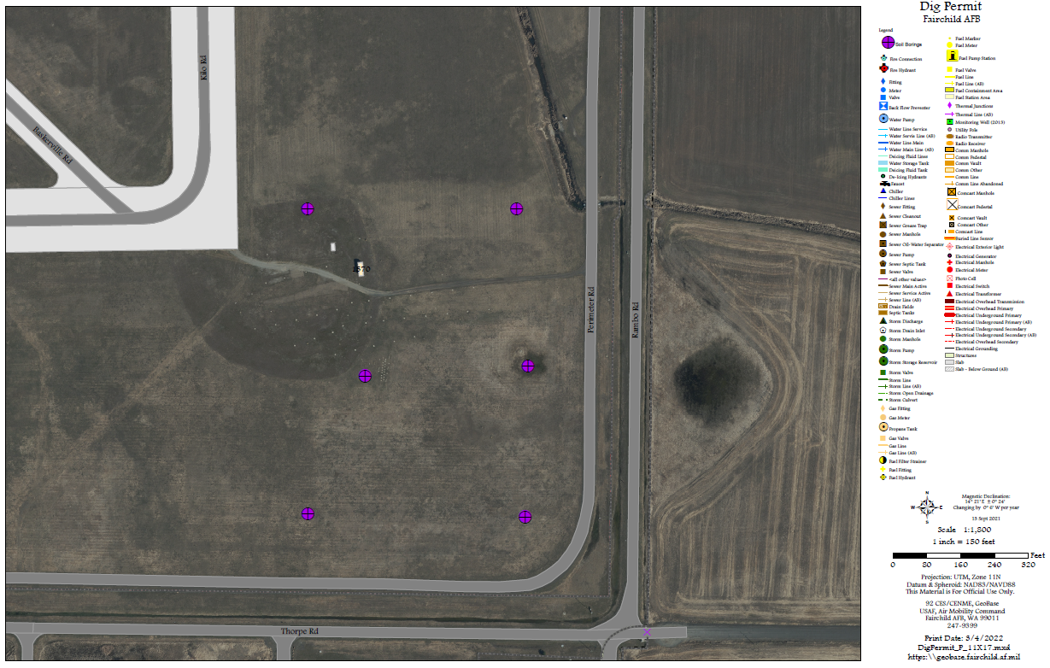
Phase I Remedial Investigation:
AFFF Release Area 1 Soil Borings

Slide 36
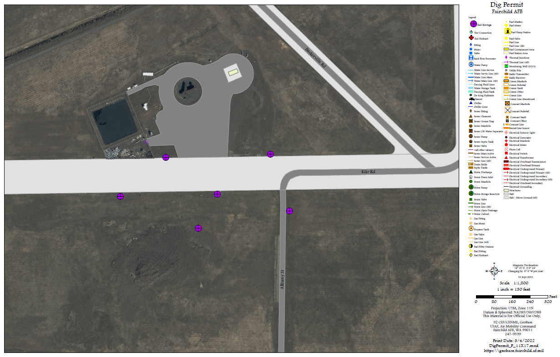
Phase I Remedial Investigation: AFFF Release Area 2 Soil Borings

Slide 37
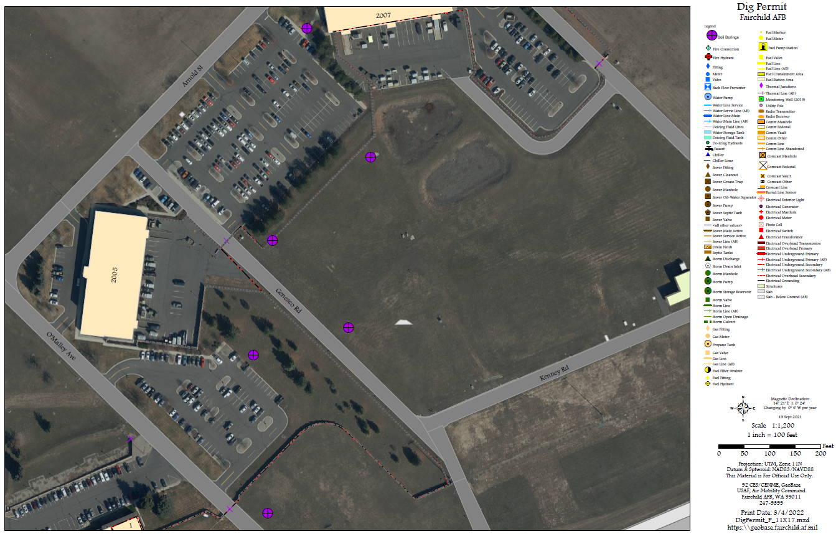
Phase I Remedial Investigation: AFFF Release Area 3 Soil Borings

Slide 38
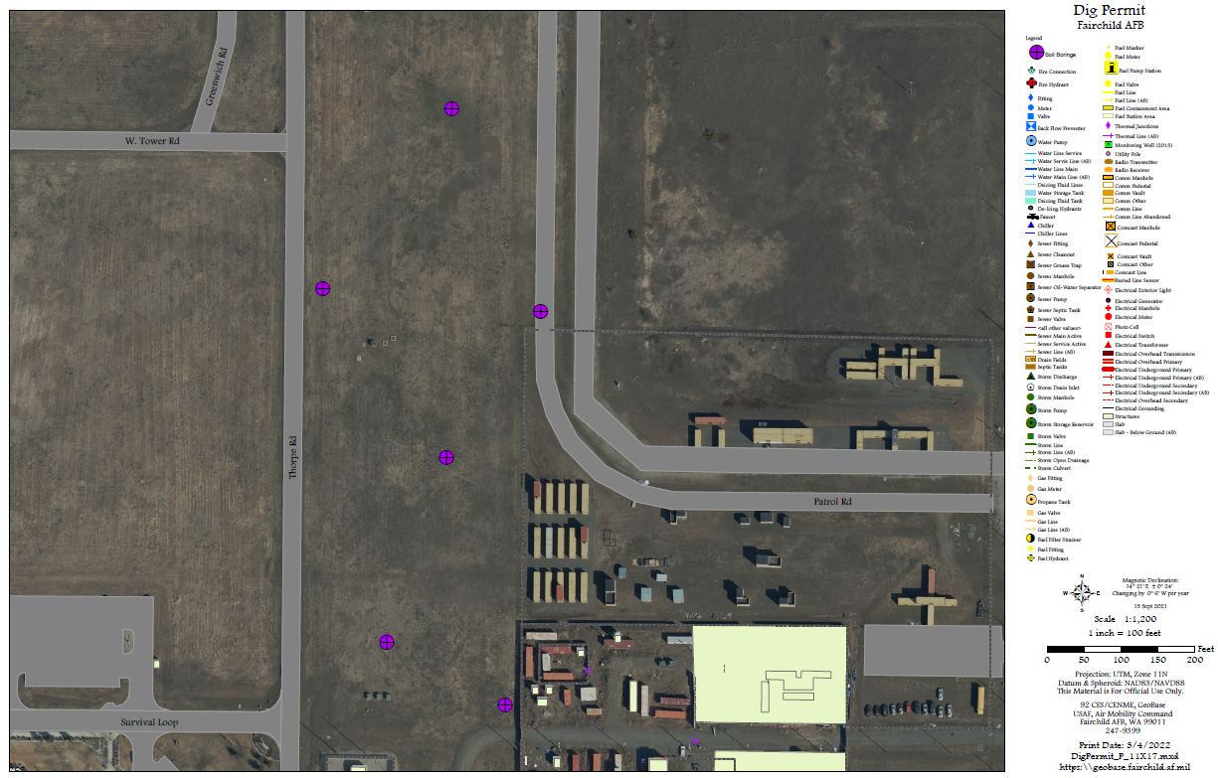
Phase I Remedial Investigation: AFFF Release Area 4 Soil Borings

Slide 39
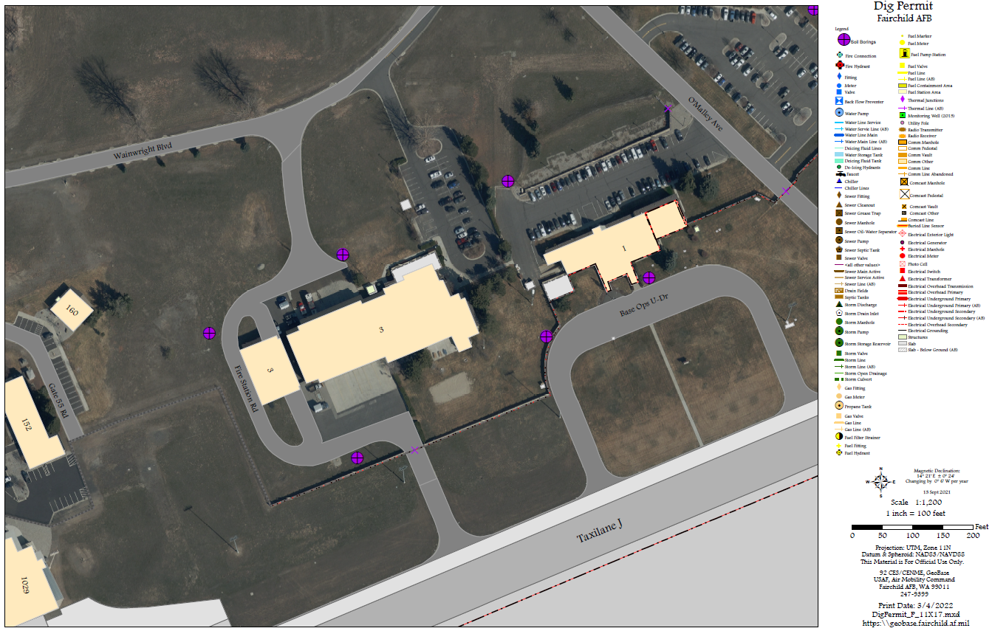
Phase I Remedial Investigation: AFFF Release Area 5 Soil Borings

Slide 40
Acronyms and Abbreviations
AF Air Force
AFFF Aqueous Film-Forming Foam
CAWH City of Airway Heights
CERCLA Comprehensive Environmental Response, Compensation, and Liability Act
CPA Critical Process Analysis
EE/CA Engineering Evaluation/Cost Analysis
GAC Granular Activated Carbon
MW monitoring well
NTCRA Non-Time Critical Removal Action
O&M operation and maintenance
PDI Pre-Design Investigation
PFOS/PFOA perfluorooctane sulfonate/perfluorooctanoic acid
POP Period of Performance
QAPP Quality Assurance Project Plan
RAB Restoration Advisory Board
RA-O remedial action-operations
RI Remedial Investigation
SVE soil vapor extraction
TCE trichloroethylene
TS treatability study
VCP Voluntary Cleanup Program
VI vapor intrusion
WDOE Washington Department of Ecology

Slide 41
BREAK
Meeting will resume in 5 minutes.

Slide 42
2021/2022 Performance-Based Remediation Overview
Bay West and AECOM
24 March 2022

Slide 43
Overview
Site Overview
2021/2022 Major Sites
  SS039, SD037, LF002, WP003, Voluntary Cleanup Program (VCP) Sites
Public Comment Opportunities in 2022

Slide 44
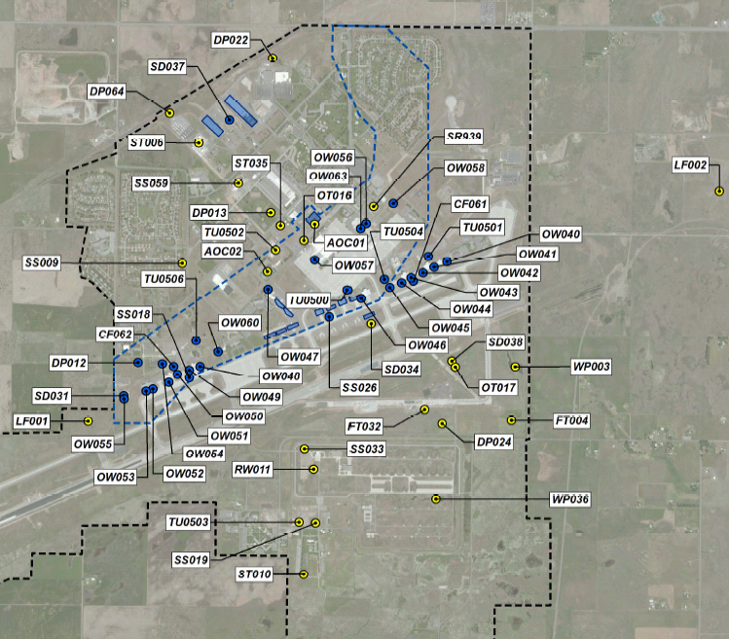
Site Overview
59 historical environmental sites. One historical Military Munitions Response Site at Fairchild Air Force Base. Environmental actions include:
Work Plans
Remedial Action-Operations (RA-O)
Treatment Operations
Remedial Design
Investigation Reports
Monitoring/Remedial Performance Reports
Treatment Reports
Notes:
Site Inventory
59 IRP Sites
1 MMRP Site
Well Inventory across Fairchild Air Force Base (AFB)

Slide 45
Orphan TCE Plumes
(SS039)
2021 Overview and Planned 2022 Actions
Ms. Kristine Weber
AECOM Site Lead
24 March 2022

Slide 46
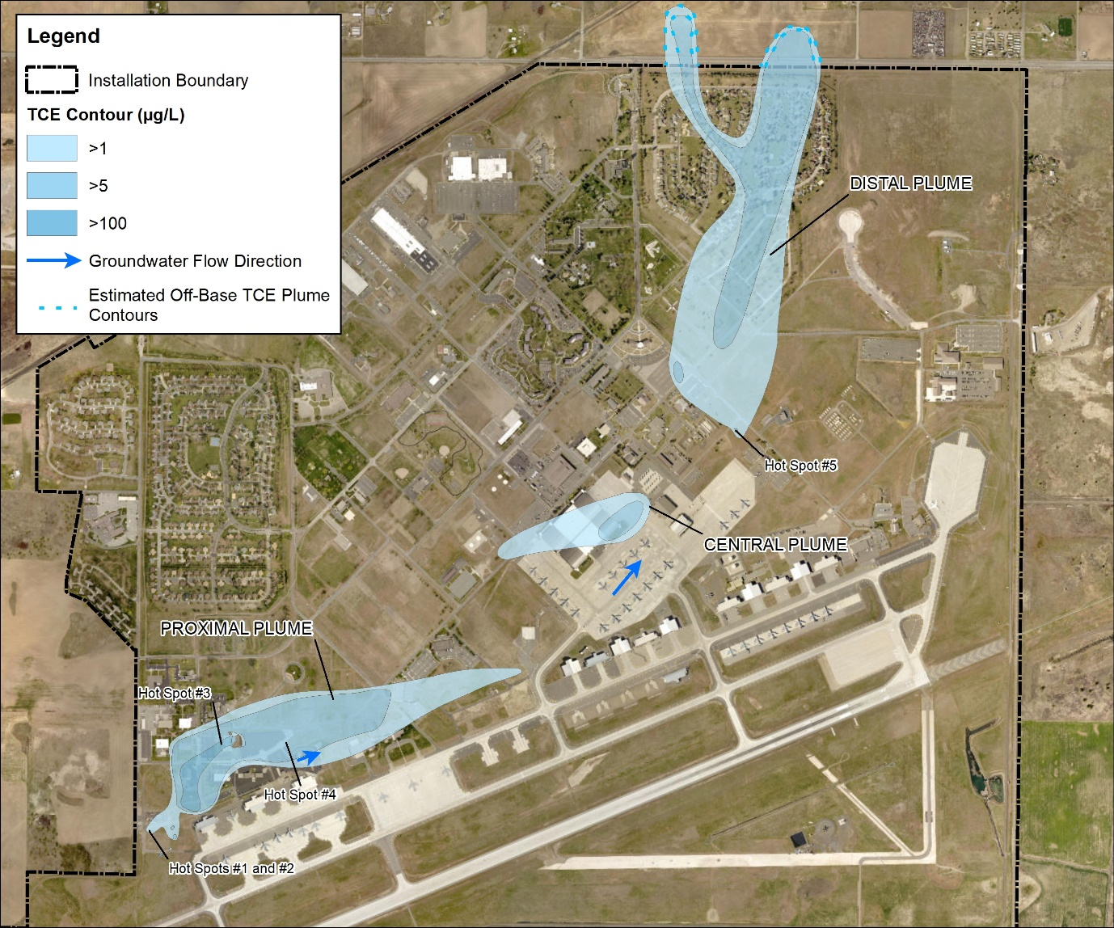
SS039 Overview
  2021 Summary
Annual GW Monitoring
Oxidant re-injection into select areas
  2022 Planned
  Semi-annual Performance Monitoring
Annual GW Monitoring and Reporting

Slide 47
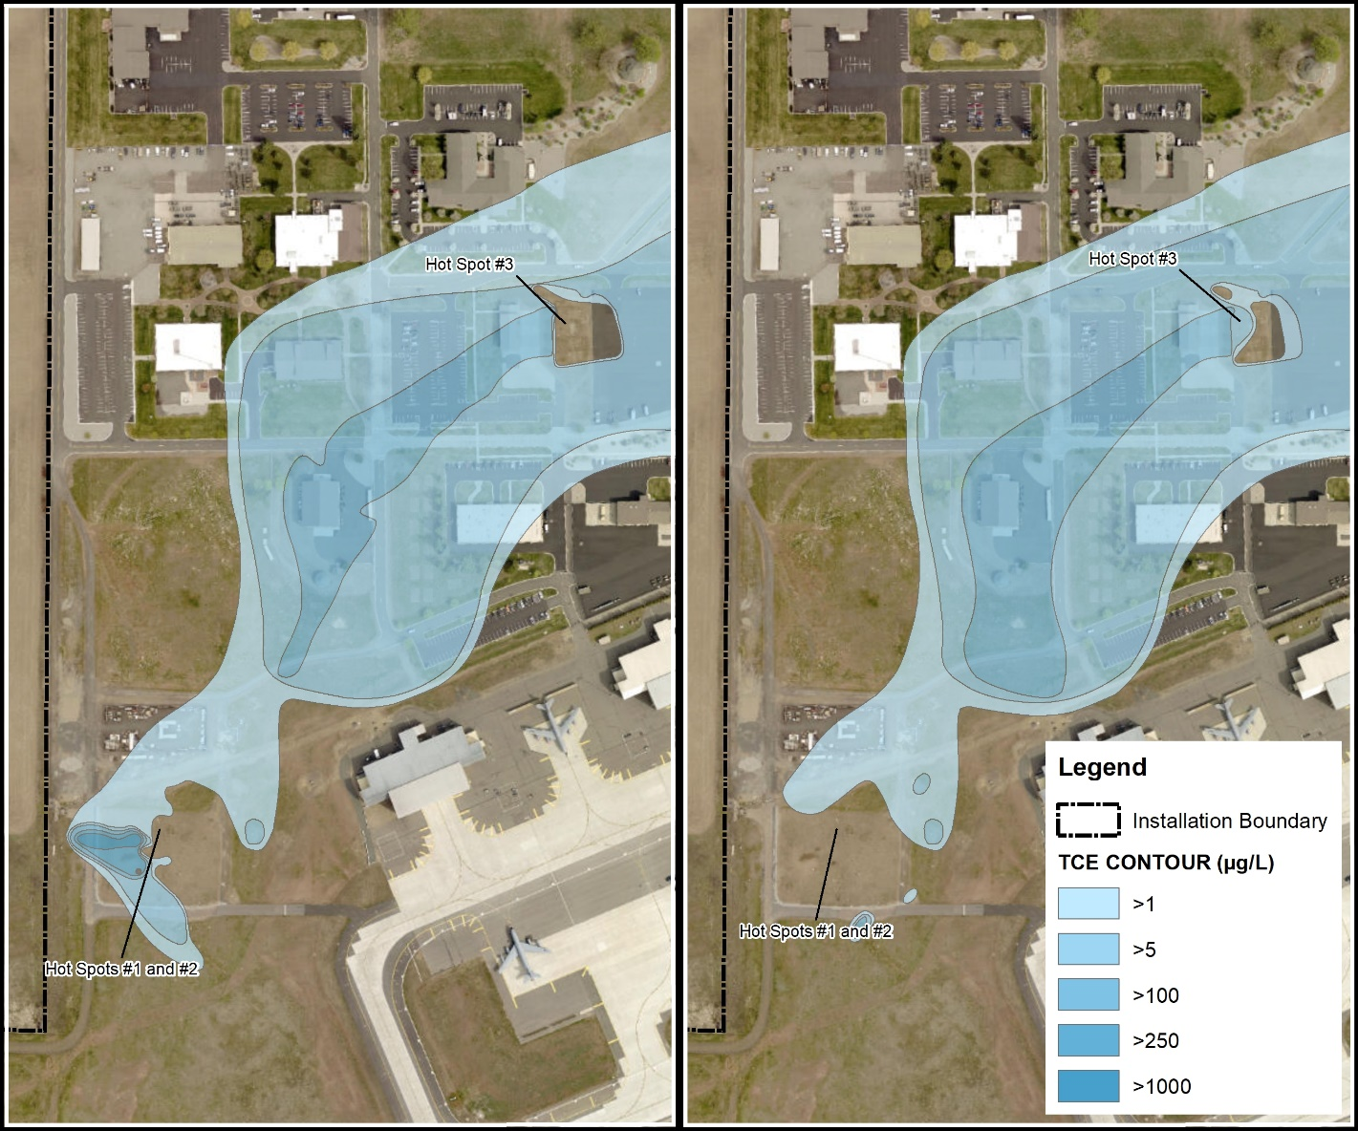
SS039 Overview
  Before and After 2021 Sodium Permanganate Injection Event
    Injected approx. 85,215 gallons (1% solution) into 5 IWs at Hotspot #1 and #2
    Injected approx. 17,006 gallons (1% solution) into 2 IWs at Hotspot #4
    Plume interpretation after one quarter of performance monitoring
Notes:
Injection wells are located in transects, cross-gradient to the plume core.

Slide 48
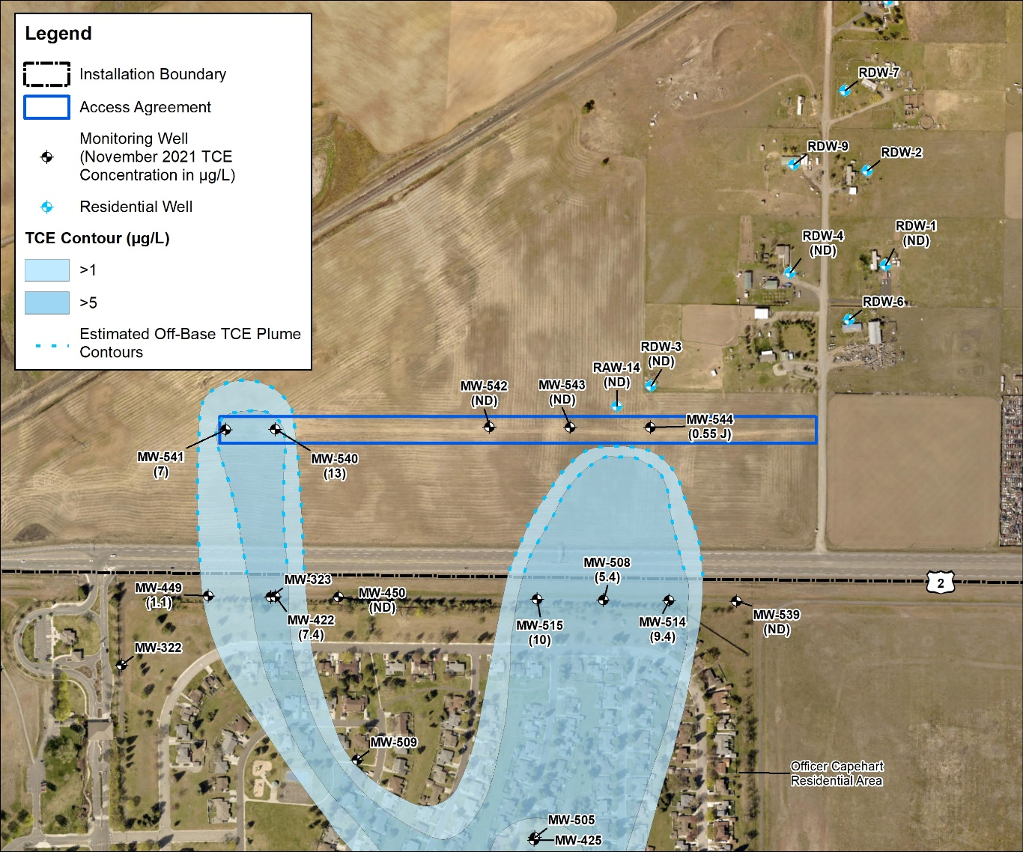
SS039 Off-Base Overview
2021 Summary
Off-Base GW monitoring
TCE was above MCLs in two western-most off-site wells
  2022 Planned
  Complete semi-annual GW monitoring

Slide 49
SD037 Buildings 2447/2451
2021 Overview and Planned 2022 Actions
Ms. Kristine Weber
AECOM Site Lead
24 March 2022

Slide 50
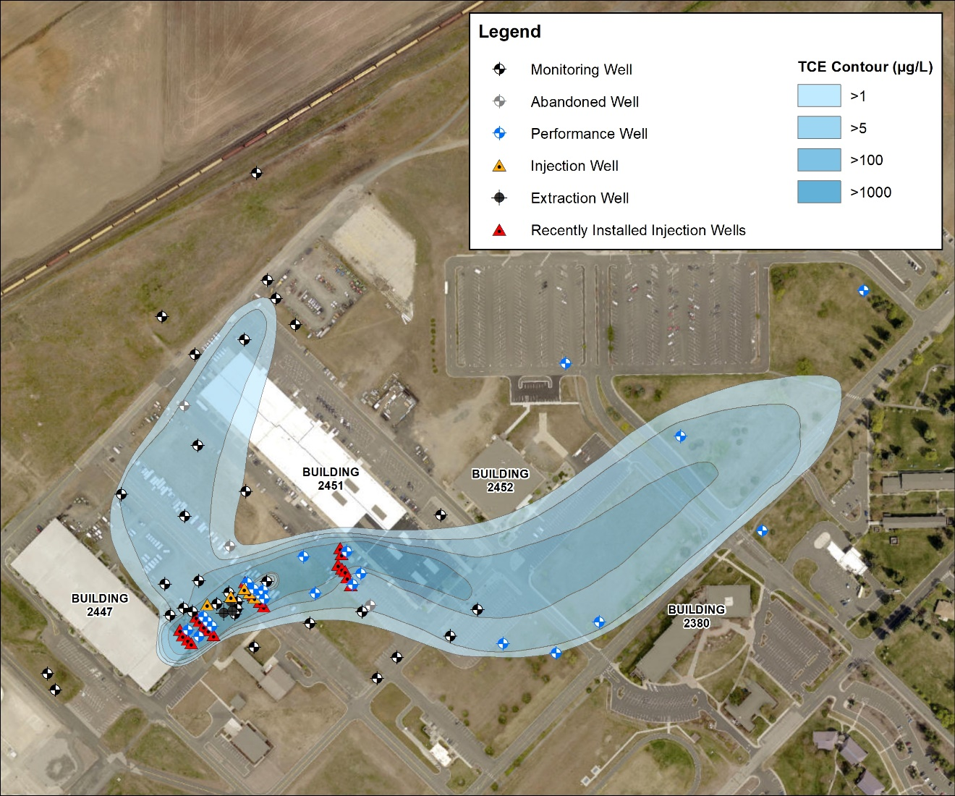
SD037 Overview
  ISCO Pilot Study and VI Evaluation
  2021 Summary
  Completed installation of 22 new IWs
  Completed installation of 6 new MWs
  Completed Baseline Performance Monitoring Sampling
  Completed injection of 96,289 gallons
  (1% solution)
  2022 Planned
  Quarterly Performance Monitoring Sampling
  Feasibility Study

Slide 51
Craig Road Landfill (LF002)
2021/2022 Remedial Action-Operations Overview
Mr. John Peper
Bay West Project Manager
24 March 2022

Slide 52
LF002 Background
  LF002 is a former landfill on AF property located about one mile east of the Base.
  Trichloroethene (TCE) was discovered in groundwater in the late 1980s and 1990s.
  Remedial action was implemented in 1995 and has consisted of:
    Groundwater containment with extraction wells and stripper tower treatment
    Construction of an engineered cap
    Land use controls
    Soil Vapor Extraction (SVE) systems were added to the remedy in 2017.
  Remedial Action Operations (RA-O) consisting of systems operation and groundwater monitoring have been preformed since 1995.

Slide 53
LF002 2021 Overview
2021 Actions
  Ongoing: Operation and Maintenance (O&M) of the Groundwater Extraction and Treatment System/Soil Vapor Extraction Systems (GETS/SVE) and RA-O Monitoring.
  RA-O Monitoring: Quarterly sampling events were completed in March, June, September, and November 2021.
  Remedial Progress: of the 58 MWs at LF002 (see map)
    In 2021 only 28 wells still have TCE concentrations above a PAL of 5 μg/L and of these, most (20) were near the PAL (5 to 20 μg/L). Only two wells had TCE concentrations greater than 100 μg/L.
    Of the 28 wells above the TCE PAL, 25 had stable or decreasing trends and 19 are projected to be below the PAL in 1 to 8 years.
  August 2021: The Final OU1 ROD Amendment is signed.
  August 2021: Well or pump maintenance were completed on EW-02, EW-06, and EW-11.
  October 2021: The 2021 Semiannual RA-O Report is finalized.
  November 2021: The 2020 Annual RA-O Report is finalized.

Slide 54
LF002 2022 Overview
2022 Actions (Actual and Planned)
  Continued O&M for the GETS and SVE systems.
  Continued RA-O monitoring planned for March, June, September, and December 2022.
  2021 Annual RA-O Report is currently being prepared and will be submitted for AF and EPA review.
  The 2022 Semiannual RA-O Report will be prepared Fall 2022.

Slide 55
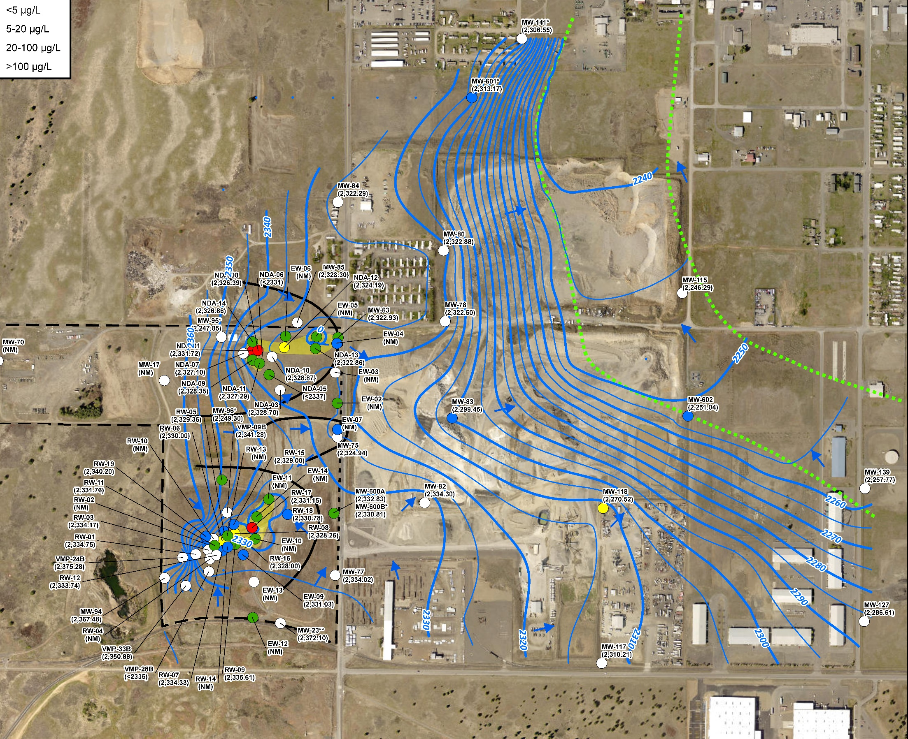
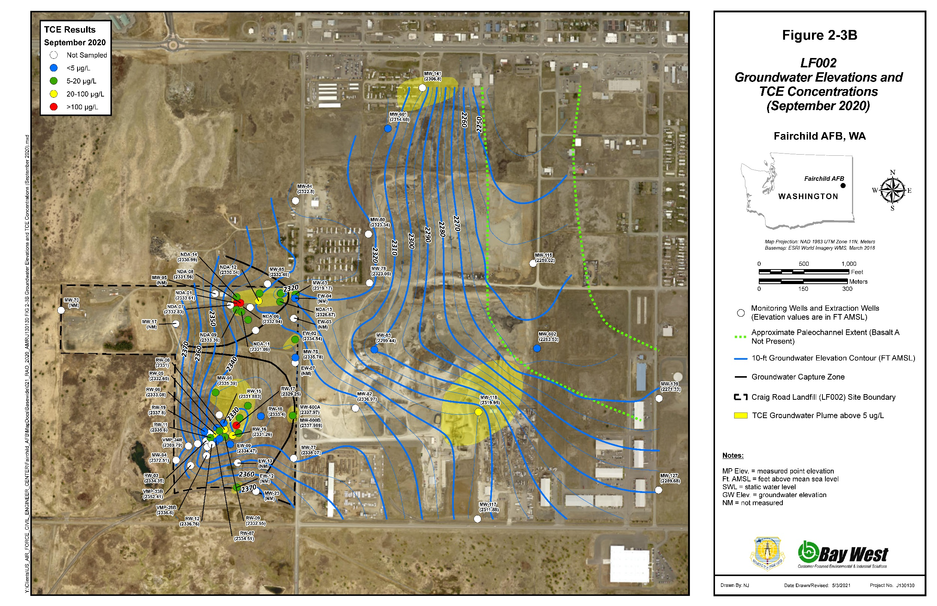
LF002 September 2022 Monitoring Results

Slide 56
Industrial Wastewater Lagoon System (WP003)
2021/2022 RA-O Overview
Mr. John Peper
Bay West Project Manager
24 March 2022

Slide 57
WP003 Background
  WP003 includes former wastewater treatment lagoons located on the east margin of the base.
  Trichloroethene (TCE) was discovered in groundwater in the late 1980s and 1990s at concentrations above regulatory limits. Subsequent monitoring also identified concentrations of vinyl chloride above the regulatory limit and arsenic above background.
  Remedial action was implemented in 1996 and has consisted of:
    Land use controls;
    1996-2004 Groundwater containment with extraction wells and stripper tower treatment;
    2000-2001 Source area excavation and organic substrate supplements.
  Remedial Action Operations (RA-O) currently consist of quarterly groundwater monitoring.
  A Feasibility Study Addendum is planned to consider additional remedies to accelerate site clean-up.

Slide 58
WP003 2021 Overview
    2021 Actions
  March, June, September, November 2021: Quarterly RA-O Monitoring of wells at WP003.
  June 2021: Completed injections for Bioaugmentation Pilot Test. Performance monitoring is ongoing and will be completed Spring-Summer 2022.
  October 2021: The 2021 Semiannual RA-O Report is finalized.
  November 2021: The 2020 Annual RA-O Report is finalized

Slide 59
WP003 2022 Overview
  2022 Actions (Actual and Planned)
    March, June, September, November 2021: Quarterly RA-O Monitoring of wells at WP003.
    Spring/Summer 2022: Complete and evaluate pilot test performance monitoring data.
Spring 2022: The 2021 Annual RA-O Report will be submitted for AF and EPA review.
  Spring 2022: Prepare a Feasibility Study Addendum to select additional remedies for WP003 remediation.
Fall 2022: The 2022 Semiannual RA-O Report will be prepared.

Slide 60
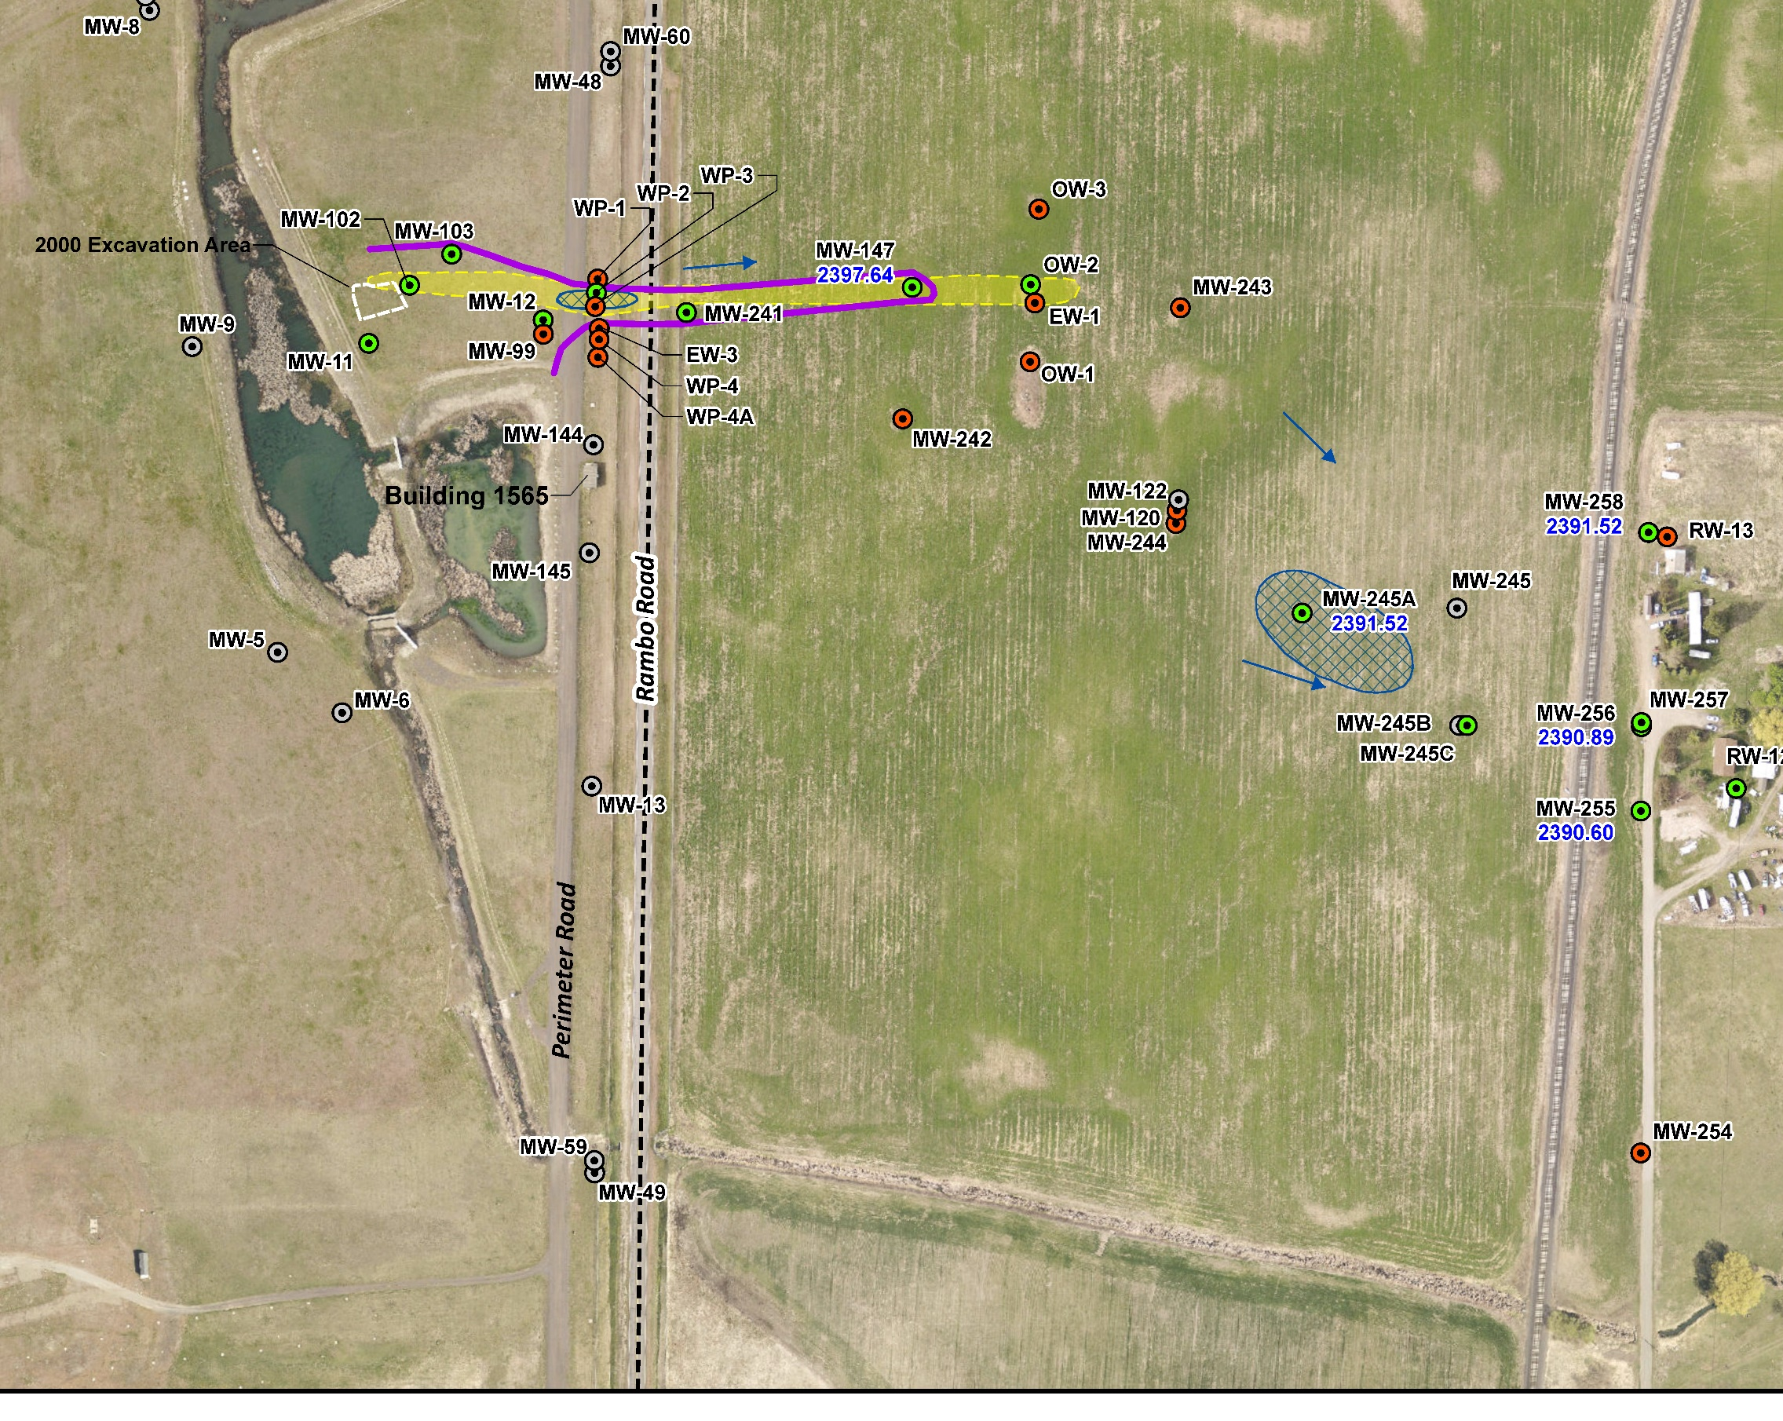
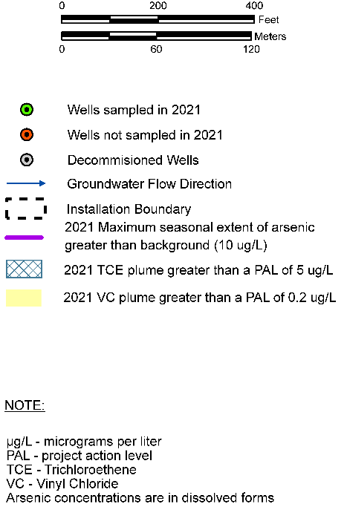
WP003 2021 Monitoring Results

Slide 61
Voluntary Cleanup Program (VCP) Sites
Mr. John Peper
Bay West Project Manager
24 March 2022

Slide 62
VCP Sites
  Eight former oil/water separator sites along the flight line have achieved AF and Washington Department of Ecology (WDOE) approval of Site Closure/No Further Action through the WDOE Voluntary Cleanup Program
    OW044, OW047, OW053, OW054, OW055, OW056, OW057, and OW063
  Other Petroleum Sites in the NFA Approval Process
    NFA Tech Memo Approved: ST010, SS033
    NFA Approved: ST006 (groundwater), OT017, FT032, ST035, AOC02, SS059
    RI/NFA Report Approved: SS059
  Petroleum Sites in the Remedial Investigation Stage
    SS009
  Petroleum Sites in the Interim Measures/Remediation Planning Stage
    TU500, TU502, TU503, TU506

Slide 63
West Flightline Plume
(TU506)
Planned 2022 Actions
Ms. Kristine Weber
AECOM Site Lead
24 March 2022

Slide 64
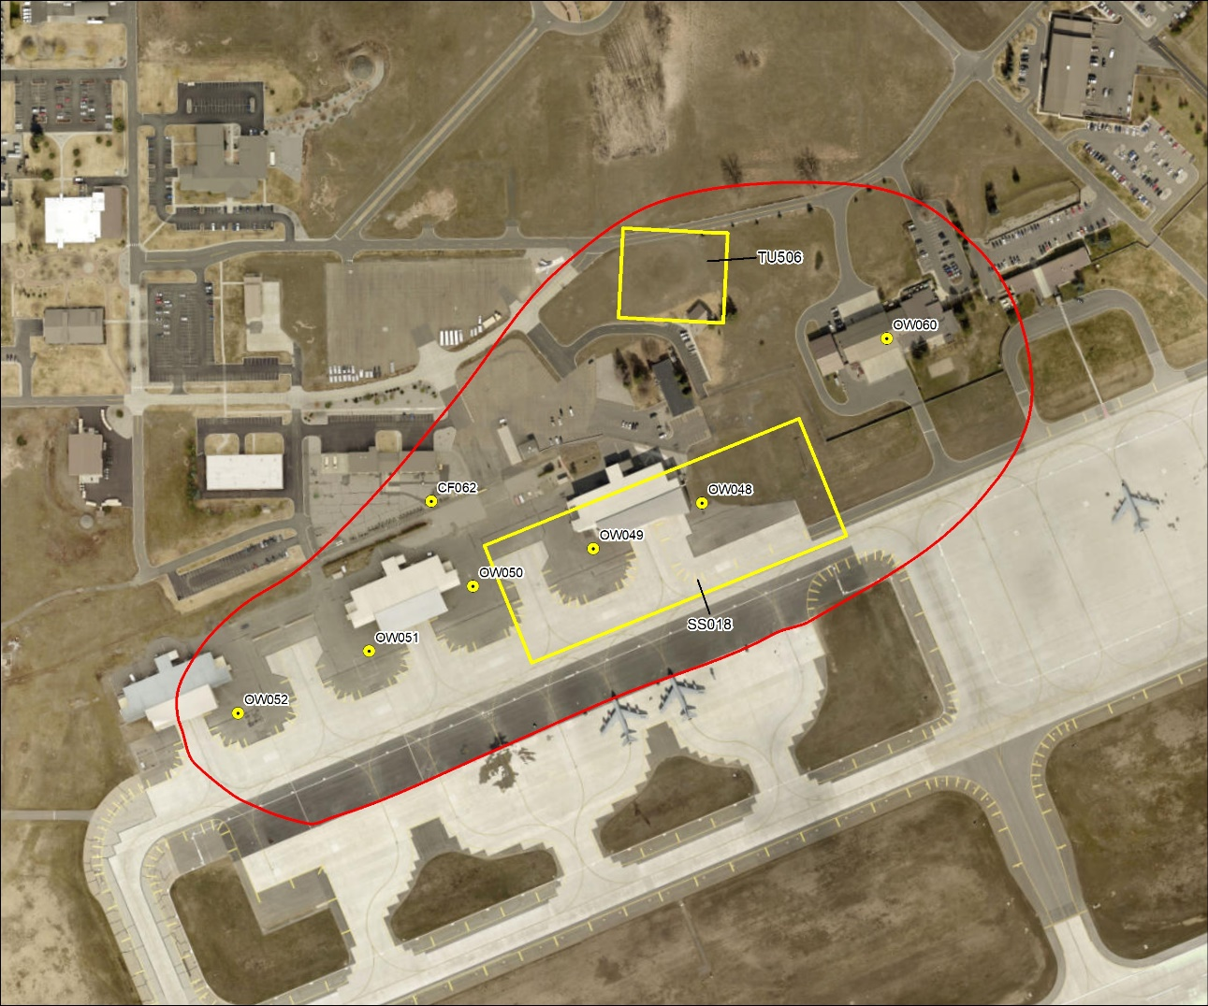
TU506 2022 Overview
  2022 Planned
  Hot Spot Excavation at OW050
  Excavation Completion Report
  Quarterly Monitoring

Slide 65
East Flightline Plume
(TU500)
Planned 2022 Actions
Ms. Kristine Weber
AECOM Site Lead
24 March 2022

Slide 66
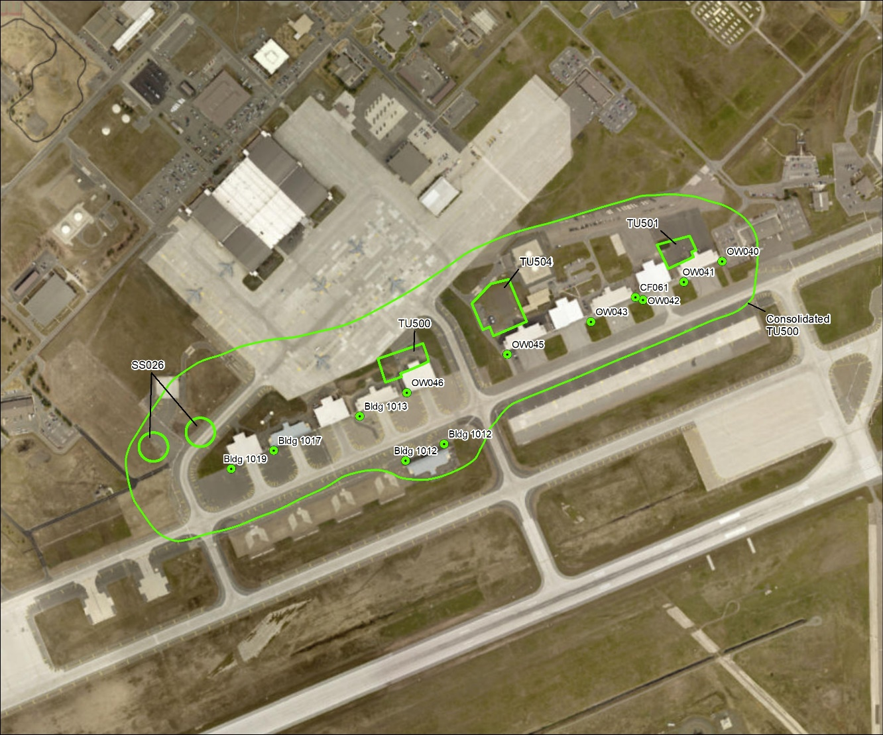
TU500 2022 Overview
  2022 Planned
  Hot Spot Excavation at OW040, OW041, OW042, OW043, and OW046
  Excavation Completion Report
  Quarterly Monitoring

Slide 67
Public Comment Opportunities in 2022
Mr. John Peper
Bay West Project Manager
24 March 2022

Slide 68
Public Comment Opportunities 2022
  OU2 (DP064, Construction Debris Landfill/Former Coal Storage Area) Proposed Plan: In production stage - Public Comment Period August 2 – September 1, 2022
    Remedial alternatives for DP064
  OU8 (WP036, Contaminated Groundwater and Sediment at Bldg 1454 and RW011, Weapon Storage Area Radioactive Disposal Area) ROD: In review stage
  Will include selected remedy for each site
  Anticipated to be finalized in summer 2022

Slide 69
Acronyms and Abbreviations
µg/L micrograms per liter
AF United States Air Force
AFB Air Force Base
EPA United States Environmental Protection Agency
GETS Groundwater Extraction and Treatment System
GW groundwater
ISCO in situ chemical oxidation
IW injection well
MCL maximum contaminant level
MW monitoring well
NFA no further action
O&M operation and maintenance
OU operable unit
PFOA Perfluorooctanoic acid
PFOS Perfluorooctanesulfonic acid
RA-O remedial action-operations
RAB Restoration Advisory Board
ROD Record of Decision
SVE soil vapor extraction
TCE trichloroethylene
VCP Voluntary Cleanup Program
VI vapor intrusion
WDOE Washington Department of Ecology

Slide 70
PUBLIC COMMENT

Slide 71
MEETING
ADJOURNED
THANK YOU!
Notes:
We greatly appreciate your attendance and participation!

