Slide 1
Welcome
Fairchild Air Force Base (AFB)
Restoration
Advisory Board (RAB) Meeting
17 November 2022

Slide 2
Fairchild AFB
Restoration Advisory Board (RAB) Meeting
4:00 p.m., November 17, 2022
RAB Meeting Agenda
4:00 – 4:05 Welcome …………………………………………….. Col. Fletcher, RAB Installation Co-Chair
4:05 – 4:15 RAB Business……………………………………… .. Liz Drake, AECOM, RAB Facilitator
      Ground rules for meeting
      Discuss meeting minutes from previous RAB meeting
      Vote on welcoming new RAB members
4:15 – 4:45 Perfluorooctane Sulfonate and Perfluorooctanoic Acid (PFOS/PFOA) Investigation and Ongoing PFOS/PFOA Projects …... Mark Loucks, AFCEC
4:45 –5:25 Update on Sites Managed Under the Performance-Based Remediation (PBR) Contract (SS039, SD037, LF002, WP003, and Voluntary Cleanup Program (VCP)) + Public Comment Opportunities
………………………………………………………… John Peper, Bay West
………………………………………………………… Kristine Weber, AECOM
5:25 – 5:30 Break
5:30 – 5:40 Public Comment Opportunity………………………. Liz Drake, AECOM, RAB Facilitator
5:40 – 6:00 Discuss Date and Agenda Items for Next Meeting
Adjourn

Slide 3


Air Force Civil Engineer Center
I n t e g r i t y - S e r v i c e - E x c e l l e n c e
November 2022
Restoration Advisory Board (RAB)
Mark Loucks,
AFCEC Hill ISS Chief

Slide 4
Agenda
Background
What have we accomplished so far?
  Mitigation efforts
Current challenges
Remedial Investigation (RI) update
Engineering Evaluation/Cost Analysis (EE/CA) action for the City of Airway Heights (CAWH)
New early actions under consideration

Slide 5
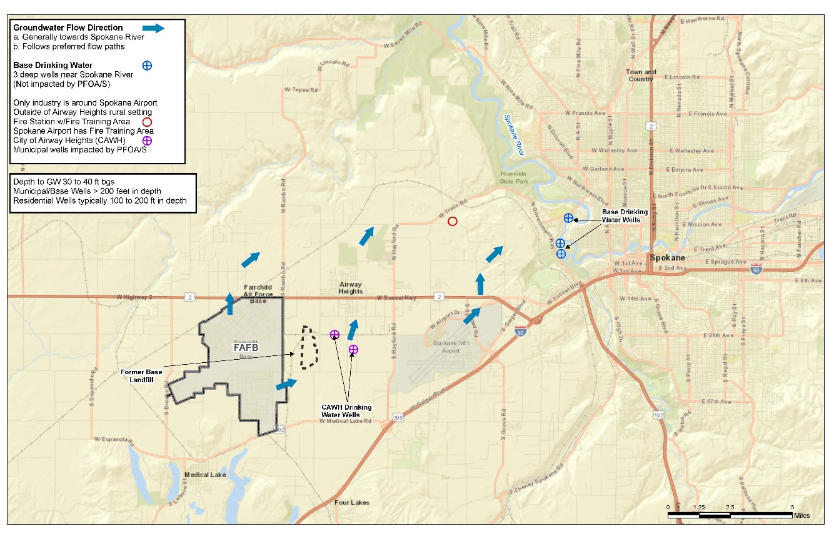
Groundwater Flow

Slide 6
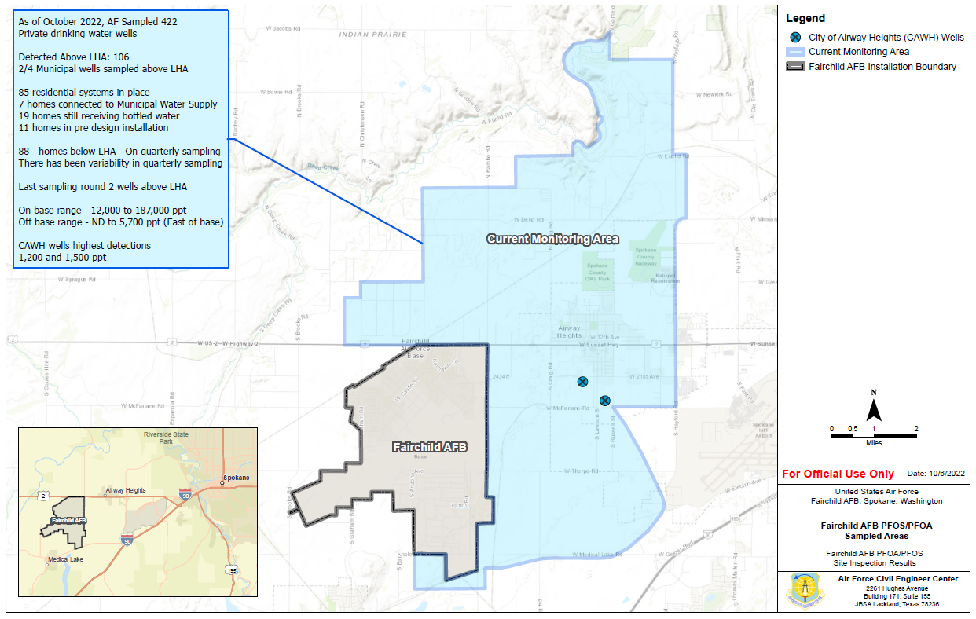
Sampling Area

Slide 7
Response Actions
Actions for residential drinking water wells
  Time Critical Removal Action (TCRA) approved March 2018; installation ongoing
  17 homes currently on bottled water
  Individual whole house Granular Activated Carbon (GAC) filtration systems:
    85 filtration systems installed
    10 wells with systems pending
    4 wells (7 homes) connected to CAWH water system
    3 wells on hold
    7 wells not currently in use (properties with more than one well)
      Wells could not be used as drinking water supply
      Currently not needed to meet homeowner requirements

Slide 8
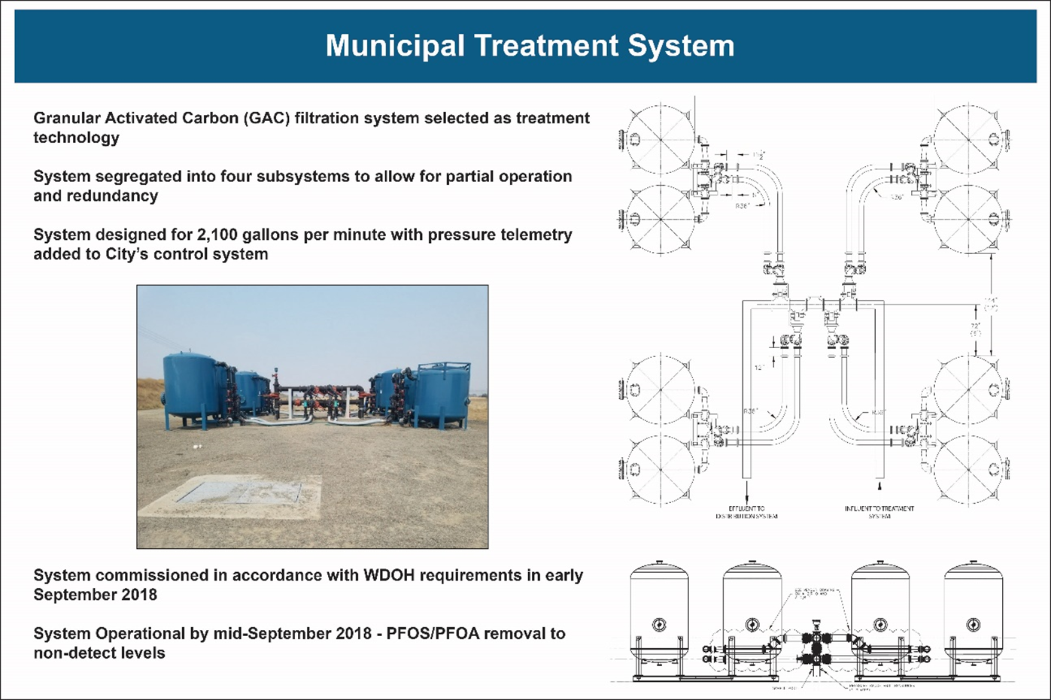
City of Airway Heights
CAWH
Approximately 6,000 users
Main CAWH Well #9 GAC system installed (Temporary solution)
Commissioned on 24 September 2018
Cost $1.5M to install, $180K per year to operate (5-month duration)
Back-up municipal well remains shut down
Acquired drinking water from City of Spokane
Environmental Services Agreement (ESA) is about $816k each year based on water usage
TCRA amendment signed in October 2019
7 homes connected to CAWH drinking water system

Slide 9
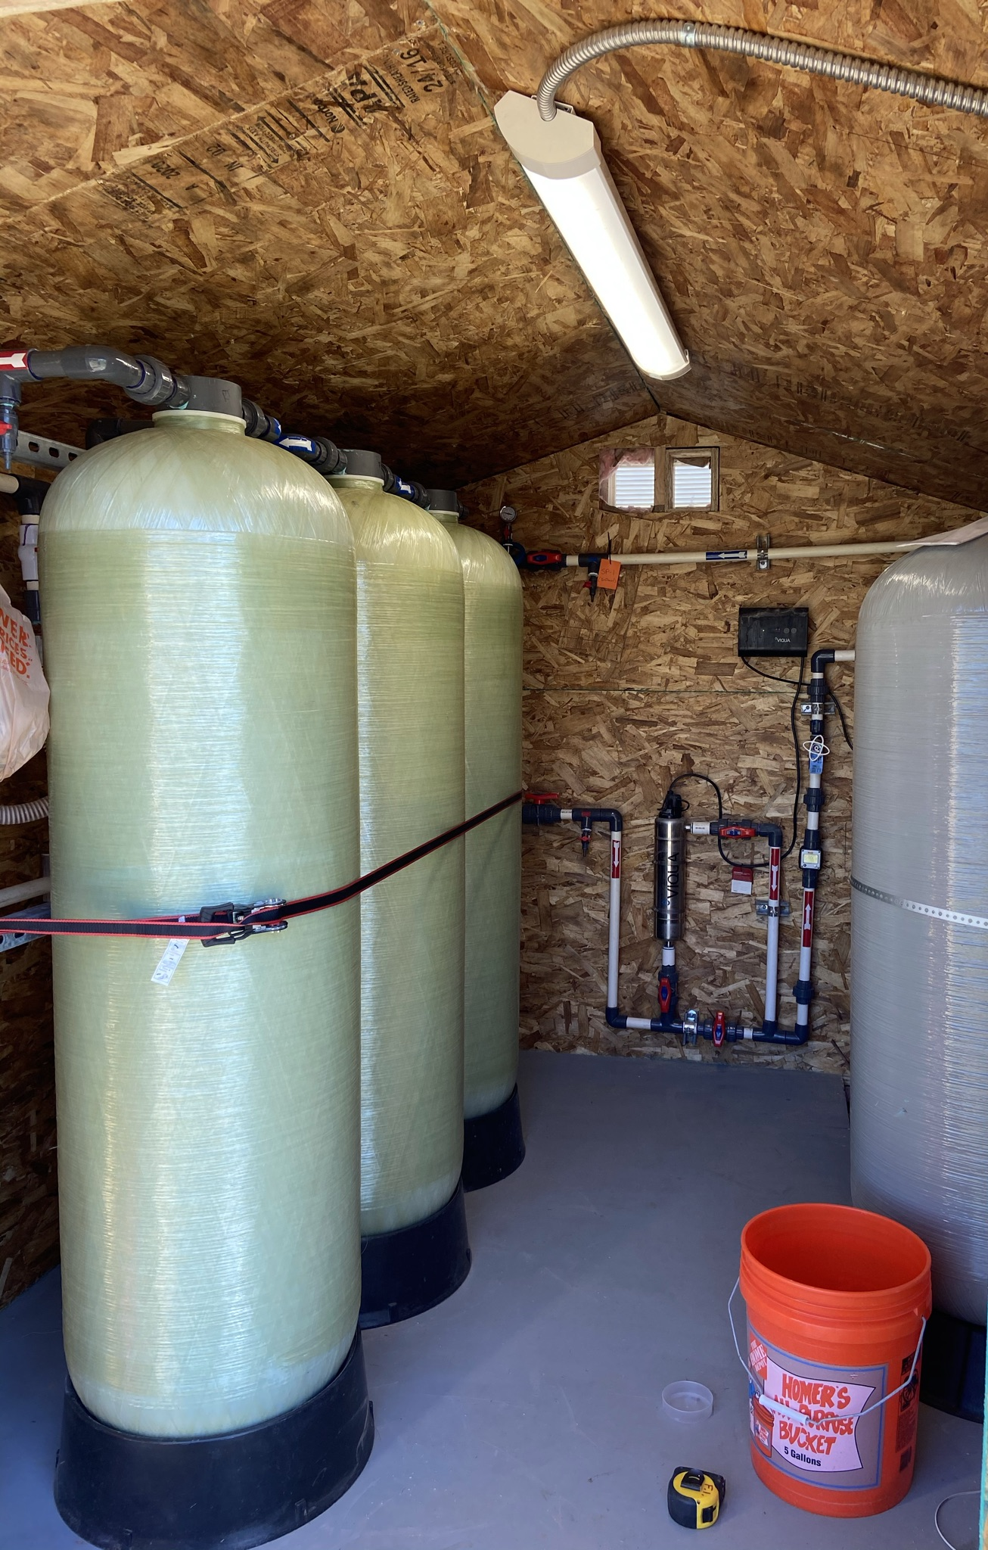
Residential treatment systems
More than 80 treatment systems have been installed at private residences from 2017 to present
Typical capacity for these systems is 10 GPM, though there are some higher flow systems
System designed with 3 tanks for redundancy and increased safety
Sampling and routine maintenance is conducted quarterly
A 24-hr hotline is available for emergency repairs and response
System also includes:
  Particulate filters to remove any sediment/sands from the well
  Ultraviolet (UV) disinfection system for additional removal of bacteria and microorganisms
9

Slide 10
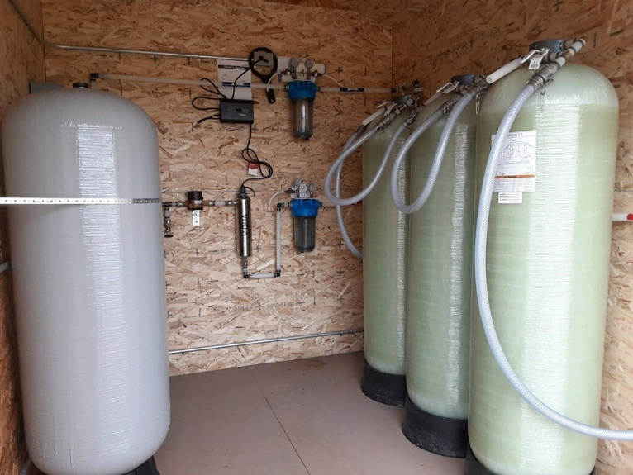
Challenges with O&M of
Residential Treatment Systems
Odor issues identified at 2 homes
  Previously identified at 7 homes
  All 7 previous homes with odor issues have been mitigated
  Performed chlorine disinfection of water distribution pipes
  Replaced all 3 GAC canisters for each location
  Performed a 24-hour flush
    Odor sampling to be completed for one new home
    High concentrations of Manganese
    Installation of an Aquasential™ Smart High Efficiency (HE) Water Softener
Low-pressure issues
  Previously identified at 5 homes
  2 homes are currently undergoing piping, frost-free hydrant, water heater, faucet, and water softener replacements
  Efforts being taken to address the other three homes.
10

Slide 11
Remedial Investigation (RI)
Phase I
  Goal: To determine the nature and extent of soil and groundwater contamination
  Starts with Work Plan/QAPP
  Typically takes multiple phases to complete delineation
  Phase I to sample existing wells and install up to 100 new monitoring wells
    Many of these monitoring wells were installed on base (28)
    Working on obtaining permission and rights to install off-base wells (16)
  Baseline Risk Assessment (BRA) is part of the RI step
  Determine if there is unacceptable risk to human health or the environment

Slide 12
RI Schedules
RI field work began on 7 June 2021
  108 soil borings completed in the 5 Aqueous Film-Forming Foam (AFFF) areas, including No-Name Ditch and the Airfield ponds as of September 2022.
  Additionally, 10 surface water samples were also collected from No-Name Ditch and the Airfield ponds.
Monitoring wells installation:
  28 installed on base, 16 to be installed off-base (Upcoming)
  Slug testing of each new monitoring well once installed
Phase I RI Report
  Regulatory review and comments due by 7/27/23
  Final Phase I RI Report due by 10/7/23
  Plan for additional RI Phases: October 2023 – April 2024

Slide 13
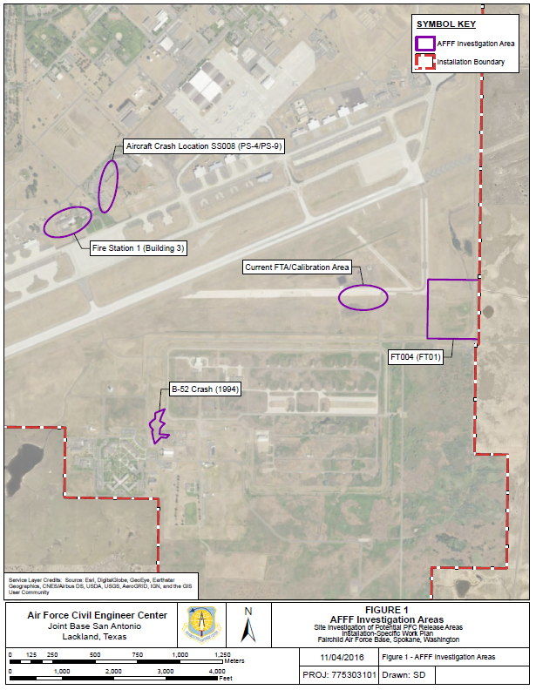
Phase I RI:
AFFF Investigation Areas
Aqueous Film -Forming Foam (AFFF) Release Areas 1-5:
AFFF Release Area 1:
  FT004 (FT01)
AFFF Release Area 2:
  Calibration Area
AFFF Release Area 3:
  Aircraft Crash Location SS008 (PS-4/PS-9)
AFFF Release Area 4:
  B-52 Crash (1994)
AFFF Release Area 5:
  Fire Station 1 (Building 1)
3
5
2
1
4
13

Slide 14
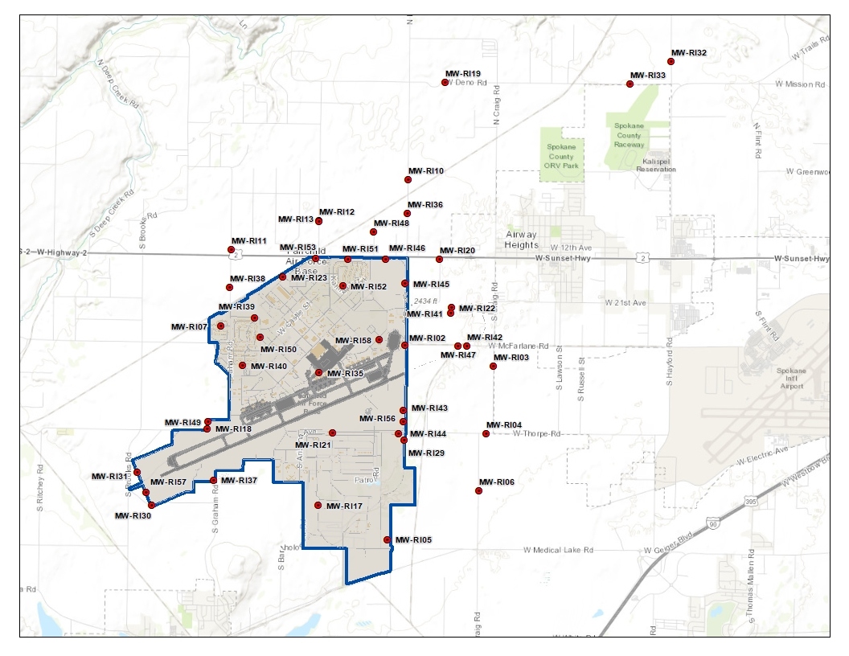
Phase I RI: Monitoring Wells
14

Slide 15
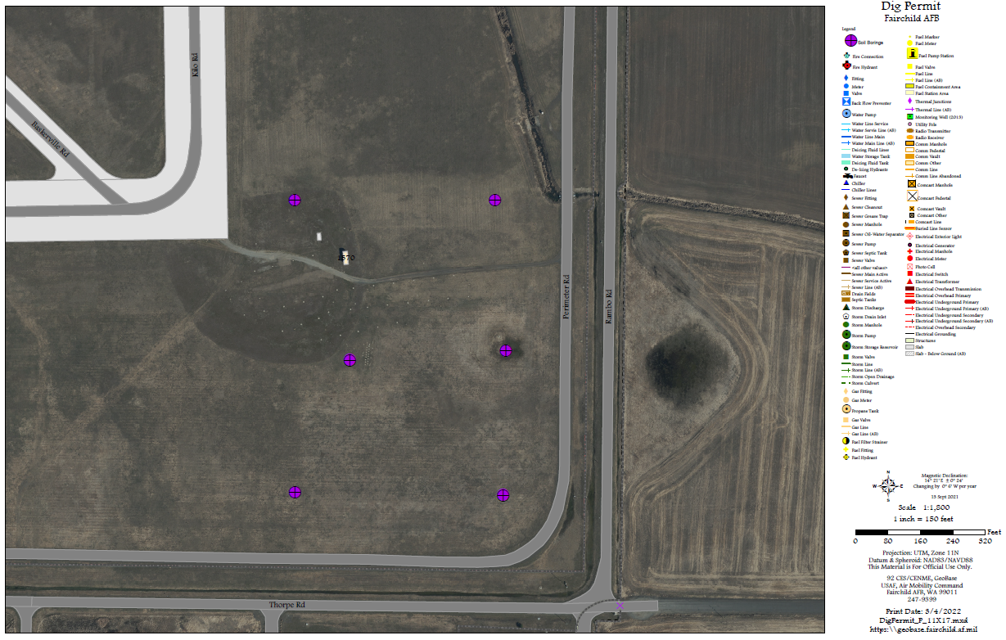
Phase I RI:
AFFF Release Area 1 Soil Borings

Slide 16
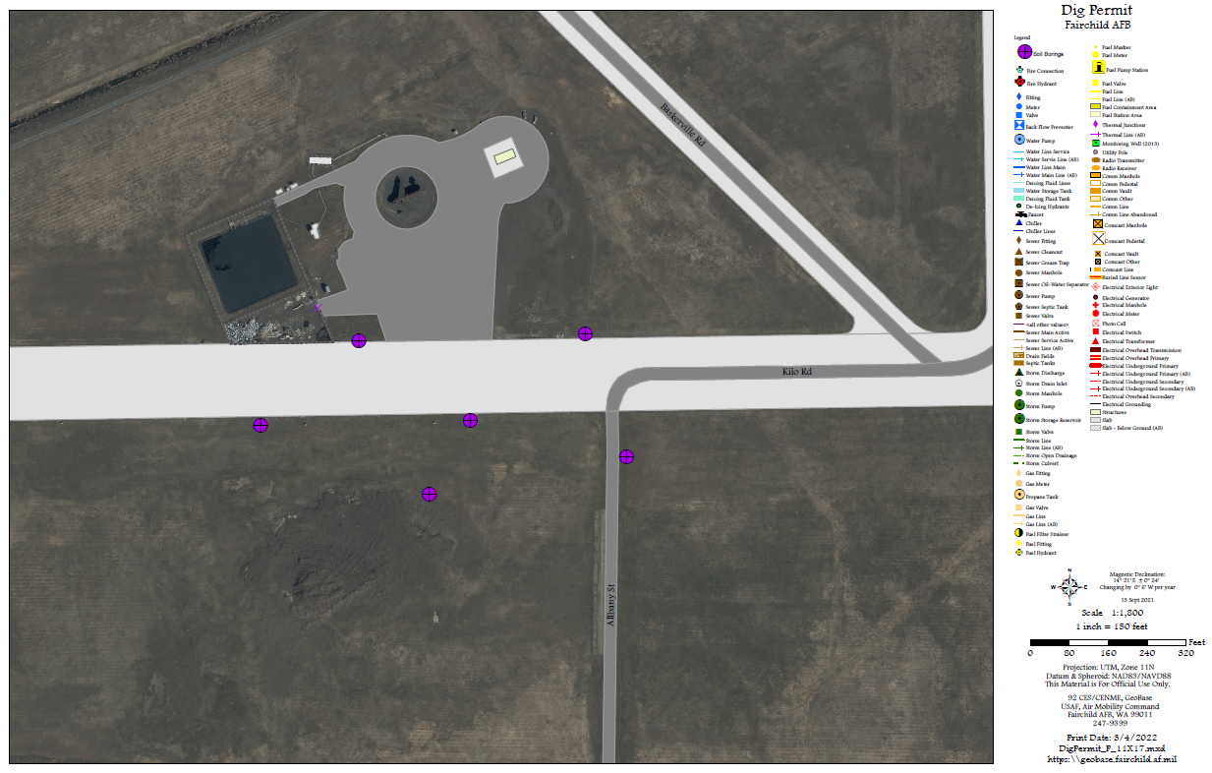
Phase I RI:
AFFF Release Area 2 Soil Borings

Slide 17
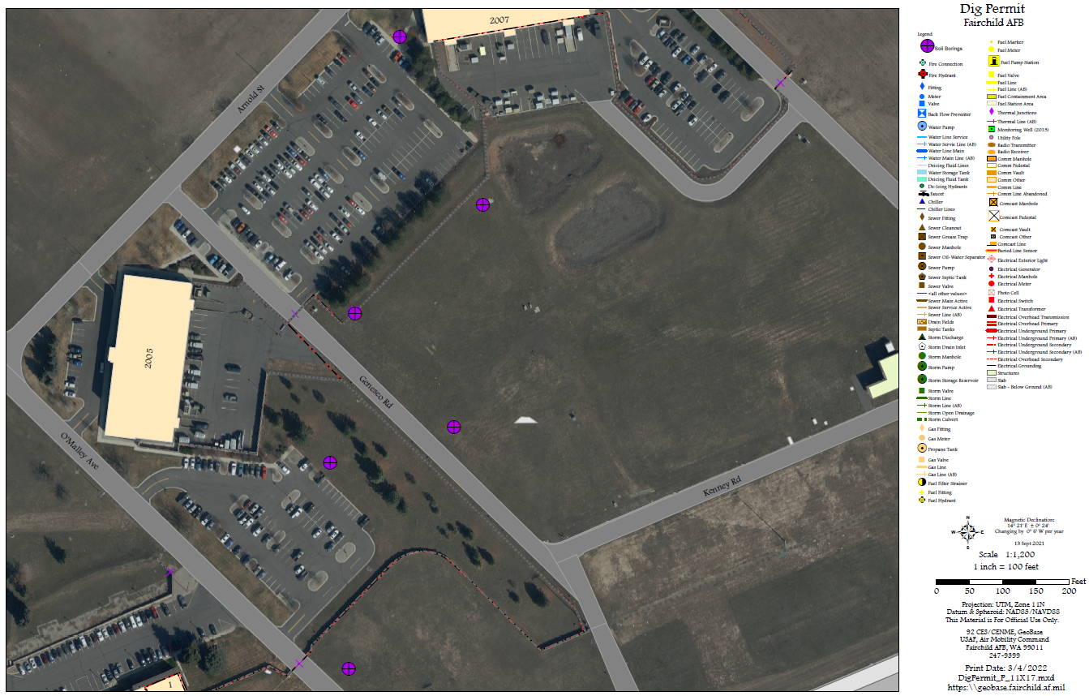
Phase I RI:
AFFF Release Area 3 Soil Borings

Slide 18
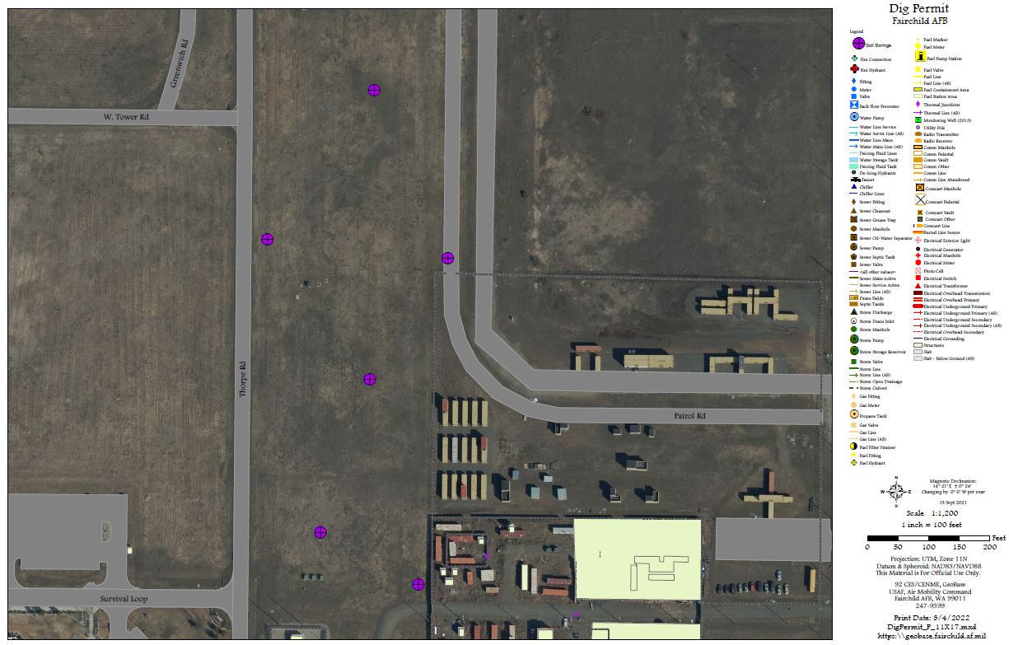
Phase I RI:
AFFF Release Area 4 Soil Borings

Slide 19
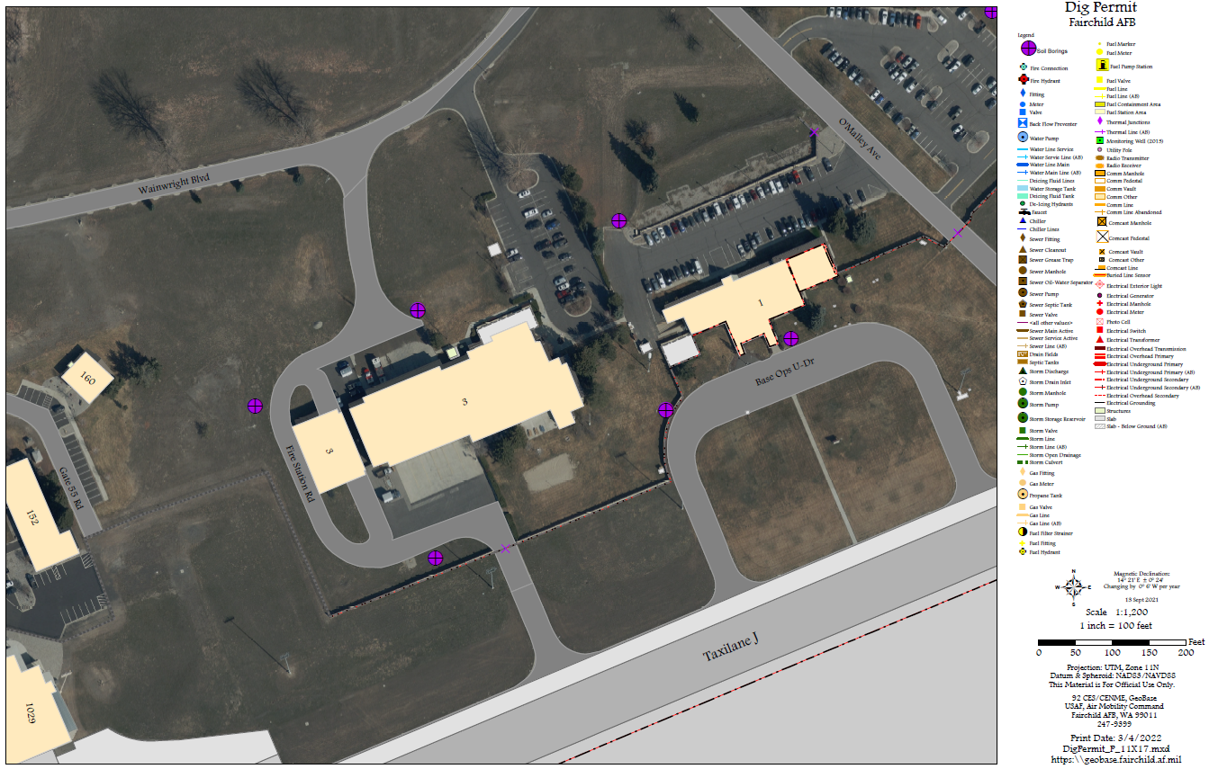
Phase I RI:
AFFF Release Area 5 Soil Borings

Slide 20
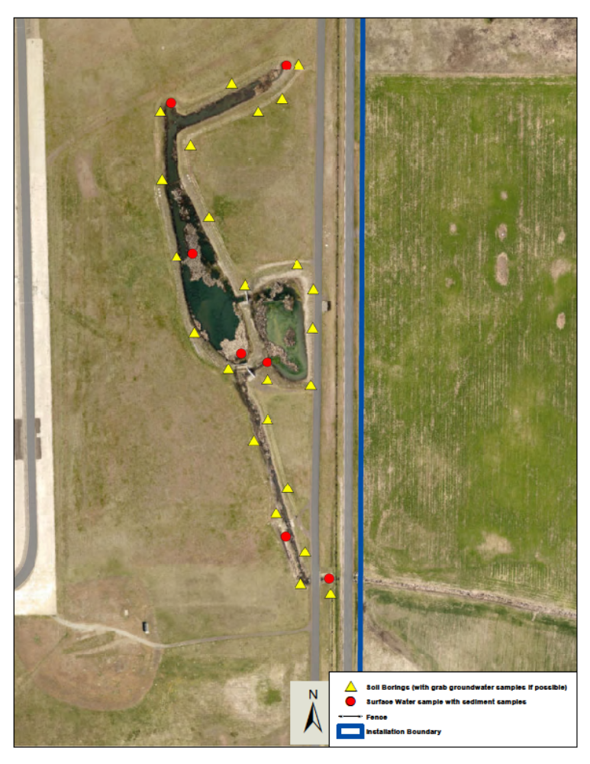
Phase I RI: No-Name Ditch Sampling
20

Slide 21
Summary of Early Action Projects
  Engineering Evaluation/Cost Analysis (EE/CA)
  Final report provided to regulators in September 2021
  Evaluate interim cleanup alternatives for mitigating impacts from PFOS/PFOA for the City of Airway Heights
  Open House held on 23 September 2021
  On hold as documents, water rights, rights-of-way, etc. were due by the CAWH on 31 October 2022 but were not received by the requested date.
    Contractor is moving forward to EE/CA completion.
21

Slide 22
Other Early Actions
Under Consideration
  Critical Process Analysis (CPA)
  The Air Force (AF) believes that it is wise to put removal system(s) at Base boundary ASAP
  Need to conduct Pre-Design Investigation (PDI) to support decision
    Data collection will include:
      Hydrogeologic data
      Bench-scale treatability studies
    The EE/CA and Action Memorandum process will be used to select the remedy
    EE/CA actions include Public Comment Period and Public Meeting
  After final remedy selections, process includes:
    Design, construction, operation and maintenance (O&M), and monitoring
  Kick-off meeting was held on 12 October 2022
  Final Project Management Plan (PMP) due by 2 January 2023
  Final Quality Assurance Project Plan (QAPP) due by 2 June 2023
  Final Waste Management Plan due by 2 June 2023
  Final Data Gap Study and Treatability Study (TS) due by 5 June 2024

Slide 23
Acronyms and Abbreviations
AFB Air Force Base
AF Air Force
AFFF Aqueous Film-Forming Foam
BRA Baseline Risk Assessment
CAWH City of Airway Heights
CERCLA Comprehensive Environmental Response, Compensation, and Liability Act
CPA Critical Process Analysis
EE/CA Engineering Evaluation/Cost Analysis
ESA Environmental Services Agreement
GAC Granular Activated Carbon
GPM gallons per minute
LHA Lifetime Health Advisory
ND non-detect
NTCRA Non-Time Critical Removal Action
O&M operation and maintenance
PBR Performance-Based Remediation
PDI Pre-Design Investigation
PFAS per- and polyfluoroalkyl substances
PFOS/PFOA perfluorooctane sulfonate/perfluorooctanoic acid
POP Period of Performance
QAPP Quality Assurance Project Plan
RAB Restoration Advisory Board
RI Remedial Investigation
SVE soil vapor extraction
TCRA Time Critical Removal Action
TS treatability study
UV ultraviolet
VCP Voluntary Cleanup Program

Slide 24
Questions?
24

Slide 25
2022/2023 Performance-Based Remediation
(PBR) Overview
Bay West and AECOM
17 November 2022

Slide 26
Overview
Site Overview
2022/2023 Major Sites
  SS039, SD037, LF002, WP003, VCP Sites
Public Comment Opportunities in 2022

Slide 27
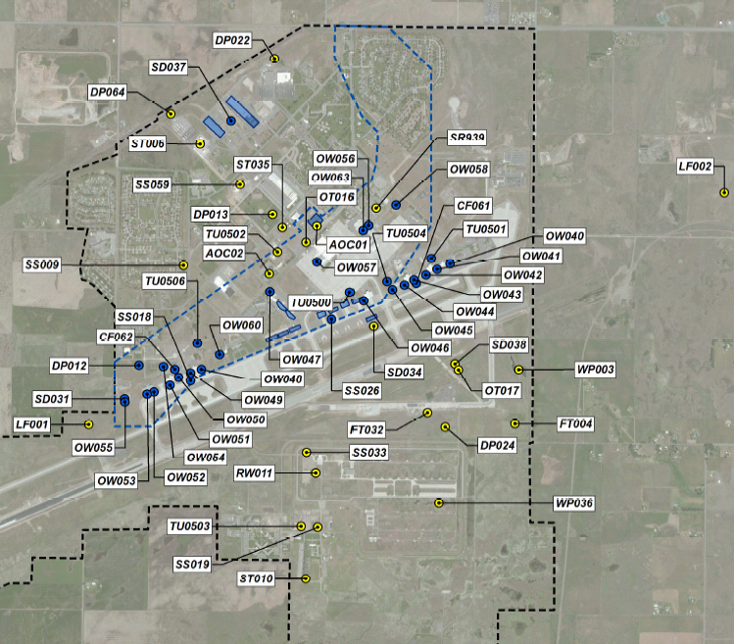
Site Overview
59 historical environmental sites. One historical Military Munitions Response Site at Fairchild Air Force Base (AFB). Environmental actions include:
Work Plans
Remedial Action-Operations (RA-O)
Treatment Operations
Remedial Design
Investigation Reports
Monitoring/Remedial Performance Reports
Treatment Reports
Notes:
Site Inventory
59 IRP Sites
1 MMRP Site
Well Inventory across Fairchild Air Force Base (AFB)

Slide 28
Orphan Trichloroethylene
(TCE) Plumes
(SS039)
2021/2022 Overview and Planned 2023 Actions
Ms. Kristine Weber
AECOM Site Lead
17 November 2022

Slide 29
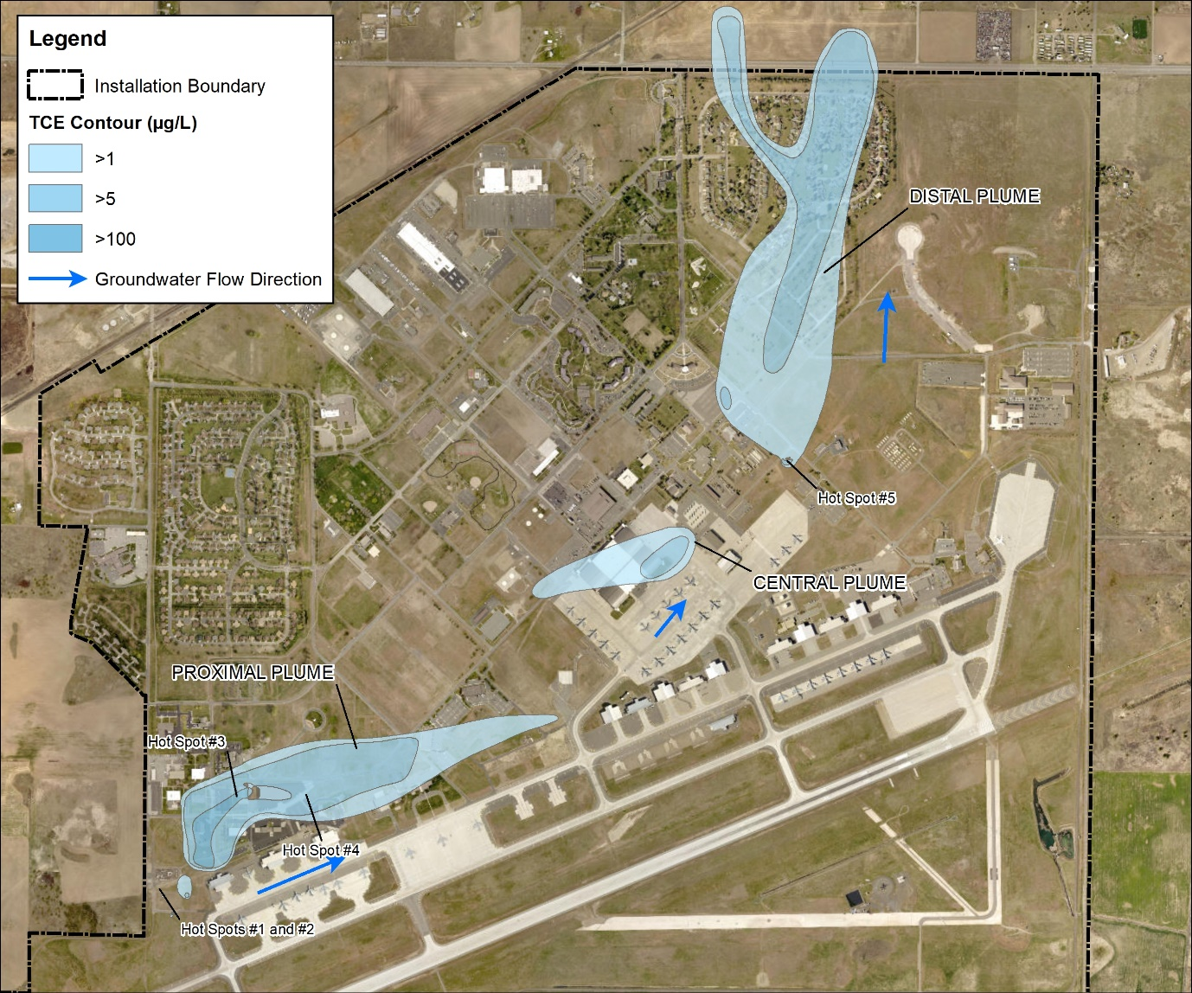
SS039 Overview
  2021 Summary
Injection activities
Semi-annual Performance Monitoring
Annual Groundwater (GW) Monitoring
  2022 Summary
  Semi-annual Performance Monitoring
Annual GW Monitoring and Reporting
  2023 Planned
  Semi-annual Performance Monitoring
Annual GW Monitoring and Reporting
Polishing Injection Activities
TCE – trichloroethylene

Slide 30
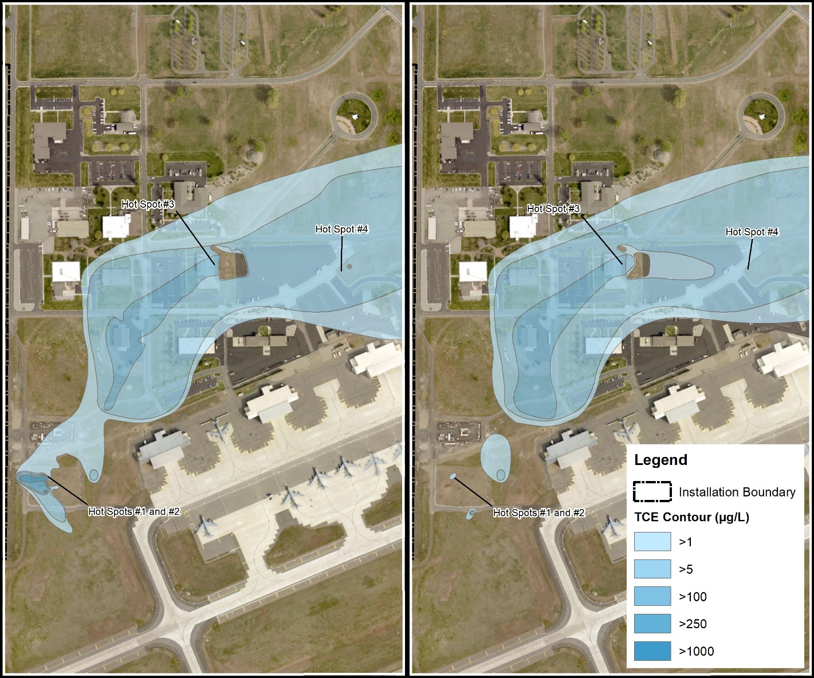
SS039 Overview
  Before and After 2021 Sodium Permanganate Injection Event
    Injected approx. 85,215 gallons (1% solution) into five injection wells (IWs) at Hotspot #1 and #2
    Injected approx. 17,006 gallons (1% solution) into two IWs at Hotspot #4
November 2020
May 2022
TCE – trichloroethylene
Notes:
Injection wells are located in transects, cross-gradient to the plume core.

Slide 31
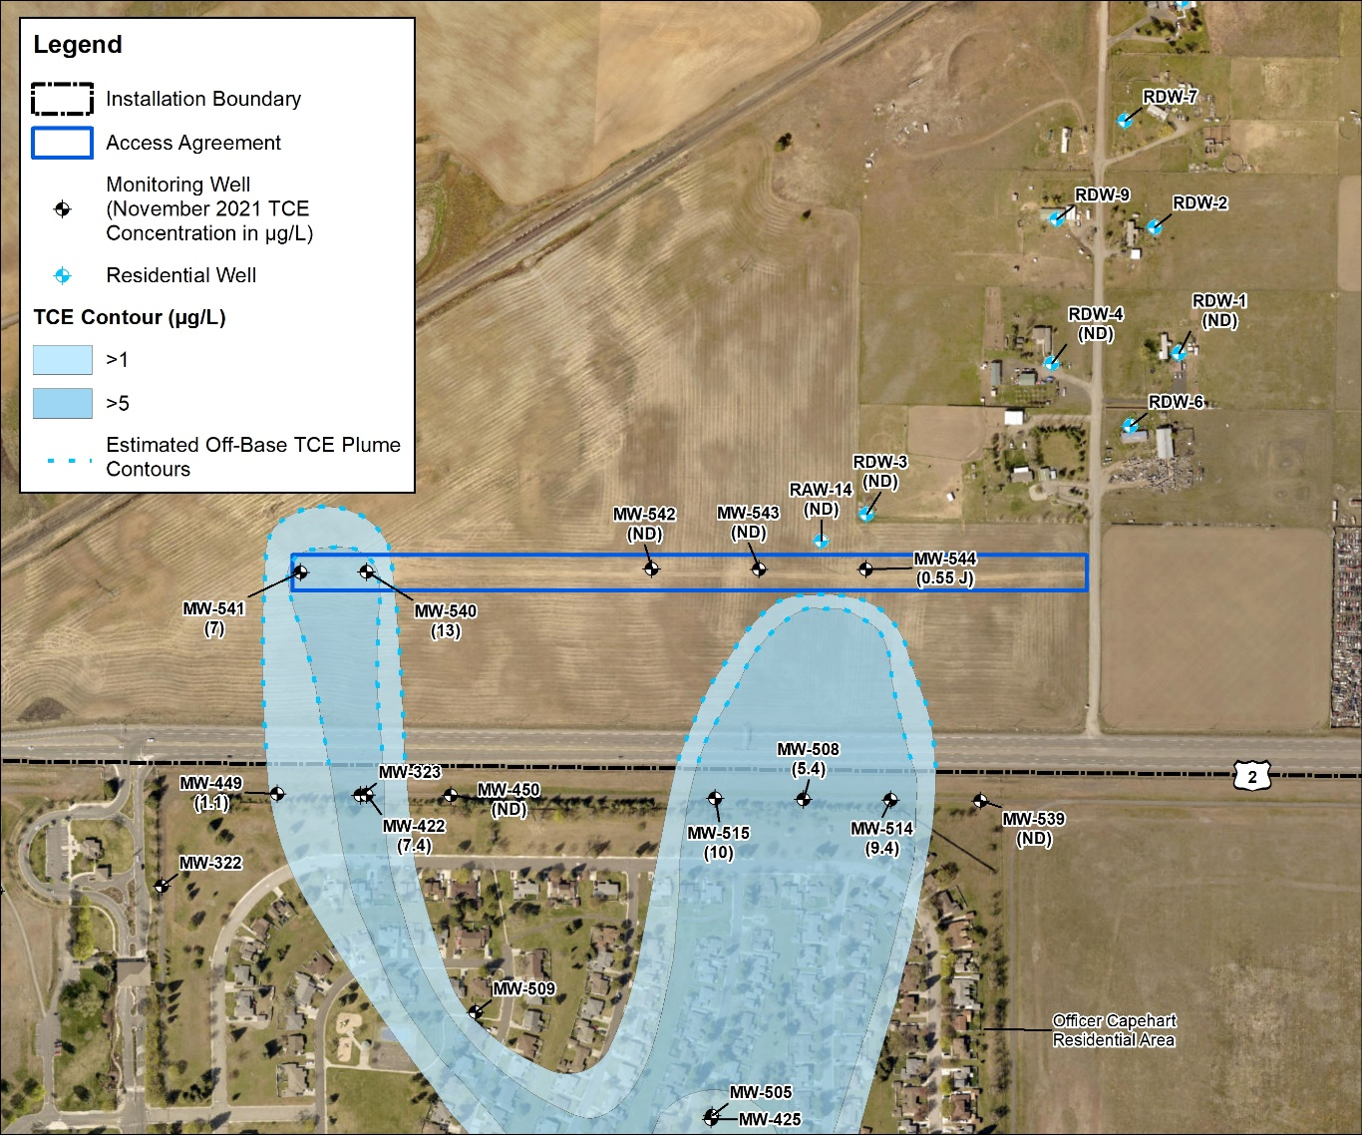
SS039 Off-Base Overview
2021 Summary
Off-Base GW Monitoring
    TCE was above the Maximum Contaminant Level (MCL) in two western-most off-site wells
  2022 Summary
  Completed Annual GW Monitoring in November 2022
  Completed Residential Well Sampling in May 2022
  2023 Planned
  Complete Annual GW Monitoring
TCE – trichloroethylene

Slide 32
SD037 Buildings 2447/2451
2021/2022 Summary and Planned 2023 Actions
Ms. Kristine Weber
AECOM Site Lead
17 November 2022

Slide 33
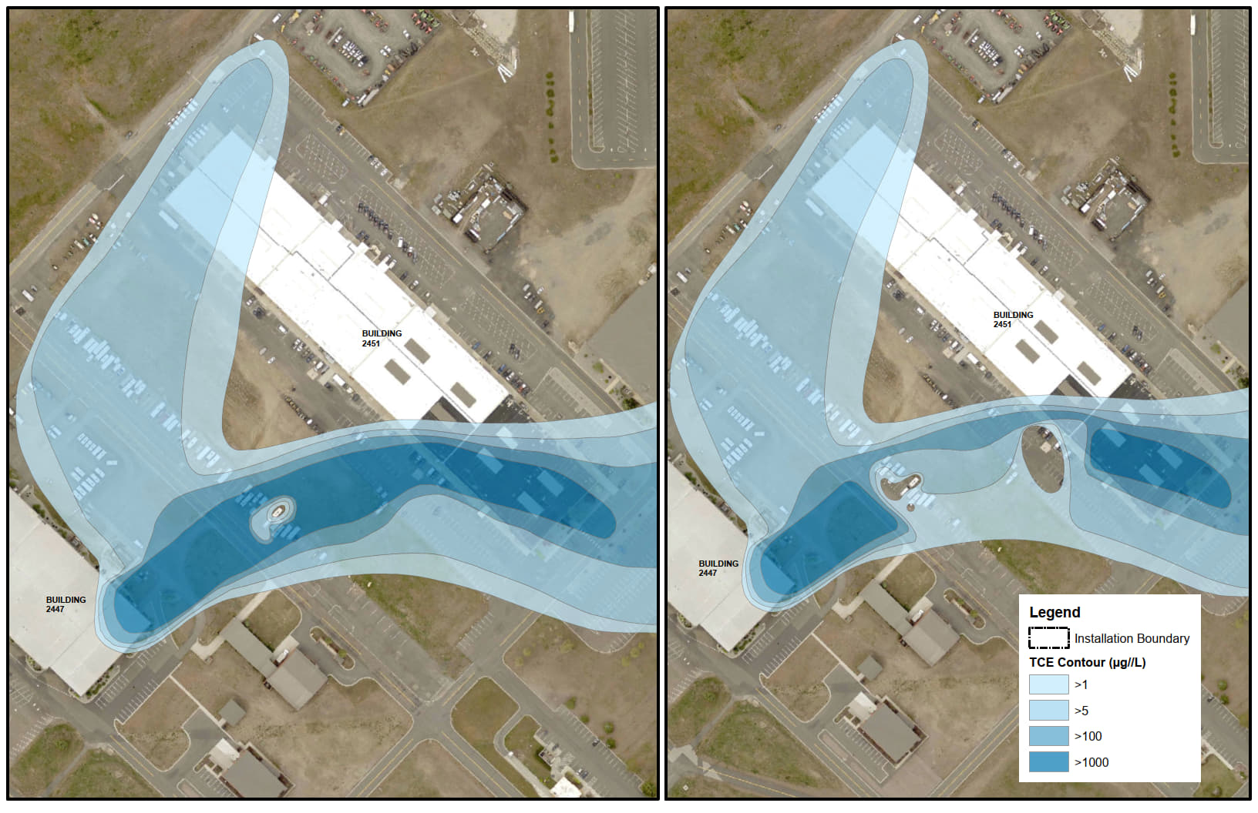
SD037 Overview
  Before and After September 2021 Sodium Permanganate Injection Event
    Installed 22 injection wells (IWs)
    Installed 6 additional monitoring wells (MWs)
    Completed injection of 96,289 gallons of sodium permanganate (1% solution)
July 2021
May 2022
Notes:
Injection wells are located in transects, cross-gradient to the plume core.

Slide 34
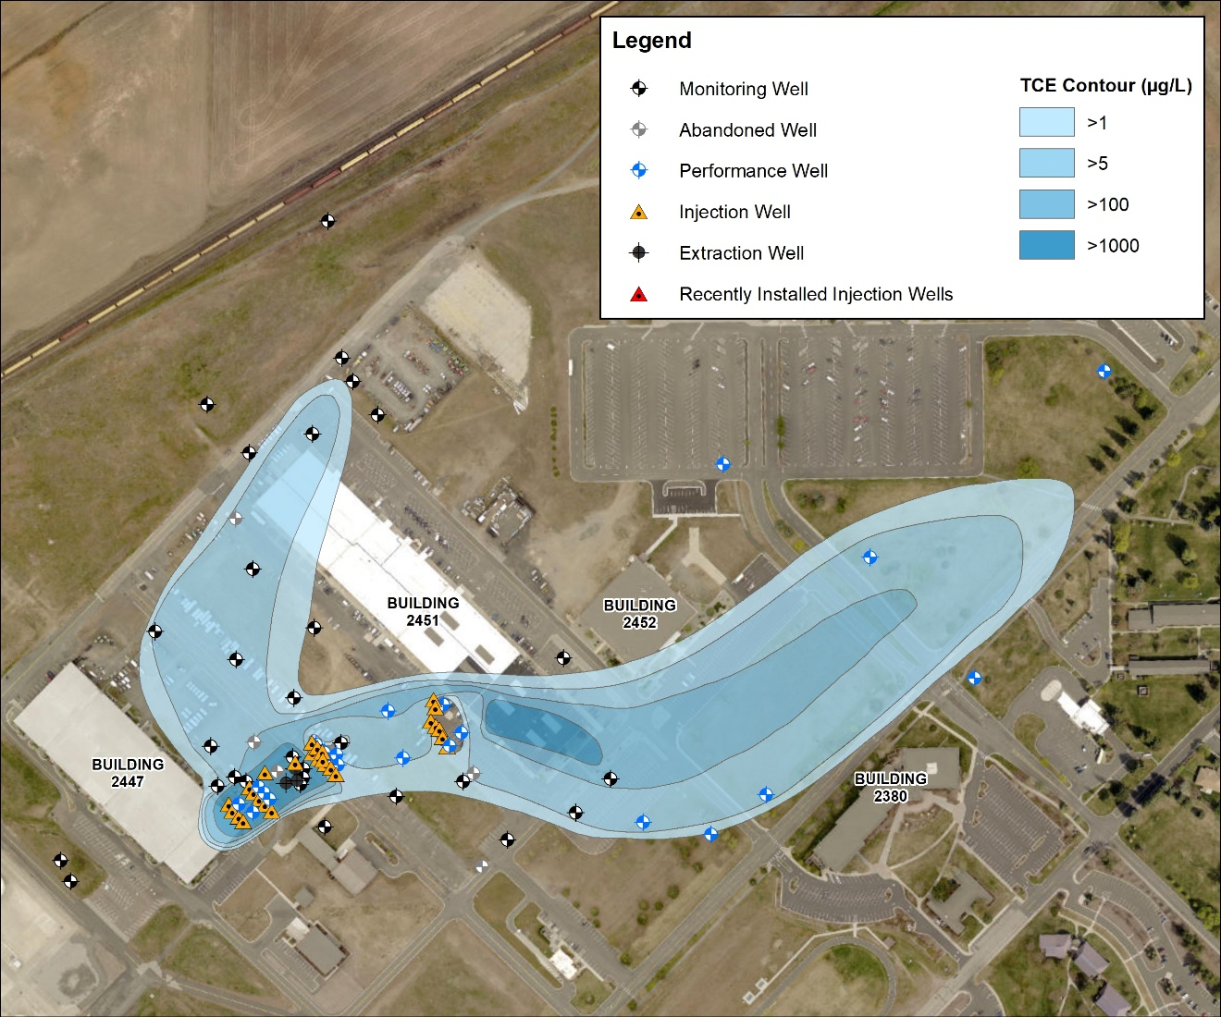
SD037 Overview
  In Situ Chemical Oxidation Pilot Study and Vapor Intrusion Evaluation
  2021 Summary
  Completed injection of 96,289 gallons of sodium permanganate (1% solution)
  2022 Summary
  Quarterly Performance Monitoring
  Feasibility Study (FS)
  2023 Planned
  Semi-annual Performance Monitoring
  Proposed Plan (PP)
TCE – trichloroethylene

Slide 35
Craig Road Landfill (LF002)
2022/2023 Remedial Action-Operations (RA-O) Overview
Mr. John Peper
Bay West Project Manager
17 November 2022

Slide 36
LF002 Background
  LF002 is a former landfill on Air Force property located about one mile east of the Base.
  Trichloroethylene (TCE) was discovered in groundwater in the late 1980s and 1990s.
  Remedial action was implemented in 1995 and has consisted of:
    Groundwater containment with extraction wells and stripper tower treatment
    Construction of an engineered cap
    Land Use Controls (LUCs)
    Soil Vapor Extraction (SVE) systems were added to the remedy in 2017.
  RA-O consisting of systems operation and groundwater monitoring have been performed since 1995.

Slide 37
LF002 2022 Overview
2022 Actions
  Ongoing: Operation and Maintenance (O&M) of the Groundwater Extraction and Treatment System/SVE Systems and RA-O Monitoring.
  RA-O Monitoring: Quarterly sampling events were completed in March, June, and September 2022, and planned for November 2022.
  August 2022: The 2021 Annual RA-O Report was finalized.
  October 2022: The 2022 Semi-annual Report was submitted for USAF Review.
  Remedial Progress:
    99.6% of the original (1995) TCE mass has been removed.
    TCE groundwater concentrations continue to decrease. The maximum TCE concentrations decreased from 20,000 micrograms per liter (μg/L) in 2018 to now (September 2022) only 140 μg/L.
    33 of the 58 wells are now below the Project Action Level (PAL) of 5 μg/L.
    18 wells have TCE concentrations near the PAL (5 to 25 μg/L).
    14 wells have TCE concentrations that are projected to decrease below the PAL in less than two years.

Slide 38
LF002 2022 Overview
2022/2023 Planned Actions
  Evaluate and develop the transition from active remediation to Long-Term Management (LTM).
  Evaluate a trial system shut down (per criteria proposed in the approved 2021 RA-O Report and with United States Environmental Protection Agency (EPA) concurrence) based on sampling results.
  Continued RA-O monitoring planned for March, June, September, and December 2023.
  Prepare 2022 Annual RA-O Report.
  The 2022 Semi-annual RA-O Report is under USAF review.

Slide 39
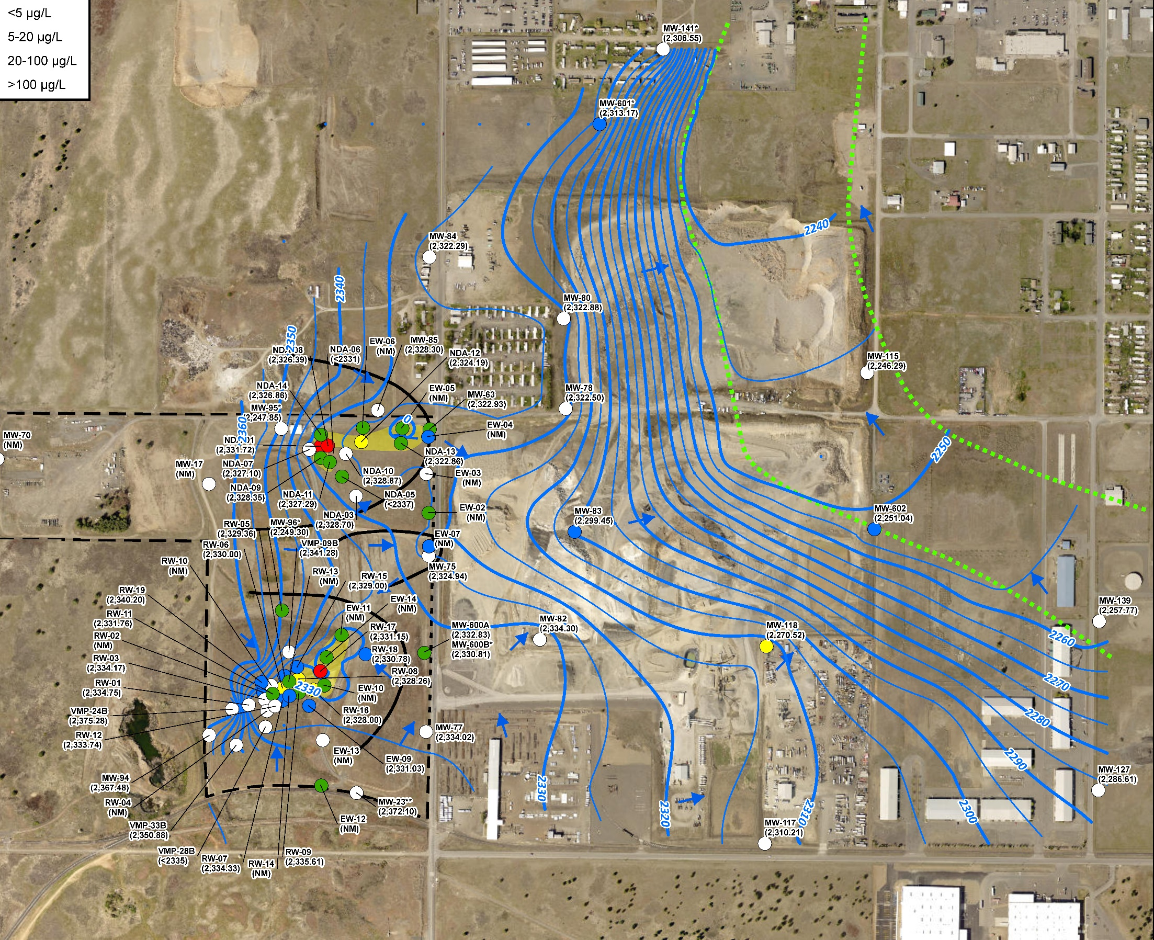
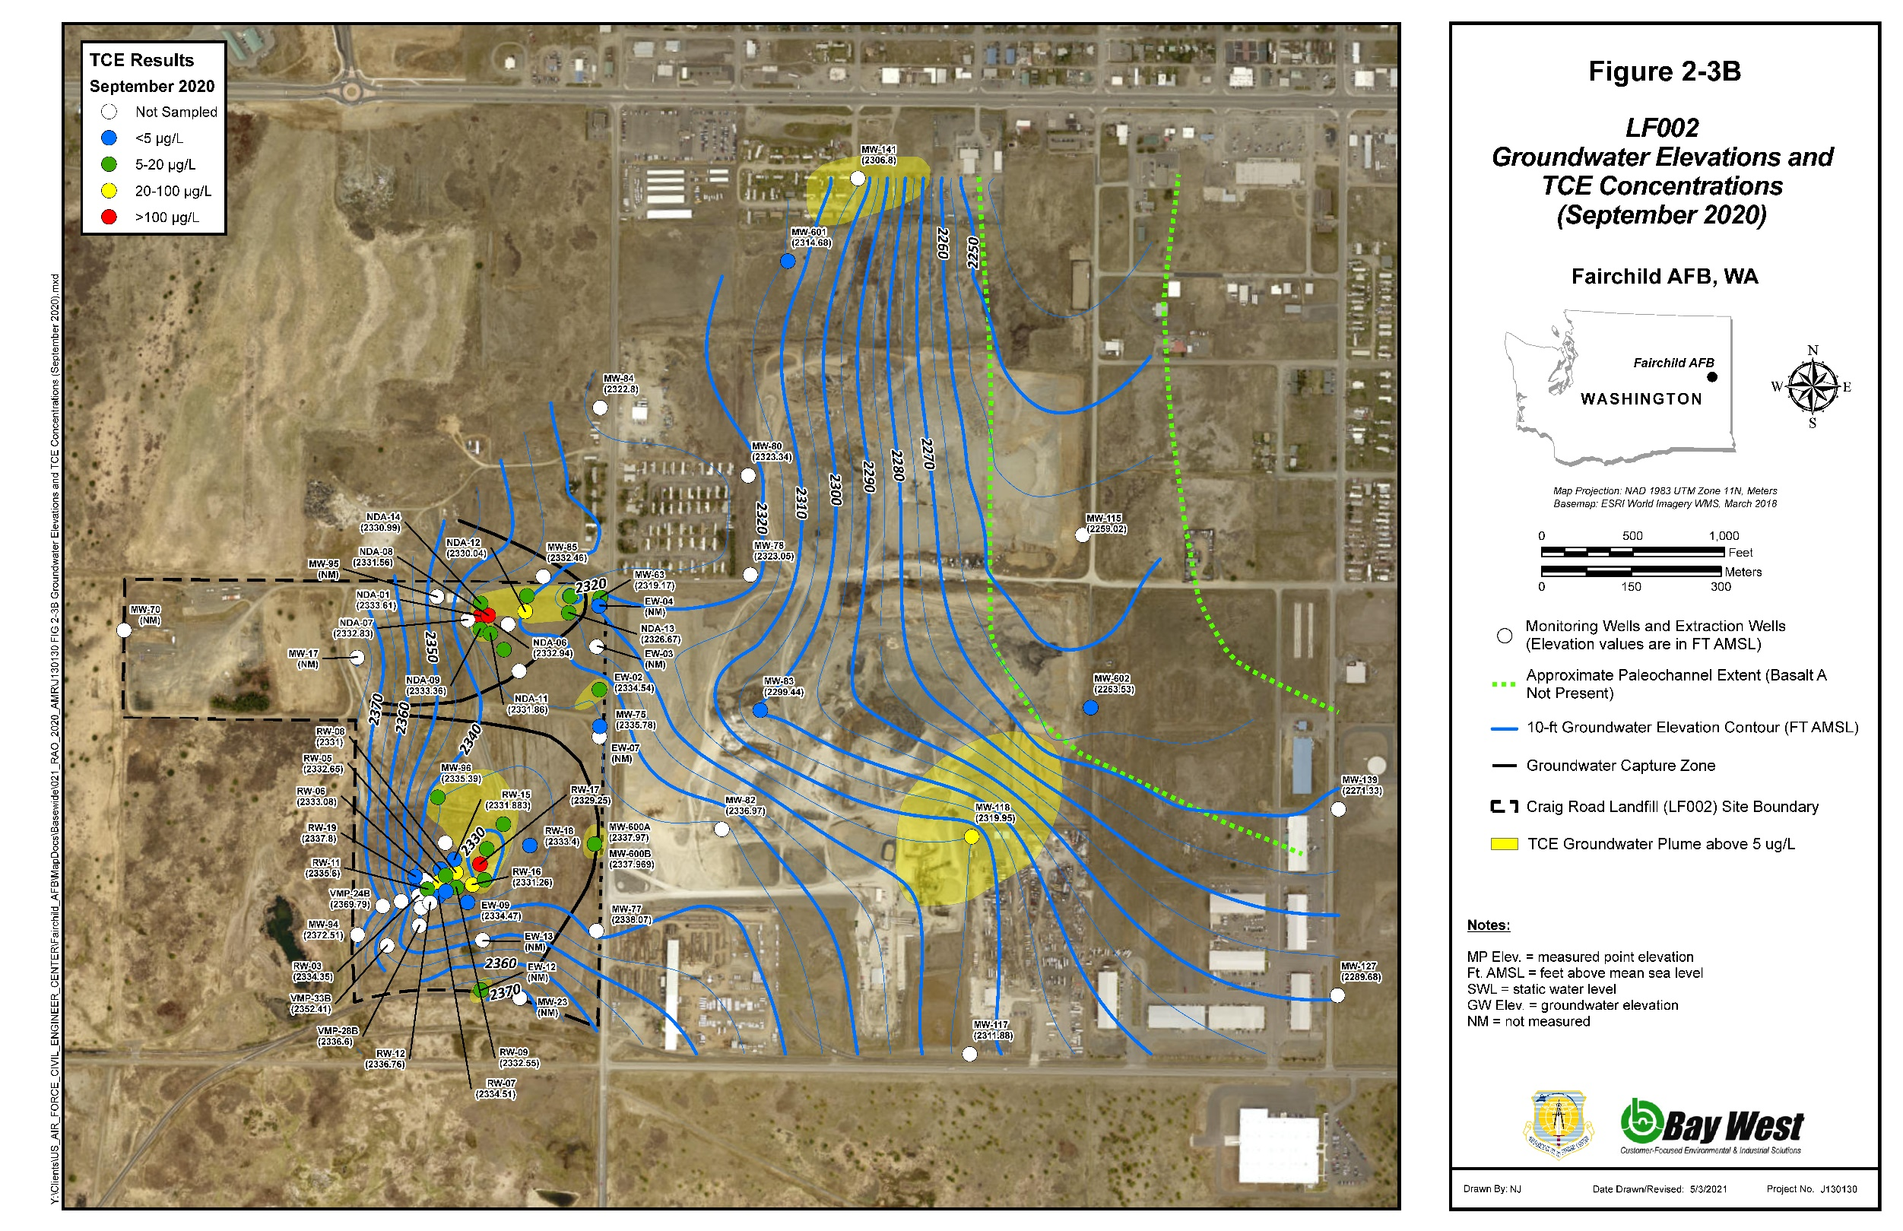
LF002 2022 Overview
LF002 September 2022 Monitoring Results
FT AMSL = feet above mean sea level
2022

Slide 40
Industrial Wastewater Lagoon System (WP003)
2022/2023 RA-O Overview
Mr. John Peper
Bay West Project Manager
17 November 2022

Slide 41
WP003 Background
  WP003 includes former wastewater treatment lagoons located on the east margin of the base.
  TCE was discovered in groundwater in the late 1980s and 1990s at concentrations above regulatory limits. Subsequent monitoring also identified concentrations of vinyl chloride (VC) above the regulatory limit and arsenic above background levels.
  Remedial action was implemented in 1996 and has consisted of:
    LUCs;
    1996-2004: GW containment with extraction wells and stripper tower treatment;
    2000-2001: Source area excavation and organic substrate supplements.
  RA-O currently consists of quarterly GW monitoring.

Slide 42
WP003 2022 Overview
    2022 Actions
  RA-O Sampling: February, June, and September quarterly RA-O sampling are completed, and November sampling is planned.
  Pilot Test Performance Monitoring: Performance monitoring has been completed quarterly in 2022 at selected wells to evaluate the June 2021 bioaugmentation injections.
    Preliminary results demonstrated the injections supported biodegradation of chlorinated ethenes for approximately one year.
    There was a 50% reduction of chlorinated ethenes and a 61% to 71% reduction of VC concentrations.
    Off-base VC concentrations remained below the PAL and below detection for Quarter 1 and Quarter 2 of 2022. There was only a slight off-base PAL exceedance in Quarter 3.
  August 2022: The 2021 Annual RA-O Report is finalized.
  August 2022: The Draft Final Feasibility Study Addendum (FSA) was submitted for EPA backcheck.
    Revised RA-Os and PALs. Preferred remedy to include bioaugmentation.
  October 2022: The 2022 Semi-annual RA-O Report was finalized.
  October 2022: The Draft Optimized Exist Strategy Plan was submitted to the USAF.

Slide 43
WP003 2022 Overview
  2022-2023 Planned Actions
    March, June, September, November 2022: Quarterly RA-O Monitoring of wells at WP003.
    Fall 2022: Finalize the WP003 Optimized Exit Strategy.
    Spring 2023: Prepare/submit the 2022 Annual RA-O Report.
    Spring 2023: Finalize the FSA.
Summer 2023: Submit the WP003 PP.

Slide 44
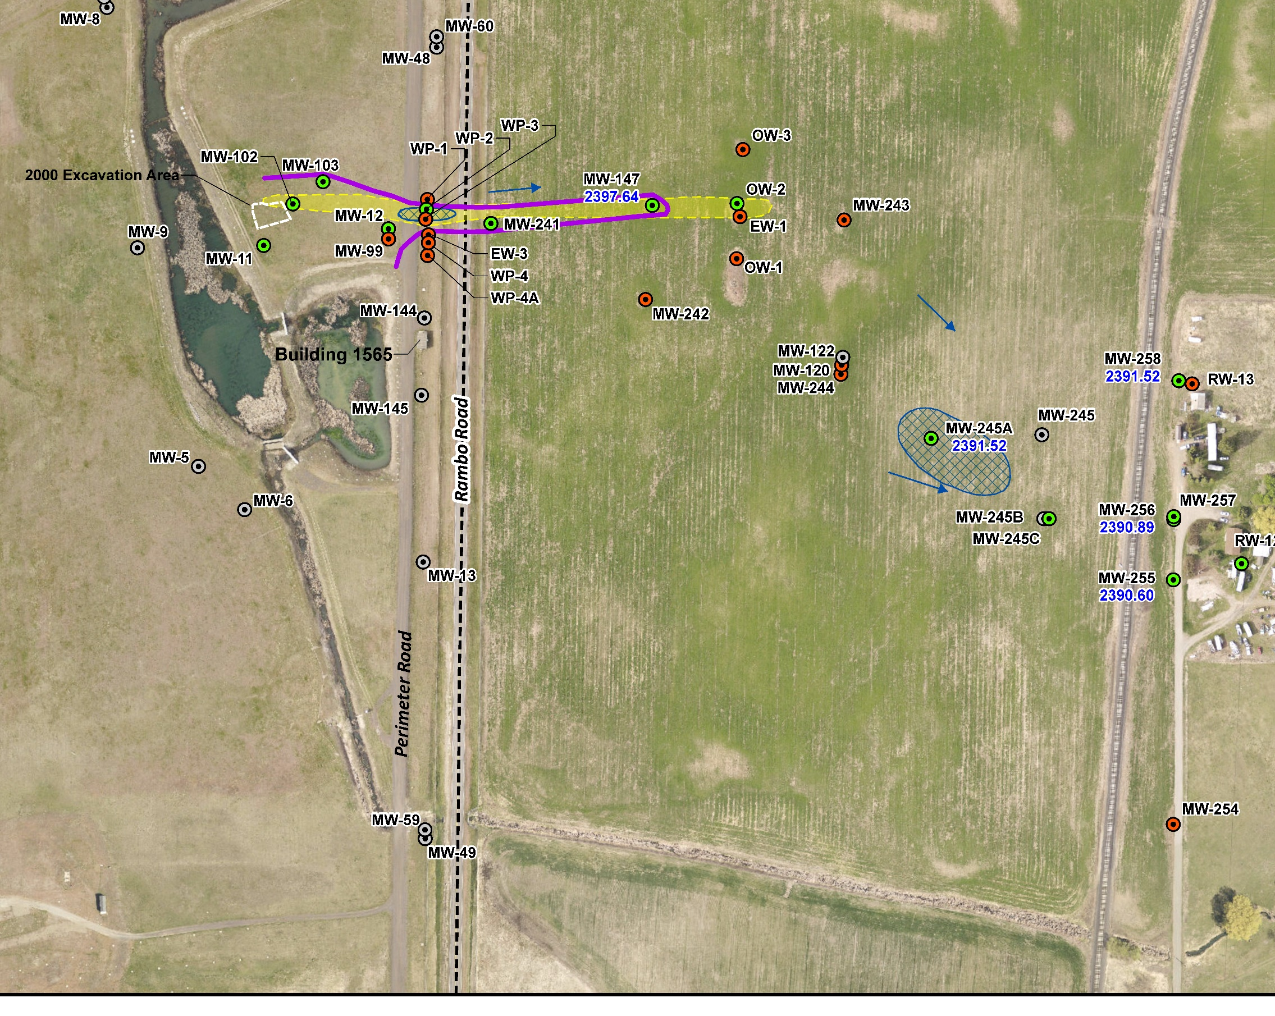
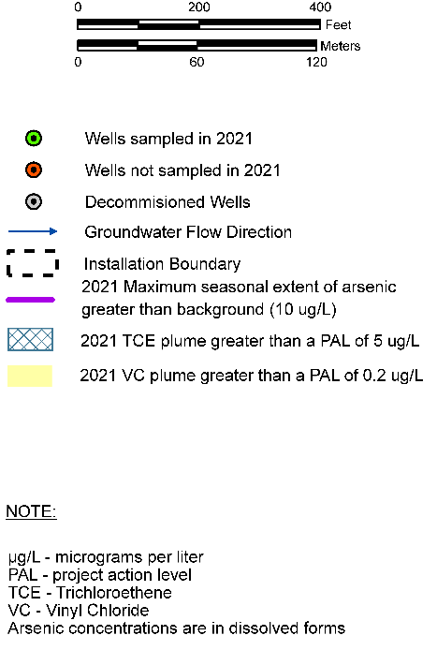
WP003 2022 Overview
WP003 2022 Monitoring Results
In Q1 and Q2 2022 VC was only detected in MW102
The arsenic and VC plumes only extended off-base in Q3 2022.
Maximum extents have remained stable for > 10 yrs.
2022 Maximum Arsenic Extent above a background of 10 μg/L
2022 Maximum TCE plume above the PAL of 5 μg/L
2022 Maximum VC plume above the PAL of 0.2 μg/L
ug/L – micrograms per liter
PAL – project action level
TCE –trichloroethylene
VC – Vinyl Chloride
Arsenic concentrations are in dissolved forms

Slide 45
Voluntary Cleanup Program (VCP) Sites
Mr. John Peper
Bay West Project Manager
17 November 2022

Slide 46
VCP Sites
  Eight former oil/water separator sites along the flight line have achieved USAF and Washington Department of Ecology (WDOE) approval of Site Closure/No Further Action (NFA) through the WDOE Voluntary Cleanup Program (VCP).
    OW044, OW047, OW053, OW054, OW055, OW056, OW057, and OW063
  Other Petroleum Sites in the NFA Approval Process
    NFA Tech Memo Approved: ST010, SS033
    NFA Approved: ST006 (groundwater), OT017, FT032, ST035, AOC02, SS059
    Remedial Investigation (RI)/NFA Report Approved: SS059
  Petroleum Sites in the RI Stage
    SS009
  Petroleum Sites in the Interim Measures/Remediation Planning Stage
    TU500, TU502, TU503, TU506

Slide 47
West Flightline Plume
(TU506)
2022 Summary and 2023 Planned Actions
Ms. Kristine Weber
AECOM Site Lead
17 November 2022

Slide 48
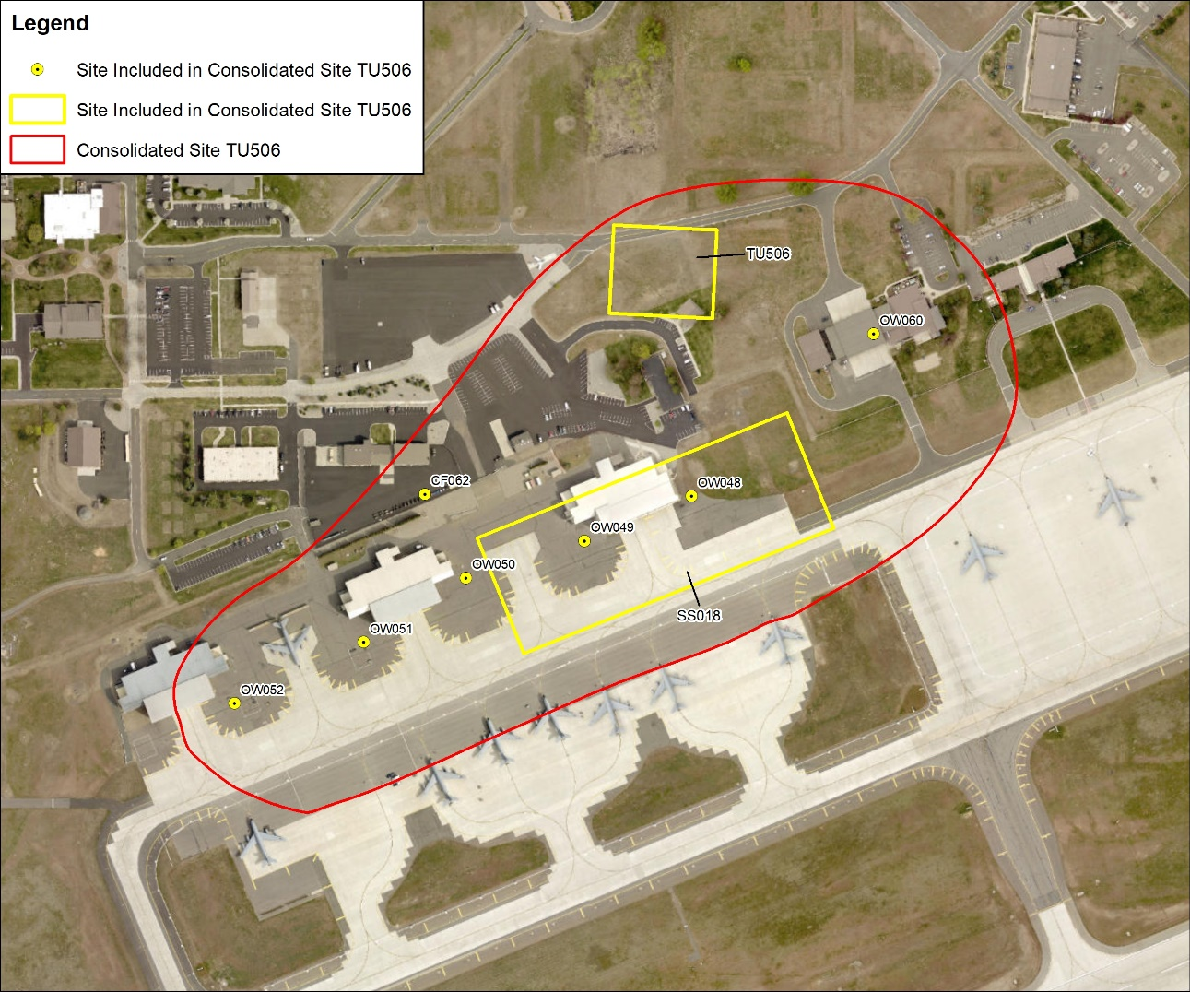
TU506 Overview
  2022 Summary
  Hot Spot Excavation at OW050
  Excavation Completion Report
  Quarterly Monitoring
  2023 Planned
  Risk Assessment Addendum
  Feasibility Study (FS)

Slide 49
East Flightline Plume
(TU500)
2022 Summary and 2023 Planned Actions
Ms. Kristine Weber
AECOM Site Lead
17 November 2022

Slide 50
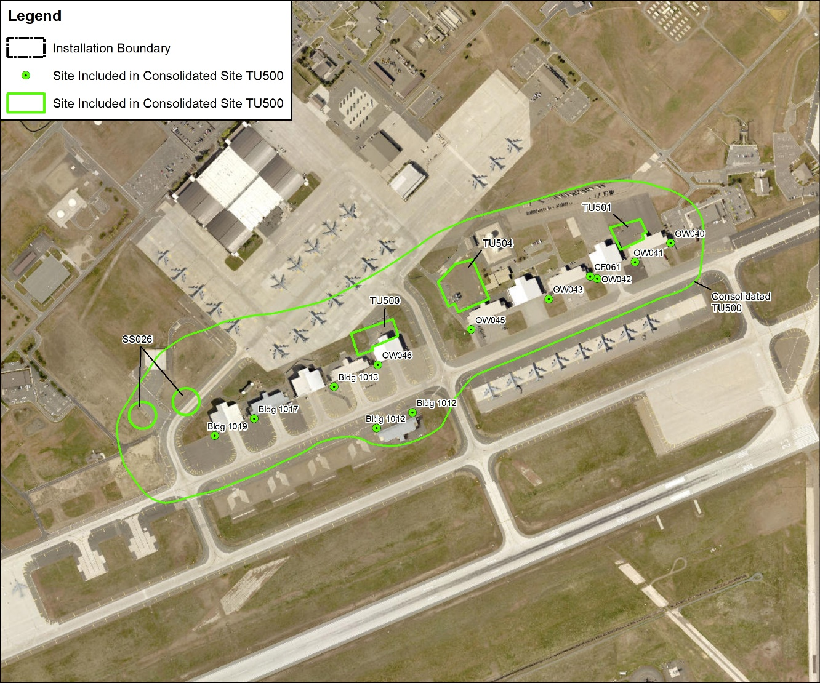
TU500 Overview
  2022 Summary
  Hot Spot Excavation at OW040, OW041, and OW043
  Excavation Completion Report
  Quarterly Monitoring
  2023 Planned
  Risk Assessment Addendum
  FS

Slide 51
Public Comment Opportunities in 2023
Mr. John Peper
Bay West Project Manager
17 November 2022

Slide 52
Public Comment Opportunities 2023
  Operable Unit 2 (OU2) (DP064, Construction Debris Landfill/Former Coal Storage Area) Proposed Plan (PP): In USAF review stage - Public Comment Period: March 1 – April 1, 2023
    Remedial alternatives for DP064
  OU2 (WP003, Industrial Wastewater Lagoon System) PP: In planning stage
  Will include selected remedy for the site based on the FSA
  Anticipated public comment period - Summer 2023

Slide 53
Public Comment Opportunities 2022
  OU2 (OW058, Hotspot #5 Total Petroleum Hydrocarbon (TPH) Contamination) PP: In production stage - Public Comment Period: Summer 2023
    Remedial alternatives for OW058
    Anticipated public comment period: Summer 2023

Slide 54
Acronyms and Abbreviations
µg/L micrograms per liter
AFB Air Force Base
AMSL above mean sea level
EPA United States Environmental Protection Agency
FSA Feasibility Study Addendum
FS Feasibility Study
GW groundwater
IWs injection wells
LTM Long-Term Management
LUCs Land Use Controls
MCL Maximum Contaminant Level
MWs monitoring wells
NFA No Further Action
OU Operable Unit
PAL Project Action Level
PBR Performance-Based Remediation
PP Proposed Plan
RA-O Remedial Action-Operations
RI Remedial Investigation
SVE soil vapor extraction
TCE trichloroethylene
TPH Total Petroleum Hydrocarbon
USAF United States Air Force
VCP Voluntary Cleanup Program
VC vinyl chloride
WDOE Washington Department of Ecology

Slide 55
BREAK
Meeting will resume in 5 minutes.

Slide 56
PUBLIC COMMENT

Slide 57
MEETING
ADJOURNED
THANK YOU!
Notes:
We greatly appreciate your attendance and participation!

