Slide 1
Welcome
Fairchild Air Force Base (AFB)
Restoration
Advisory Board (RAB) Meeting
30 March, 2023

Slide 2
Fairchild AFB
Restoration Advisory Board (RAB) Meeting
Date: March 30, 2023 - Time: 3:00 pm
RAB Meeting Agenda
3:00-3:05 p.m. Welcome & Introductions………………………….........Col. Charles Fletcher, RAB Installation Co-Chair
Pledge of Allegiance……………………………………….……..........Liz Drake, AECOM RAB Facilitator
RAB Mission Statement……………………........................................Liz Drake, AECOM RAB Facilitator
3:05-3:15 RAB Business…………………………………….......…...……………Liz Drake, AECOM RAB Facilitator
          RAB Code of Conduct & RAB Meeting Ground Rules
          Nov. 17, 2022 meeting minutes
          Standard Operating Procedures
          Draft MCL and what does it mean
          3:15-3:45 Perfluorooctane Sulfonate and Perfluorooctanoic Acid (PFOS/PFOA)
          Investigation and Ongoing PFOS/PFOA Projects
          20 minutes Presentation…………………………………………………………………………....Mark Loucks, AFCEC
          3:45-4:15 Update on sites Managed Under the Performance-Based Remediation (PBR) Contract
          10 minutes Presentation………………………..…………….……….…………………………….John Peper, Bay West
          10 minutes Presentation……………………………………………….…………………..…….Kristine Weber, AECOM
          4:15-4:25 Public Comment Opportunity…………………………………….....Liz Drake, AECOM, RAB Facilitator
          4:25-4:30 Agenda Items for September 2023 RAB Meeting
          4:30 p.m. Adjourn Until 5:30 p.m. for Fairchild AFB Open House
          Fairchild Air Force Base Open House
          5:30 to 8:00 p.m.
          Fairchild AFB leadership and project managers available to speak with the public about the environmental cleanup program.

Slide 3
RAB Mission Statement
“The purpose of the Restoration Advisory Board is to promote community awareness and obtain constructive community review and comment on environmental restoration actions in the overall cleanup of Fairchild Air Force Base.”

Slide 4
Public Code of Conduct
Commentors shall be courteous and respectful at all times.
Interruptions will not be tolerated during the RAB presentations or while another person is speaking.
Profanity or any use of inappropriate language during the presentations or public comment period is prohibited.
Instigating any type of mass outbursts by the public will not be tolerated.
The RAB facilitator may limit length of comments to manage meeting and presentation times. Public comments during the public comment opportunity will be limited to ten minutes.
The RAB facilitator will moderate the meeting to ensure the meeting stays on schedule and focused on the topics at hand.
All members of the public are asked to remain seated in the area designated for the public during the RAB presentation.
Racist, sexist, or homophobic comments will not be tolerated.

Slide 5
RAB Member Expectations
Attend all regular meetings. If the member is unable to attend, it is the member’s responsibility to ensure the alternate attends the meeting in his or her place.
Participate actively and appropriately at meetings and other activities. Behavioral norms can be found on the back of the member's name tents.
All RAB members, including alternates, are invited and encouraged to attend training sessions and participate on work groups.
Read all RAB meeting minutes.
Be available to communicate with local community residents and interest groups concerned with specific base cleanup issues. This may include attendance at Info Fairs, responding to direct contacts and taking the initiative to establish contact with community residents.
Identify all actual, potential, and perceived conflicts of interest, as defined in Section IV.G., before any discussion that may affect the conflicting interest, and recusal from participating in such discussion.

Slide 6
Draft MCL and What does it Mean?
USEPA has proposed a Draft Maximum Contaminate Level (MCL) of 4 parts per trillion (ppt)
“DoD respects and values the public comment process on this proposed nationwide drinking water rule and looks forward to the clarity that a final regulatory drinking water standard for PFAS will provide.”
“In anticipation of the final standard that EPA expects to publish by the end of 2023, the Department is assessing what actions DoD can take to be prepared to incorporate EPA's final regulatory standard into our current cleanup process, such as reviewing our existing data and conducting additional sampling where necessary.”
“In addition, DoD will incorporate nationwide PFAS cleanup guidance, issued by EPA and applicable to all owners and operators under the federal cleanup law, as to when to provide alternate water when PFAS are present."

Slide 7


Air Force Civil Engineer Center
I n t e g r i t y - S e r v i c e - E x c e l l e n c e
March 2023
Restoration Advisory Board (RAB)
Mark Loucks,
AFCEC Hill ISS Chief

Slide 8
Agenda
Background
What have we accomplished so far?
  Mitigation efforts
Current challenges
Remedial Investigation (RI) update
Engineering Evaluation/Cost Analysis (EE/CA) action for the City of Airway Heights (CAWH)
New early actions under consideration

Slide 9
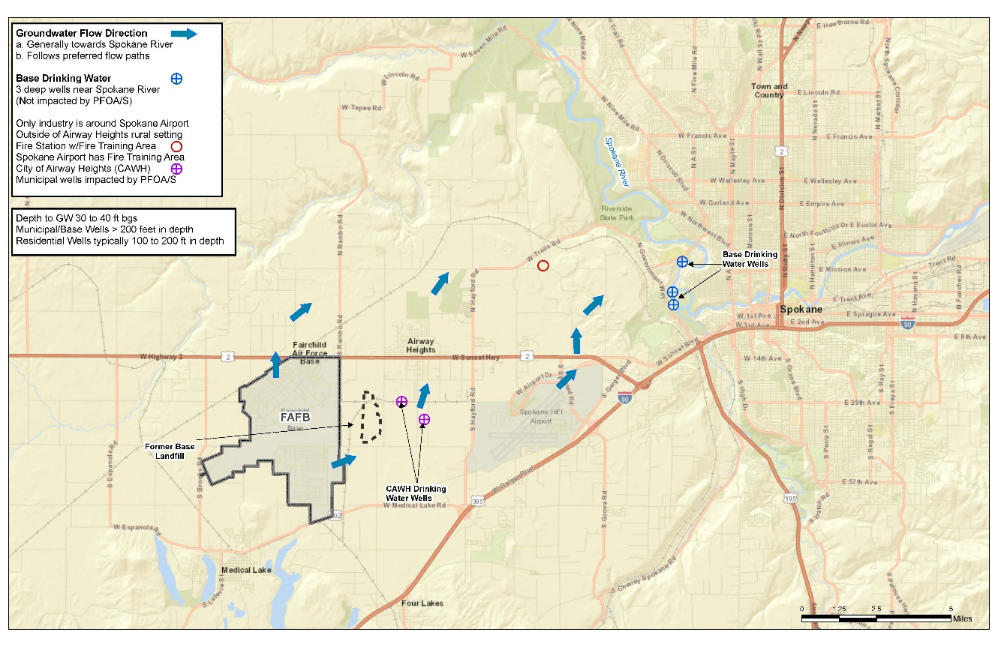
Groundwater Flow

Slide 10
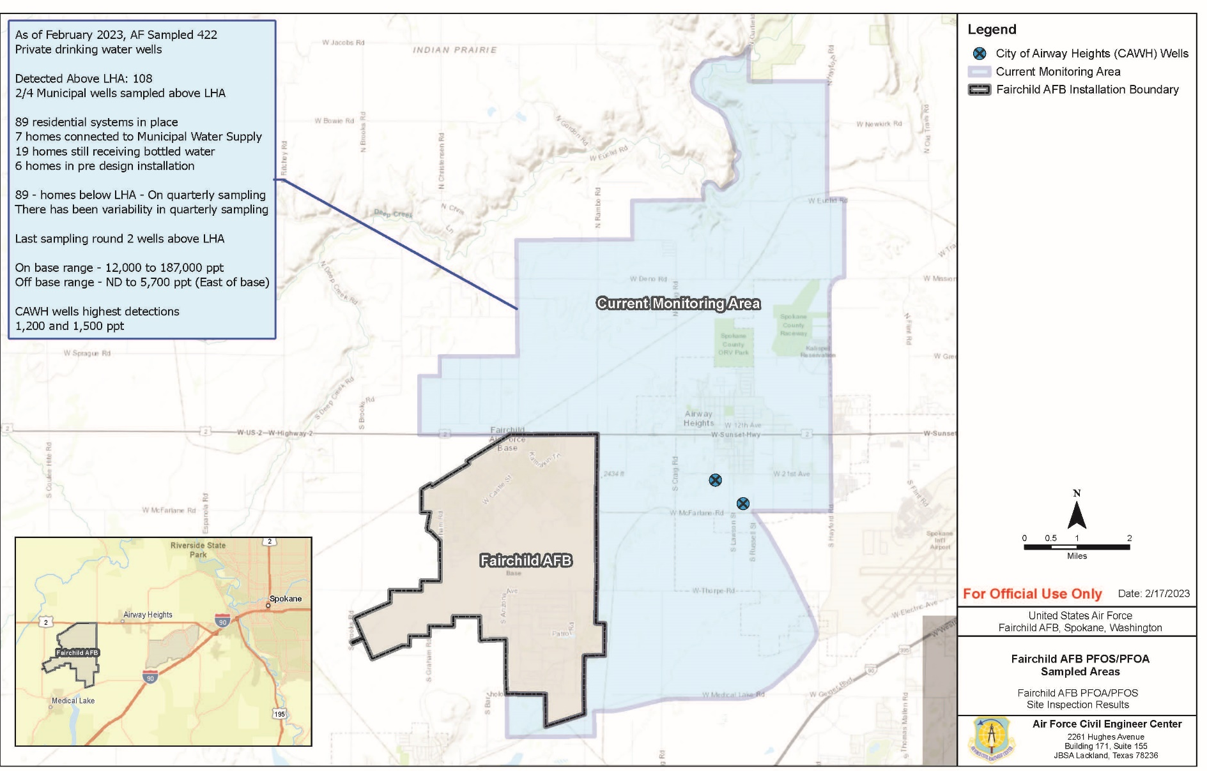
Sampling Area

Slide 11
Response Actions
Actions for residential drinking water wells
  Time Critical Removal Action (TCRA) approved March 2018; installation ongoing
  Individual whole house Granular Activated Carbon (GAC) filtration systems:
  89 filtration systems installed
    4 wells with systems pending
    4 wells (7 homes) connected to CAWH water system
    5 wells on hold
      2 homeowners refused system
      1 homeowner refuses to sign access agreement
      1 homeowner prohibiting AF entry
      1 homeowner no longer in communication with AF
    7 wells not currently in use (properties with more than one well)
      Wells are not used as drinking water supply
      Currently not needed to meet homeowner requirements

Slide 12
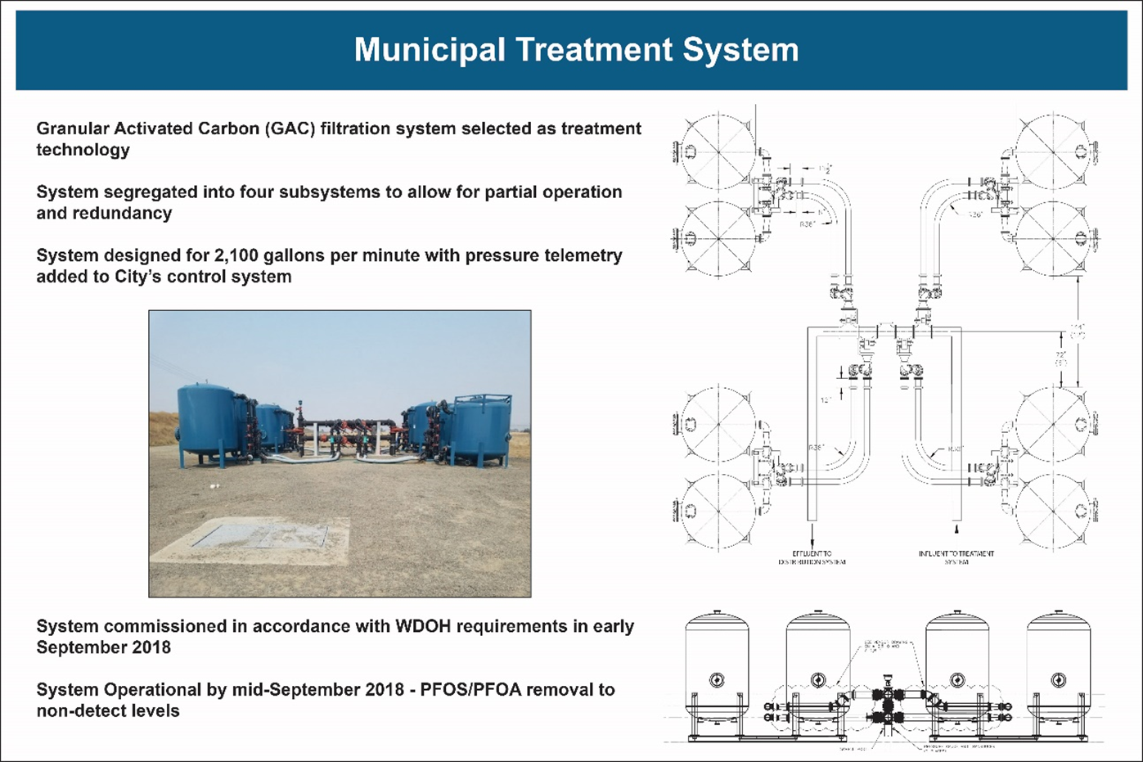
City of Airway Heights
CAWH
Approximately 6,000 users
Main CAWH Well #9 GAC system installed (Temporary solution)
Commissioned on 24 September 2018
Cost $1.5M to install, $180K per year to operate (5-month duration)
Back-up municipal well remains shut down
Acquired drinking water from City of Spokane
Environmental Services Agreement (ESA) is about $816k each year based on water usage
TCRA amendment signed in October 2019
7 homes connected to CAWH drinking water system

Slide 13
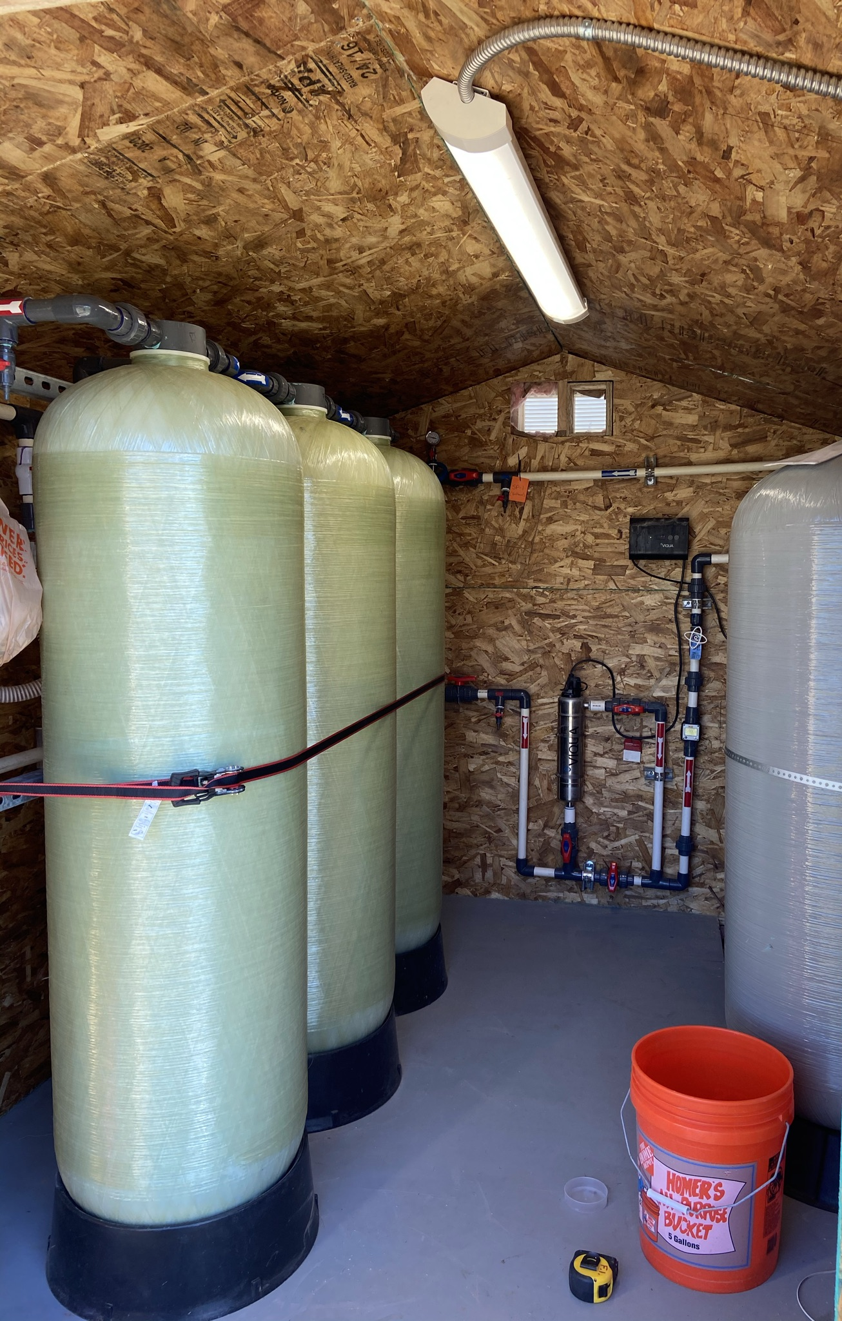
Residential Treatment Systems
89 treatment systems have been installed at private residences from 2017 to present
Typical capacity for these systems is 10 GPM, though there are some higher flow systems
System designed with 3 tanks for redundancy and increased safety
Sampling and routine maintenance is conducted quarterly
A 24-hr hotline is available for emergency repairs and response
System also includes:
  Particulate filters to remove any sediment/sands from the well
  Ultraviolet (UV) disinfection system for additional removal of bacteria and microorganisms

Slide 14
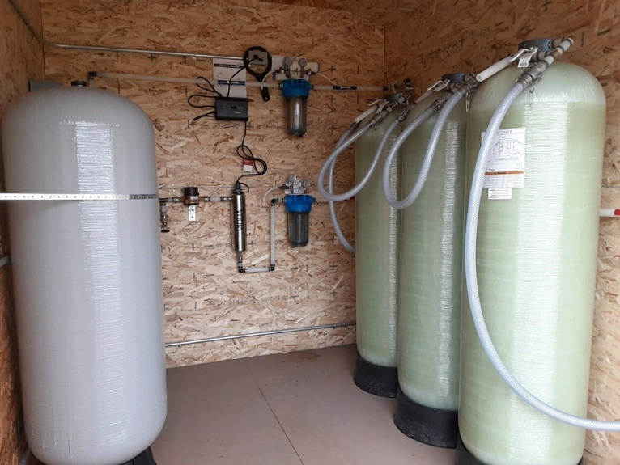
Challenges with O&M of
Residential Treatment Systems
Odor issues
  Identified at 9 homes
  7 homes have been mitigated
    Performed chlorine disinfection of water distribution pipes
    Replaced all 3 GAC canisters for each location
    Performed a 24-hour flush
  2 homes still trouble-shooting
    Odor sampling to be completed for one new home
      High concentrations of Manganese
      Performing PH and Hardness tests to see if a water softener would be viable solution
    Remove each GAC canister to isolate the odor
Low-pressure issues
  Identified at 7 homes
  3 homes mitigated
    piping, frost-free hydrant, water heater, faucet, and water softener replacements
  4 homes - Efforts being taken to address
14

Slide 15
Remedial Investigation (RI)
  Goal: To determine the nature and extent of soil and groundwater contamination
  Starts with Work Plan/QAPP (completed)
  Typically takes multiple phases to complete delineation
Phase I - delineation
  Soil sampling at the 5 source areas and at stormwater pond/no name ditch
  Sample existing wells and install/sample up to 100 new monitoring wells
    Sampled existing on base Monitoring wells (completed)
    Install and sample 23 new monitoring wells on base (completed)
    Install 16 off-base monitoring wells on Spokane County property starts 13 March 2023
    Working on obtaining permission and rights to install 10 off-base wells within the City of Airway Heights
  Phase II - Baseline Risk Assessment (BRA)
  Determine if there is an unacceptable risk to human health or the environment

Slide 16
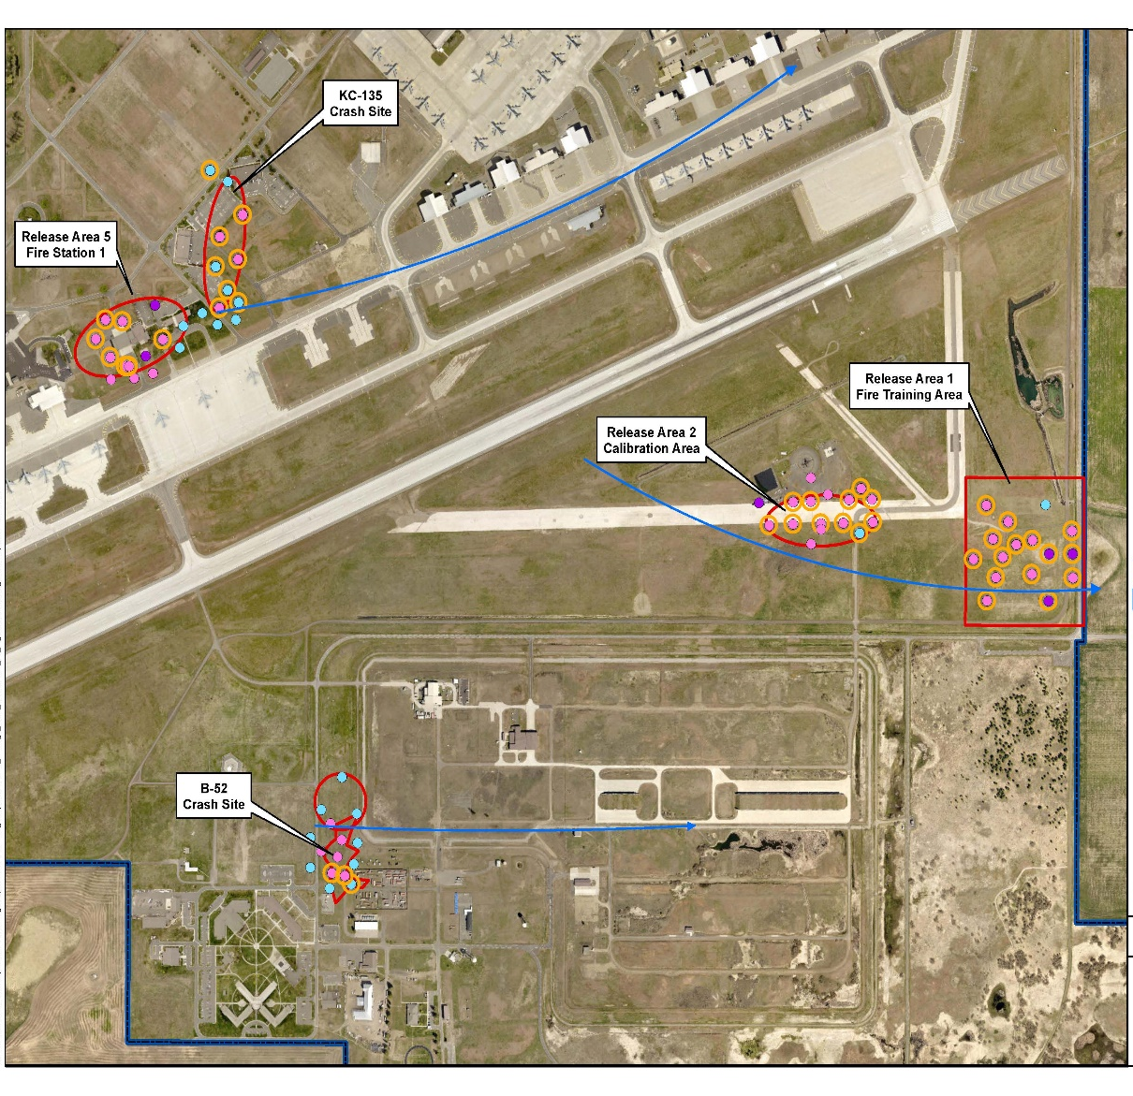
Phase I RI:
AFFF Investigation Areas
Aqueous Film -Forming Foam (AFFF) Release Areas:
AFFF Release Area 1:
  Fire Training 1 / FT01 / FT004P-sub
AFFF Release Area 2:
  Calibration Area / RS003P
AFFF Release Area 3:
  Aircraft Crash Location (PS-4/PS-9) / SS008P-sub
AFFF Release Area 4:
  B-52 Crash (1994) / RS002P
AFFF Release Area 5:
  Fire Station 1 (Building 1) / RS001P
3
5
2
1
4
16

Slide 17
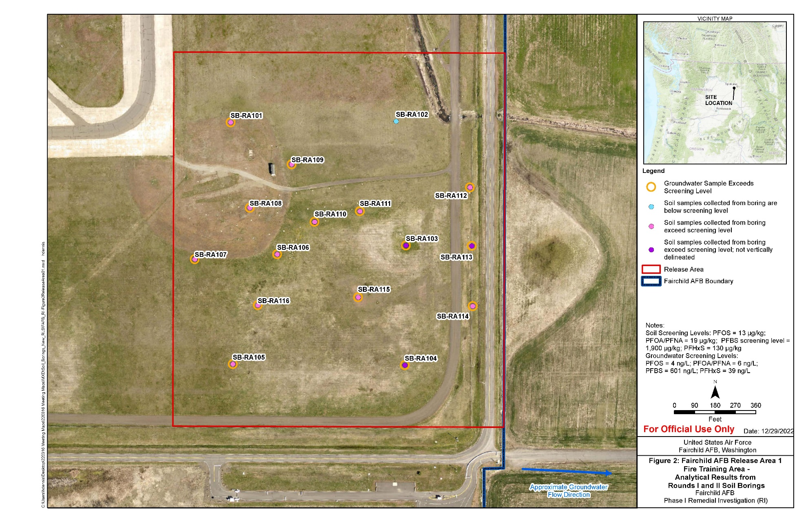
Phase I RI:
AFFF Release Area 1 Soil Borings

Slide 18
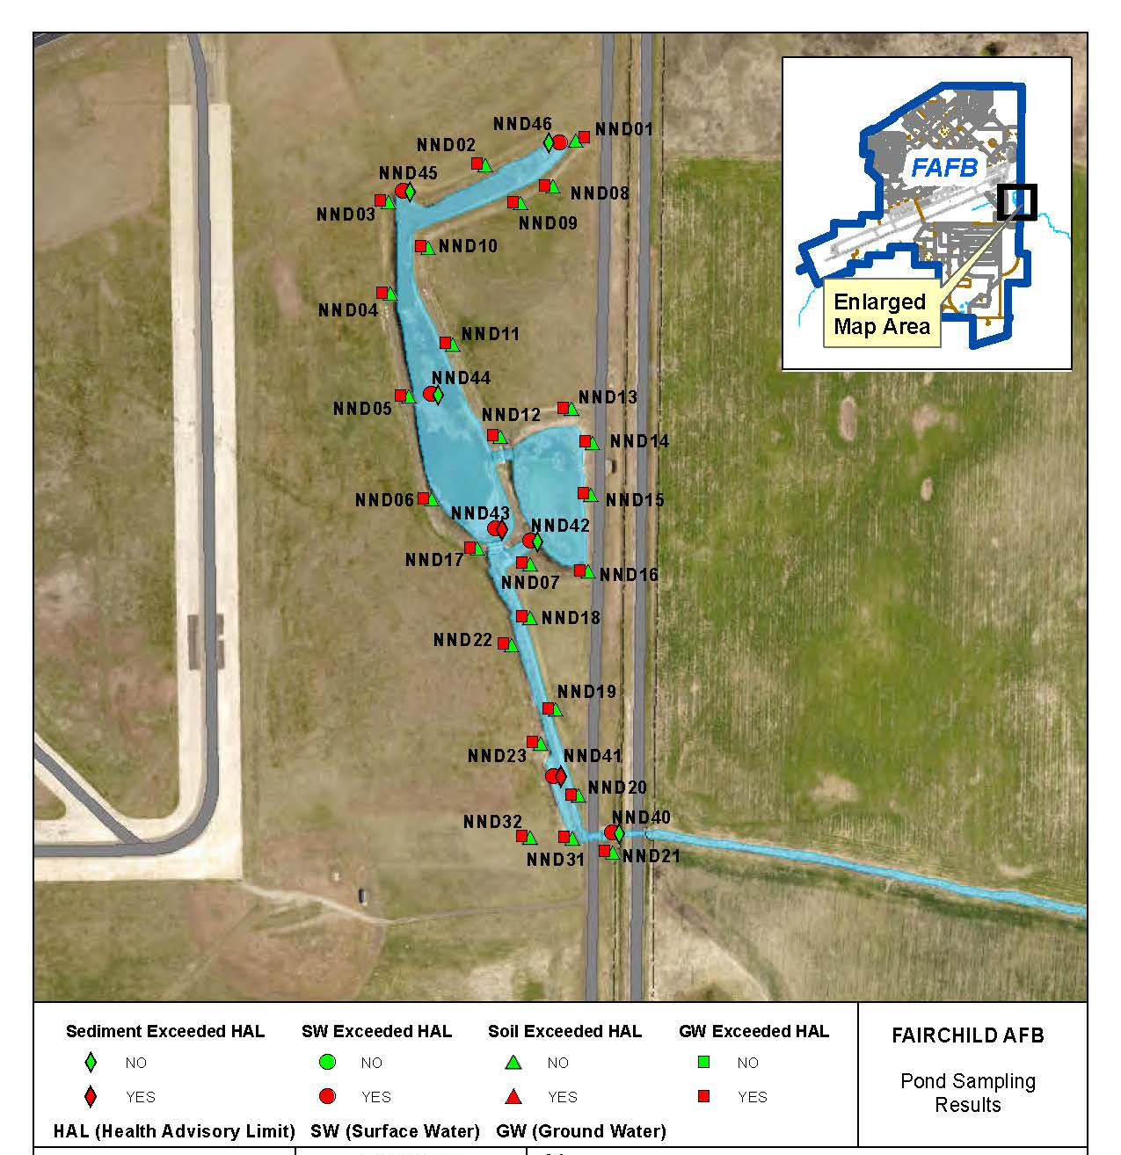
Phase I RI: No-Name Ditch Sampling
18

Slide 19
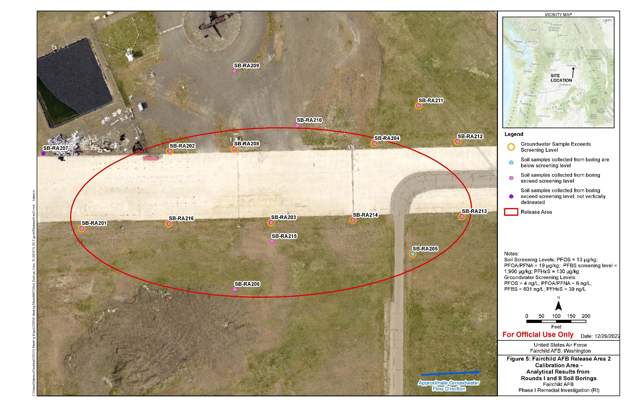
Phase I RI:
AFFF Release Area 2 Soil Borings

Slide 20
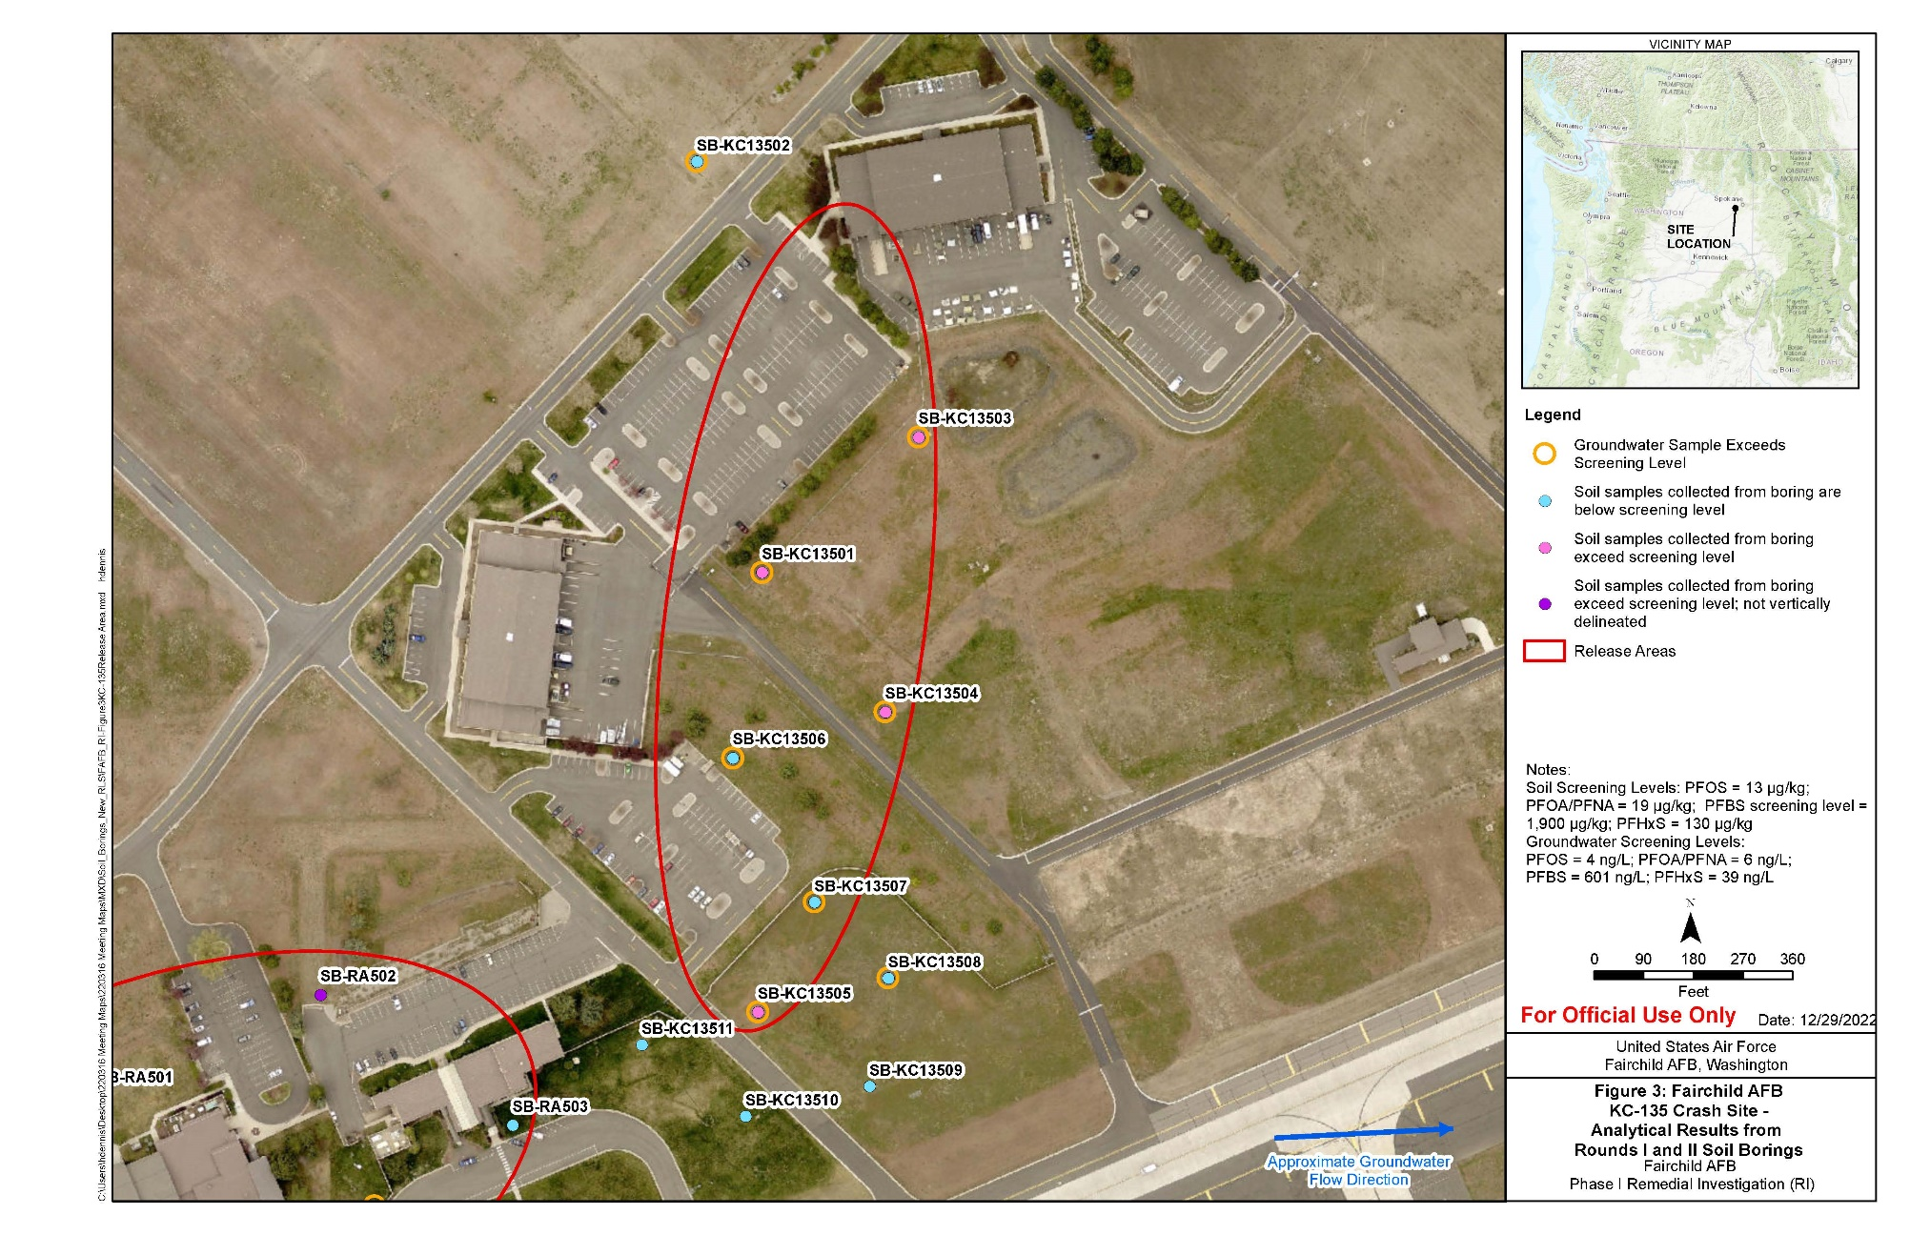
Phase I RI:
AFFF Release Area 3 Soil Borings

Slide 21
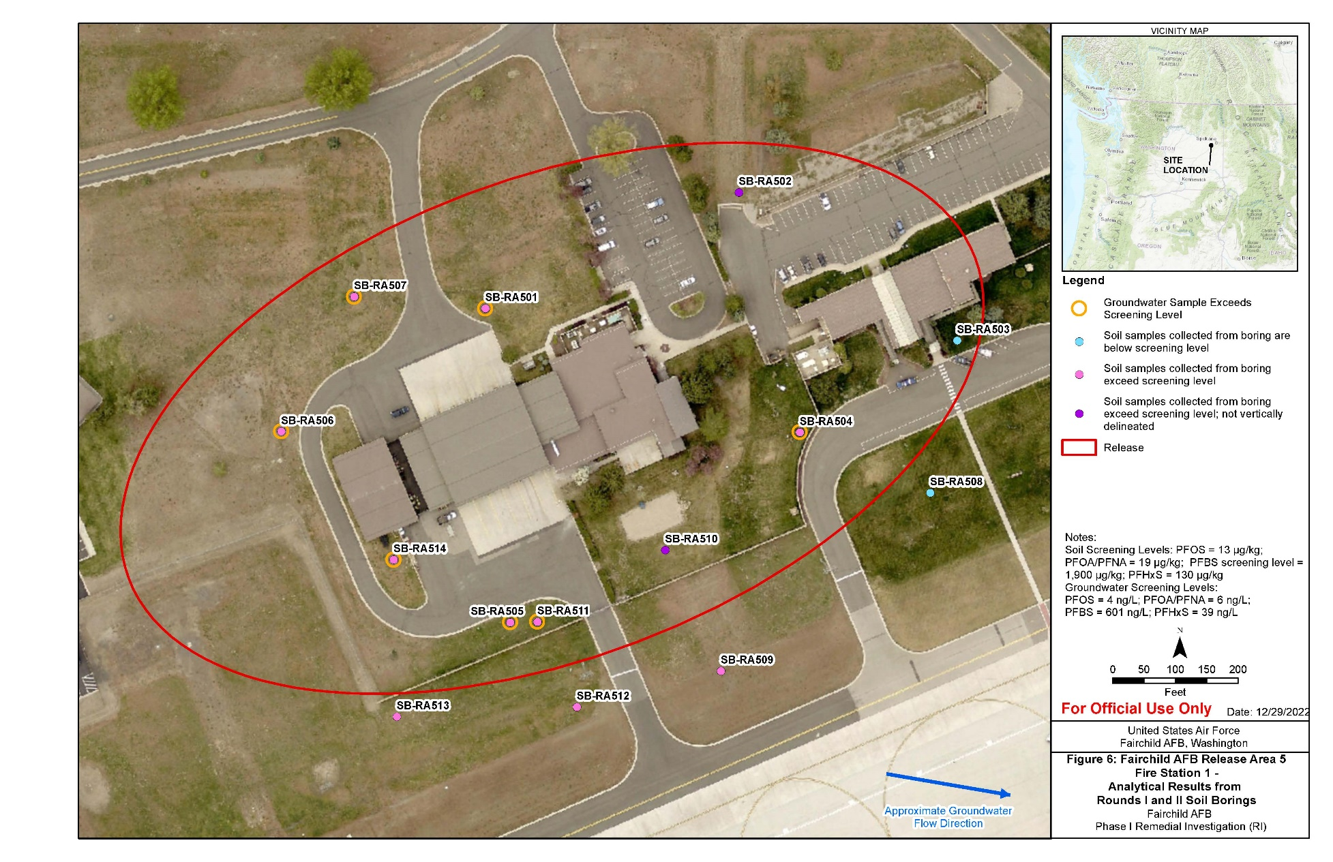
Phase I RI:
AFFF Release Area 5 Soil Borings

Slide 22
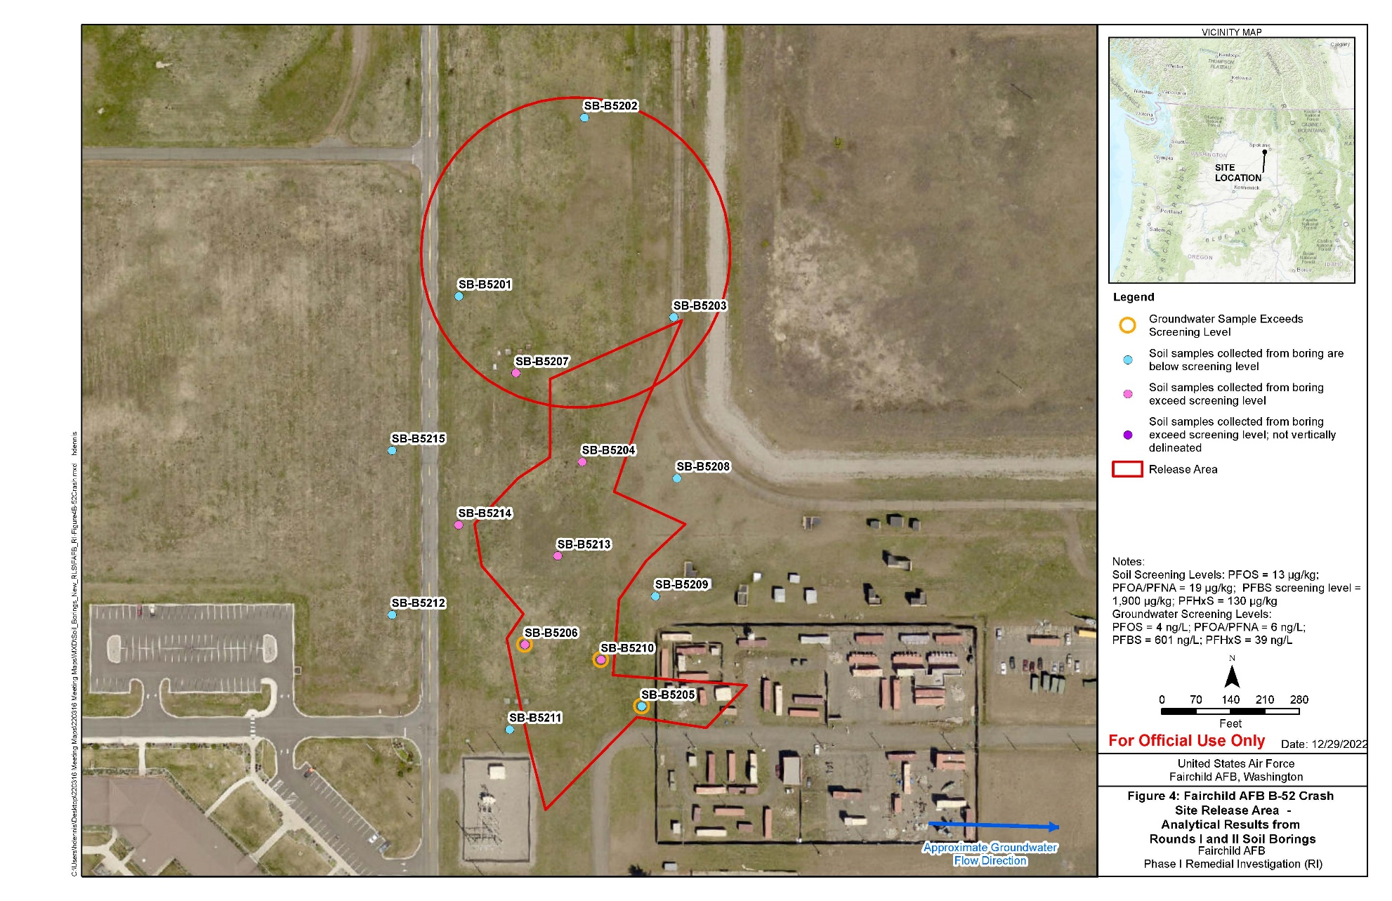
Phase I RI:
AFFF Release Area 4 Soil Borings

Slide 23
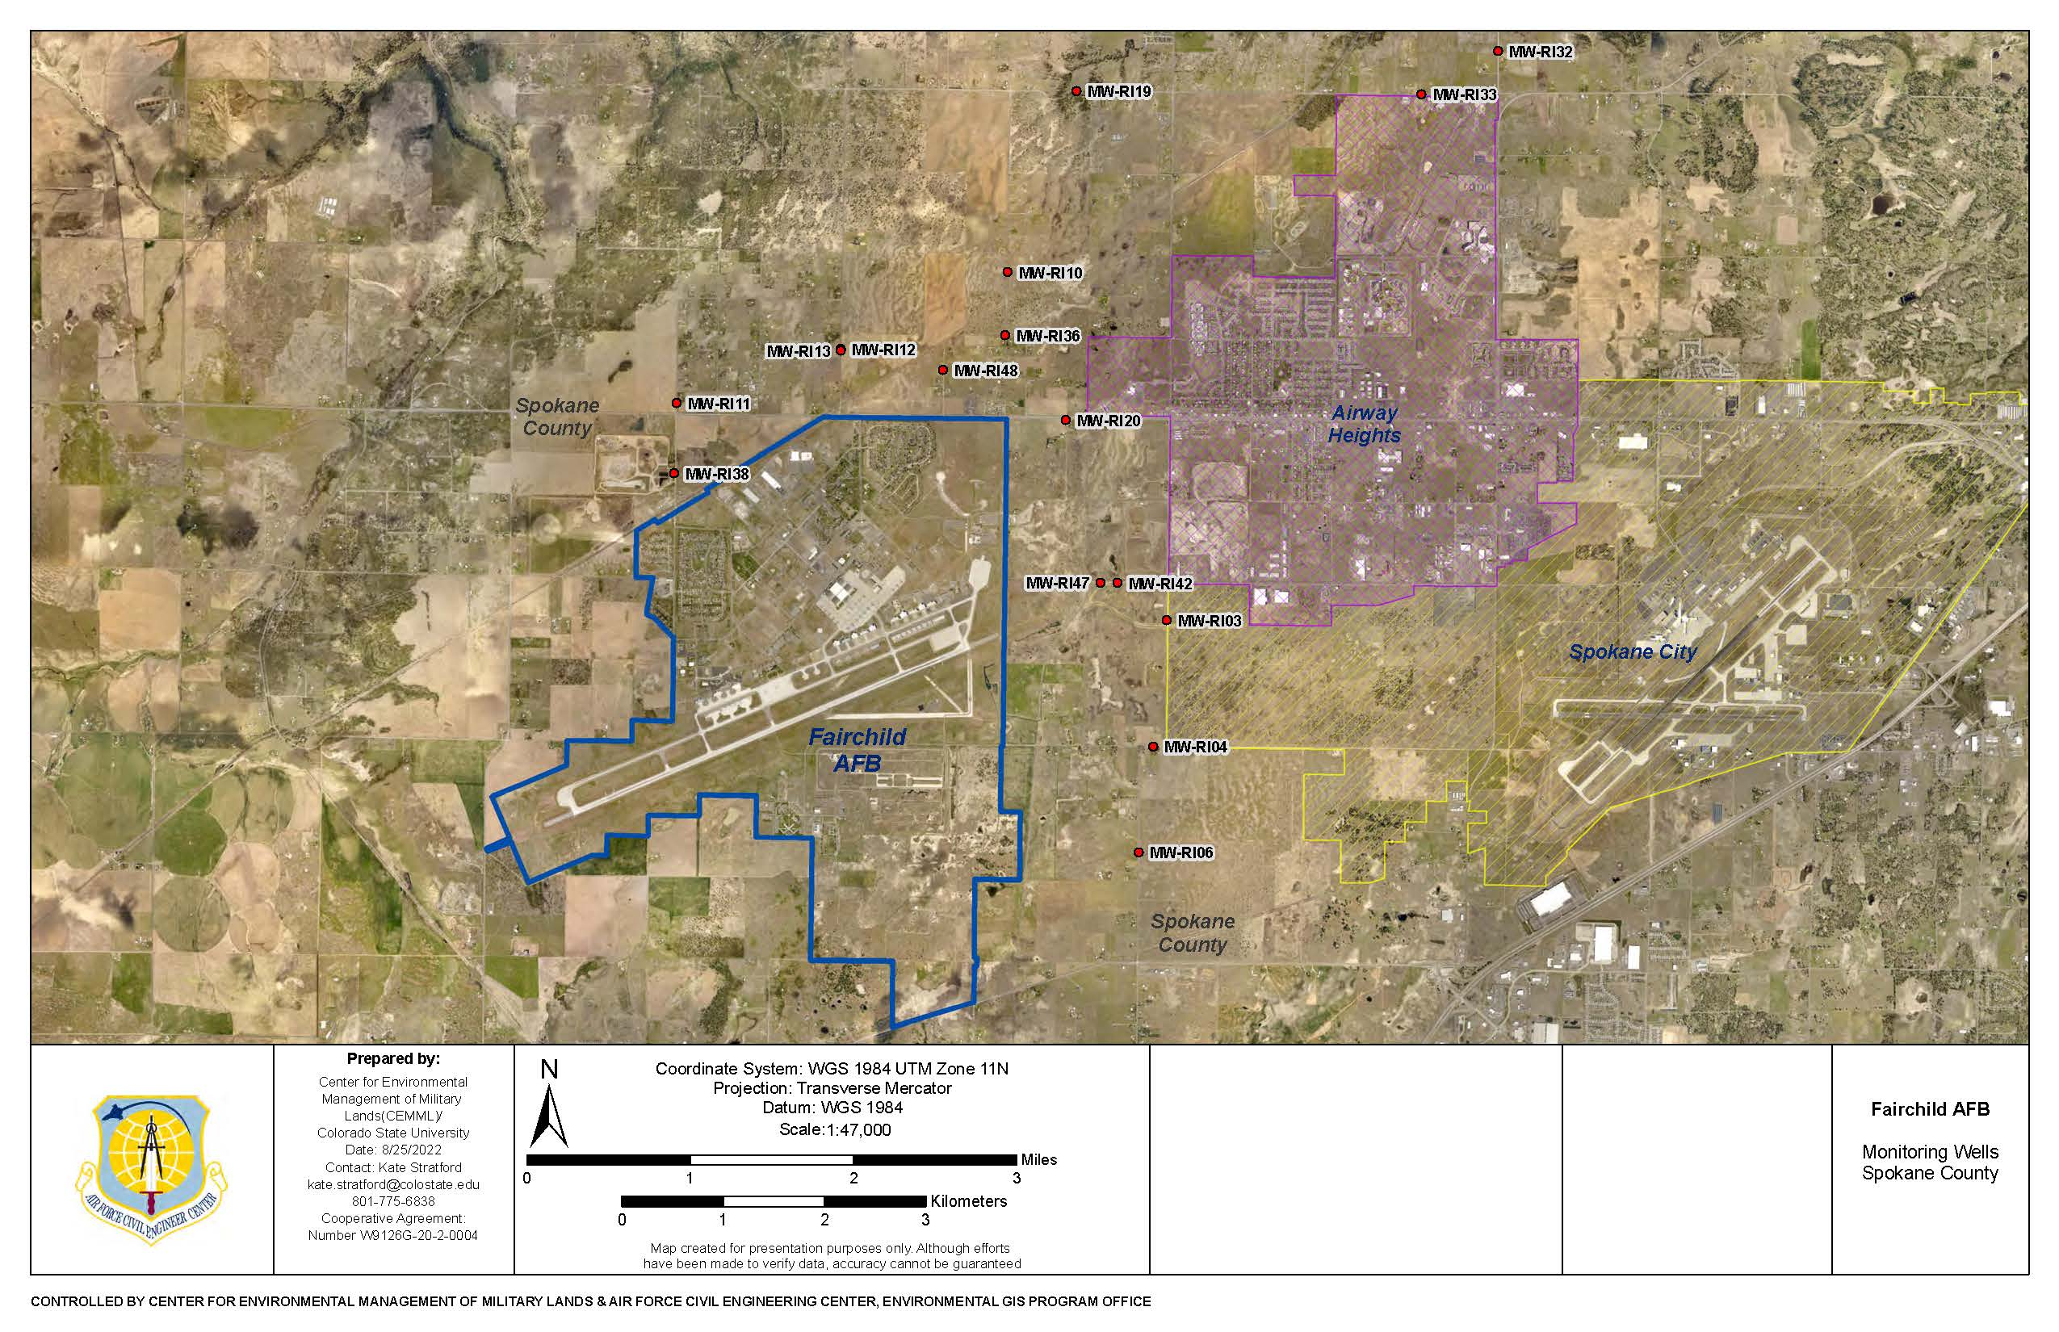
Phase I RI: Monitoring Wells
Spokane County
23

Slide 24
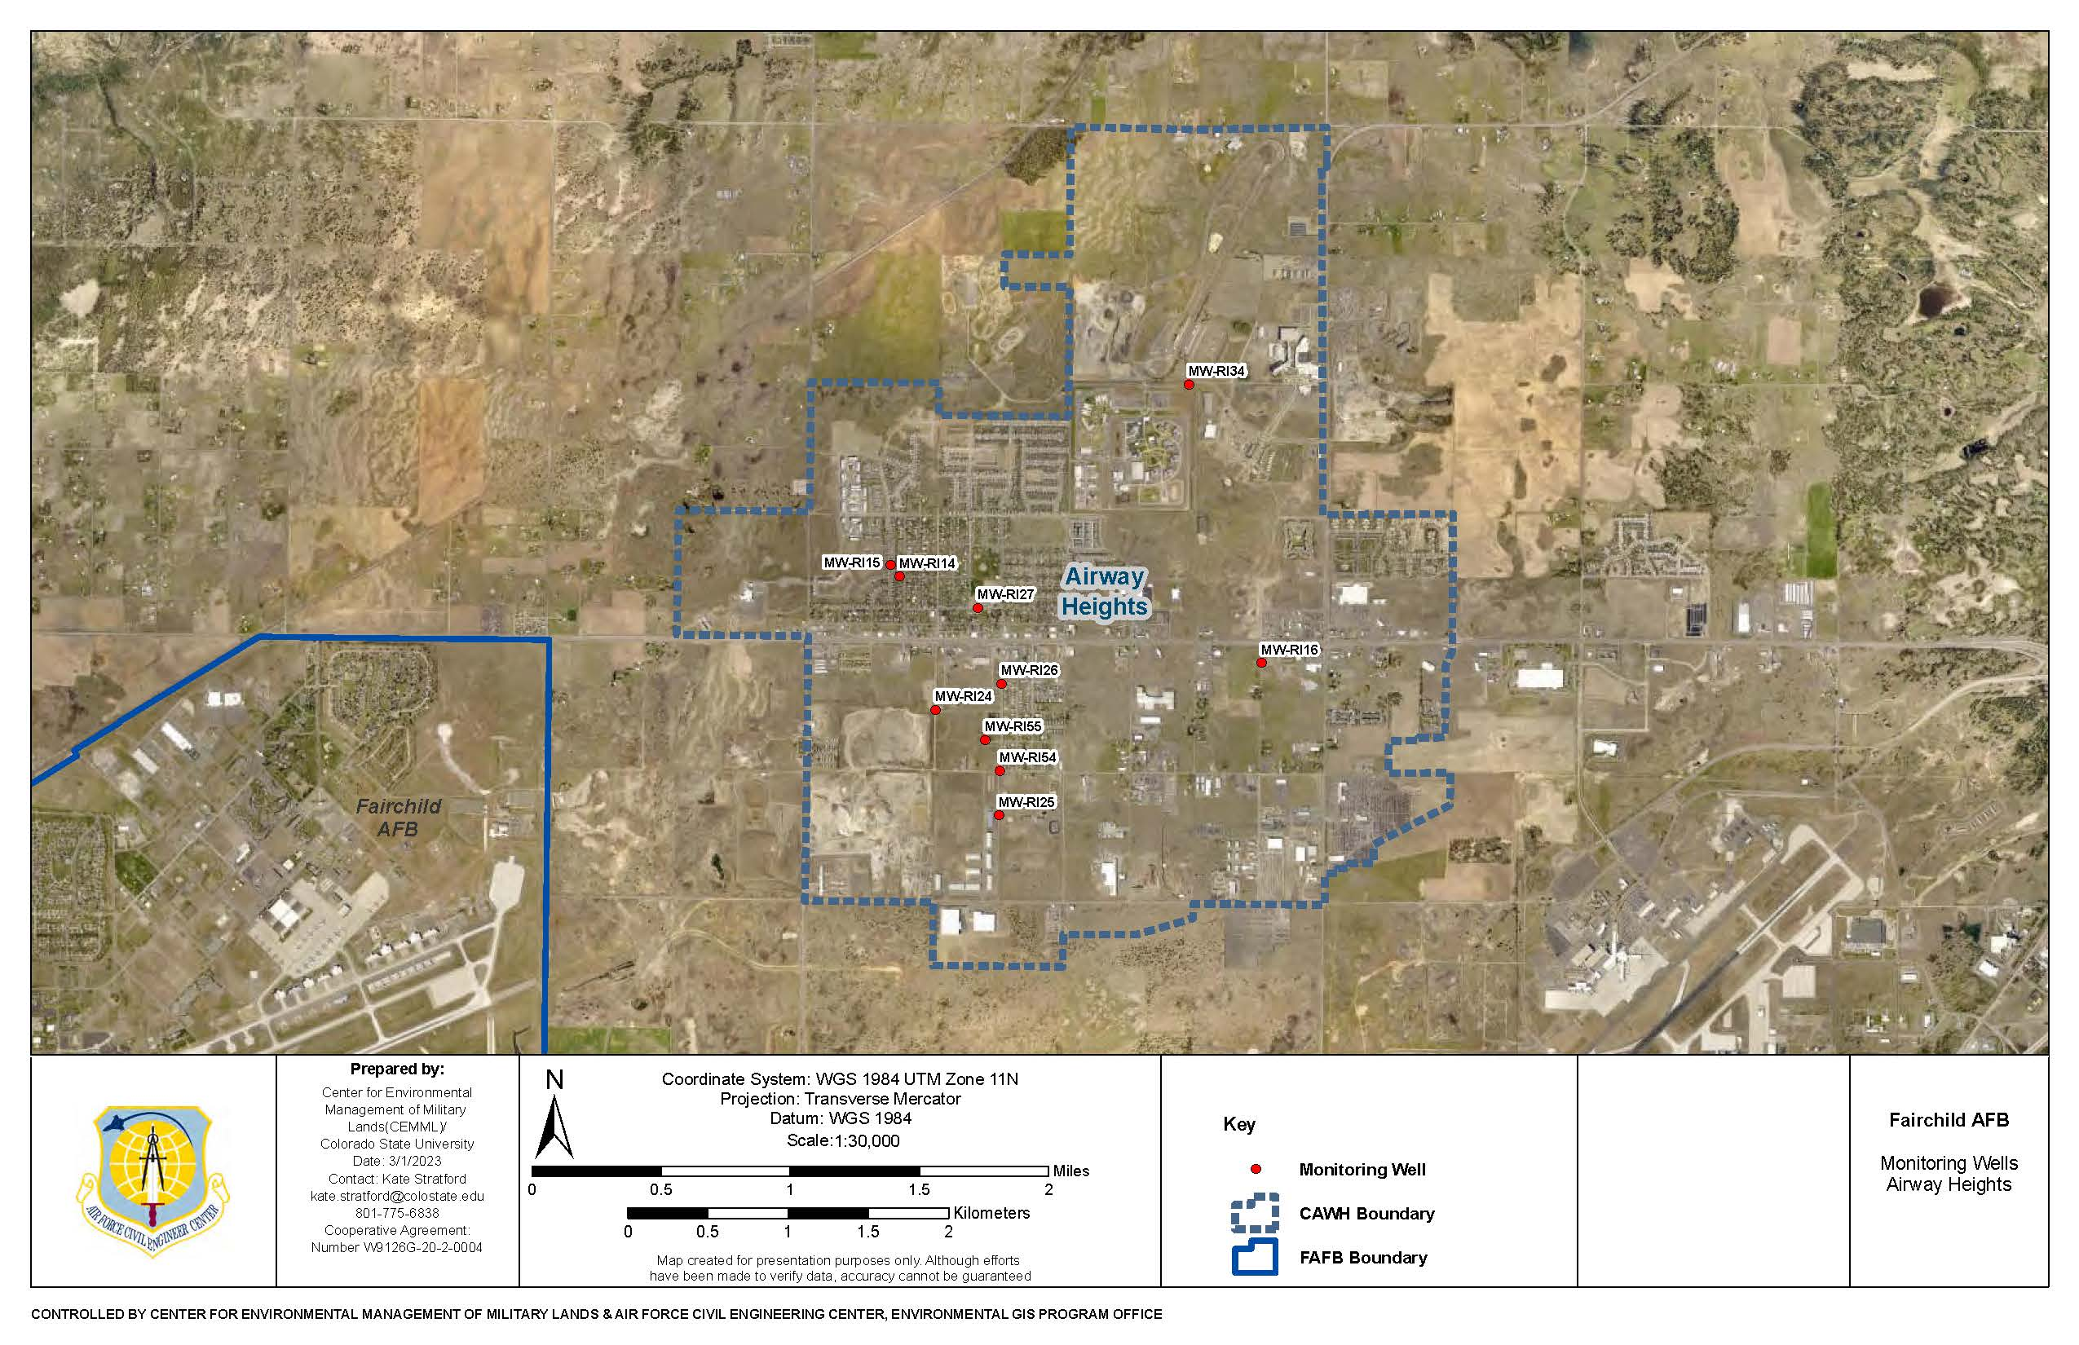
Phase I RI: Monitoring Wells
City of Airway Heights
24

Slide 25
RI Schedules
RI field work began on 7 June 2021
  108 soil borings completed in the 5 AFFF areas, including No-Name Ditch and the Airfield ponds as of February 2023.
  Additionally, 10 surface water samples were also collected from No-Name Ditch and the Airfield ponds.
Monitoring wells installation:
  23 installed on base, 16 installed off-base on Spokane County property and 10 to be installed on the City of Airway Heights property (upcoming)
  Begun discussions with six (6) small business owners to install one (1) monitoring well on their property
  Slug testing of each new monitoring well once installed
Phase I RI Report
  Regulatory review and comments due by 9 May 2024
  Final Phase I RI Report due by 14 June 2024
  Plan for additional RI Phases: October 2023 – April 2024

Slide 26
Early Action Projects
  Engineering Evaluation/Cost Analysis (EE/CA) for Fairchild AFB Impacts to City of Airway Heights Water Supply
  Evaluated interim cleanup alternatives for mitigating impacts from PFOS/PFOA on the City of Airway Heights
    Alternative 1 (status quo)
    Alternative 2 (Activated Carbon Wellhead Treatment at Wells 1/4 and 9)
    Alternative 3 (Ion Exchange Wellhead Treatment)
    Alternative 4 (Reverse Osmosis Wellhead Treatment)
    Alternative 5 (New Water Supply Well)
    Alternative 6 (Continued Use of Spokane Water Supply)
  Final report provided to regulators 24 June 2021
  Open House held on 23 September 2021
  Action Memo (stating the preferred alternative) drafted – selecting Alternative 2
Final Action Memo on hold – City of Airway Heights would like to implement Alternative 5; however, resolution on ability to obtain water rights, rights-of-way, etc. still being resolved
26

Slide 27
Early Action Projects (Cont.)
  EE/CA for PFAS at FT004
  The Air Force (AF) believes that it is wise to take an early action to stop PFAS from put a removal system(s) at Base boundary ASAP as well as “No Name Ditch”
  A Data Gap Study and Treatability Study are needed to support selection of a removal action
    Data collection will include: Hydrogeologic data or Bench-scale treatability studies
    EE/CA actions include a Public Comment Period and Public Meeting
  After the removal action selection, the NTCRA process includes:
    Design, construction, operation and maintenance (O&M), and monitoring
  Schedule
    Final Quality Assurance Project Plan (QAPP) due by 19 May 2023
    Final Waste Management Plan due by 29 May 2023
    Final Data Gap Study and Treatability Study (TS) due by 17 February 2024

Slide 28
Acronyms and Abbreviations
AFB Air Force Base
AF Air Force
AFFF Aqueous Film-Forming Foam
BRA Baseline Risk Assessment
CAWH City of Airway Heights
CERCLA Comprehensive Environmental Response, Compensation, and Liability Act
CPA Critical Process Analysis
EE/CA Engineering Evaluation/Cost Analysis
ESA Environmental Services Agreement
GAC Granular Activated Carbon
GPM gallons per minute
LHA Lifetime Health Advisory
ND non-detect
NTCRA Non-Time Critical Removal Action
O&M operation and maintenance
PBR Performance-Based Remediation
PDI Pre-Design Investigation
PFAS per- and polyfluoroalkyl substances
PFOS/PFOA perfluorooctane sulfonate/perfluorooctanoic acid
POP Period of Performance
QAPP Quality Assurance Project Plan
RAB Restoration Advisory Board
RI Remedial Investigation
SVE soil vapor extraction
TCRA Time Critical Removal Action
TS treatability study
UV ultraviolet
VCP Voluntary Cleanup Program

Slide 29
Questions?
29

Slide 30
2022/2023 Performance-Based Remediation Overview
Bay West and AECOM
30 March 2023

Slide 31
Overview
Site Overview
2022/2023 Major Sites
  SS039, SD037, LF002, WP003, Voluntary Cleanup Program (VCP) Sites
Public Comment Opportunities in 2023

Slide 32
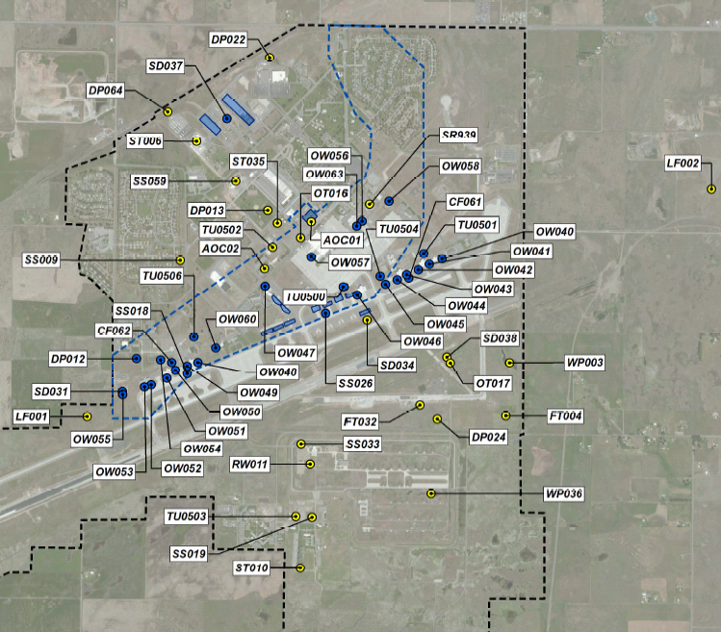
Contract Sites Overview
59 historical environmental sites. One historical Military Munitions Response Site at Fairchild Air Force Base. Environmental actions include:
Work Plans
Remedial Action-Operations (RA-O)
Treatment Operations
Remedial Design
Investigation Reports
Monitoring/Remedial Performance Reports
Treatment Reports
Notes:
Site Inventory
59 IRP Sites
1 MMRP Site
Well Inventory across Fairchild Air Force Base (AFB)

Slide 33
Orphan TCE Plumes
(SS039)
2022 Overview and Planned 2023 Actions
Ms. Kristine Weber
AECOM Site Lead
30 March 2023

Slide 34
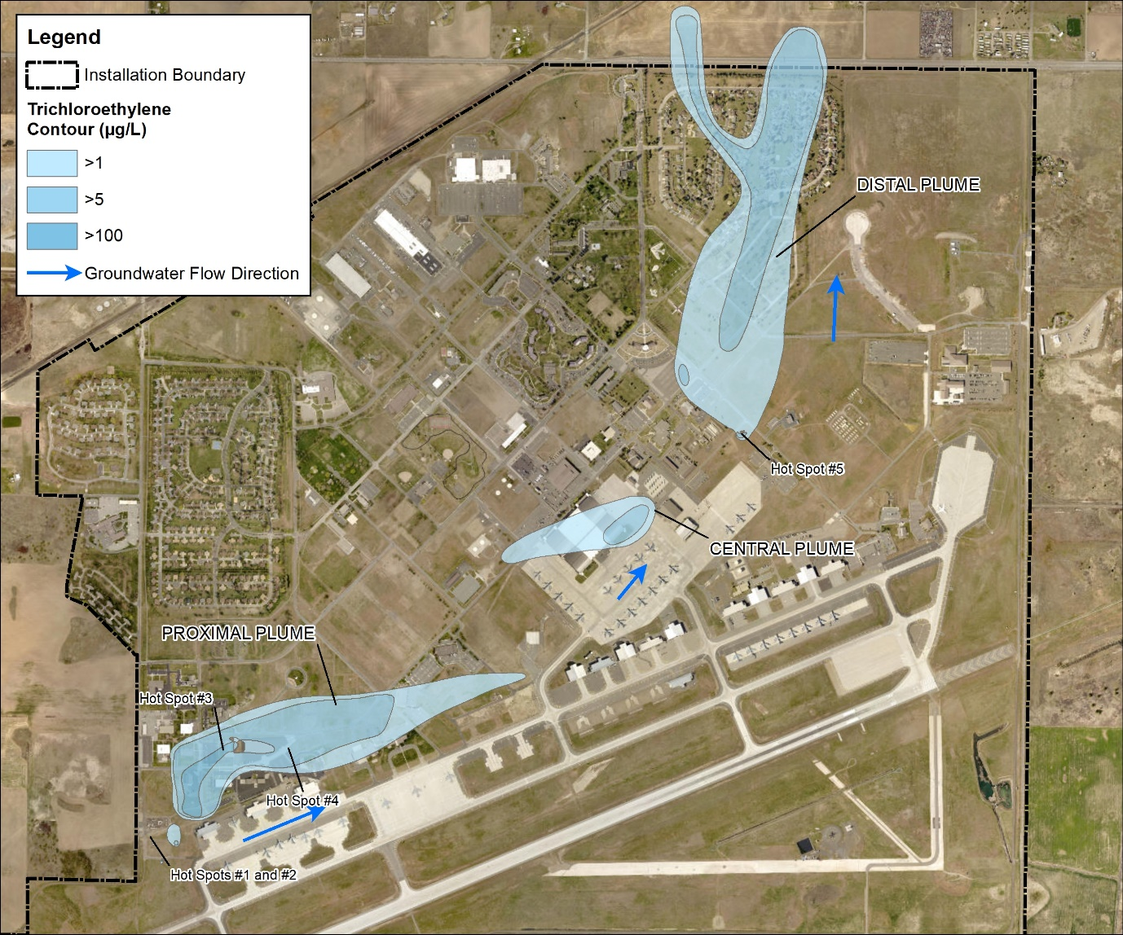
SS039 Overview
  2022 Summary
  Semi-annual Performance Monitoring
Annual GW Monitoring and Reporting
  2023 Planned
  Semi-annual Performance Monitoring
Annual GW Monitoring and Reporting
Polishing Injection Activities

Slide 35
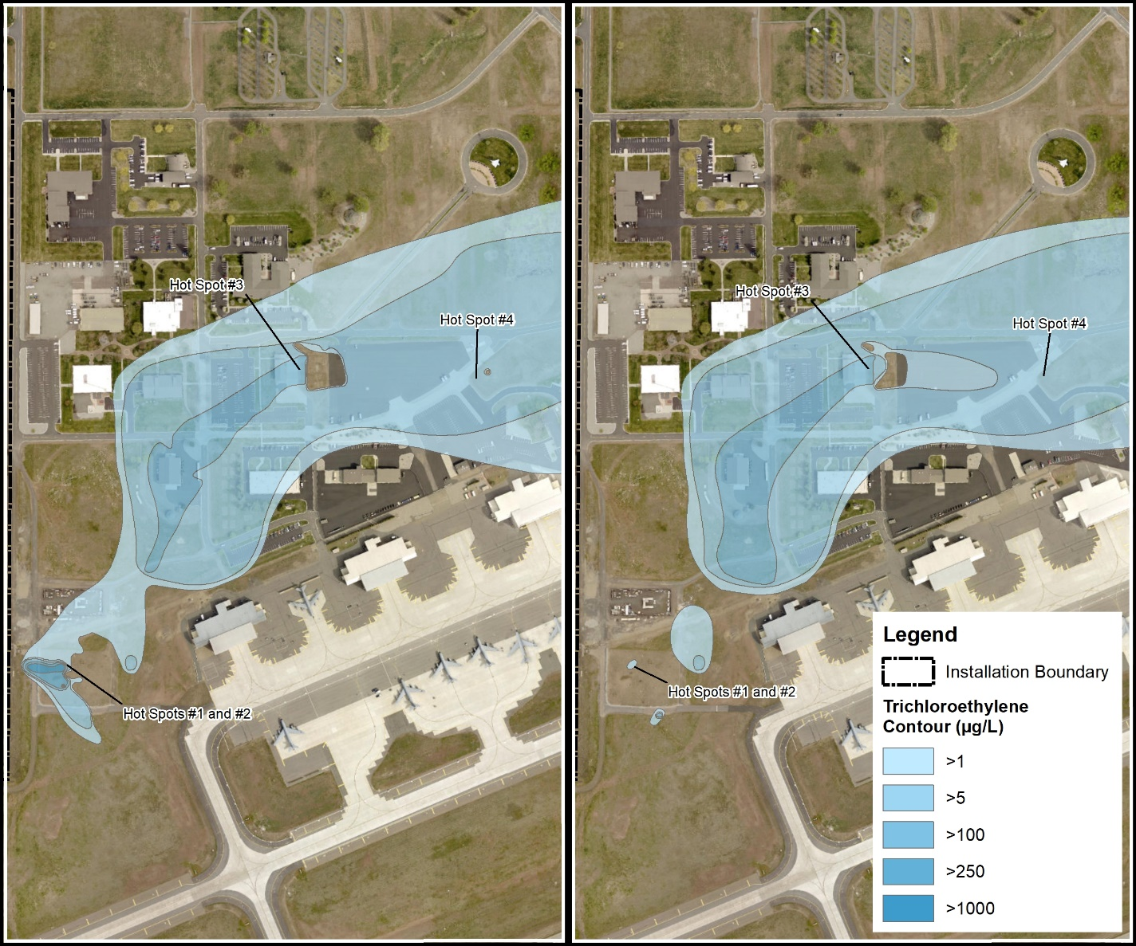
SS039 Overview
  Before and After 2021 Sodium Permanganate Injection Event
    Injected approx. 85,215 gallons (1% solution) into five IWs at Hotspot #1 and #2
    Injected approx. 17,006 gallons (1% solution) into two IWs at Hotspot #4
November 2020
May 2022
Notes:
Injection wells are located in transects, cross-gradient to the plume core.

Slide 36
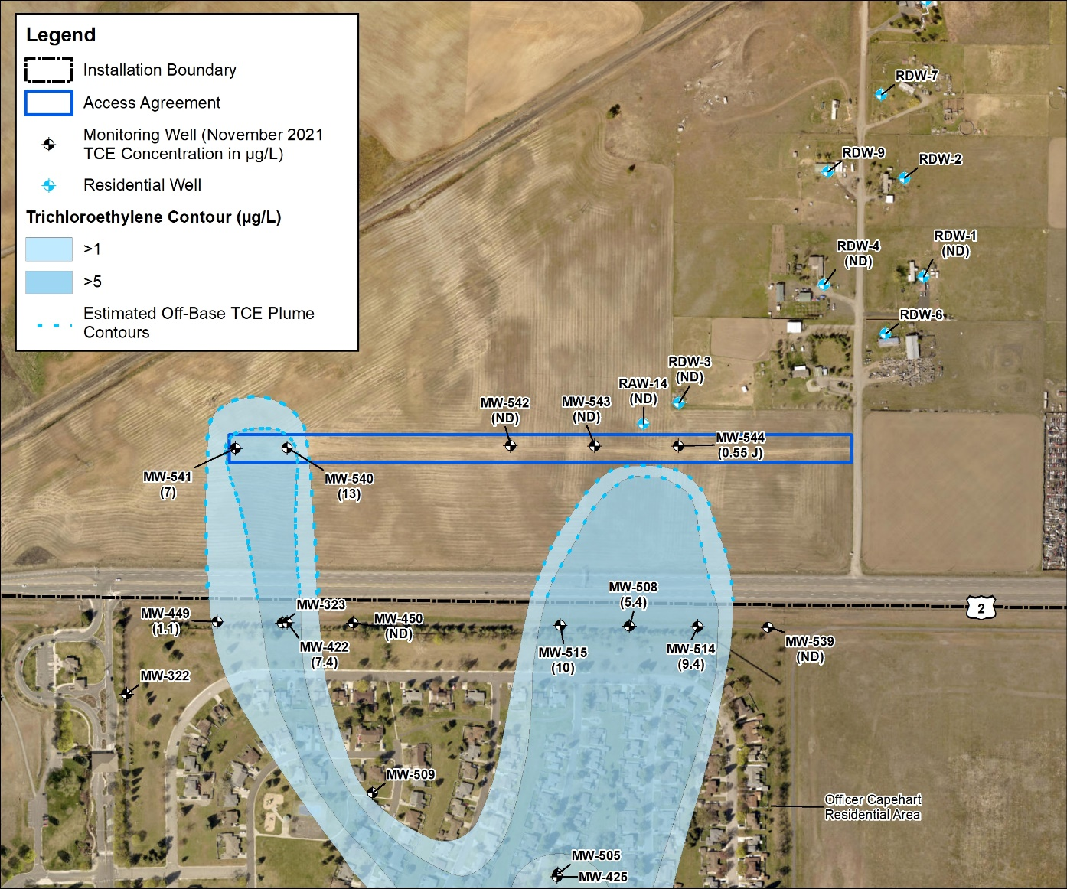
SS039 Off-Base Overview
  2022 Summary
  Completed Residential Well Sampling in May 2022
  Completed Annual GW Monitoring in November 2022
  2023 Planned
  Complete Residential Well Sampling in May 2023
  Complete Annual GW Monitoring

Slide 37
SD037 Buildings 2447/2451
2021/2022 Summary and Planned 2023 Actions
Ms. Kristine Weber
AECOM Site Lead
30 March 2023

Slide 38
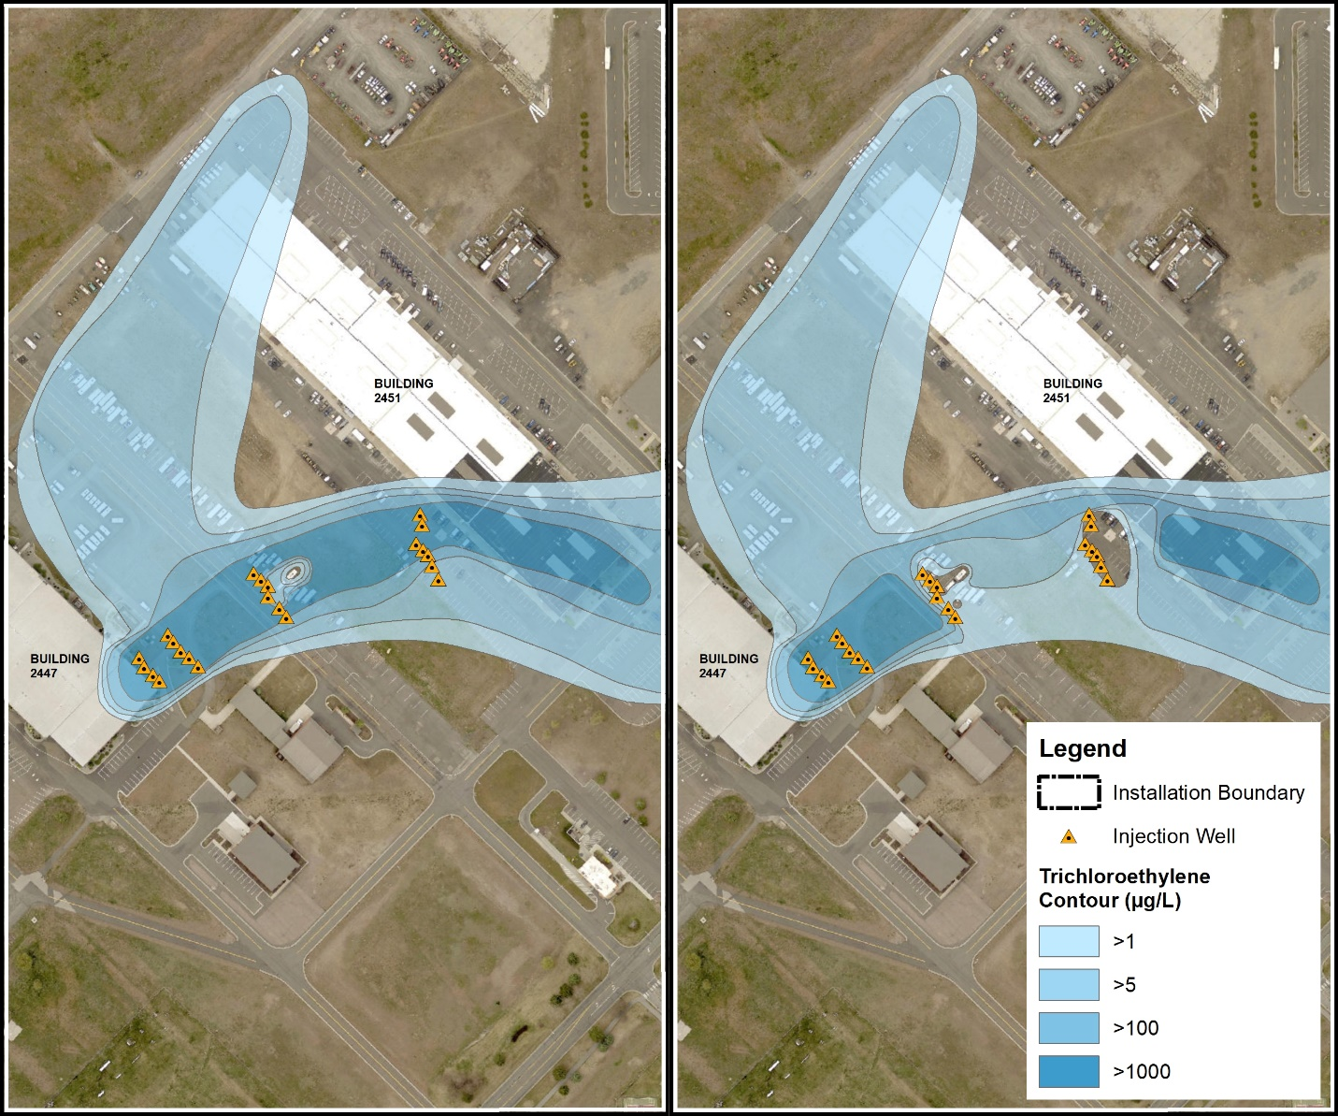
SS039 Overview
  Before and After September 2021 Sodium Permanganate Injection Event
    Installed 22 injection wells
    Installed 6 additional monitoring wells
    Completed injection of 96,289 gallons of sodium permanganate (1% solution)
July 2021
May 2022
Notes:
Injection wells are located in transects, cross-gradient to the plume core.

Slide 39
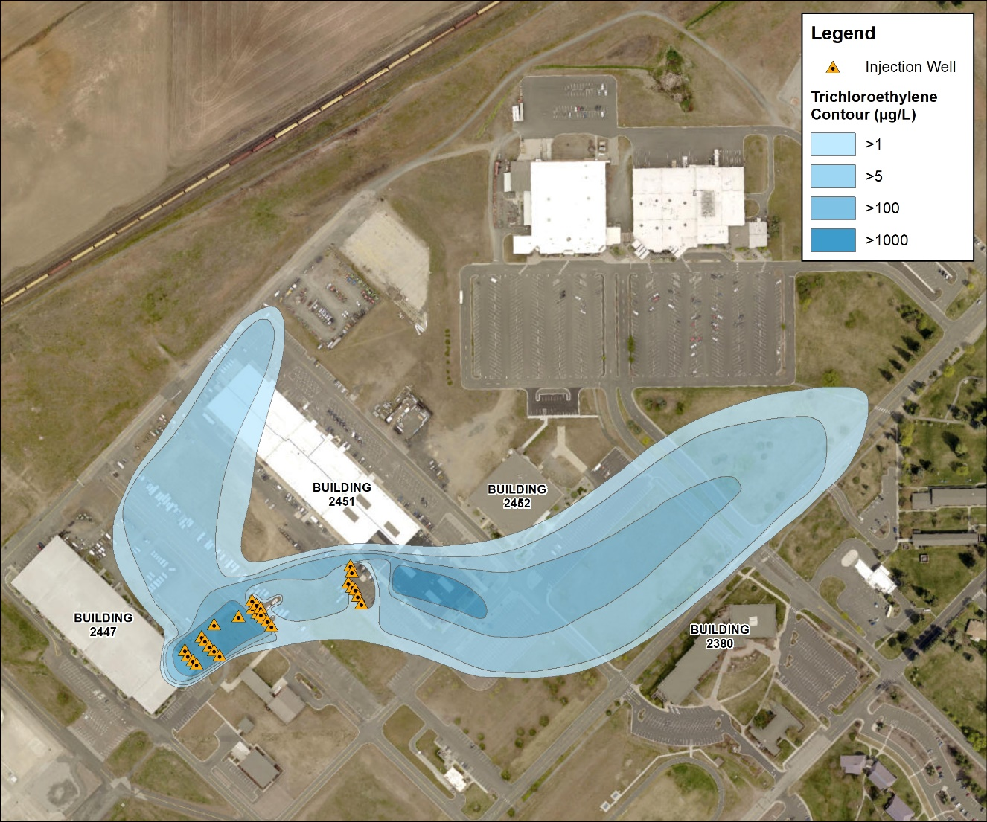
SD037 Overview
  In Situ Chemical Oxidation Pilot Study and Vapor Intrusion Evaluation
  2021 Summary
  Completed injection of 96,289 gallons of sodium permanganate (1% solution)
  2022 Summary
  Quarterly Performance Monitoring
  Feasibility Study
  2023 Planned
  Semi-annual Performance Monitoring
  Proposed Plan

Slide 40
Craig Road Landfill (LF002)
2022/2023 Remedial Action-Operations Overview
Mr. John Peper
Bay West Project Manager
30 March 2023

Slide 41
LF002 Background
  LF002 is a former landfill on Air Force property located about one mile east of the Base.
  Trichloroethylene (TCE) was discovered in groundwater in the late 1980s and 1990s.
  Remedial action was implemented in 1995 and has consisted of:
    Groundwater containment with extraction wells and stripper tower treatment
    Construction of an engineered cap
    Land use controls
    Soil Vapor Extraction systems were added to the remedy in 2017.
  Remedial Action Operations (RA-O) consisting of systems operation and groundwater monitoring have been performed since 1995.

Slide 42
LF002 2022/2023 Overview
2022/2023 Actions
  GETS Trial Shutdown: Proposed in 2021 RA-O Report. Formal request to EPA 16 December 2022. EPA concurred 22 December 2022.
    Justifications:
      Over 28 yrs. of operation, the GETS has depleted the source mass by 99.7%. Influent concentrations are now near or below the MCLs; therefore, the GETS has become inefficient at treating the remaining mass.
      The TCE concentrations are low enough that natural attenuation can contain and treat the remaining contamination. There is no longer a benefit to operating the GETS.
      Land use controls and monitoring programs are in place to protect receptors.
      Groundwater monitoring has been increased during the trial shutdown and re-activation triggers are in place should plume off-property migration be detected.
  RA-O Reporting: The 2021 Annual RA-O Report was finalized in August 2022. The 2022 Annual RA-O Report is in preparation and will be submitted to the USAF in March 2023.
  RA-O Monitoring: Quarterly RA-O monitoring will be performed in 2023.

Slide 43
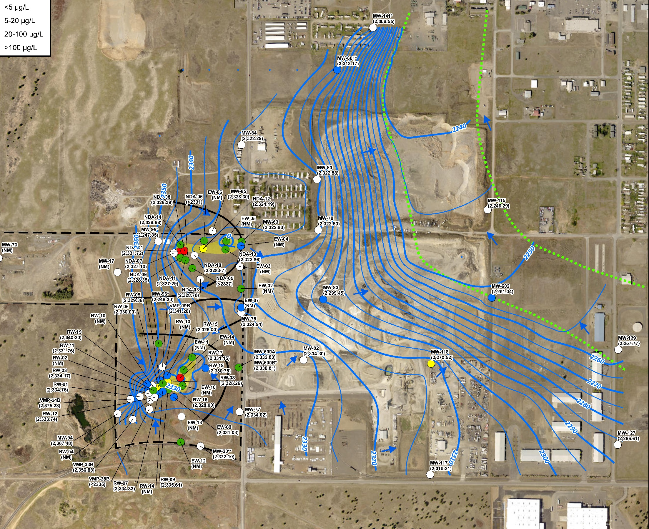
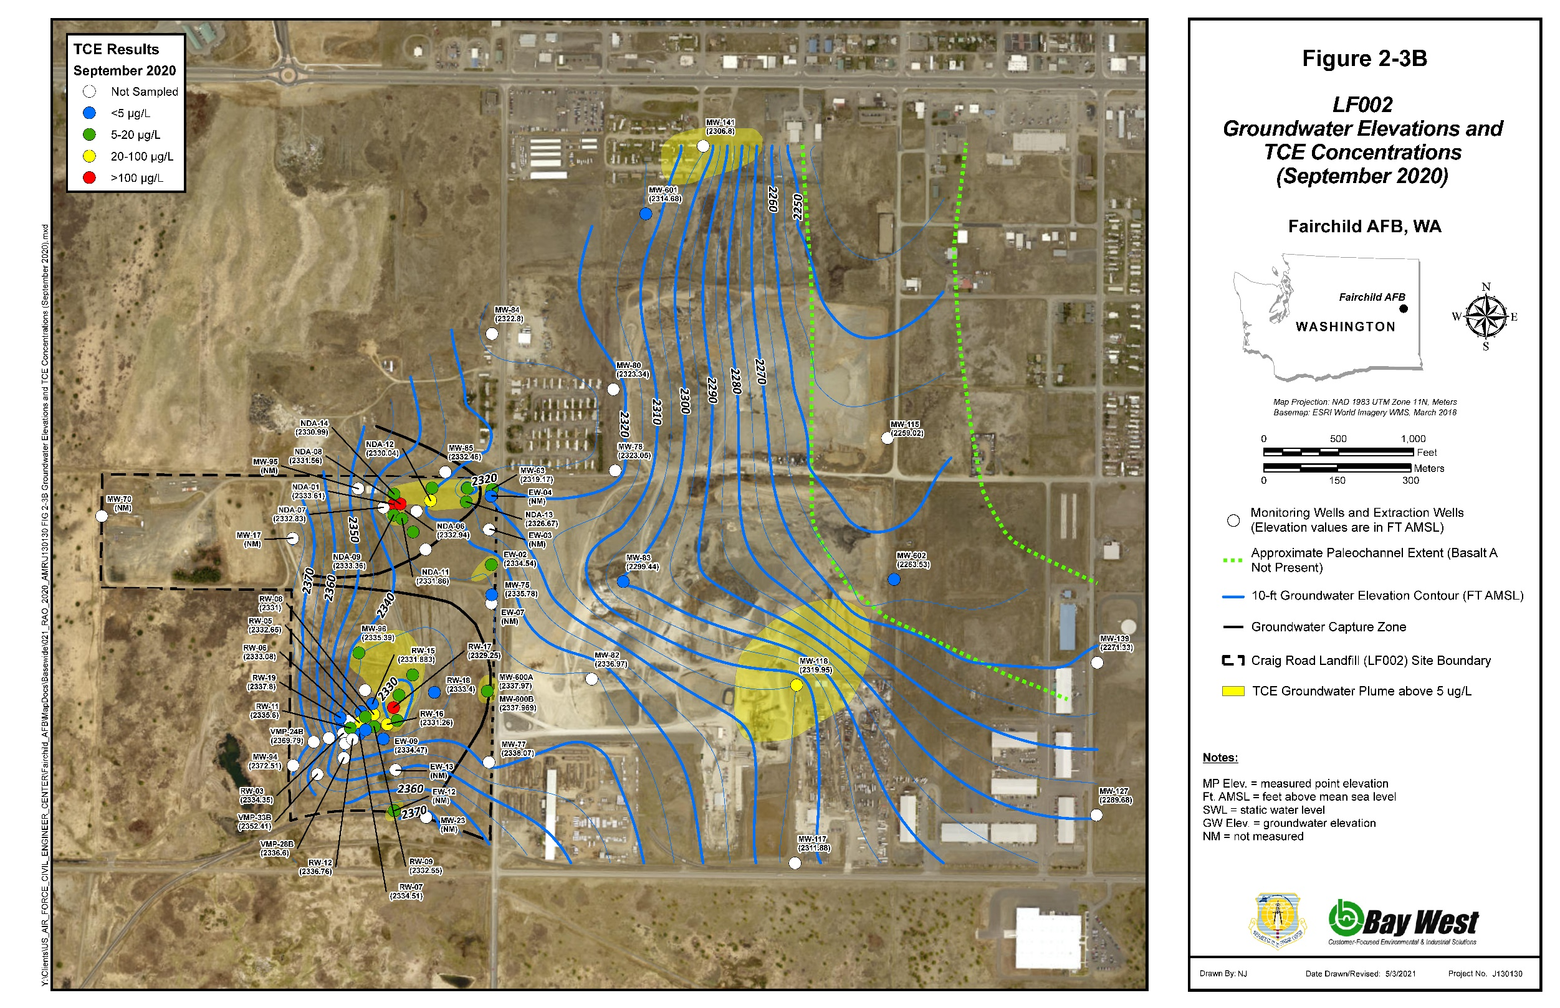
LF002 September 2022 Monitoring Results
FT AMSL = feet above mean sea level
2022

Slide 44
Industrial Wastewater Lagoon System (WP003)
2022/2023 RA-O Overview
Mr. John Peper
Bay West Project Manager
30 March 2023

Slide 45
WP003 Background
  WP003 includes former wastewater treatment lagoons located on the east margin of the base.
  TCE was discovered in groundwater in the late 1980s and 1990s at concentrations above regulatory limits. Subsequent monitoring also identified concentrations of vinyl chloride (VC) above the regulatory limit and arsenic above background.
  Remedial action was implemented in 1996 and has consisted of:
    Land use controls
    1996-2004 Groundwater containment with extraction wells and stripper tower treatment
    2000-2001 Source area excavation and organic substrate supplements
  RA-O currently consists of quarterly groundwater monitoring.

Slide 46
WP003 2022/2023 Overview
    2022/2023 Actions
  Pilot Test: A pilot test was implemented in June 2020 to augment existing bioremediation of TCE and VC at WP003. Quarterly performance monitoring for the pilot test continued in 2022.
  Pilot Test Results: The performance data have indicated the following:
    Preliminary results demonstrated the injections supported biodegradation of chlorinated ethenes for approximately one year.
    There was a 50% reduction of chlorinated ethenes and a 61% to 71% reduction of VC concentrations.
    In 2023 the VC plume shrunk to only one on-base well for quarters 1, 2, and 4 and only had a slight off-base detection in the 3rd quarter.
    Bio-augmentation is effective at accelerating VC remediation.
  RA-O Monitoring Results:
    The VC, TCE, and arsenic plume extents have remained stable or decreasing and the concentrations have stable or decreasing trends. The plumes are naturally attenuated. Land use controls and monitoring programs are in place to be protective of receptors.

Slide 47
WP003 2022/2023 Overview
  2022/2023 Actions (Continued)
    RA-O Reporting: The 2021 Annual RA-O Report was finalized in August 2022. The 2022 Annual RA-O Report is in preparation and will be finalized later in 2023.
    RA-O Monitoring: Semiannual and annual monitoring will be performed at WP003 to continue to document concentration trends and plume attenuation.
    Proposed Plan for ROD Amendment: A Proposed Plan for ROD Amendment is currently in review and is anticipated to be finalized later in 2023. The document will be available for public review and comment. The purpose of the Proposed Plan and ROD Amendment is as follows:
      Add VC and arsenic as chemicals of concern (they not in the original ROD).
      Add bioaugmentation as a remedy component.
      Update land used controls.
      Update the remedial action objectives.
    ROD Amendment: The ROD Amendment is anticipated to be finalized in late 2023 or early 2024.

Slide 48
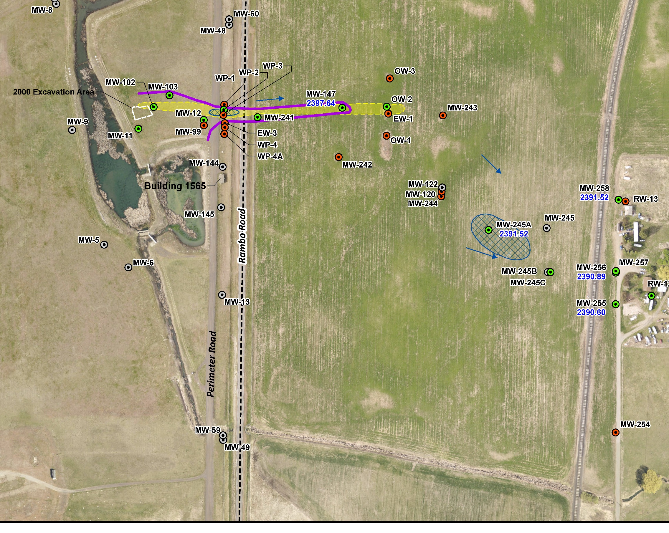
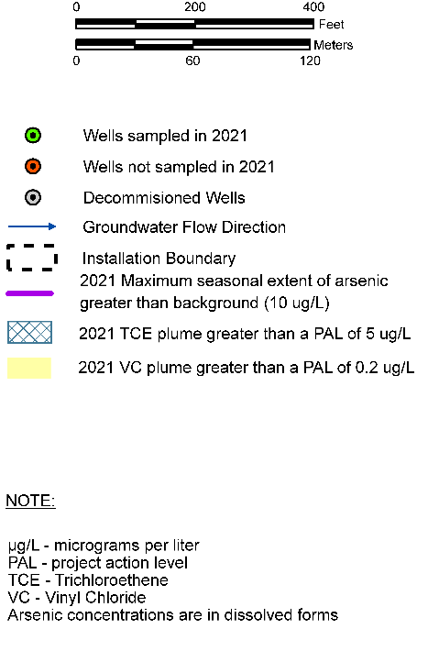
WP003 2022 Monitoring Results
In Q1 and Q2 2022 VC was only detected in MW102
The arsenic and VC plumes only extended off-base in Q3 2022.
Maximum extents have remained stable for > 10 yrs.
2022 Maximum Arsenic Extent above a background of 10 μg/L
2022 Maximum TCE plume above the PAL of 5 μg/L
2022 Maximum VC plume above the PAL of 0.2 μg/L
ug/L – micrograms per liter
PAL – project action level
TCE –trichloroethylene
VC – Vinyl Chloride
Arsenic concentrations are in dissolved forms

Slide 49
Voluntary Cleanup Program (VCP) Sites
Mr. John Peper
Bay West Project Manager
30 March 2023

Slide 50
VCP Sites
  Eight former oil/water separator sites along the flight line have achieved USAF and Washington Department of Ecology (WDOE) approval of Site Closure/No Further Action (NFA) through the WDOE VCP
    OW044, OW047, OW053, OW054, OW055, OW056, OW057, and OW063
  Other Petroleum Sites in the NFA Approval Process
    NFA Tech Memo Approved: ST010, SS033
    NFA Approved: ST006 (groundwater), OT017, FT032, ST035, AOC02, and SS059
    Remedial Investigation/NFA Report Approved: SS059, TU503
  Petroleum Sites in the Remedial Investigation Stage
    SS009
  Petroleum Sites in the Interim Measures/Remediation Planning Stage
    TU500, TU502, TU506

Slide 51
West Flightline Plume
(TU506)
2022 Summary and 2023 Planned Actions
Ms. Kristine Weber
AECOM Site Lead
30 March 2023

Slide 52
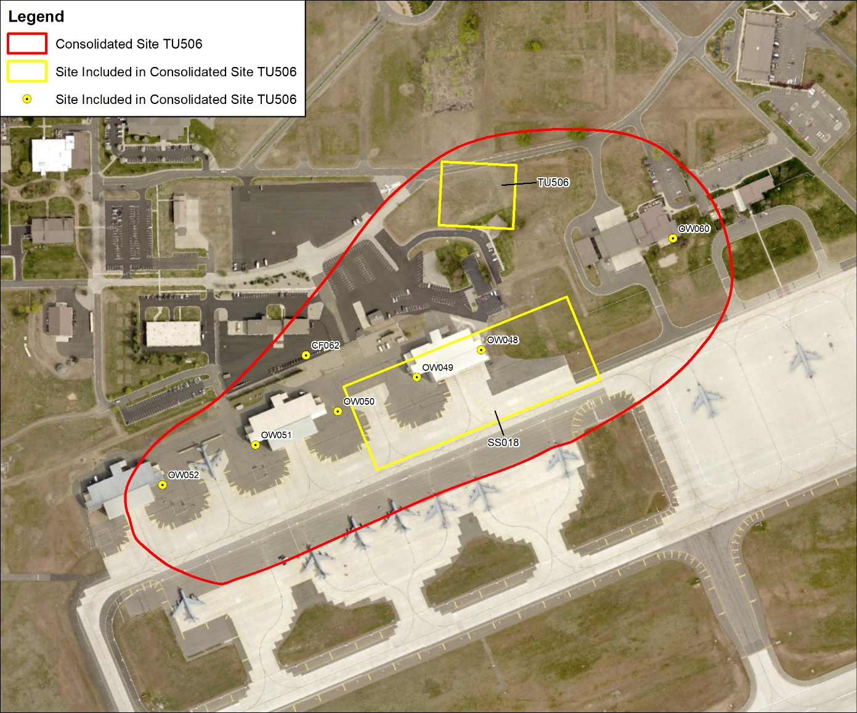
TU506 Overview
  2022 Summary
  Hot Spot Excavation at OW050
  Excavation Completion Report
  Quarterly Monitoring
  2023 Planned
  Risk Assessment Addendum
  Feasibility Study

Slide 53
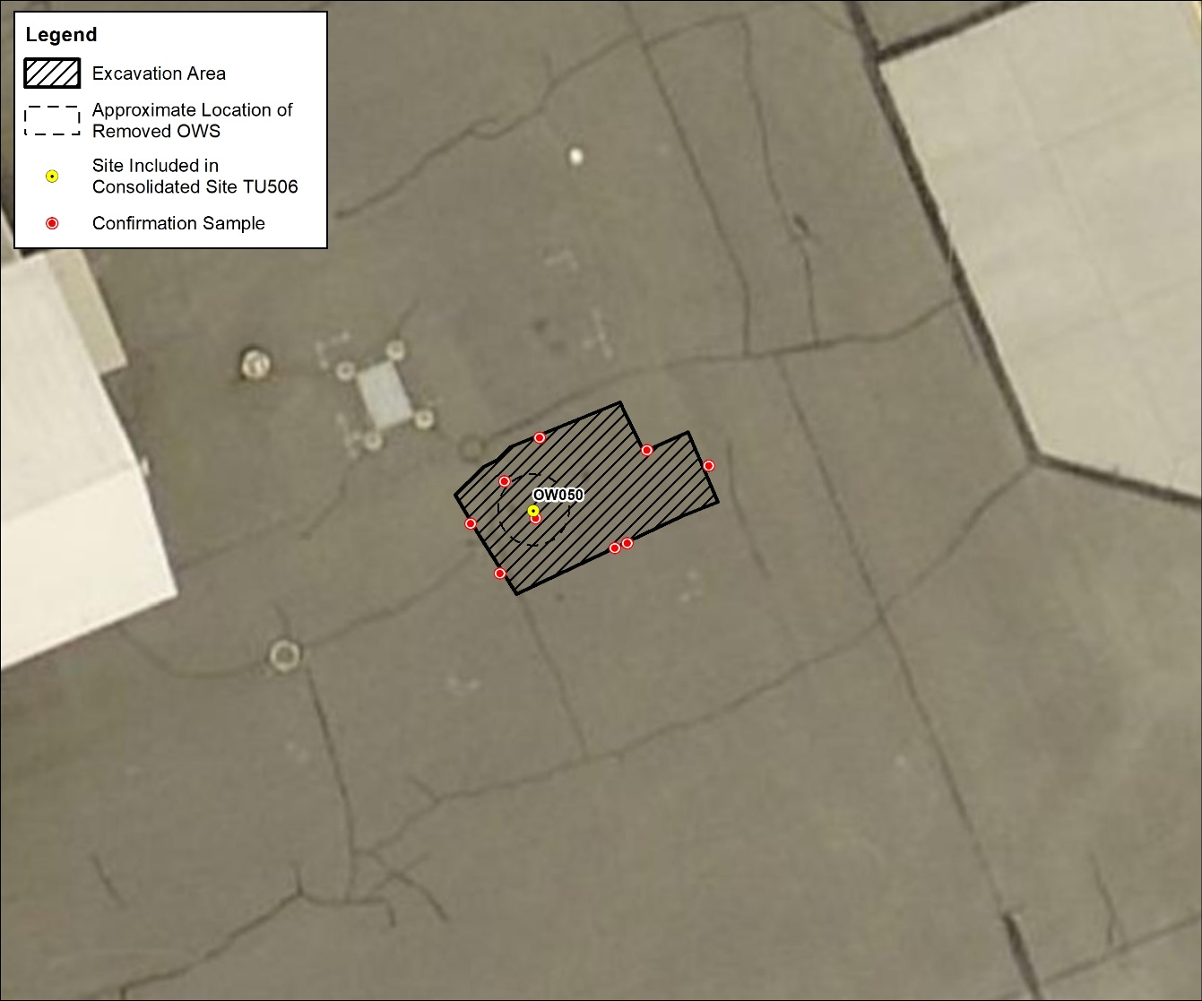
TU506 Overview
  The excavation at TU506 included the removal of 69.5 tons of Total Petroleum Hydrocarbon – Gasoline Range Organics-contaminated soil.

Slide 54
East Flightline Plume
(TU500)
2022 Summary and 2023 Planned Actions
Ms. Kristine Weber
AECOM Site Lead
30 March 2023

Slide 55
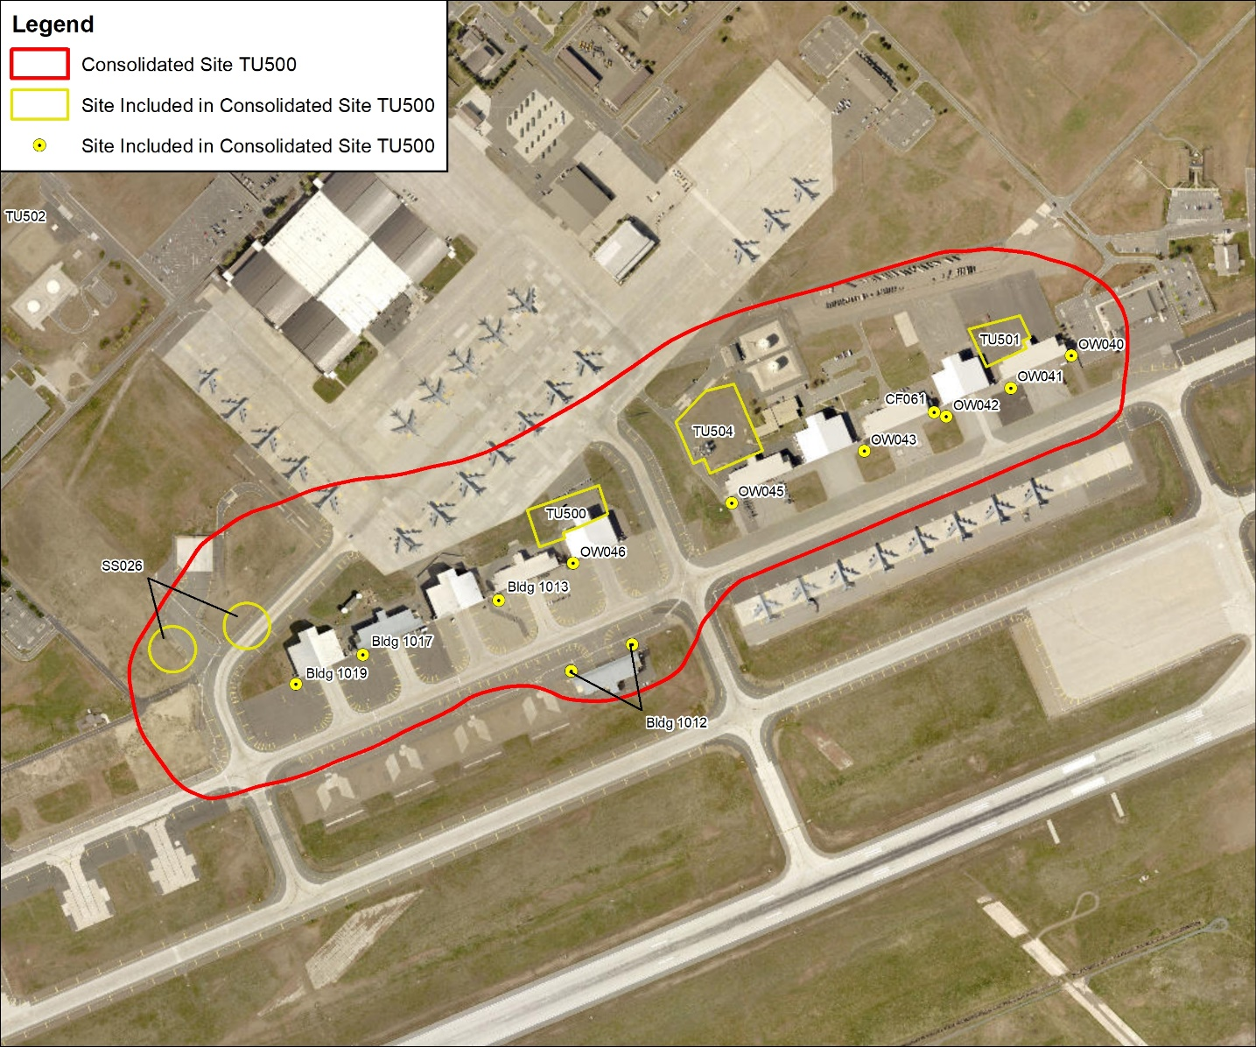
TU500 Overview
  2022 Summary
  Hot Spot Excavation at OW040, OW041, and OW043
  Excavation Completion Report
  Quarterly Monitoring
  2023 Planned
  Risk Assessment Addendum
  Feasibility Study

Slide 56
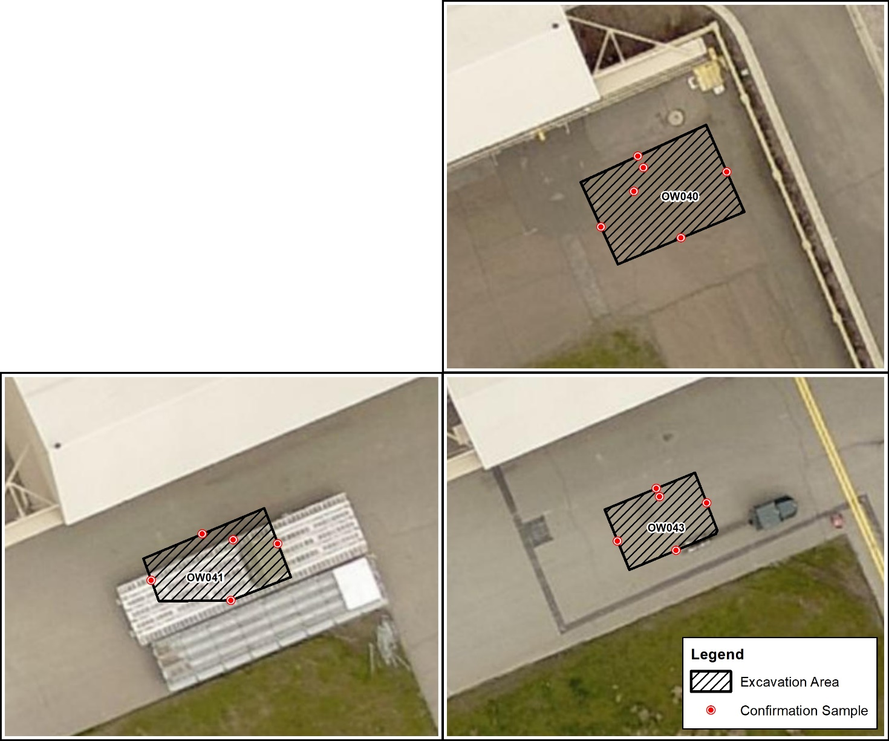
TU506 Overview
  The excavation at TU500 included the removal of 250 tons of Total Petroleum Hydrocarbon – Gasoline Range Organics-contaminated soil.

Slide 57
Public Comment Opportunities in 2023
Mr. John Peper
Bay West Project Manager
30 March 2023

Slide 58
Public Comment Opportunities 2023
  OU2 (DP064, Construction Debris Landfill/Former Coal Storage Area) Proposed Plan (PP): In Review Stage - Public Comment Period April 15 – May 15, 2023, following regulatory review
    Remedial alternatives for DP064
  OU2 (WP003, Industrial Wastewater Lagoon System) PP: In Review Stage - Public Comment Period May 15 – June 15, 2023, following regulatory review
  Will include selected remedy for the site based on the Feasibility Study Addendum (FSA)
  Anticipated public comment period summer 2023

Slide 59
Public Comment Opportunities 2022
  OU2 (OW058, Hotspot #5 TPH Contamination) PP: In production stage - Public Comment Period summer, 2023
    Remedial alternatives for OW058
    Anticipated public comment period summer 2023
  SD037 (Building 2447 and 2451 TCE Contamination) PP: In production stage - Public Comment Period summer, 2023
    Remedial alternatives for SD037
    Anticipated public comment period summer 2023

Slide 60
Acronyms and Abbreviations
µg/L micrograms per liter
AFB Air Force Base
AMSL Above Mean Sea Level
EPA United States Environmental Protection Agency
GW groundwater
IW injection well
NFA no further action
OU operable unit
RA-O remedial action-operations
TCE trichloroethylene
TPH Total Petroleum Hydrocarbon
USAF United States Air Force
VCP Voluntary Cleanup Program
WDOE Washington Department of Ecology

Slide 61
Questions?
61

Slide 62
BREAK
Meeting will resume in 5 minutes.

Slide 63
PUBLIC COMMENT
(10 Minutes)

Slide 64
MEETING
ADJOURNED
THANK YOU!
Fairchild Air Force Base
Open House
5:30 to 8:00 p.m.
Notes:
We greatly appreciate your attendance and participation!

