Slide 1

Site Closure Presentation For Department of Ecology Consideration
Whittaker SKS Site PPCD #13-2-27556

Slide 2

Prepared by – Aspect consulting
Dave Cook, LG, CPG
Principal Geologist
206.838.5837 : dcook@aspectconsulting.com
Ali Cochrane, LG
Associate Geologist
206.949.7478 : acochrane@aspectconsulting.com
Baxter Call, EIT
Project Engineer
206.369.7652 : bcall@aspectconsulting.com
On behalf of– LMI - West Seattle, LLC (aka GID)
Elton Lee
Vice President, Asset Management- GID
415.495.3003 : elee@gid.com

Slide 3
Presentation goals
Summarize current and historical environmental conditions on the Site
Show basis for empirical demonstration of compliance as stated in WAC-173-340-747
Provide information in support of formal requests for:
Certificate of Completion and Closure of Site #6015
Delisting from the Hazardous Sites List
Close out of PPCD No. 13-2-27556-2
Removal from the Hazardous Sites List
Dismissal of the PPCD at King County Superior Court

Slide 4
Agenda
Project Timeline and Milestone Recap
Compliance Monitoring Site Conditions
Compliance Groundwater Monitoring Results
Empirical Demonstration of Compliance
Site Closure

Slide 5
Project Milestones

Slide 6

Project Milestones
On-Property excavation of petroleum-contaminated soil
Pilot study indicated well system and formation not suitable for injections
Quarterly compliance monitoring focuses on MW115
Dewatering of petroleum-contaminated groundwater
2015 Construction & Remedial Excavation Completed
January 2021 Pilot Study for in-situ Treatment
January 2022 Replace Dewatering Wells with Compliance Well
March 2016 to December 2020 Quarterly Compliance GWM
March 2022 to June 2023 Resume Compliance GWM
Late 2023 Request Site Closure from Department of Ecology
The “RW” wells showed persistent DRO above Method A CUL
The “RW” wells replaced with proper compliance well, MW115
Original well network:
11 compliance groundwater wells
4 repurposed dewatering wells (the “RW” wells)
DRO = diesel-range organics
CUL = cleanup level
GWM = groundwater monitoring

Slide 7
Compliance monitoring site conditions

Slide 8

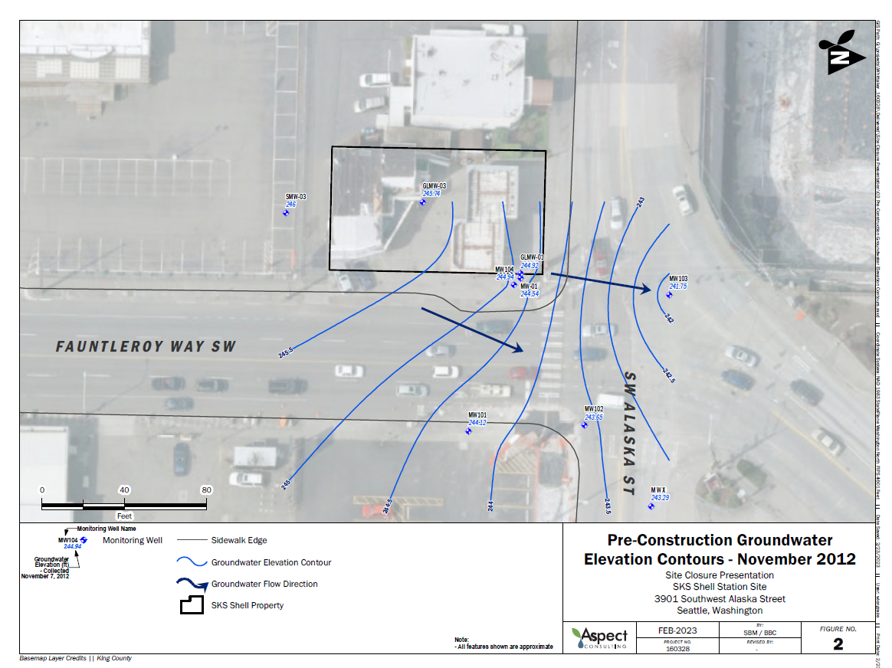
Pre-construction groundwater flow
Pictured groundwater elevation contours from November 2012.
Historically, groundwater flow to North-Northeast following West Seattle’s natural gradient.

Slide 9
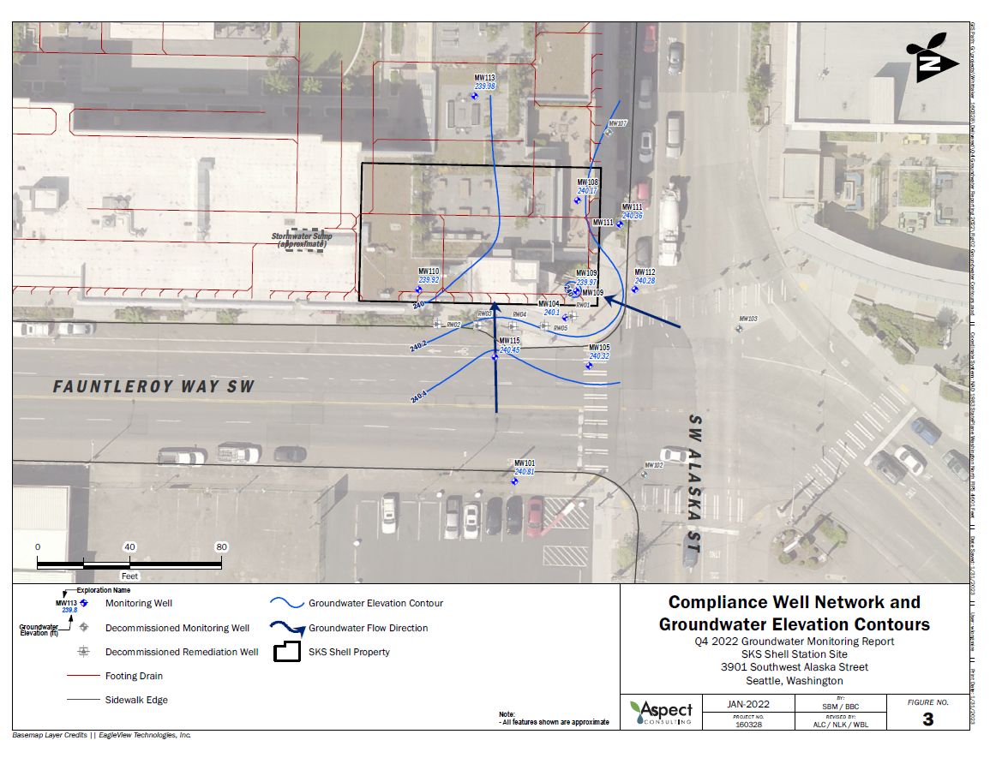
Post-Construction groundwater flow
Pictured groundwater elevation contours from Q4 2022 compliance monitoring event.
Since construction was completed, localized groundwater flow has been reversed.
Now flows South-Southwest towards footing drain.

Slide 10
FINAL EXCAVATION LIMITS – NE PROPERTY CORNER
Photograph from Cleanup Action Report, SKS Shell Station Site, 3901 Southwest Alaska Street, Seattle, Washington, dated October 20, 2016

Slide 11
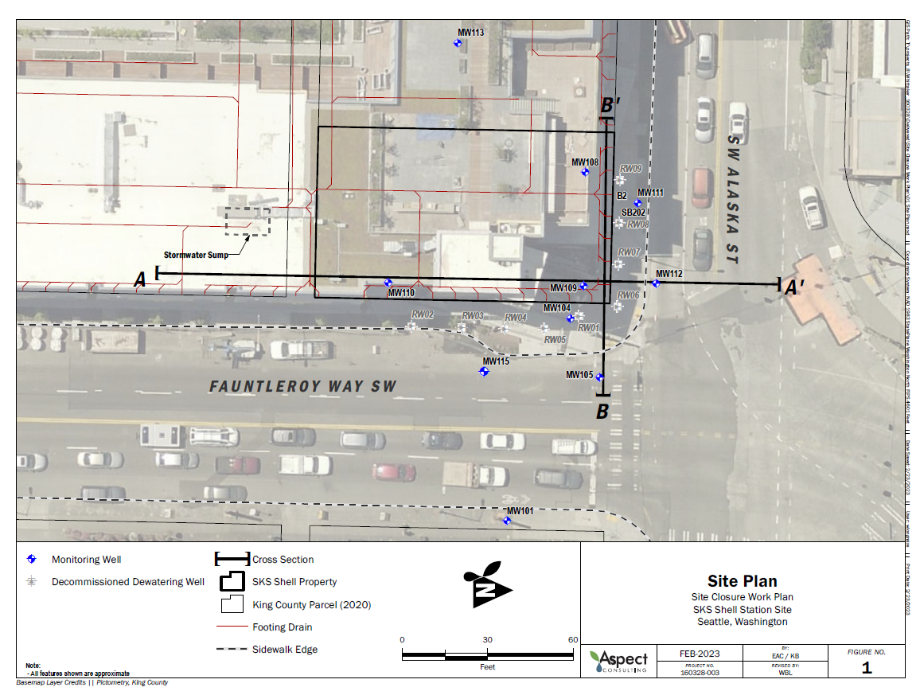
Compliance monitoring site map
10 compliance monitoring wells shown in blue
Cross sections depict existing soil conditions at remedial excavation boundaries.
There is an estimated 500 yd³ of DRO and GRO contaminated soil remaining in the vadose zone capped under Fauntleroy Way, and SW Alaska St ROW.

Slide 12
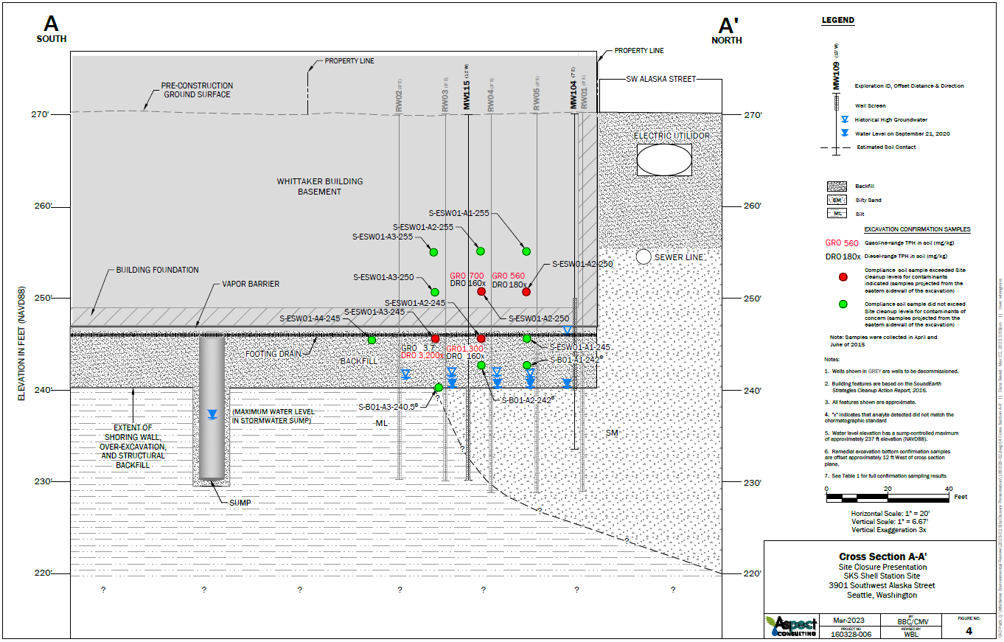
Fauntleroy way right-of-way Cross section

Slide 13
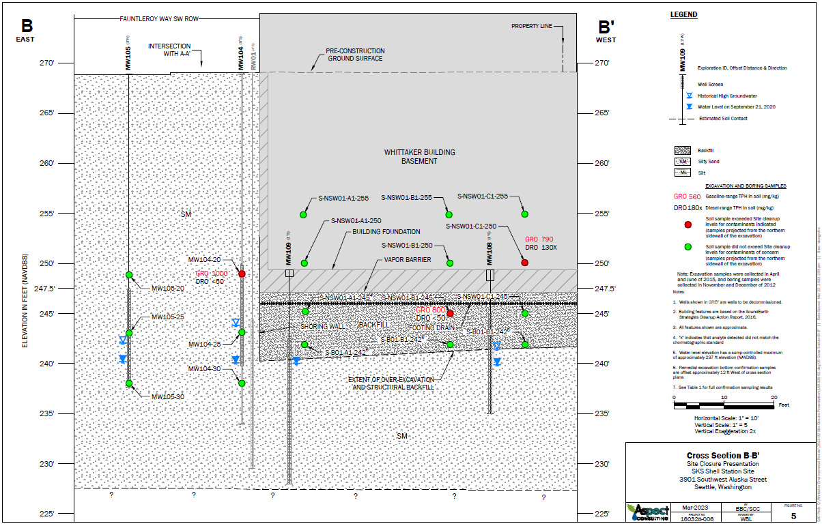
Alaska street right-of-way Cross section

Slide 14
Compliance Groundwater Monitoring Data

Slide 15
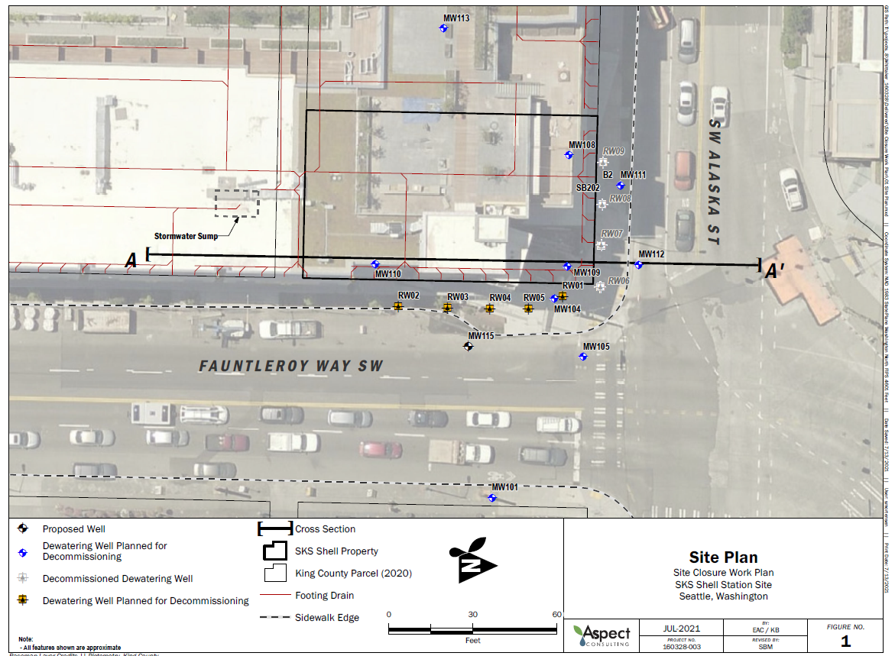
Groundwater Monitoring Data
As of Q2 2019, all wells show COCs below MTCA Method A
Except RW03 and RW04 (dewatering, extraction wells): showed persistent diesel-range TPH above Method A
Decommissioned & replaced with MW115 in Q1 2022

Slide 16
Groundwater Monitoring Data
Four consecutive quarters below MTCA. Other Site COCs have been ND or below MTCA Method A cleanup levels in all MW115 sampling events

Slide 17
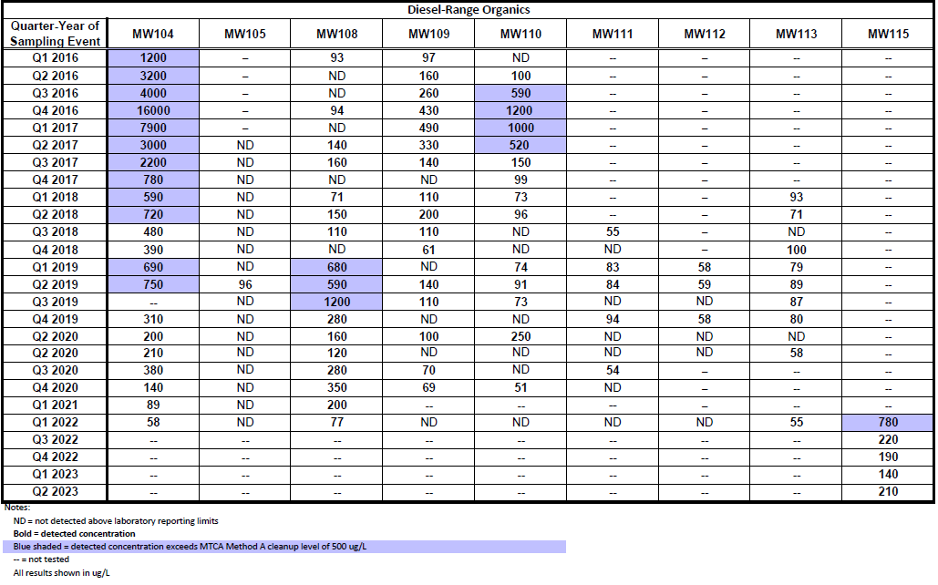
Diesel-range TPH Results
Groundwater Monitoring Data
7 Consecutive Quarters Below MTCA
4 Consecutive Quarters Below MTCA

Slide 18

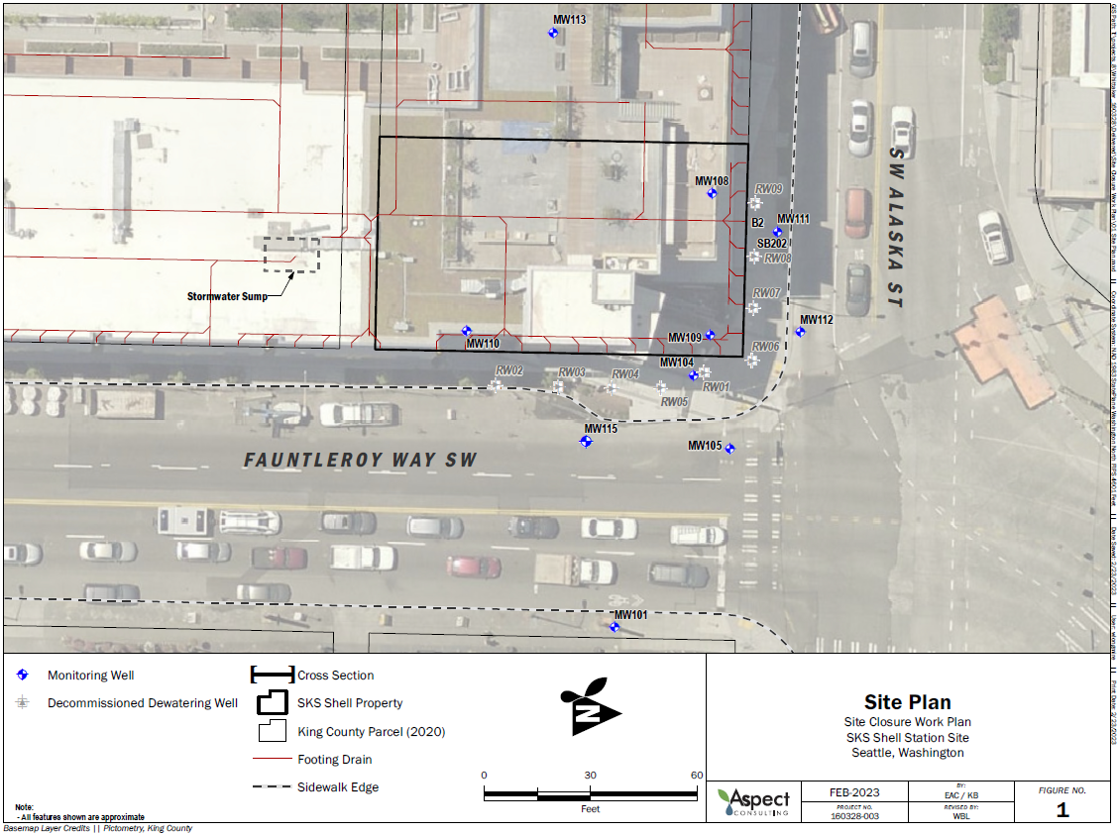
Compliance Groundwater Data Summary
MW115 has 4 consecutive quarters of results below MTCA Method A cleanup levels
All other existing wells (9) in network have at least 7 consecutive quarters of results below MTCA Method A cleanup levels for all Site COCs

Slide 19
Empirical demonstration of compliance

Slide 20
Case for empirical demonstration
Requirements for Empirical Demonstration¹ | Case for Empirical Demonstration at SKS Whittaker Site | Requirement Met?
The measured groundwater concentration is less than or equal to the applicable groundwater cleanup level². | Entire compliance monitoring well network has at least four consecutive quarters of results below cleanup levels. | ✓
The measured soil concentration will not cause an exceedance of the applicable groundwater cleanup level² at any time in the future. | Sufficient time has passed for migration of hazardous substances from soil into groundwater to occur. | ✓
 | The characteristics of the site are representative of future site conditions, and owner has no intention to change site use.
 | Residual soil contamination exists only in the vadose zone and is not in direct contact with groundwater.
¹As stated in WAC 173-340-747 (9)(b)
²Established under WAC 173-340-720

Slide 21
Compliance Monitoring at downgradient Wells
MW104, MW108, MW109, and MW110 are directly downgradient of, and closest to, residual soil contamination.
All have at least 7 consecutive quarters of compliance monitoring data below MTCA Method A CULs for all Site COCs.

Slide 22
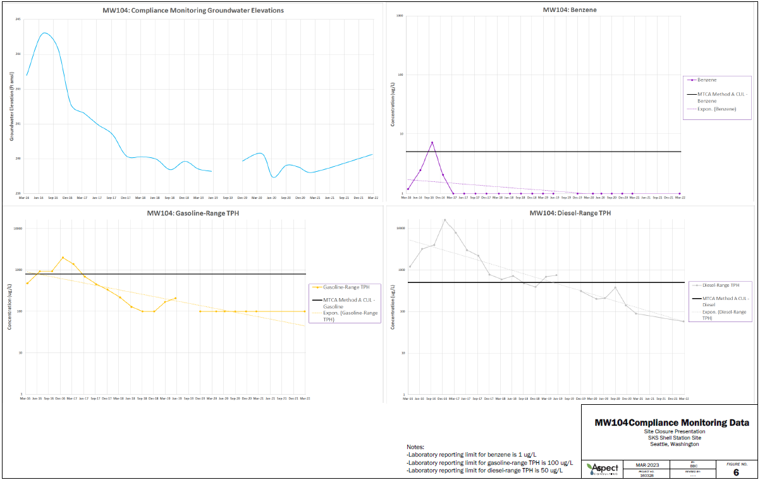
MW104 Compliance groundwater trend
Groundwater Elevation
Benzene
Gasoline-Range TPH
Diesel-Range TPH

Slide 23
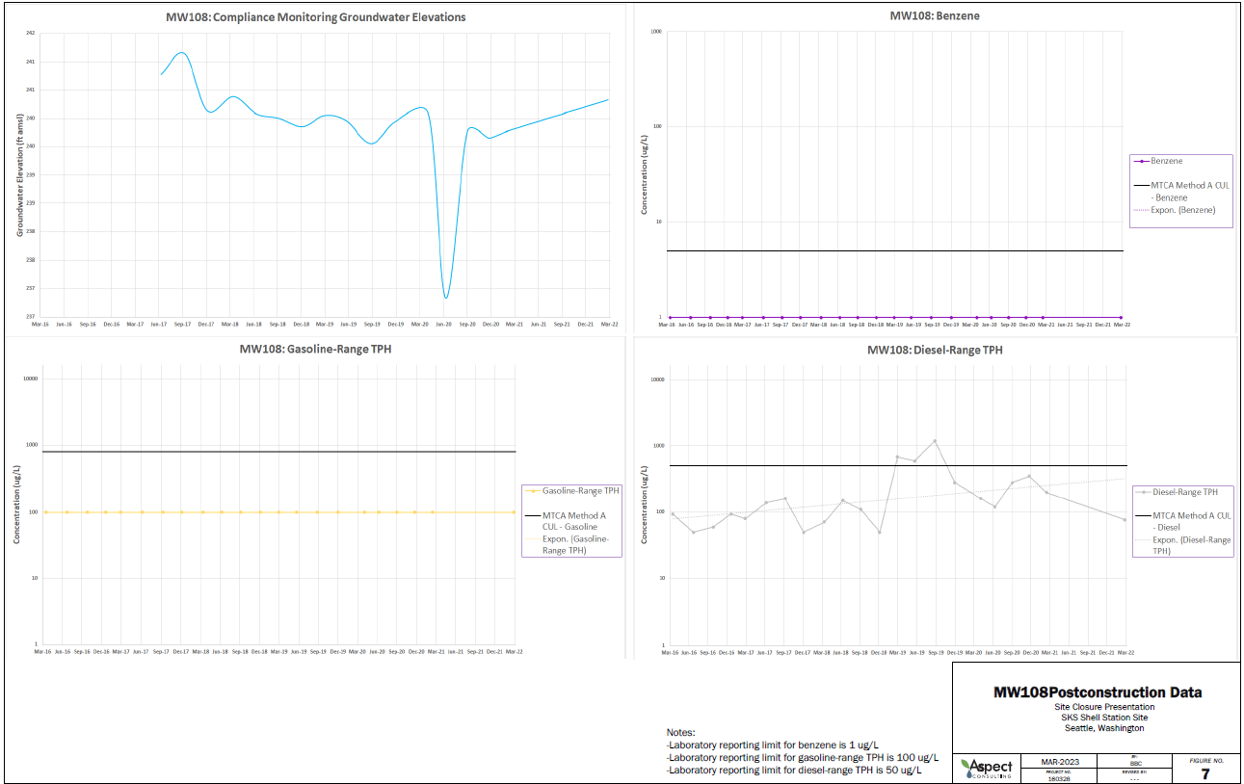
MW108 compliance groundwater trend
Groundwater Elevation
Benzene
Gasoline-Range TPH
Diesel-Range TPH

Slide 24
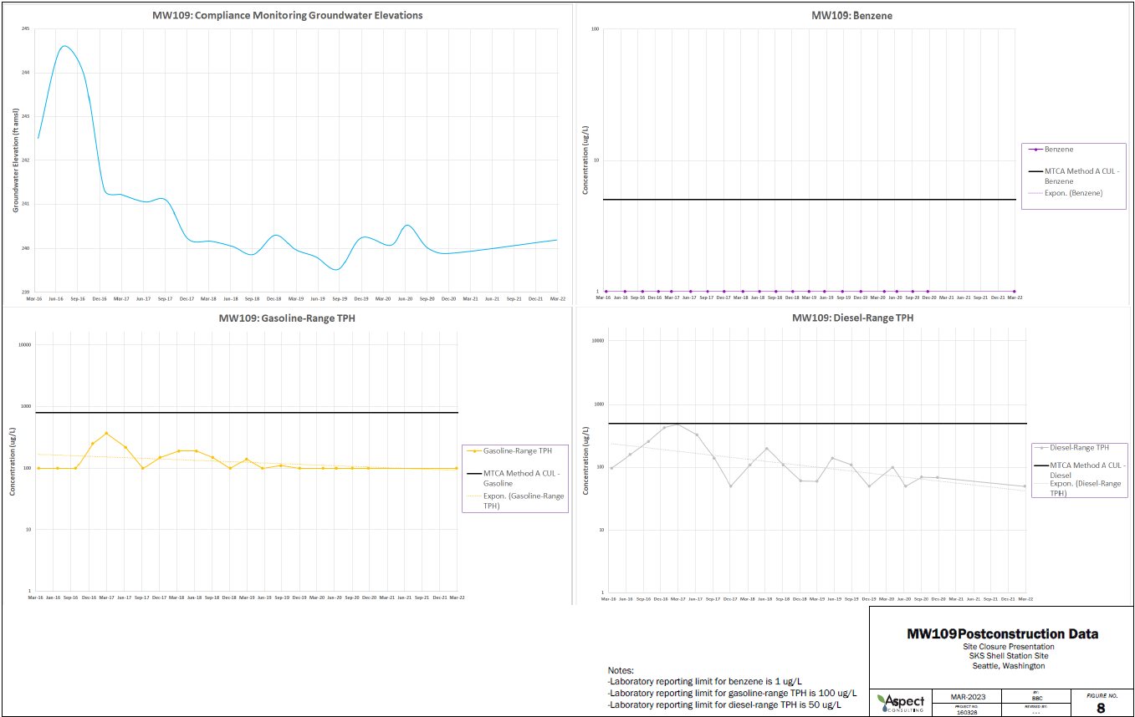
MW109 compliance groundwater trend
Groundwater Elevation
Benzene
Gasoline-Range TPH
Diesel-Range TPH

Slide 25
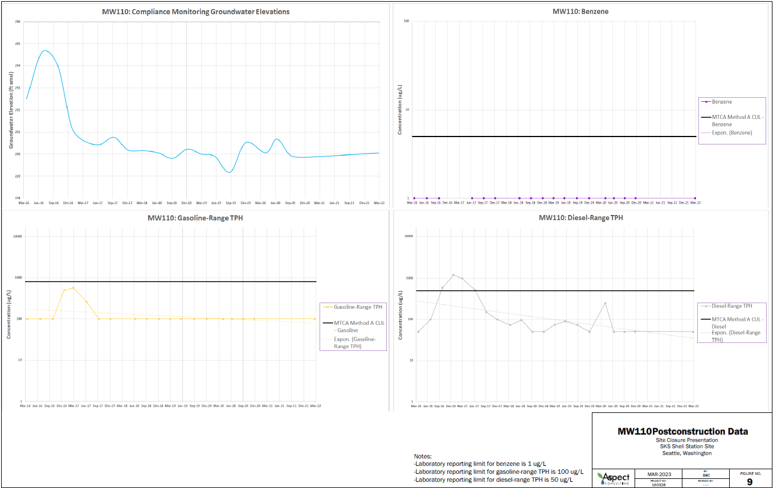
MW110 compliance groundwater trend
Groundwater Elevation
Benzene
Gasoline-Range TPH
Diesel-Range TPH

Slide 26
Proposed next steps

Slide 27
Proposed Next Steps
Prepare and submit Site Closure request, late 2023
Submit a Prospective Purchaser Consent Decree close out letter to Ecology, and request a Certificate of Completion, late 2023
Decommission remaining Site monitoring wells, early 2024
Work with the AGO to dismiss the PPCD in King County Superior Court, early 2024
Delisting the Site from the Hazardous Sites List, early 2024

Slide 28
Questions?

