Slide 1
Spic N Span Cleaners
Prospective Purchaser Consent Decree and Public Participation Plan
Open House: February 22, 2024

Slide 2
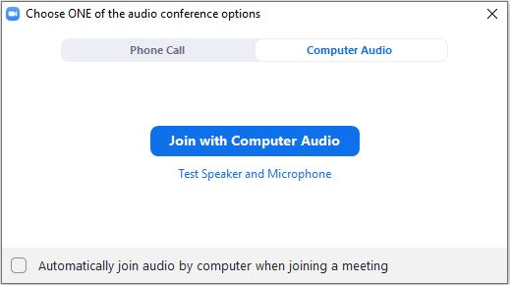
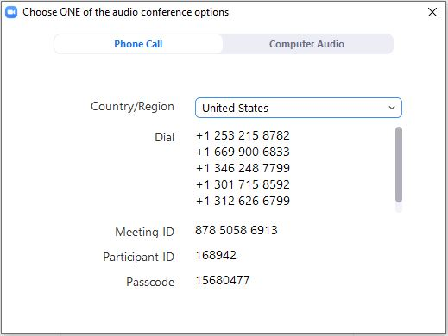
Welcome to our online open house
We will begin taking questions shortly.
No sound? We will unmute soon for sound checks.
Join
Participate
Try your computer audio first.
Tip
Question? Need help? Chat with us!
Connect Audio & Join
If you’d like, you can test your speaker and microphone before joining.
Audio
A
Best Option: Use computer for audio
B
If selecting “Phone Call”…
Dial: 253 215 8782 (Tacoma)
Enter Zoom Meeting ID 858 6512 5117 followed by “#”
Enter your unique Zoom Participant ID, followed by “#”
(If you do not enter the Participant ID, you will be prompted to enter the Passcode.)
Unique Zoom-generated IDs and Passcode
Turn on the Chat box and Participant list from your toolbar.
Notes:
Augie to switch meeting info

Slide 3
Online Open House Flow
Put your question in the chat or raise your hand to request to be unmuted.
We will connect you with the best staff to answer your questions one by one.
No questions right now? Slides will advance every 30 seconds, for a total of 5 minutes. This is a digital version of the posters on display at the open house, with some background information, and will repeat on a loop.
Notes:
Ian
Presentation Outline:
Welcome and Introductions (Ian with Team)
Cleanup Process and Public Participation (Ian)
Site Background (David)
Site Investigation and Contamination (David)
Renovations and Interim Actions (David)
Park Background and Operations (City)
Planned Next Steps (Ian)
How to Comment (Ian)
Questions/Answers (Ian with Kennedy Jenks)

Slide 4
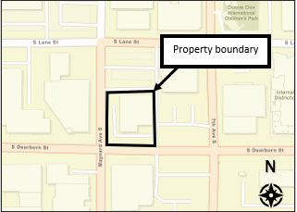
Ecology Staff Available Today
Zak Wall
Cleanup Site Manager
Augie Nuszer
Community Outreach Specialist
Aerial map of site location
Notes:
Ian (with team)
Ian introduces speakers (top to bottom, left to right).
Each speaker should say “Hello” for the online audience (so the attendees online can recognize voices).
For Scott and Karsten – please describe your roles with City of Seattle
NOTE: I will also introduce other folks that are joining from City of Seattle (Megan Joplin) and the City’s consultants to help with Q/A as needed, but will not be presenting.

Slide 5
The Model Toxics Control Act (MTCA)
Washington’s Formal Cleanup Process
Notes:
Ian
MTCA infographic explanation:
The Model Toxics Control Act (or MTCA) directs the formal cleanup process that you see here.
MTCA is WA’s environmental cleanup law.
Cleanup progress:
The Duwamish Waterway Park site is beginning Washington State’s formal cleanup process.
The City of Seattle, the Potential Liable Person (PLP), has negotiated a legal agreement to address contamination at the site – hence our comment period and this meeting.
The legal agreement at this point in the formal cleanup process outlines the steps required to investigate the nature and extent of contamination, evaluate cleanup alternatives, and create a draft Cleanup Action Plan.
In addition to the legal agreement, Ecology has a public participation plan out for public review. In the Fall of 2022, Ecology received public comments about a Public Participation Plan. Ecology will address any changes to both that PPP and this PPP since they are very similar for sites that are also very close to each other.
Public Participation:
As you can see by the orange comment bubbles, public participation is built-into this process with required comment periods for key steps.
After this comment period, the RI/FS and the CAP will both have comment periods in the future.

Slide 6
Affordable Housing Cleanup Grant Program
Ecology’s Affordable Housing Cleanup Grant Program provides grants for the planning and cleanup of contaminated sites intended for affordable housing development.
The Seattle Chinatown International District Preservation and Development Authority (SCIDpda) has received a planning grant through the Affordable Housing Cleanup Grant program.
The grant will fund work to assess, study, and plan the cleanup at Spic N Span. This work is currently underway.

Slide 7
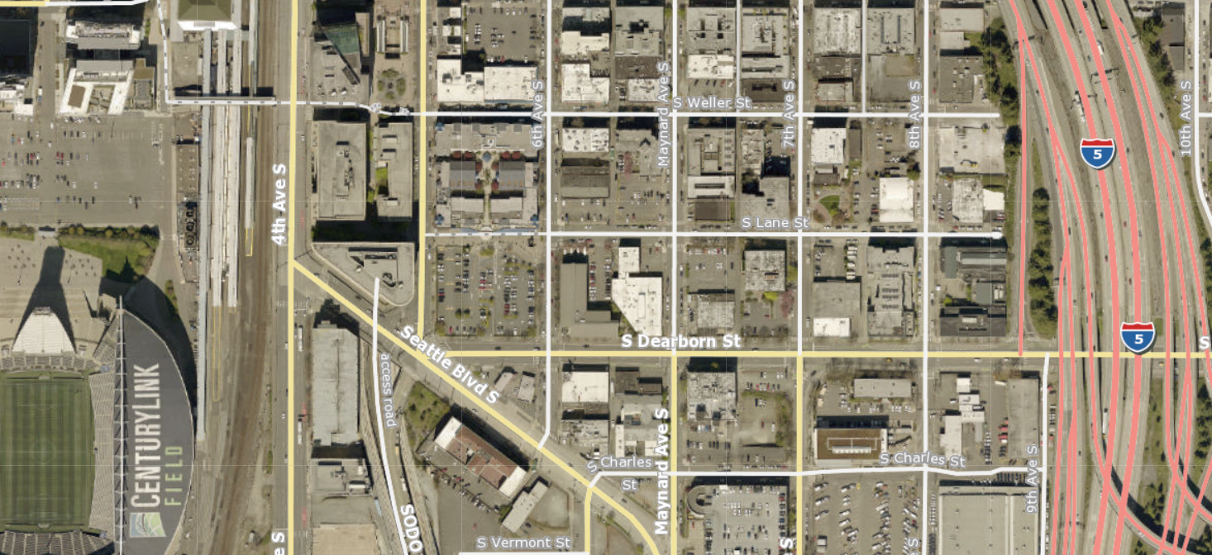
N
International District/Chinatown Community Center
Spic N Span Cleaners
652 S Dearborn Street

Slide 8
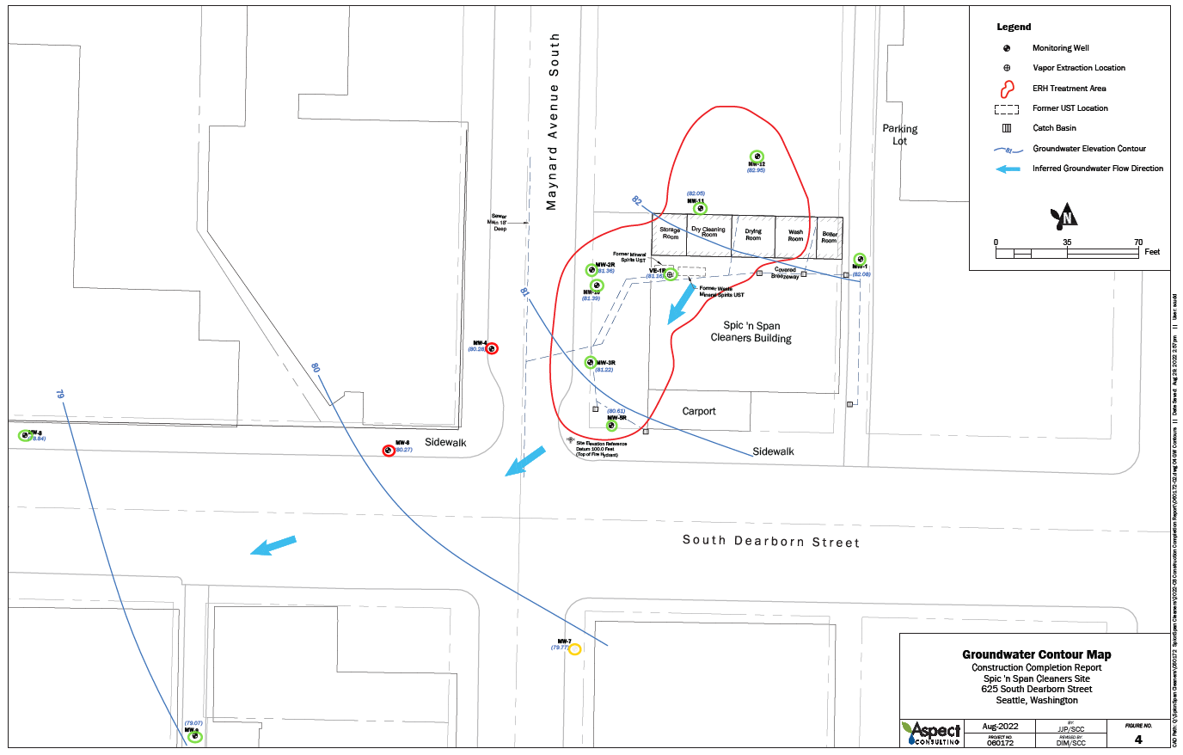
2023 Groundwater Sampling Results
Groundwater contaminants not detected
Groundwater contaminants detected, but below site cleanup levels
Groundwater contaminants detected above site cleanup levels
2023 Groundwater Elevation Contours
And
Groundwater Sampling Results

Slide 9
How to Comment February 12, 2024 – March 12, 2024
Comment Online
www.bit.ly/Ecology-SpicNSpan-Comments
Site Manager Contact Information
Zak Wall
PO Box 330316
Shoreline, WA 98133-9716
Zak.Wall@ecy.wa.gov
Notes:
[Animation note: options appear on clicks]
Ian
How to comment
Comment Online via Ecology’s online comment form (referred to as “eComments”)
Email/Mail Ecology

Slide 10
Find this presentation on our webpage at: Spic N Span Cleaners
Thank you for joining!
Zak Wall
(425) 758-5231
Zak.Wall@ecy.wa.gov
Augie Nuszer
(425) 533-5537
Augie.Nuszer@ecy.wa.gov
Presentation Icons: www.thenounproject.com and Ecology-created.
Notes:
Ian (with team)
Thank you and reminder of presentation PDF on webpage
[Reminder: Add eComments link and emails to Chat]

