Slide 1
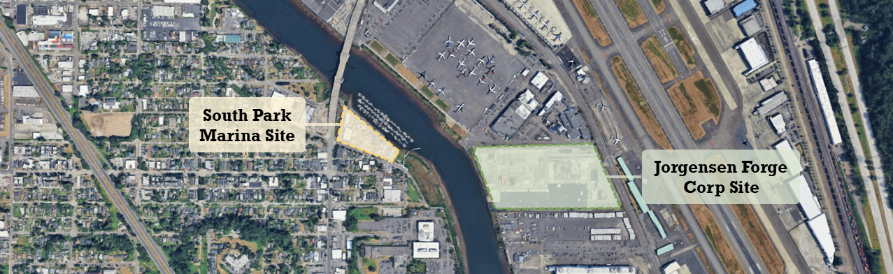
Jorgensen Forge Corp Site & South Park Marina Site
Beau Johnson and Priscilla Tomlinson
March 2026
Notes:
Meredith to start.

Slide 2
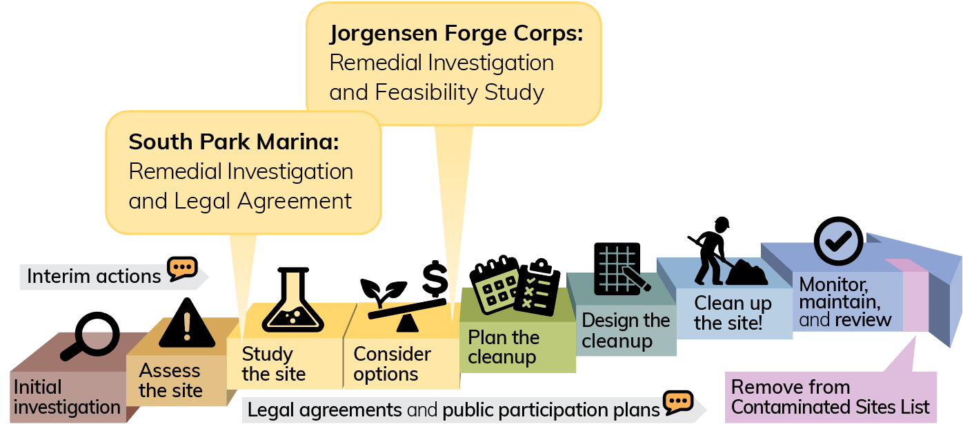
Agenda
1
Jorgensen Forge Corps Site
2
South Park Marina Site
3
How to comment
Notes:
Meredith

Slide 3
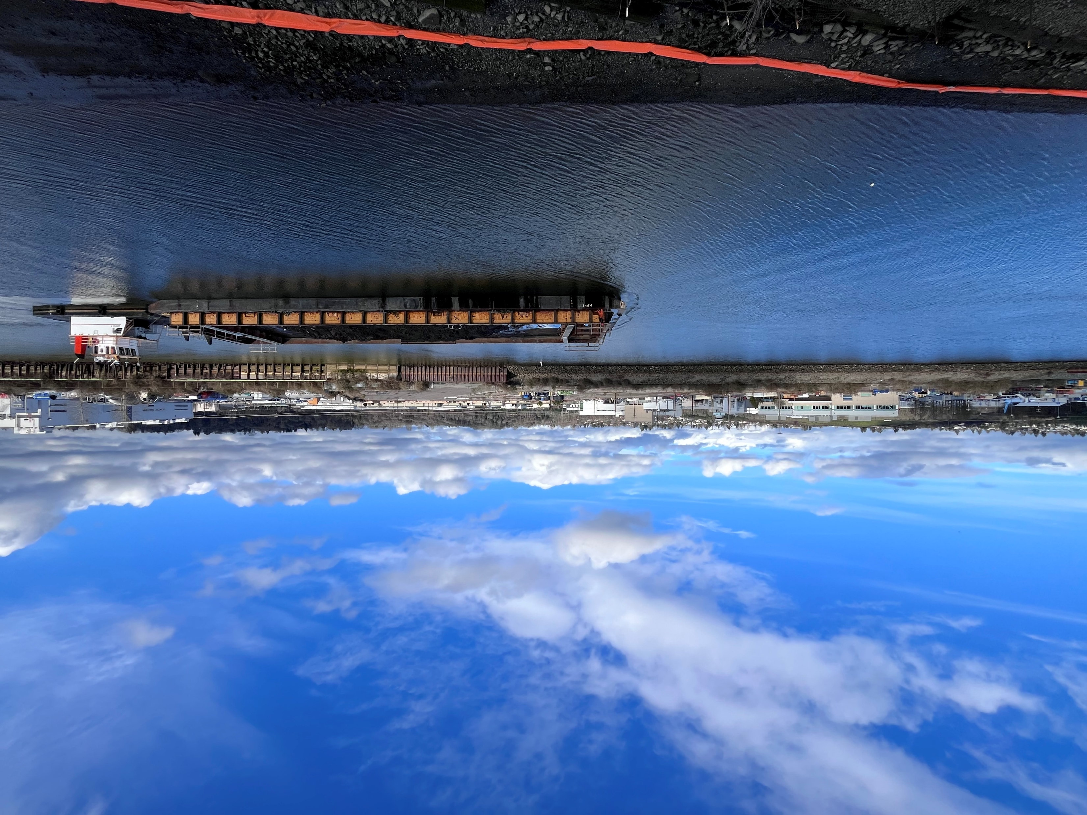
Jorgensen Forge Corp Site
Site Manager: Beau Johnson
beau.johnson@ecy.wa.gov
206-638-0816
Notes:
Turns it over to Beau.

Slide 4
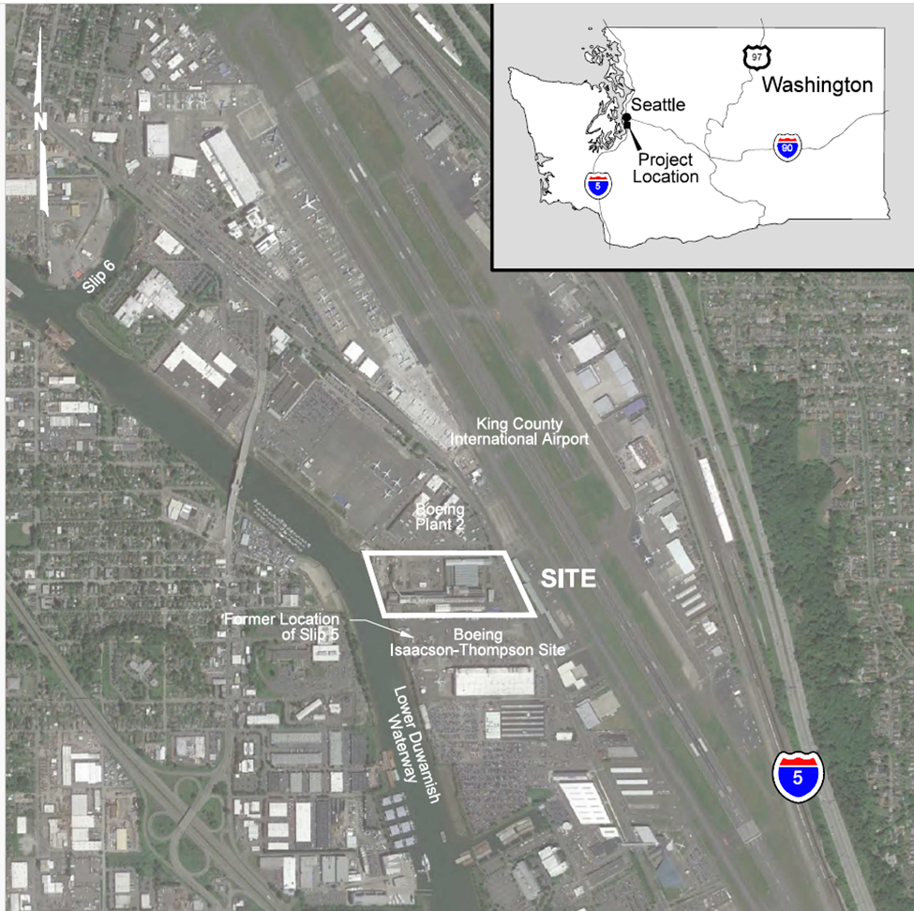
Jorgensen
Forge
& nearby sites
Boeing Plant 2
King County International Airport
South Park Bridge
Early action area sediment cleanup
Former location of Slip 5
Boeing Isaacson-Thompson Site
Notes:
This property was used for forging and molding metals and making alloys during World War II.
The Boeing Isaacson Thompson cleanup site is to the south. Boeing Plant 2 is to the north. King County Airport is across the street.
The sediment next to the Jorgensen site was cleaned up several years ago during one of EPA's early actions. EPA is working on their final sediment cleanup of the upper reach now.
The ways chemicals could move at this site and the ways people could be exposed are similar to what I described for South Park Marina.
There is boat access for clamming along the shoreline.

Slide 5
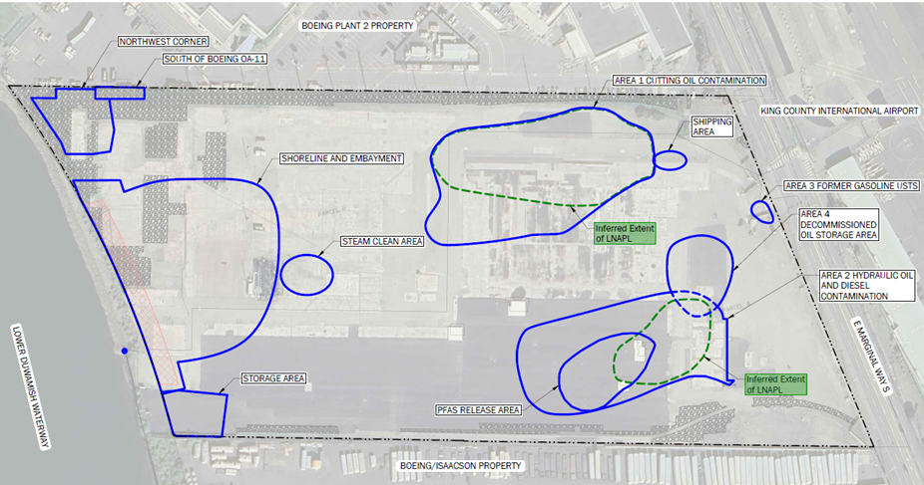
Areas Requiring Cleanup
Area 1
Area 2
Notes:
There are 11 areas requiring cleanup.
Areas 1 and 2 have high concentrations of petroleum. Area 2 also has high concentrations of PFAS. The contamination in both areas appears to be staying in place.
Contamination in other areas is at lower concentrations.
We have monitoring wells along the shoreline that occasionally show low concentrations of metals, but overall we don't think much contamination is reaching the river.

Slide 6
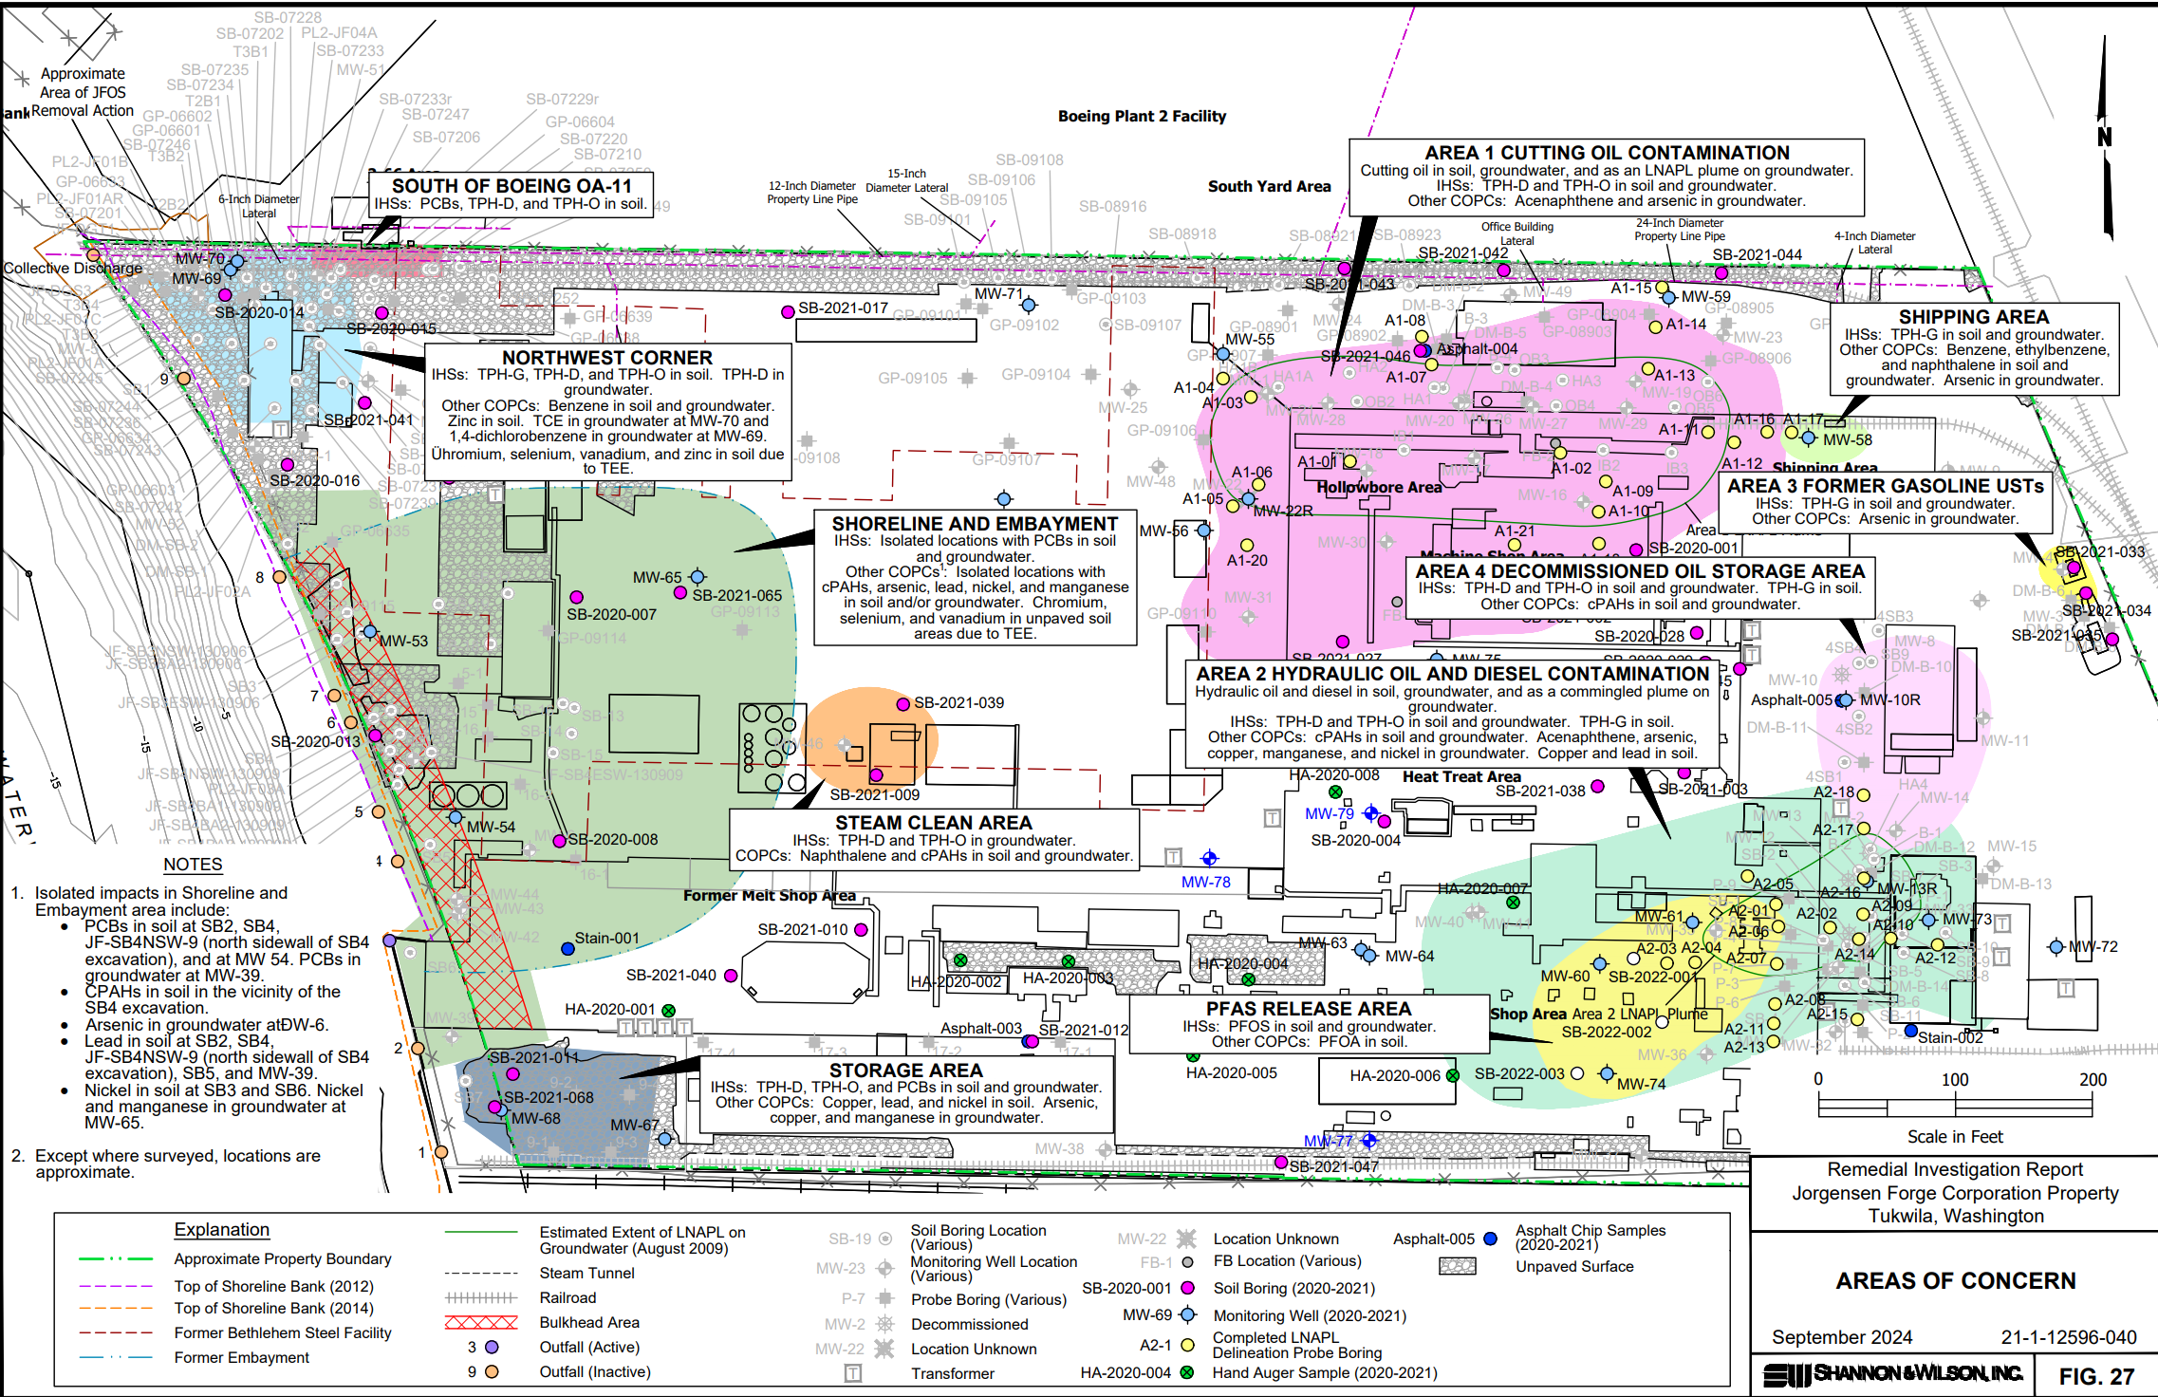
Investigation Locations and Areas of Concern from Remedial Investigation
Notes:
This is a more complex version of the slide you just saw to show the site investigation that has occurred.
Each dot or diamond on the map is a location where soil and/or groundwater samples were collected.

Slide 7
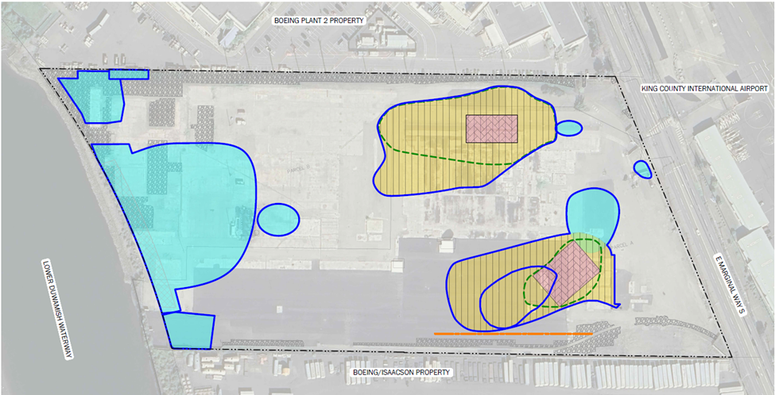
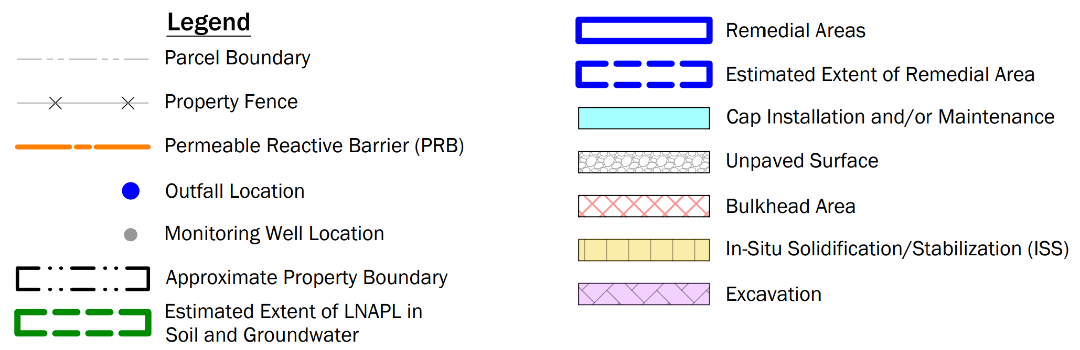
Proposed Cleanup Alternative 3/3B
Boeing Plant 2 Property
Area 1
Area 2
Boeing Isaacson-Thompson Property
Notes:
The buildings were demolished and storage tanks were removed in 2024.
We'll excavate the highest concentrations from Areas 1 and 2. Lower concentrations in these areas will be stabilized with concrete or something like it.
All other areas will be capped and the whole property will be monitored.
We think the PFAS in Area 2 are stable. But if we see them start moving south toward the Boeing/Isaacson property, we have a contingency plan to install a permeable reactive barrier. It acts like a water filter you might use on your sink, except we put the filtering chemicals into the ground to catch the contaminants in the groundwater.
We'll also monitor the wells along the shoreline in case contamination moves toward the river. If that happens, we'll do more cleanup and/or install a PRB.

Slide 8
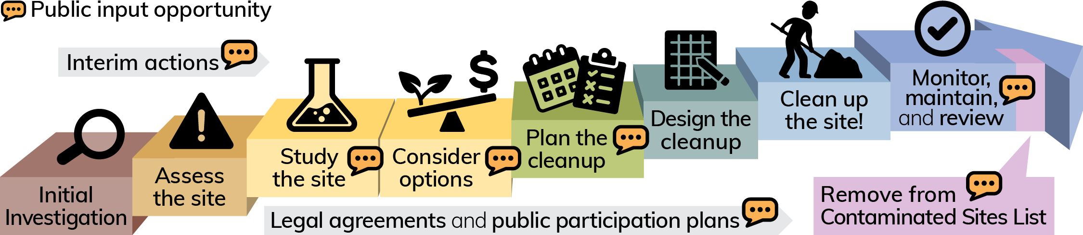
What's Next at Jorgensen Forge
New legal agreement
Cleanup Action Plan
Notes:
The next step for this site is the CAP and a new legal agreement (AO or CD). If there are substantial changes made to RI/FS after this comment period, we may hold another comment period on these same documents before moving forward.
We expect pilot testing will be needed for the stabilization.
The PLP intends to sell the property. We don't know what the future use will be.
We expect the CAP and the new legal agreement will likely be ready for a public comment period by the end of 2026.
Meredith removed the following text from the slide that was under Cleanup Action Plan:
Following completion of the public comment period for the RI and FS, Ecology will choose the cleanup action for implementation at the site.

Slide 9
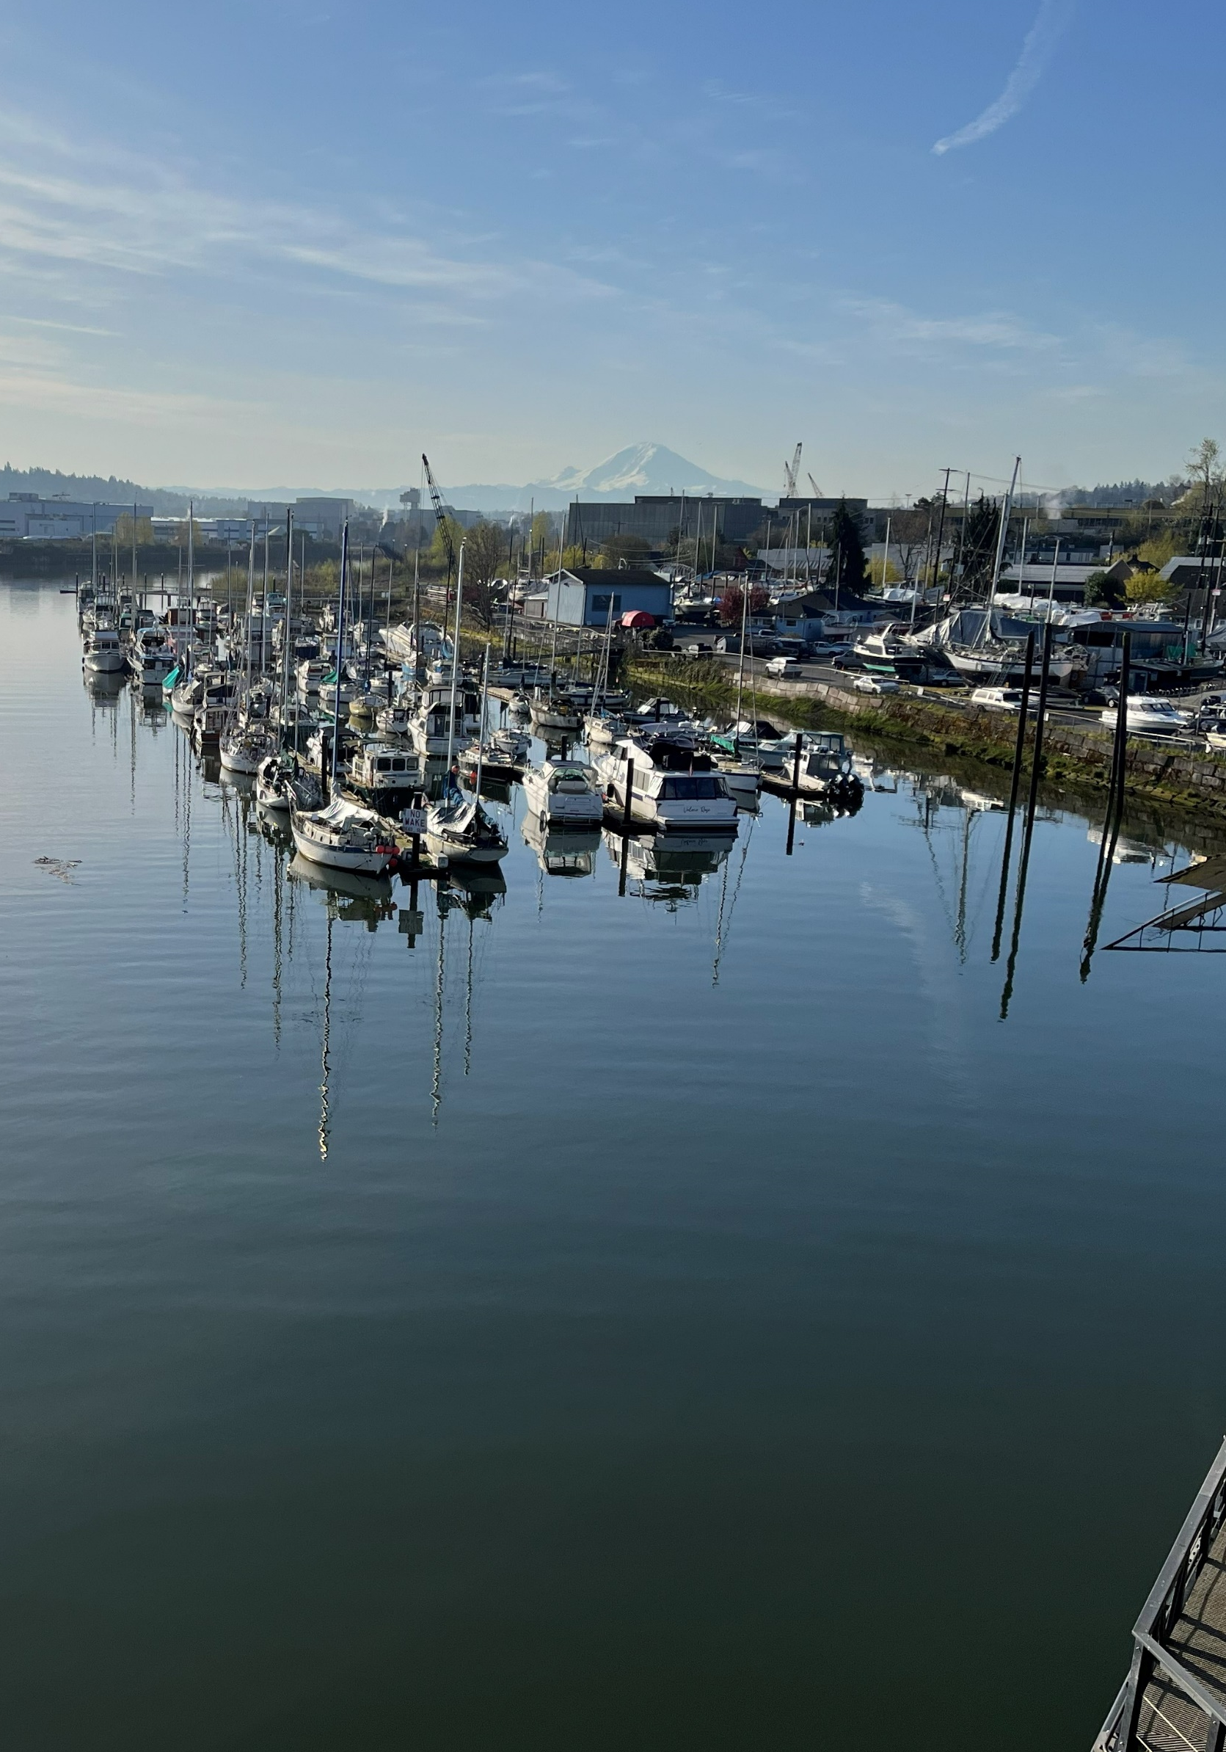
South Park Marina Site
Site Manager: Priscilla Tomlinson
priscilla.tomlinson@ecy.wa.gov425-324-0732
Notes:
Beau to continue with SPM site. Take questions at end.

Slide 10
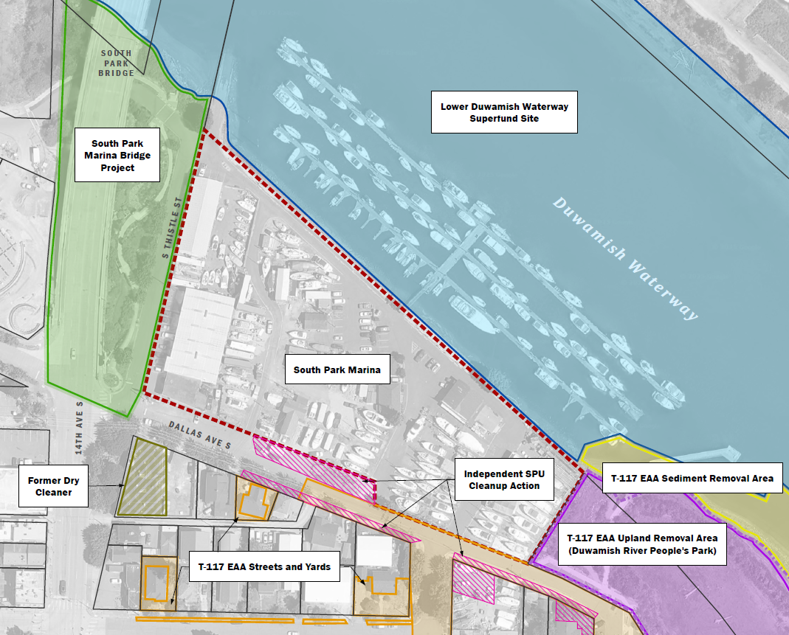
South Park Marina and nearby sites
Notes:
SPM is in the South Park neighborhood just north of the T-117 site, which is now a habitat restoration area and park.
T-117 and some streets and yards in the neighborhood were cleaned up by EPA and the City of Seattle in 2015.
A dry cleaner used to operate on the southeast corner of Dallas Ave and 14th Ave.

Slide 11
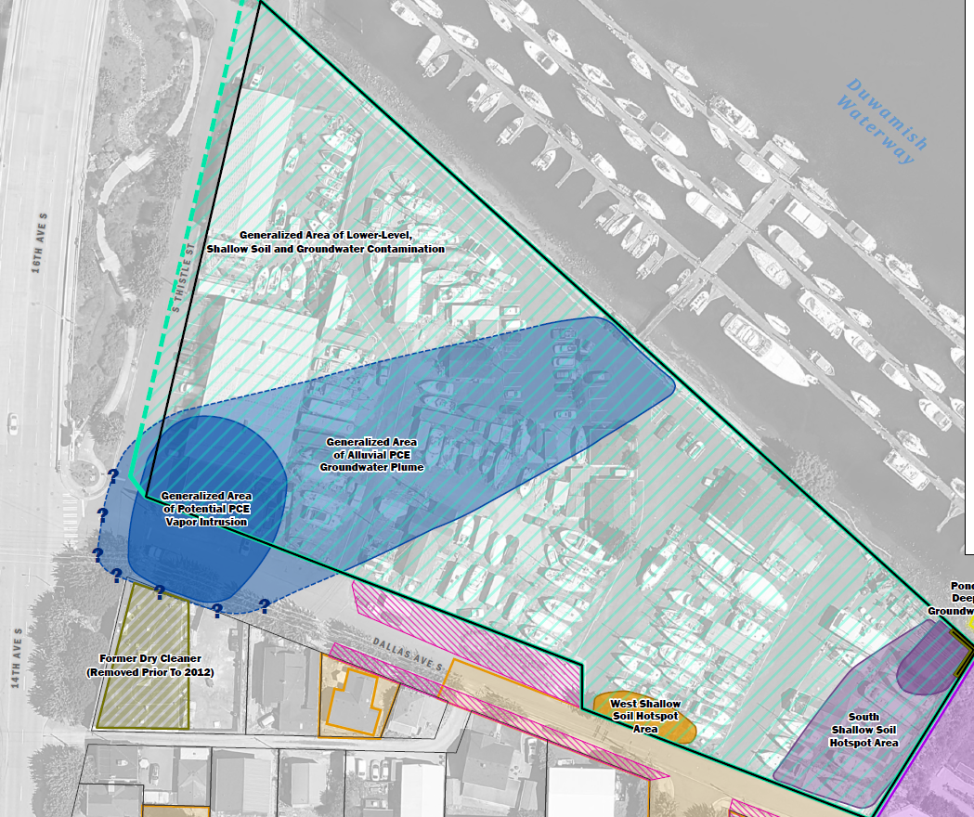
Areas of concern
Central Area
Scattered detections
Lower concentrations
South Area
Former barrel recycler with waste pond
Widest variety of chemicals
Highest concentrations in soil & groundwater
North Area
Former auto service & maintenance
Former dry cleaner across street
Hot Spot
PCBs and PAHs
Notes:
Marina operations have occurred across the whole property.
The former waste pond in the southeast corner is the most contaminated area with a wide variety of chemicals, some at high concentrations.
There's a small hotspot of PCBs and PAHs in shallow soil along Dallas Ave.
A plume of PCE from off-site is at the northwest corner. It's possible that PCE vapors could be entering the overlying building but PCE is also used inside the building, so it's hard to distinguish where the vapors are coming from. The PCE in groundwater might be getting into the river.
The remainder of the property has scattered, lower level contamination.

Slide 12
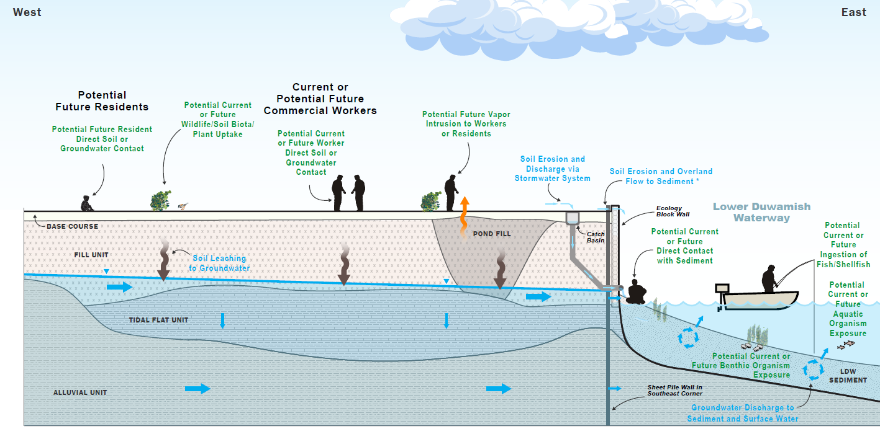
Potential exposure pathways
Notes:
Animals, plants, and people living or working at the property can contact contaminated soil in some areas. Other areas are covered by pavement or gravel that reduce soil contact.
Vapors could accumulate in the existing buildings in the north area. If a building were built above the pond area, vapors could accumulate in that building.
Chemicals in the soil can leach into the groundwater and then travel with the groundwater to the river where they could get into the sediment and water in the river. A sheet pile wall in the southeast corner holds back the groundwater contamination in that area.
Chemicals in the soil can also be washed into storm drains. Water in some of the storm drains goes through a treatment system before it discharges to the river.
In 2022-2024, we evaluated potential pathways by which contaminants could reach the river and concluded the site is not currently contaminating the river.
Some clamming might occur at the northern and southern boundaries of the marina and people could contact the sediments. Fortunately sediments around the marina don't have much contamination.
To the extent that site contamination has reached the water in the river, it could be taken up by fish. Animals and people could eat the fish. Remember, only eat salmon from the river.

Slide 13
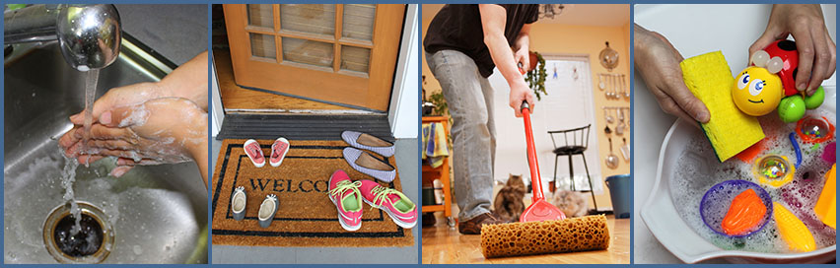
Protect yourself from chemicals in dirt
Wash your hands with soap
Wash children’s toys and pacifiers frequently
Mop and vacuum once a week
Take your shoes off at the door

Slide 14
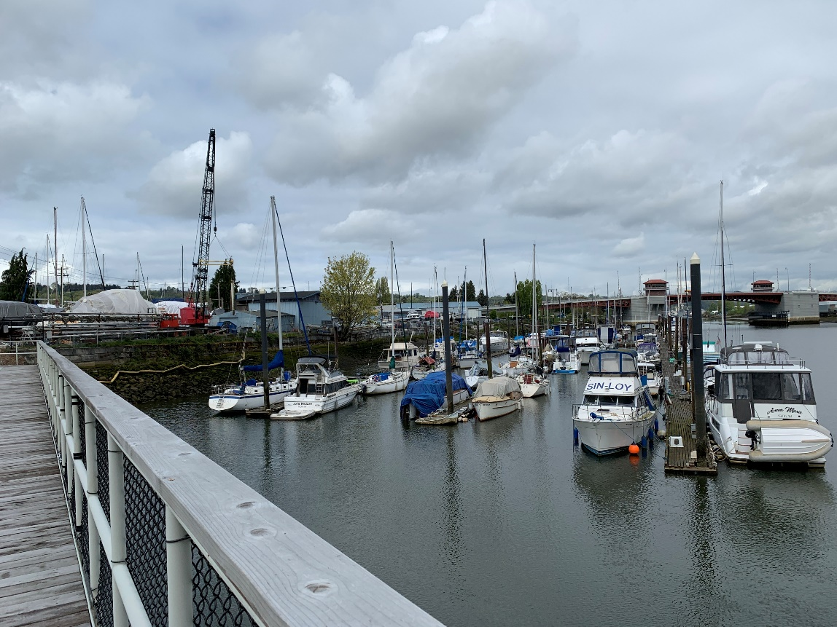
What's next at South Park Marina?
Feasibility study
  Evaluate which cleanup technologies could work at this site
  Compare "alternatives," combinations of technologies to complete the cleanup
Cleanup action plan
  Ecology identifies our selected alternative

Slide 15
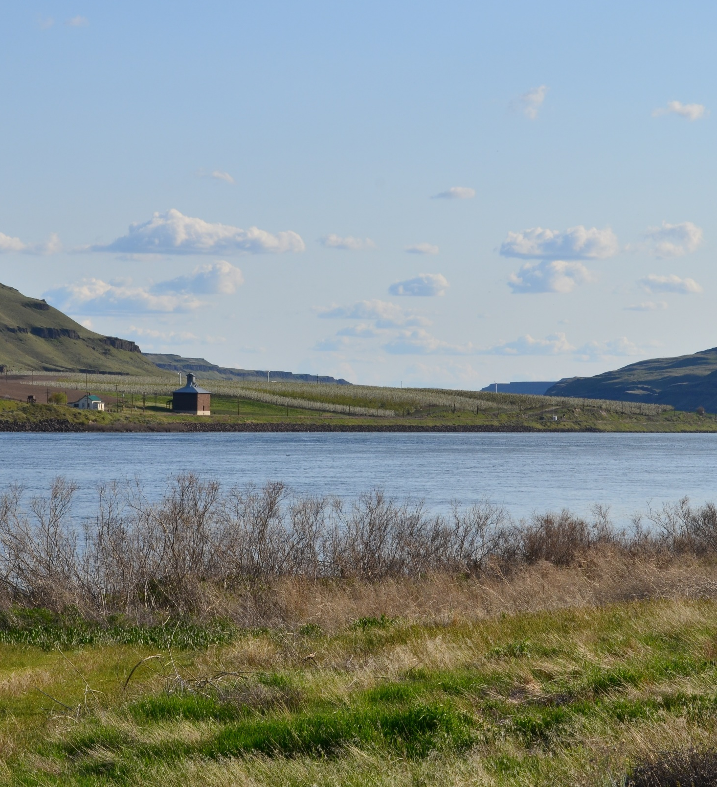



Thank you
South Park Marina Site
Priscilla Tomlinson
(425) 324-0732
priscilla.tomlinson@ecy.wa.gov
Jorgensen Forge Corps Site
Beau Johnson
(206) 638-0816
beau.johnson@ecy.wa.gov
Notes:
Meredith to review how to submit comments or get in touch with a site manager.
Feel free to call, email, or submit question using the comment portal. You do not need to be an expert to comment. We are happy to answer questions and talk about our cleanup sites.

