Slide 1
Tacoma Smelter Plume Yard Program Technical Workshop
April 11, 2013
Wilson High School

Slide 2
Yard Program Workshop Topics
Program overview
How we set the Service Area
How soil sampling works
Engineering soil cleanup
Tacoma Smelter Plume Project, Toxics Cleanup Program
2
Notes:
Purpose: To update you on the Tacoma Smelter Plume Residential Yard Sampling and Cleanup Program, also known as the Yard Program
We’ll cover the settlement and the money and work our way from your last update in 2011 through where we are today with the yard program.

Slide 3
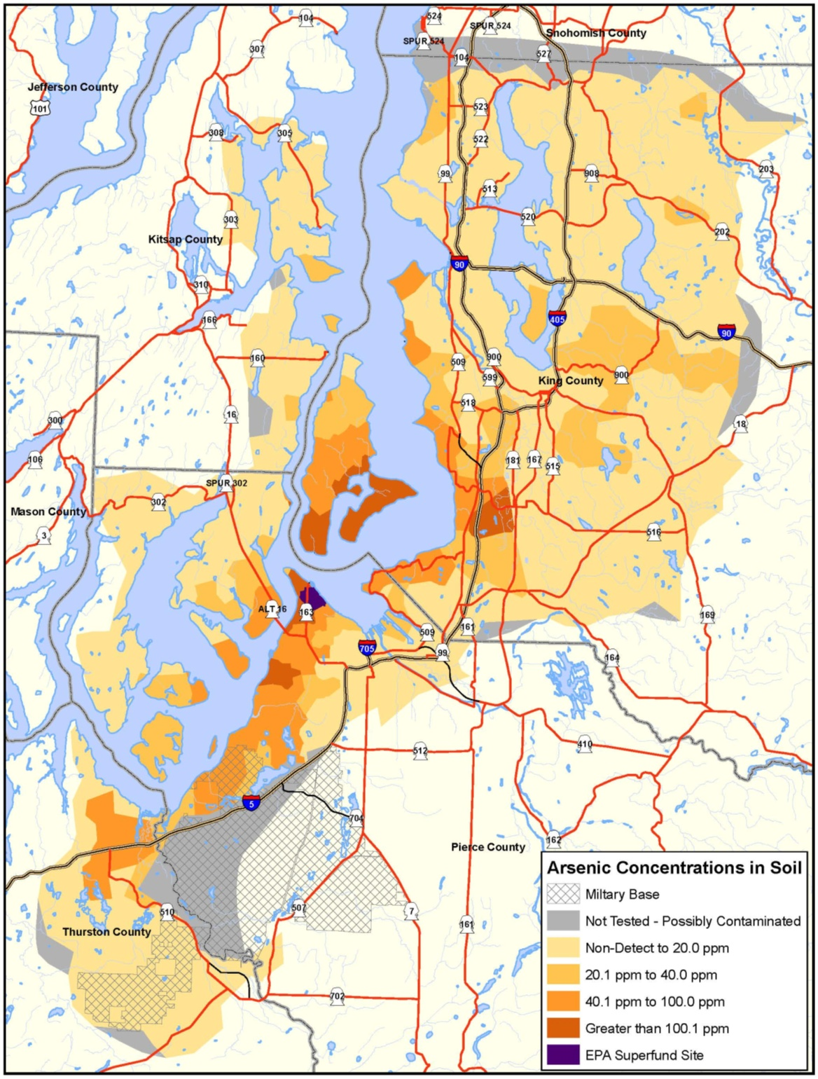
The Problem
Over 1,000 square miles impacted
Arsenic and lead stay in soils
Risk varies across the plume
Tacoma Smelter Plume Project, Toxics Cleanup Program
3
Notes:
Contamination tends to be higher closer in to the former smelter (purple zone in north Tacoma). It also tends to follow the predominant NNE and SSW wind directions.
However, levels vary greatly from one yard to the next, depending on when the home was built and how much the surface soils have been disturbed. This means we really have to sample soils to know the levels of contamination in a given yard.

Slide 4
Goals for the Yard Program
Address highest contamination first
Maximize Asarco settlement funds
Balance sampling and cleanup costs
Increase public awareness
Tacoma Smelter Plume Project, Toxics Cleanup Program
4
Notes:
We received $94.6 million from Asarco for the future costs of cleaning up the plume. About $62-64 million of that will go towards yard cleanups.

Slide 5
The Yard Program Overview
Access
Sampling
Results Above Thresholds
Cleanup
Restore
Tacoma Smelter Plume Project, Toxics Cleanup Program
5
Notes:
This is the general process that we went out with for the yard program – a settlement funded program that offers sampling and cleanup to residential properties within an area that is the worst affected by the TSP.

Slide 6
Action Levels
Arsenic | 100 ppm
Lead | 500 ppm
Threshold Levels
Arsenic | 90 ppm
Lead | 500 ppm
Tacoma Smelter Plume Project, Toxics Cleanup Program
6
Notes:
When Asarco went to bankruptcy court, we asked for funding to address residential properties with arsenic over 100 parts per million (ppm).
To get the arsenic threshold of 90 ppm, we considered:
-Sampling strategies
-Error rates – how confident are we that 99 ppm is not 100 ppm
-Advice from EPA on earlier cleanup work in Ruston/North Tacoma
Statistical “power curves”
We decided that at 90 ppm we had a much better chance of not missing properties where arsenic is 100 ppm.

Slide 7
Variability in Soil Sampling
Average arsenic = 110 ppm
Average arsenic = 95 ppm
Average arsenic = 85 ppm
Average arsenic = 105 ppm
ACTUAL average arsenic = 100 ppm
Tacoma Smelter Plume Project, Toxics Cleanup Program
7
Notes:
Soil sampling is not a perfect measure of actual levels of arsenic and lead. That’s what sampling means—taking a sampling of the many different levels throughout a yard.
Say we somehow know the actual average arsenic in a yard…if we took four different samples…[view the slideshow to see four possible sets of sampling results]
If the threshold is 100 ppm, we end up not cleaning up the yard 50% of the time because the sampling shows something lower than the actual level of 100 ppm.
If the threshold is 90 ppm, 75% of the time, we will clean up a yard that is actually at 100 ppm.
We can’t drop the threshold too low because we will end up cleaning up a lot of yards under 100 ppm, using up funds before we reach all the neighborhoods that may need cleanup.

Slide 8
Yard Program Service Area Development

Slide 9
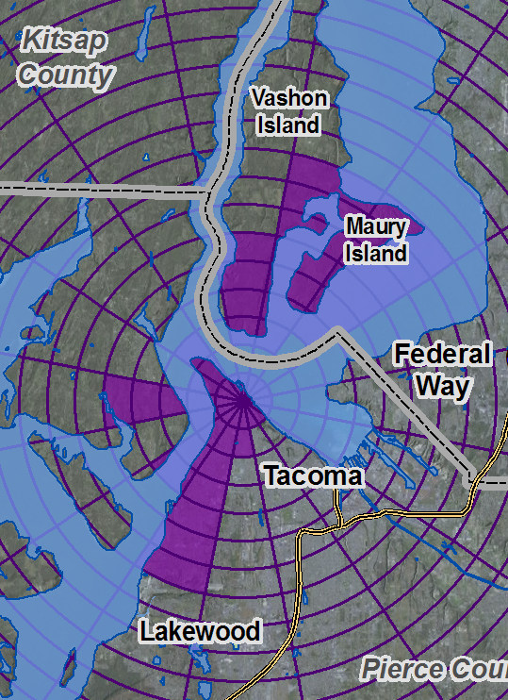
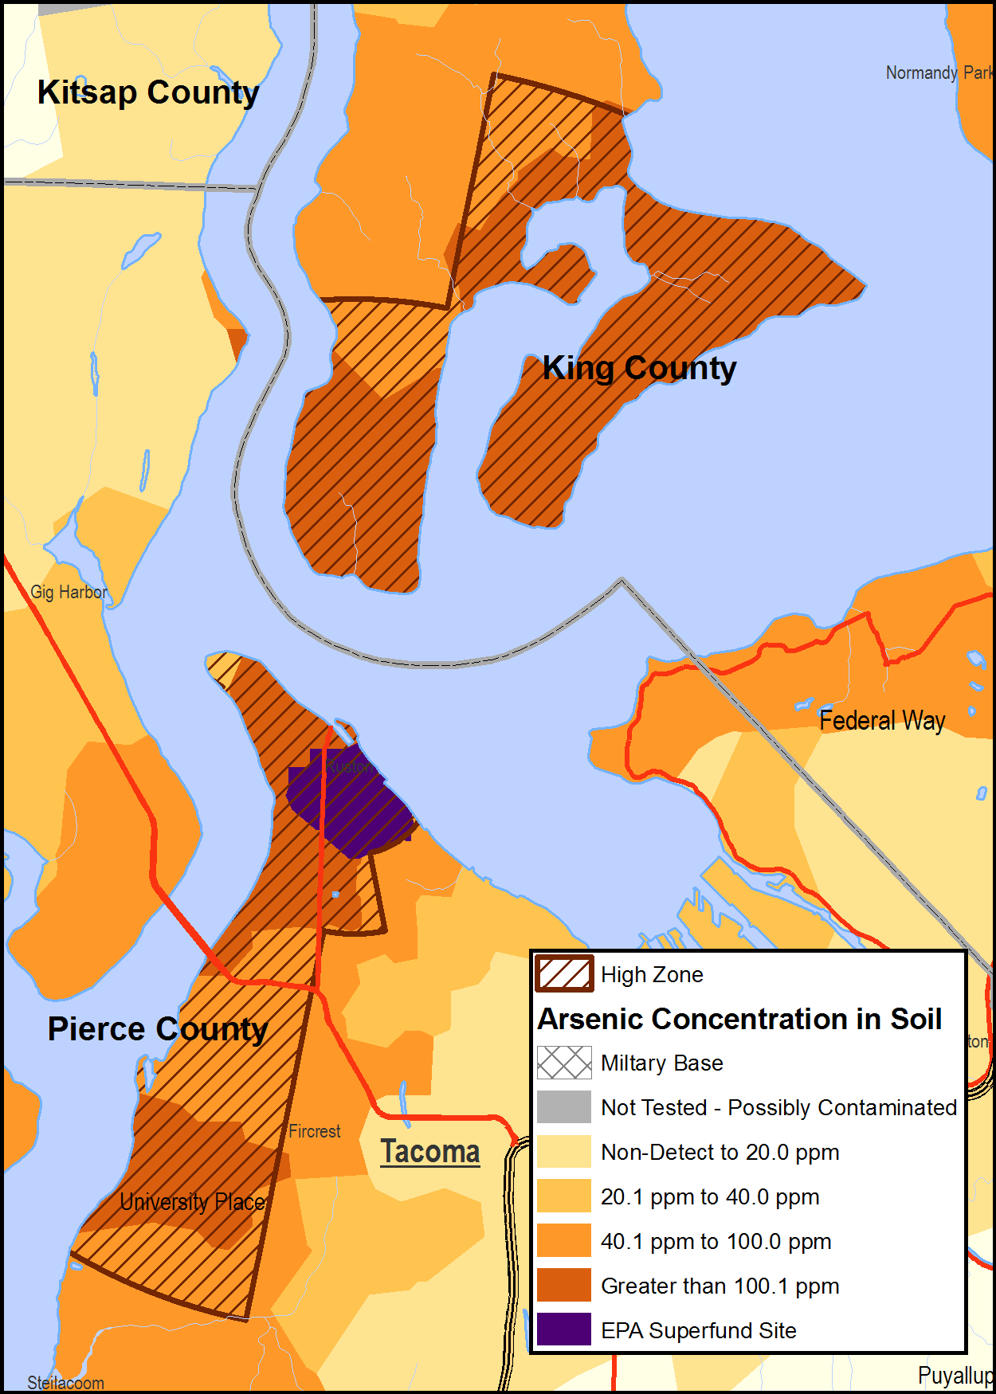
2011 Early Service Area Map
Tacoma Smelter Plume Project, Toxics Cleanup Program
9
Notes:
When we went out with the 2011 Interim Action Plan, we came out with this draft service area for the yard program.
This map was created using existing data sets grouped into bins and the bins in the bins we found those that had samples over 100 ppm. Areas included:
5% developed properties > 100 ppm
30% forested > 100 ppm

Slide 10
Modeling Estimated Arsenic Levels
1.Prepare existing data
2. Collect more data
3. Build a basic model
4. Refine the model
5. Map the outputs
6. Make decisions
Tacoma Smelter Plume Project, Toxics Cleanup Program
10
Notes:
This was the process for creating a new map to help set a service area boundary.

Slide 11
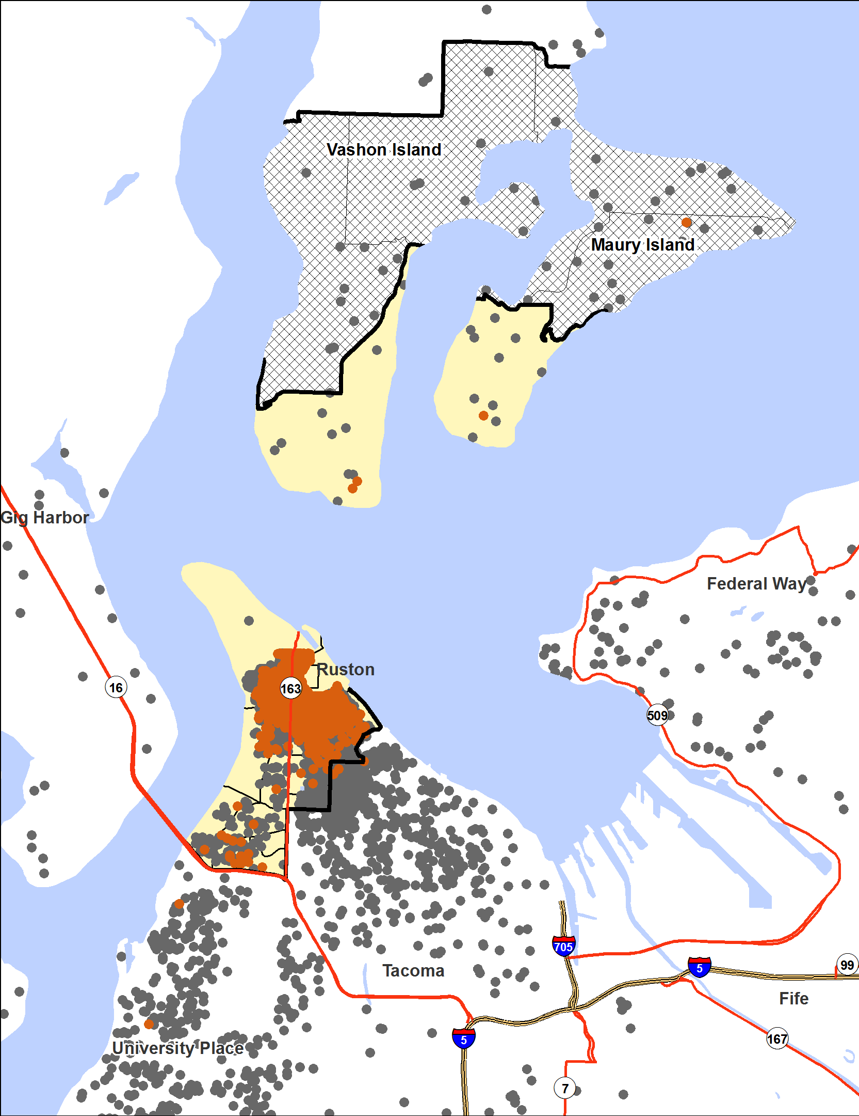
1. Prepare existing data
>100 ppm
Tacoma Smelter Plume Project, Toxics Cleanup Program
11
Notes:
This map shows the dataset of residential points that was provided to our mapping consultants. Ecology compiled a very large dataset of all our arsenic samples that met the criteria from our past studies on both disturbed and undisturbed parcels, averages were calculated, and this information was then provided to the consultant.
The consultant then created a model using: elevation, slope, direction and distance. He then compared his models outputs to our datasets and made some adjustments. The model we got from him allows us to look at three different variables in two scenarios:
We can hold the concentration and probability constant and determine the percent exceedance; or
We can hold the percent exceedance and the concentration constant and look at the probability.
We have reviewed a number of maps to determine the service area.

Slide 12
2. Collect more data
2012 Vashon-Maury Island study
40 ppm arsenic
20 ppm arsenic
Tacoma Smelter Plume Project, Toxics Cleanup Program
12
Notes:
In the fall of 2012, we sampled 63 properties on southern Vashon and Maury Island to try to fill some of the data gaps in the map shown here. The graph shows the results. We then added the data to our model.

Slide 13

3. Build a basic model
Elevation
Distance from the smelter
Slope
Direction from the smelter
Tacoma Smelter Plume Project, Toxics Cleanup Program
13
Notes:
The four variables that best predict soil arsenic levels are:
Distance from the smelter
Direction from the smelter (along major wind directions)
Slope (facing toward or away from the smelter)
Elevation

Slide 14
Individual Property History Impacts Arsenic and Lead Levels
1900 Land logged
1920 Home built
1950 Lawn put in
1970 Major landscaping
1990 Deck built
Tacoma Smelter Plume Project, Toxics Cleanup Program
14
Notes:
However, levels can vary greatly depending on how much soils have been disturbed through activities like these. We could not account for individual property history in the model, so the model is not a perfect predictor of levels.

Slide 15
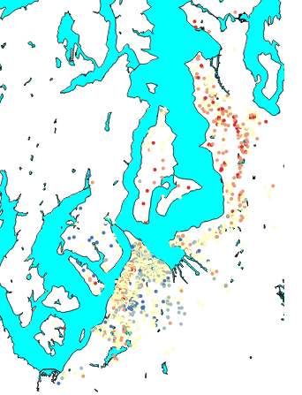
4. Refine the model
Where model under-estimated arsenic levels
Over-estimated
Varies by place!
Tacoma Smelter Plume Project, Toxics Cleanup Program
15
Notes:
We took every location we had sampling data for and put its distance, direction, slope, and elevation into the model to get a predicted arsenic level.
We then looked at whether the predicted level was the same as (or higher or lower) than the actual sampling data showed.
This map shows where the model under-estimated or over-estimated arsenic values. It shows us that, depending on what area of the plume you are in, the model systematically over- or under-predicts levels. What does this mean?
On a very basic level, it means that there’s something different going on in mainland King County, vs. Vashon Island, vs. Pierce County. Something that our model is not accounting for.
One of the things we did next was to run three separate models, one for each of those geographic areas. In the end, we got better predictions.

Slide 16
Model Outputs
Geography
Census block group
(hundreds of parcels)
Parcel
Probability >X ppm arsenic
% parcels >X ppm arsenic
Variables
Arsenic (ppm)
% parcels
Probability
Tacoma Smelter Plume Project, Toxics Cleanup Program
16
Notes:
At the most basic level of the model, we have a probability that a single parcel will be over a certain arsenic level, like 90 ppm.
However, for our program, we’re interested in what’s going on at the neighborhood level. We use census block groups, which contain hundreds of parcels, with around 300 – 800 households. Within the block groups, we can get the percent of parcels over 90 ppm or any other threshold, at a certain probability.

Slide 17
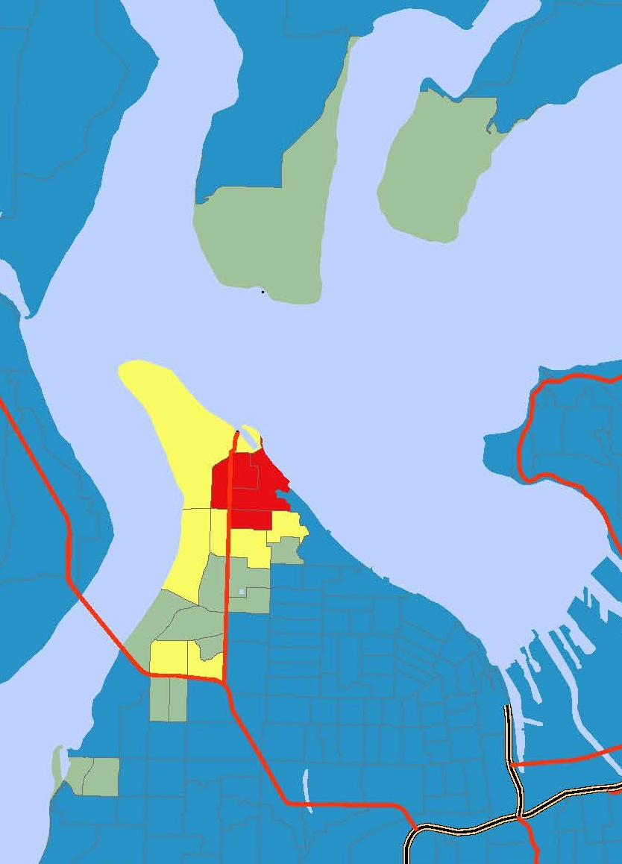

5. Map the outputs
% parcels over 90 ppm
20% probability map
Tacoma Smelter Plume Project, Toxics Cleanup Program
17
Notes:
Next, we mapped the model outputs. We had three variables:
Threshold, in ppm arsenic
Percent of parcels in a block group over that threshold
Probability
In this map, we set the threshold at 90 ppm because we are planning to clean up yards over 90 ppm. We set the probability at 20% and watched how the % parcels over 90 ppm varied across space.
You can see a pattern showing that a higher % of parcels is likely to be over 90 ppm, the closer you get to the smelter.

Slide 18
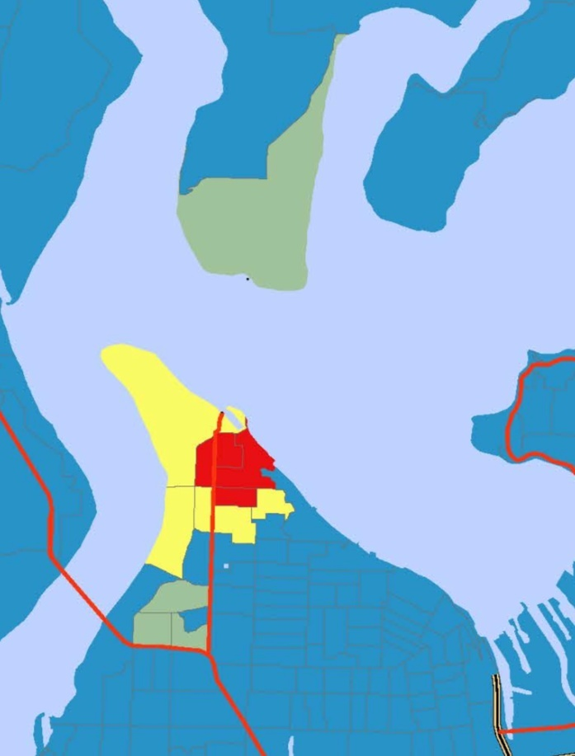
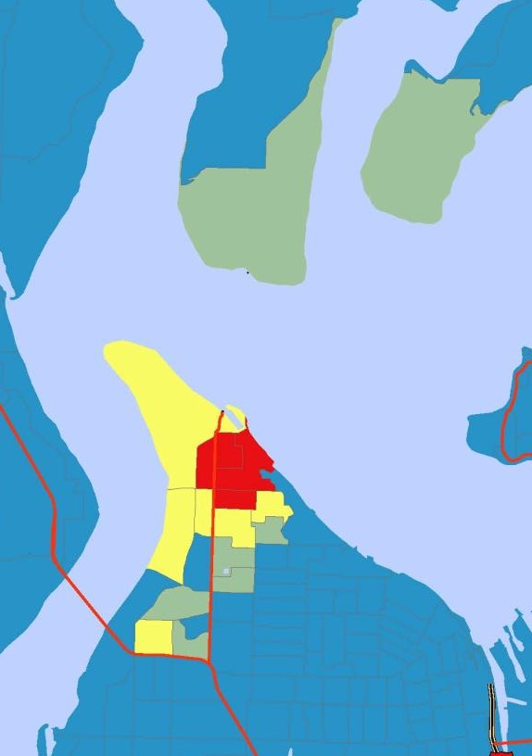

6. Make decisions
% parcels over 90 ppm
80% probability
50% probability
20% probability
Tacoma Smelter Plume Project, Toxics Cleanup Program
18
Notes:
To decide on a service area, we looked at three different probabilities. The 20% probability maps gives us a larger area where some yards might be over 90 ppm.

Slide 19
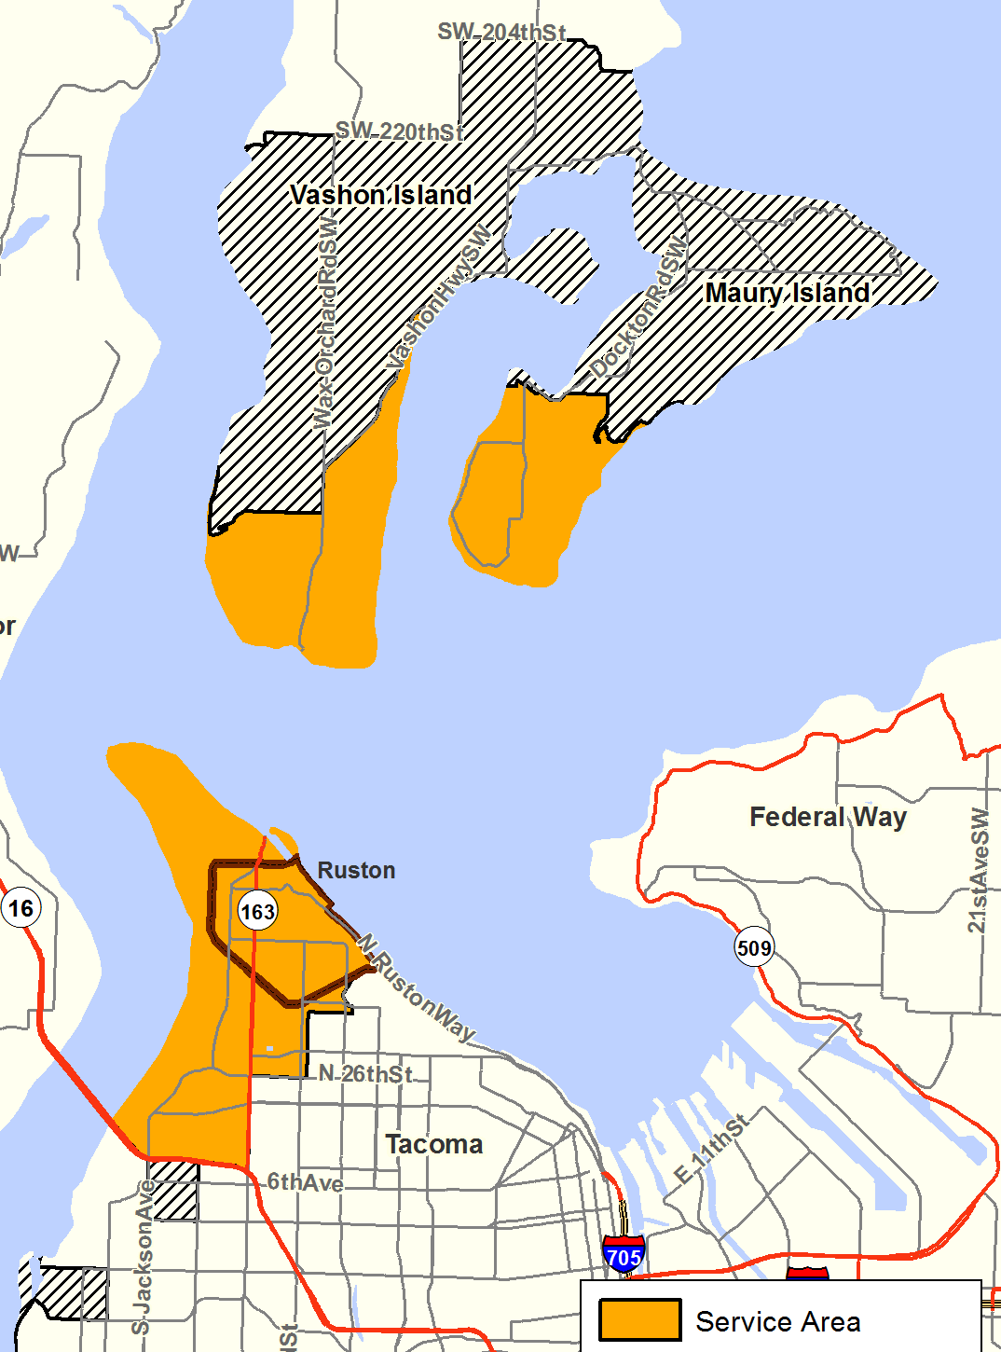
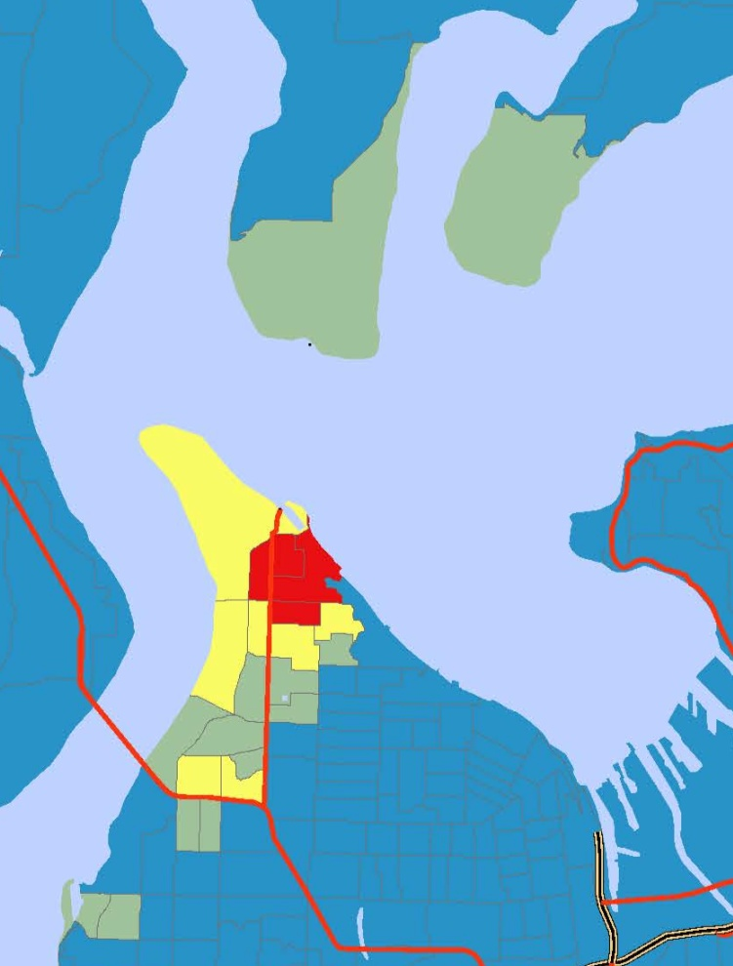
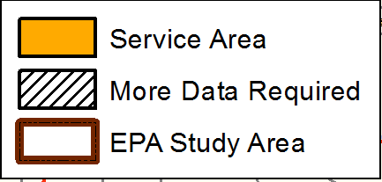
2013 Service Area
Tacoma Smelter Plume Project, Toxics Cleanup Program 19
Notes:
We then drew a service area boundary around all the block groups with 10% or more parcels expected to be over 90 ppm. We marked the four southern-most block groups as needing more sampling data before including or excluding them.
This map shows in orange the service area for the yard program. The service area covers from South Vashon-Maury Island, across to Tacoma and to Highway 16. Included in the service area is the EPA Study Area. The EPA Study Area is the one mile area that surrounded the smelter stack and where the federal government operated its cleanup program.

Slide 20
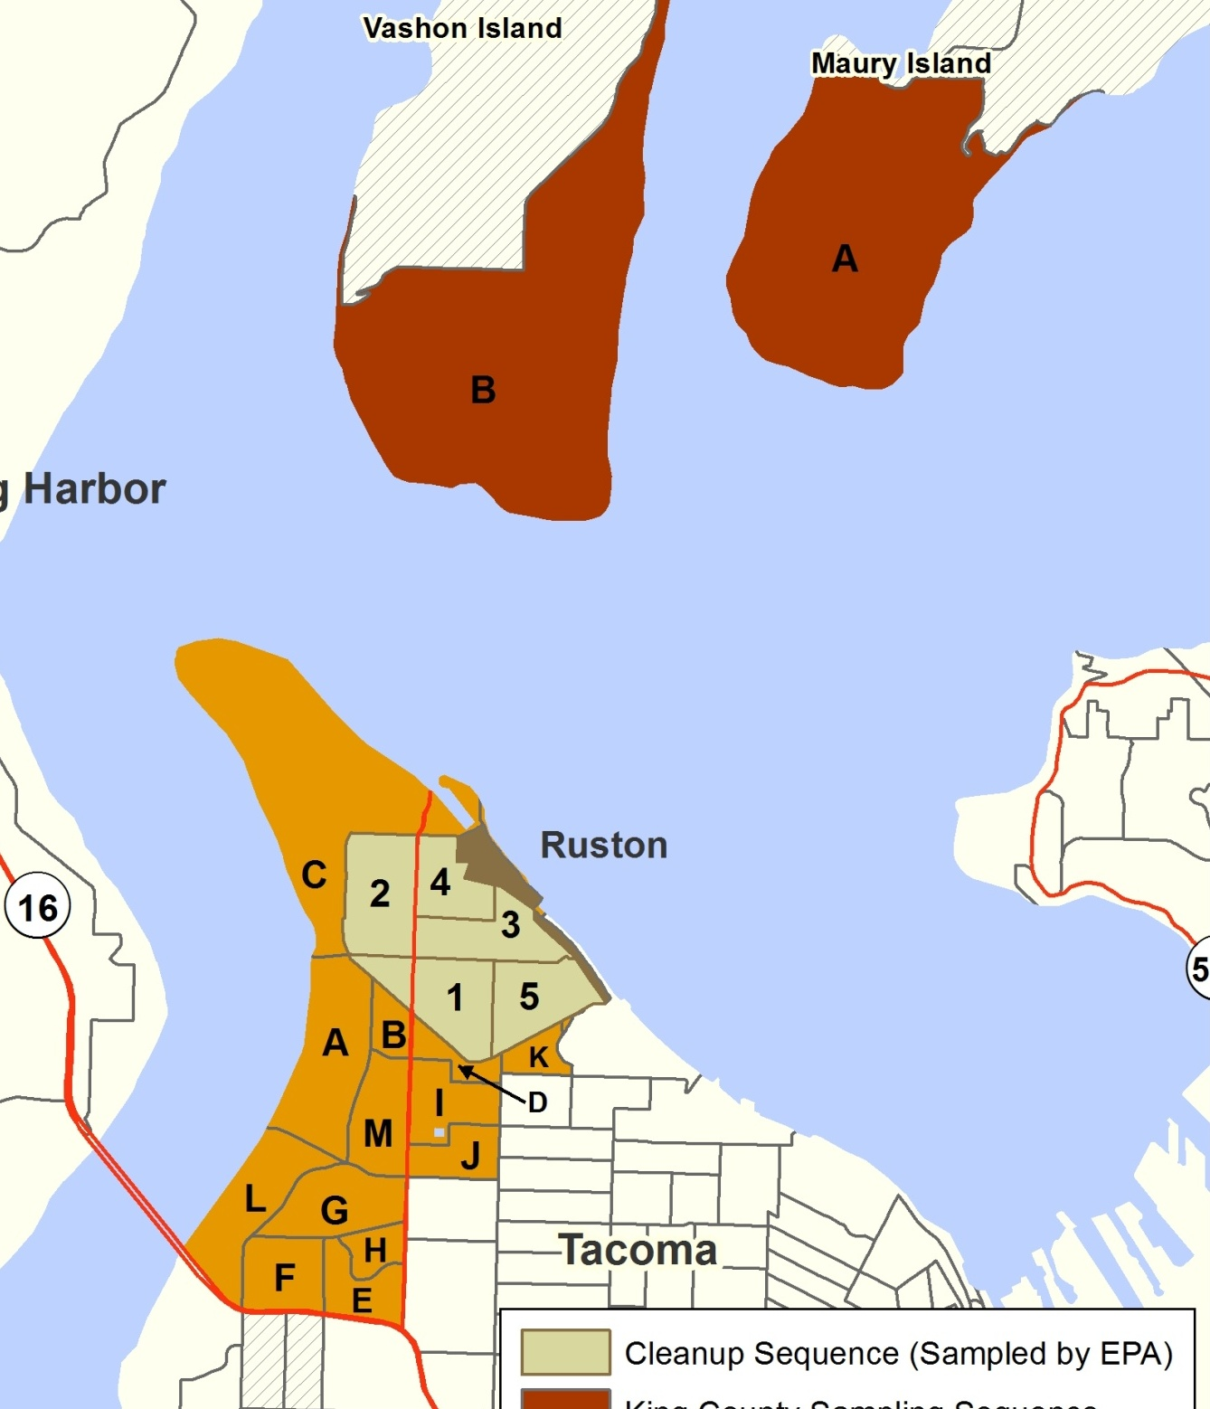
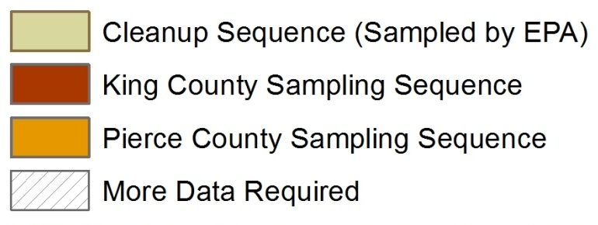
Program sequence
Tacoma Smelter Plume Project, Toxics Cleanup Program 20
Notes:
The model also informs the program sequence…
Ecology will start with Cleanup in the EPA study area. We are starting here because we already have sampling results and can hit the ground running with cleanup plans. You will notice that the Study area has numbers 1-5. We will start in the area marked one and proceed in numerical order. The numbers were assigned by evaluating the existing data and prioritizing properties where EPA has not done any work and properties where higher levels of contamination remain.
For sampling we have a different sequence. We have divided the area into King County and Pierce County, and then broken the area into letter groups. These groups were assigned during our mapping project which helped us define the service area of the program and the sequence. We will start with letter A and proceed in alphabetical order. Letter A has the highest probability of finding properties that will exceed the action level. Cleanup in the areas outside the study area will generally follow the same sequence as sampling.
Once the program is up and running, we will work concurrently in all three areas of the program.

Slide 21
How Soil Sampling Works

Slide 22
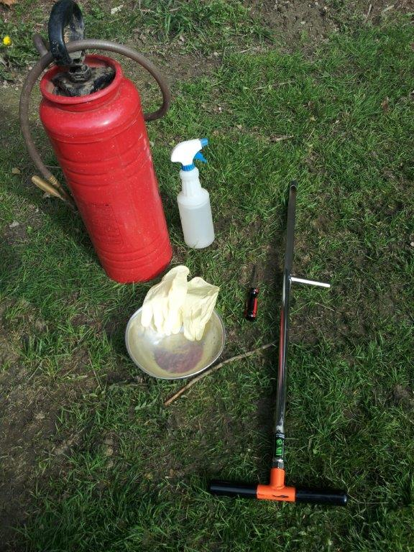
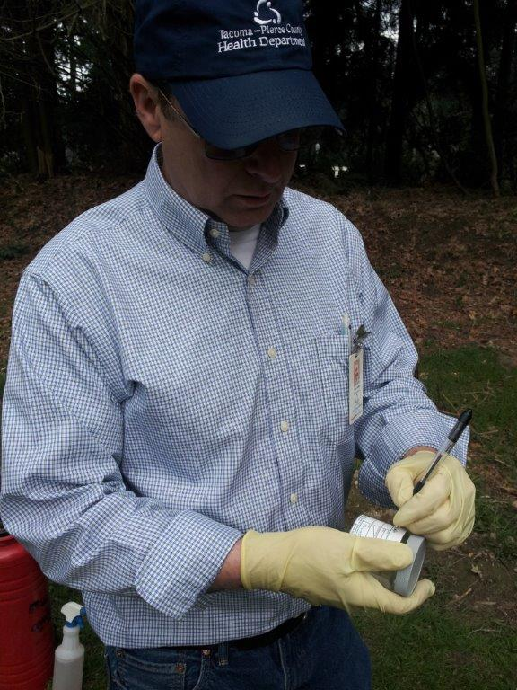
Tacoma Smelter Plume Project, Toxics Cleanup Program
22

Slide 23
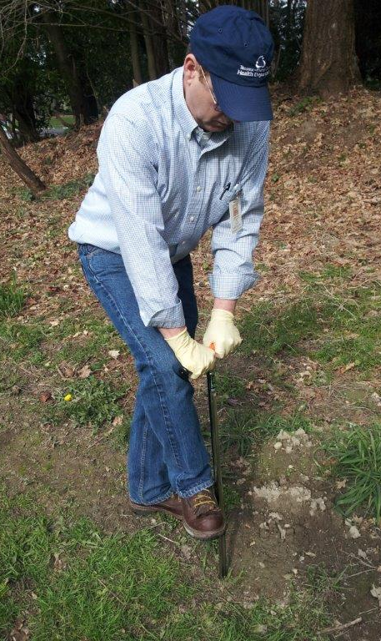
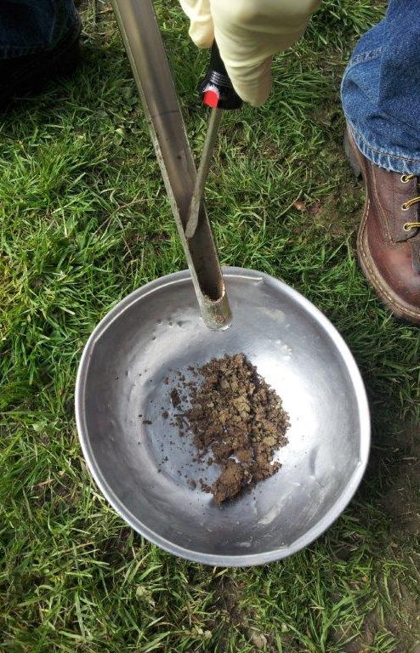
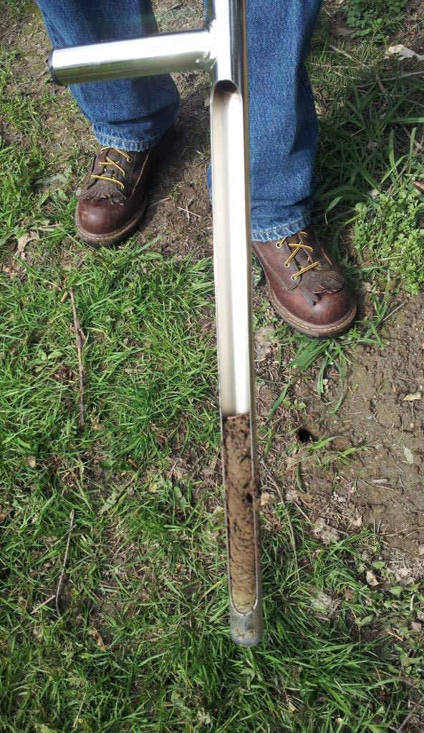
Tacoma Smelter Plume Project, Toxics Cleanup Program
23

Slide 24
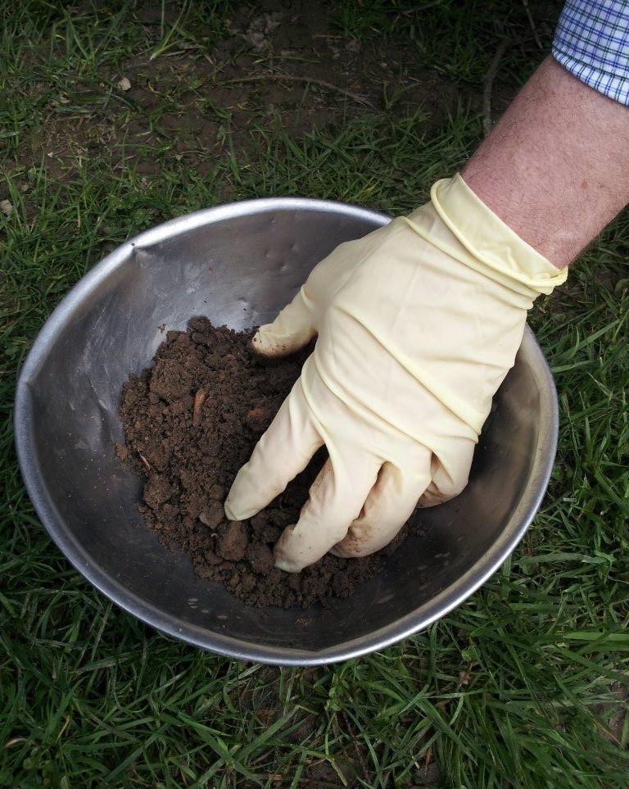
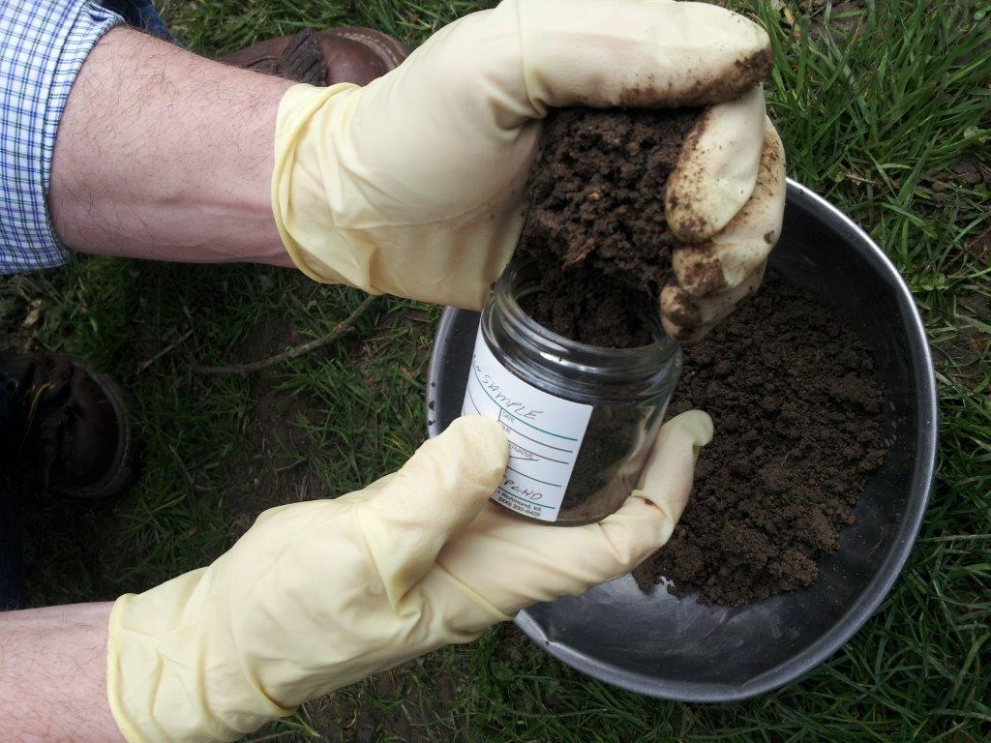
Tacoma Smelter Plume Project, Toxics Cleanup Program
24

Slide 25
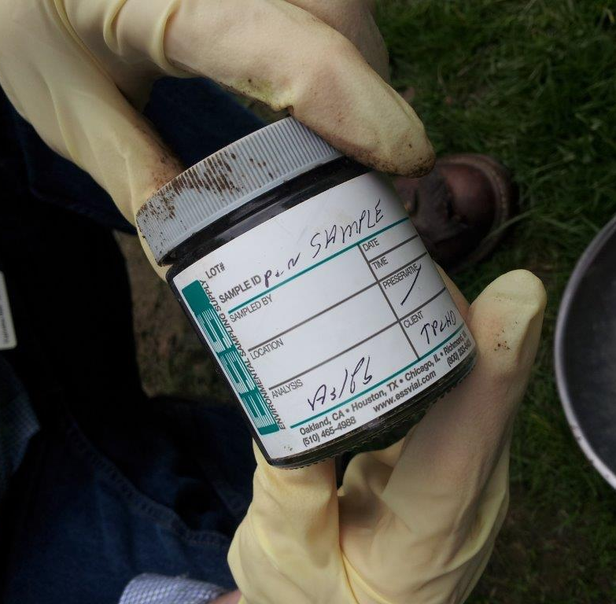
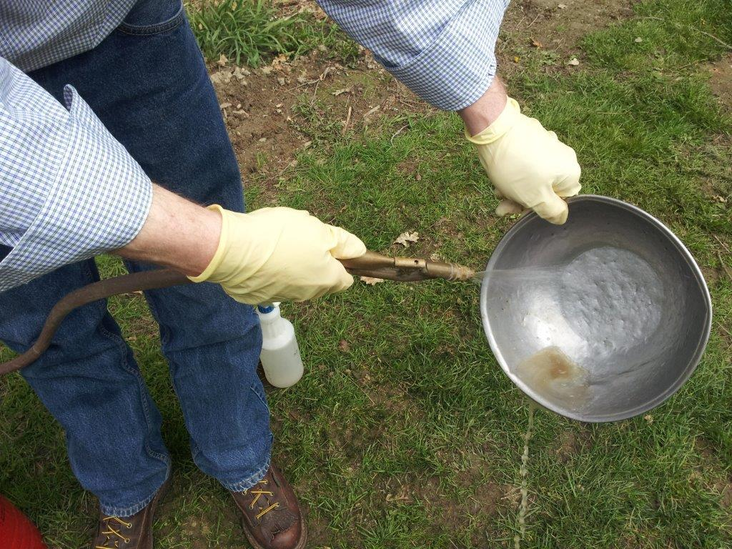
Tacoma Smelter Plume Project, Toxics Cleanup Program
25

Slide 26
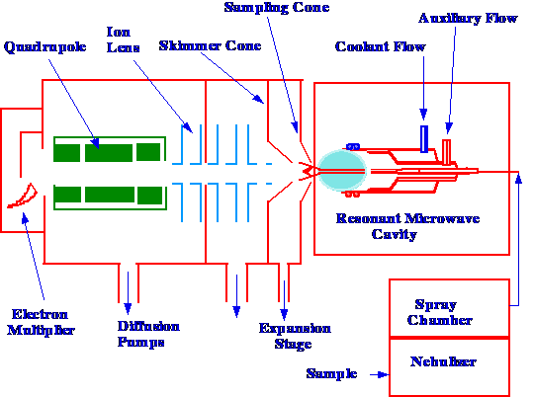
Inductively Coupled Plasma (ICP)
Tacoma Smelter Plume Project, Toxics Cleanup Program
26
Notes:
The typical way we have sampled analyzed in a lab.

Slide 27
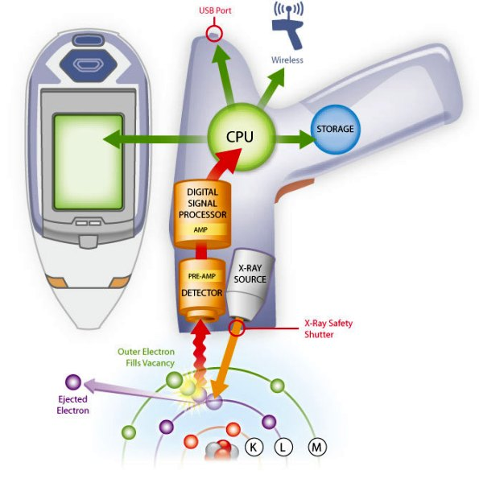
X-Ray Fluorescence Spectrometer (XRF)
http://www.nachi.org/images10-2/XRF-Gun-Diagram.jpg
Tacoma Smelter Plume Project, Toxics Cleanup Program
27
Notes:
A portable tool we might use for certain types of soil samples.

Slide 28
Soil Cleanup Engineering

Slide 29
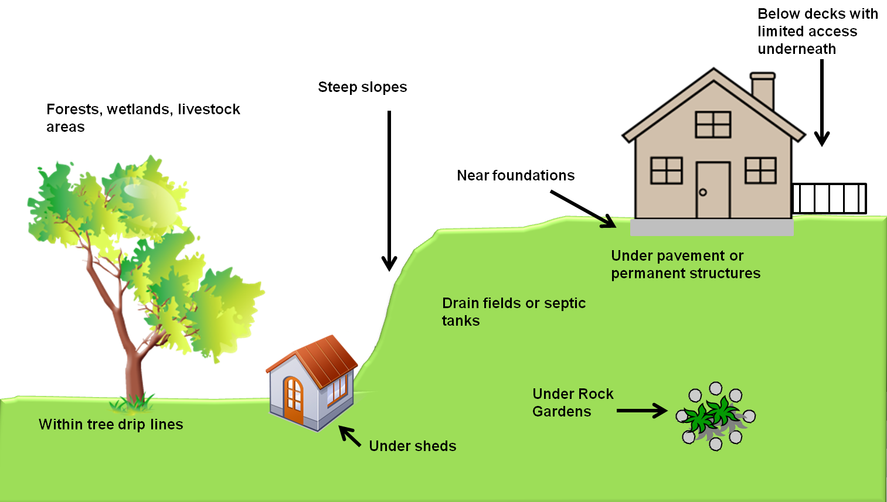
Areas Excluded from Sampling and Cleanup
Tacoma Smelter Plume Project, Toxics Cleanup Program 29
Notes:
One of the first decisions we had to make was if we would do full property cleanups or partial. We really wanted to do full cleanups but found in looking at the size of the area, the number of parcels left with contamination, reviewing what other large residential cleanup programs like EPA Study Area and the Omaha Lead Site that partial cleanups allowed us to address more properties and manage risk.
We came up with the concept on for large properties > .25 acres that we would focus on:
High Use Areas – places where residents are most likely to come in contact with contaminated soils

Slide 30
Working Near
Foundations
Original ground surface
Foundation
1 foot
Bottom of excavation
1 foot
Tacoma Smelter Plume Project, Toxics Cleanup Program
30

Slide 31
Avoiding Steep Slopes
Too close
Proper setback
Excavation
Digging too close to the base destabilizes the slope
Tacoma Smelter Plume Project, Toxics Cleanup Program
31

Slide 32
Protecting Trees
Small roots take up most of the tree’s nutrients
Drip line
Roots may grow wider
Tacoma Smelter Plume Project, Toxics Cleanup Program
32

Slide 33
Protecting Environmental &
Human Health
Keep soil moist to control dust
Prevent storm water runoff
Wash truck wheels
Protect workers
Tacoma Smelter Plume Project, Toxics Cleanup Program
33

Slide 34
Septic Systems
Shallowly-buried septic tanks can be easily damaged
Heavy equipment and vehicles can not be used over drainfields
Septic tank
Drainfield
Tacoma Smelter Plume Project, Toxics Cleanup Program
34

Slide 35
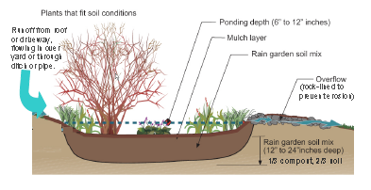
Rain Gardens
Plants that fit soil conditions
Ponding depth (6 – 12 inches)
Runoff from roof or driveway, flowing over yard or through ditch or pipe
Mulch layer
Rain garden soil mix
Overflow (rock-lined to prevent erosion)
Rain garden soil mix
(12 – 24 inches deep)
1/3 compost , 2/3 soil
Tacoma Smelter Plume Project, Toxics Cleanup Program
35
Notes:
We are going to run a pilot program to see if it’s feasible to offer rain gardens as a more environmentally-friendly replacement for lawn.

Slide 36
Additional Slides

Slide 37
Arsenic Risk Levels
State Cleanup Level
Yard Program Action Level
0.67
20
100
Parts per million arsenic
Long-term cancer risk from regular exposure
1 in 1 million
3 in 100,000
15 in 100,000

Slide 38
How Arsenic Contributes To Illness
Genes
Water
Health Status
Soil
Food
Arsenic
Diet
Air
Lifestyle
Chemicals

