Slide 1
Update Pasco Sanitary Landfill Site
Presentation to Pasco City Council
July 14, 2014
Favor de comunicarse con Gregory Bohn
para obtener información en español al
tel. 509/454-4174 o por email
gregory.bohn@ecy.wa.gov

Slide 2
Site Location
Dietrich Road by intersections of Kahlotus Road and U.S. Highway 12

Slide 3
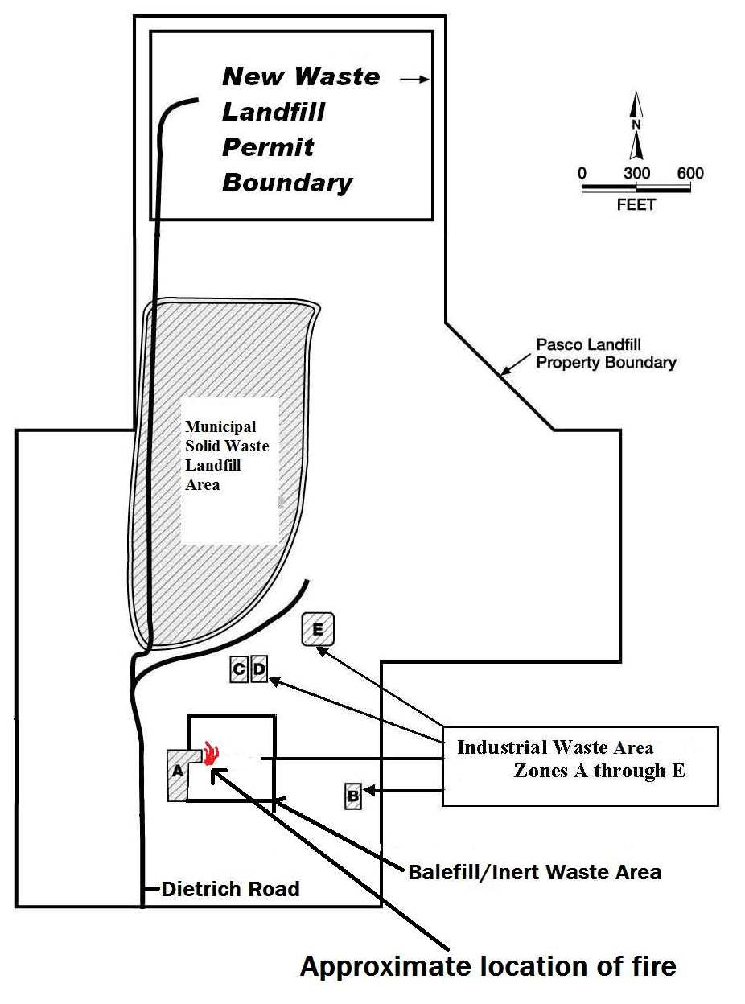
Geographic Overview

Slide 4
Update Topics
Balefill Area Underground Fire
Site-wide Cleanup Activities
(2011 – Present)
Final Cleanup Remedy Steps Ahead

Slide 5
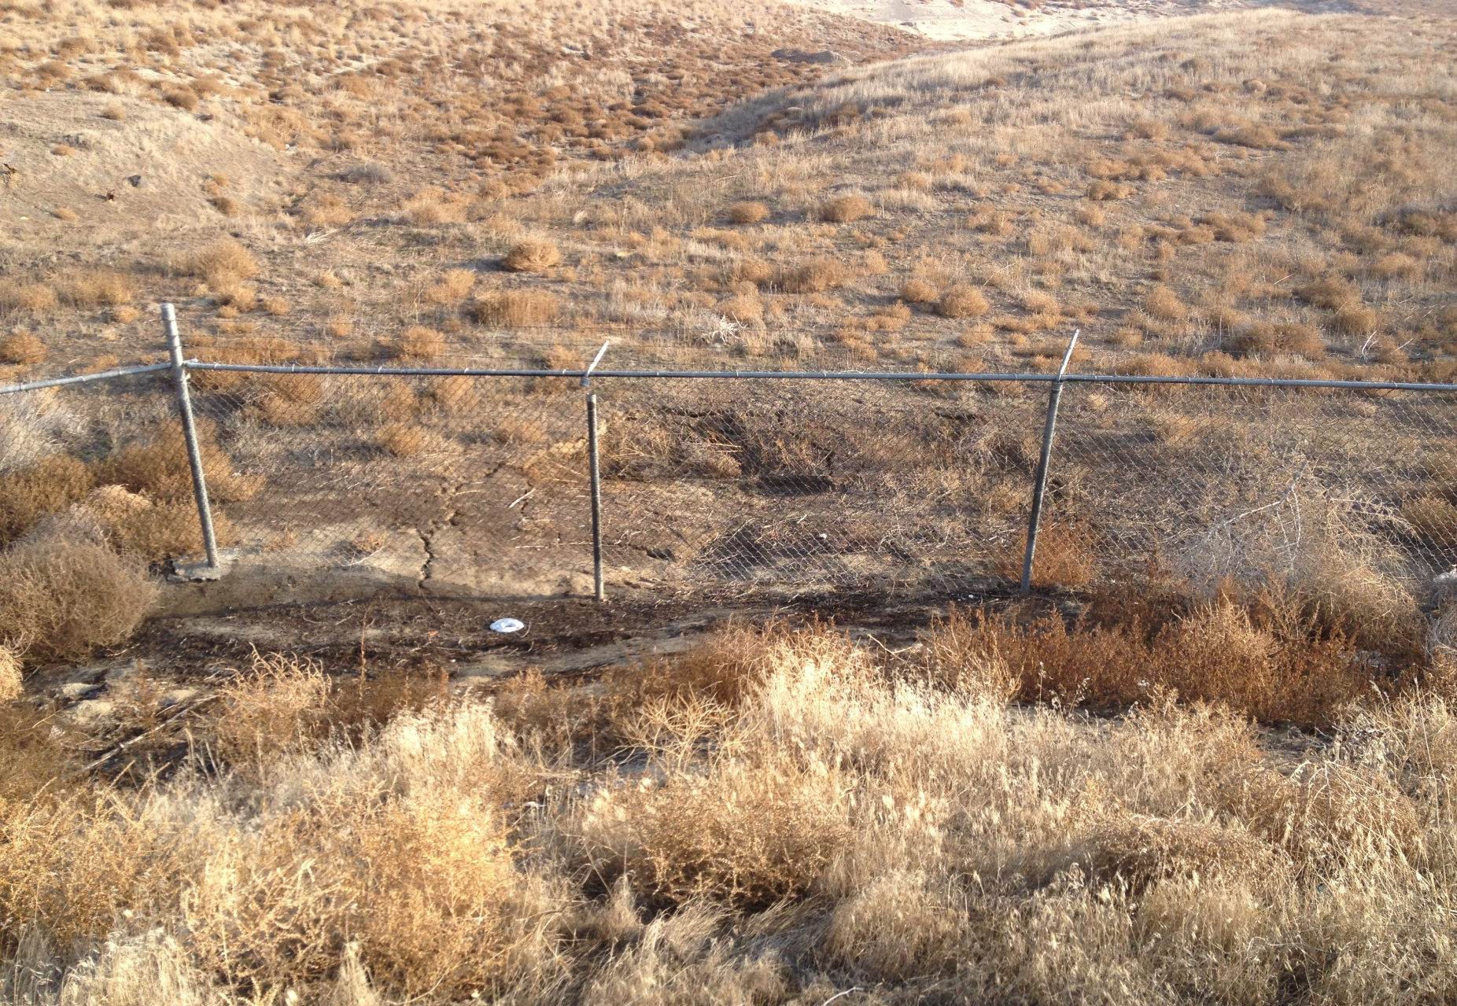
Balefill Area Underground Fire

Slide 6
Balefill Area Underground Fire
Identified Late November 2013
Immediate actions by Ecology, PLPs, and
local emergency management:
Assess conditions in fire area
Protect public from potential harm
Initiate fire suppression planning
Upgrade existing soil cover
Modify nearby remediation activities
Active community outreach: postcards,
press releases, meet with local residents

Slide 7
Balefill Area Underground Fire
What do We know?
How Large How Deep How Hot
Type of Waste Material Burning
Actions to Put Out the Fire

Slide 8
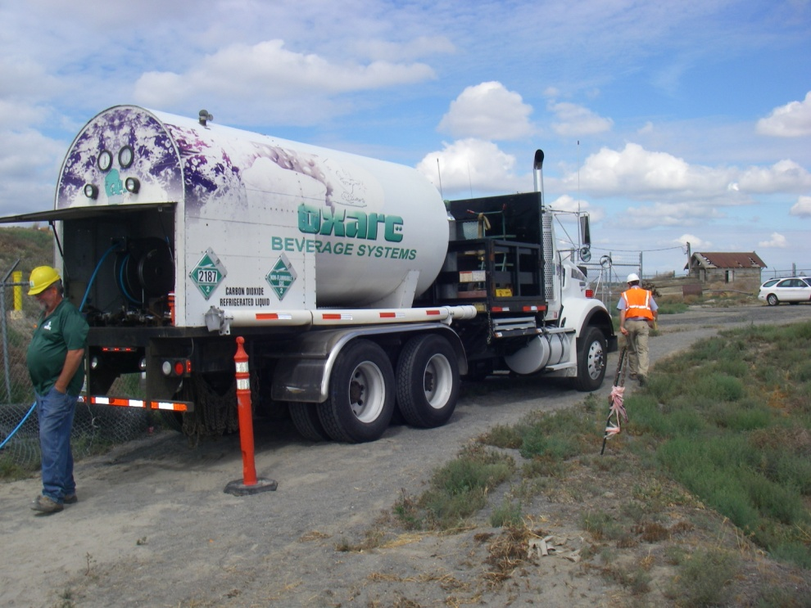
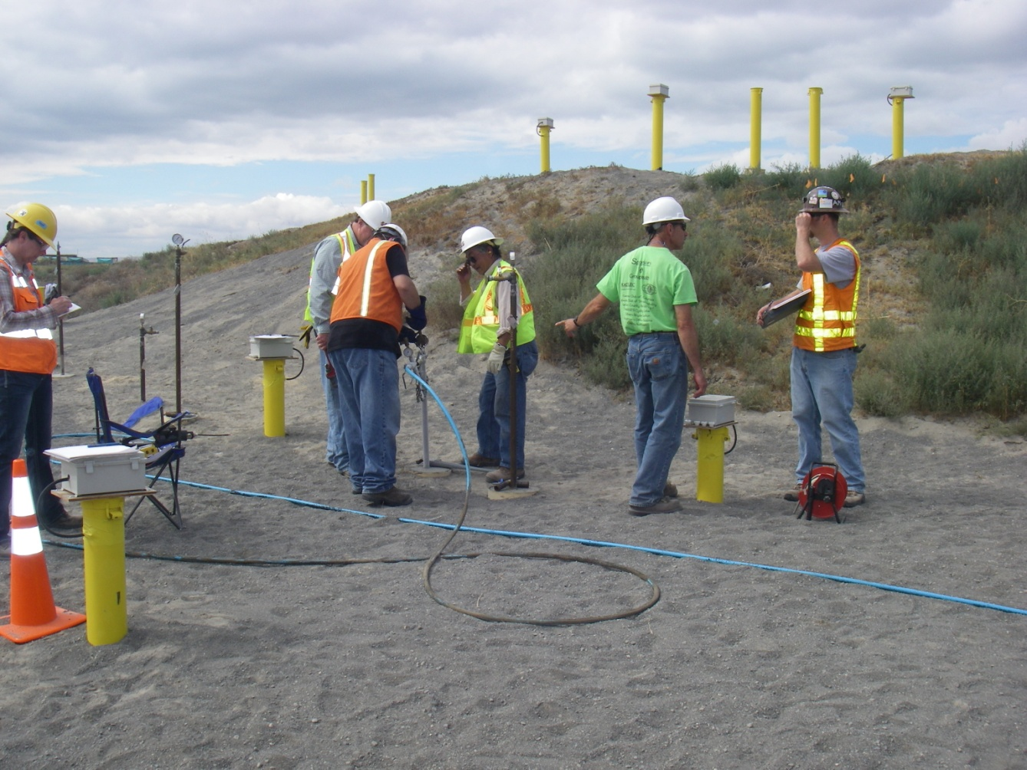

Liquid Carbon Dioxide Injection
June 26 & 27, 2014

Slide 9
Balefill Area Underground Fire
Next Steps
Additional CO₂ Injection Events
Monitor Underground Temperatures
Fully Extinguish the Fire [Options]
Preventing Future Fires

Slide 10
Site-wide Cleanup Actions
(2010 to present)
Zone A – Drum Repository
Improved Soil Vapor Extraction System
(SVE) Installed in 2010/2011
Enhanced Capture of Contaminants
Planning Underway for New Vapor
Treatment System

Slide 11
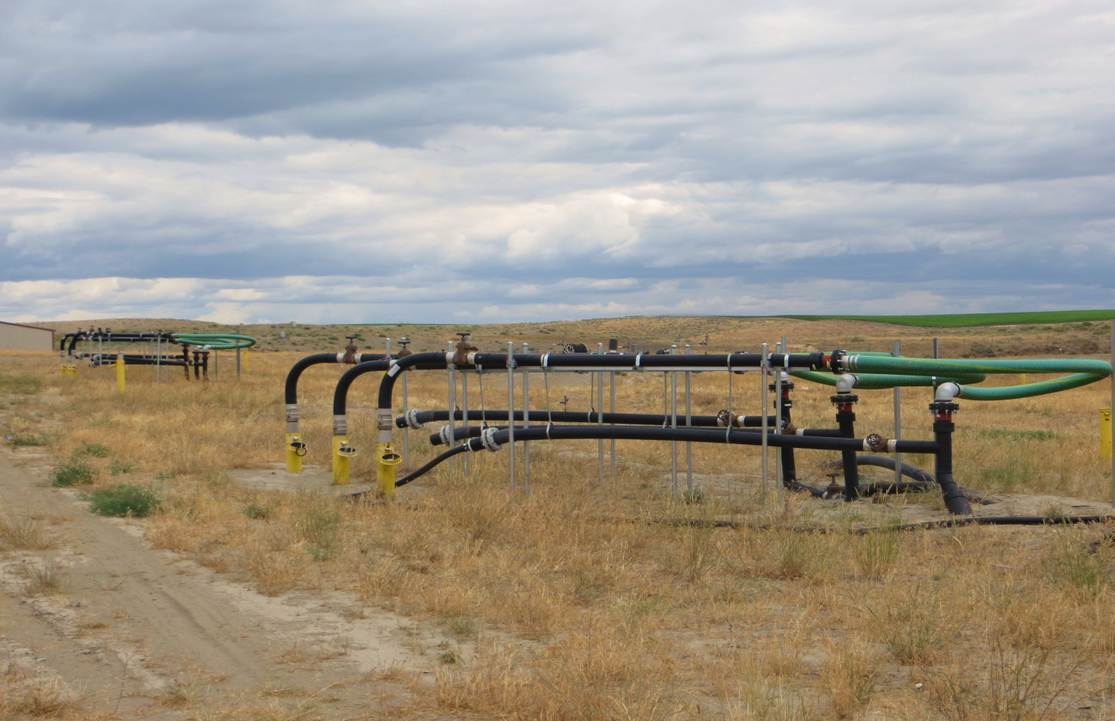
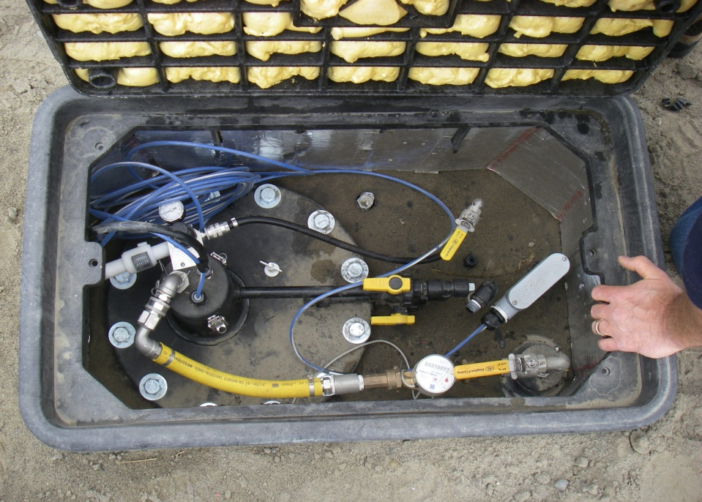
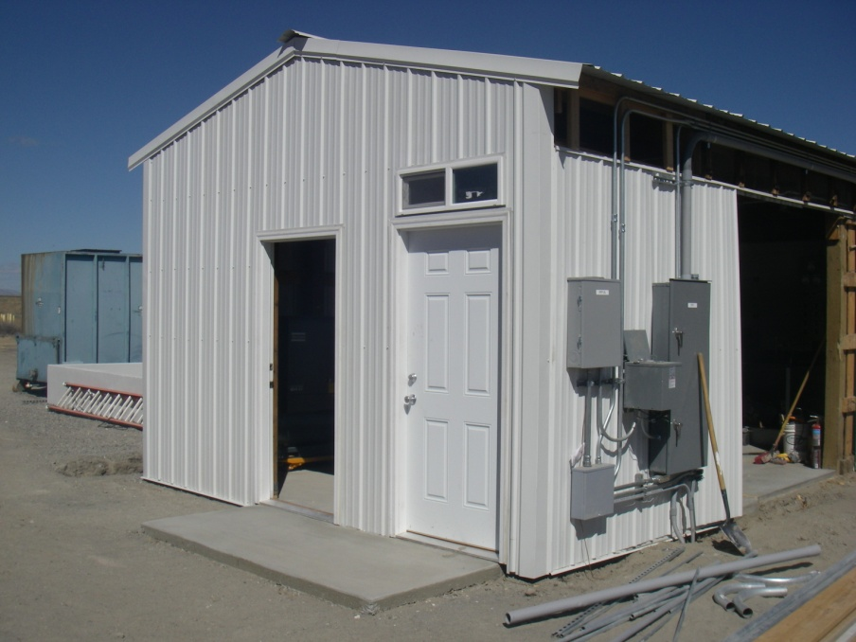
Zone A
SVE System Upgrades

Slide 12

SVE Upgrades

Slide 13
Zone B Herbicide Waste Repository Area
Drums disposed off-site in 2002
Excavated localized soil contamination
Constructed new multi-layer cover system
Modified property boundary

Slide 14
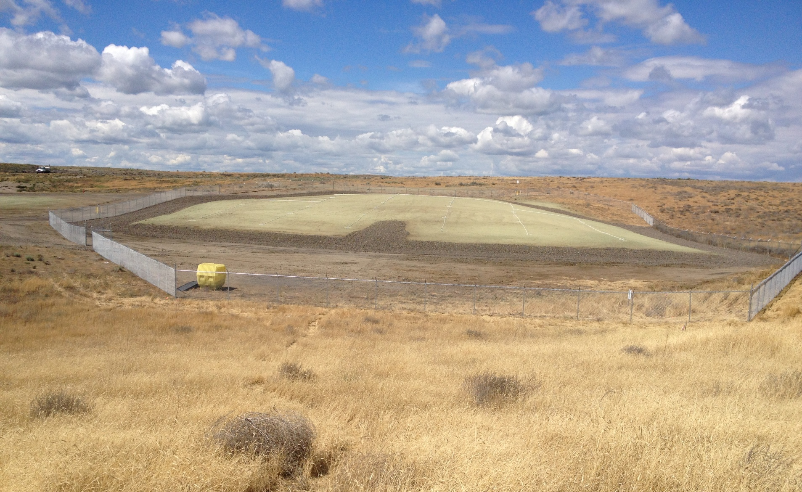
Zone B – RCRA C
Cover System (June 2013)
New Zone B Cover is about 1 acre in size

Slide 15
MSW Landfill & Flare Unit Cleanup Actions
Cover System, Gas Extraction Well Network and High Temperature Flare Unit
Ongoing Recovery of Landfill Gas
Flare Modifications to Enhance Performance
Flare Treats Landfill Gas and Zone A SVE
Vapors

Slide 16
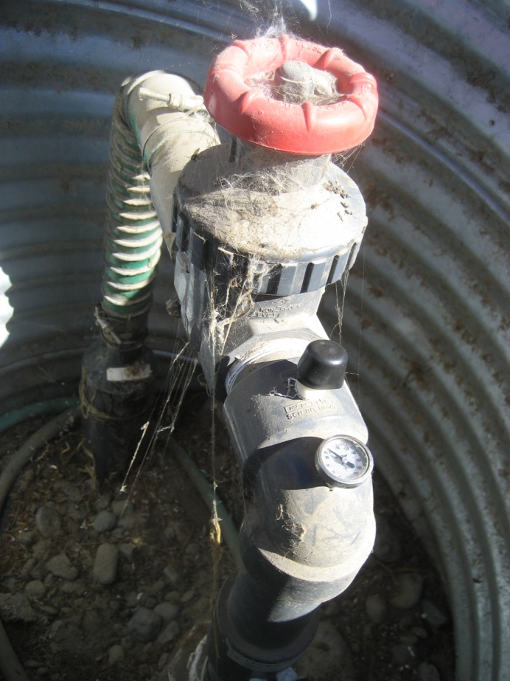
MSW Landfill Gas Control
System
Gas Extraction Well

Slide 17
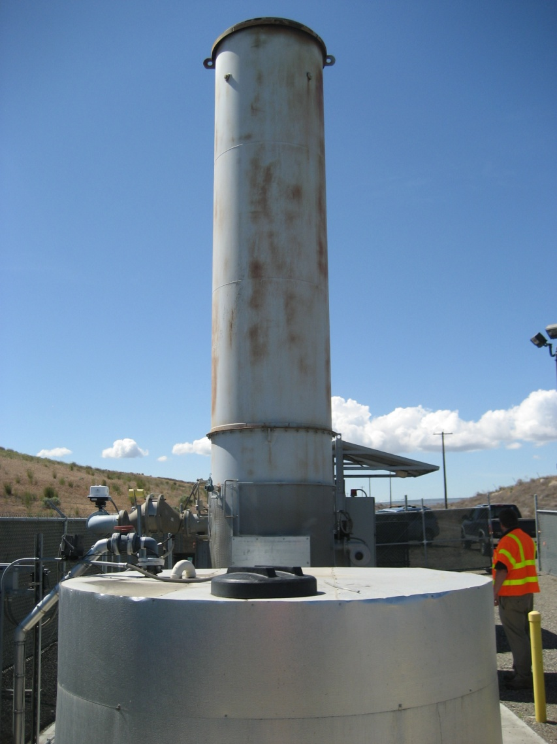
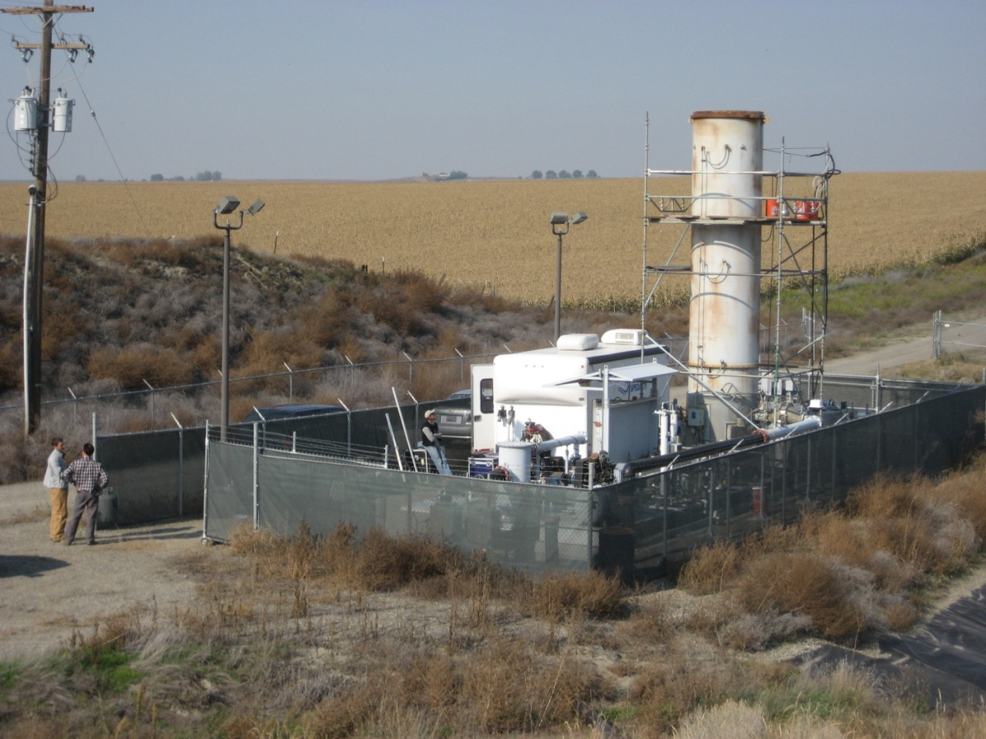
MSW Landfill and Flare Unit
Flare Unit Treats Landfill Gas and Vapors from Zone A SVE

Slide 18
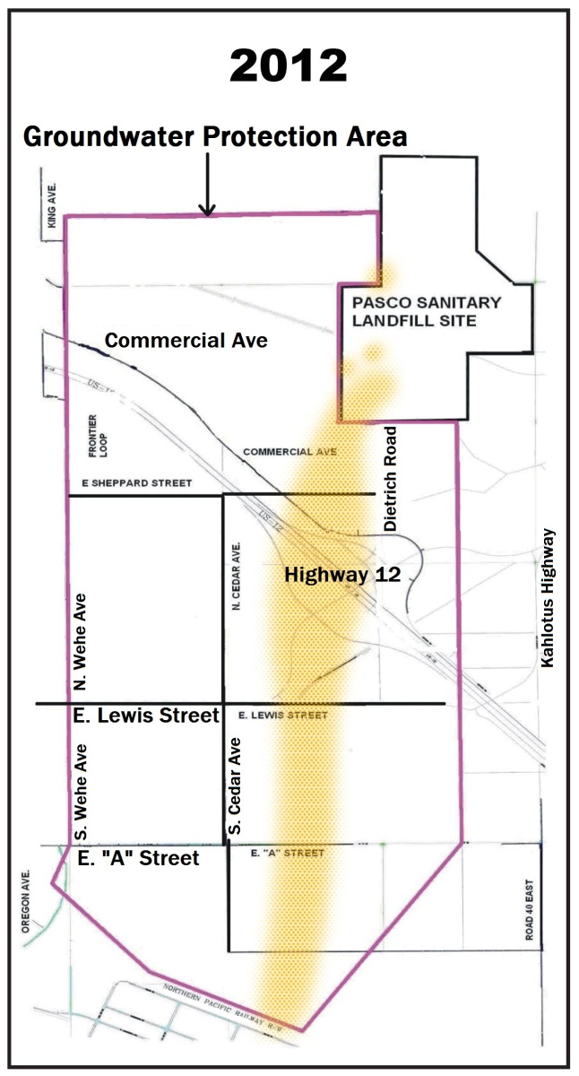
Improvements in
Groundwater Plume
2014
Groundwater quality is improving, and the plume is shrinking in response to cleanup actions.

Slide 19
Remaining Steps Towards Cleanup
Focused Feasibility Study (in progress)
Draft Cleanup Action Plan (dCAP)
Public Review & Involvement
Ecology Selects Preferred Cleanup Option
Negotiate New Orders with PLPs
Design and Implement Final Remedy

Slide 20
Project Contacts
WA Department of Ecology
Chuck Gruenenfelder, Cleanup Project Manager
4601 N. Monroe
Spokane, WA 99205-1295
509/329-3439
Charles.gruenenfelder@ecy.wa.gov

Slide 21
Project Contacts
Pasco Landfill PLPs
Barbara Smith Harris & Smith Public Affairs
P.O. Box 1478
Mercer Island, WA 98040
206/343-0250
barbara@harrisandsmith.com

Slide 22
Questions?
Thank You

Slide 23
