Slide 1
U.S. Navy Sand Point Cleanup
Public Meeting
October 21, 2014

Slide 2
U.S. Navy Sand Point Cleanup Public Meeting October, 2014
Open House 6 - 7 PM
Presentations 7 - 7:50 PM
Break 7:50 - 8 PM
Q & A 8 – 9 PM
Conclude 9 PM

Slide 3
What is purpose of this meeting?
Provide an update on cleanup actions
Explain the cleanup process
Identify who is responsible for the cleanup
Describe the next steps
Answer questions

Slide 4
Who is at the meeting?
Department of Ecology
Seattle Parks and Recreation
Department of Health
Heart of America
NE District Neighborhood Council
Roosevelt High School Students

Slide 5
Presentations
Introduction and Welcome –Thea Levkovitz, Ecology
Cleanup Overview - Ching-Pi Wang, Site Manager, Ecology
Health and Safety – Al Conklin, Washington State Dept. of Health
Rep. Gerry Pollett
History of Magnuson Park –Jodi Sinclair, Environmental Analyst, Seattle Parks and Recreation
Clean up Activities – Chris Generous, U.S. Navy, Project Manager

Slide 6
Questions and Answers
3 ways to ask a question
Comment card on your seat
Posters on the side of the room
Asking directly during the Q & A
Please keep you comments to a time that will allow for others to speak

Slide 7
Ecology Contacts
Ching-Pi Wang, Site Manager
(425) 649-7134
Cwan461@ecy.wa.gov
Thea Levkovitz, Outreach Specialist
(425) 649-7286
Thea.Levkovitz@ecy.wa.gov

Slide 8
Warren G. Magnuson Park Map

Slide 9
Areas of Investigation

Slide 10
What has been discovered?
The Navy used the rooms to repaint aircraft cockpit dials with glow-in-the-dark radium paint in the 1940s and 1950s.
Radiological contamination was found in parts of Buildings 2 and 27, both former aircraft hangars.

Slide 11
What’s been done so far?
Cleanup work under way since June 2013.
The Navy is responsible for cleanup of all contamination left from its operations.

Slide 12
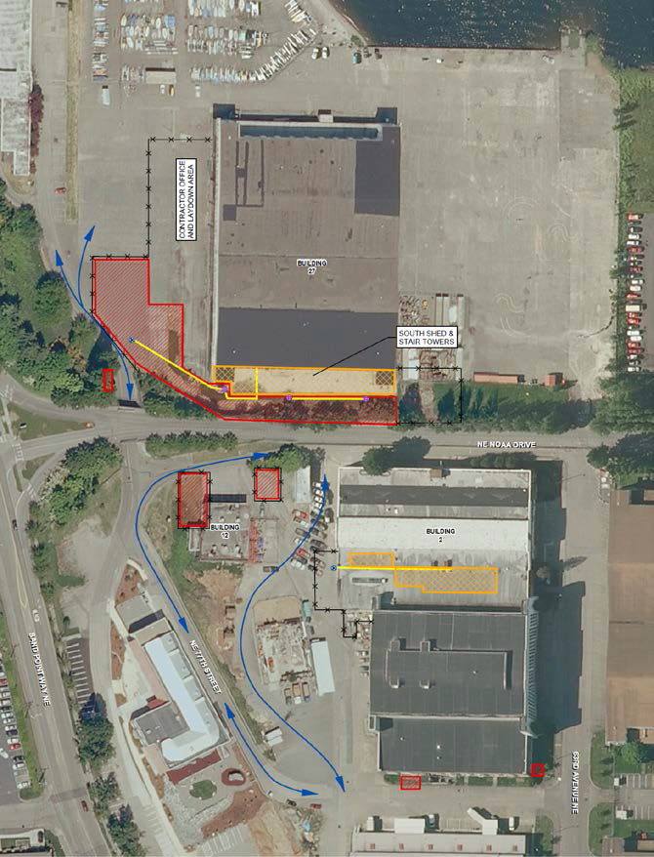
Magnuson Park Cleanup Areas

Slide 13
Building 27 Nearby Soil Hotspots

Slide 14
Cleanup Areas
Arena Sports, an indoor athletic facility, is located in Building 27. A former radium-painting room at Building 27 was in an annex, referred to as the South Shed
The annex and nearby contaminated grounds are fenced, locked, and closed to public access.
Building 2 is used for park equipment storage, and has a small area used as offices by the Seattle Conservation Corps.

Slide 15
Roles & Responsibilities
US Navy
Former owner
Responsible for cleanup
City of Seattle
Current owner
Dept. of Ecology
Technical review & public education
Dept. of Health
Radiation health and safety

Slide 16
Who is Responsible?
U.S. Department of Defense - Navy
The Navy is conducting its work under federal cleanup laws that apply to former and current military facilities.
State of Washington
Ecology provides technical advice for the Navy
Ecology provides public education.
Dept. of Health regulates radiation safety.

Slide 17
What does Ecology Do?
Technical reviews
Evaluates test data to find out if and where contamination is located in the buildings, soils, pipes, and elsewhere.
Ensure removal of contaminants are complete.
Monitors cleanup progress.

Slide 18
What does Ecology Do?
Public Education
Held public meeting July 2013; before work started.
Community Updates
Magnuson Park Advisory Committee
NE District Council Coordinators
The Waldorf School
Heart of America NW
City and state representatives
All data available on websites

Slide 19
Washington Dept. of Health
Ecology has relies on Dept. of Health, Office of Radiation Protection for radiological expertise
Health conduct test:
Radiological surveys
Air monitoring
Cleanup complete confirmation sampling

Slide 20
What cleanup has been done?
Building 27:
Radiological contaminated building materials, asbestos, lead paint, mercury.
Outside soil removed.
Building 2:
Radiological contaminated building materials, asbestos, lead paint.
Outside soil removed.
Building 12: Outside soil removed.

Slide 21
What is the Result?
Repeated Navy and Health Department tests have confirmed that no radiation above what naturally occurs in soils and rocks.

Slide 22
What’s next
The Navy has completed its interior cleanup of the annex of Building 27 (Arena Sports).
The Navy will dismantle the annex by end of year.
Dept. Health will test to make sure all contamination has been removed.

Slide 23
What’s next?
Navy will conduct additional investigations:
Storm drain line cleaning.
Sediments of outfalls
Search historical records for other areas of potential contamination.

Slide 24
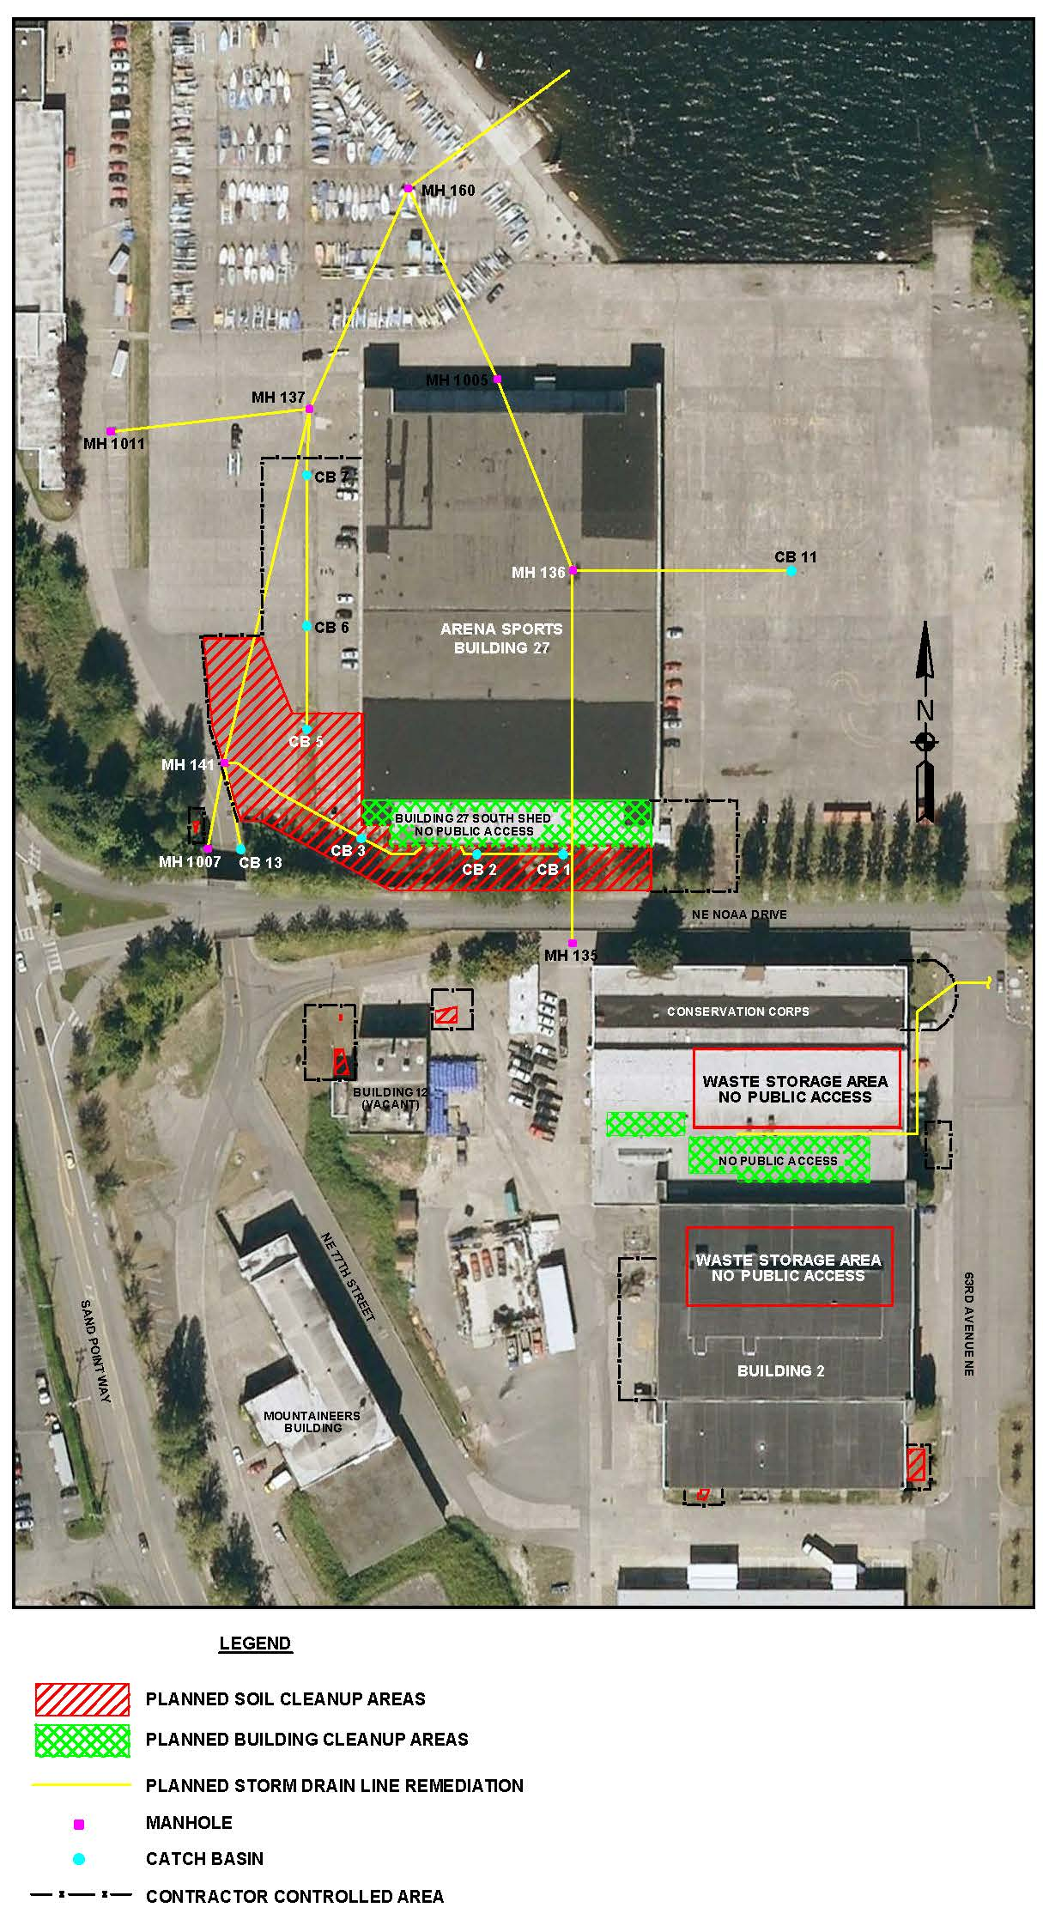
What’s next?

Slide 25
Ecology Contacts
Ching-Pi Wang, Site Manager
(425) 649-7134
Cwan461@ecy.wa.gov
Thea Levkovitz, Outreach Specialist
(425) 649-7286
Thea.Levkovitz@ecy.wa.gov

Slide 26
U.S. Navy Sand Point Cleanup Public Meeting October, 2014
Open House 6 - 7 PM
Presentations 7 - 7:50 PM
Break 7:50 - 8 PM
Q & A 8 – 9 PM
Conclude 9 PM

