Slide 1
Former Naval Station Puget Sound (Sand Point) Warren G Magnuson Park, Seattle, WA
Radiological Cleanup Update
Buildings 2 and 27
October 2014

Slide 2
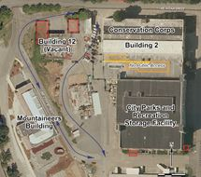
Time Critical Removal Action Buildings 2 and 12 Completed Work
Building 2 and 12
Contaminated building materials removed from 2nd floor that contained 1939 and 1941 instrument shops.
Confirmation surveys have been conducted by WDOH to confirm removal action is complete.
Radiological soil and storm line removal near Bldgs. 2 & 12 and confirmation soil sampling by WDOH completed.
Storm line cleaning under Building 2 remains and is scheduled to begin in October 2014.

Slide 3
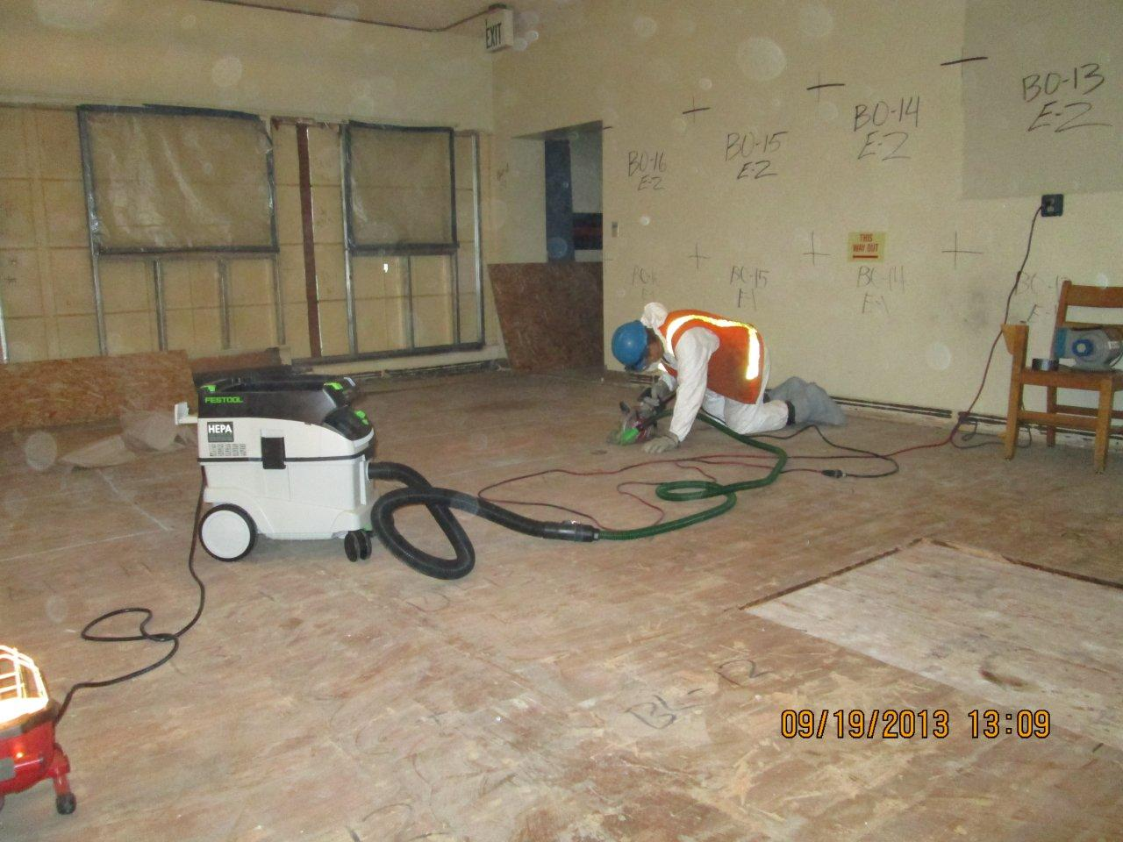

Slide 4
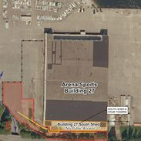
Time Critical Removal Action Buildings 27 Completed Work
Building 27 South Shed
(adjacent to Arena Sports Hangar)
Contaminated Building surfaces have been removed in main south shed structure.
Contaminated soil/storm line piping and catch basin removal and confirmation soil sampling completed in outside areas.
One discrete area of soil removal remains within the fenced area that cannot be accessed due to park power systems. Soil removal will commence once Park removes the power system scheduled to be completed in October 2014.

Slide 5
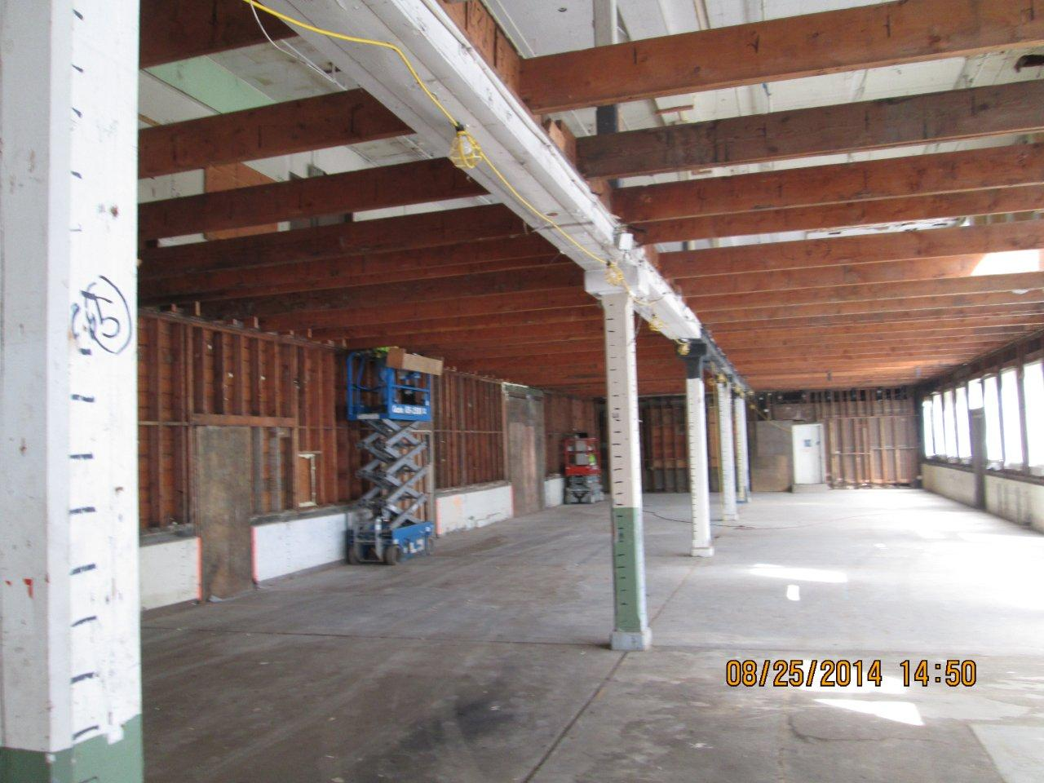

Slide 6
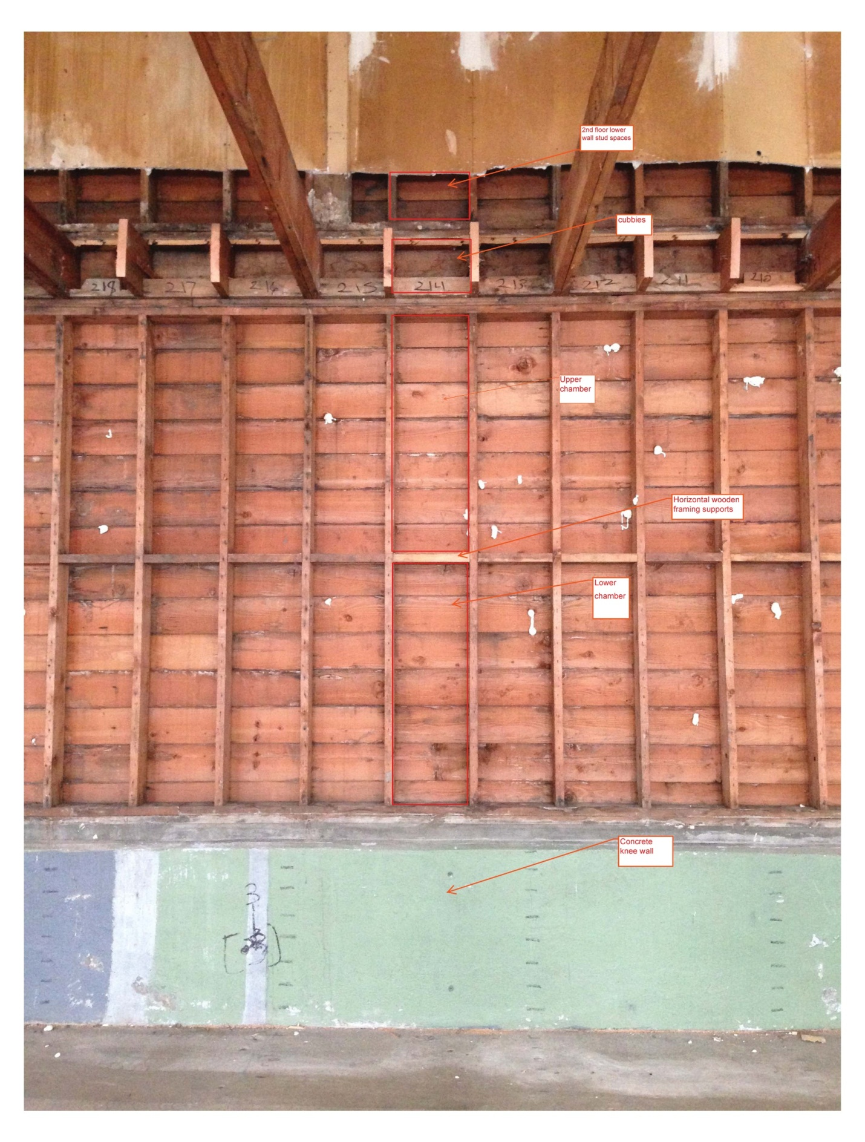

Slide 7
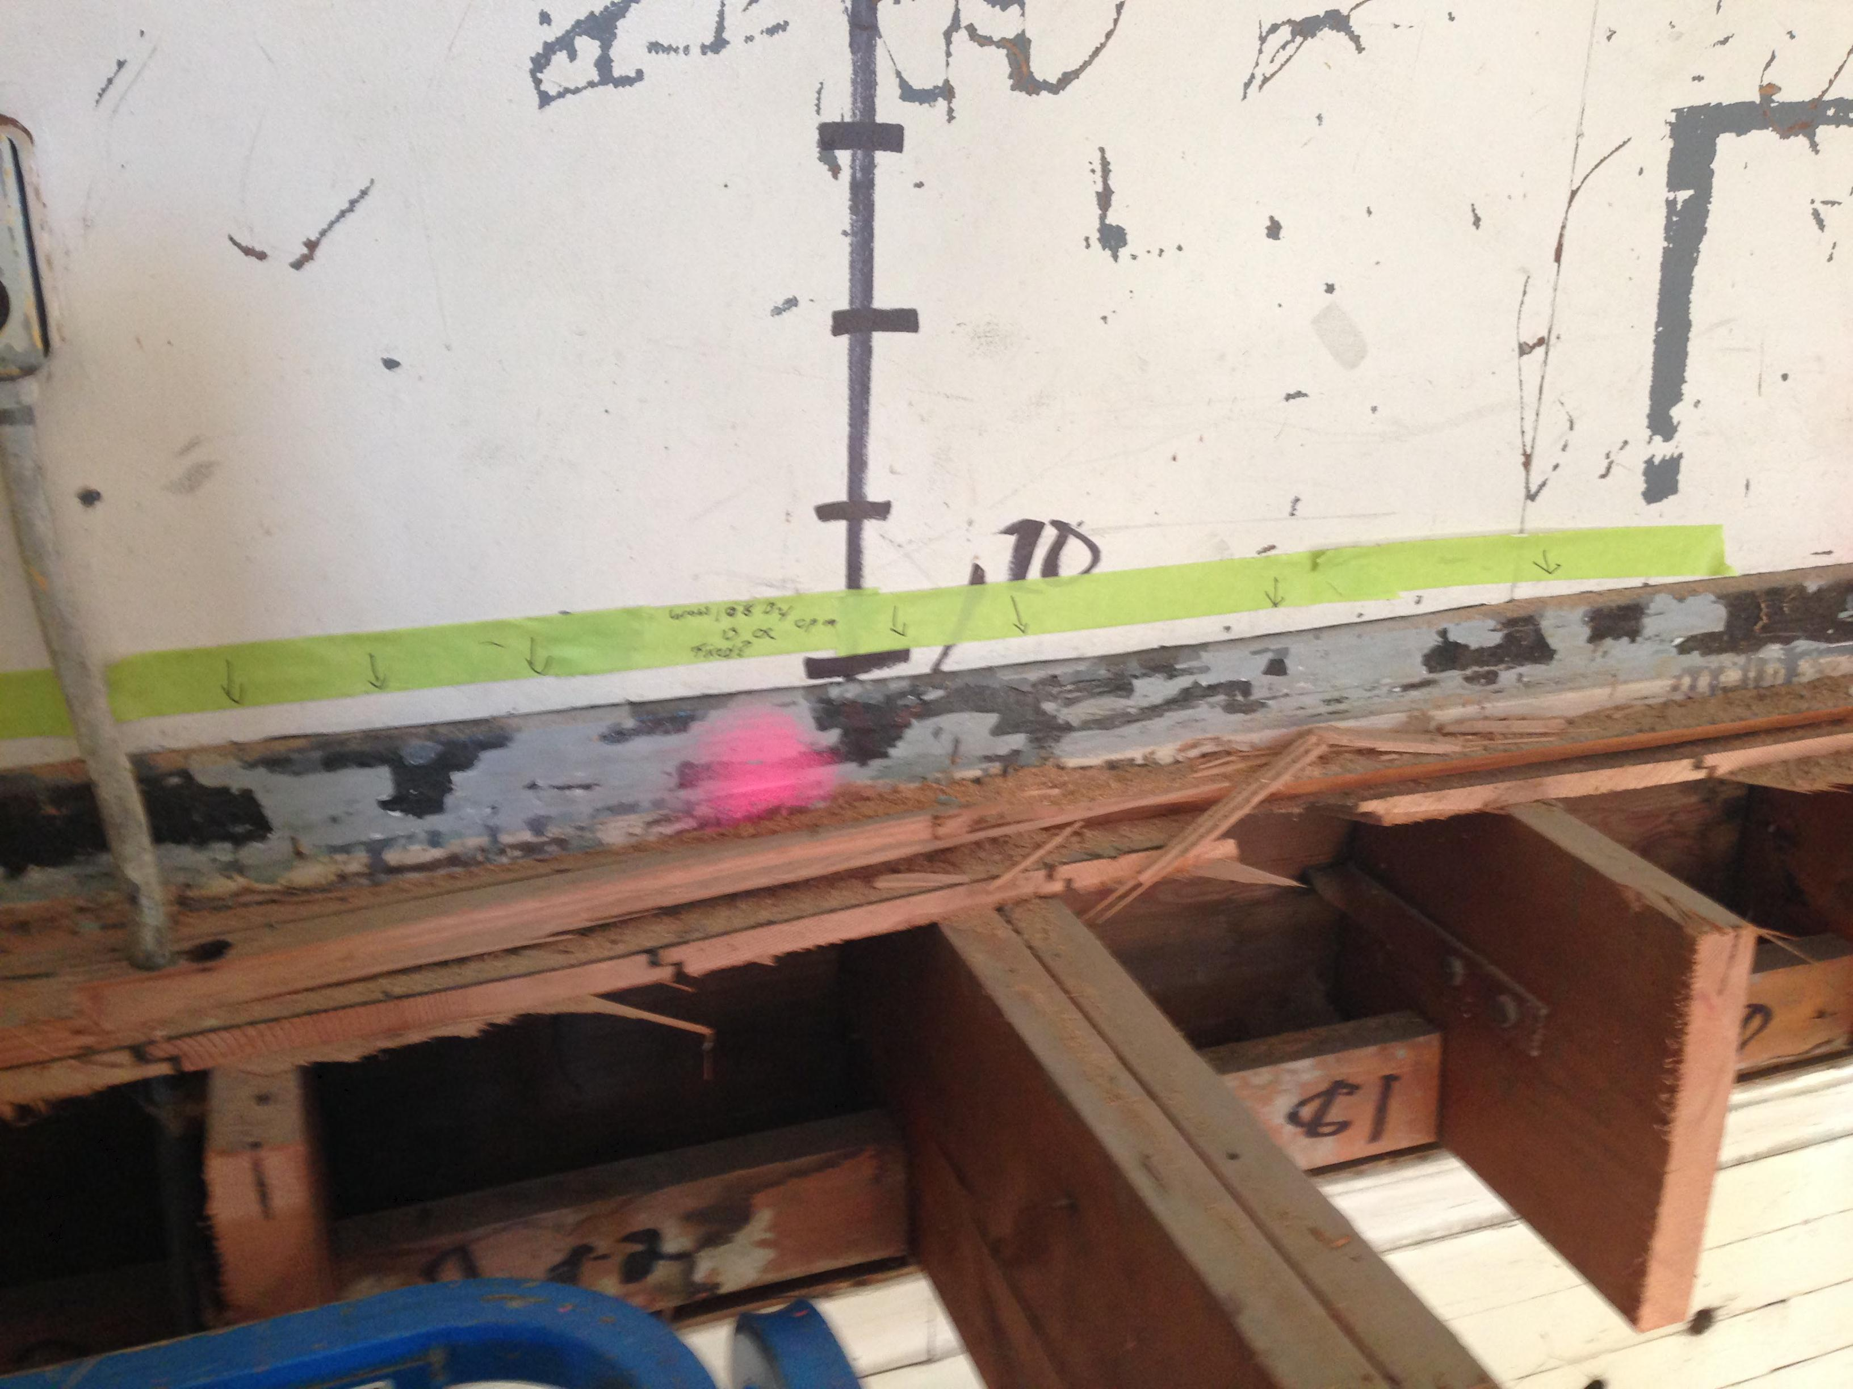

Slide 8
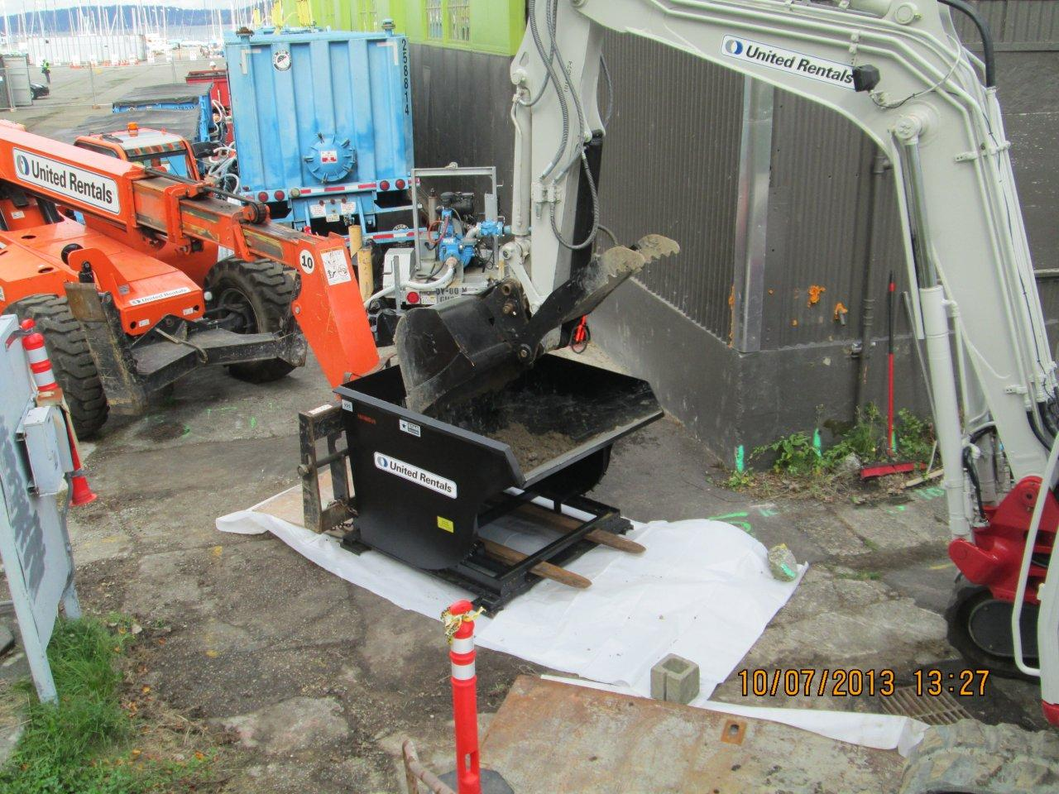

Slide 9
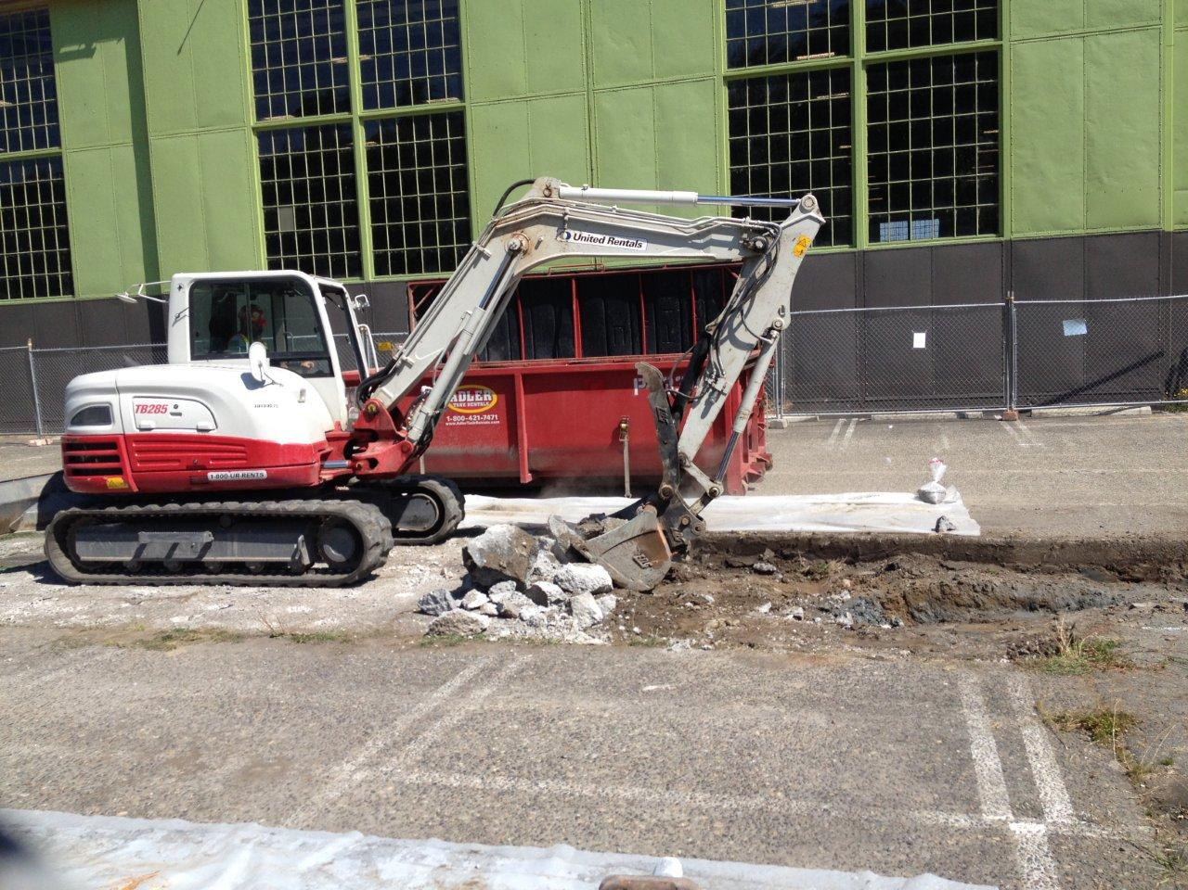

Slide 10
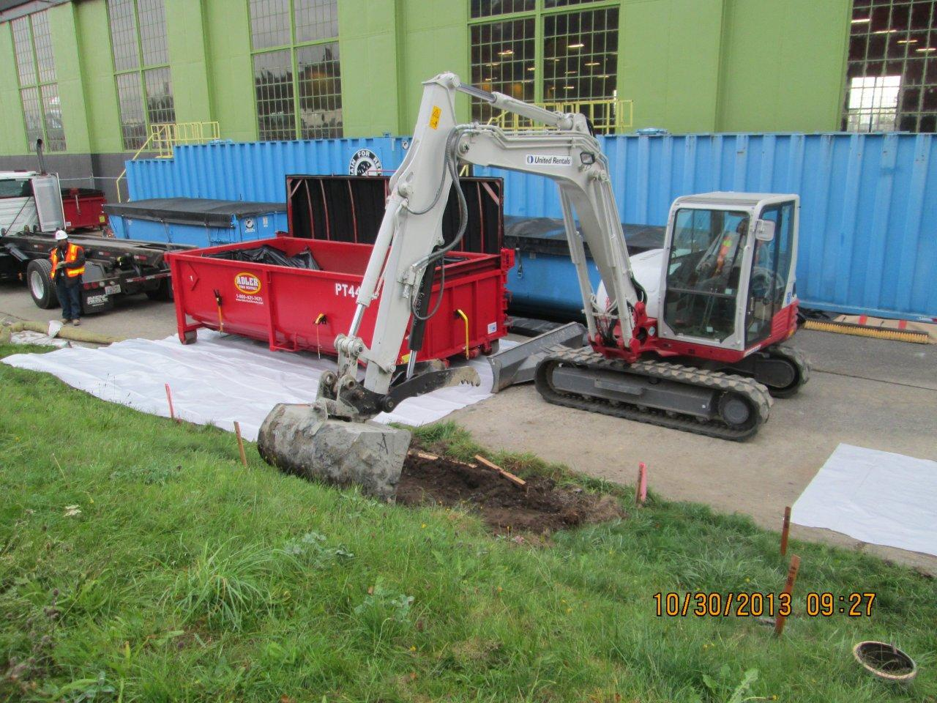

Slide 11
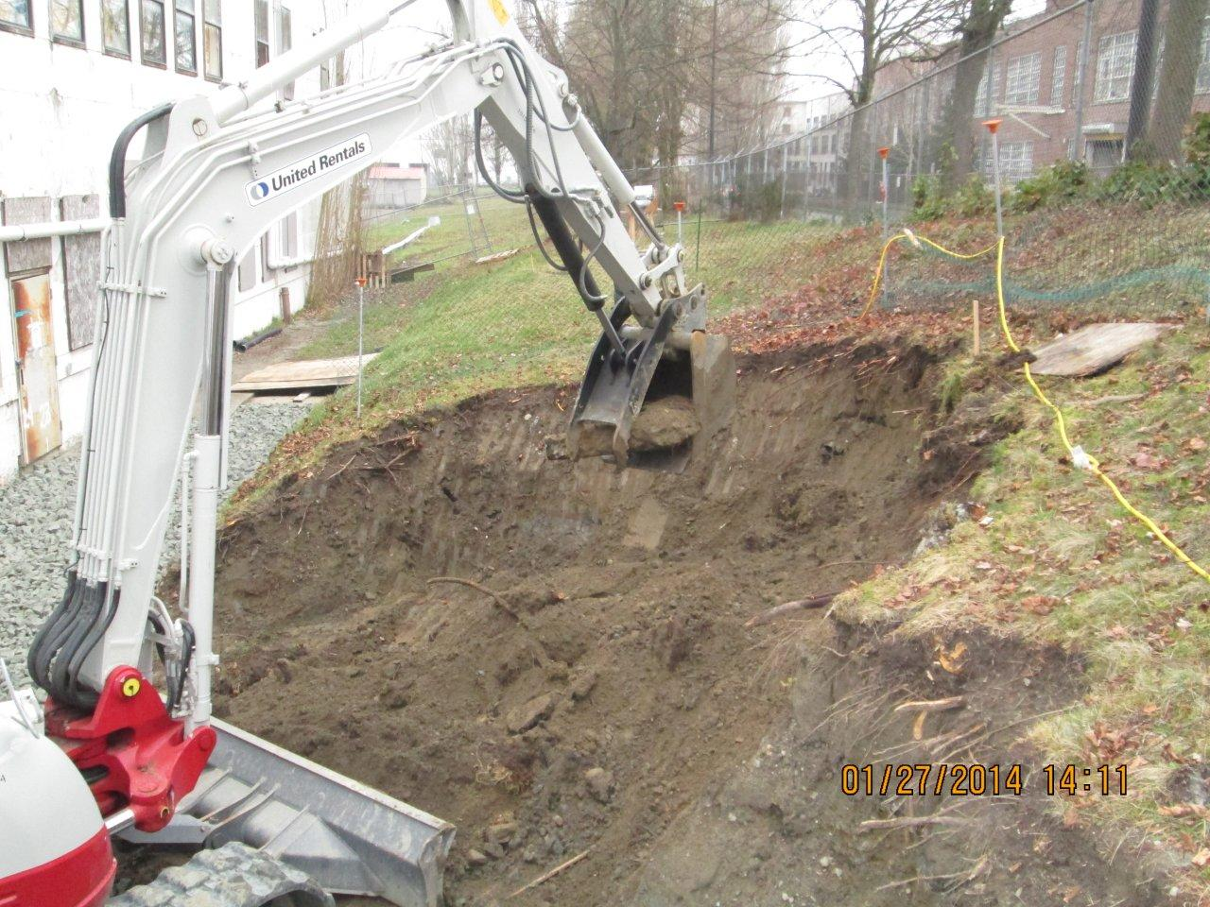

Slide 12
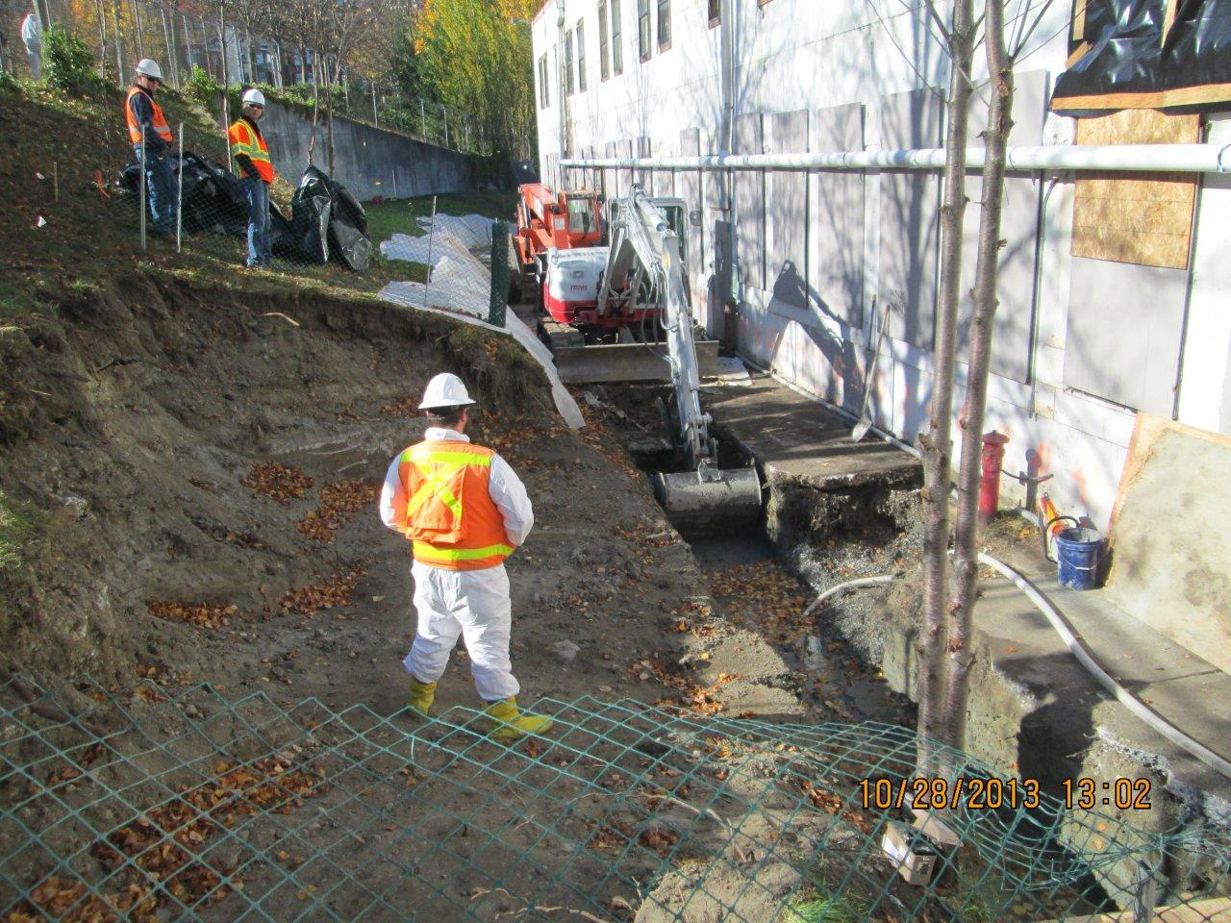

Slide 14
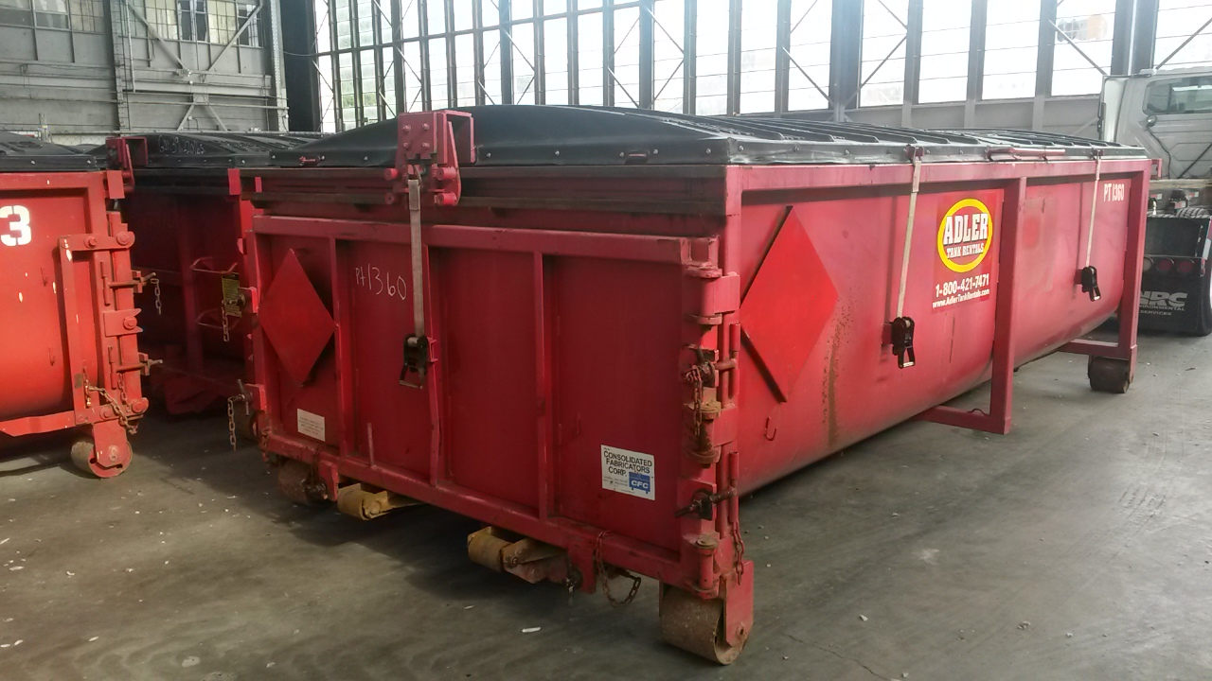
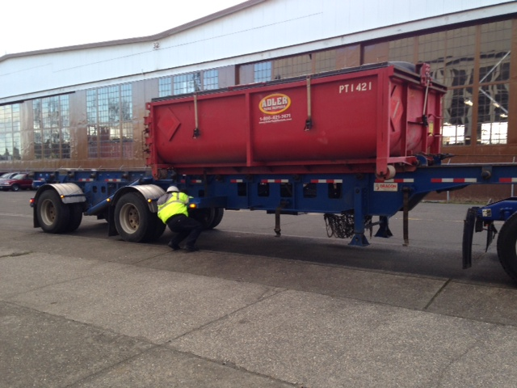
Radiological Waste Disposal October 14, 2014
131 Waste Disposal Shipments to US Ecology Idaho
73 Soil Shipments Totaling 933 Cubic Yards
58 Bldg. Debris Shipments Totaling 1044 Cubic Yards

Slide 15
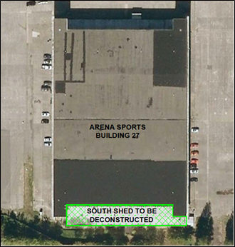
Work Planned South Shed

Slide 16
Work Planned Storm Line Cleaning

Slide 17
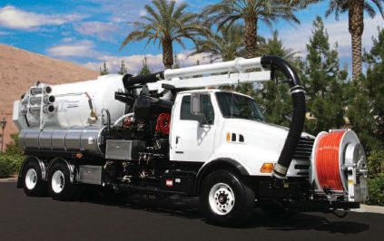
Vactor Truck

Slide 18
Work Planned Preliminary Assessment (PA)
Researching and reviewing:
Historical documents and maps. Documents include Navy instructions for the safe handling of radium paint,
Construction Drawings.
Changes to facilities, structures, and the lake’s shoreline, and
Previous radiological sampling/surveying.
Conducting interviews of former employees
Preliminary Assessment anticipated to be completed this Winter

Slide 19
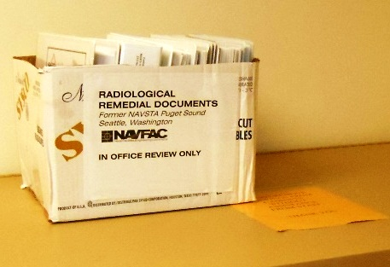
Thank You
Christopher Generous LG
Remedial Project Manager
Cindy L O’Hare PE
BRAC Environmental Coordinator
Cindy.ohare@navy.mil
More information:
Magnuson Park Building 30 (8:30AM-4:30PM)
or
http://go.usa.gov/kQ6e
We’ve been updating the website weekly during construction

