Slide 1
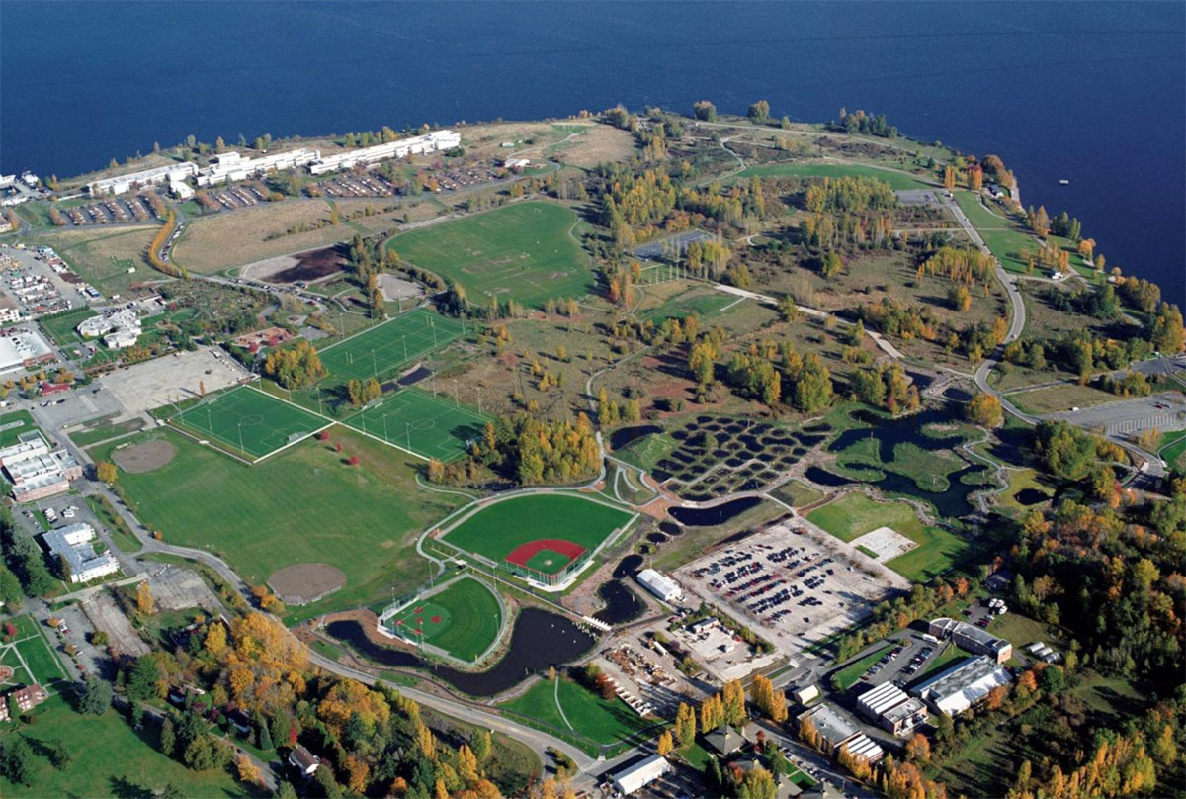
Ensuring Clean-Up of Radioactive Contamination in Magnuson Park to Protect the Health and Safety of Children and Generations to Come
Gerry Pollet
State Representative, 46th District;
Executive Director, Heart of America Northwest,
“The Public’s Voice for Hanford Cleanup”;
Clinical Instructor, UW School of Public Health

Slide 2
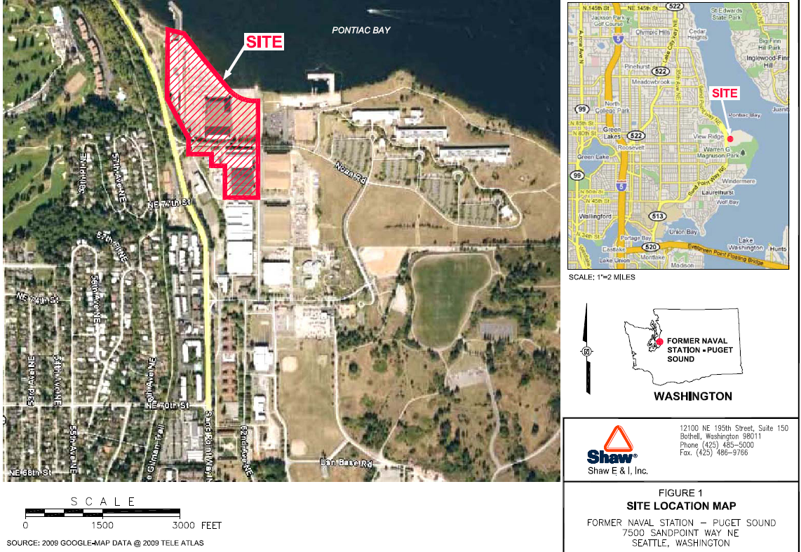
Site Map

Slide 3
Background on Radioactive Contamination in Magnuson Park
Where: The northern side of park. Soil and parking lots around, and building attached to, Hangar (Building 27) housing Arena Sports; soils, parking lots and buildings (2 and 12) behind (east) Mountaineers – former indoor soccer and volleyball facility (Earth Corps)
However, all indications are that it is safe to play/exercise at Arena Sports and Magnuson Athletic Club.
What We Don’t Know: residential and other areas
When: Contamination confirmed in 2010 by surveys. 2009 Seattle Parks asked about radium room while preparing for renovation.

Slide 4
Notice Not Given Public for Three Years after Navy and Seattle Parks Documented Radioactive Contamination in Magnuson Park
Notice? For over 3 years after confirming high levels of radiation, the Navy and Seattle Parks chose NOT to disclose that there was contamination.
How: The Park used to be a Naval Facility. The Navy used radium-based paint for aircraft instrument panels or other glow-in-the-dark needs. The Navy has refused to identify the sources of Strontium and Cesium, however. You should ask them where those came from tonight.
Why: When the land was transferred to the City, the Navy signed off that there were no hazardous substances such as radioactive contamination.

Slide 5
The Radiation Levels Were NOT “Low-Level” as the Navy Kept Saying - Radiation Levels Outside Building 27 Very High
Hottest Spot was Equivalent to 1,200 x-rays per year if someone sat on the soil year around before a metal plate was put over it.
This hot spot was NOT in fenced off until May, 2013
While soil is being removed, contamination level being left is too high with serious risk.
Many grass and parking areas with contamination were not fenced off

Slide 6
“Hot Spots” – These were NOT “Low-Levels” of radiation:
Navy’s own contractor calculated radiation levels in the soils to the south and west of Building 27, which now houses Arena Sports and the Magnuson Athletic Club, at:
1.4 millirem per hour from
332,754 counts per minute (cpm)
Indisputably = 12,264 mrem / year
Need to present dose and risk in terms public understands:
= equivalent of 1,200 x-rays / year IF exposed year around.
12% fatal cancer risk from lifetime exposure to an adult woman (3 to 10x this for a child).
Hot spots 1 and 2 Survey # RSS-403-m2 September 30, 2010 page 5 = 1.4 millirem per hour with backfill removed

Slide 7
The Radiation Levels Were NOT “Low-Level” as the Navy Kept Saying Radiation Levels Outside Building 27 Very High
Radiation survey results on South and West Side of Building 27 (Arena Sports) show soil areas with gamma & beta radiation levels up to 187,277 counts per minute
This equals a radiation dose in the black dot areas – eg. Grass between parking areas – of 1,638 millirem per year
Cancer risk for adult male lifetime exposure to these spots: approximately 8.7%

Slide 8
“Site Boundary” now extends through Solid Ground housing with 400+ residents, growing to 700 (CIP pg 10 – lower portion all the way to 65th St.)

Slide 9
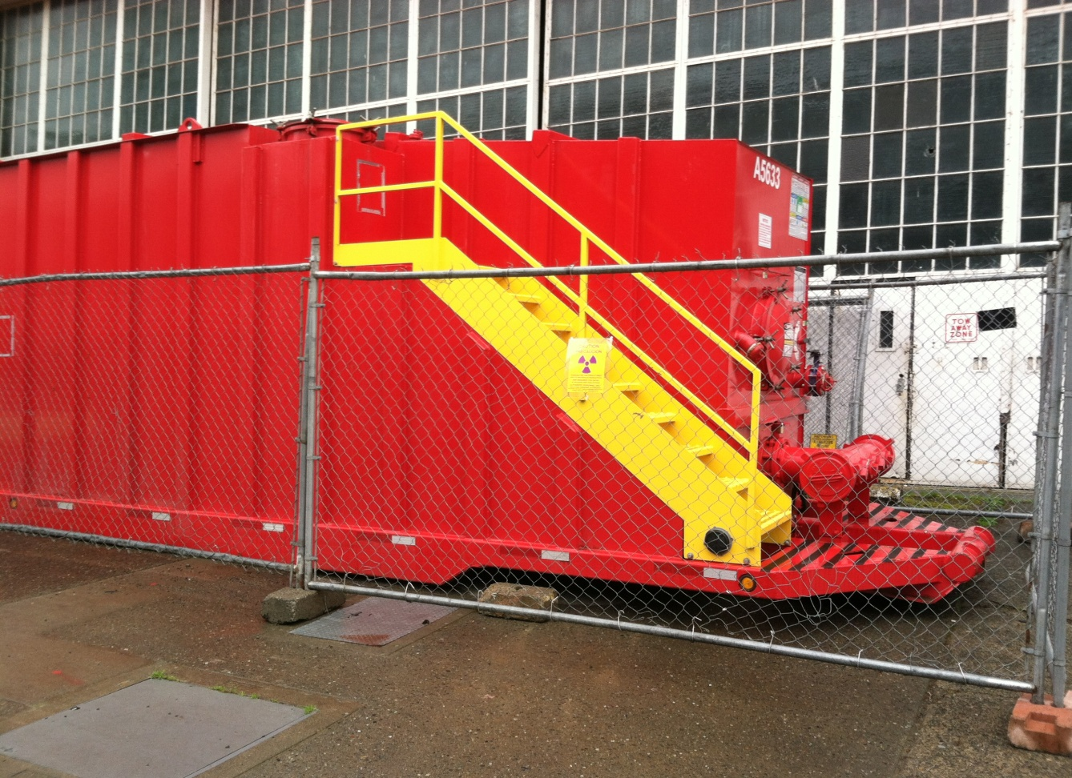
Contaminated Water Tank Fenced, thanks to concerned public

Slide 10
Is This a Low Level of Radioactivity?
Navy would leave behind radioactive Radium, Strontium and Cesium at levels allowing 15 millirem exposure to public
Your input needed on how children may be exposed and for how long
For adult women, this = 1.6 additional fatal cancers for every 1,000 exposed. (per BEIR VII – Nat’l Academy)
Children and women = 3 -10 x higher risk
State law (MTCA) requires cleanup to cancer risk level so that no more than 1 additional cancer for every 100,000 persons exposed.
Notes:
Navy ignores school opened in building 20 yards away from highly contaminated soils, likelihood that the park will have additional pea patches (especially important for alpha and Strontium exposures), soil ingestion, groundwater use… swimming. Navy has refused to investigate outfalls to lake where people swim and use for sailing dock and hand launch beach.

Slide 11
Navy’s Cleanup Plan Would Leave Behind Radioactive Contamination at Levels Estimated to Cause Fatal Cancers in1% of Children Residing in Park
Our State Cleanup Standard says cleanup so risk to children is no more than 1 in 100,000
EPA has not used the 15 millirem dose standard, which Navy cites, for several years.
EPA rejected nearly 20 years ago the 25 millirem dose used by WA DoH as not protective of health at Superfund sites
EPA, at sites like Hanford, requires estimating dose based on residential use of the area. Navy uses just 2 hours a day, 5 days a week of exposure.
Child cancer risk estimate of 1.2% is actually conservative utilizing National Academy of Science national consensus scientific report on risk from radiation doses, using most conservative childhood increased risk level and just 50 hours a week exposure instead of 10

Slide 12
Should Not Assert We Know Where Contamination Is, or That No Public Access Areas May be Contaminated
Navy has acknowledged need to investigate other areas
Lesson from Treasure Island, CA, former Naval Station, where Cesium buttons were found throughout area of former Navy housing turned into public housing
Even Building 30 shown as potential historic contamination and grassy areas around it.

Slide 13
Need to Disclose How Dangerous Cesium and Strontium Are
“Button” and pit of highly radioactive Cesium found under grass in front of and behind Building 2
Cesium buttons were also found throughout housing area at Navy’s former Treasure Island base in CA
Why has there been no disclosure of how hot / radioactive the Cesium button was, or radiation levels from Strontium found???
Cesium and Strontium not generally considered “low-level” radioactive wastes.
Navy has still failed to disclose records of where Sr & Cs were used or disposed.
Why haven’t Ecology and Parks insisted on disclosure?

Slide 14
Why haven’t Navy, Seattle and Ecology public fact sheets disclosed Mercury contamination?
Materials from Navy and Ecology only refer to low level radioactive waste, no mention of mercury.
What quantities, where?

Slide 15
Cleanup Levels are based on:
How Much Time Someone is Exposed
How they are exposed (e.g., eat soil, plants, water, radiation from soil)
The dose from those exposures
The risk from that combined dose

Slide 16
Is 2 hours a day the maximum your children and future generations will use Magnuson Park???
2 hours a day, 5 days a week is what the Navy is using as the MAXIMUM exposure people will have at Magnuson Park.
The Navy plan will leave behind contamination at levels which will give someone a radiation dose of 15 millirem a year from using the Park just 2 hours a day, 5 days a week
What about the hundreds of residents???
This is truly an environmental justice issue (or environmental injustice).

Slide 17
Public Needs to be Asked if what is maximum reasonable foreseeable exposure
Rules require notice of restriction on use of resources with comment
Park is actually residential use area with 400 current residents, growing to 700+ with schools and camps
Unrestricted 2 hours / day, 2 days/week
EPA rejected both 25 mr/year and 15 mr/year as cleanup level and rejects use of dose based level
Important topic for a cleanup advisory committee including residents, experts…

Slide 18
Contaminated Storm Line under Building 27 (Arena Sports) runs out to Lake Washington

Slide 19
At public meetings in 2013, Navy denied storm line was contaminated; Now, Navy acknowledging needs cleanout, but there is no evaluation of alternatives for public to review and comment on

Slide 20
Why has there been no evaluation and comment of hydro jet cleaning of storm drains?
Navy continues to use process (TCRA) which improperly avoids preparation of analysis of alternatives and public comment
(Time Critical Response Action, which is typically limited to cleanups taking under 6 months)
No excuse for TCRA and failure to prepare analysis of alternatives for public to review and comment on (EE/CA, FS or Cleanup Plan)
In 2010, newly released records show some of the same objections we have voiced over “hydro jet” cleaning and said not good option.

Slide 21
Cleanup Standards
Washington state’s Model Toxics Control Act (MTCA) requires cleanup to levels which protect against the reasonably foreseen highest exposed individuals from having a greater than 1 in 100,000 chance of cancer from contamination left behind.
Neither 25 or 15 millirem of dose is the State standard
The standard the Navy proposes to use has an additional cancer rate which is 150x MTCA for children. In a high-use public park, that is very significant.
Notes:
Transition from previous: Another impact of the improper authority arrangement are clean-up standards not consistent with state law…

Slide 22
The Appropriate State Cleanup Standard Should be Applied
Ecology’s recent presentation said: “EPA and Nuclear Regulatory Commission standard is 25 mrem/year.”
WRONG!!!
EPA rejected 25 millirem over a decade ago as not protective of health!!!
EPA no longer even allows use of 15 millirem!!!
EPA forbids use of dose based, instead of cancer risk based, cleanup standard for setting cleanup levels.

Slide 23
A child’s cancer risk from the Navy plan may be over 1%
15 Millirem/year is approximately 8 fatal cancers for every 10,000 adult males and 15 for every 10,000 women
Children are up to 10 times more susceptible to cancer from the same dose as an adult. At 10x, approximately 5 to 15 out of every 1,000 children might be at risk of getting cancer from this dose. For this calculation we use the minimum in the EPA risk range of children being 3 times more susceptible than the adult male. This is 2.4 fatal cancers in 1,000 from 15 millirem of annual exposure.
The Navy is planning on leaving contamination at levels giving 15 millirem of dose from just 2 hours a day, 5 days a week. Resident children are likely to be exposed 8 hours a day, 7 days a week. The Hanford residential exposure scenario is even more conservative. This is at least 5 times what the Navy is using as maximum exposure (56 hours/week versus 10 hours/week). The Navy ignores exposure from ingestion, growing vegetables or picking blackberries or from exposure to soil dug up for utility lines, and buildings.
Thus, a resident child’s cancer risk from the Navy’s cleanup plan to leave residual contamination resulting in 15 millirem of dose from 10 hours a week – without adding other exposure pathways such as ingestion - would conservatively be estimated to cause an excess cancer fatality rate amongst children of 1.2%.
This illustrates why EPA no longer allows use of 15 millirem of dose as a cleanup standard, and requires use of a residential exposure scenario where there is a reasonably foreseeable residential use of a Superfund site after cleanup.

Slide 24
Does the Exposure Scenario take into account the residents and high use of the Park?
Your views on what is the reasonably foreseeable maximum exposure from different routes is supposed to be considered:
Vegetable and fruit gardens; blackberry picking;
Use of groundwater;
How many hours a day do residents use Park? Campers? Students? Is it reasonable to expect utility lines and other excavation will expose contamination left behind?

Slide 25
Testing Needed for Contamination in Lake, Groundwater, Other Areas
Despite the opinions of multiple experts, the Navy refuses to include in its work plan for additional testing:
Groundwater – experts say there is likely contamination. Groundwater runs into Lake Washington and upwells onto parking areas and soils. Just a few feet below the highly contaminated soils. State law requires cleanup level to protect groundwater from contamination!
Storm Lines – storm drain lines are highly contaminated. The Navy needs to test the full length of the lines to their discharge points into Lake Washington at sailing dock and beach.
Lake Sediment – Seattle Parks first asked the Navy to test Lake Sediment near the contaminated drain lines in 2010. It still hasn’t – but the potential for contamination is greater than ever. People wade; swim; launch canoes, kayaks, sail… here
Notes:
Transition from previous slide could be: Worse than not cleaning up fully is not cleaning up at all

Slide 26
What You Can Do – Ask Ecology, SPS and Navy to:
Create a Community Advisory Committee, and hold regular public meetings
Test and remediate additional contamination areas
Groundwater, Lake Sediment, Storm Lines, Other buildings and soils
Use state law (MTCA) process and clean-up standards – follow our state cleanup standards and process:
Resulting in 150x lower additional cancer rate for children
Give us the reviews we need to provide informed input
A meaningful Public Involvement Plan needed: advisory committee to review plans and involve public, post proper signage disclosing contamination, on-going public meetings, updates, review of impact statement and alternatives AFTER testing.

Slide 27
What You Can Do – Ask Ecology, Seattle Parks and Navy to:
Plan a better course of action, with the public, using an advisory committee:
Test for additional contamination.
Test residential and other areas (e.g., NOAA).
Do the cleanup of soil and groundwater Right the FIRST TIME.
Ok if Navy proceeds with demolition of auxiliary building and interior of buildings, but test and plan soil, sewer line and groundwater cleanup as well.

Slide 28
What You Can Do – Ask Ecology, Seattle Parks and Navy to:
Meet our State’s Cleanup Standards, which are risk based and use public input on how people are likely to be exposed and for how long
Basing cleanup on 2 hours a day of exposure is unacceptable
Reject the level of contamination and risk the Navy would leave because a cancer risk of over 1% for children is unacceptable.
Base the cleanup on cancer risk not exceeding one additional cancer in 100,000
Analyze and publish test results with public reviews, then clean-up including soils, ground-water, and Lake sediment
Return to public for comment with results of additional testing, proper review of alternatives for cleanup and their impacts.
Create a cleanup advisory committee as over 1,400 local residents have requested.

