Slide 1
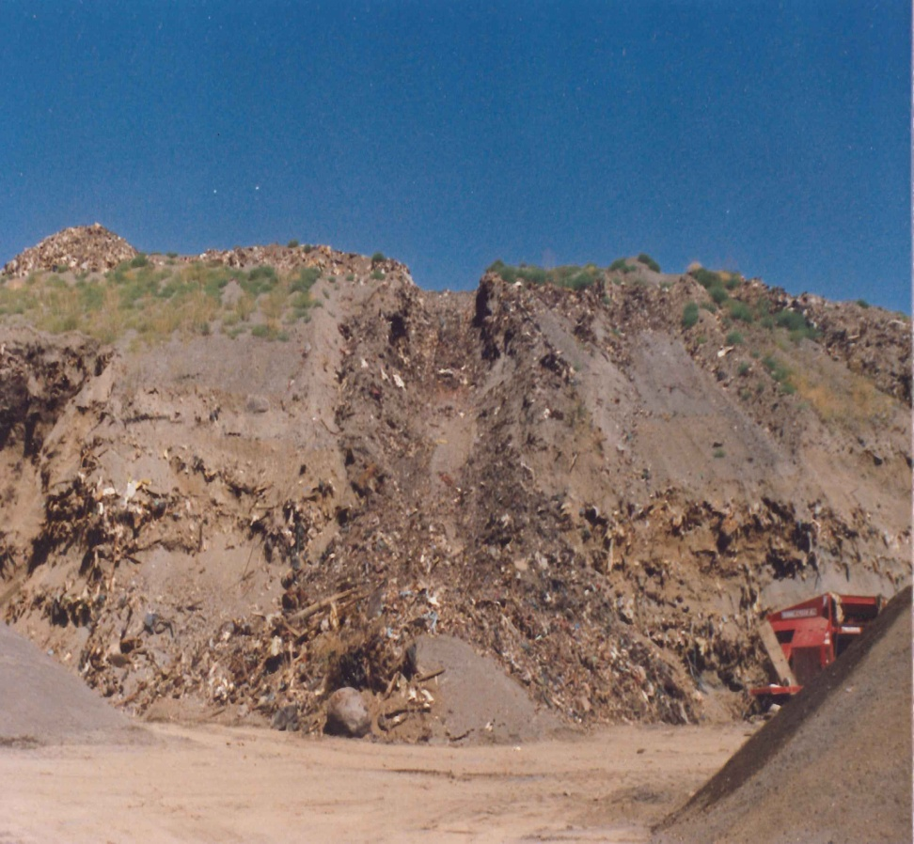
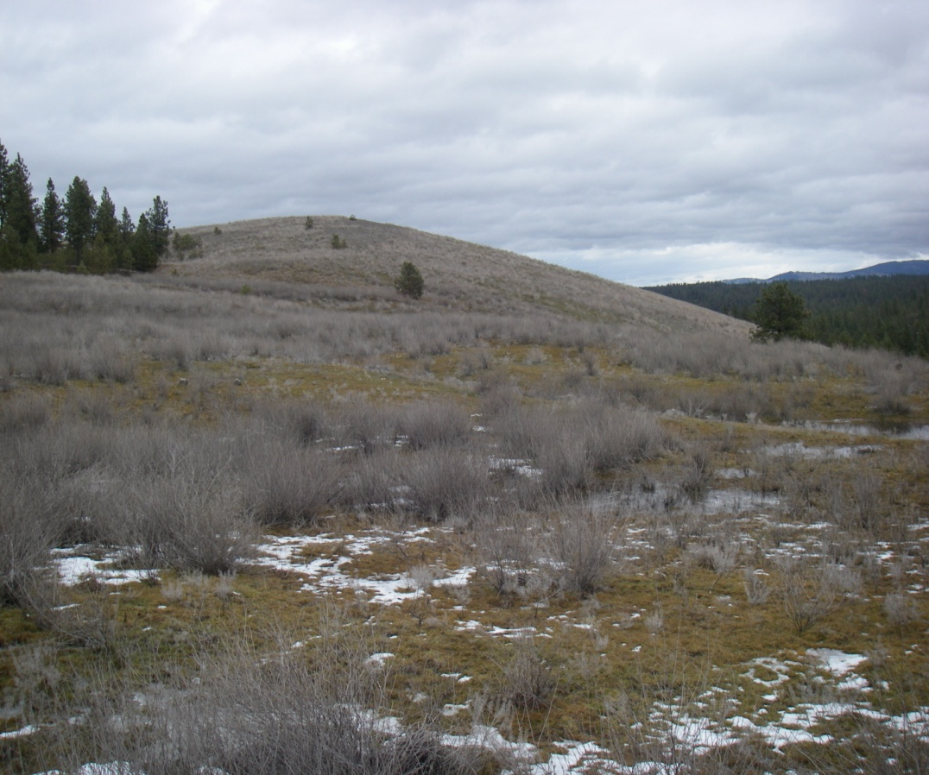
Marshall Landfill Site
Notes:
Photo on left: Exposed southern face of Main Cell at the Marshall Landfill in 1990, showing alternating layers of solid waste and sandy cover material.
Photo on right: Face of Main Cell at the Marshall Landfill today.

Slide 2
Washington State Department of Ecology Team
Patrick Cabbage, Hydrogeologist/Site Manager
Bill Fees, Engineer
Carol Bergin, Public Involvement Coordinator

Slide 3
Involving the Public
The Model Toxics Control Act (MTCA)
Community Interviews
Public Comment

Slide 4
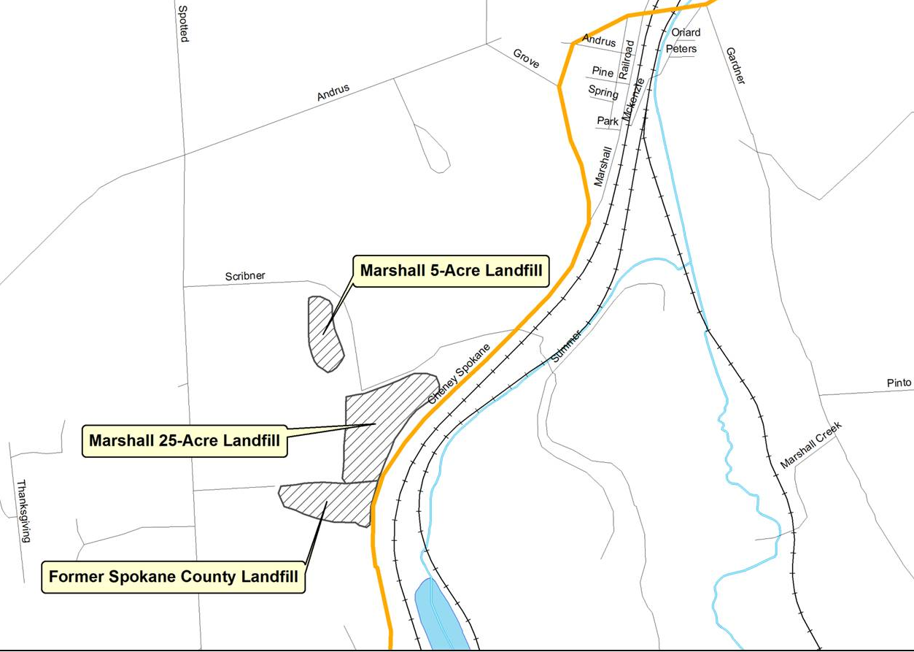
Site Location
Marshall Landfill Property

Slide 5
Steps of the Formal Cleanup Process
Site Discovery
Initial Investigation
Ranking the Site
Remedial Investigation/Feasibility Study
Ecology Selects Cleanup Action (CAP)
Conduct the Cleanup

Slide 6
Site History
1970-1990 Marshall Landfill operations
Late 1980s Contamination detected in nearby residential wells
1991 Marshall Landfill, Inc. conducted site
characterization to investigate soil gas,
and to investigate groundwater
contamination

Slide 7
Site History
1993-2011 Quarterly groundwater sampling
under Spokane Regional Health
District’s post-closure requirements
2013 Ecology received funding from
Legislature to perform Remedial
Investigation and Feasibility Study
2015 Remedial Investigation

Slide 8
Why is Ecology Doing this Work Now?
Contaminant levels at the site have not met
Washington State standards in the past
Funding and resources are available to
investigate the contamination
Understanding current conditions will ensure adequate protection for humans, wildlife, and the environment

Slide 9
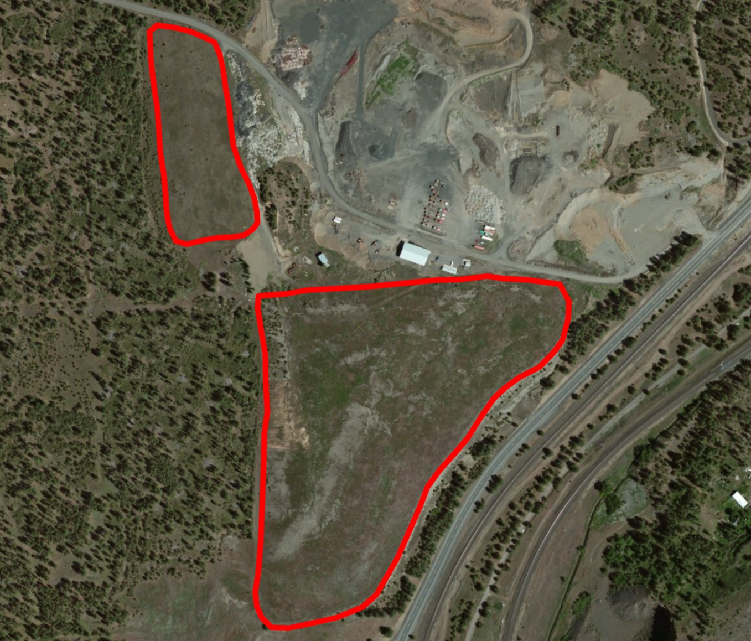
Current Conditions

Slide 10
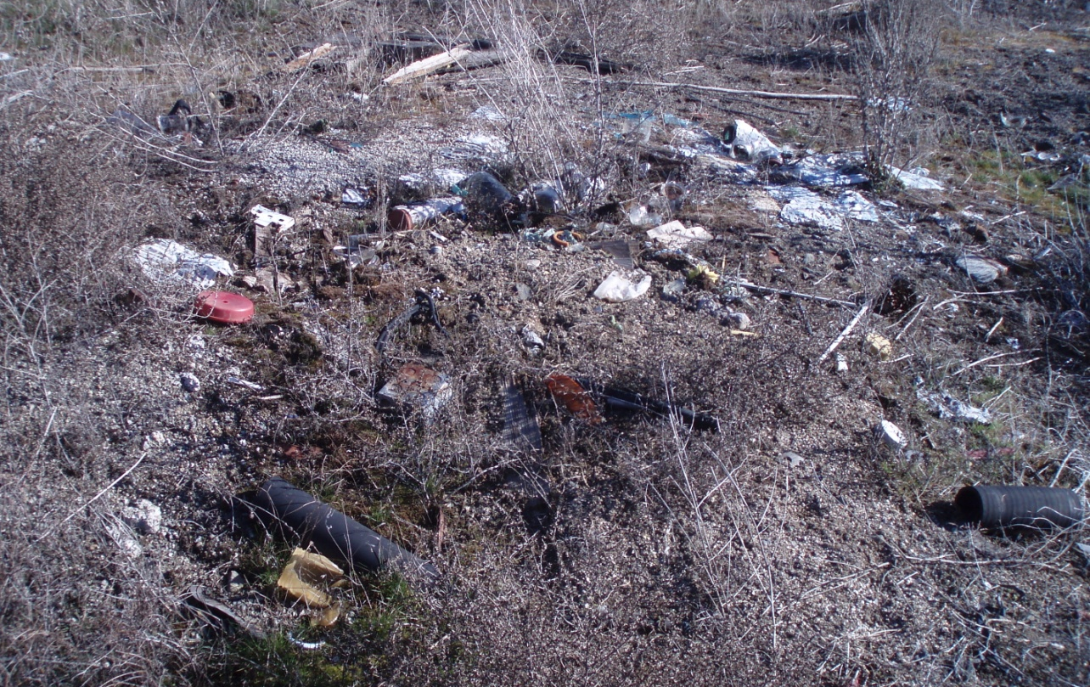
Why Ecology is Here

Slide 11
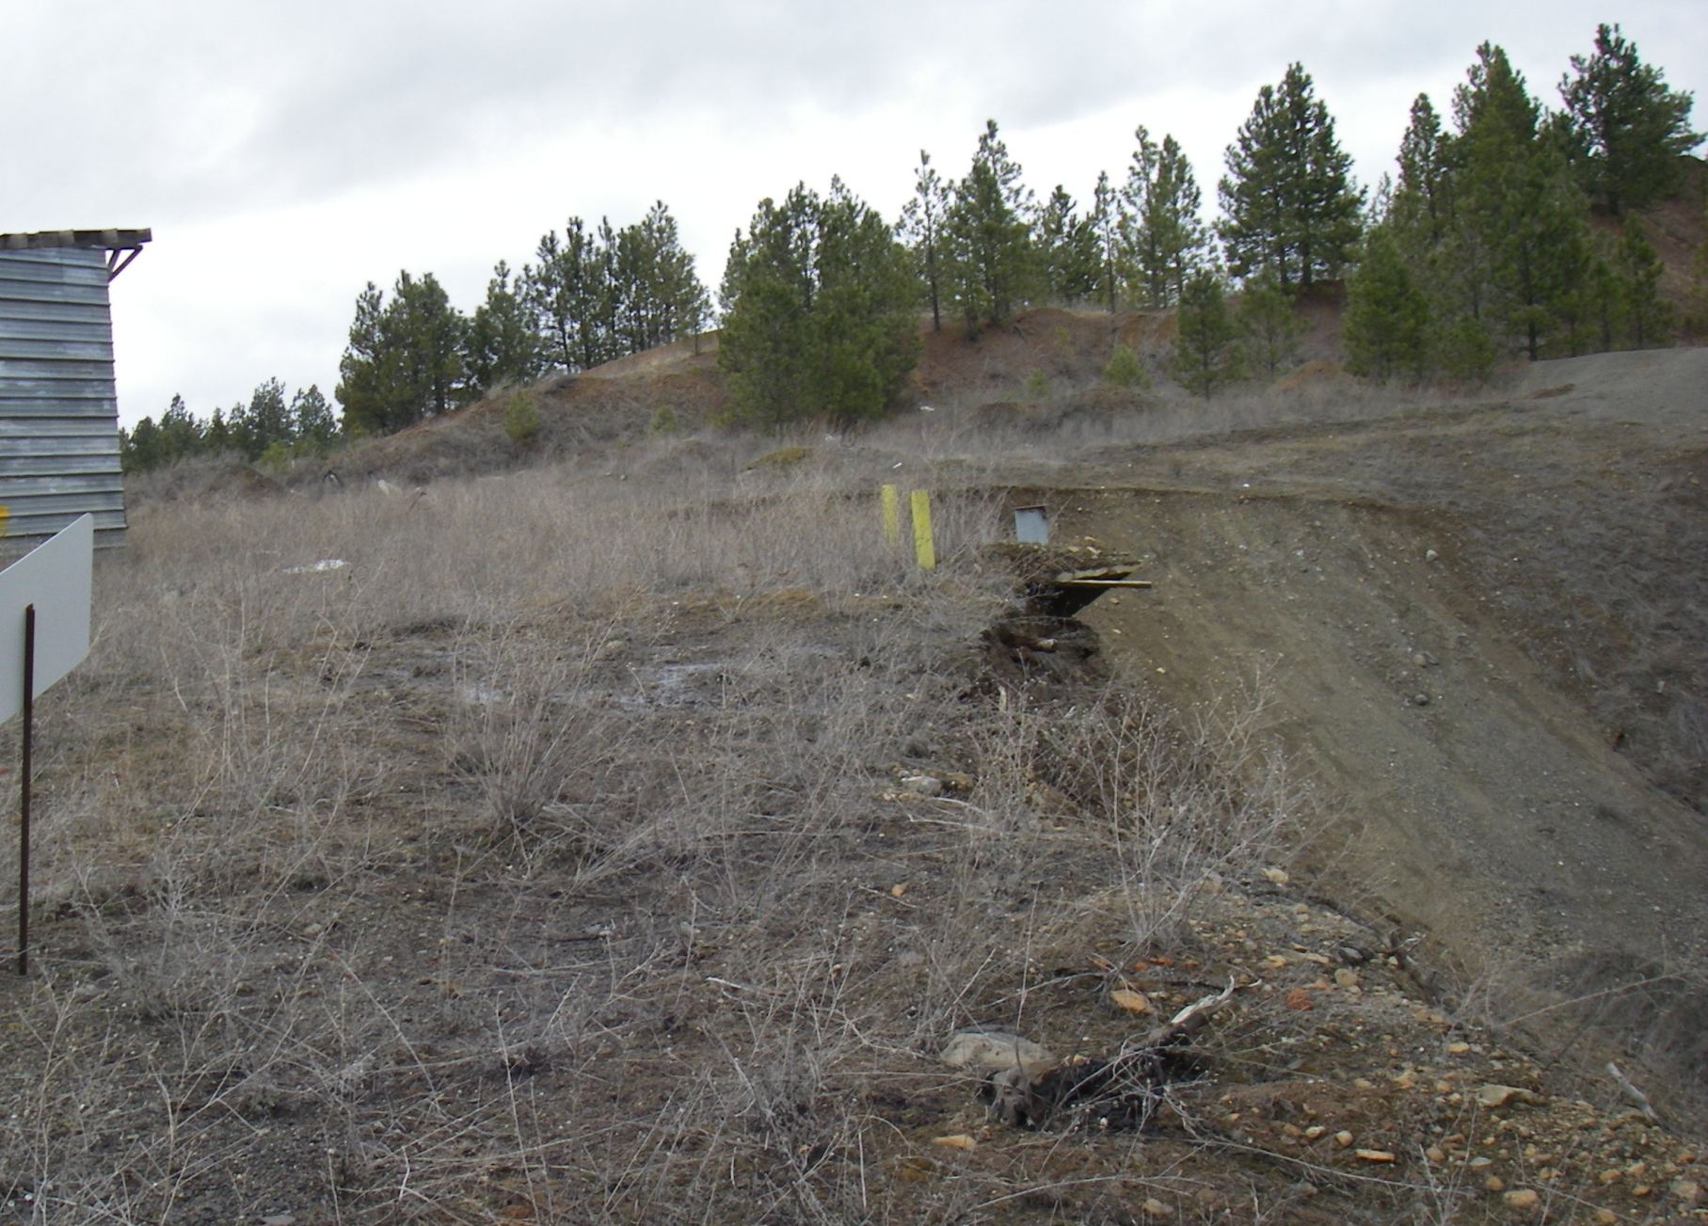
Why Ecology is Here

Slide 12
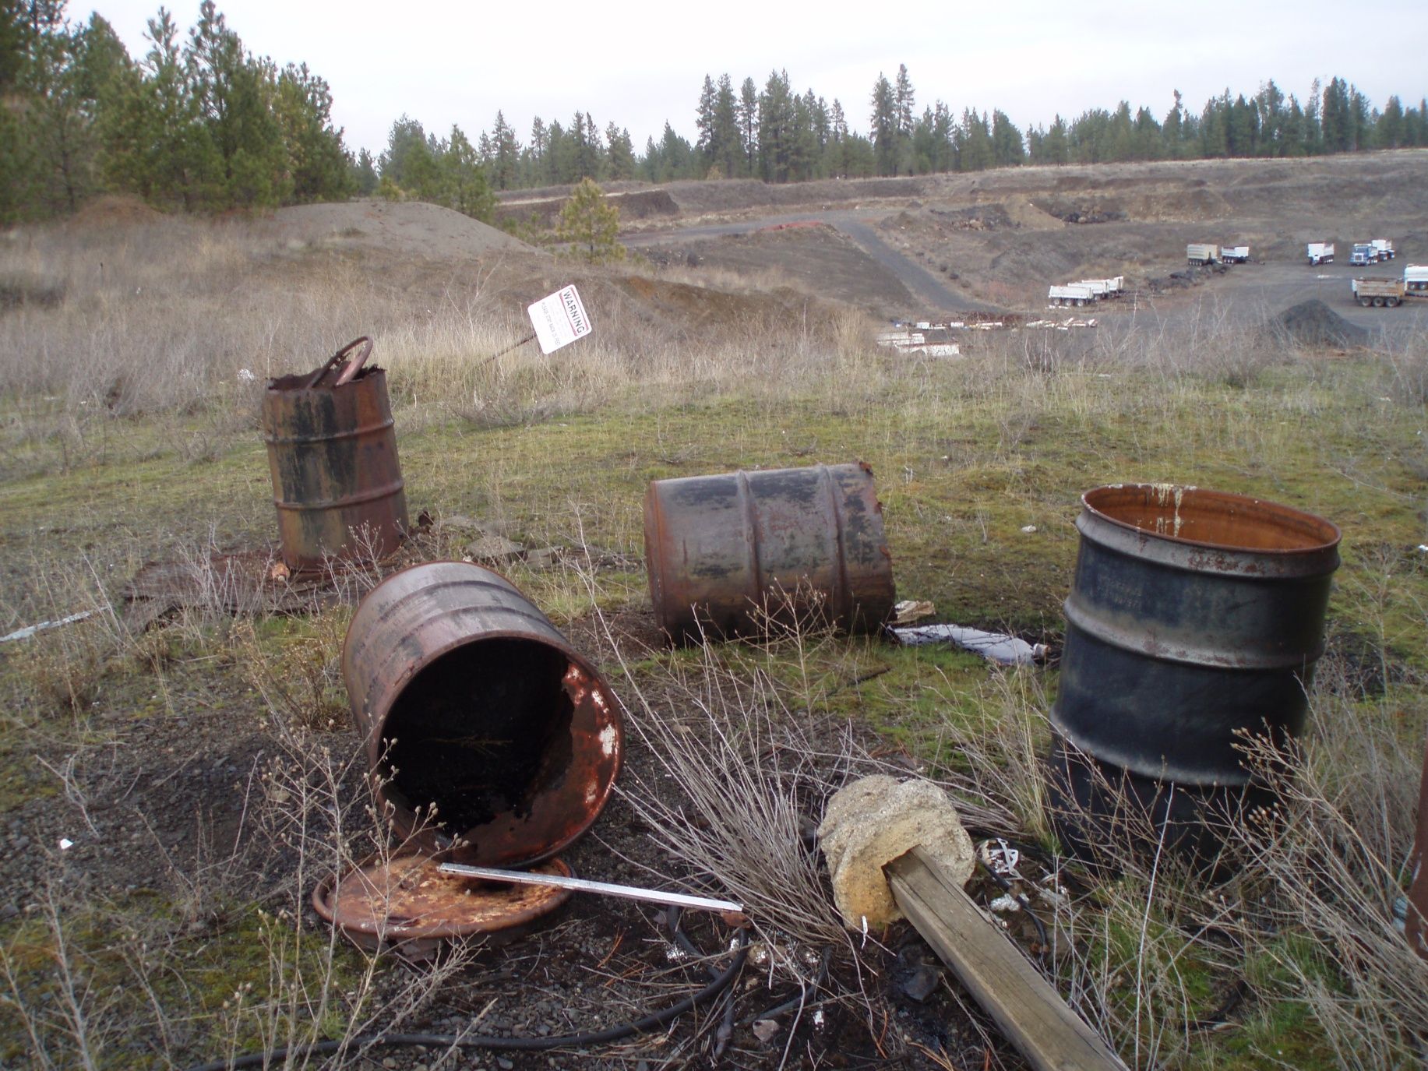
Why Ecology is Here

Slide 13
What are the Contaminants of Concern?
Volatile organic compounds (VOCs) and
semi-volatile organic compounds (SVOCs)
Metals including arsenic, cadmium, lead,
mercury
Hydrocarbons - gas, diesel, and oil range
Pesticides and herbicides

Slide 14
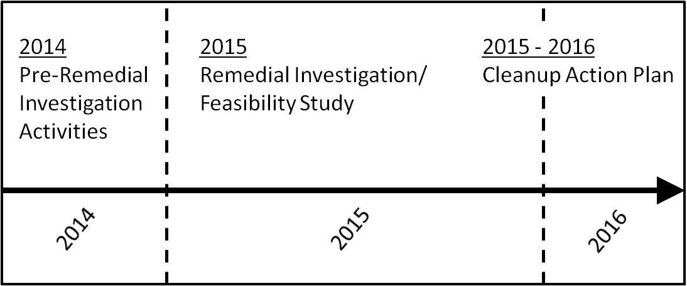
Project Timeline

Slide 15
Remedial Investigation Actions
Define extent of waste
Groundwater investigation
Soil gas/Landfill gas investigation
Geotechnical investigation

Slide 16
Define Extent of Waste – Where is It?
Excavate small test pits - define edge of landfill where waste was dumped during operations
Identify waste dumped since the landfill was closed

Slide 17
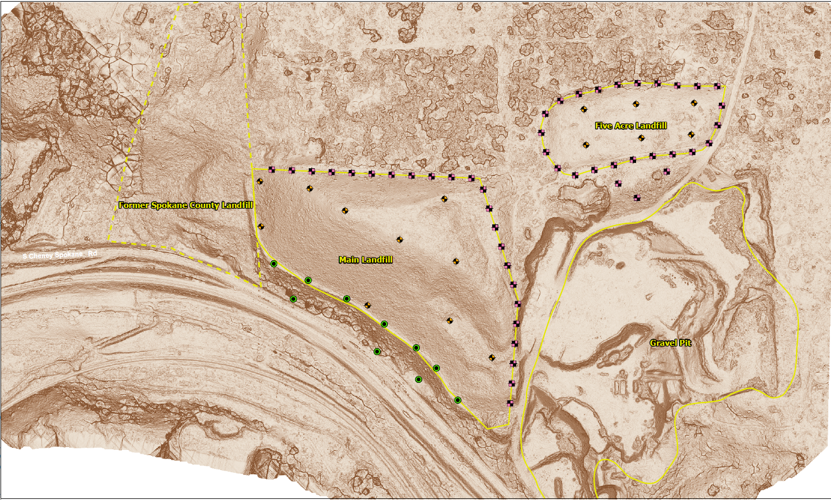
Define Extent of Waste

Slide 18
Groundwater Investigation
Repair/rehabilitate existing groundwater wells
Install new monitoring wells to fill gaps in groundwater monitoring network
Collect groundwater samples

Slide 19
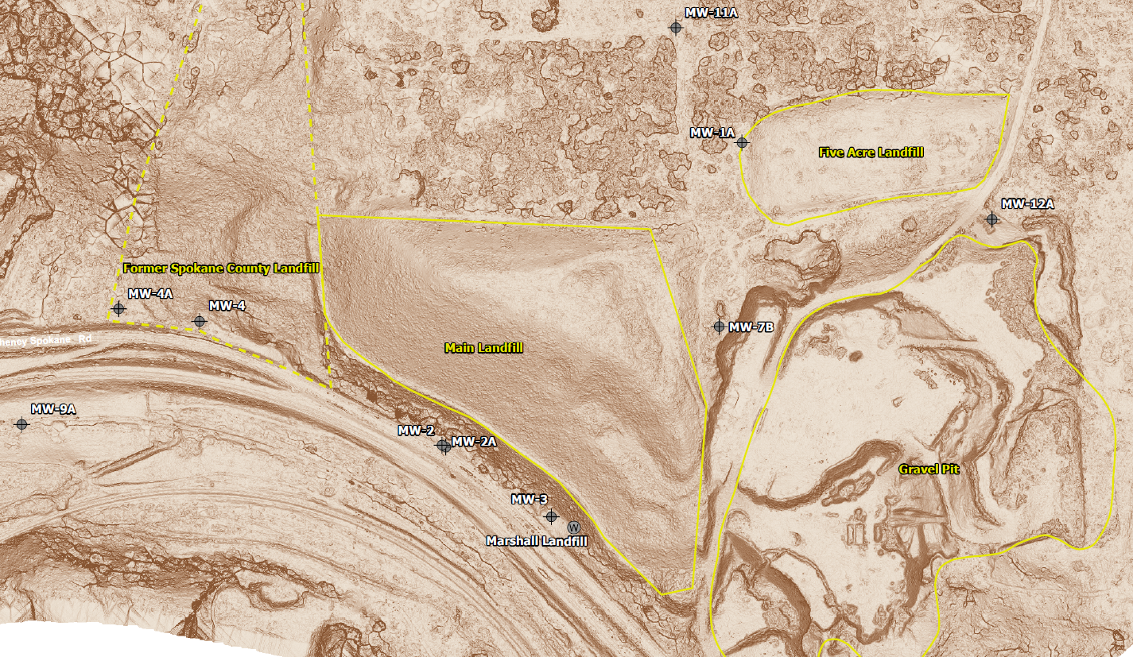
Groundwater Investigation

Slide 20
Groundwater Investigation

Slide 21
Soil Gas/Landfill
Gas Investigation
Past report of landfill gas being generated
Unknown if landfill gas is currently being generated by waste
Five-Acre cell has gas vent pipes, Main Cell has no gas vents
Install new soil-gas monitoring wells in both landfill cells
Collect soil-gas samples

Slide 22
Soil Gas/Landfill Gas Investigation

Slide 23
Geotechnical Investigation
Toe Buttress
Toe Buttress provides structural support for Main Cell
Face of Main Cell is very steep slope
Confirm stability of toe buttress
Main Cell
Confirm thickness and nature of waste in Main Cell

Slide 24
Geotechnical Investigation

Slide 25
Is My Water Safe to Drink?
Yes. Based on the recent evidence from the Health District’s post-closure sampling, drinking water wells are safe from site-related contaminants
The Marshall Community Well is sampled routinely
Ecology will sample monitoring wells at the site. If contamination is detected in those wells, Ecology may ask to sample nearby residential wells
You will be notified immediately if there is a problem that needs immediate attention

Slide 26
What is the Purpose of the Feasibility Study?
Identifies more than one cleanup option
Evaluates cleanup options based on Model Toxics Control Act (MTCA), State, Federal, and local regulations
Includes Cost Benefit Analysis
Ecology identifies a Preferred Cleanup Option from options evaluated
Includes Public Comment before finalizing

Slide 27
What Are the Next Steps?
Submit comments for the RI/FS Work Plan by March 25, 2015
Field work begins after comments are considered approximately April to June, 2015
Draft RI/FS Report: August, 2015, with Public Comment period to follow

Slide 28
Thank You for Coming Tonight!
Comments will be accepted until March 25, 2015
Please submit your comments to:
Patrick Cabbage
WA Department of Ecology
4601 N. Monroe, Spokane, WA 99205-1295
E-mail: patrick.cabbage@ecy.wa.gov
Phone: 509/329-3543

Slide 29
Questions?

