Slide 1
Georgia Pacific West Proposed Interim Action
Public Meeting & Open House – July 12, 2011

Slide 2
Meeting Presenters
Brad Petrovich – Department of Ecology, Public Involvement Coordinator
Brian Sato – Department of Ecology, Site Manager
Brian Gouran – Port of Bellingham, Environmental Site Project Manager

Slide 3
Meeting Purpose
To provide information on a proposed interim cleanup for the Georgia Pacific West Site on the Bellingham waterfront.
The cleanup (interim action) is described in a proposed amendment to a 2009 Agreed Order between Ecology and the Port of Bellingham
Public review of the proposed amendment is required under state law

Slide 4
Meeting Agenda
6:05 – 6:15 GP West Site Location and Background Information
6:15 – 6:25 State Cleanup Process Brian Sato, Ecology
Cleanup process
Interim actions
6:25 – 6:40 Site History, Environmental Conditions and Proposed Interim Action Brian Gouran, Port of Bellingham
6:40 – 6:55 State Evaluation – Brian Sato, Ecology
Source Removal
Regulatory requirements (Remediation Levels)
Integration into RI/FS
6:55 – 7:00 Closing and next steps – Brian Sato, Ecology
7:00 – 7:15 Questions and answers
7:15 – 8:00 Open house

Slide 5
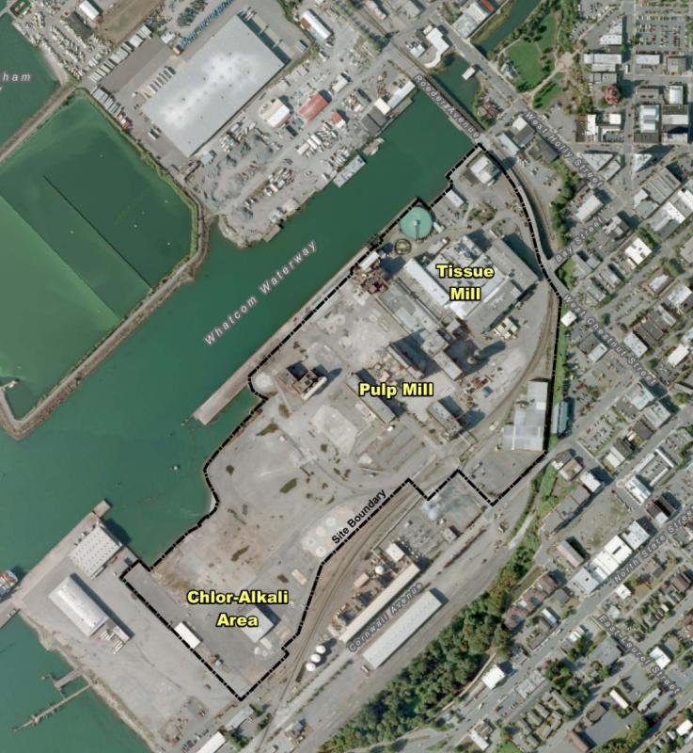
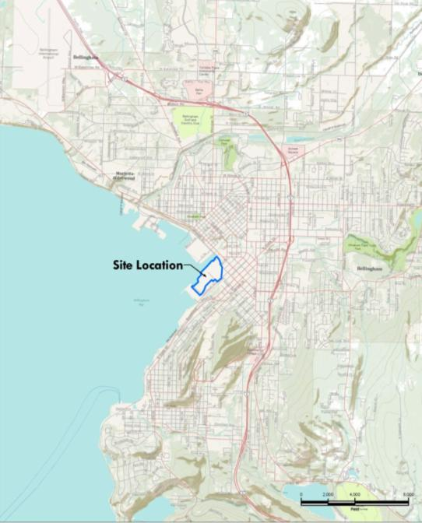
GP West Site Location
You Are Here

Slide 6
Site Environmental Documents
Agreed Order No. 6834 for RI/FS August 2009
GP West RI/FS Work Plan September 2009
Addendum 1 & 2 to the RI/FS Work Plan March & November 2010
GP West Interim Action Pre-Design Investigation Report April 2011
Draft First Amendment to Agreed Order DRAFT – June 2011
Public Review Draft Interim Action Work Plan DRAFT June 2011
https://fortress.wa.gov/ecy/gsp/Sitepage.aspx?csid=2279

Slide 7
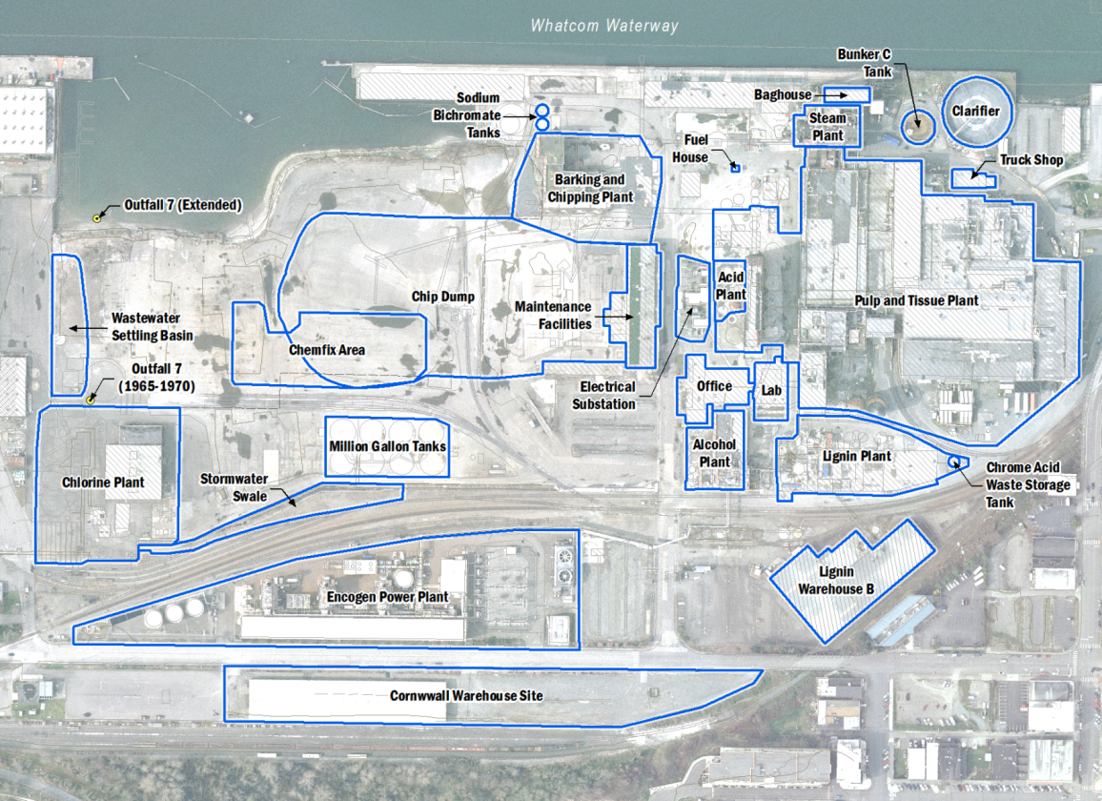
Historic Operational Areas

Slide 8
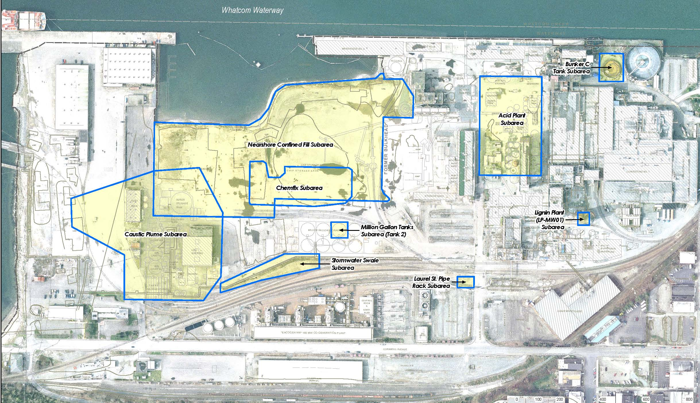
Site “Subareas”

Slide 9
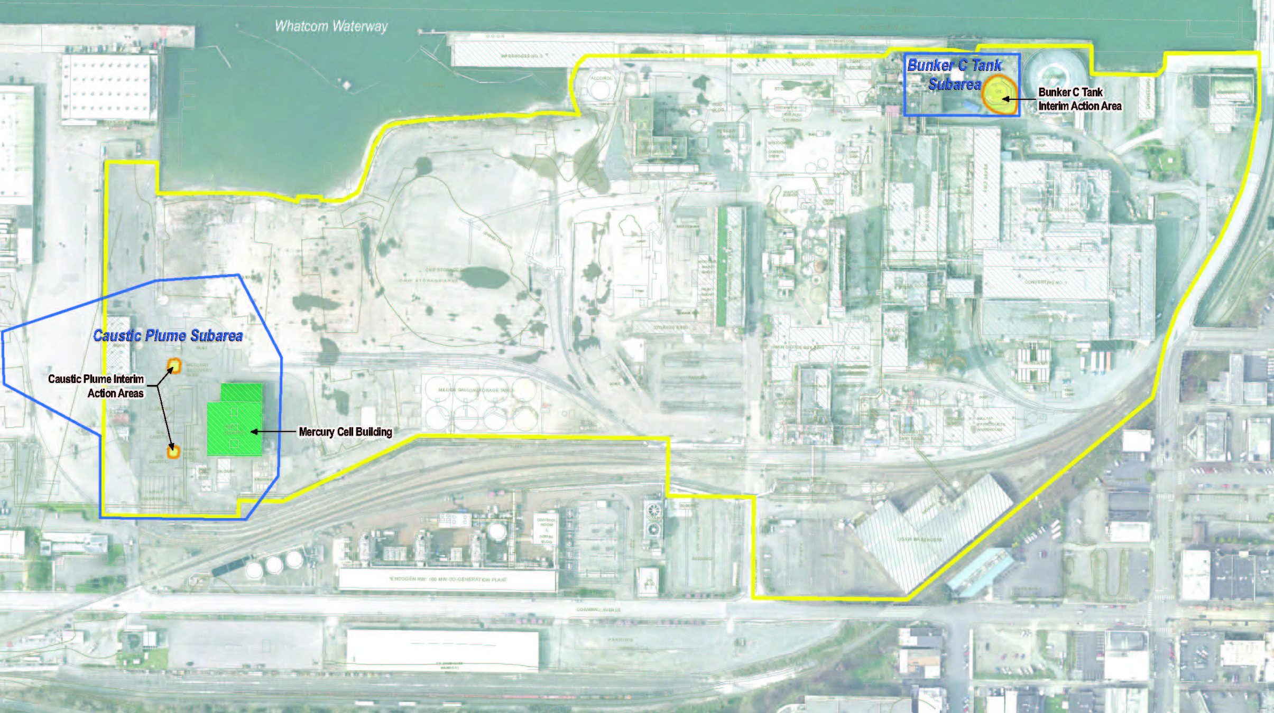
Proposed Interim Action Areas

Slide 10
State Cleanup Process
Initial Site Assessment
Remedial Investigation/ Feasibility Study (RI/FS)
Interim Actions (if necessary)
Consent Decree & Cleanup Action Plan
Remedial Design, Permitting, Construction, and Monitoring

Slide 11
Interim Actions
An Interim Action:
Reduces threat to health or environment;
Corrects problem that may become worse or more costly, OR ;
Provides for Site Assessment, RI/FS, or cleanup design.
If cleanup action is known, interim action shall be consistent with it;
If cleanup action is not known, interim action shall not foreclose reasonable alternatives.

Slide 12
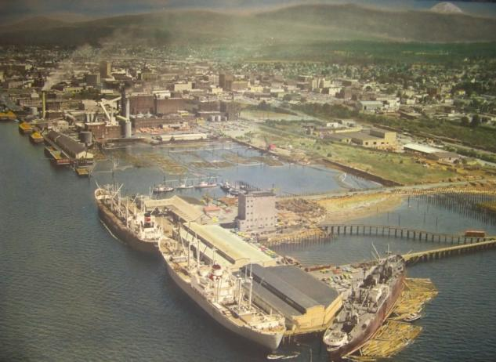
Site History
64 acre upland property
Port, State, BNSF, & City ownership
Historic Tide Flats & Submerged Lands
Pulp/paper mill, 1926 - 2007
Chlorine plant, 1965 – 1999
Ongoing Demolition & Cleanup
GP conducted investigations and independent cleanup actions (incl. 2 Agreed Orders)
Port & Ecology Agreed Order for RI/FS (2009)
RI/FS underway

Slide 13
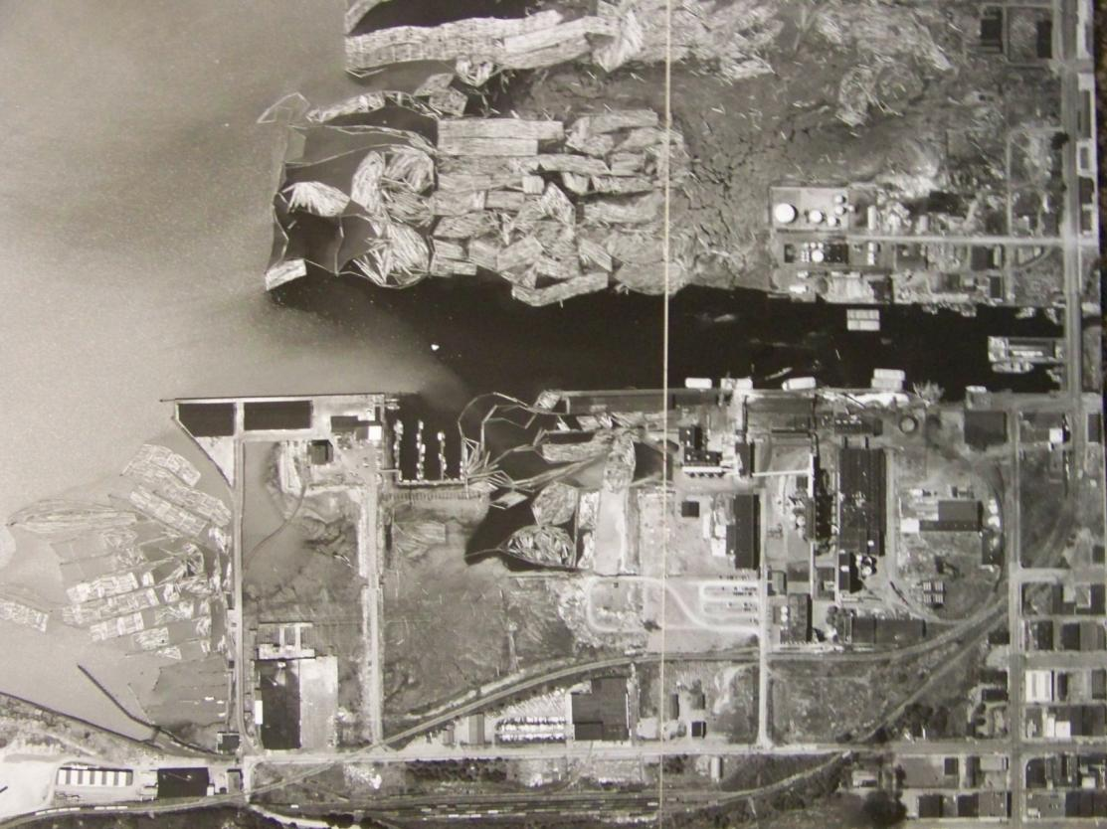
Site History
1950

Slide 14
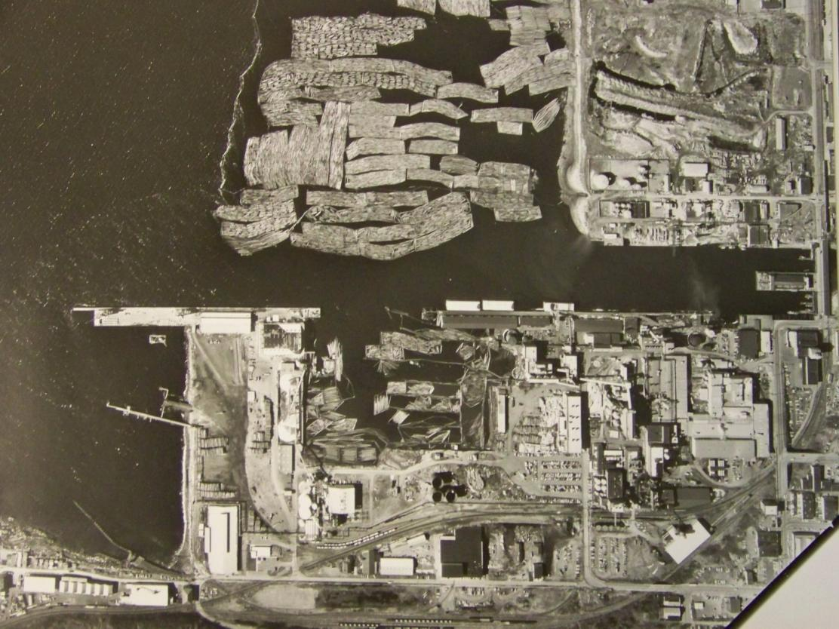
Site History
1969

Slide 15
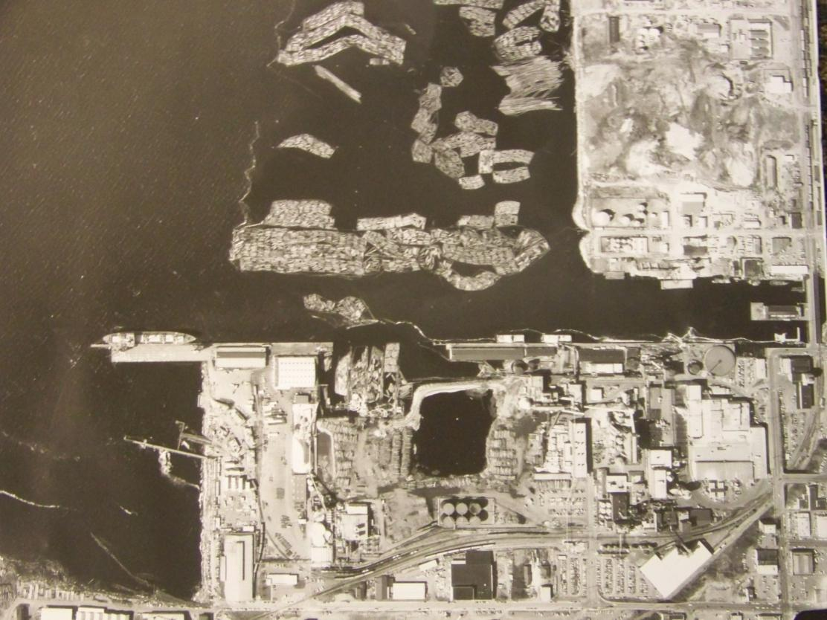
Site History
1975

Slide 16
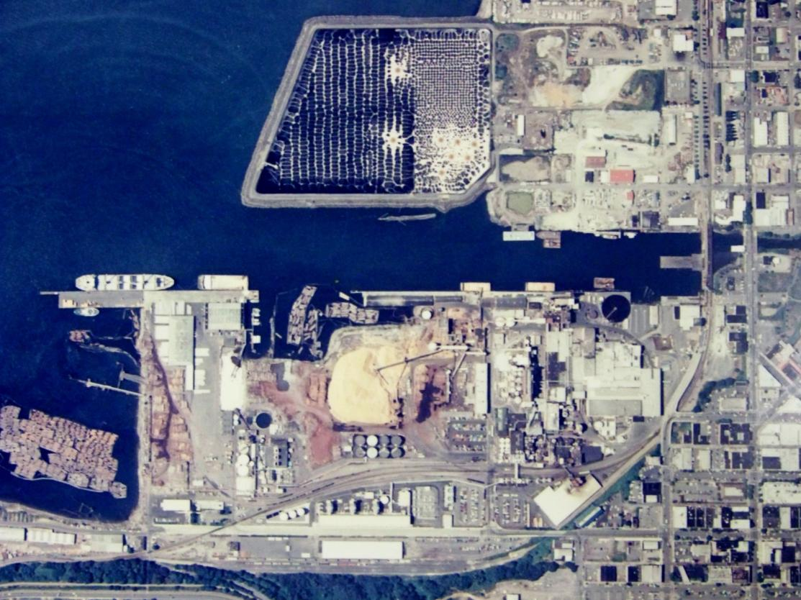
Site History
1990’s

Slide 17
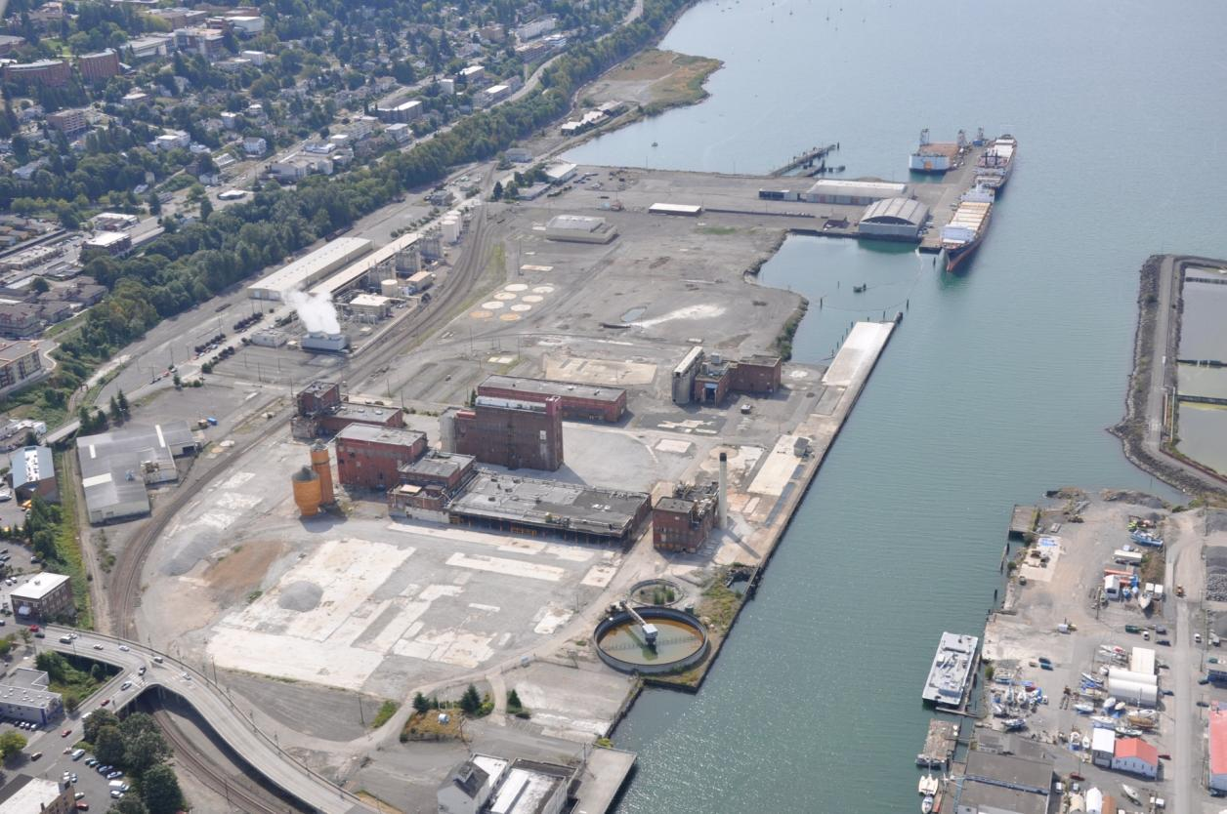
Site History
Cell Building & Mercury
Bunker C
2010

Slide 18
Interim Action Areas

Slide 19
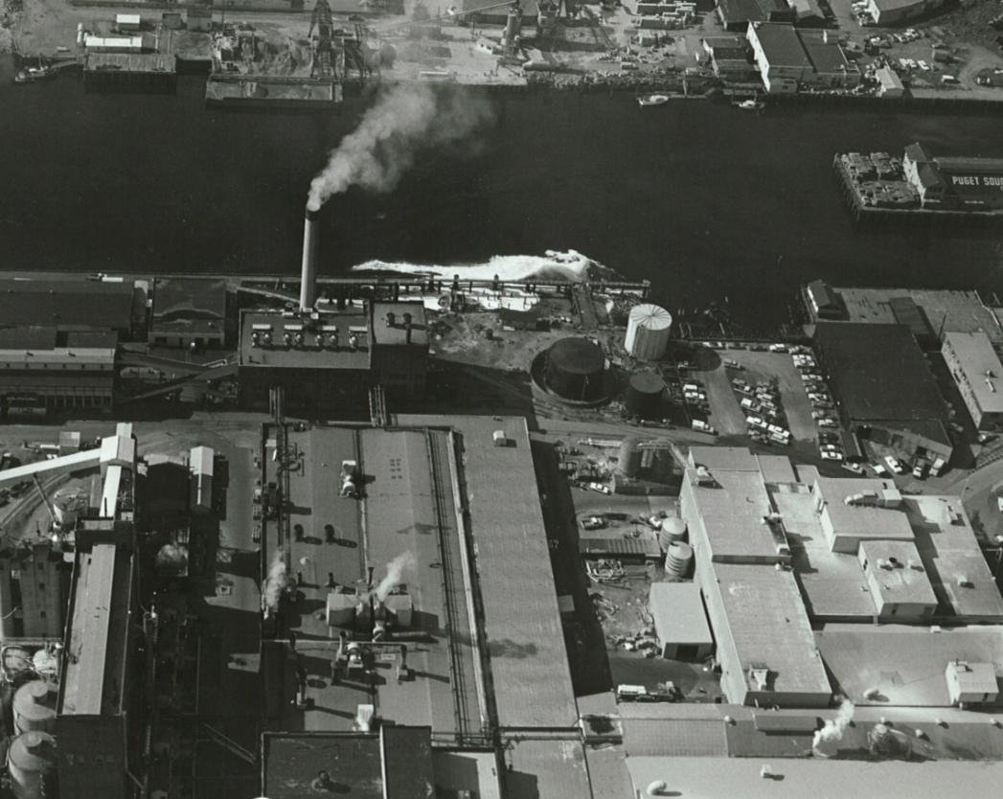
Bunker C Interim Action Area
1969

Slide 20
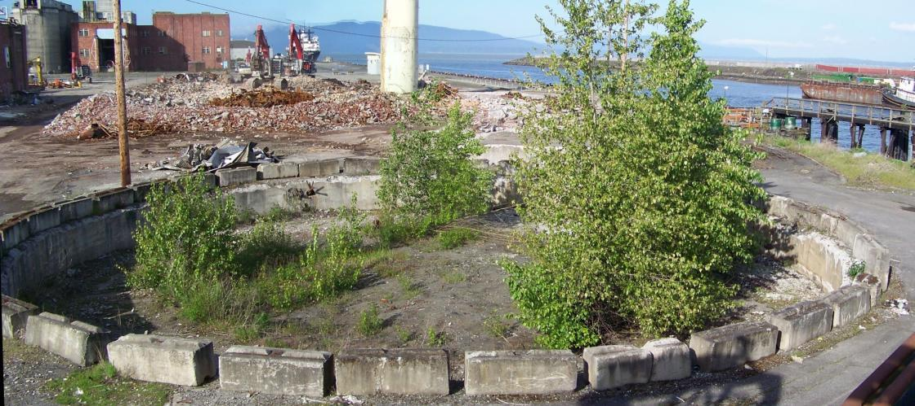
Environmental Conditions
Bunker C Area
Oil Saturated soil beneath former storage tank
Source of petroleum free product
Adjacent to Whatcom Waterway
Other impacts (elevated TPH in adjacent soils) to be addressed in final action.

Slide 21
Proposed Interim Action
Bunker C Area
Excavation and proper off-site disposal of petroluem-saturated soil beneath former fuel storage tank
Removal of 8,000+/- tons (5,000 cubic yards) TPH impacted soil (Bunker C)
Manage groundwater during excavation
Excavate drier soil in upper 15 feet
Dispose of water to ASB under NPDES Permit
Protect adjacent clarifier and bulkhead structures during excavation
Performance monitoring

Slide 22
Proposed Interim Action

Slide 23
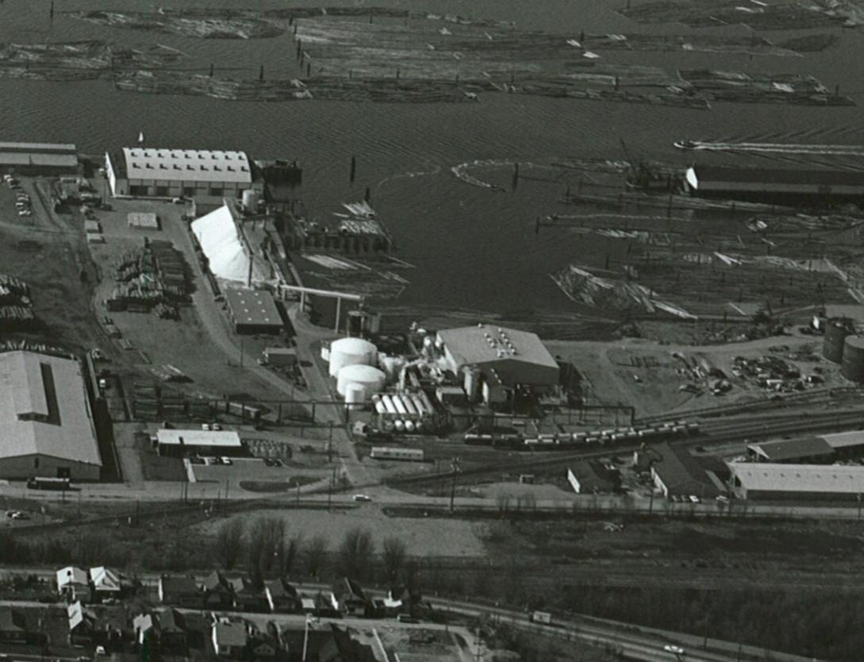
Caustic Plume Interim Action Area
1969

Slide 24
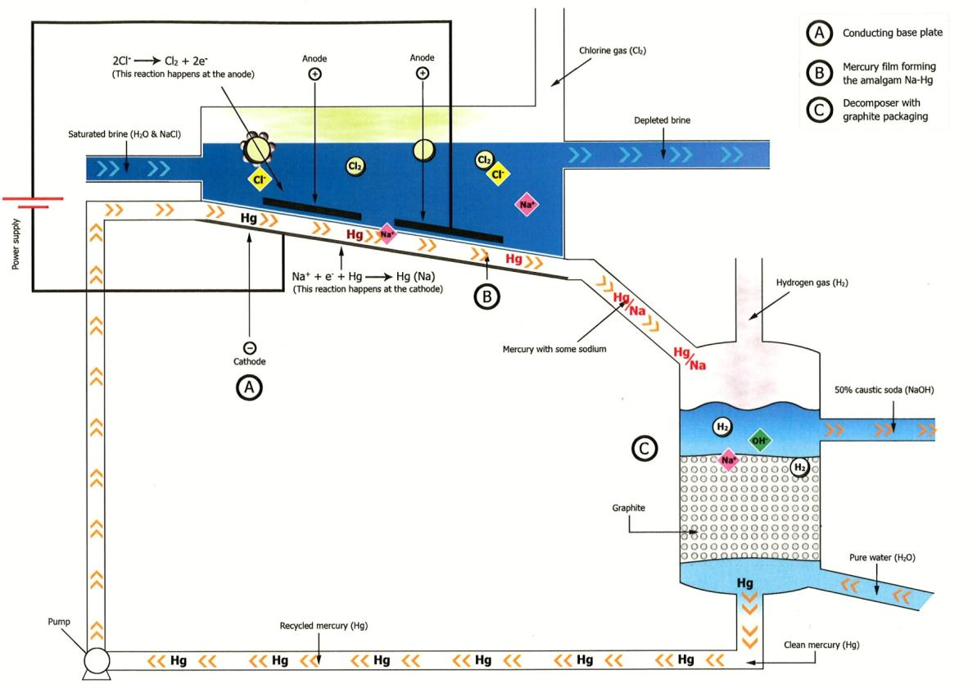
Chlor-Alkali Process
http://www.eurochlor.org/animations/mercury-cell.asp

Slide 25
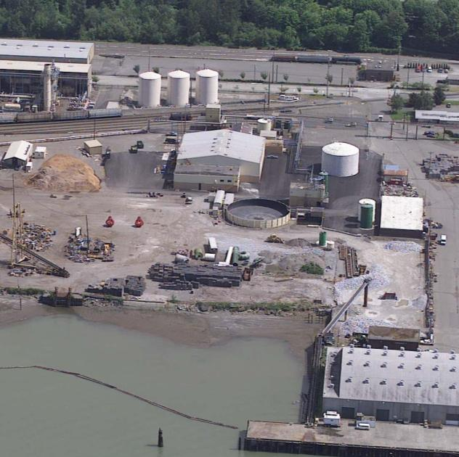
Environmental Conditions
Caustic Plume/Mercury Cell Building
Isolated areas of visible elemental mercury in soil.
Caustic Filter House
Mercury Recovery Unit
Ongoing source to vapor and groundwater
Aquitard and deep aquifer considerations
Interior building materials impacted with mercury.
Other impacts (high pH and dissolved mercury) to be addressed in final action.

Slide 26
Proposed Interim Action
Caustic Plume Area
Excavation and proper off-site disposal of soil containing visible elemental mercury
Removal of 450+/- tons (280 cubic yards) of Mercury impacted soil
Former Caustic Filter House
Former Mercury Recovery Unit
Manage groundwater during excavation
Dewater upper 15 feet
Depressurize lower aquifer to maintain integrity of aquitard
Dispose of water to ASB under NPDES Permit
Performance monitoring

Slide 27
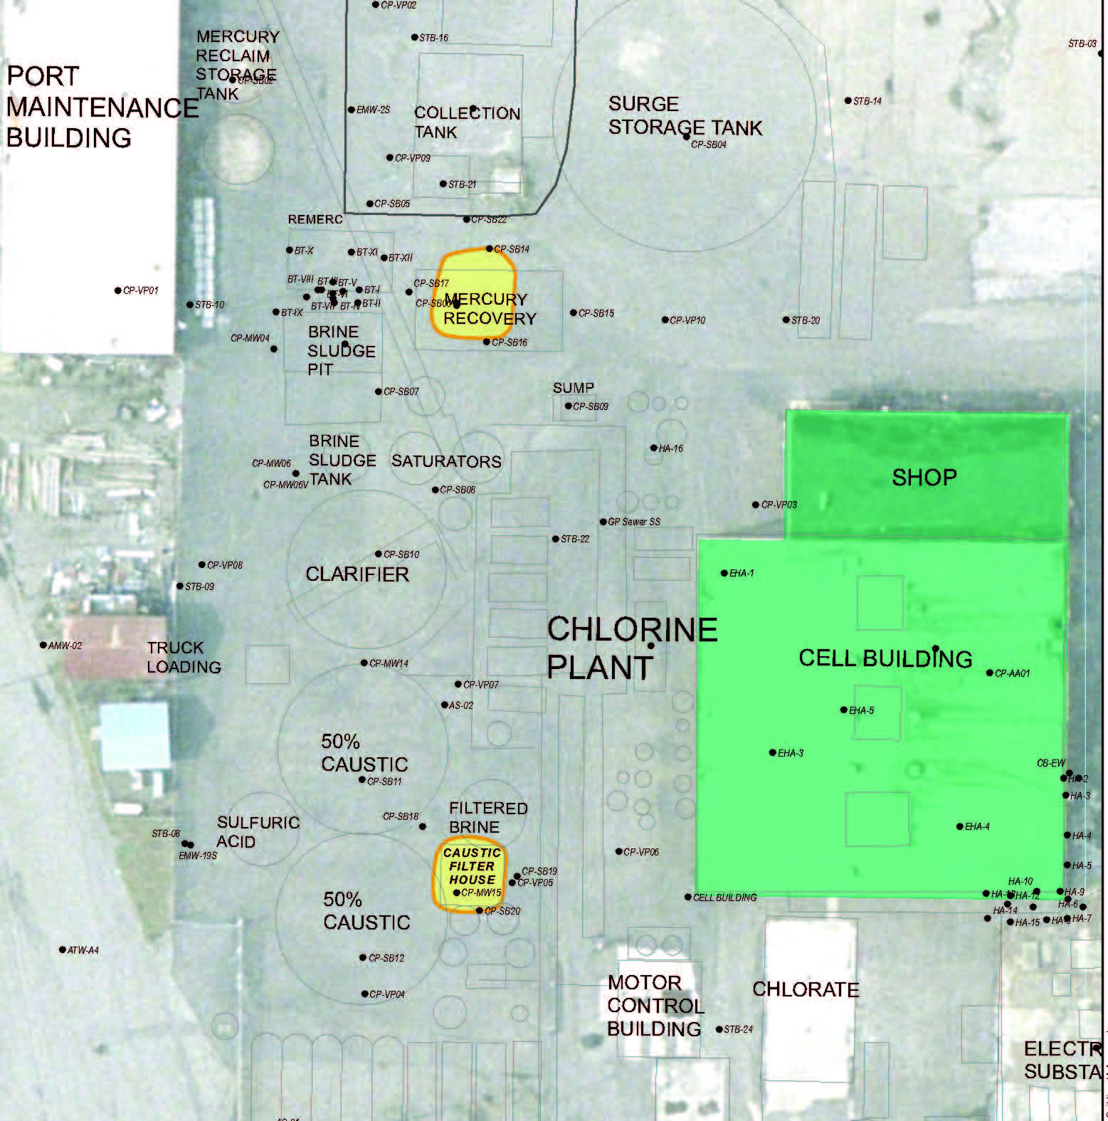
Proposed Interim Action

Slide 28
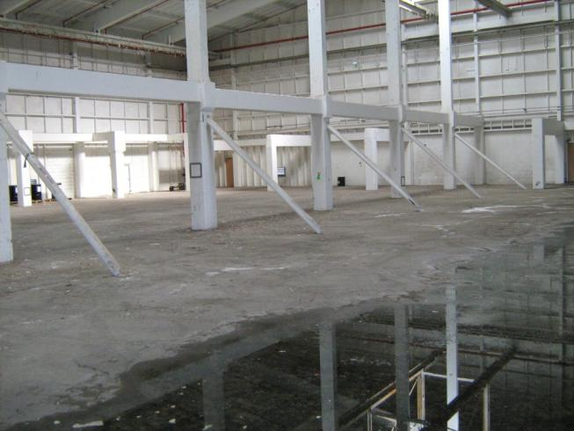
Proposed Interim Action
Mercury Cell Building
Profile remaining structural building materials
Abate remaining regulated building materials
Demolish building
Properly dispose of demolition waste

Slide 29
State Evaluation
Source Removal Action
Reduces threats to human health and then environment
Proposed Interim Action does not foreclose reasonable alternatives for feasibility study or final cleanup.
Remediation Levels
TPH remediation levels:
Lateral: 10,000 mg/kg (GW & vapor migration)
Vertical: 3,100 mg/kg (direct contact)
Mercury remediation levels:
Lateral: Visible mercury and 2,100mg/kg (GW & vapor migration)
Vertical: 24 mg/kg (direct contact) or upper two feet of aquitard
Integration into RI/FS

Slide 30
Next Steps & Schedule
Proposed Agreed Order Amendment
30 day public comment ends August 3rd
Ecology response to comments
Ecology Decision
Port SEPA Determination (MDNS) Available for review and comment through August 3rd
Phased Construction
Bunker C Area – Fall 2011
Mercury Source Area & Cell Building – Spring 2012
Incorporate Interim Action into Final RI/FS (2012)

Slide 31
Ecology Wants Your Comments
Document Availability
Ecology’s Web Site https://fortress.wa.gov/ecy/gsp/Sitepage.aspx?csid=2279
Document Repositories
Bellingham Library - Main Branch
Ecology’s Bellingham Field Office - Fairhaven
Ecology’s Northwest Regional Office – Bellevue
Submit Comments by August 3, 2011
Ecology will prepare response to comments after public comment period

Slide 32
Questions?

