Slide 1
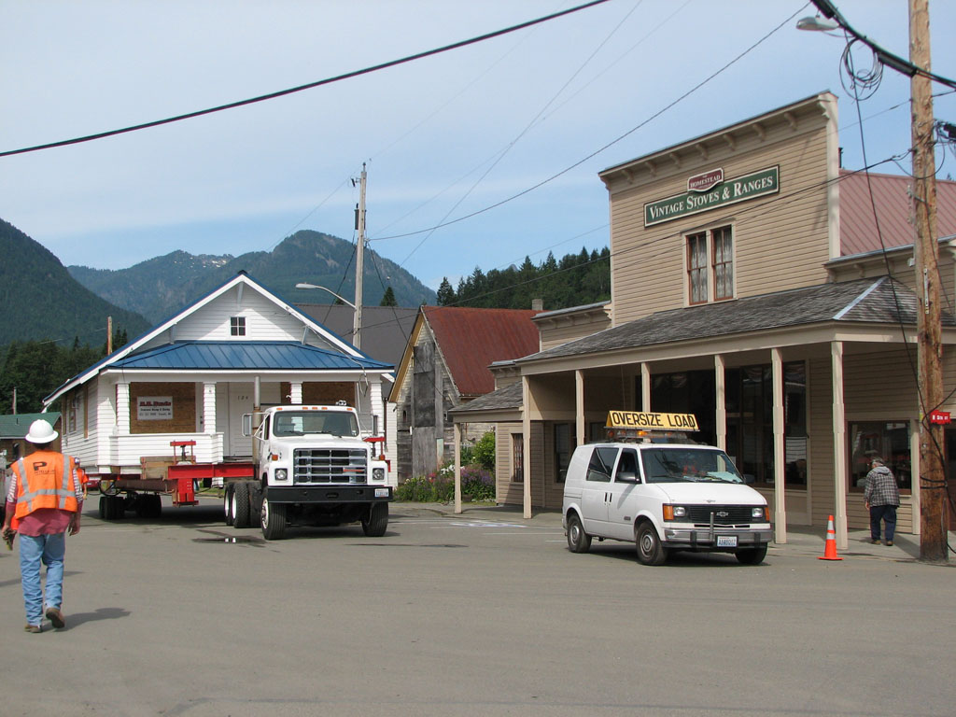
The Cleanup and Restoration of SKYKOMISH, WASHINGTON
Washington State Department of Ecology
Toxics Cleanup Program (February 2010)
Program Manager: Jim Pendowski
Notes:
Infrastructure Design Class

Slide 2
Program Goals and Mission
Preamble to the Model Toxics Control Act (MTCA)
“Each person has a fundamental and inalienable right to a healthful environment, and each person has a responsibility to preserve and enhance that right. The beneficial stewardship of the land, air, and waters of the state is a solemn obligation of the present generation for the benefit of future generations.”
The goals and mission of the Toxics Cleanup Program is to get contaminants from the environment and keep them out.

Slide 3
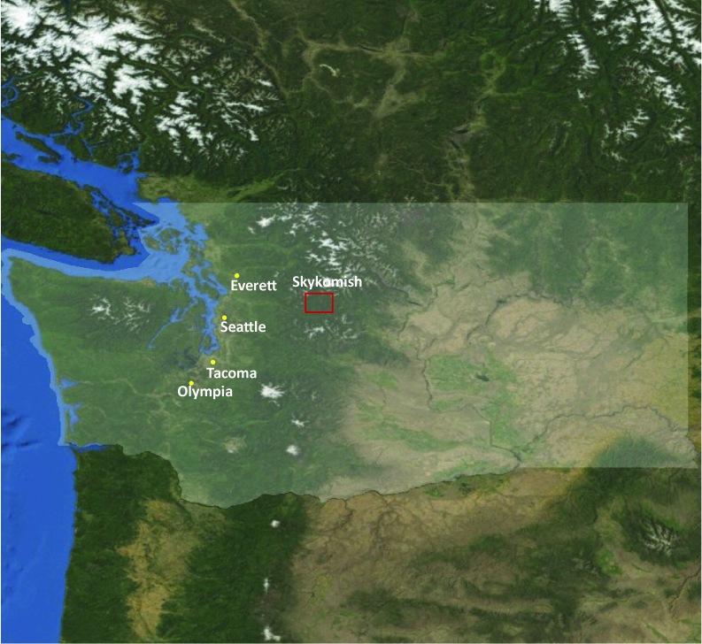
Skykomish, Washington
Approximately 1.5 hours NW from Seattle.
25 miles from Stevens Pass Ski Resort.
Town population is about 200;
500 including the surrounding communities.
Notes:
Town gets significant snow from November to May.

Slide 4
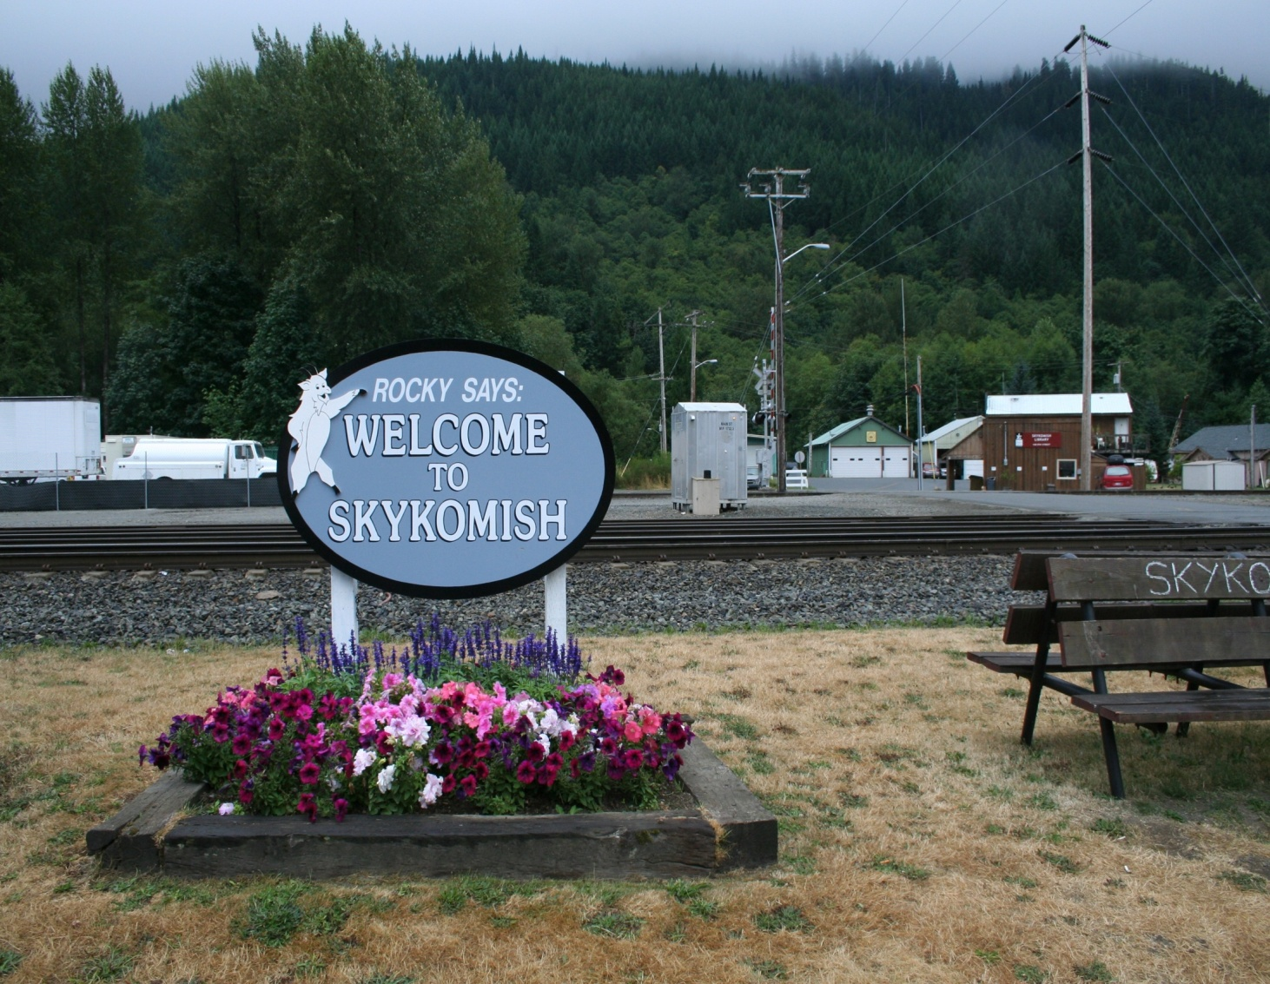
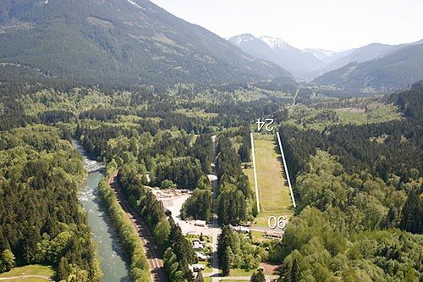
Skykomish, Washington
Tourist community --
close to Stevens Pass for skiing; fishing, hunting, and hiking.
Popular recreational flying community in the summer with its own airstrip.
Notes:
Skykomish was once a refueling and maintenance stop for Great Northern Railway (now BNSF) before trains passed over the Cascade Mountains.
Situated on the Skykomish River, which eventually merges with the Snoqualmie River and discharges into Puget Sound.

Slide 5
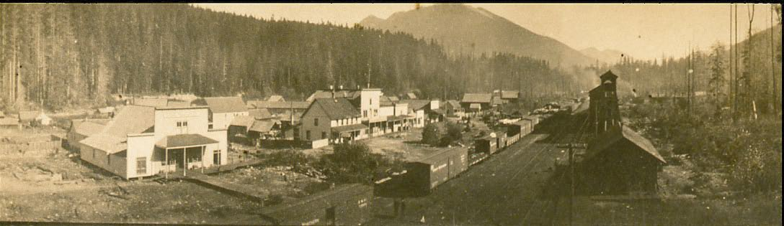
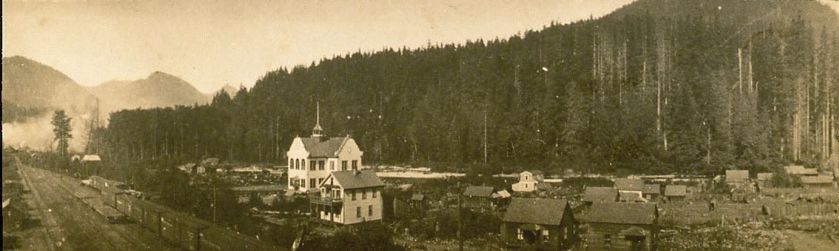
Historic Skykomish
Notes:
Begin to put into context –
This was a “typical” operation.
There are thousands of these fueling stations around the country.
This means there are many more areas where there are or were once similar operations (and not just for refueling trains), many that are even abandoned, with product that was spilled or leaked into the environment.
Their are consequences to our desire to get around and ship products.

Slide 6
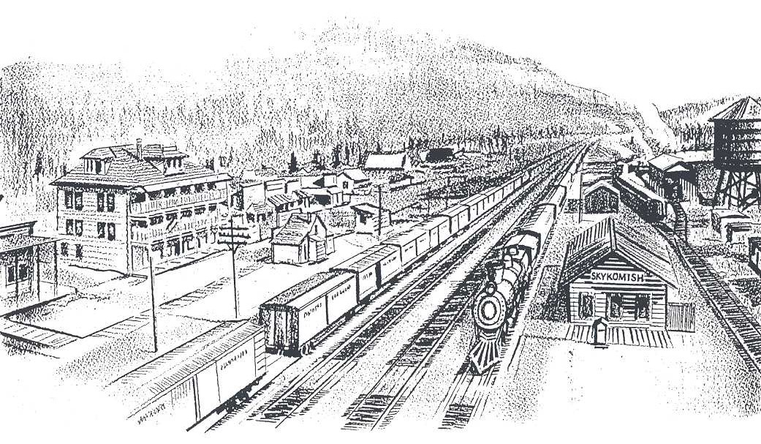
BNSF-Skykomish
Former Maintenance and Fueling Facility
Great Northern Railroad, (later merged with other companies), used the rail yard to refuel and maintain trains from late 1800s until 1974.
Operations resulted in discharges of petroleum products (bunker-c oil).
Discharges to Skykomish River and Maloney Creek first documented in 1920s.
Notes:
Great Northern Railroad, later merged with other companies, used the rail yard to refuel and maintain trains from late 1800’s until 1974; now used as BSNF base for track maintenance and snow removal crews.
Operations resulted in discharges of petroleum products (bunker-c oil).
Discharges to Skykomish River and Maloney Creek first documented in 1920s.
Ecology first aware of contamination in 1989, and listed the Site on the State Hazardous Sites List in 1991. The Site was found to be among sites with highest level of concern, and assigned highest priority for investigation.

Slide 7
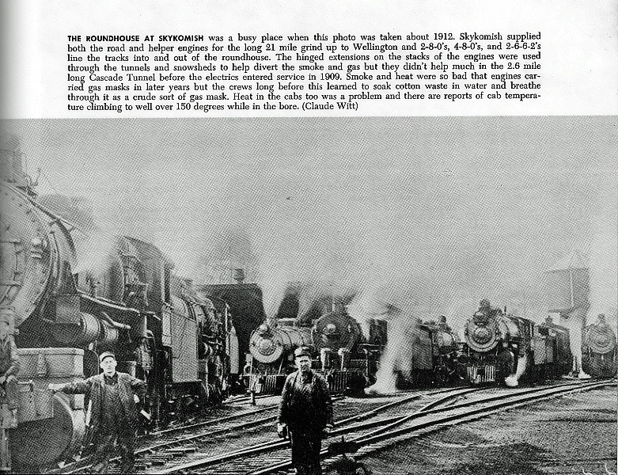
Historic railway photo

Slide 8
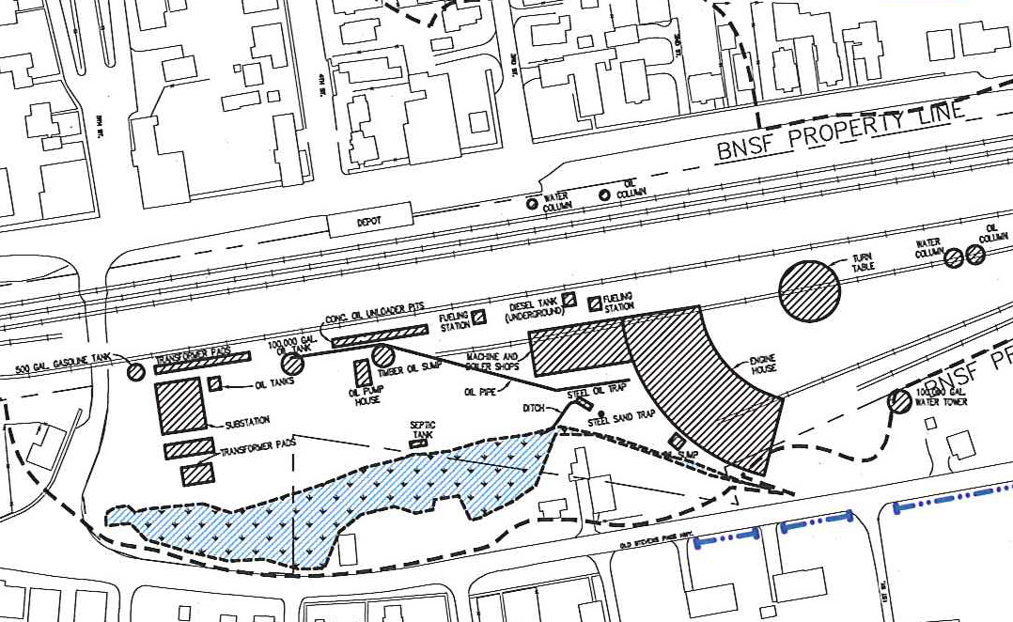
Historic Railyard Facilities
So, what happened?
Bunker C leaked from wood-lined cribs.
Later, diesel was allowed to overflow when filling locomotives.

Slide 9
BNSF-Skykomish: 2006
2006 – Immediate interim cleanup actions required.
Notes:
2006 –
Map showing known contamination under the Town.
Ecology and BNSF sign a second agreed order.
This order required immediate interim cleanup actions on the Skykomish River while the Cleanup Action Plan and Consent Decree are finalized.

Slide 10
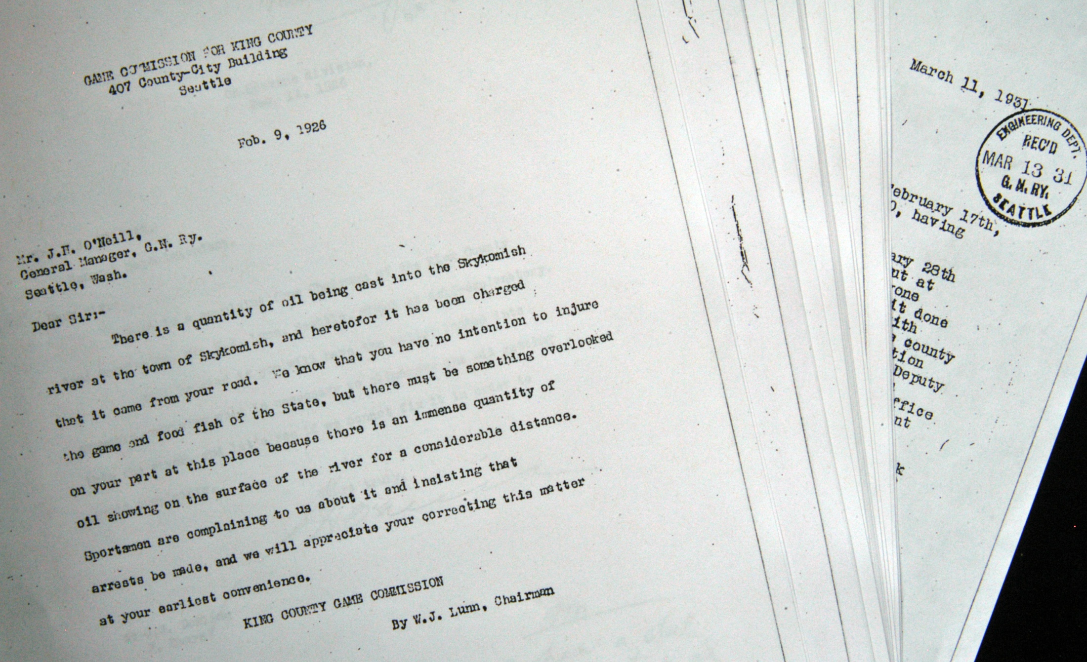
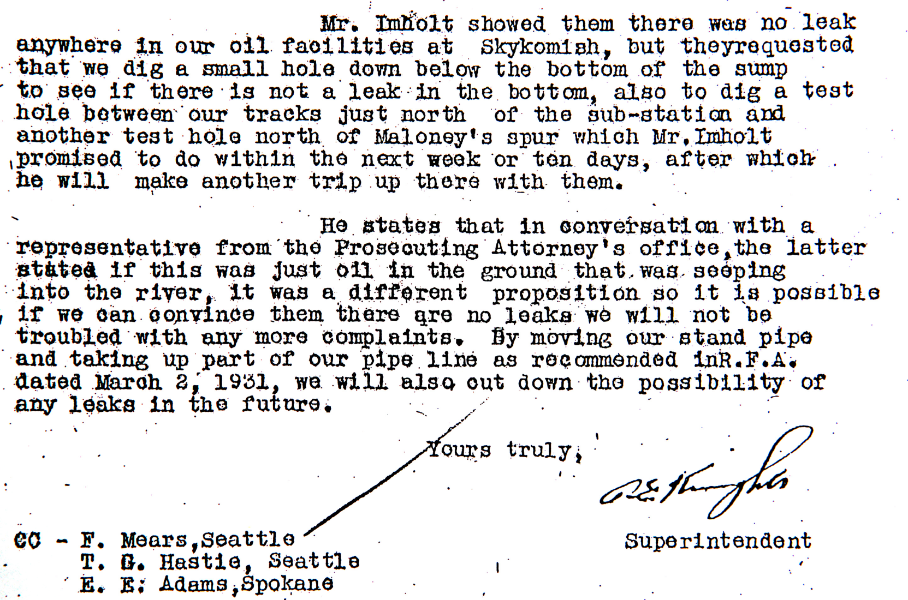
Oil was reported in the river in 1926; the problem was considered over the next 5 years.

Slide 11
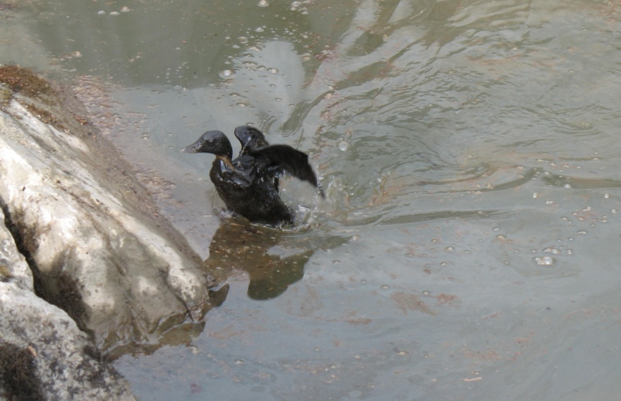
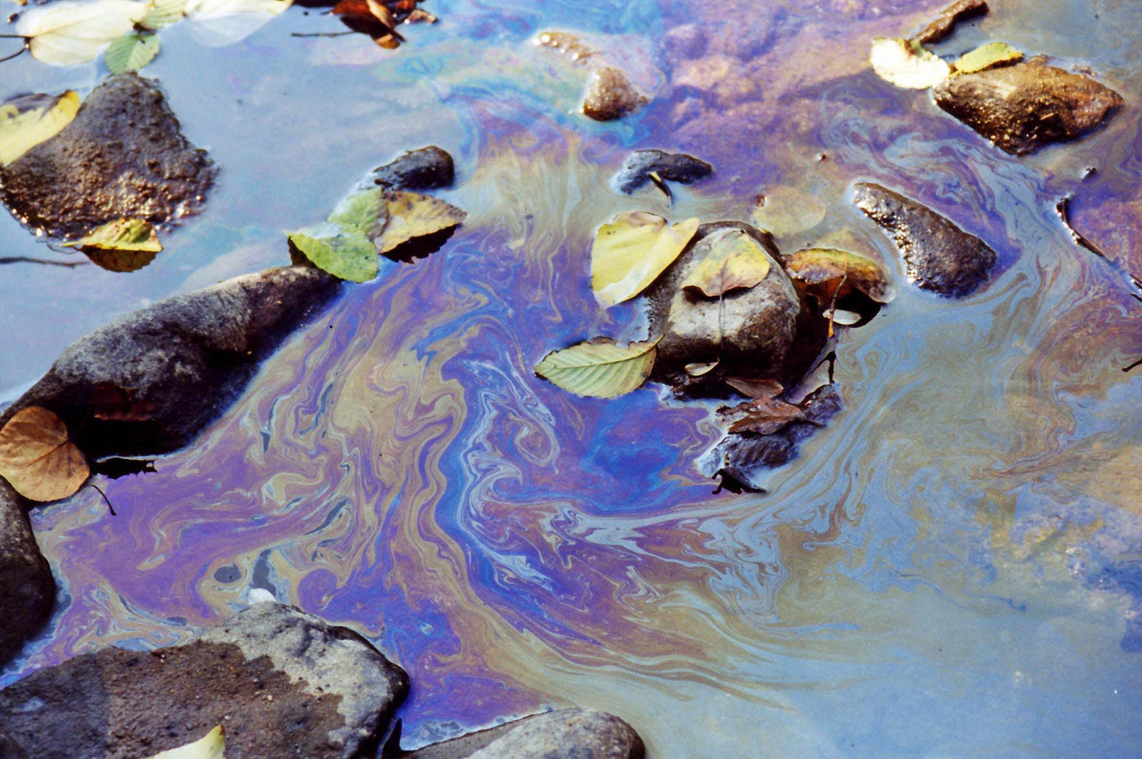
Skykomish
Contamination in the River
Notes:
Ecology begins working with the community – providing information about the contamination under the Town that’s moving towards and into the Skykomish River.

Slide 12
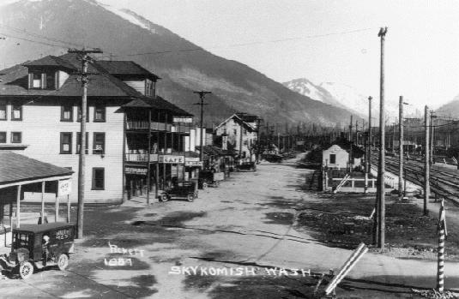
Skykomish: Over 100 years old
1991 -- Ecology enters into Agreed Order with BNSF for a Remedial Investigation and Feasibility Study.
BNSF conducts investigation throughout the 90s and submits a Feasibility Study in 1999.
Ecology conducts further
studies through 2005 to
fill data gaps, and in 2005
develops a Cleanup Action
Plan based on these
studies.

Slide 13
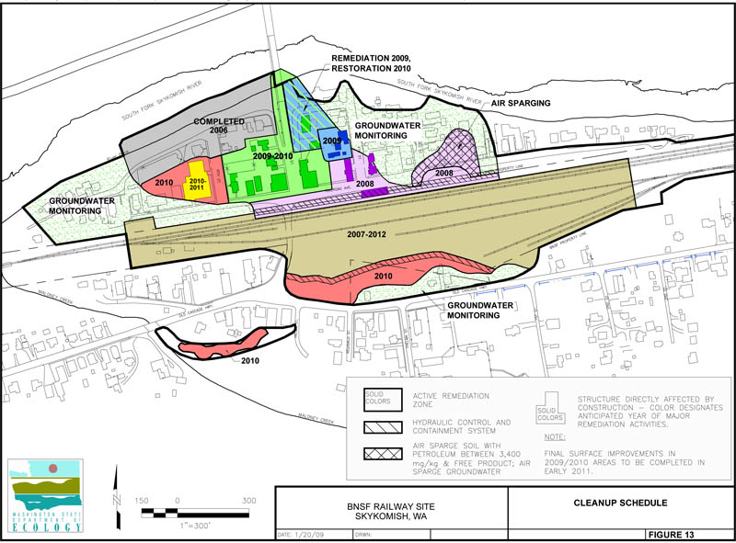
BNSF-Skykomish: 2006
Notes:
2006 –
Map showing known contamination under the Town.
Ecology and BNSF sign a second agreed order.
This order required immediate interim cleanup actions on the Skykomish River while the Cleanup Action Plan and Consent Decree are finalized.

Slide 14
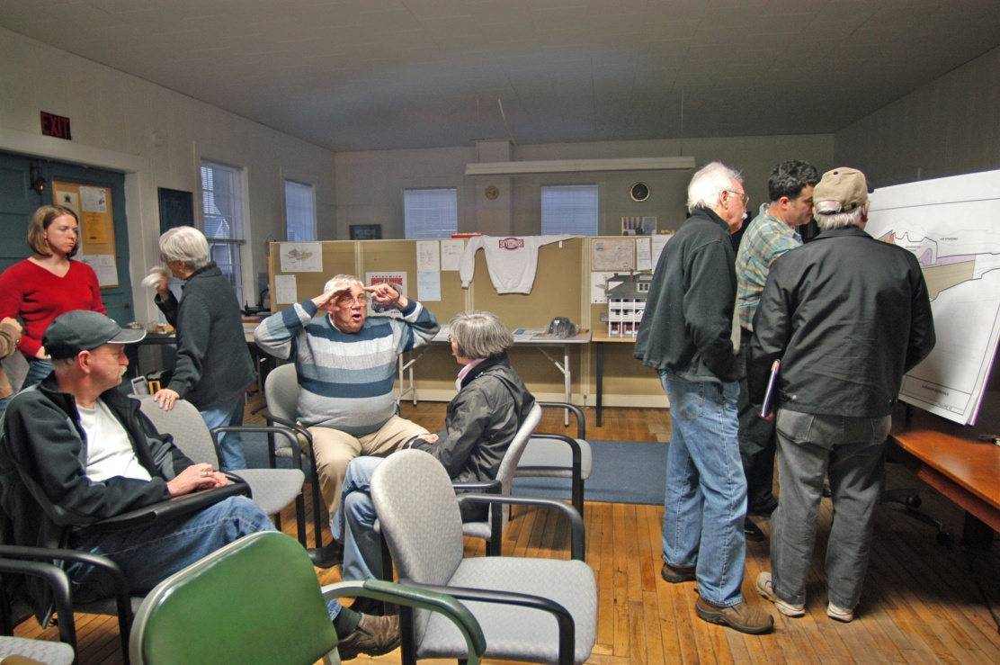
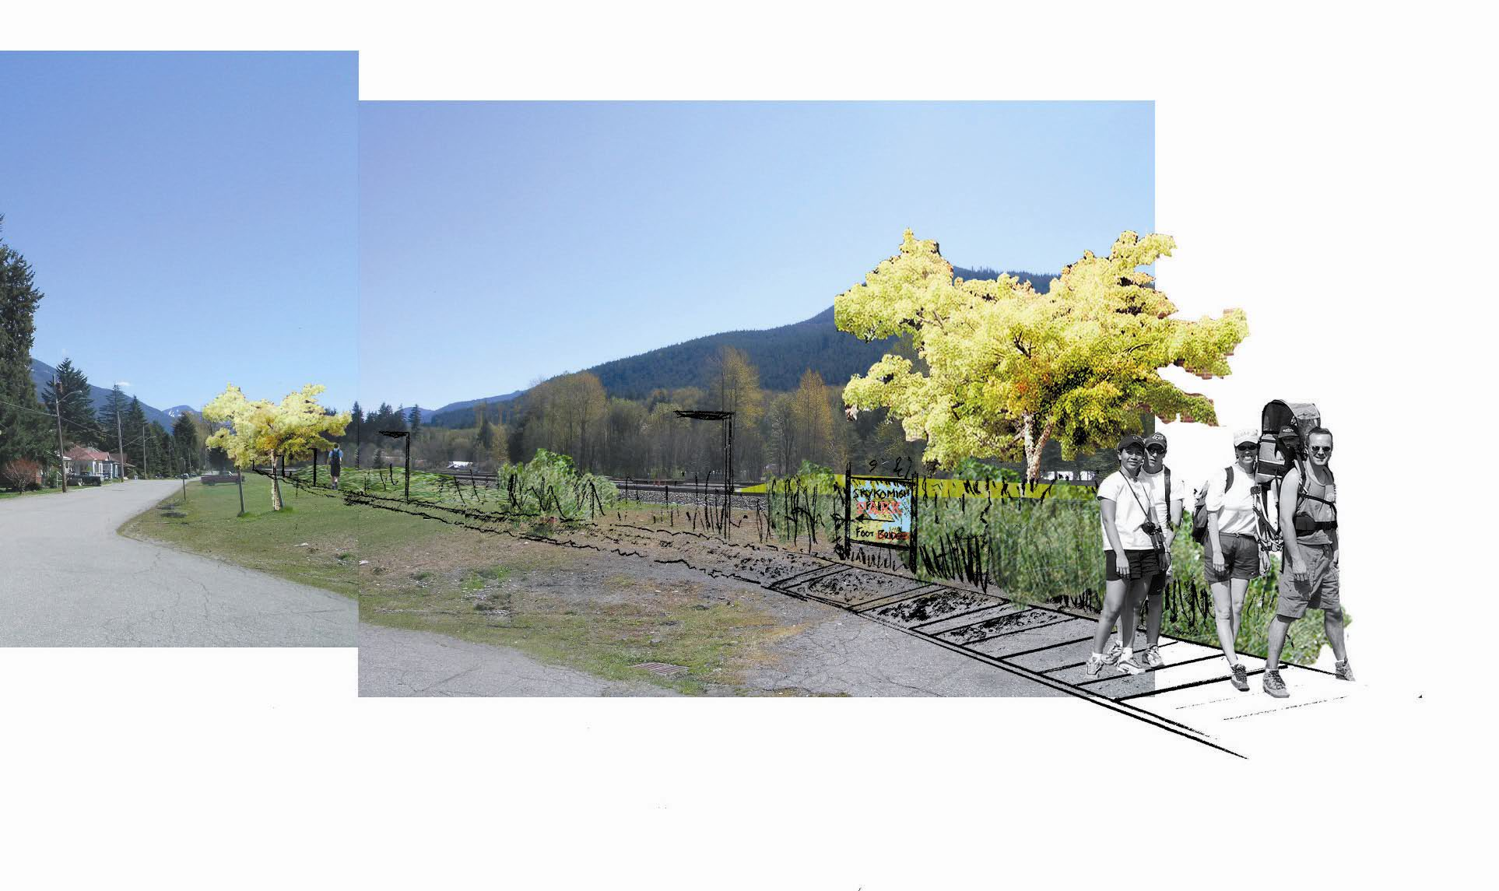
Creating a Town Vision
2005 -- Ecology partners with the community to develop a vision for their Town after the cleanup.
There were workshops, brainstorming sessions, and public discussions to create a final Vision for the Town of Skykomish.
Notes:
Leadership from the State
Set the vision, goals and schedules early
Form public/private sector partnerships
Focus investigations and feasibility studies
Use interim and removal actions more
frequently
Include restoration of habitat

Slide 15
6 Principles Guiding the Vision

Slide 16
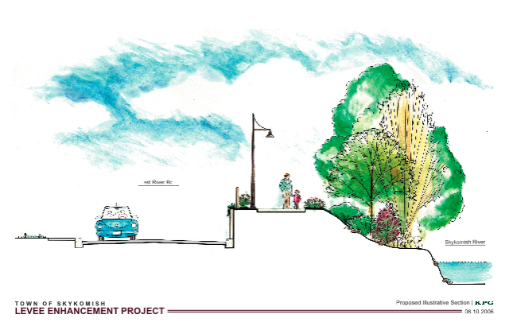
Creating a Town Vision
Future vision consistent with the Town Comprehensive Plan;
Community defined themes for vision;
Define options for development in the Town and specific projects following the cleanup.

Slide 17
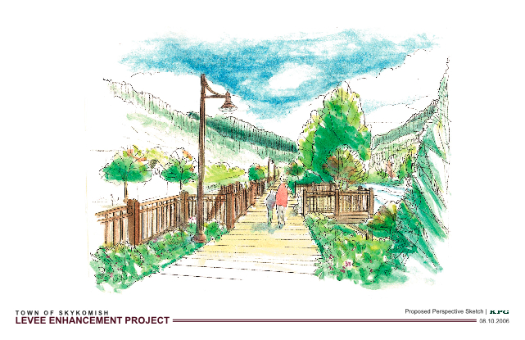
Creating a Town Vision
Future vision of the levee.

Slide 18
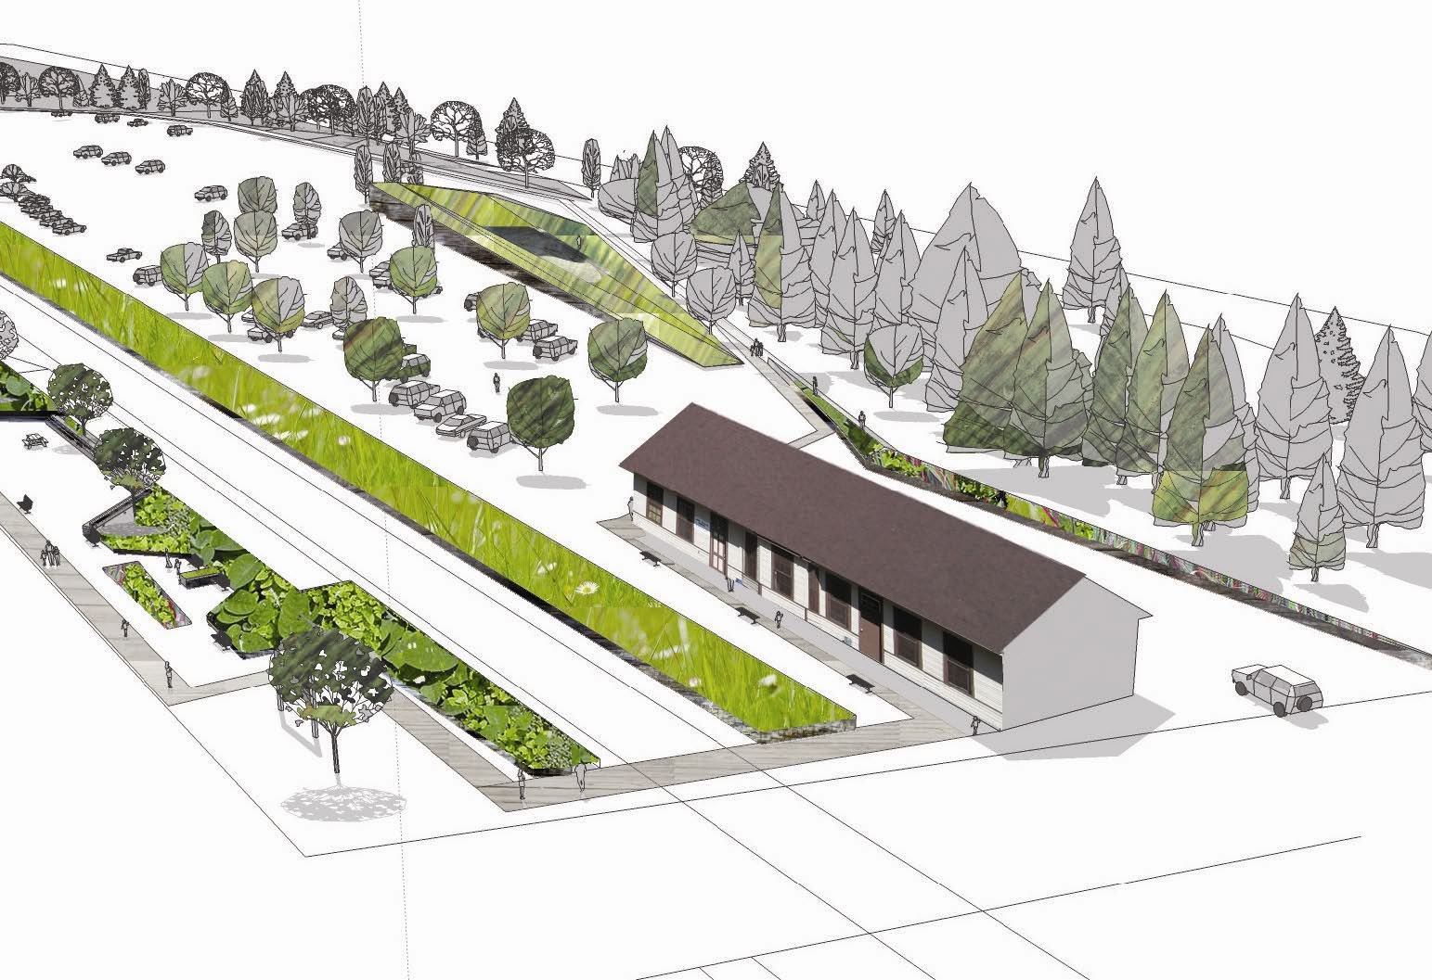
Creating a Town Vision
Future vision of the town.

Slide 19
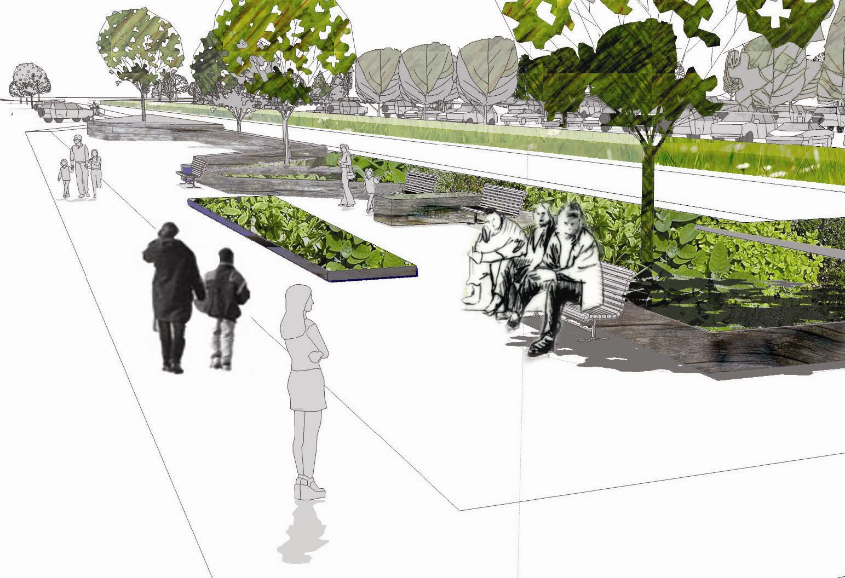
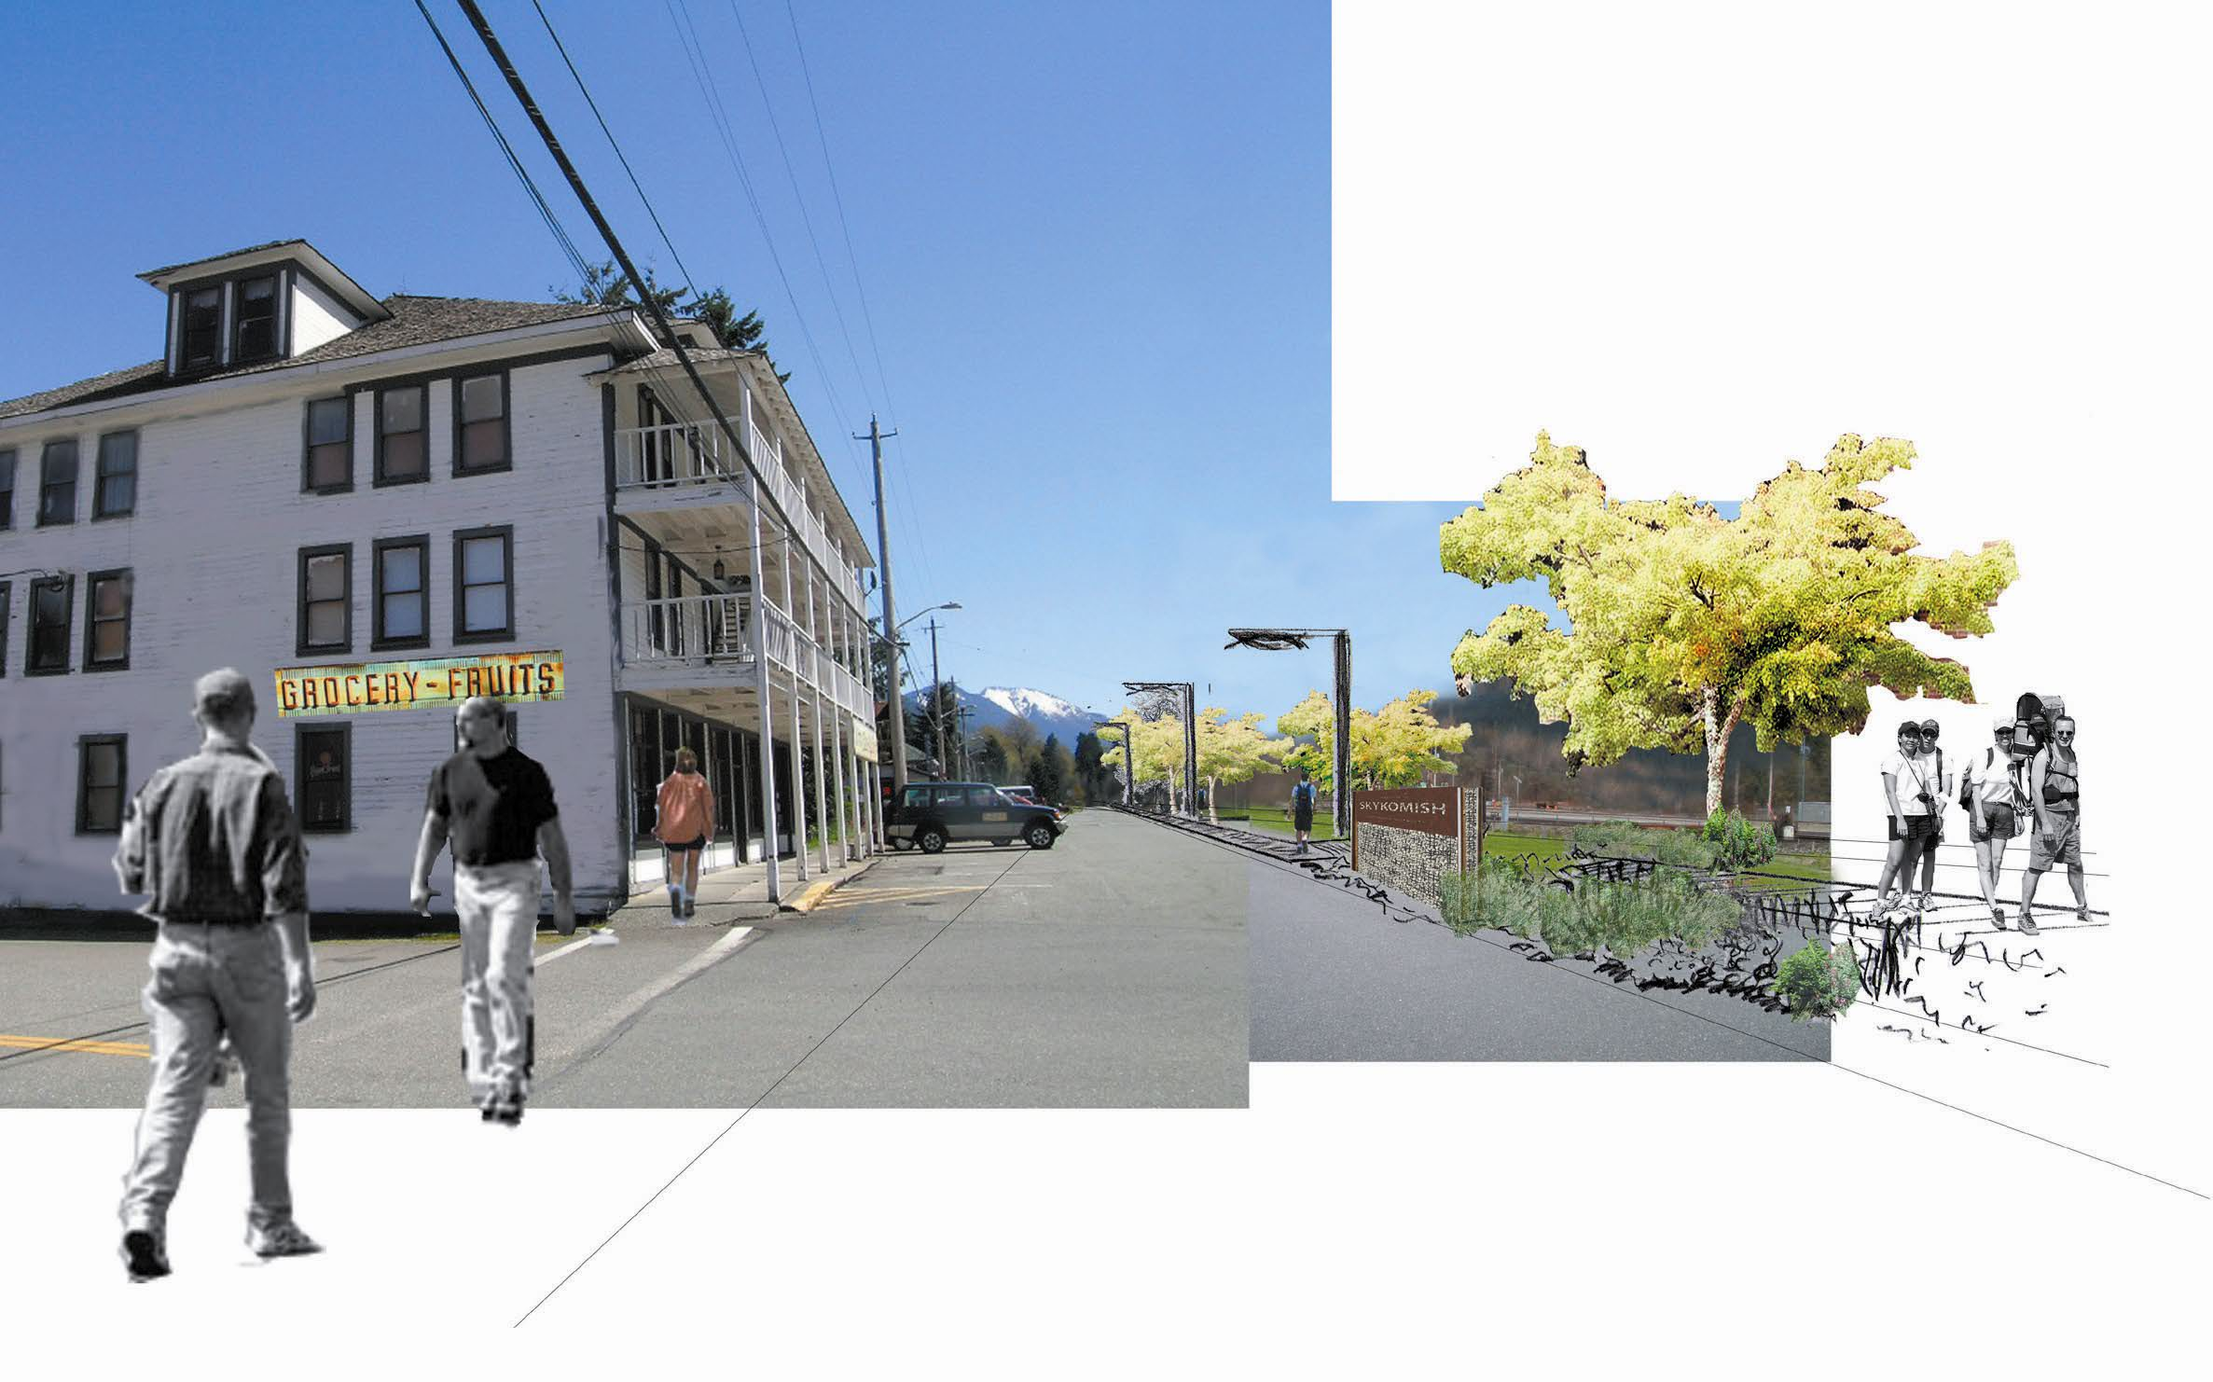
Creating a Town Vision

Slide 20
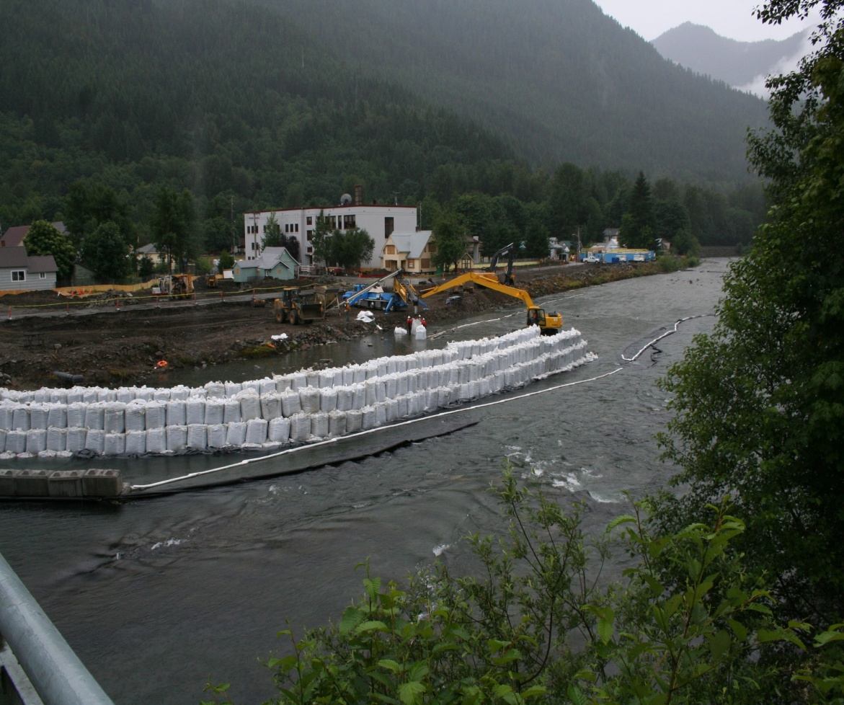
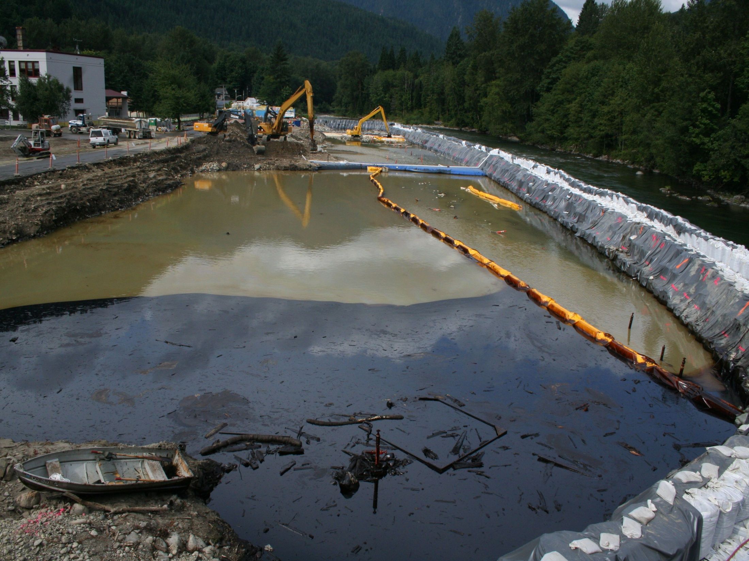
Skykomish: 2006
Notes:
Construction of levee to protect the Skykomish River from the cleanup activities.

Slide 21
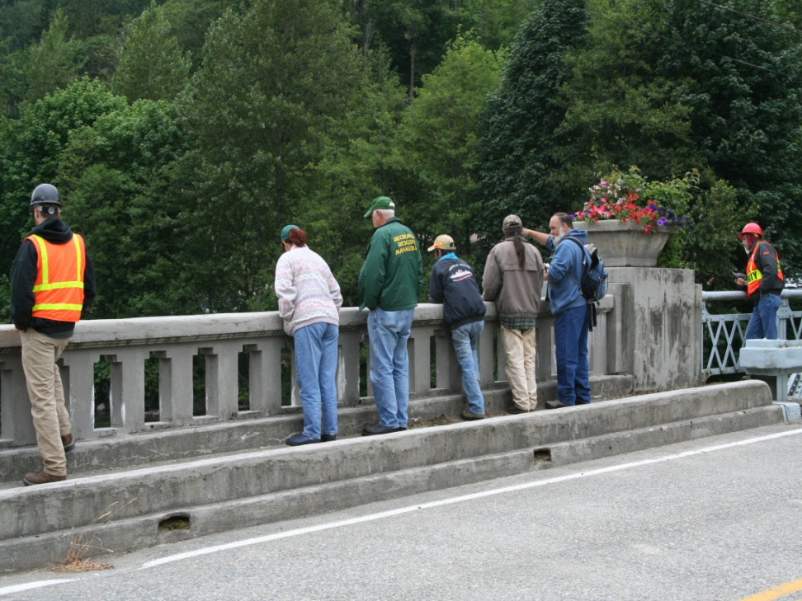
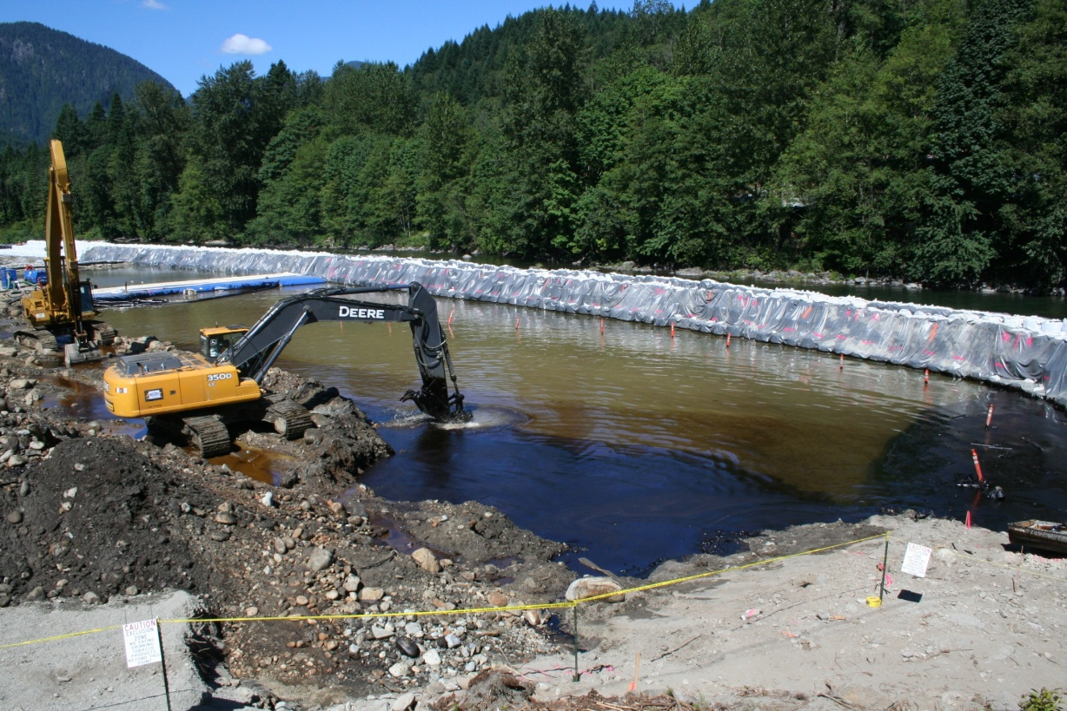
BNSF-Skykomish: 2006
Massive amounts of contamination leaches from the land towards the river.
This is one of the first times people in the community really see the extent of the contamination under their town.
Removed over 100,000 tons of contaminated soil; over 30,000 gallons of oil.
Notes:
Removed & replaced contaminated river sediments & soil in river bank.
Replaced river flood levee & removed existing contaminants.

Slide 22
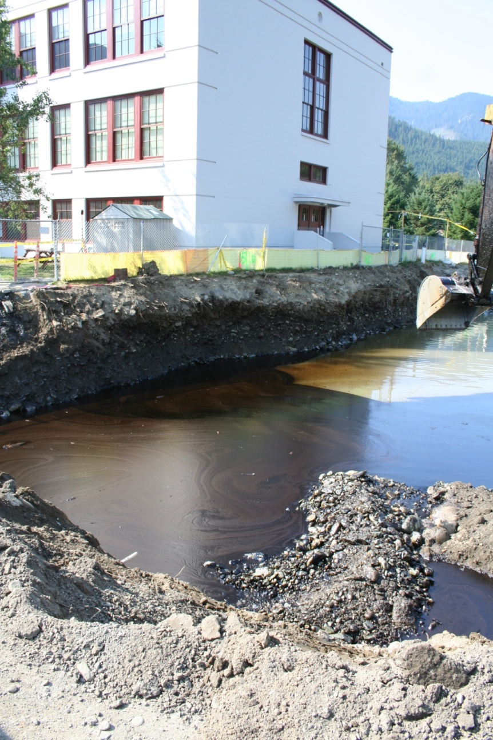
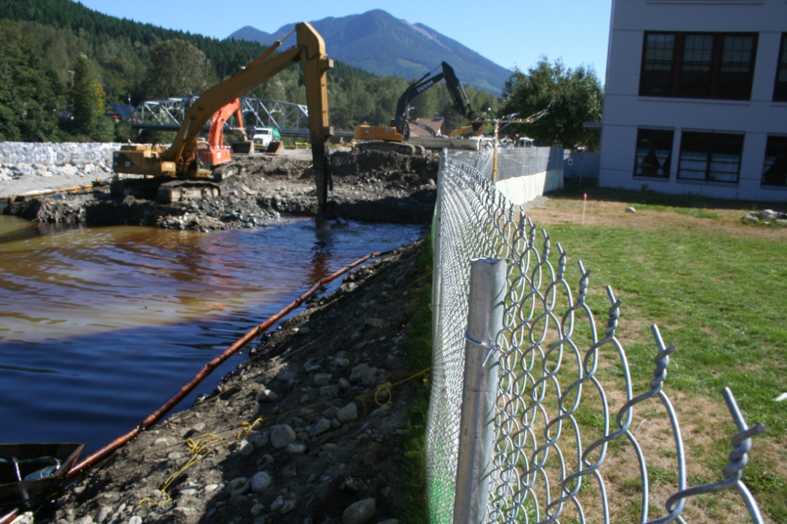
BNSF-Skykomish: 2006
Removed & replaced contaminated river sediments & soil in river bank.
Replaced river flood levee and removed existing contaminants.
Notes:
Cleanup work near the school.

Slide 23
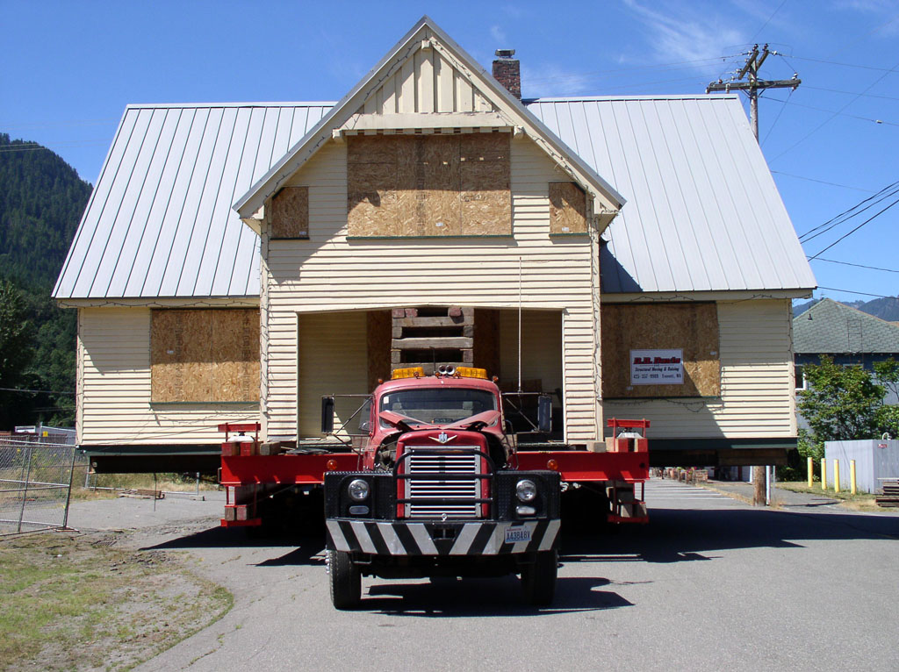
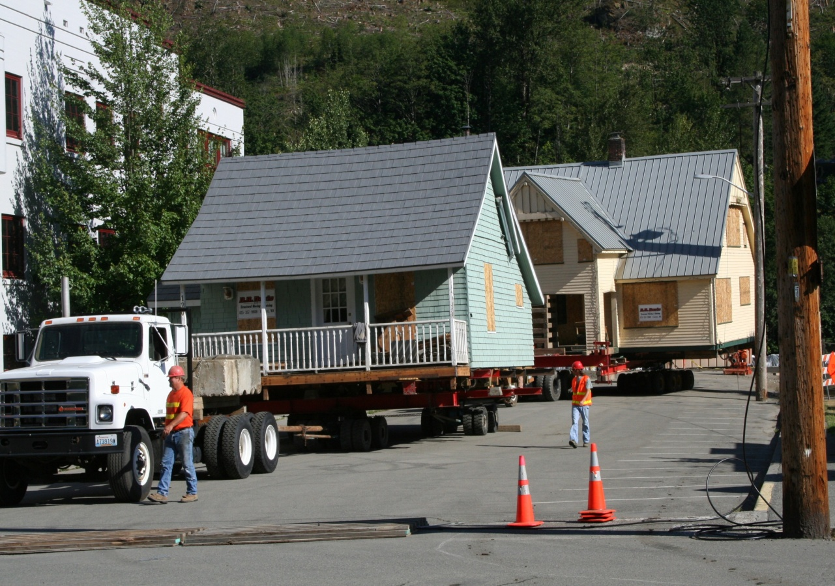
BNSF-Skykomish: 2006
Excavated five properties; included relocating & returning residences.
Notes:
Excavated five properties; included relocating & returning residences.

Slide 25
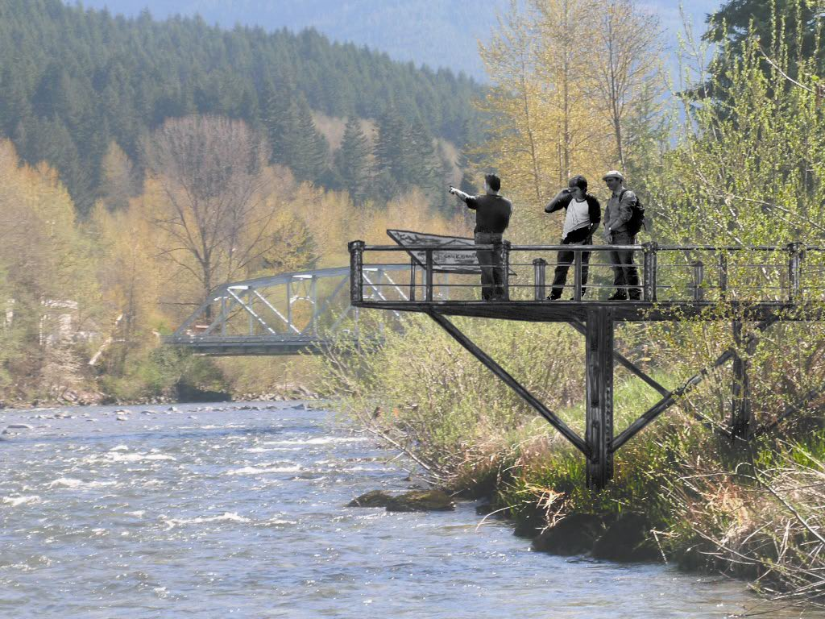
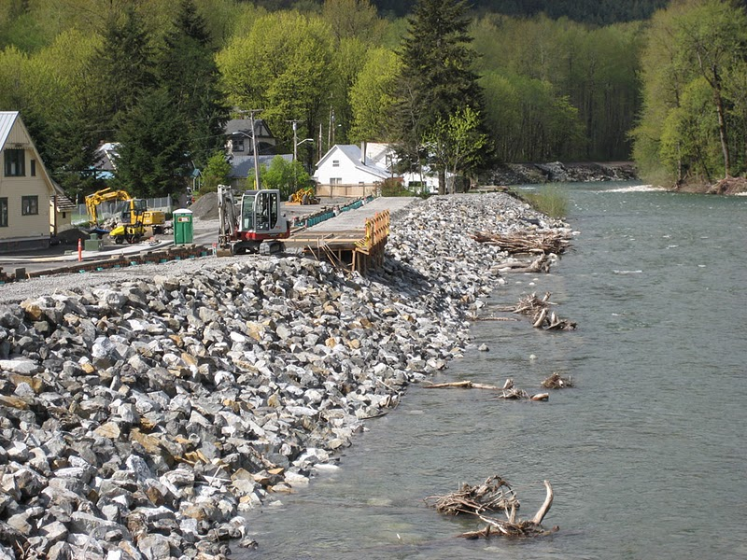
Skykomish: 2006
And….from conceptual ideas…
To actual construction.
Photo from Town of Skykomish website.

Slide 26
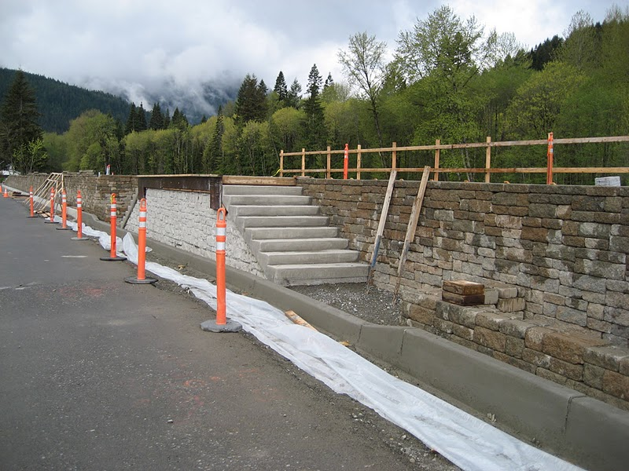
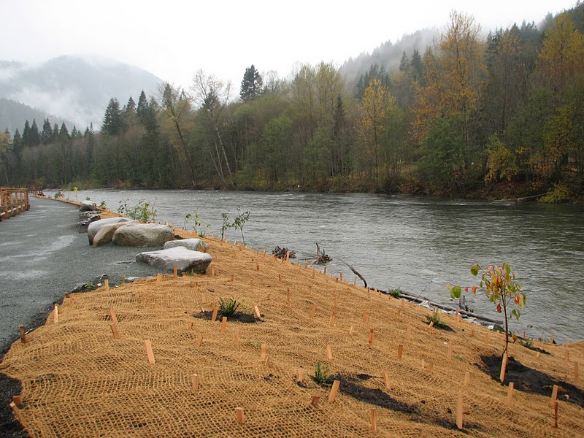
Skykomish: 2006
Further construction and...
…restoration of the levee.
Photos from Town of Skykomish website.

Slide 27
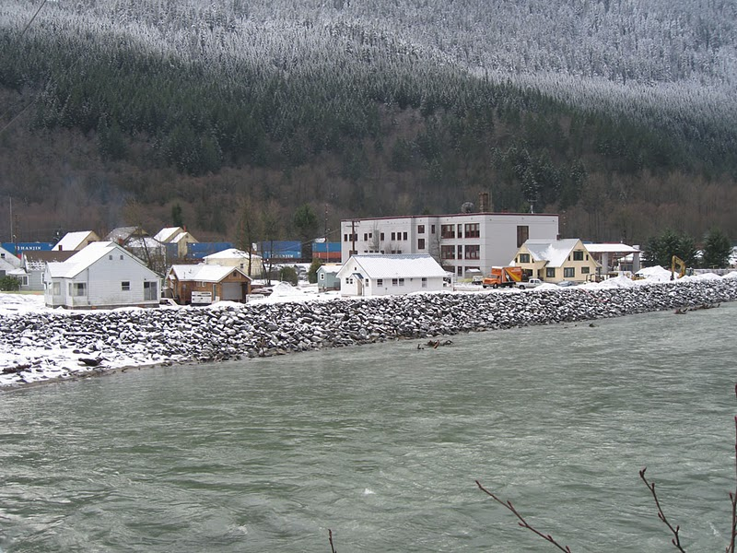
Skykomish: 2006
Homes were restored to their original locations. Photo from Town of Skykomish website.

Slide 28
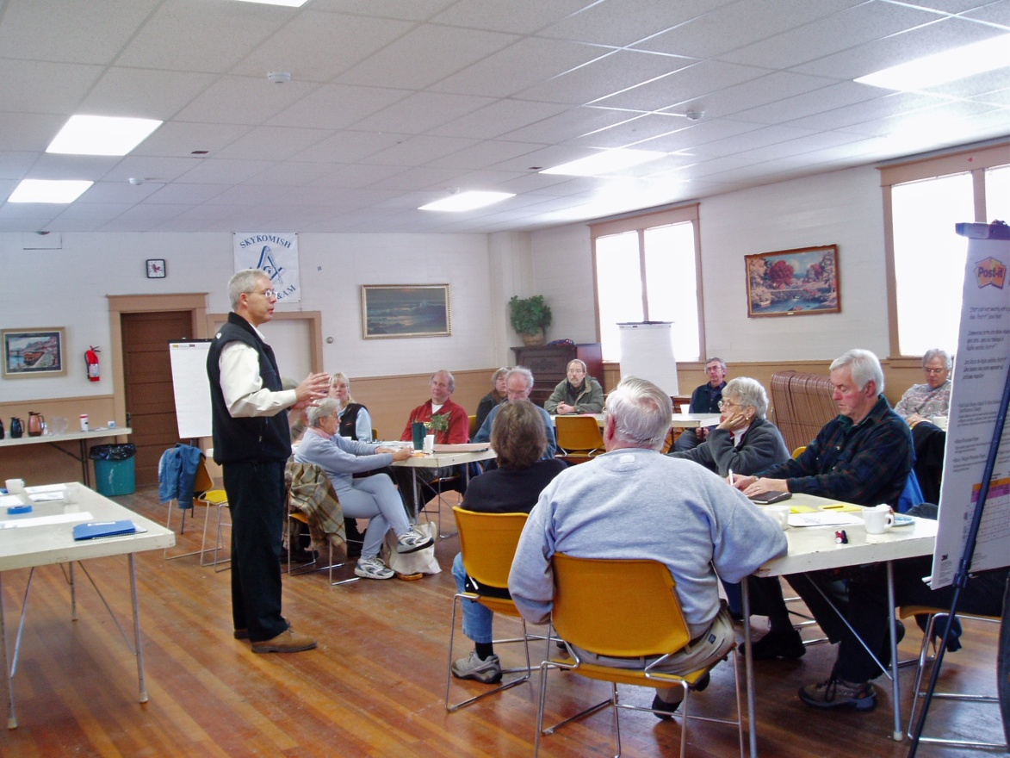
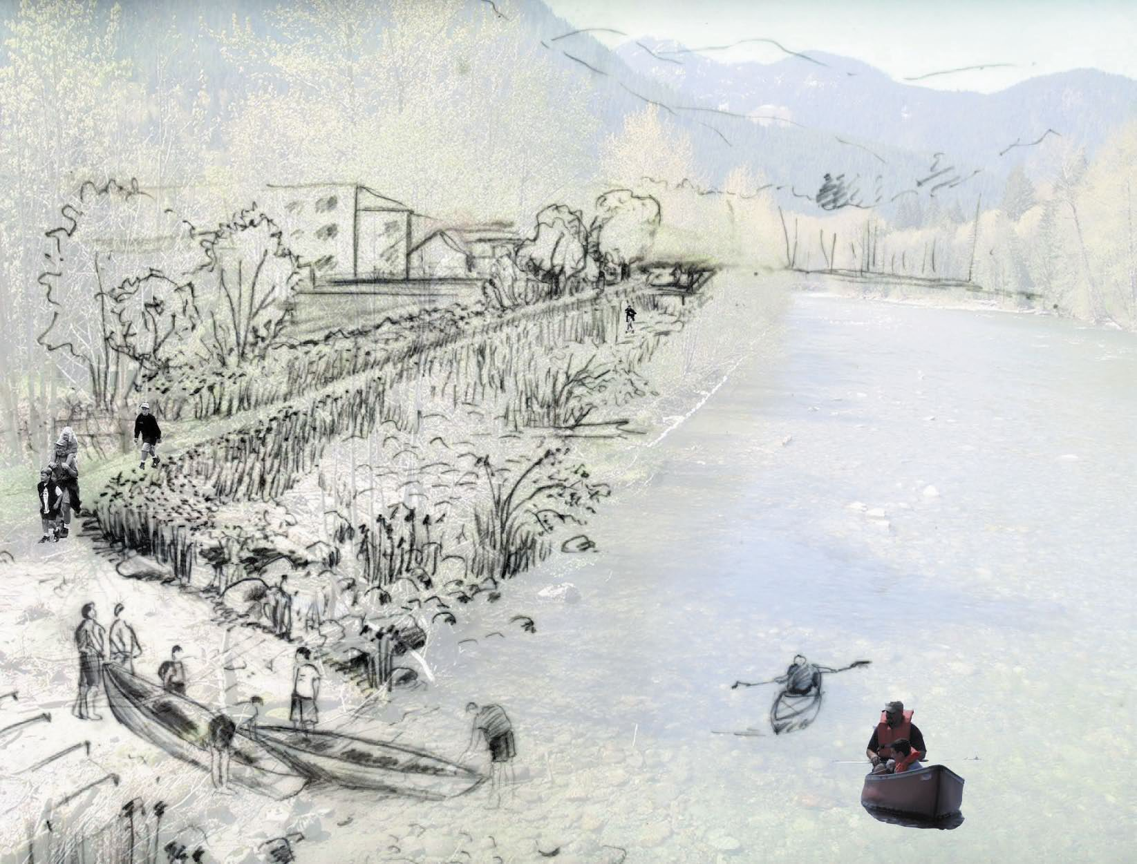
Skykomish: 2007
Consent Decree signed
This included:
  Cleanup Action Plan
  Schedule for Cleanup
  Public Participation Plan
  Required deliverables
Ongoing monitoring and delineation of pollution
Public Planning and input on the Consent Decree.

Slide 29
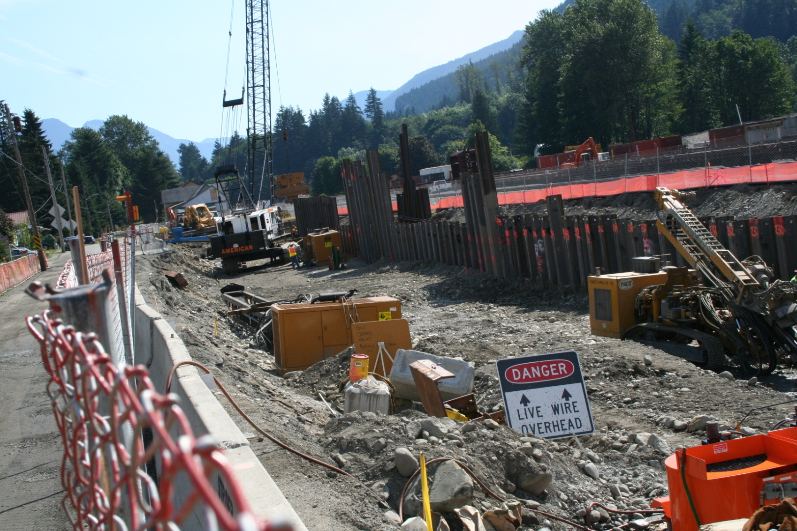
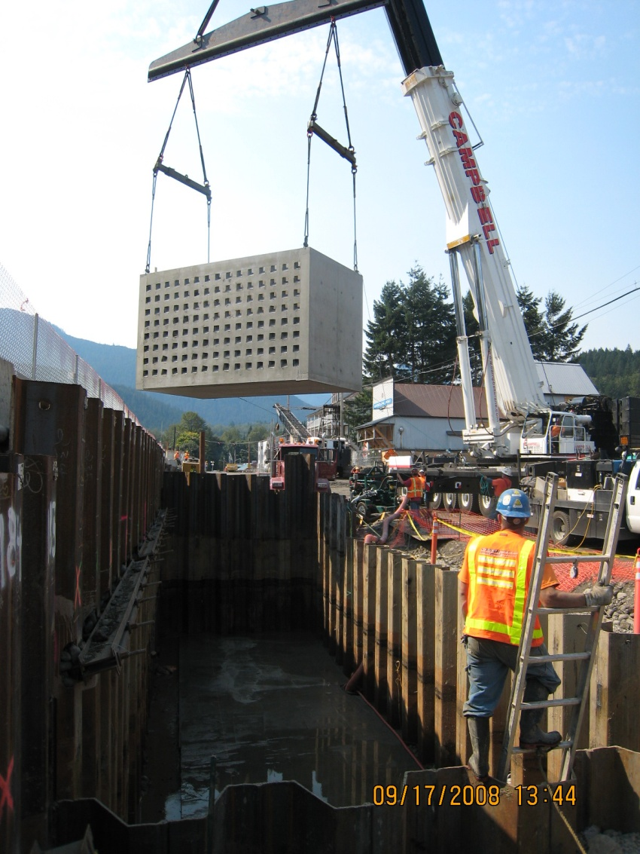
BNSF-Skykomish: 2008
Construct Hydraulic Control & Containment System (HCC) (wall).
Dropped vaults in to filter contaminants flowing towards the town and river.
Notes:
Couldn’t dig up the railroad – part of the cleanup agreement.
Created a giant wall –
400 interlocking steel piles
Vaults lowered in front to filter out pollution

Slide 30
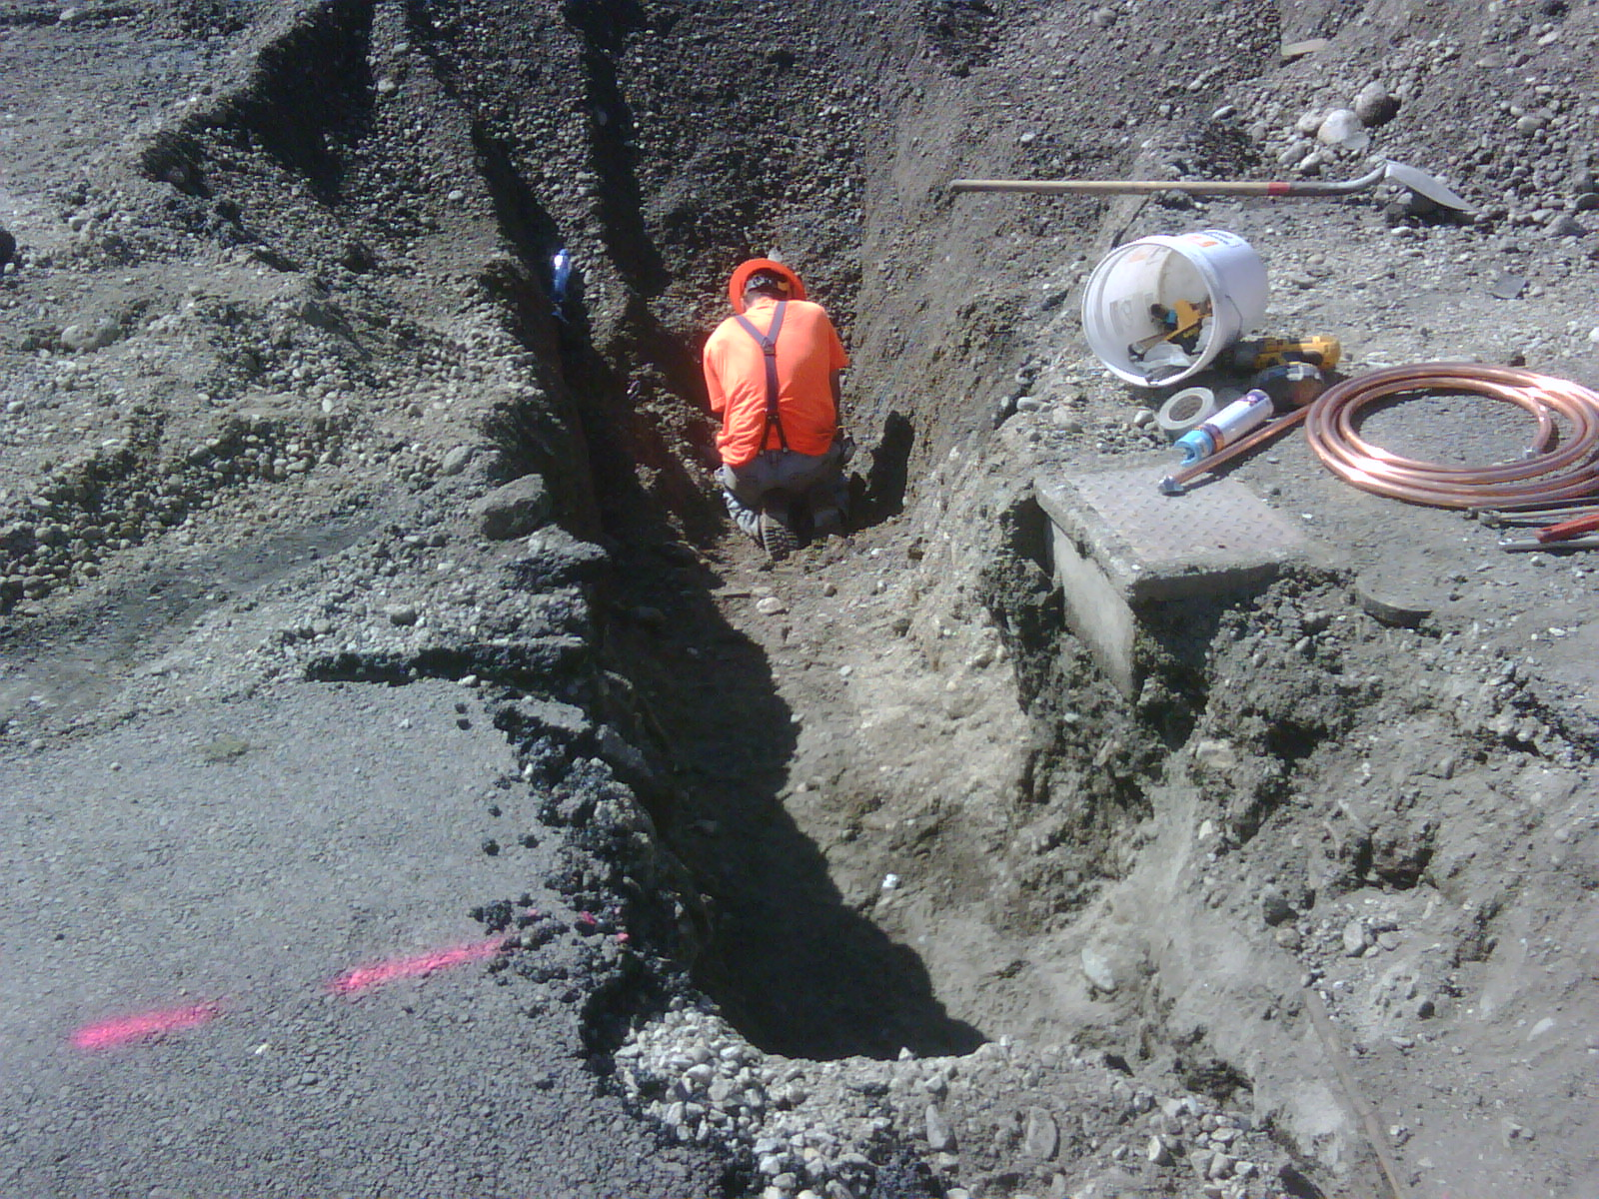
Joint Utility Trench being constructed

Slide 31
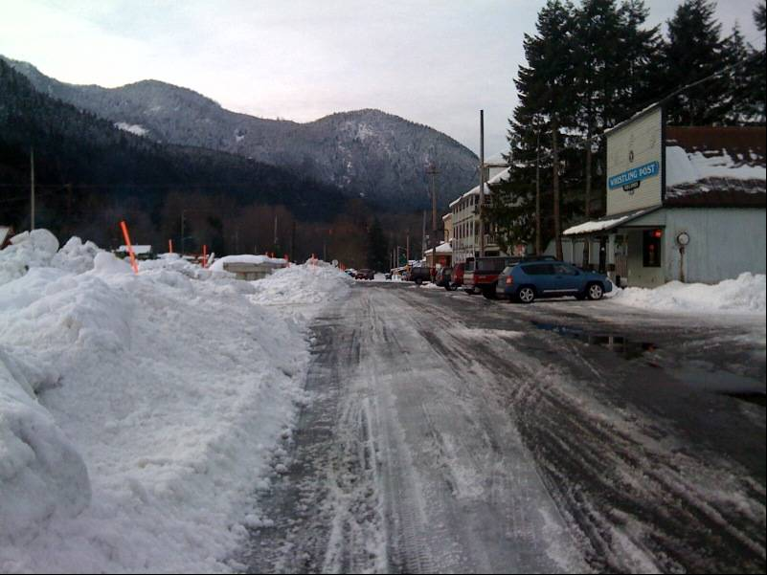
BNSF-Skykomish: 2008
Move and return 3 structures --
included Whistling Post Tavern and
historical Railroad Depot.
Excavate 2 properties.
Whistling Post

Slide 32
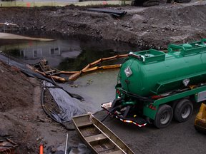
BNSF-Skykomish: 2008
Removed and replaced more than 30,000 cubic yards of contaminated soil.
Removed more than 12,000 gallons of oil.
Oil recovery from excavation area.

Slide 33
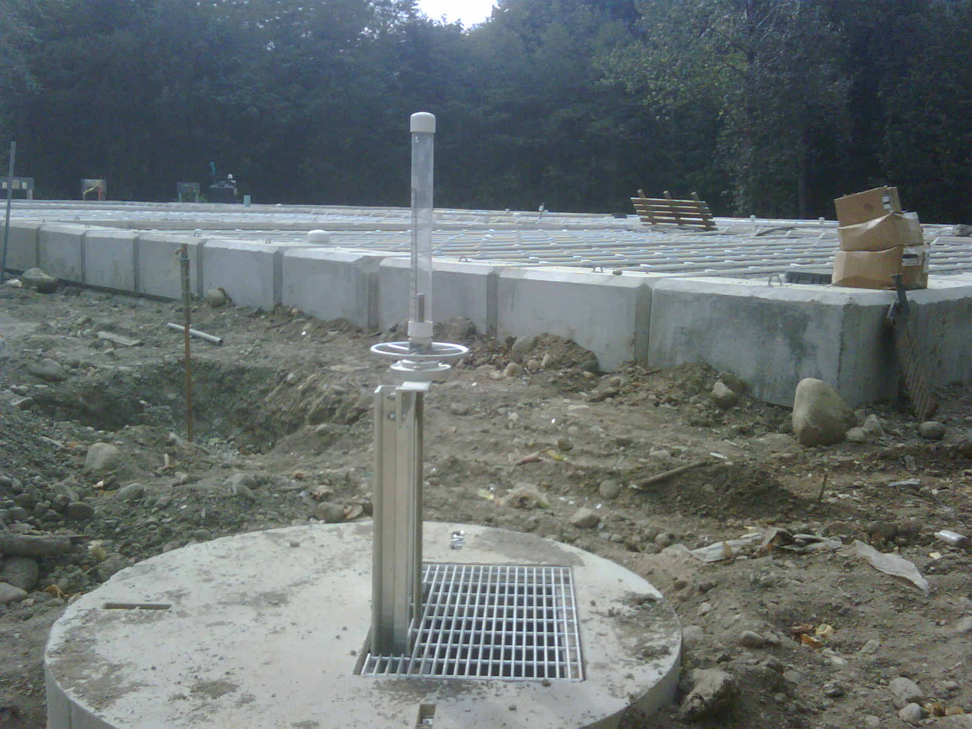
Waste Water Treatment Plant

Slide 34
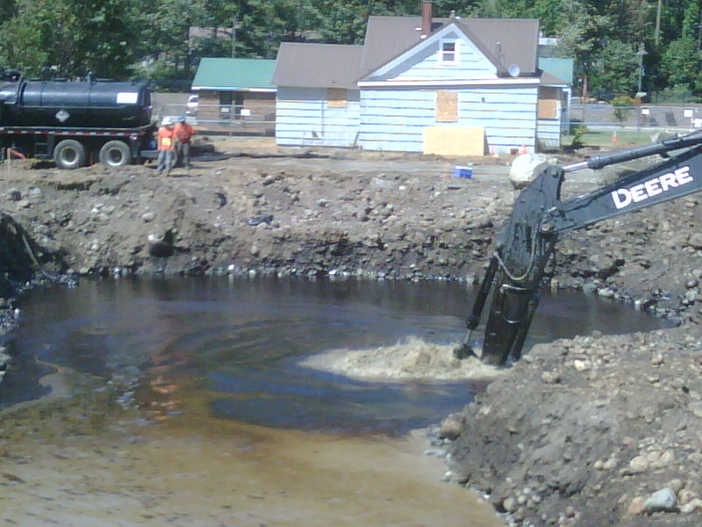
BNSF-Skykomish: 2009
Cleanup moved to “heart” of contaminated area:
    Con: largest amounts of pollution found
    Pro: largest successes to date
Removed:
  Over 100,000 tons of contaminated soil;
  Over 55,000 gallons of oil removed.
Treated:
  Over 5 million gallons of contaminated ground water and returned to Skykomish River.
Excavated seven properties.

Slide 35
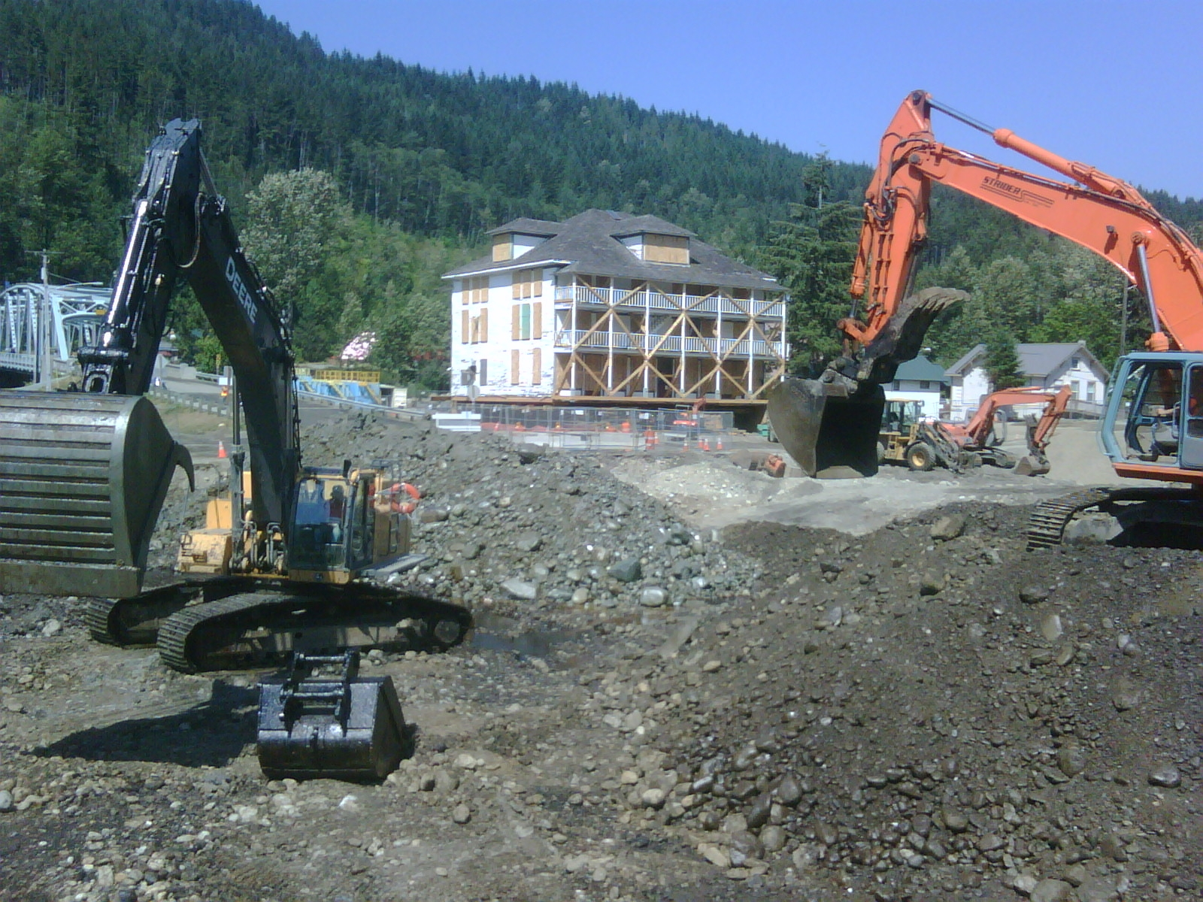
BNSF-Skykomish: 2009
Notes:
Current status of the cleanup activities.

Slide 36
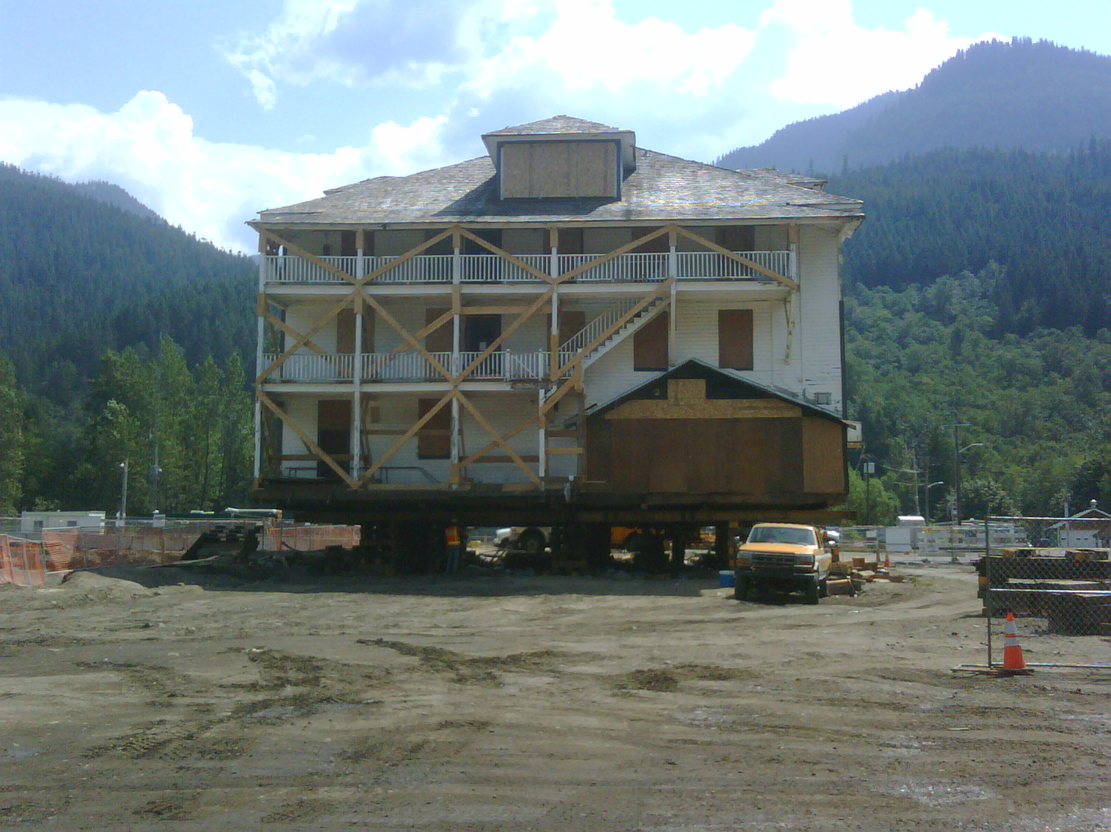
Skykomish Hotel jacked up & being moved...

Slide 37
BNSF-Skykomish: 2009

Slide 38
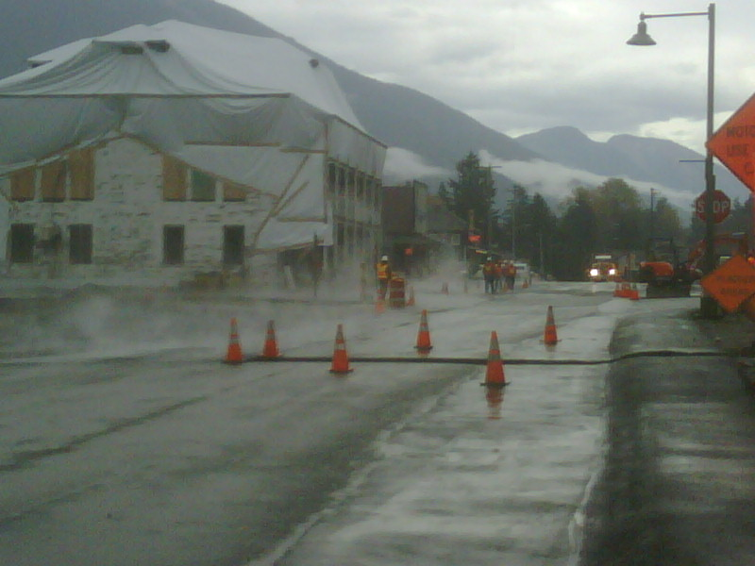
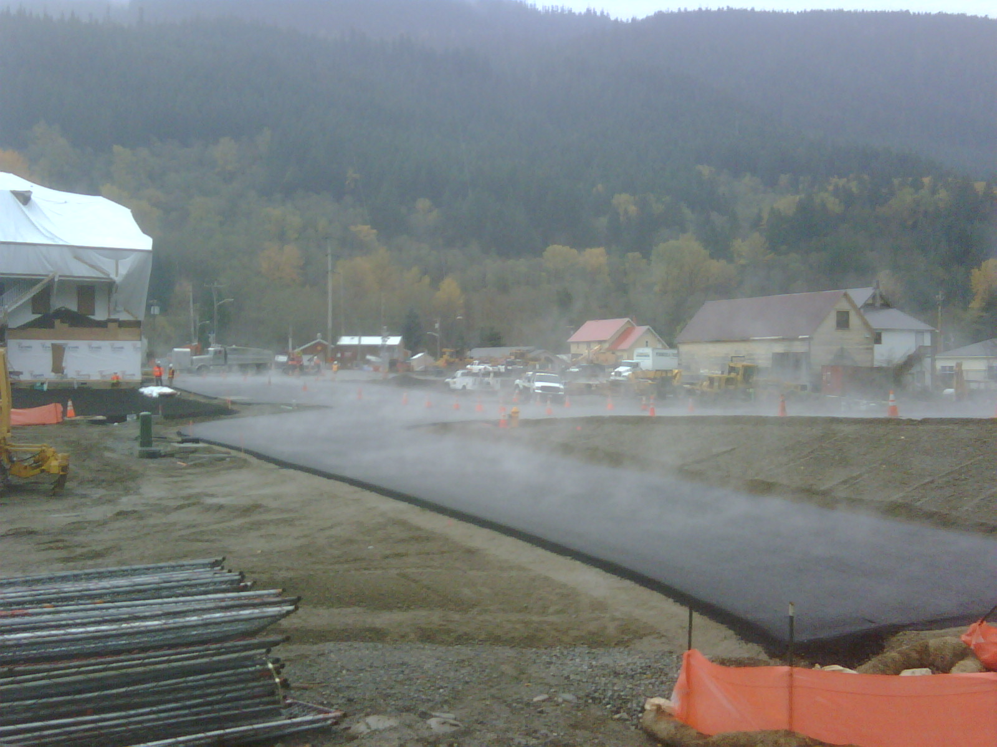
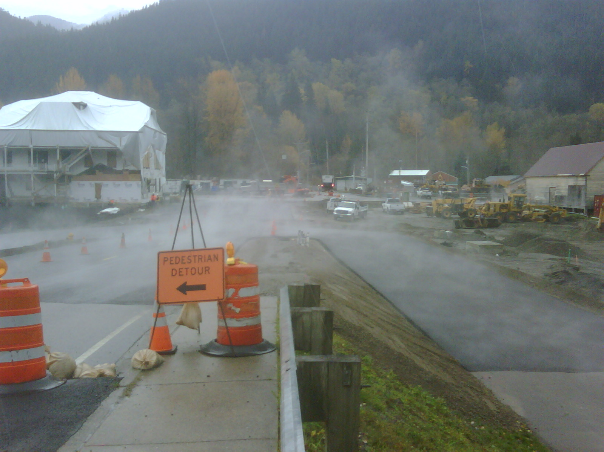
Temporary
Asphalt

Slide 39
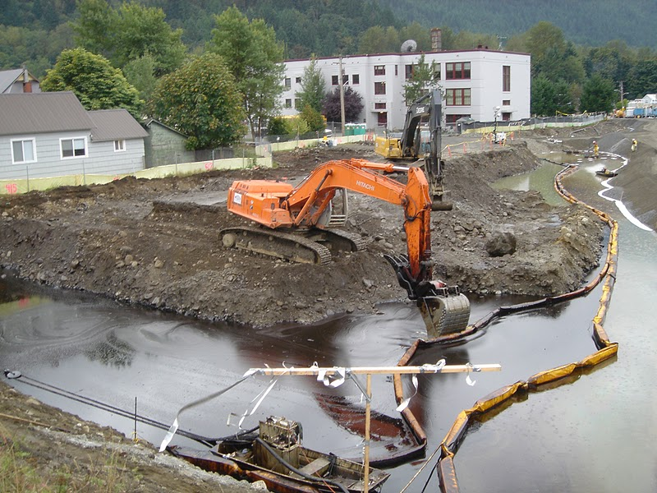
BNSF-Skykomish:
Successes through 2009
Overall successful partnership between BNSF, State of Washington, Town of Skykomish. Results to date:
    Over 220,000 tons of contaminated soil removed
    100,000 gallons of oil removed & recycled
    14 properties successfully
    cleaned up
    90% completion of waste
    water treatment plant

Slide 40

BNSF-Skykomish: Successes
More results to date:
    Skykomish River bed and levee
    successfully cleaned;
    record Salmon counts in 2009
    Record investments for a cleanup in Washington:
      Burlington Northern Santa Fe Railroad
      > $100 million
      State of Washington > $10 million
      Natural Resource Damages > $5 million

Slide 41
Next -- Skykomish: 2010-2012
Wetlands excavated and cleaned (2010)
Former Maloney Creek cleaned (2010-11)
Five properties excavated & cleaned (2010)
Bridge abutment soil excavated (2010)
Completion of Town Waste Water Treatment System (2010)
School Property cleaned (2011-12)
    -excavation with underpinning structure
    -creation of temporary school facilities for 1 year
Town restoration efforts (2011-2012)

Slide 42

BNSF-Skykomish: Challenges
Rebuilding a Town
  Restoration – utilities, infrastructure
  Business community – survival, future
  Social – identity, branding, long term vision
The Town is still under major construction right now –
though will become something special in the near future.
Notes:
Social fabric has been affected by the contamination.
Some businesses have left.
The cleanup, when completed, will provide opportunities for the community to build a long lasting and healthy system.

Slide 43



