Slide 1
Lora Lake Apartments Cleanup Site
Managing Risk
Site History
Contaminants
Cleanup Actions
Stormwater Re-routing
Proposed SR 518 Off-ramp
Documents for Review
Question and Answer
David L. South
Site Manager

Slide 2

Managing Risk at Cleanup Sites
Risk = Hazard x Exposure
Suzie
Sharon

Slide 3
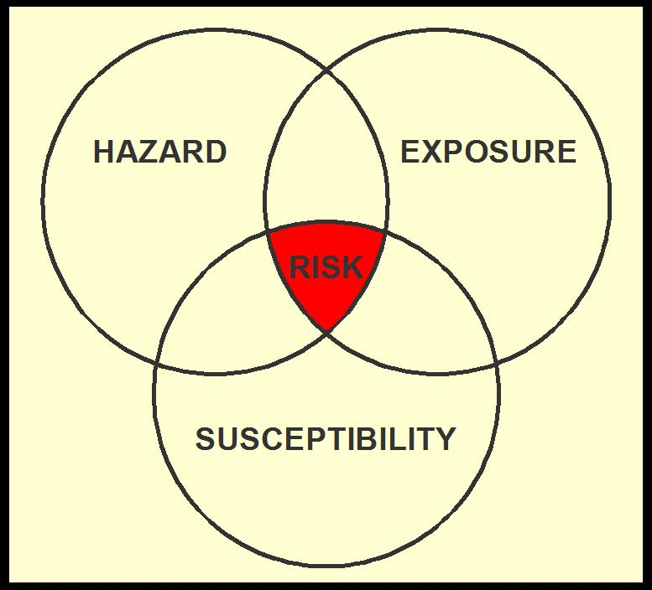
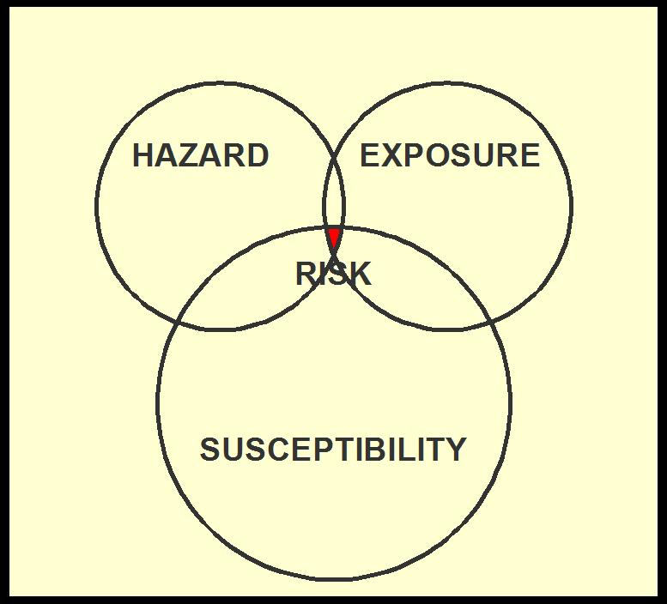
How does Ecology manage risk at cleanup sites?
Cleanup actions are selected that are appropriate for the level of hazard.
The highest exposure that can be reasonably expected to occur is used to calculate cleanup levels.
Cleanup actions reduce hazard, exposure, or both, to return land to productive use.
Cost is not considered in deciding what needs to be cleaned up.
Cost is considered in deciding how cleanup is to be accomplished.
Toxicity parameters protect sensitive individuals and ecosystems.
Notes:
200 mg/d is the upper 95th percentile of soil ingestion rates. CPF slope is extrapolated from high doses assuming it goes through 0 and an upper bound on the slope is used.

Slide 4
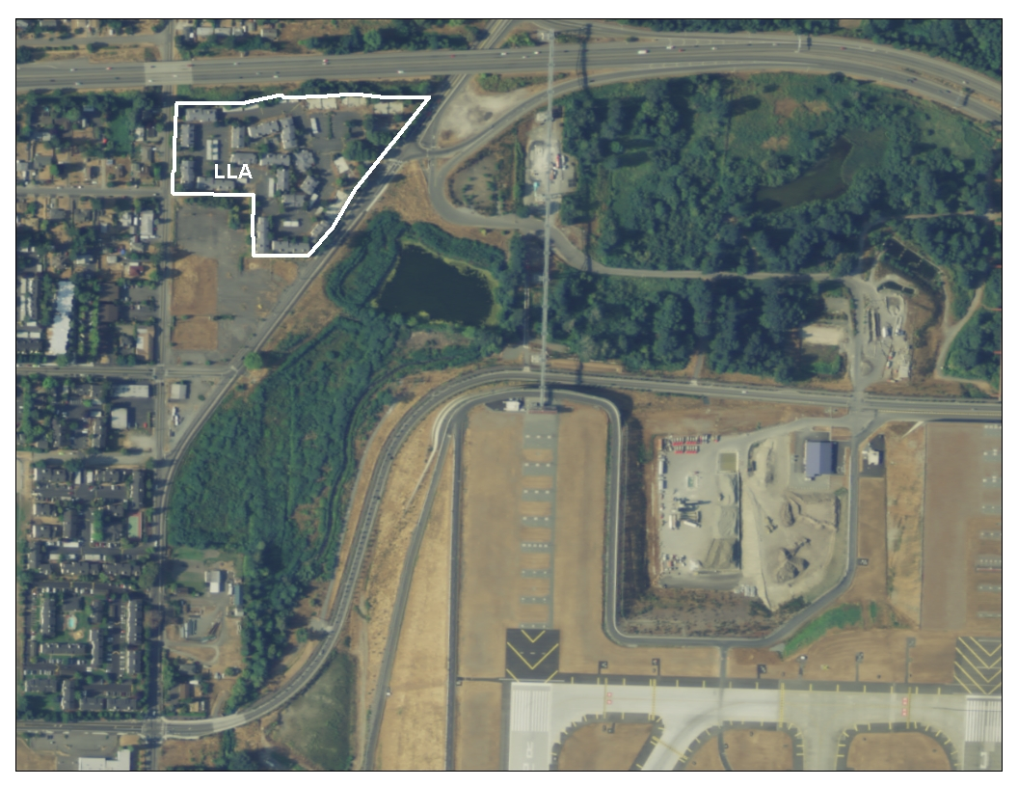
Location - Aerial
SR 518
The Lora Lake Apartments parcel is at the intersection of SR 518 and Des Moines Memorial Drive.
Two other areas of interest are Lora Lake and an area where sediment dredged from Lora Lake in 1982 was placed, the Dredged Material Containment Area.
DMCA
LL
Des Moines Mem. Dr.
Miller Creek

Slide 5
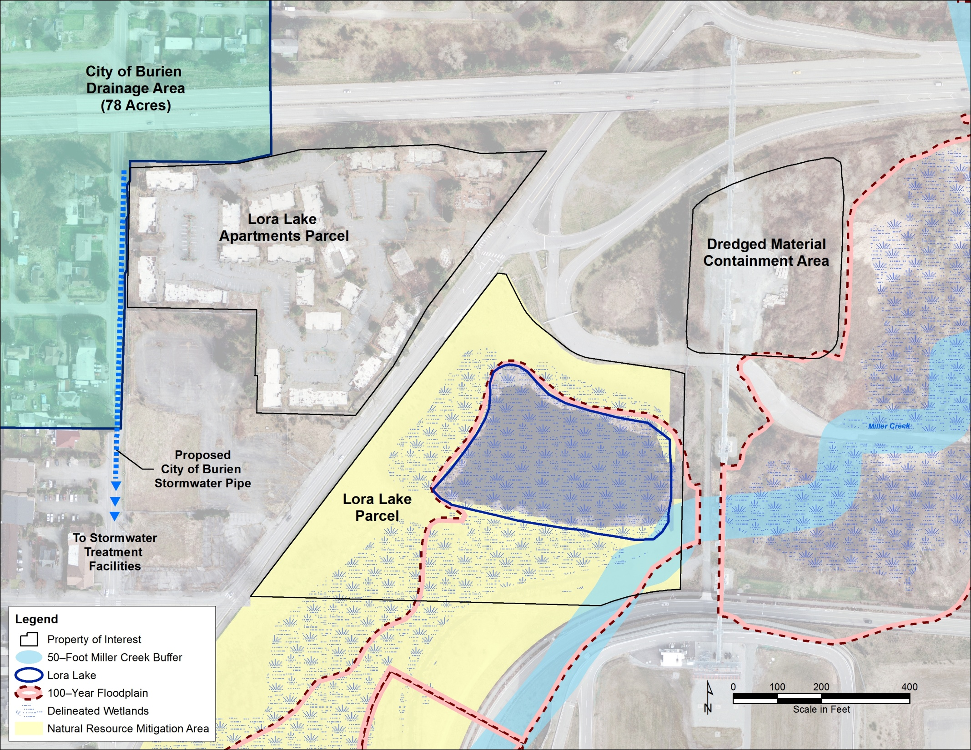
Site Map
Current Stormwater Pipe

Slide 6
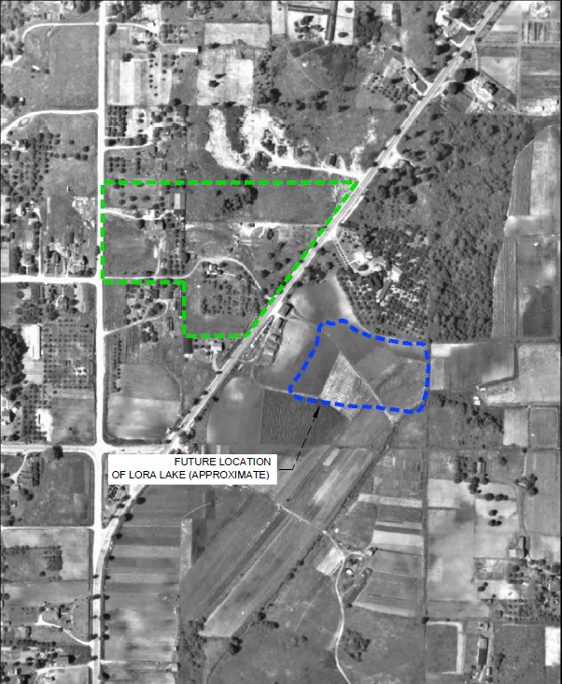
1936
The Apartments Parcel was rural.
Excavation of the peat mine that would become Lora Lake had not begun.

Slide 7
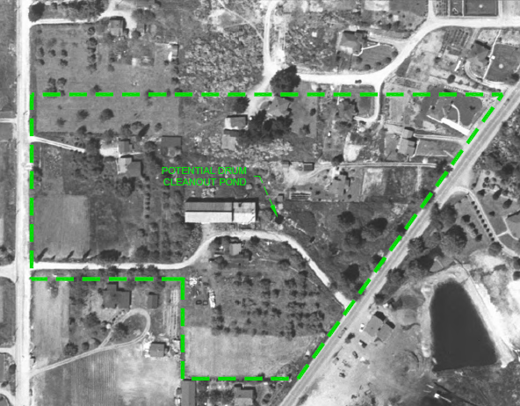
1946
Novak Barrel Washing recycled drums that had contained industrial chemicals. Lora Lake had been created by peat mining.

Slide 8
1980
Burien Auto Wrecking
(mid-1950s to the 1980s)
Lora Lake was surrounded by homes.

Slide 9
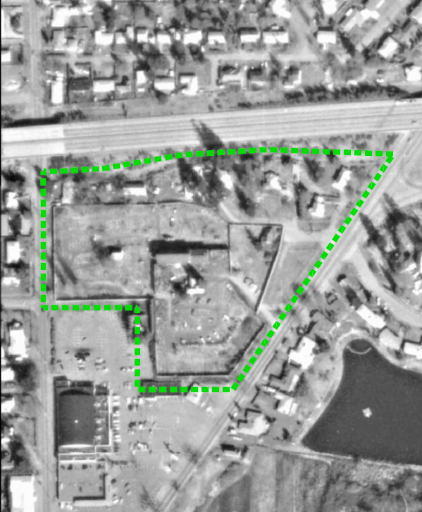
1985
1980s – The site was cleared to construct the Lora Lake Apartments.
1982 – King County dredged the lake .
The dredged material was placed on airport land north of the lake (the DMCA).

Slide 10
2004
1990s – The Port acquired the Lora Lake Apartments.
Part of the Apartment property is needed for the Runway Protection Zone for the Third Runway.

Slide 11
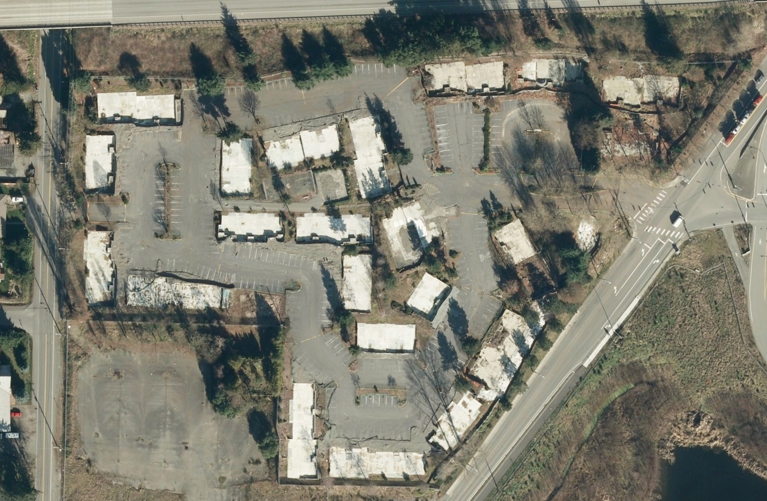
Currently, the Apartments Parcel is mostly paved or covered with foundations. It is fenced.

Slide 12
What chemicals need to be cleaned up?
Dioxins/furans
drive the cleanup
Chemicals
Arsenic and lead
Petroleum hydrocarbons and associated volatile chemicals
Pentachlorophenol
Carcinogenic polyaromatic hydrocarbons
Dioxins/furans
Most widespread.
The other chemicals occur with the dioxins/furans.
Removing dioxins/furans will remove the other chemicals.
This presentation will focus on dioxins/furans.

Slide 13
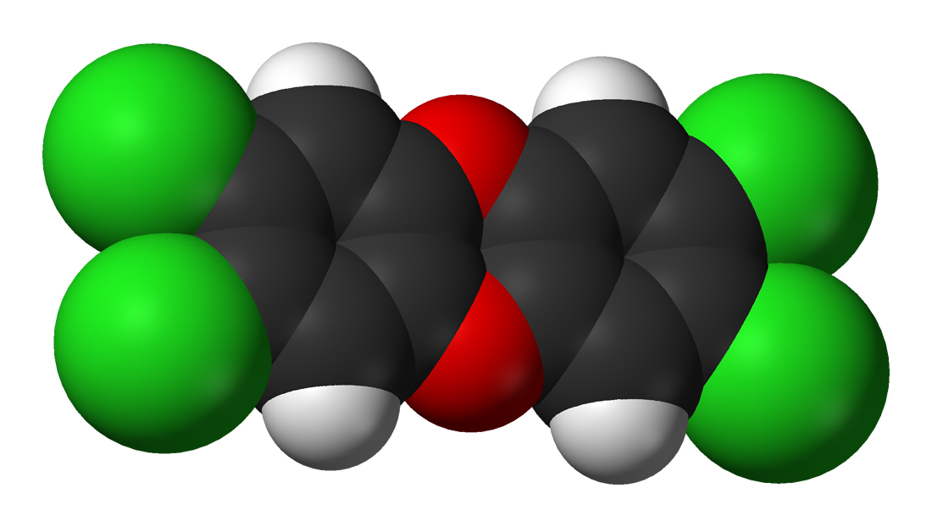
What are dioxins and furans?
Molecular diagram
210 related chemicals (number and locations of chlorines varies).
17 are toxic, with varying degrees of toxicity.
Concentrations are reported as the sum of the 17, adjusted for their toxicity.
This is called the Toxicity Equivalent (TEQ) concentration.
C = Carbon H = Hydrogen O = Oxygen Cl = Chlorine
H
Cl
O
C
2,3,7,8-tetrachlorodibenzo-p-dioxin is the most toxic dioxin/furan.
Dioxins have two oxygens, furans only one.
Notes:
Colorless solid at room temperature

Slide 14
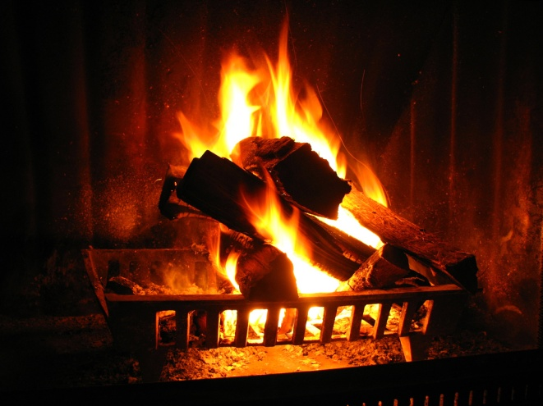

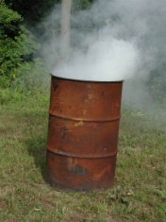
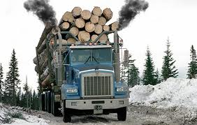
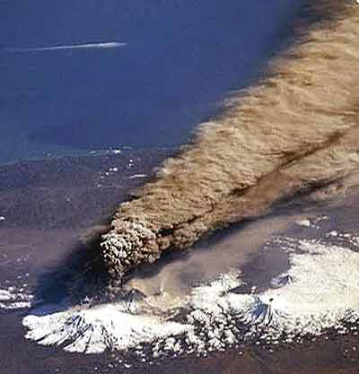
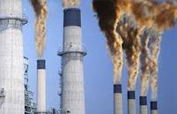
Dioxins/furans form when organic matter is burned in the presence of chlorine.
Natural Sources
Some Man-Made Sources
Forest Fires
Volcanos
Residential wood burning
Backyard burn barrels
Chlorinated chemical
  production
Diesel exhaust
Chlorine bleaching of pulp
Burning salt-laden wood
  in hog-fuel boilers
Waste incineration
Cement kilns
Crematoriums
Notes:
According to EPA, between 1987 and 2000, there was an approximately 90% reduction in the release of dioxins/furans to the circulating environment of the United States from all known sources combined. This reduction in environmental releases of dioxin-like compounds is attributable to source-specific regulations (Clean Water and Clean Air Acts), improvements in source technology, and advancements in the pollution control technologies specific to controlling dioxin discharges and releases.

Slide 15
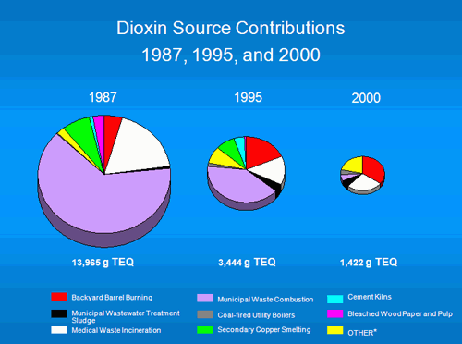
Dioxins/furans emissions declined 90% between 1987 and 2000 (EPA). In 2000, backyard burn barrels were the largest source.
Burn Barrels
Municipal Waste
Combustion
http://www.dioxinfacts.org/dioxin_health/dioxin_food/dioxin_foodsupply.html

Slide 16
Dioxins/furans are widespread in the environment. Some characteristics:
Persistent – last a long time in the environment.
Low volatility – do not evaporate easily.
Low mobility – attach to organic carbon in soil.
Low solubility – do not dissolve easily in water.
Bioaccumulative – concentrate in organisms.

Slide 17
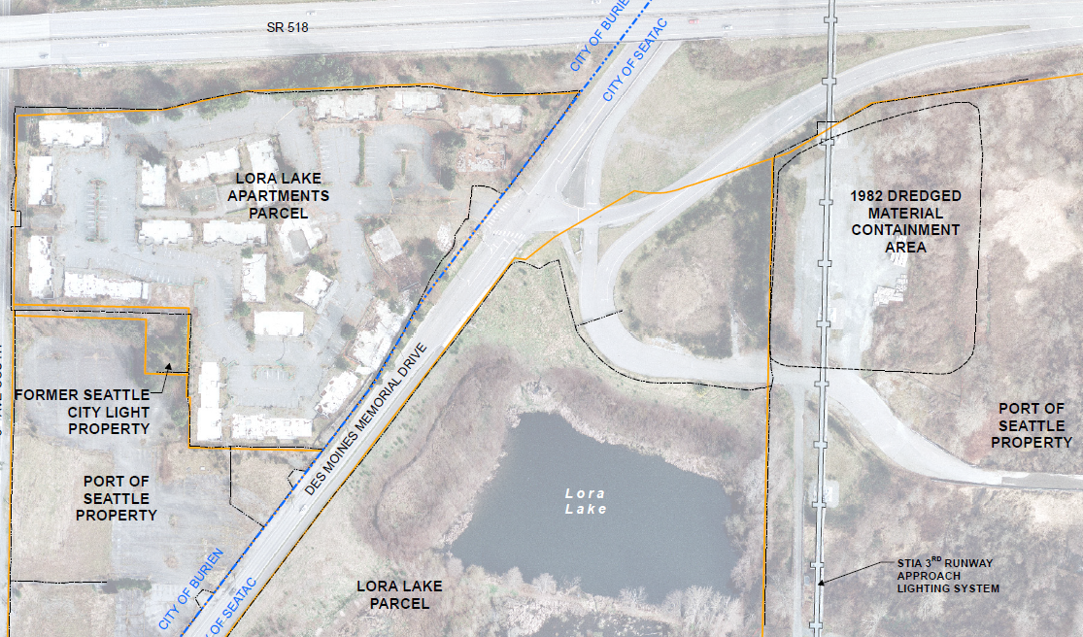
The Port of Seattle will clean up the three areas of the site, overseen by Ecology.

Slide 18
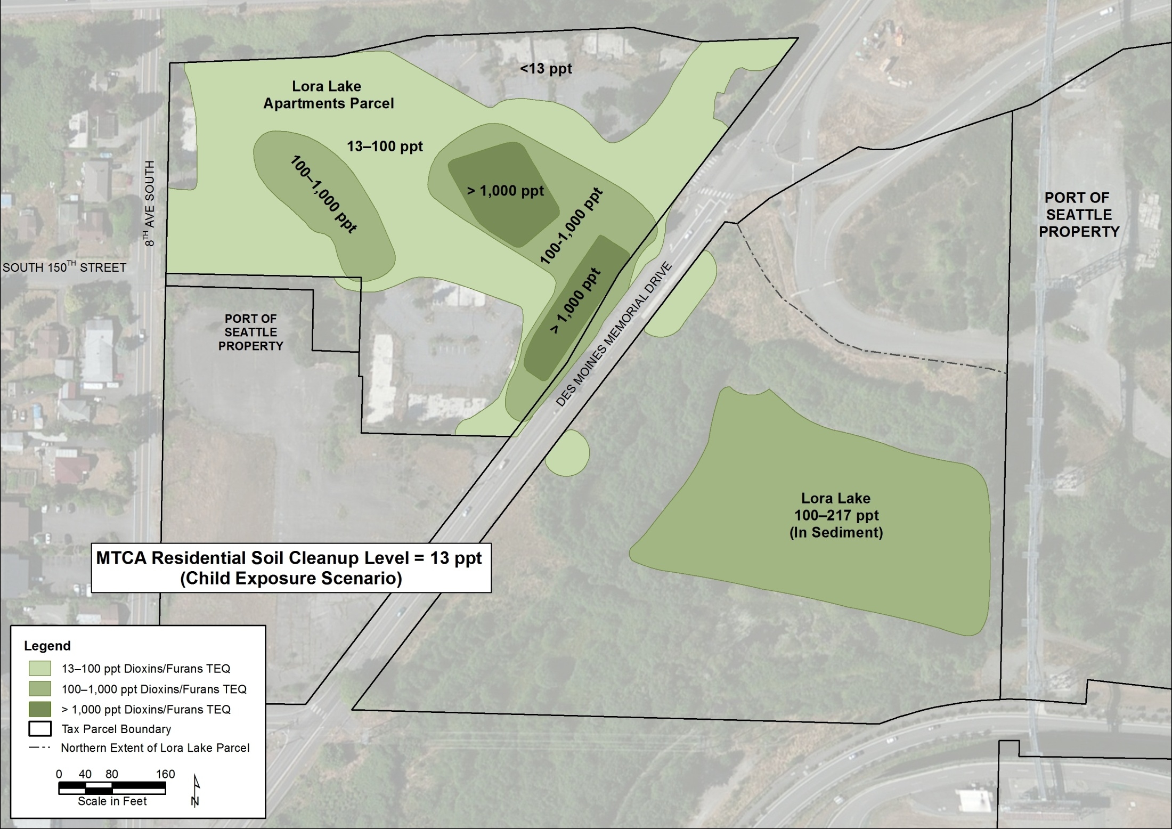
Within the Lora Lake Apartments Parcel dioxins/furans soil contamination is highest at and downhill from the old barrel cleanout area. Over much of the western part of the property dioxins/furans concentrations are < 100 parts per trillion (ppt).
A
A’

Slide 19
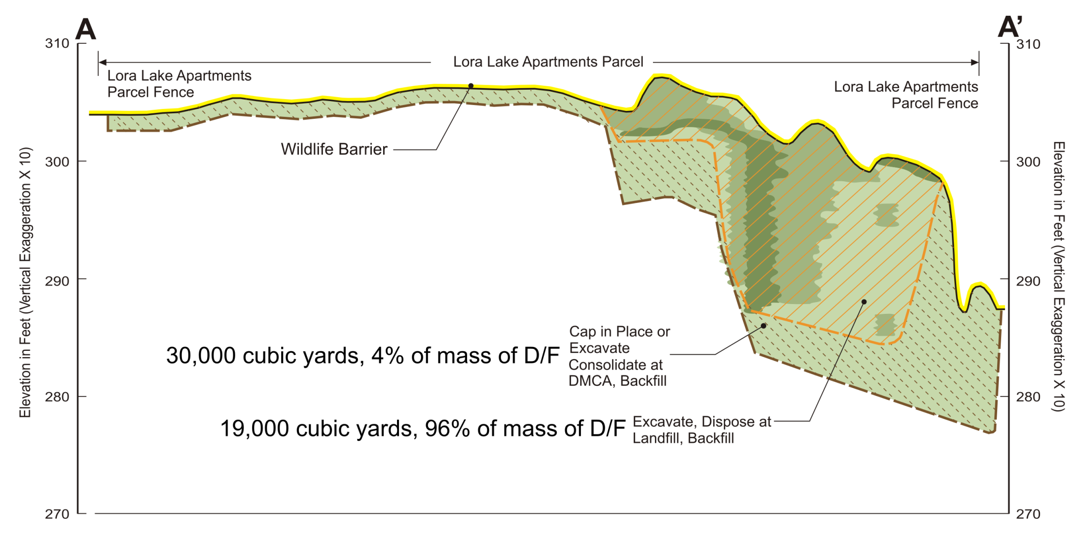
Soil cleanup at the Lora Lake Apartments Parcel
Excavate, Manage On Site, Backfill
Greater than 100 ppt - excavated and sent to a landfill
Less than 100 ppt - capped and contained on site

Slide 20
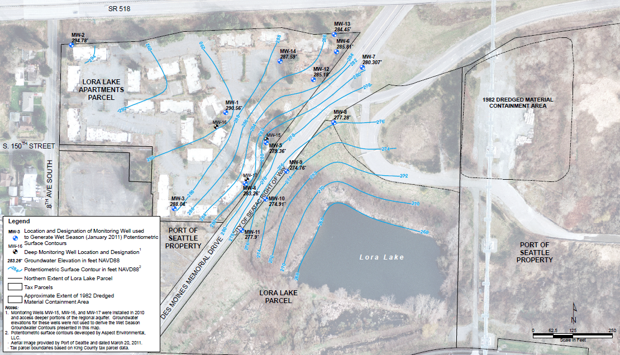
Dioxins/furans concentrations in ground water
(parts per quadrillion)
3
Ground water cleanup level = 6.7 ppq
6
2
3
3
Upgradient
Well
3
38
GW FLOW
3
2
4
2
3
3
3
3
3
4
Except for the well at the barrel-cleanout location, ground water concentrations are near the limits of detection.

Slide 21
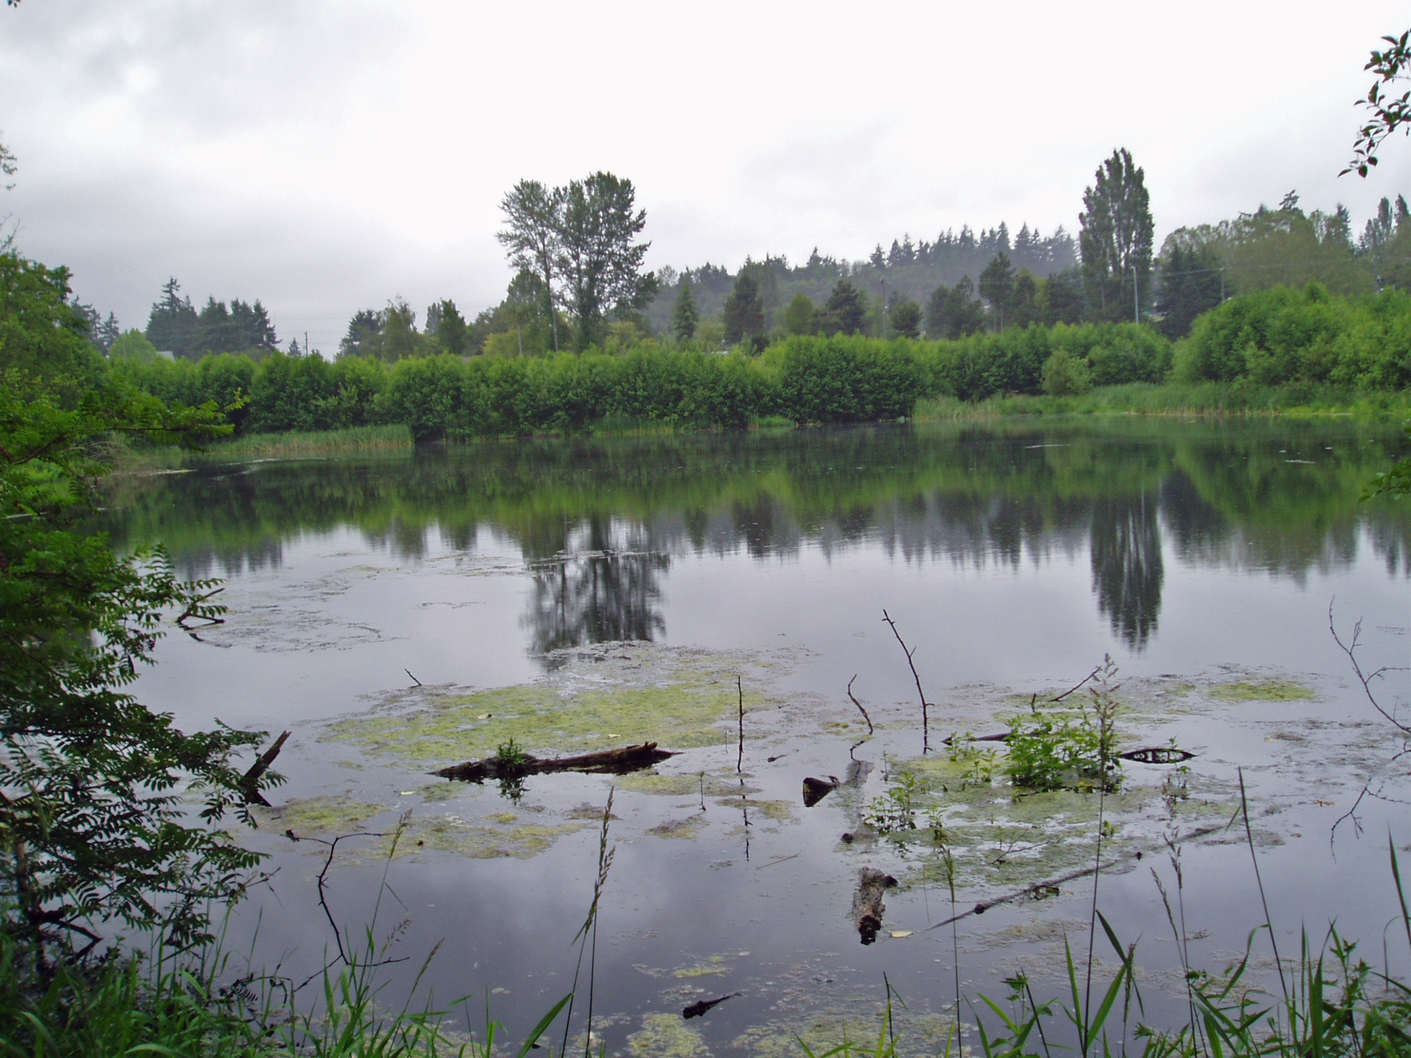
Lora Lake, looking southwest
(Size ~ 3 acres)

Slide 22
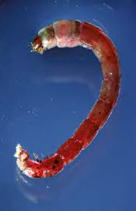
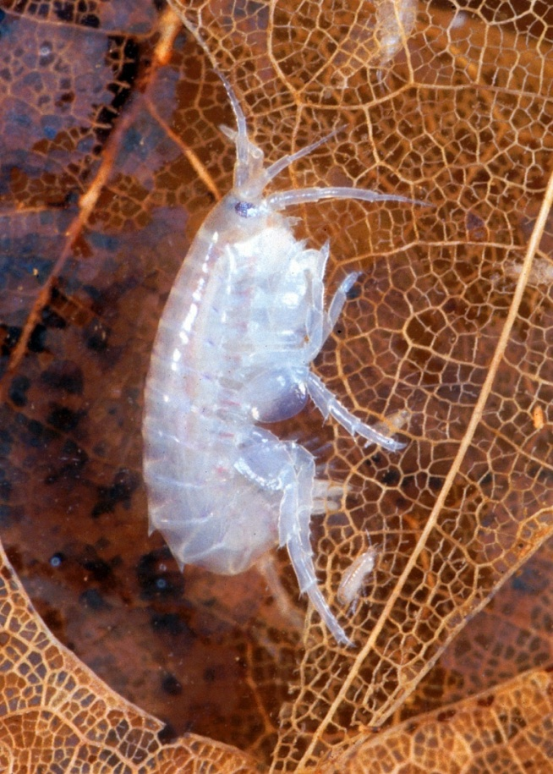
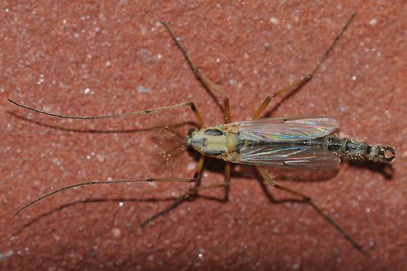
Bioassays were performed to assess sediment effect on aquatic life.
(No numerical standards)
Scuds and midge larvae were exposed to surface sediment from Lora Lake and Miller Creek.
The effect on their growth and mortality was measured.
Midge larvae (Chironomous dilutus)
Scud
(Hyalla azteca)
Midge – adult stage

Slide 23
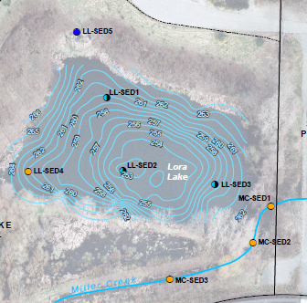
Bioassay results:
Surface sediments are unlikely to cause adverse effects on biological receptors except in the deepest part of the lake (LL-SED2).
The adverse effect is thought to be due to high sulfides.
Bioassays were performed at all
locations except LL-SED5.
Pass
Pass
Fail, Sulfide
Pass
Pass
Pass
Pass

Slide 24
Dioxins/furans concentrations in surface sediments (ppt)
Cleanup of Lora Lake sediment is needed to protect human health against bioaccumulation in fish.
Storm Drain Outfall
Contaminated sediments are
a little less than 2 ft thick at
the deepest part of the lake,
and thin towards the lake margin.
8
193
149
217
152
UPSTREAM
0.44
Dioxins/furans concentrations in Miller Creek sediment are much lower than in Lora Lake sediment.
0.44
LL OUTFALL
DOWNSTREAM
0.33
Notes:
Background dioxins/furans in marine sediment if 4 ppt. No freshwater data.

Slide 25
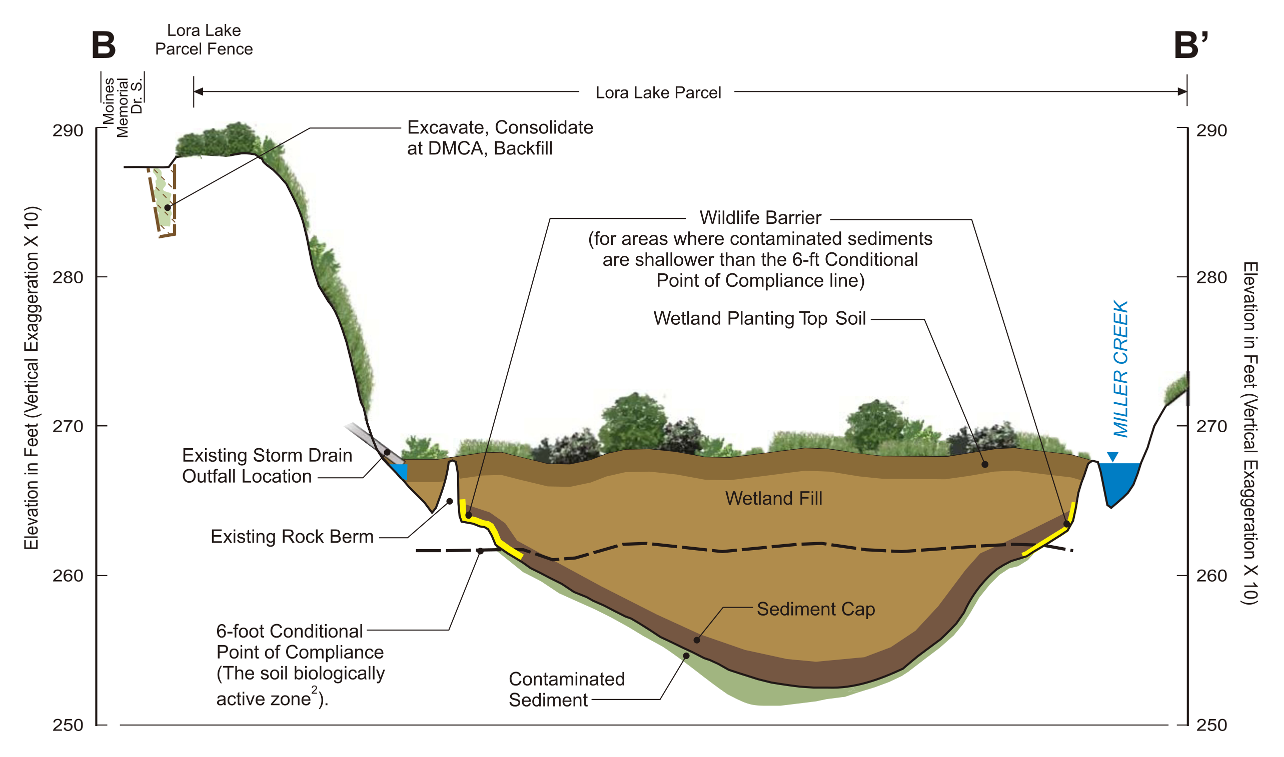
West side of Lora Lake Parcel – remove contaminated soil.
Lora Lake – cap contaminated sediment to keep dioxin/furans in place.
– create a new wetland at Lora Lake.
How will the cap be monitored?
Notes:
Better to disturb the sediment as little as possible to avoid stirring things up.

Slide 26
Advantages of Proposed
Lora Lake Sediment Cleanup Remedy
Eliminates low oxygen, high temperature water source to Miller Creek.
Eliminates non-native fish that compete with and prey on salmon in Miller Creek.
Improves floodplain response.
Reduces bird strike hazard to aircraft.

Slide 27
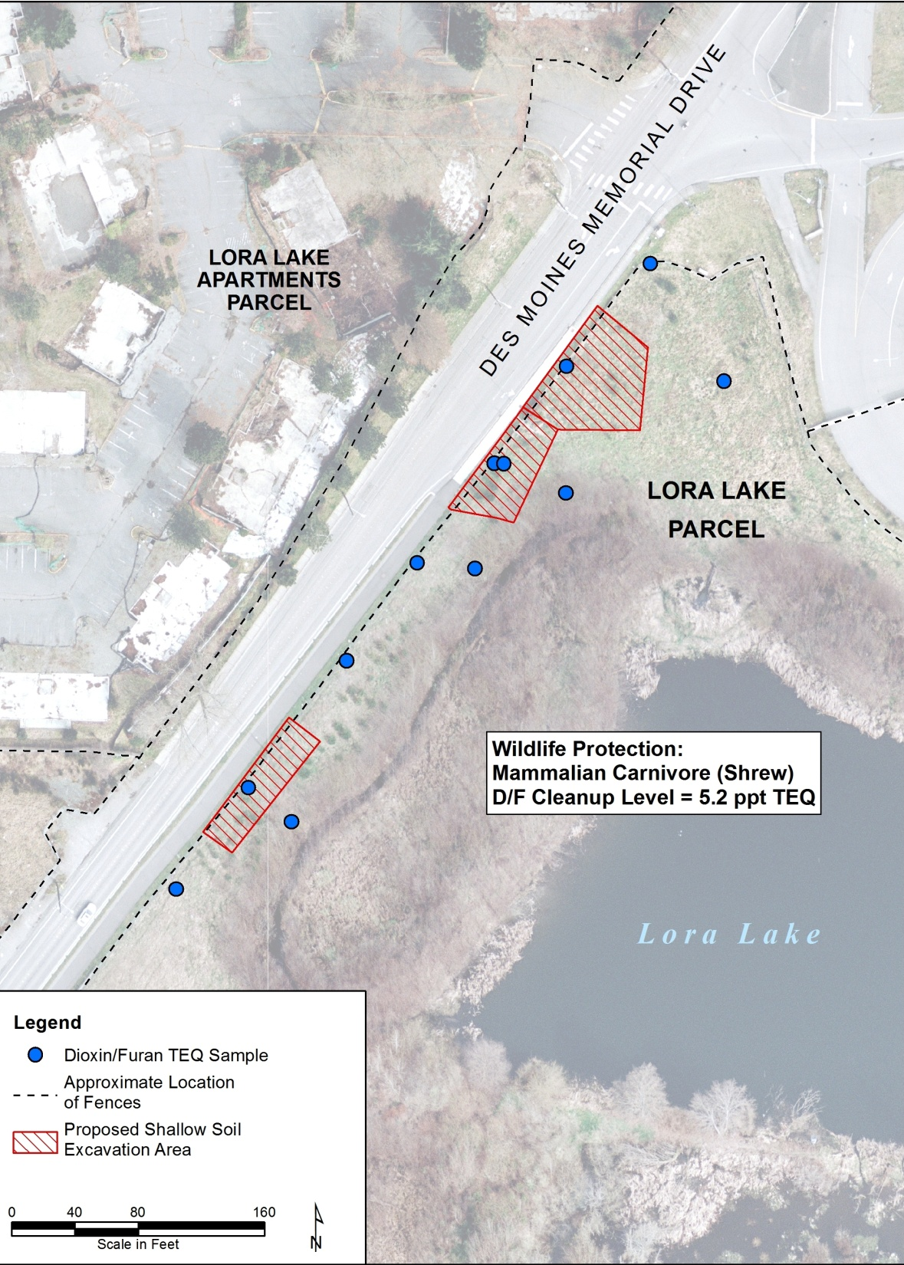
Lora Lake Shallow Soil Excavation
MAXIMUM CONCENTRATION
AT LOCATION (ppt)
4
40
40
3
Any activity in the Mitigation Area … shall use methods that minimize damage to the Mitigation Area.
(from Miller Creek/Lora Lake/Vacca Farm Wetland and Floodplain
Mitigation Area Restrictive Covenants.)
1
6
5
6
13
2
2

Slide 28
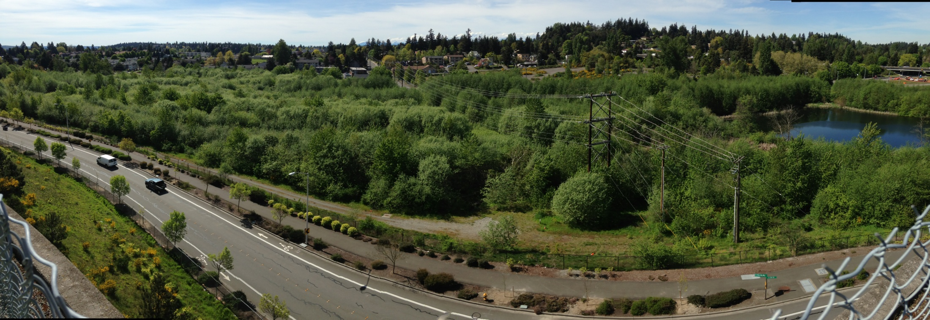
After cleanup the area will be similar to the rest of the habitat mitigation area.

Slide 29
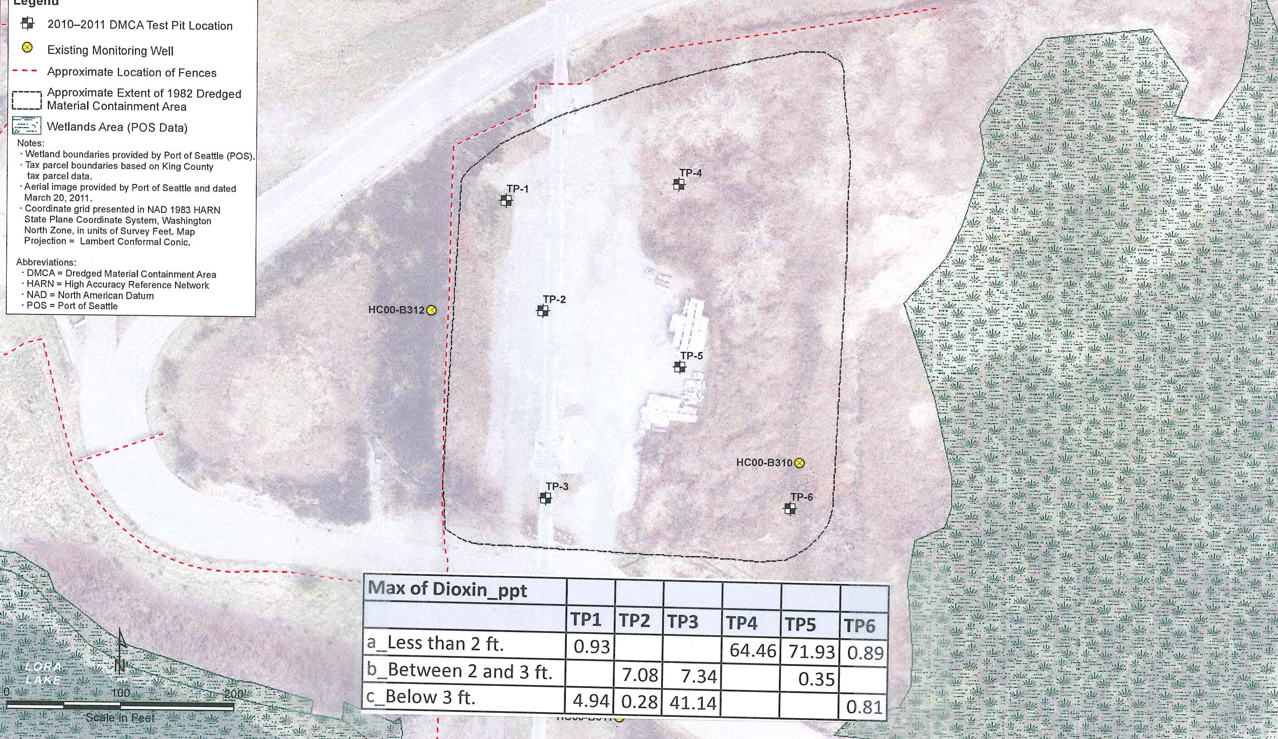
Dredged Material Containment Area
TP-1
TP-4
TP-2
Gravel Surface
TP-5
TP-3
TP-6

Slide 30
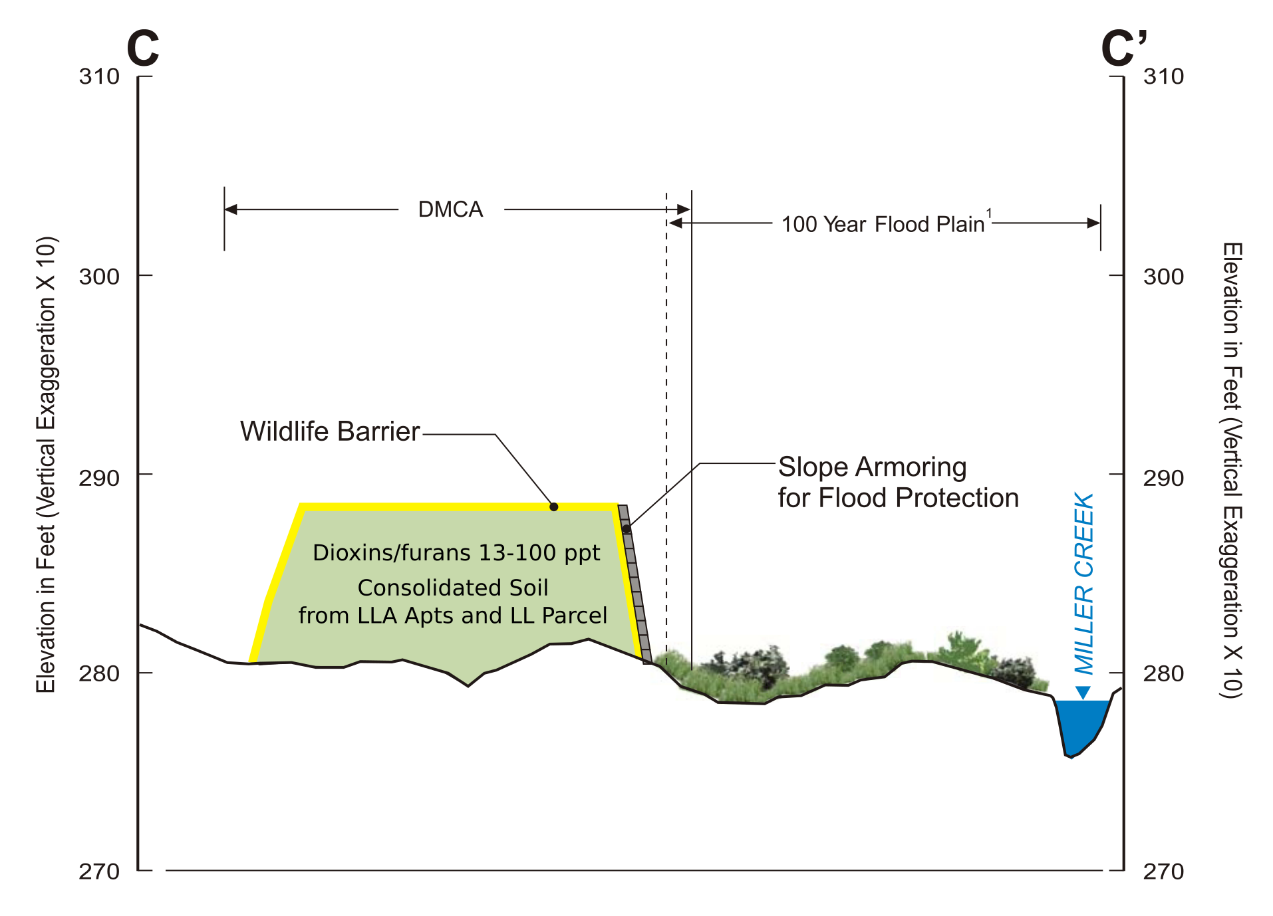
Soil with dioxins/furans less than 100 ppt will likely be consolidated at the Dredged Material Containment area. This is compatible with Ecology’s goal of integrating cleanups with site redevelopment.
About
8 feet
high.

Slide 31
Construction Considerations
Health and Safety
Traffic
There will be a project-specific Health and Safety Plan.
Dust will be controlled and monitored.
  No visible dust will be allowed.
  Dust monitoring will be done upwind, within, and at the periphery of the Site.
There will be a City of SeaTac Maintenance of Traffic Plan.

Slide 32
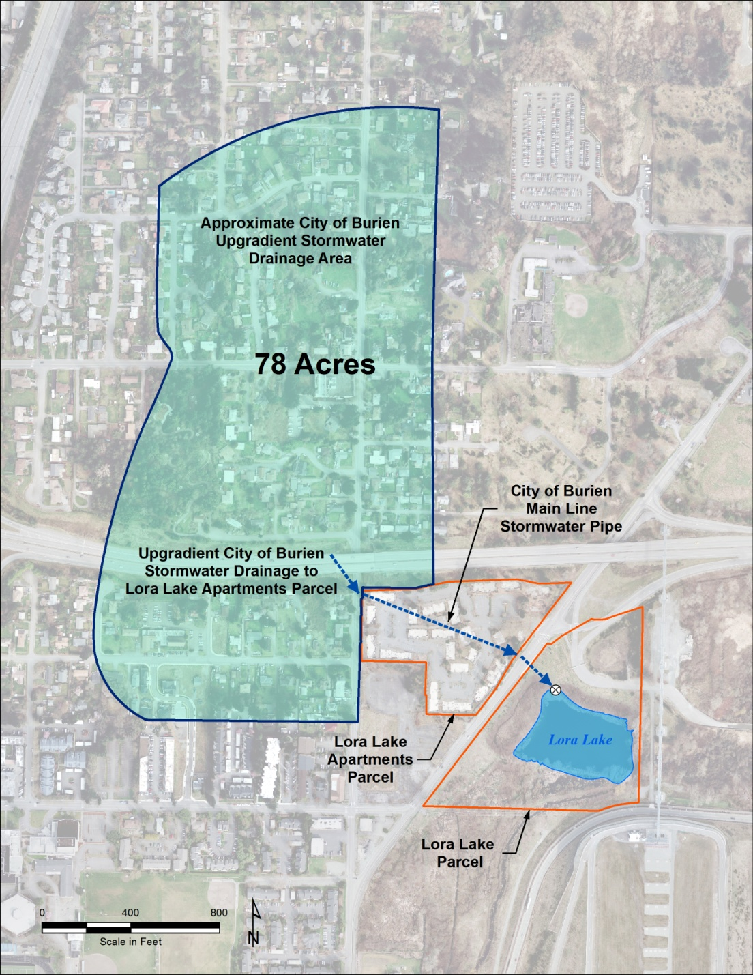
Stormwater and storm drain solids.
Samples were collected to assess whether the Site was contaminating stormwater discharge to Lora Lake, and whether immediate action was necessary.
There was no statistical difference in chemical concentrations in upstream samples compared to downstream samples.
Immediate action was not necessary.

Slide 33
Companion Stormwater Project
A city of Burien storm drain currently conveys stormwater from a 78-acre area upstream of the former apartment complex to Lora Lake.
Burien proposes to re-route this storm water to a Low Impact Development infiltration facility south of the former apartment complex.
Ecology has offered Burien a $1.45 million grant to partially fund this project.
If this project is not done before cleanup, stormwater will be temporarily diverted to Port property or Miller Creek.
If the project is not done at all the stormwater will be conveyed to the rehabilitated wetland and infiltrated.
Stormwater from the Lora Lake Apartments Parcel itself will be routed to the south into an infiltration facility after soil cleanup is complete.

Slide 34
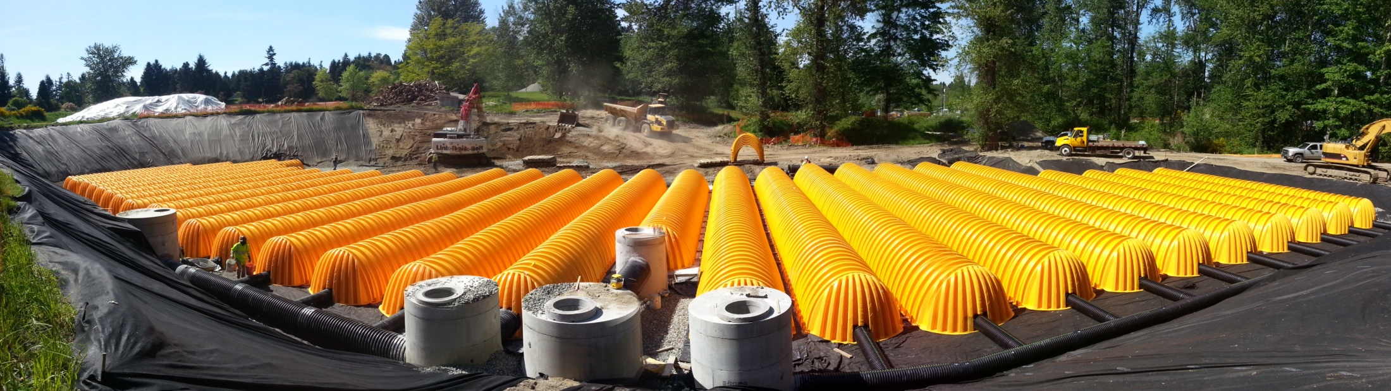
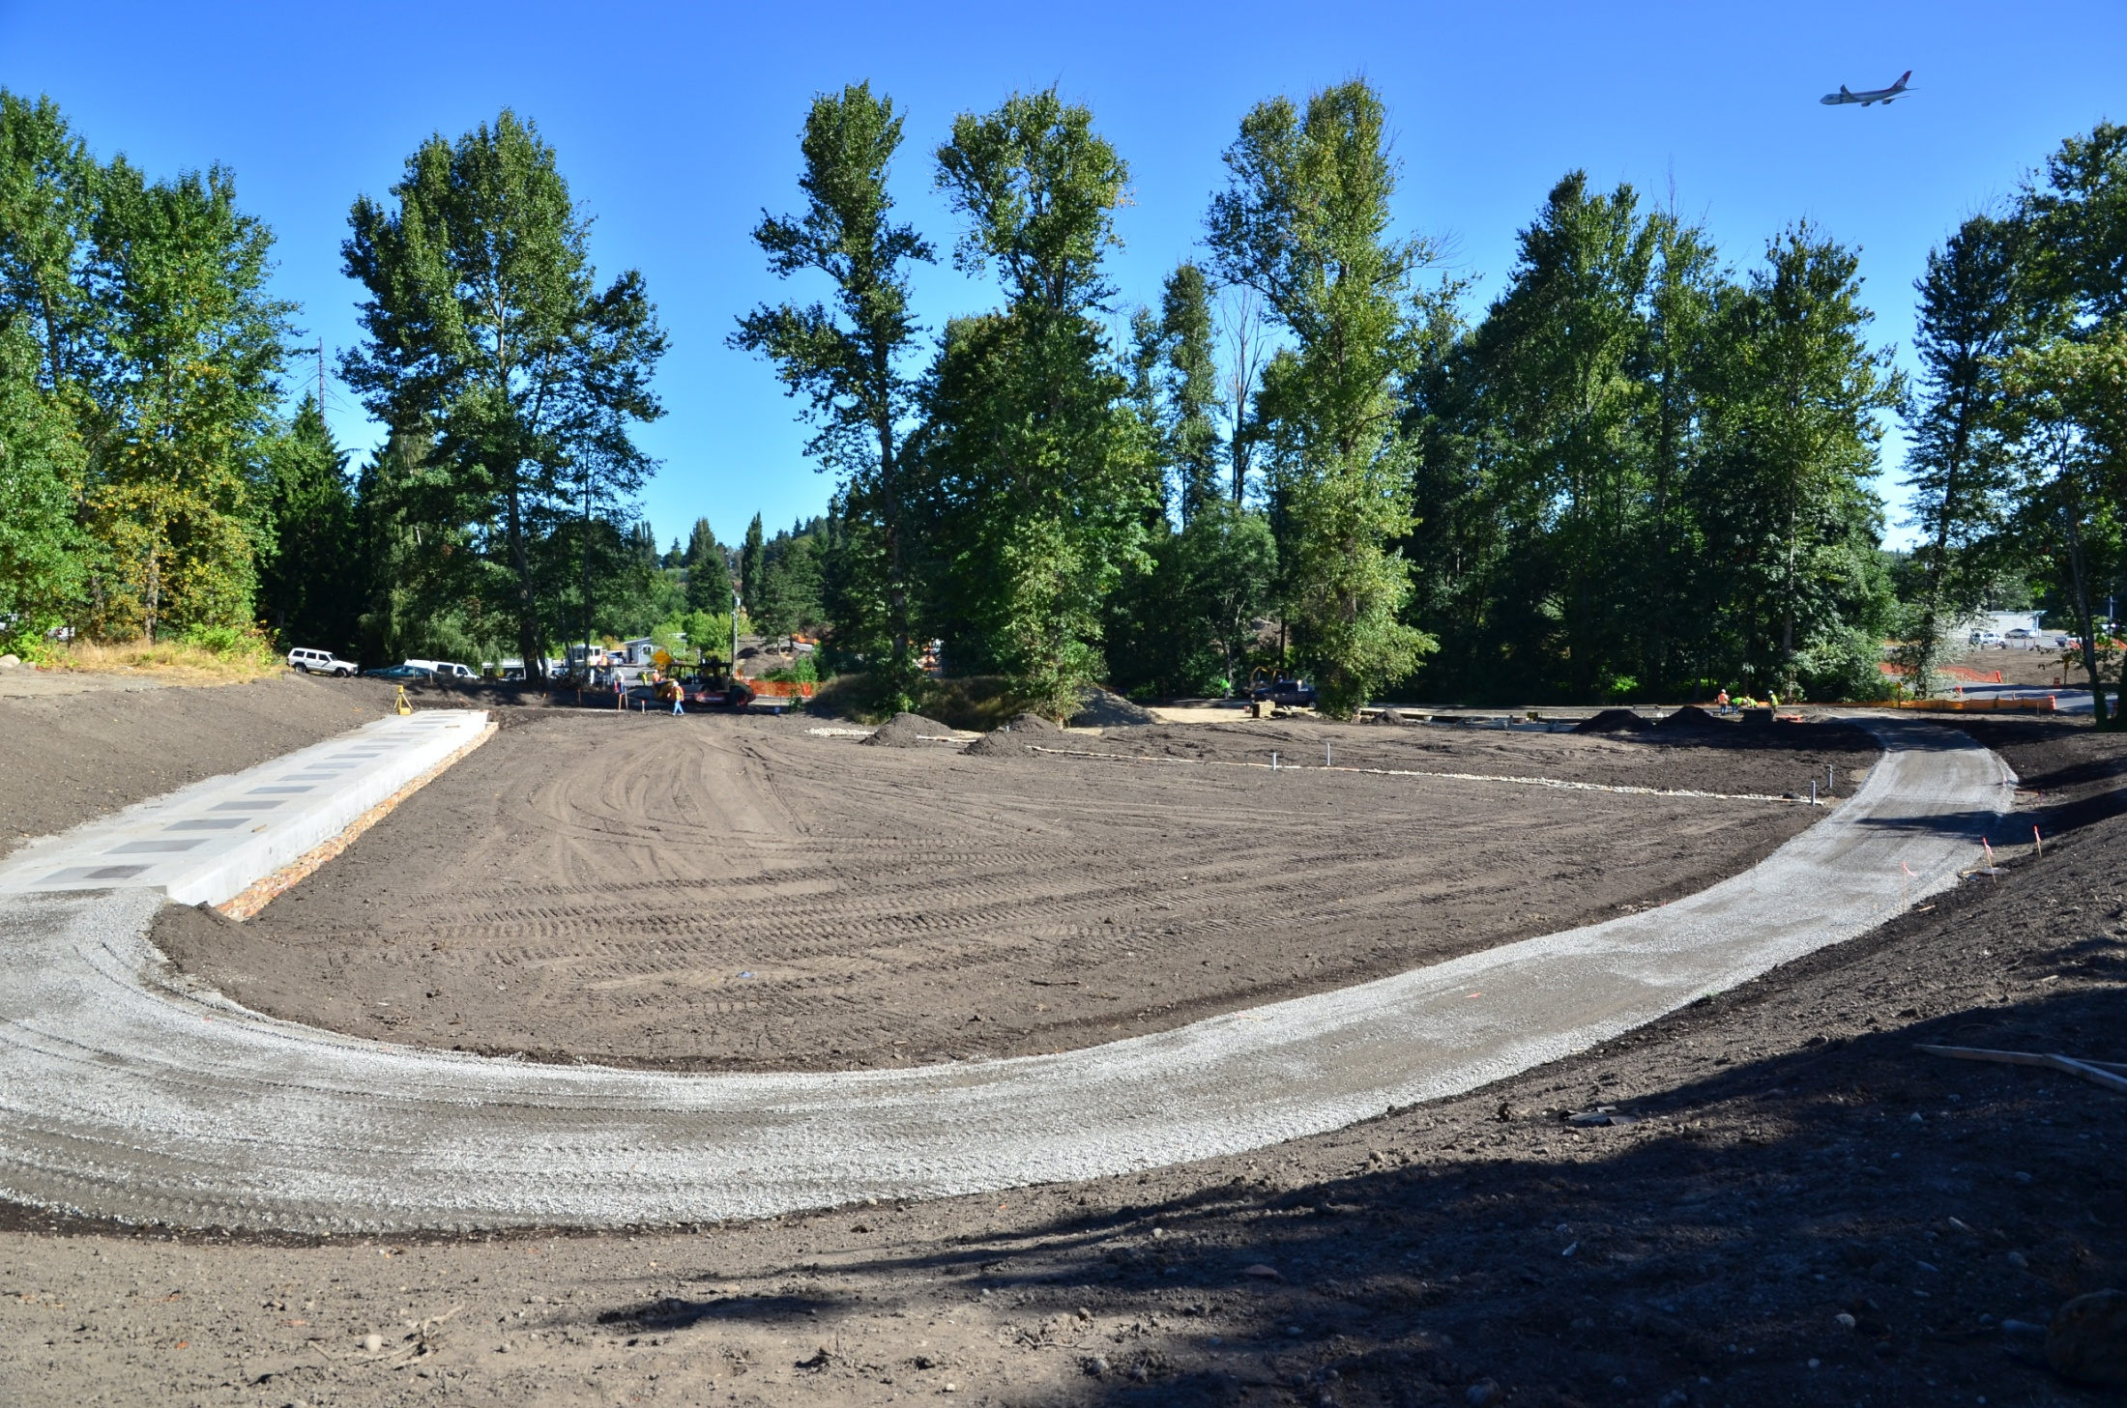
Installation of an Infiltration Gallery – Part of Burien stormwater improvements for the Northeast Redevelopment Area
Total Cost: $4.6 million
Ecology share: ~ $1 million
Photo courtesy
Dan O’Brien, City of Burien

Slide 35
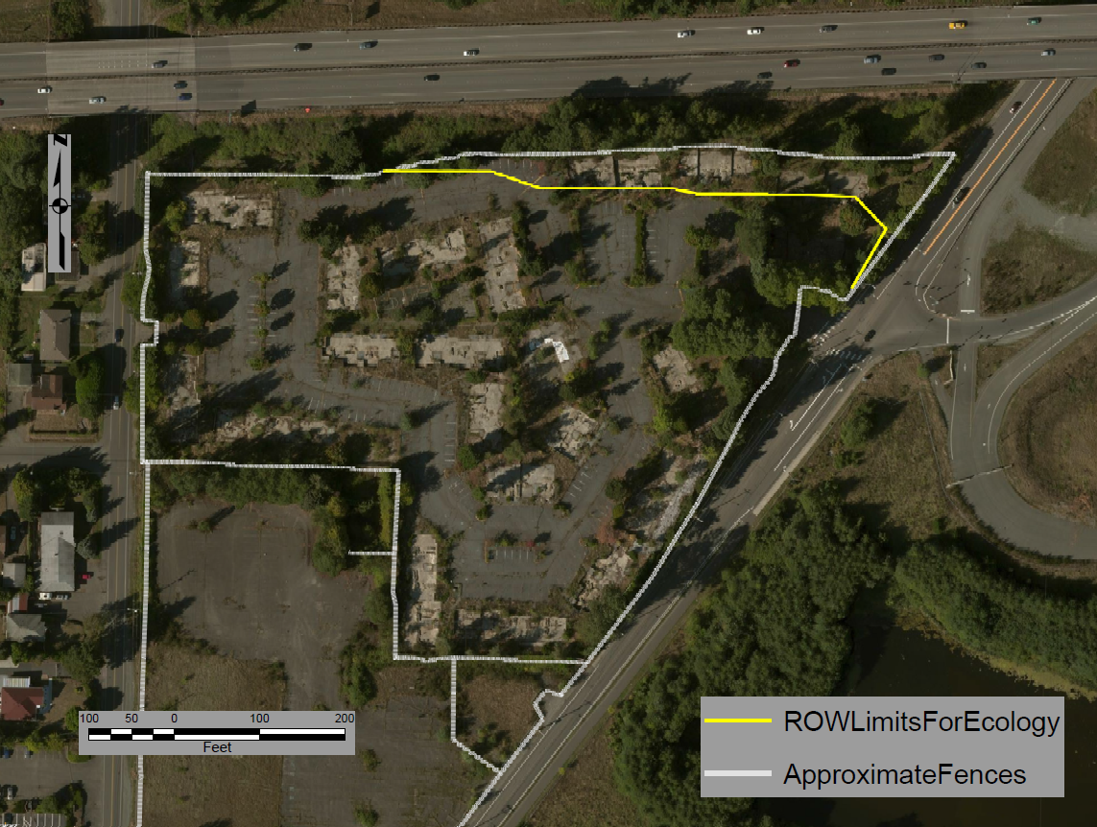
Proposed SR 518 Ramp Limits

Slide 36
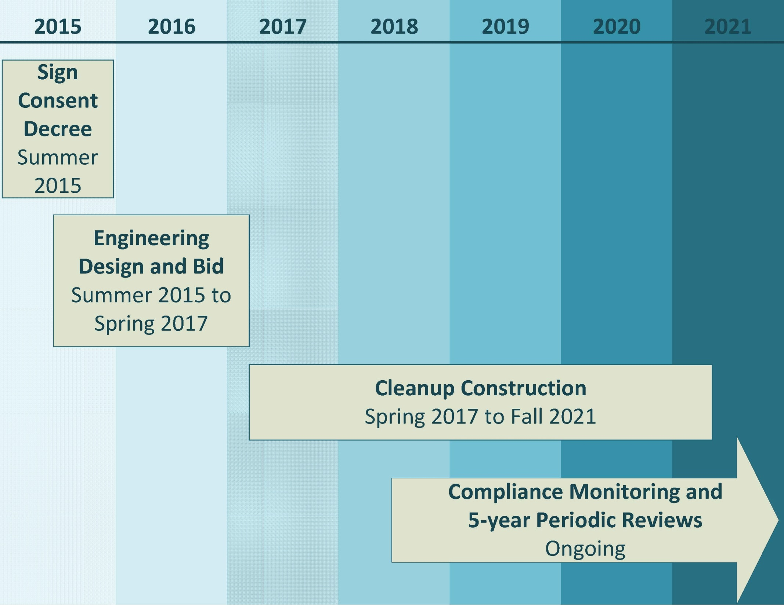
Schedule

Slide 37
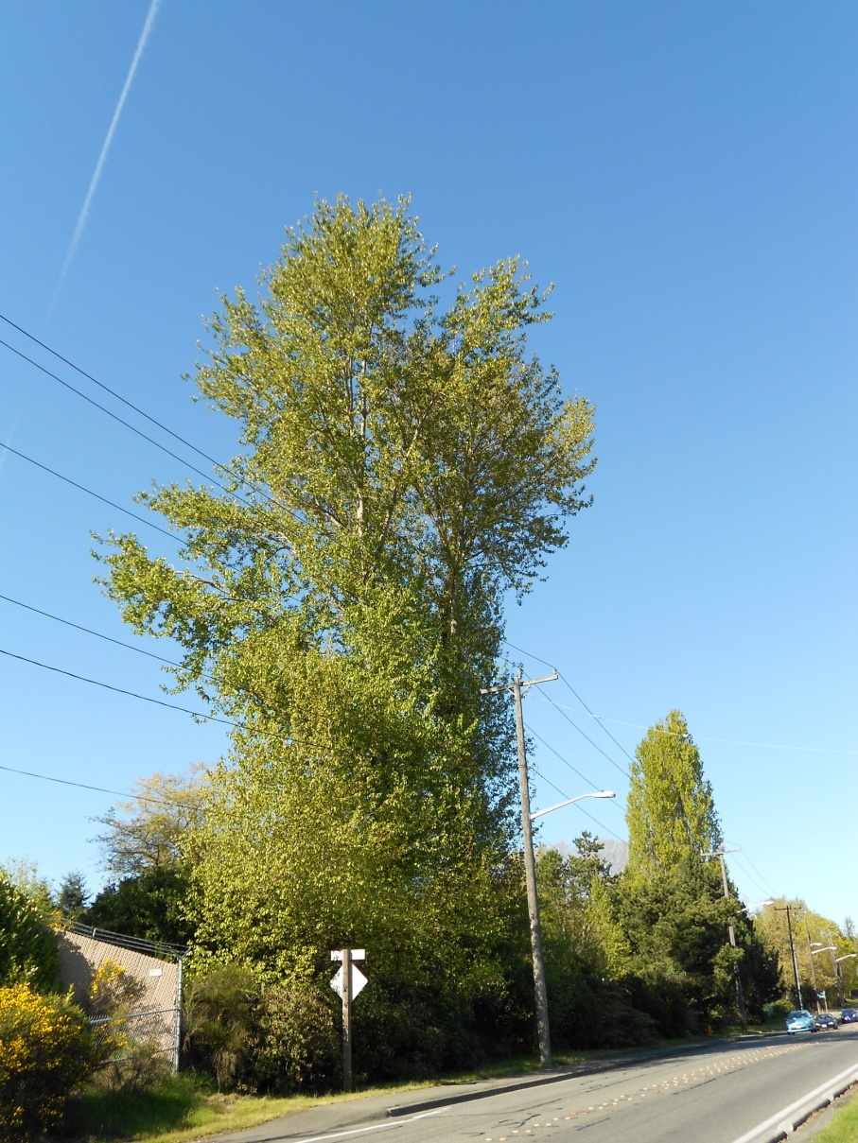
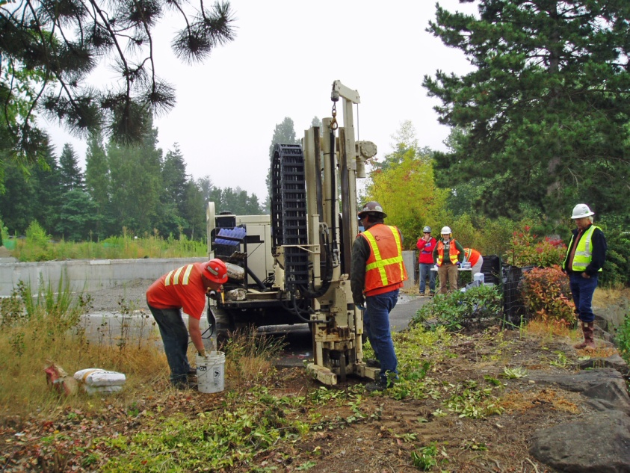
2015 Site Activities
Soil Sampling
Tree Felling
by Seattle City Light

Slide 38
Summary:
Dioxins/furans drive the cleanup. Removing the dioxins/furans will remove the other chemicals.
The Lora Lake Apartments Site has not contributed measurable amounts of dioxins/furans to Miller Creek sediment.
Contamination will be excavated , capped, or immobilized, depending upon concentration and location.
Cleanup integrity will be maintained by monitoring and restricting land use.
Ecology will review Site conditions at least every five years to assess whether the cleanup action remains effective.

Slide 39
Documents for Review
Draft Consent Decree with attached Cleanup Action Plan (Exhibit B of the Consent Decree)
SEPA Documents (Appendix A of the Cleanup Action Plan)
  Withdrawal of previous Mitigated Determination on Nonsignificance
  New Mitigated Determination of Nonsignificance
  SEPA Environmental Checklist of potential impacts

Slide 40
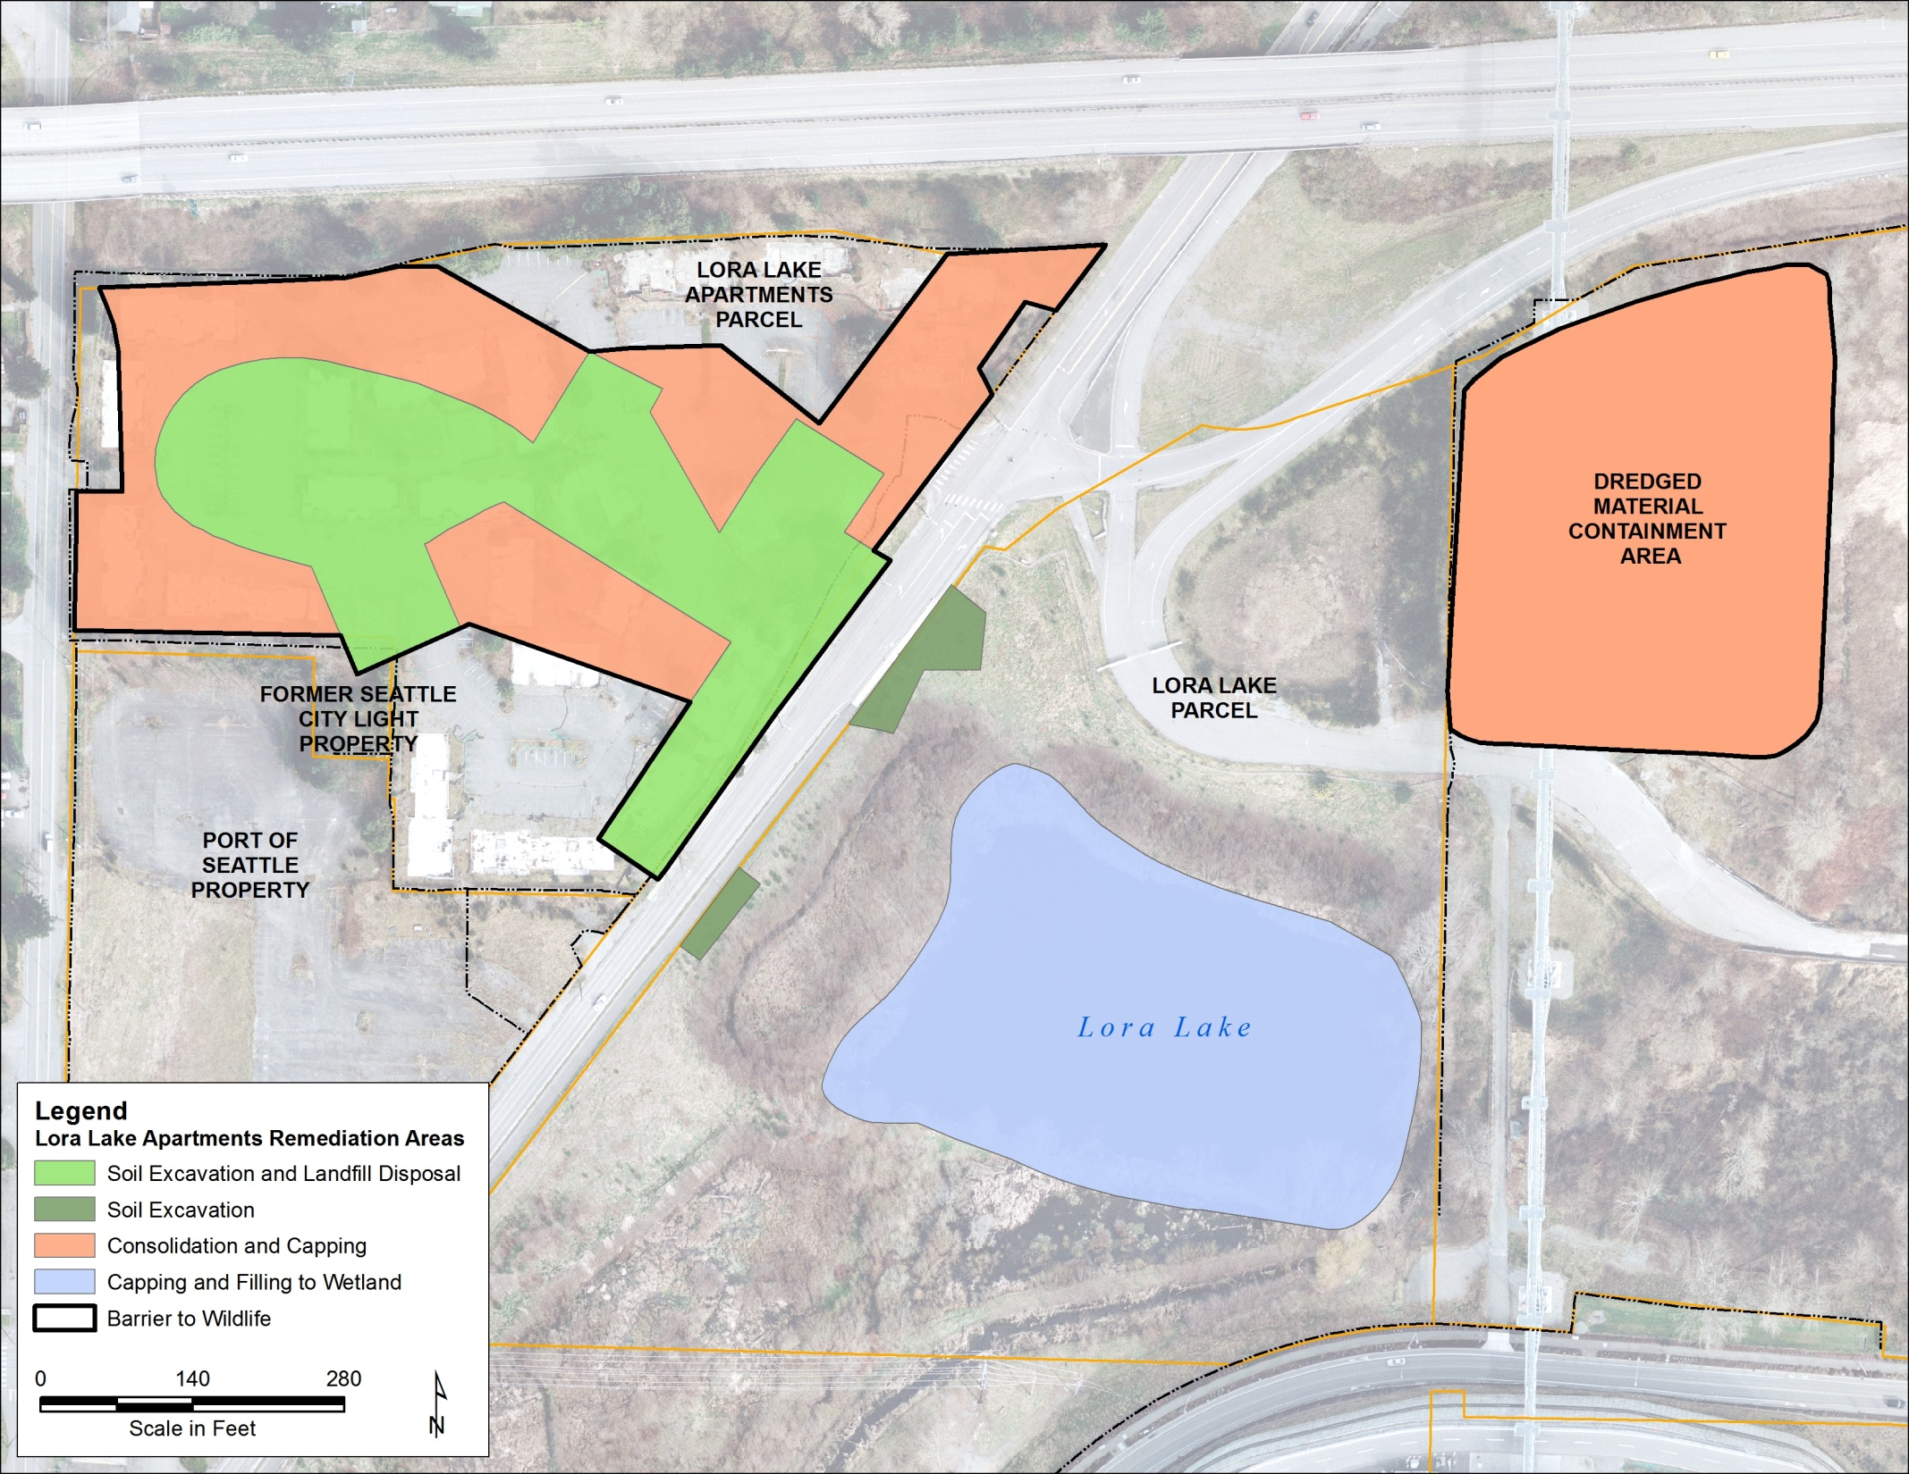
Summary of Cleanup Actions
Consolidation & capping
Excavation and landfill disposal
Consolidation &
capping
Capping & Filling to
create wetland
Excavation
Questions?

Slide 41
Reserve Slides

Slide 42
Overview of Cleanup Activities
Lora Lake Apartments Complex
Lora Lake
Dredged Material Containment Area
Remove highly contaminated soil for disposal.
Place a cap (such as pavement) over less contaminated areas.
Place a deed restriction to protect the cap and limit Site to commercial use.
Fill the lake with clean soil to contain contaminated sediment
Re-establish a former wetland to protect water quality in Miller Creek
In response to public comments, remove a small area of lightly contaminated soil west of the lake.
Consolidate less contaminated soil from the Lora Lake Apartments Complex.
Cover sediment from a past Lora Lake Dredging with pavement or gravel
Place a deed restriction to maintain the cover.

Slide 43
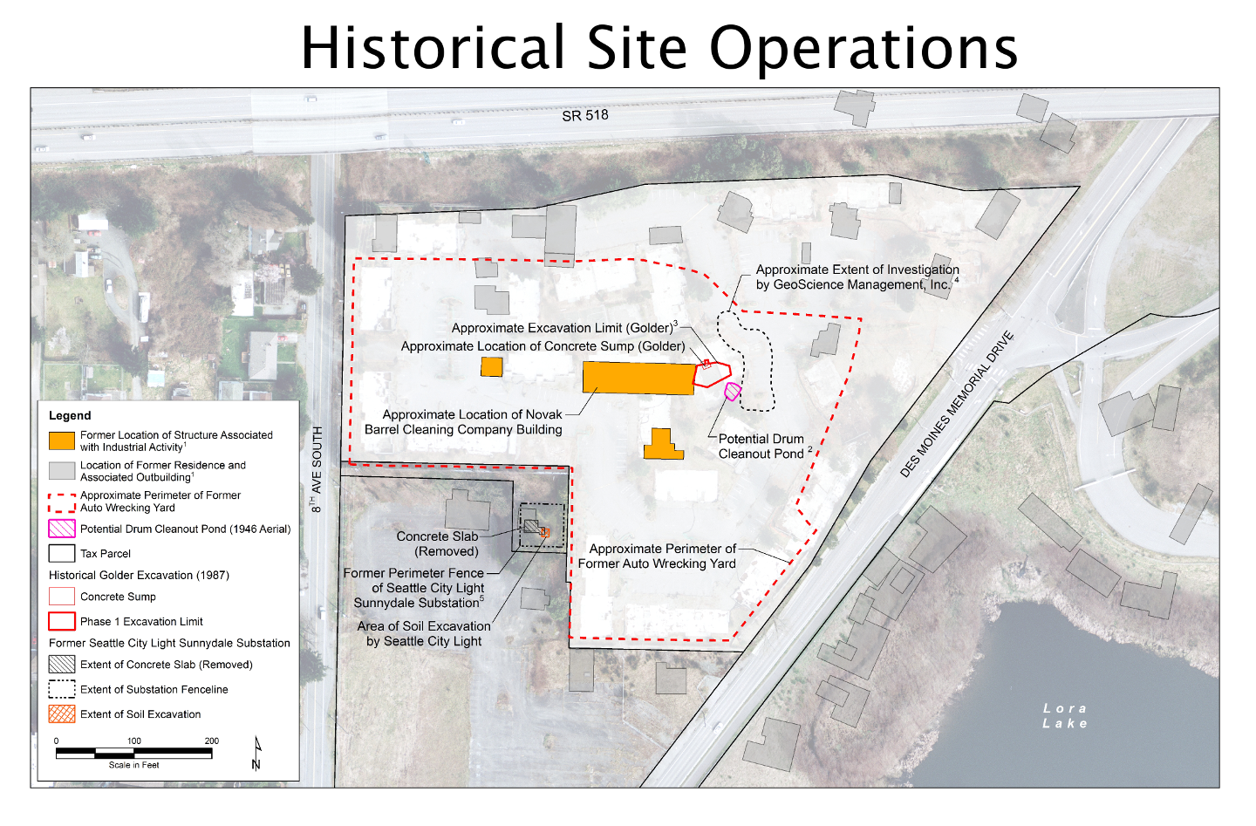
Historical Site Operations

Slide 44
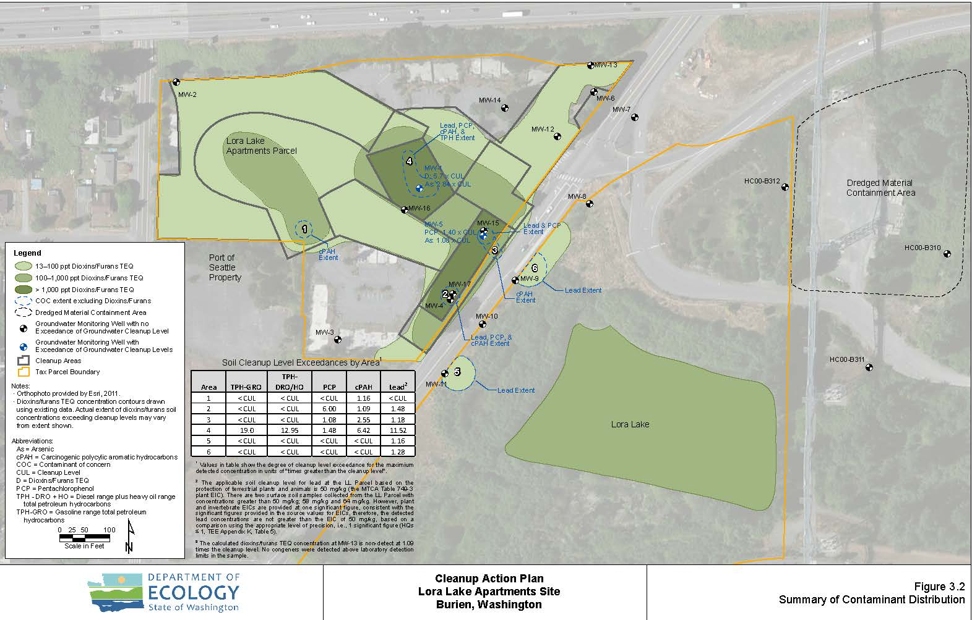
Summary of Chemical Locations

Slide 45
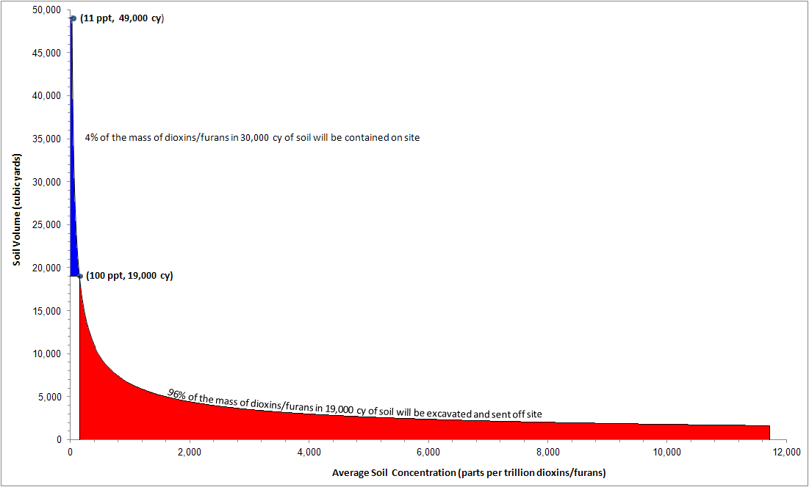
Soil Volume Exceeding vs. Concentration
13 ppt; 49,000 cy
4% of mass of dioxins/furans in 30,000 cy of soil will be managed on site
100 ppt; 19,000 cy – point at which the cost of off site disposal becomes
disproportionate to the environmental benefit
96% of mass of dioxins/furans in 19,000 cy of soil will be sent off site

Slide 46
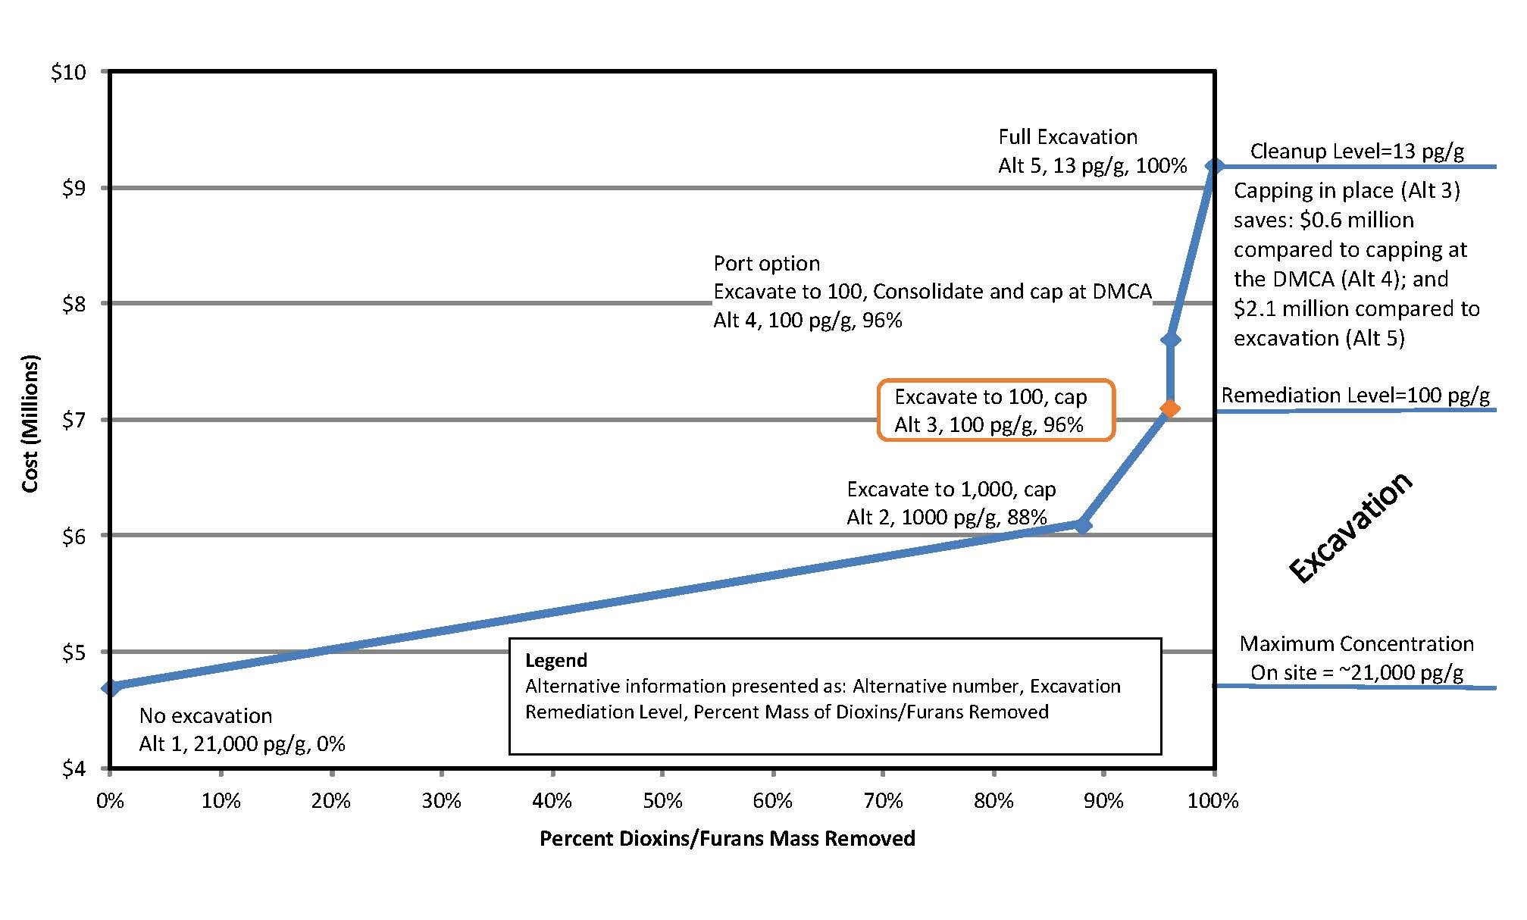
Cleanup Cost vs. Mass Removed

Slide 47
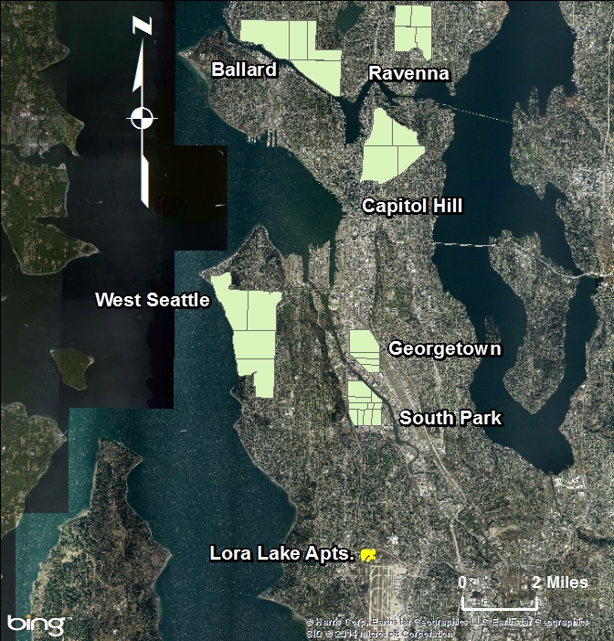
Seattle Urban Soil Dioxins/
Furans Study Areas

Slide 48
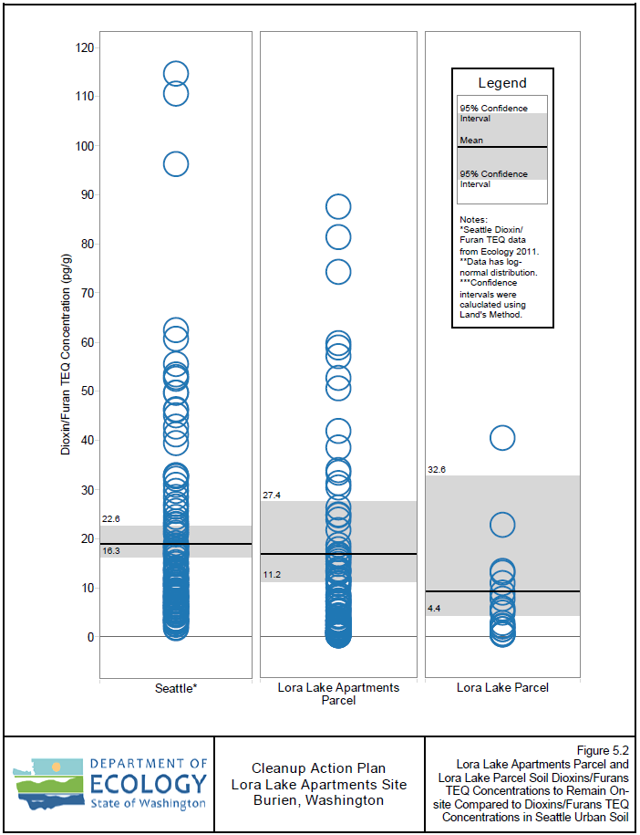
LLA<100, LL cf Urban

Slide 49
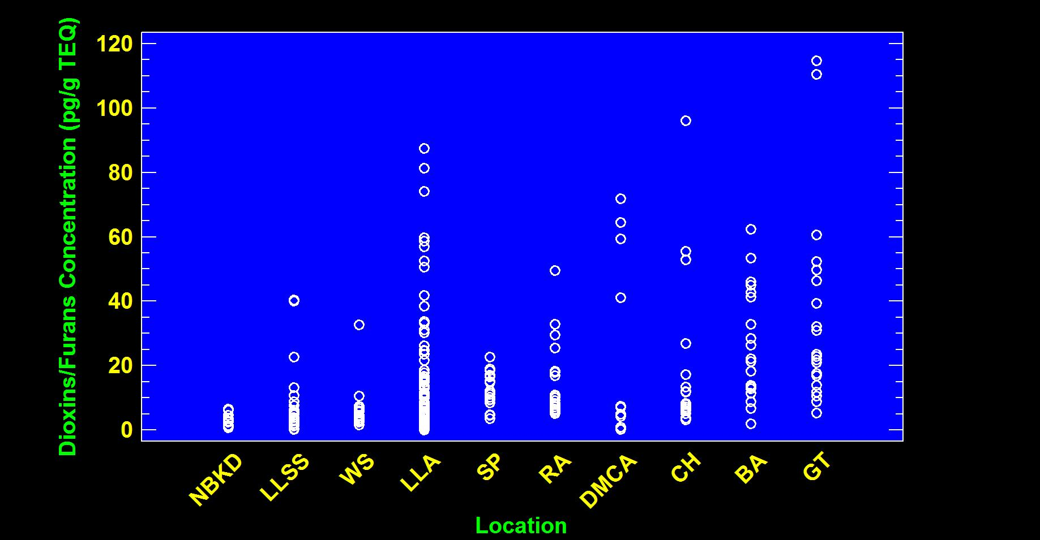
Comparison of Dioxins/Furans Natural Background, Urban Background, and Lora Lake Apartments Site (< 100) Soil Concentrations

Slide 50
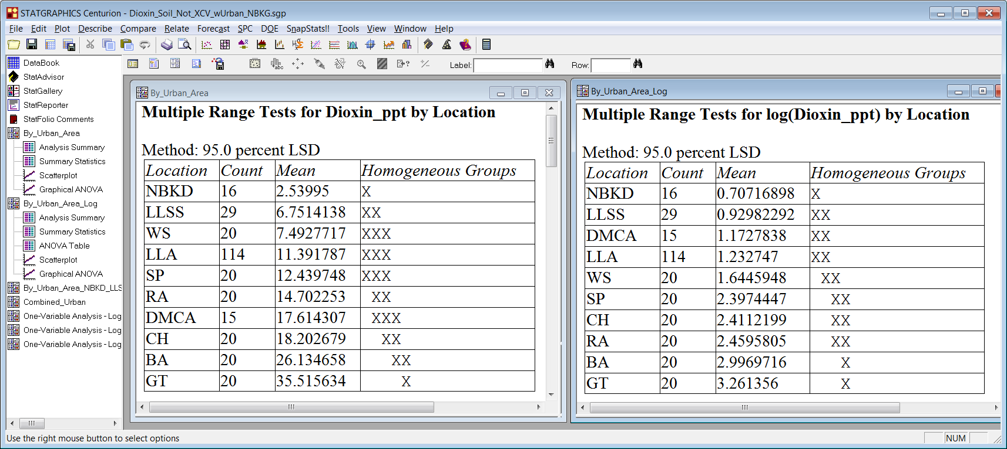
Multiple Range Tests for Dioxin_ppt and Log(Dioxin_ppt) – columns show data sets for which there is no significant difference in the means at the 95% significance level
Normal Distribution
Lognormal Distribution

Slide 51
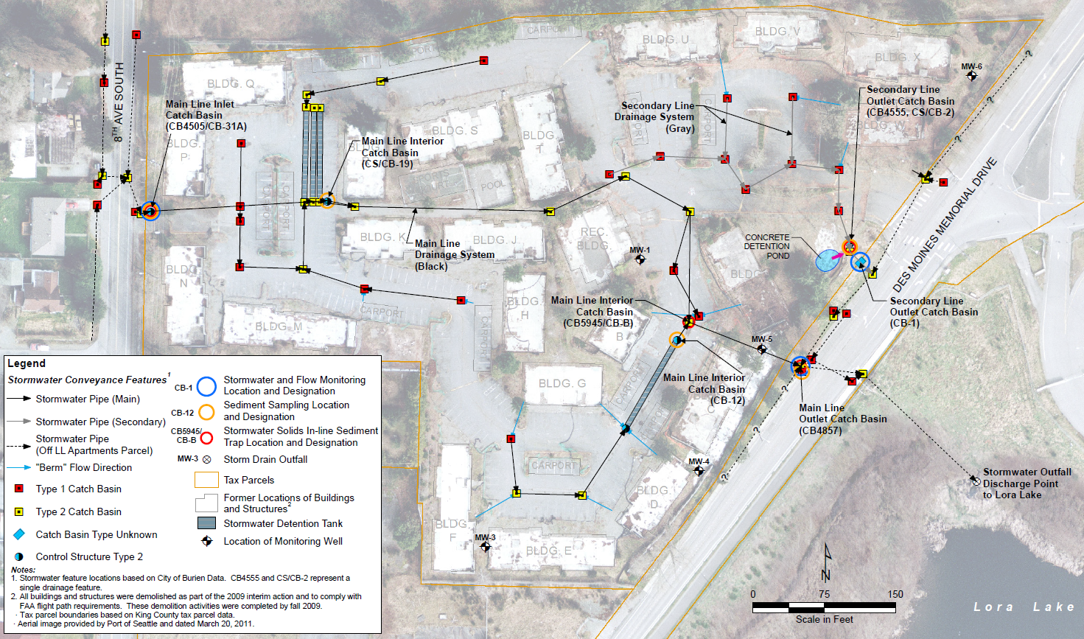
Dioxins/furans in catch-basin solids (ppt)
The catch basin solids were removed in 2010
In ⇨ 36
89
45
143
13 ⇨ Out

Slide 52
Dioxins/furans in in-line solids traps (ppt)
In ⇨ 107
44
181
63 ⇨ Out

Slide 53
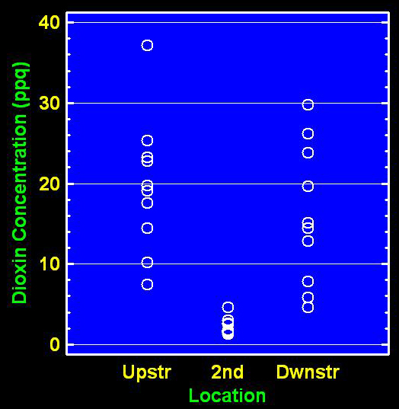
Dioxins/furans in Storm Water
Some standards for context:
No numerical standard – for protection of aquatic life.
30 ppq – Safe Drinking Water Act (Federal)
6.7 ppq – MTCA Drinking water standard (State)
1 – 6 ppq – limits of detectability; depends upon what else is in the water.
0.013 ppq – National Toxics Rule, Human Health, consumption of organisms and water. This has to be measured in the receiving water, not the stormwater.
0.010 ppq – MTCA, consumption of organisms.
0.005 ppq – National Recommended Water Quality Criteria, consumption of organisms and water, measured in the receiving water.
Upstream and downstream stations were statistically the same
IN
OUT

