Slide 1
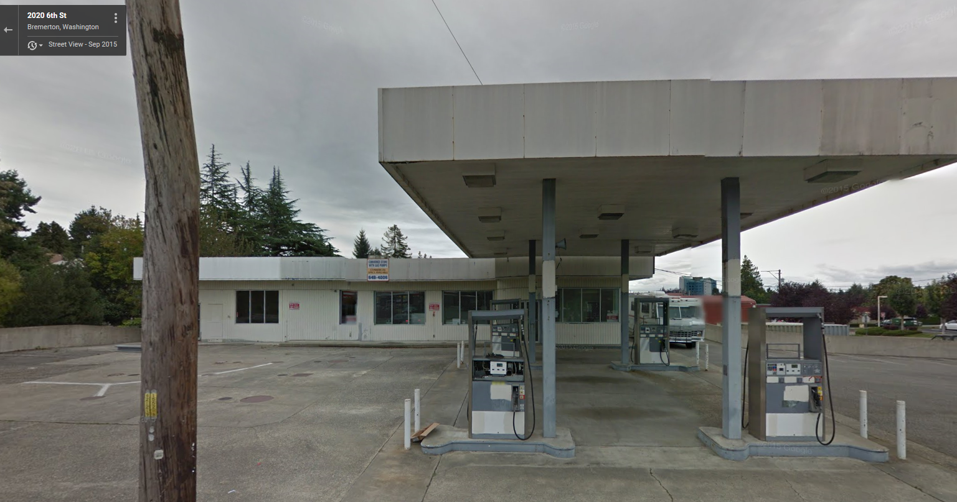
Key Project Meeting #2 RI Planning Meeting

Slide 2
Purpose of this Meeting
Plan Remedial Investigation field work
Review conceptual site model
We do not have one
Review SAP and QAPP requirements
Discuss data needs
Establish communications strategy
Discuss timing and purpose of future meetings
Pre-RI Check in meeting
Second of 5 key project meetings

Slide 3
Overview
Communications
Conceptual Site Model and potential exposure pathways
Schedule and process for Work Plans
Goal: Complete site characterization and remedy selection within 2 years, and construction within 5 years following execution of Agreed Order

Slide 4
Communications
Ecology expects that all communications whether via email or phone to be promptly responded to, given individual work schedules and availability. At a minimum an approximate timeframe for an appropriate response should be given.
Ecology also expects follow-up communications be made in a timely manner with a status update if an appropriate response is not available to due other parties within your organization.

Slide 5
Communications
Work standards
Field decision-making
Informal meetings
Data review and unexpected results
Progress/status reports
Goal: Set expectations that support a single document review cycle

Slide 6
Work Plan Expectations
Developed jointly between PLPs and Ecology
Health & Safety Plan
Sampling & Analysis Plan
Quality Assurance Project Plan
Waste Management Plan & IDW handling protocol

Slide 7
Work Plan Expectations
Make decisions quickly upon receipt of data, prior to completion of an RI Report
Begin feasibility study as soon as sufficient data available
Begin draft CAP once preferred remedy identified

Slide 8
Sampling & Analysis Plan
Known and suspected conditions
On-site and off-site characterization
Define extent of contamination in all applicable media

Slide 9
Quality Assurance Project Plan
Data Quality Objectives
Contaminants of Concern
Diesel
Gasoline
BTEX Constituents
Additives, lead
VPH/EPH
Silica gel cleanup – use selectively and show soil data with and without SGC
PQLs
Data Validation

Slide 10
Work Plan Requirements
Cleanup levels
Terrestrial Ecological Evaluation
Vapor Intrusion pathway
Data submittal/EIM
Work Plan must meet the requirements of WAC 173-340-350

Slide 11
On-Site Characterization
Mitigate/Assess free-product presence
Monitoring & sampling of on-site wells
Review well construction & condition
Drilling, sampling, and well installation goals
Extent of groundwater & soil impacts on-site
Hydrogeology - establish thickness of semi-confined groundwater unit
Selecting screened intervals

Slide 12
This is what I want to discuss in this meeting
Checklist and Templates
Remedial Investigation Checklist
Remedial Investigation Template
Feasibility Study Checklist
Cleanup Action Plan Checklist
Cleanup Action Plan Template

Slide 13
Naming of Documents
Agency review draft Remedial Investigation Work Plan
Public Review draft Remedial Investigation Work Plan
Remedial Investigation Work Plan (post Public Comment period)
Agency Review draft Remedial Investigation
Agency Review draft Remedial Investigation/Feasibility Study Report
Public Review draft Remedial Investigation/Feasibility Study Report
Remedial Investigation/Feasibility Study Report (post Public Comment period)

Slide 14
The Cleanup Action Plan is an Ecology document
Agency Review draft Preliminary Cleanup Action Report
The CAP is prepared by the PLP’s for Ecology’s use
Public Review draft Preliminary Cleanup Action Plan
PLP’s shall incorporate Ecology’s edits & comments and prepare CAP under Ecology’s direction for Public review
For Public review, HG and/or PE sig’s & stamps required
Final Cleanup Action Report
After public comment PLP’s shall prepare for Ecology the Final ‘working’ document

Slide 15
Remedial Investigation Work Plan
The Work Plan shall clearly describe the project management strategy for implementing and reporting on RI activities
The Work Plan shall describe general facility information; site history and conditions; including previous operations; past field investigations, including any data collection and analysis of soils, air, groundwater, surface water, and sediments; a conceptual site model showing contaminants, migration pathways in all environmental media, potential receptors, and screening levels based on the conceptual site model; geology and groundwater system characteristics; past, current, and future land use; identification of natural resources and ecological receptors; hazardous substances and their sources, etc

Slide 16
Quality Assurance Project Plan and Sampling and Analysis Plans
The Work Plan will also identify specific data collection procedures in a Sampling and Analysis Plan (SAP) and Quality Assurance Project Plan (QAPP) as part of the Work Plan in compliance with WAC 173-340-820 and WAC 173-204-600 for defining the nature and extent of contamination.
The SAP identifies the proposed number and location of all environmental samples and methods, including soil borings, groundwater monitoring wells, soil, groundwater, stormwater, seep, catch basin, approximate depths, and includes a quality assurance project plan
The QAPP will be prepared in accordance with the Guidance for Preparation of Quality Assurance Project Plans, EPA Region 10, Quality Data Management Program, QA/R-5 and requirements of the EPA Contract Laboratory Program. The QAPP will also follow Ecology's Guidelines for Preparing Quality Assurance Project Plans for Environmental Studies

Slide 17
QAPP, SAP & HASP
The SAP, including the QAPP, will be submitted to Ecology for review and approval. As with all environmental work at the Site, work may not begin without written approval from Ecology.
The PLPs will also submit a copy of the Health and Safety Plan (HASP) for the project.
Full details for the QAPP, SAP, and HASP are discussed in detail in Agreed Order – Exhibit B – Scope of Work

Slide 18
Data Validation Requirement
Environmental data validation must be performed using Ecology’s TCP Data Validation and Sampling Analysis Plan (SAP)/Quality Assurance Project Plan (QAAP) for data validation for all Formal Cleanup Sites (Ecology September 23, 2016). Data validation shall be performed at Quality Assurance Level 2 (EAP2) with Third Party Data Validation

Slide 19
Policy 840 Environmental Information Management System (EIM)
Ecology has updated Policy 840 related to data submittal requirements for TCP sites. Policy 840 requires environmental monitoring data collected at TCP sites as part of site investigations and cleanups to be submitted into EIM at the time of submittal for Ecology review of any report containing this data.

Slide 20
EXHIBIT C – SCHEDULE OF DELIVERABLES
Deliverable | Due Dateª
Agency Review Draft Remedial Investigation (RI) Work Plan | 90 days after the Agreed Order effective date
Final RI Work Plan | 30 days after receipt of Ecology comments
RI Field Investigations Completed | 180 days after Final RI Work Plan
Agency Review Draft RI Report | 90 days following receipt of RI validated data

Slide 21
Applied Geotechnology, Aug 1990

Slide 22
Piping Diagram, Applied Geotechnology, October 1990

Slide 23
Geoprobe Exploration Locations, GeoScience Management, 11-2000

Slide 24
Pinnacle Sample location map 08-20-2009

Slide 25
Pinnacle Results, Conclusions & Recommendations
Soil beneath dispenser islands impact with gasoline & benzene above MTCA Method A (Borings BM-4, -5, -6, -7)
Total depth of impacts not known
12-feet bgs was maximum depth with concentrations increasing (BM-5 @ 12’ = 4,400 mg/kg TPH)
Soil adjacent to former UST nest shows impacts (BM-12)
Soil adjacent to convenience store show impacts (BM-8)
Report recommends further investigation of beneath dispenser islands
Former interior hydraulic lifts and indoor sump not investigated

Slide 26
Groundwater Investigation
During previous investigations groundwater has not been encountered at this Site
Questions
To what depth are we to investigate
How many borings will be required for GW investigation
Locations for these 50-ft borings
Regional & local depth to GW

