Slide 1
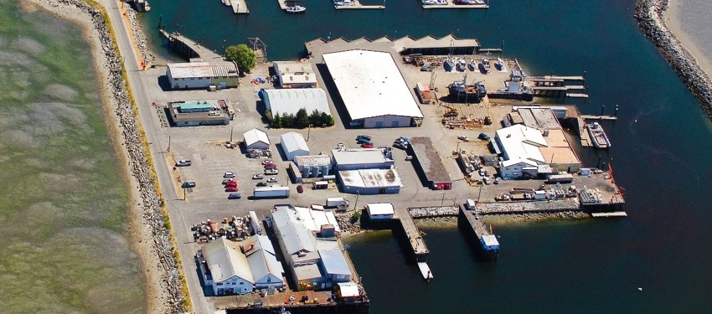
Blaine Marina, Inc. Draft Consent Decree – Cleanup Action
Public Meeting – May 10, 2018
Notes:
1

Slide 2
Meeting Agenda
6:00 – 6:15 Meeting Purpose & Process Overview – Brad Petrovich - Ecology
6:15 – 6:30 Site History & Environmental Conditions – Ben Howard - Port of Bellingham
Jeremy Davis – Landau Associates
6:30 – 6:45 Site Cleanup – Cris Matthews - Ecology
Draft Consent Decree and Cleanup Implementation
6:45 – 7:00 Closing and next steps –
Cris Matthews, Brad Petrovich - Ecology
7:00 – 8:00 Questions and answers
Notes:
2

Slide 3
Meeting Purpose
To provide information on Draft Consent Decree for cleanup implementation at the Blaine Marina, Inc. Site:
Describe State Cleanup Process (MTCA)
Describing the site history and conditions
Discussing the cleanup action
Outlining the legal agreement between Ecology and the Port of Bellingham
To provide opportunity for public to ask questions and obtain additional information on the site and the process.
Notes:
3

Slide 4
State Cleanup Process
Initial Site Assessment
Remedial Investigation/ Feasibility Study (RI/FS)
Interim Actions (if necessary)
Remedial Design, Permitting, Construction, and Monitoring
Agreed Order Amendment & Cleanup Action Plan
Notes:
4

Slide 5
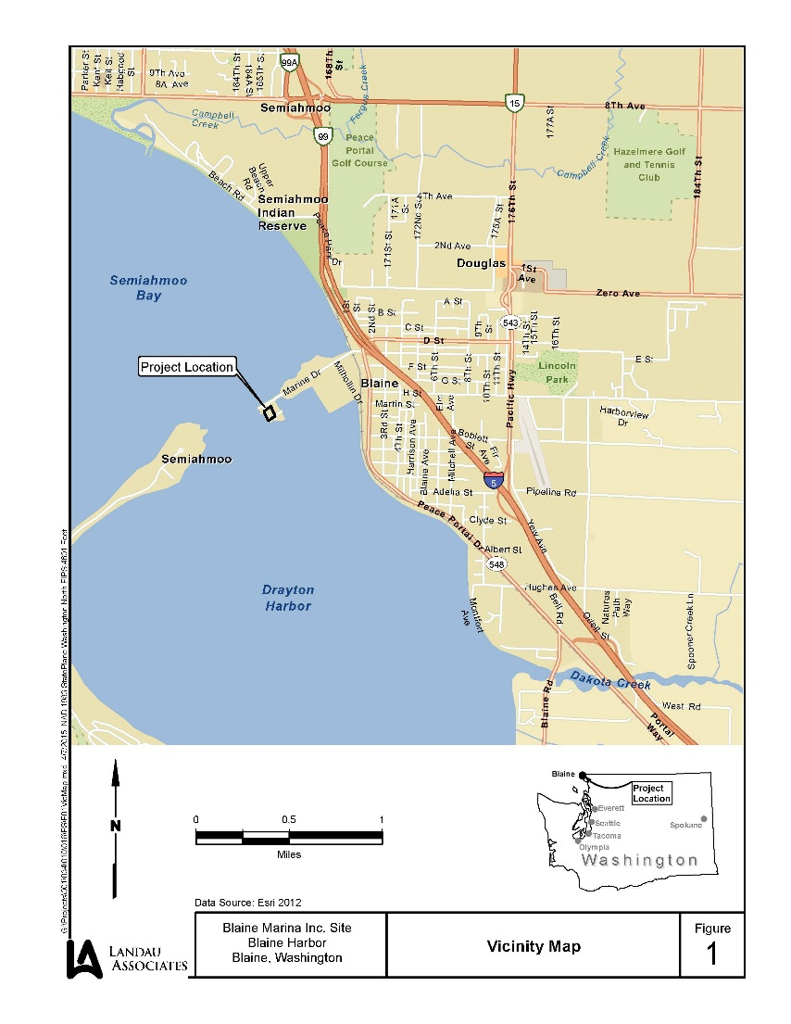
Blaine Marina, Inc. Site Location
Notes:
5

Slide 6
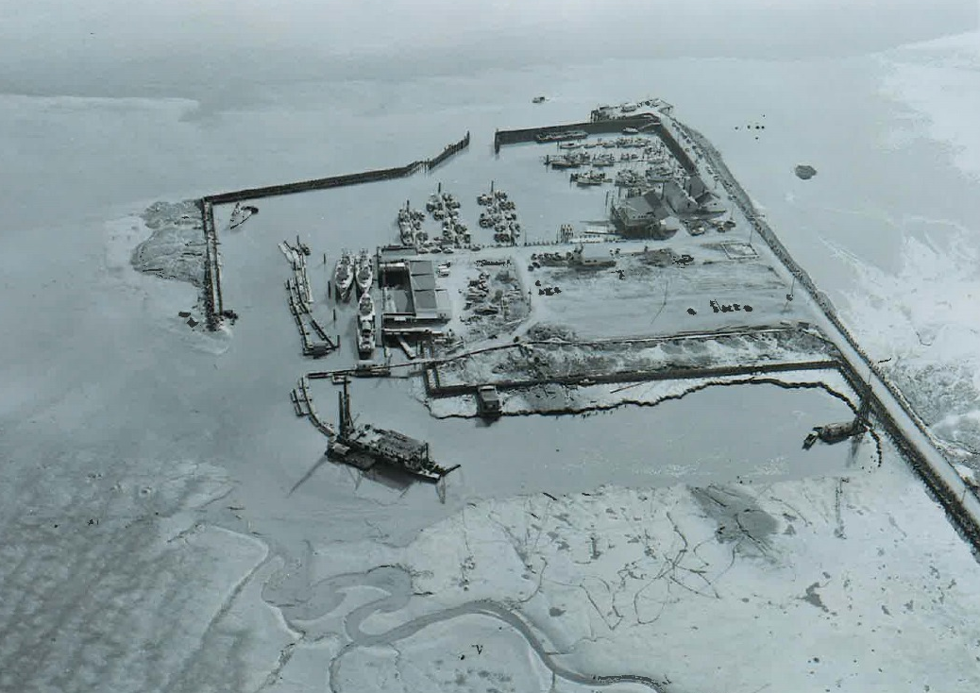
Beginnings
1949 - Creation of Blaine Harbor
1953 – Continued Development of Blaine Harbor

Slide 7
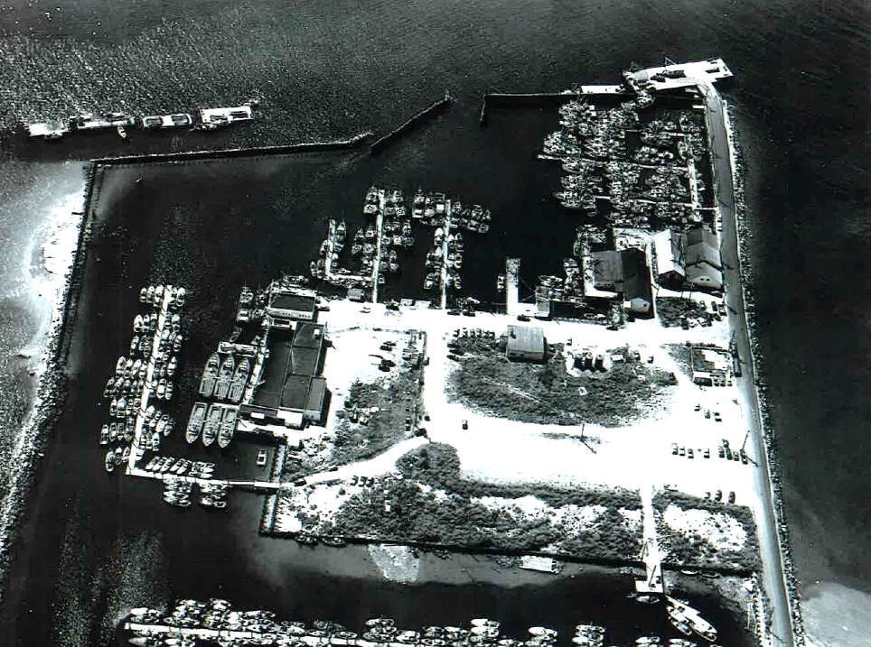
Early Development
1955 – Fuel Facility Development
1957 – Fuel Facility Operation and Commercial Fishing Fleet

Slide 8
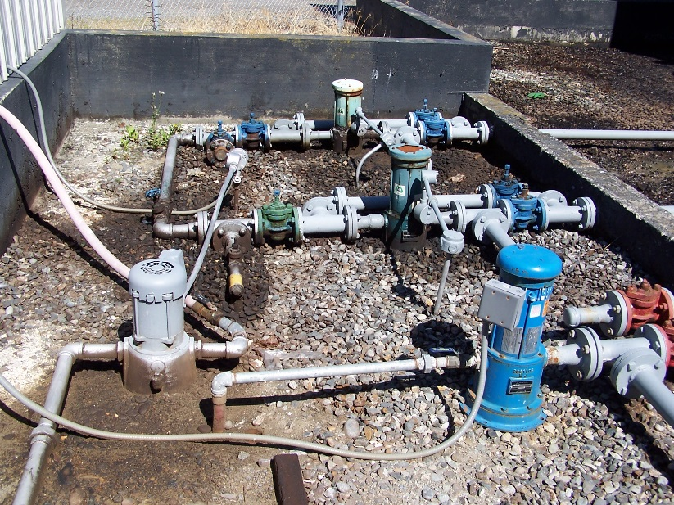
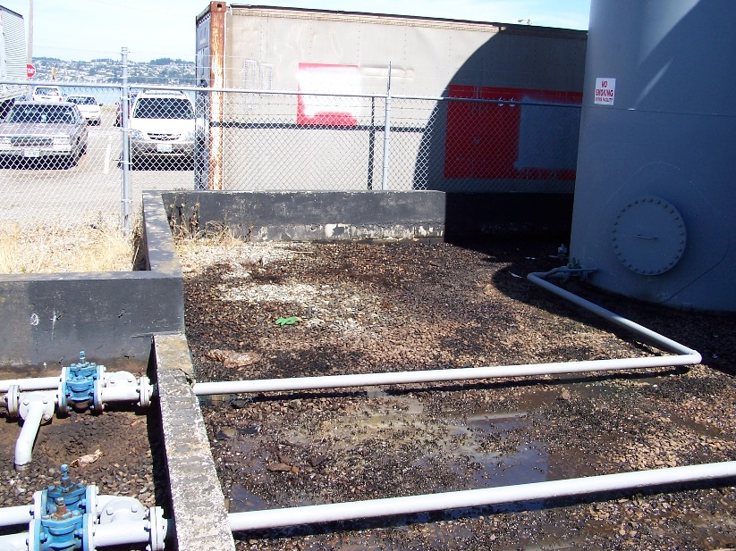
Fueling Operation
Fuel facility operated from 1950’s to 2015
Environmental controls limited during operational period
Unlined containment area
Documented spills and releases to soil and groundwater

Slide 9
Facility Closure & Present Day
Fuel facility closed in 2015 (operator retired)
Opportunity for cleanup of historical spills and releases
Ongoing planning to determine future land use

Slide 10
Remedial Investigation
Notes:
10
3 Geotechnical borings
22 Direct-push soil borings
Soil vapor evaluation
Sediment quality testing
12 Groundwater grab samples
9 Groundwater monitoring wells
LNAPL Evaluation
Surface water quality testing

Slide 11
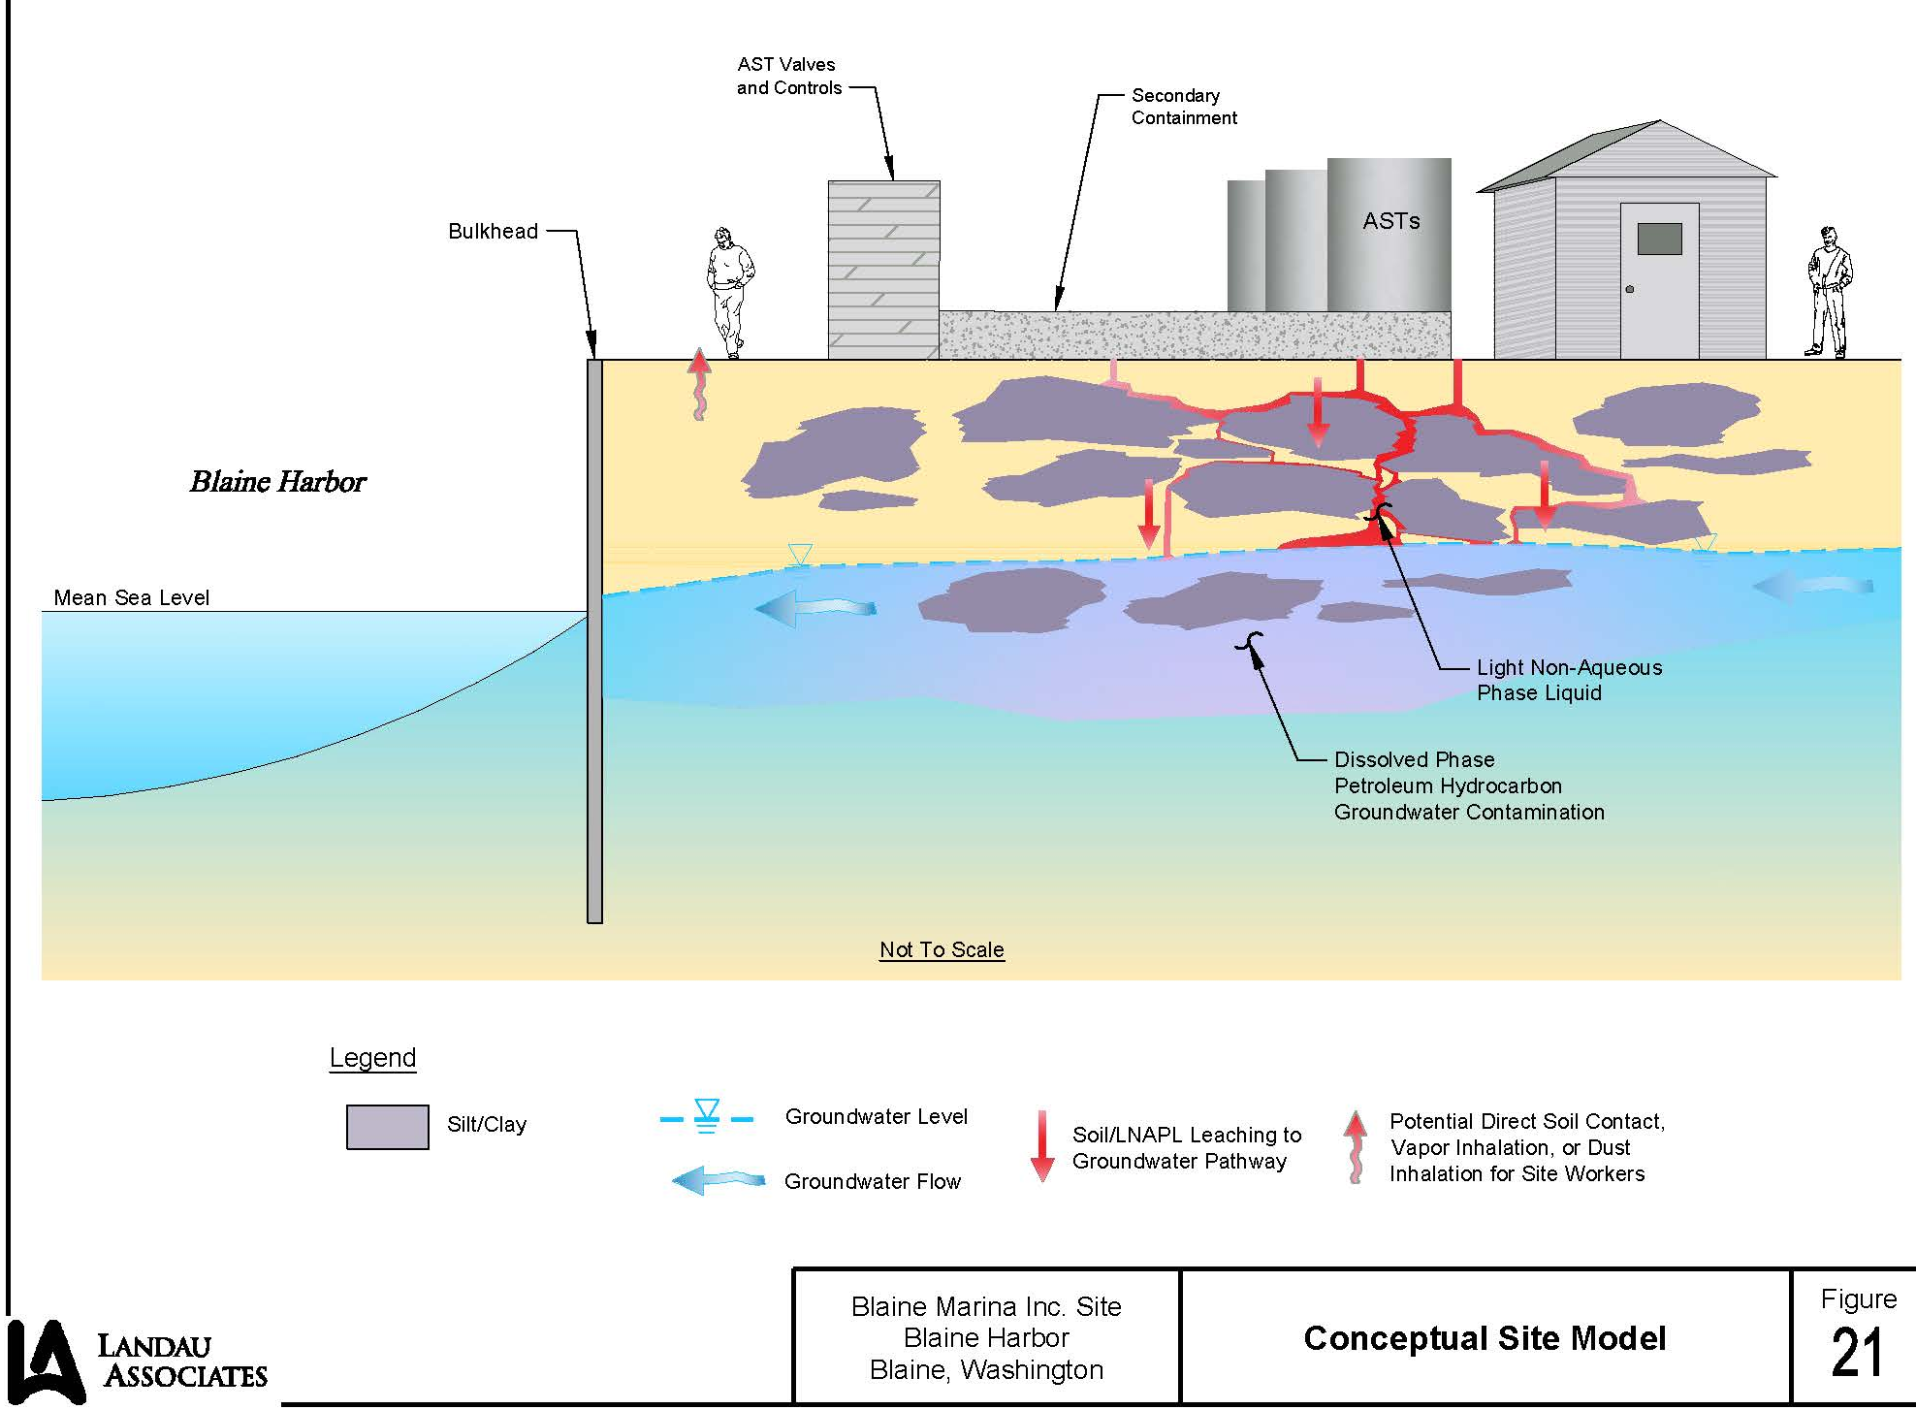
Site Conceptual Model
Notes:
11
Source – LNAPL and petroleum residuals from historical fueling facility
F&T – Petroleum and constituents in soil and groundwater
Pathways – groundwater and vapor migration
Potential Receptors – workers and adjacent aquatic organisms

Slide 12
Hazardous Substances
Soil
Total Petroleum Hydrocarbons
Gasoline- and diesel-range (TPH-G, TPH-D)
Benzene
Ethylbenzene
Xylenes
Total Naphthalene
Groundwater
Total Petroleum Hydrocarbons (TPH-D, TPH-G)
Benzene
Total Naphthalene
Soil Vapor
Benzene
1,3-butadiene
Notes:
12

Slide 13
Legal Process
Consent Decree
Formal legal agreement filed in court
Settlement agreed to by the Port, Ecology, and Attorney General’s office
Consent Decree describes site activities that must occur for Ecology to determine that the cleanup objectives have been satisfied
Consent Decrees are subject to public review
Notes:
13

Slide 14
Cleanup Action
Site preparations & source removal
Above ground storage tanks (ASTs) & fueling system decommissioned, demolished, and disposed off-site
Buildings & slabs demolished & disposed off-site
~3,000 tons of contaminated soil excavated, disposed/treated off-site
Cover & institutional controls
Pavement & soil cover
Possible Restrictive Covenant
Sheet-pile Bulkhead
Potential extension of existing structure to provide hydraulic barrier & reduce near-shore tidal exchange
Notes:
14

Slide 15
Cleanup Action
Bioremediation & Monitored Natural Attenuation
Introduction of growth media to stimulate natural microbial activity
Possible 12 injection events extending over 4 years
Monitored Natural Attenuation (MNA) may follow bioremediation depending on degree of success & timeframe of active measures
Compliance Monitoring
Protection monitoring during source removal
Performance monitoring gauging effectiveness of removal work
Confirmation monitoring of groundwater overtime to measure progress/success of remedial work
Notes:
15

Slide 16
Cleanup Action
Source: Draft Cleanup Action Plan – Figure 3
Notes:
16

Slide 17
Next Steps
Ecology’s Public Comment Period:
May 7, 2018 – June 5, 2018
Ecology’s review and response to comments and any non-substantive changes; if substantial changes, documents go back to cleanup parties for authorization & new public comment period
Design and Construction Plans – Spring/Summer 2018
Construction - Anticipated Late July 2018 to October 2018
Notes:
17

Slide 18
Ecology Wants Your Comments
Document Availability
Ecology’s Web Site
Bit.ly/Ecology-BlaineMarina
Document Repositories
Blaine Library
Ecology’s Bellingham Field Office – Bellingham
Ecology’s Northwest Regional Office – Bellevue
Submit Comments by June 5, 2018
Ecology’s e-comments web page:
Bit.ly/Ecology-BlaineMarina-Comments
E-mail:
Cris.Matthews@ecy.wa.gov
Notes:
18

