Slide 1
Remedial Investigation Planning Meeting Texaco/Strickland
Department of Ecology
Toxics Cleanup Program
September 10, 2018

Slide 4
Remedial Investigation Planning Meeting
Purpose: Set the stage for performance of the RI
Schedule of Deliverables
Establish Communications
Chri-Mar Apts. & Data Gaps
Access Agreements
EIM, SAP, QAPP Requirements
Cleanup Goal, Cleanup Process, Public Participation
Extensions

Slide 5
Schedule of Deliverables
Agreed Order fully executed August 28, 2018
Agency Review Draft Remedial Investigation (RI) Work Plan.
No later than 90 days after the AO effective date
I am making that date reflective of this meeting date September 10, 2018.
This makes December 10, 2018 as the due date for the Agency Review Draft Remedial Investigation Work Plan (RIWP)

Slide 6
Schedule of Deliverables
Agency Review Draft Remedial Investigation (RI) Work Plan
Ecology Project Manager will participate in development of the Work Plan to be sure that all the expectations for the work are addressed and increase the chance that the Work Plan can be approved in one (1) iteration.
Final Remedial Investigation Work Plan
30 days after receipt of Ecology comments.
Ecology will not be giving comments until after January 2, 2019

Slide 7
Establish Communication Protocol
Ecology’s Project Team
Dale Myers - Ecology Project Manager
Mike Warfel - Hydrogeologist
Strickland Project Team
William ‘Chip’ Goodhue (Aspect)
Chevron’s Project Team
Eric Hetrick – CEMC Project Manager
Russ Shropshire - Leidos
Identify a primary point of contact
Other project team members

Slide 8
Recent Concern for Potential Comingling with Dry Cleaner Plume
2016 Limited Subsurface Sampling & Testing Chri-Mar Apartments.
The Chri-Mar Apartment complex is located adjacent & south of the Texaco Strickland Site. Five Geoprobes were advanced along the northern property boundary of the apartment complex. Data from soil & grab groundwater samples showed:
volatile organic compounds above MTCA Method A cleanup levels
potentially relating to a former dry cleaning operation, Slaters 1 Hour Cleaners, located directly north of the apartment complex and west of the Texaco/Strickland Site.
Soil vapor analysis showed benzene above MTCA Method B screening levels in borings B-1 and B-3.
What is the source for the benzene?
Soil vapor analysis from boring B-3 showed trichloroethene (TCE) above MTCA Method B screening levels.

Slide 9
Chri-Mar Apartments Investigation

Slide 10
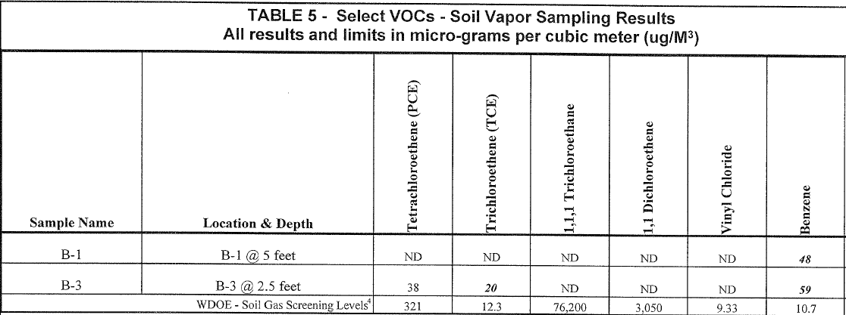
Chri-Mar Apts.
Action Levels TCE
67 ug/m³ TCE soil gas
Short-term action level for pregnant women
11 ug/m³ TCE soil gas

Slide 11
Data Gaps
Disposition of the Underground Storage Tanks unknown
Vertical and lateral extent of groundwater plume not defined
Current groundwater conditions unknown, last monitoring performed in 2012
TPHg plume comingled with the dry cleaner solvent plume?
Jiffy Lube Oil release will need to be clearly characterized within the Formal Site Investigation The VCP Opinion stating that they were a separate and distinct releases was based on Silica Gel Cleanup analysis
Vapor Intrusion Assessment Required:
Aloha Café, Chri-Mar Apts., Strip Mall-

Slide 12
Wells with Separate Phase Liquids

Slide 13
Ground Water Flow Direction

Slide 14
Groundwater
Shallow groundwater beneath the Site is present at average depths varying between approximately 6.1 to 14.9 feet bgs in Site monitoring wells
Concentrations of TPHg and BTEX, related to the former service station operations, are persistently detected above the MTCA Method A screening levels in monitoring wells MW-1, MW-2, and MW-10.
Separate Phase liquids (SPH), also known as light non-aqueous phase liquids (LNAPL), are present in ground water monitoring wells (MW-3, MW-4, MW-5, and MW-8) at the Site.
Fuel fingerprint analysis conducted in late 2009 concluded that the SPH detected in monitoring wells MW-3, MW-4, and MW-5 (and likely intermittently detected SPH in MW-8) consists of weathered gasoline. All three samples contained weathered leaded gasoline with a mixture of lead alkyls that were only available from the mid-1960s to the mid-1980s.

Slide 15
Chemicals of Concern
Gasoline-, Diesel-, Oil-range Total Petroleum Hydrocarbons (TPHg, TPHd, TPHo) in Soil and Ground Water
Benzene, Toluene, Ethylbenzene, Xylene (BTEX) in Soil and Ground Water; and Naphthalene in Soil
Chlorinated solvents from the dry cleaners and benzene in adjacent property to the west

Slide 16
Access Agreements
Will need to obtain Access Agreements with the Chri-Mar Apts. Owner, and Strip Mall Owner
Chri-Mar Apts.
19618 68th Ave W, Lynnwood, 98036
Parcel Number 27042000200900
Jay Whitebread, Excel Properties RCI
7850 E. Green Lake Dr. N Seattle, WA 98103
206-931-1988
Strip Mall
6820 196th St SW Lynnwood, 98036
Parcel Number 27042000200800
Kathie Nelson, Nelson Investments LLC
2200 Macnaughton Ln, Lake Stevens, 98258

Slide 17
EIM, SAP, QAPP Requirements
Environmental Data Validation
Environmental data validation must be performed using Ecology’s TCP Data Validation and Sampling Analysis Plan (SAP)/Quality Assurance Project Plan (QAPP) for data validation for all Formal Cleanup Sites (Ecology September 23, 2016).
Data validation shall be performed at Quality Assurance Level 2 (EAP2) with Third Party Data Validation.

Slide 18
EIM, SAP, QAPP Requirements
Policy 840 states that all data will be uploaded to EIM and validated at time of any report submittal.
Ecology Site/Project Managers will not review reports until this is done.
This does not apply when raw data needs to be communicated to me and a quick decision needs to be made!!!
If a decision rests on conferring with me, send me the raw data and schedule a quick meeting so we can make that decision.

Slide 19
Cleanup Goal
Complete Site characterization and remedy selection within two years of effective date of Agreed Order
Agency Review Draft RI work Plan
RI Field Activities completed
Agency Review Draft RI/Feasibility Study (FS) Report
Public Review Draft RI/FS
Final RI/FS
Agency Review Preliminary Draft Cleanup Action Plan
Public Review Draft Cleanup Action Plan
Final Cleanup Action Plan

Slide 20
Cleanup Process
RI Work Plan – developed jointly between PLPs and Ecology that includes:
Health & Safety Plan
Sampling & Analysis Plan (Data Validation Requirement)
Quality Assurance Project Plan (Data Validation Requirement)
Conduct RI and prepare an RI Report (see RI Checklist)
Begin FS as soon as sufficient data available (see FS Checklist)
Begin draft CAP once preferred remedy identified
Public Notice and Comment

Slide 21
Public Participation
Consistent with other Cleanup sites under Agreed Orders
RI, FS, DCAP, and SEPA
RI & FS can be combined or separate
Public Participation Plan for community outreach
Public meeting if requested
Response to comments

Slide 22
You want a What?

Slide 23
Extensions
Extension Request
An extension of schedule shall be granted only when a request for an extension is submitted in a timely fashion, generally at least thirty (30) days prior to expiration of the deadline for which the extension is requested, and good cause exists for granting the extension. All extensions shall be requested in writing. The request shall specify:
The deadline that is sought to be extended
The length of the extension sought
The reason(s) for the extension; and
Any related deadline or schedule that would be affected if the extension were granted.

Slide 24
Bottom Line for requests for Extension
Don’t wait
As soon as it is recognized that you will possibly not meet any schedule date of any Major Deliverable.
Communicate with me and begin the process of your Extension Request
Good Communications will most likely result in Ecology’s Approval

Slide 25
I’m Done!
Do you guys have any questions or comments you’d like to add or address?
The floor is yours.

