Slide 1
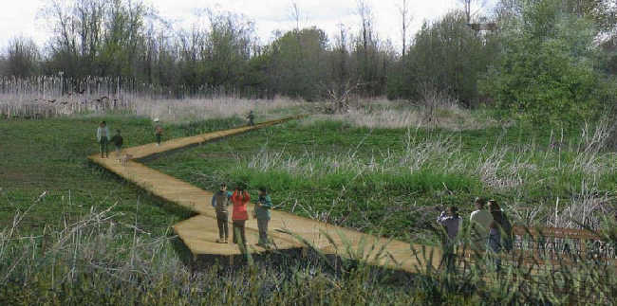
Boeing Auburn Fabrication Site Clean Up
2018 Update
Notes:
I’m Thea Levkovitz with the Boeing Auburn Fabrication Site clean up on behalf of the Washington Department of Ecology.
With me are:
Robin Harrover, Ecology, cleanup site manager
Jeremy Porter, Aspect consulting to Ecology
We are here to update you on the clean up of groundwater contamination from the Boeing Auburn Facility.
We have given these briefings every year for the last 5 years. Thank you.

Slide 2
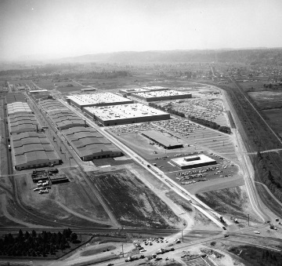
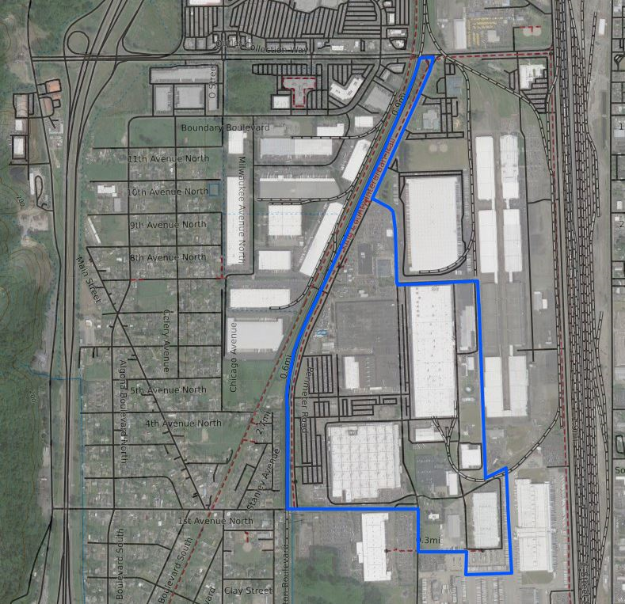
What happened?
Notes:
On the left is a historical photo of the Boeing Auburn facility
On the right is a map showing the property boundary today
As a reminder:
In parts of Auburn and Algona, the groundwater is contaminated with a chemical degreaser trichloroethene (TCE) and,
other chemicals that can get into air (volatile organic compounds (VOCs)) that result from breakdown of TCE such as vinyl chloride (VC).
Contamination likely originated from two different areas on the Boeing Auburn facility.
We also oversaw studies of groundwater and surface water and indoor air in places where contaminated groundwater could have:
come to the surface in ponds, hards or ditches or
turned to vapor and entered buildings.

Slide 3
What we know
People are not being exposed to unhealthy concentrations of the chemicals.
We’ve studied groundwater, soil, and air.
We enforce cleanup even when people are not exposed to the contamination.
Notes:
Here is what we know about the contamination:
People are not being exposed to unhealthy concentrations of the chemicals.
We’ve studied groundwater, soil, and air and people are not being exposed in any of these ways
We enforce cleanup even though people are not exposed to the contamination.

Slide 4
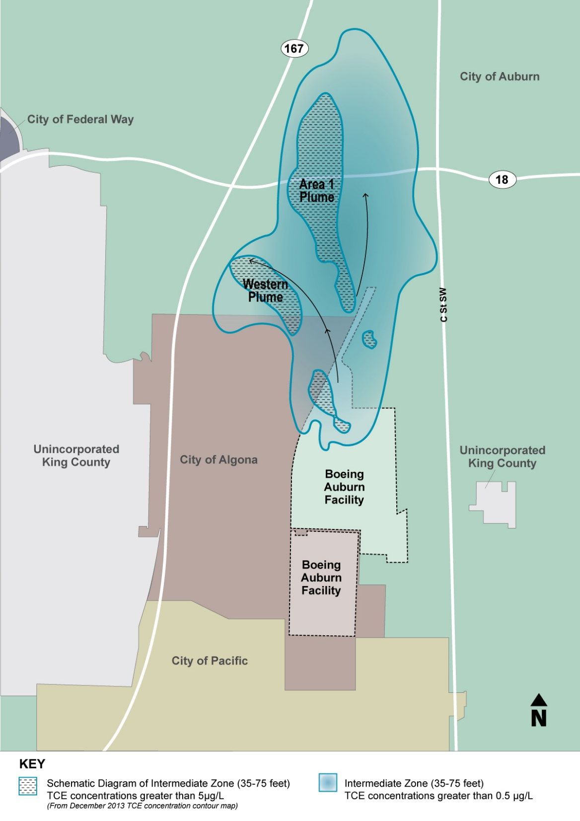
Groundwater Contamination is stable
TCE in Intermediate groundwater
35 to 75 ft.
Notes:
The contaminated groundwater flows north and northwest away from the Boeing property under portions of southwest Auburn and northeast Algona.
Most of the contamination between 35 and 75 feet below the surface. (Intermediate zone )
It is found in two plumes of groundwater that came from two areas on the Boeing Property.
The concentrations of chemicals (TCE and VC) are either not changing, decreasing or not detected at most of the site’s wells.
That is why we consider the plume to be stable.
There are nearly 300 wells that monitor the contamination in the groundwater.
That is a lot of wells. Other cleanup sites have far fewer.
We will continue to monitor the plume.
We can always direct Boeing to do more investigation, if we see a change in the location, concentration or direction of contamination.
---
BACK POCKET
Where did the plumes come from?
Area 1 Plume
The TCE degreaser and tank line in former Building 17-05 leaked.
It is the source for the Area 1 groundwater plume.
From 2004 to 2006, we oversaw a TCW cleanup (Interim Remedial Action)
Western Plume
The former TCE vapor degreaser in Building 17-07 (S-13a) is the likely source of the western groundwater plume
( based on operational history and groundwater and soil gas data.)
Other sources may be:
Former chrome waste holding tank
Former north lagoon on the Boeing property. This degreaser structure, holding tank and piping have been removed and the north lagoon has been closed.
Future groundwater cleanup will be incorporated into the site-wide groundwater cleanup proposals for the FS.
Above those cleanup levels.
There are 16 wells that have had some increase of TCE and 12 wells that had increases of VC, but most are stable.

Slide 5

Is the drinking water safe?
YES! Public drinking water is regularly monitored by the Washington Department of Health.
Can you eat vegetables and fruits from your garden?
YES! The water in your garden hose is drinking water.
Are your pets safe?
YES! We took samples from surface water in Algona and none are high enough to harm wildlife or pets.
Notes:
Drinking water
Public drinking water is regularly monitored by the Washington Department of Health.
We continue to monitor the boundaries of the contaminated groundwater
The contaminated groundwater is a safe distance from the public water supplies and is not affecting drinking water.
Vegetables and fruits
The water in your garden hose is drinking water from those same public water supply wells.
Even if you watered with the groundwater the fruits and vegetables would be safe for adults and children.
The chemicals do not commonly build up in the plant or fruit tissue.
Pets
We evaluated samples from ditches, ponds, yard water and other surface water. The concentrations are not nearly high enough to harm wildlife or domestic pets.

Slide 6
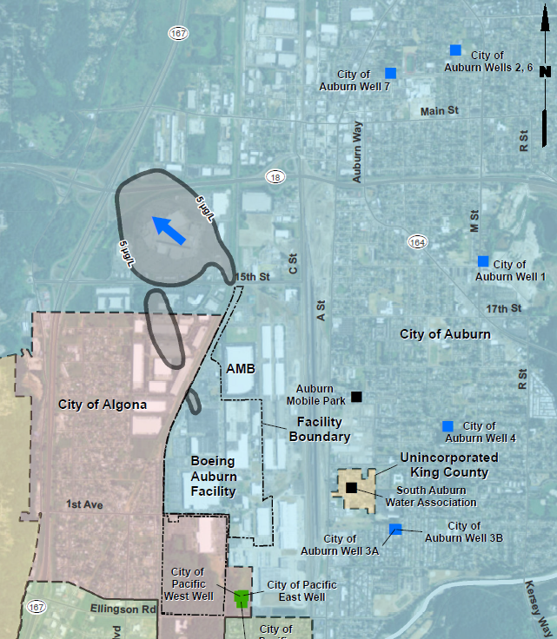
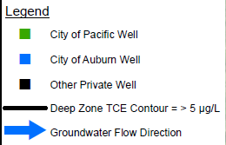
drinking water is safe
Groundwater flows away from wells
Notes:
Just to re-emphasize
Drinking water is safe
Drinking water for the City of Algona and Auburn comes from municipal wells.
These wells are located east of the plume and are not impacted by the groundwater contamination.
The groundwater flows away from the wells.
Municipal drinking water is regularly tested and monitored by the Department of Health.
[This map shows the contaminated groundwater plume in the Deep zone is 80-100 ft. Drinking water wells take water from there and deeper]

Slide 7
We are here
Notes:
Here’s a reminder of the process that we must follow according to our cleanup laws:
The remedial investigation was completed in 2017. We held a comment period.
From the RI we know:
Where GW contamination is located,
The concentrations,
And if there are risks for the environment or human health.
We also use the information from the RI to help us research the methods that Boeing will use to cleanup the contamination. That information will be included in the Feasibility Study
[click for “We Are Here”]
The Feasibility Study Report will be out for public comment in mid-2019.
We are doing that evaluation right now and will discuss it more in a moment
We also just finished a public comment period for Boeing’s Corrective Action Permit renewal.
July 19th- September 7th
This is not shown on the graphic
It was a procedural matter, not a result of any new development on the site
There were radio ads, mailers, listserv announcements and other outreach. We also attended Algona Family Fun Days.
As a reminder - Boeing pays for the cleanup.

Slide 8





What will be in the feasibility study?
Measurable CLEAN UP OBJECTIVES
CLEAN UP METHODS suited for the site
Methods are combined into CLEAN UP OPTIONS that meet the objectives. These are evaluated in the study.
Notes:
The objective of a feasibility study is to determine the best cleanup option for a site.
It starts with identify cleanup objectives: such as setting cleanup levels (concentrations of chemicals that are safe) for air, surface water, groundwater, and soil, and needing to achieve these within a reasonable timeframe
The next step is to screen clean up methods (sometimes called technologies) and identify which methods are best suited for the site
After a short list of the best methods applicable to the site, one or more of the methods are combined to meet the cleanup objectives in a variety of ways, these are known as clean up options. A range of cleanup options are developed that allow comparison of the benefits and disadvantages of different approaches.
The clean up options are evaluated relative to one another based on regulatory criteria; e.g., protectiveness, effectiveness, permanence, implementability, cost, and how quickly objectives are achieved.

Slide 9
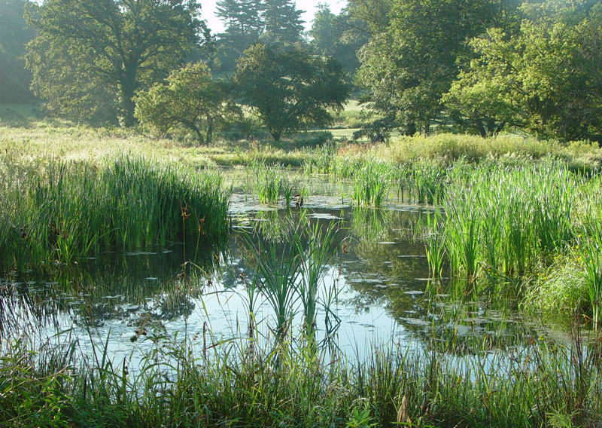
Monitored Natural Attenuation
Notes:
Note that there are many remedial technologies but not all are applicable to this particular case (large, dilute plume). Most likely potentially applicable technologies include the following.
MNA –Bacteria in soil and groundwater can, under natural conditions, break down chemicals into non-toxic end products. Analogy of wetland, where active biogeochemical processes clean water – same thing happens underground.
MNA- monitoring the natural degradation of contaminants to ensure that treatment is fast enough and no one is being exposed.

Slide 10
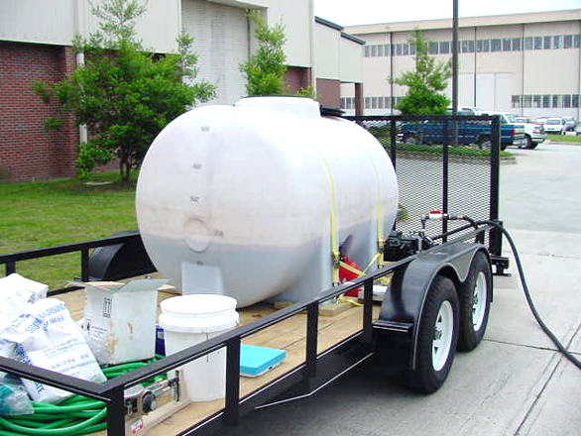
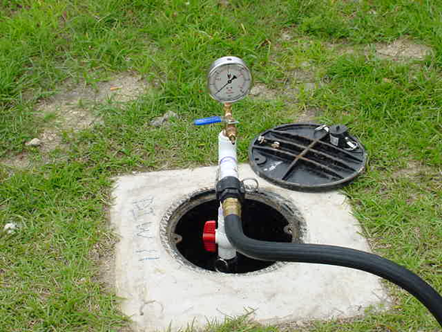
Enhanced Bioremediation
Notes:
Note that there are many remedial technologies but not all are applicable to this particular case (large, dilute plume). Most likely potentially applicable technologies include the following.
MNA/Bioremediation
Bacteria in soil and groundwater can, under natural conditions, break down chemicals into non-toxic end products.
MNA- monitoring the natural degradation of contaminants
Enhanced Bioremediation – stimulating with amendments (food/nutrients) to increase the degradation rate

Slide 11
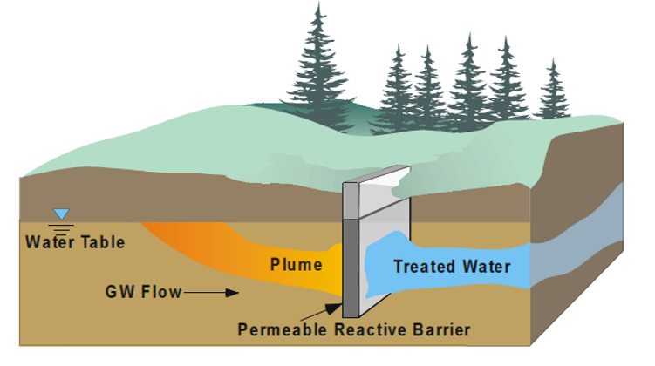
Chemical Treatment
Notes:
Physical/chemical treatment
Describe chemical treatment processes
Note that chemical treatment can be applied passively (e.g., permeable treatment wall) or actively (injected oxidants)
General note: technologies do not necessarily get applied to the entire plume; some may be focused on particular areas and combined with other technologies to address the rest of the site.

Slide 12
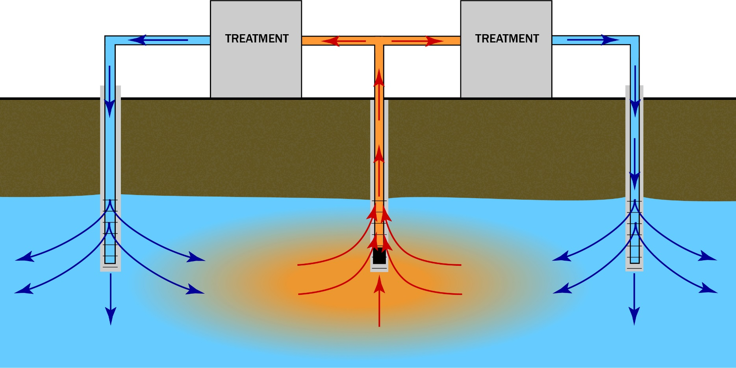
Dynamic Groundwater Recirculation
Notes:
Physical/chemical treatment
Describe pumping, treating, reinjecting
Clean water injection flushes out remaining contamination faster than natural attenuation
General note: technologies do not necessarily get applied to the entire plume; some may be focused on particular areas and combined with other technologies to address the rest of the site.

Slide 13

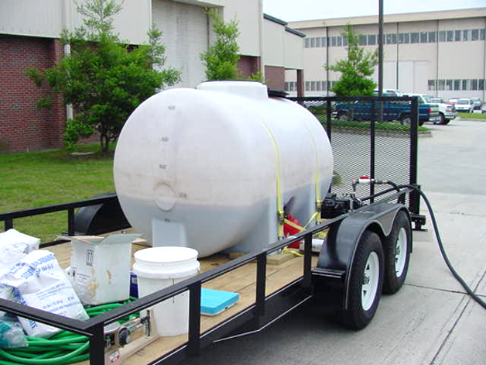
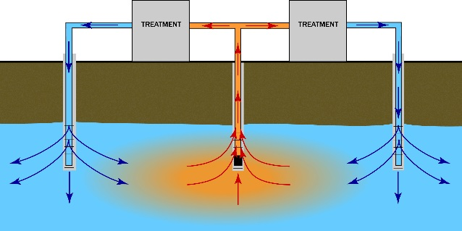

Example clean up options
OPTION A
OPTION B
Notes:
As a reminder, several clean up methods can go into one clean up option. Here is an example of two clean up options
Option A uses enhance bioremediation and Monitored Natural Attenuation
Option B uses a combination of Chemical Treatment, Dynamic Groundwater Recirculation, and Monitored Natural Attenuation

Slide 14
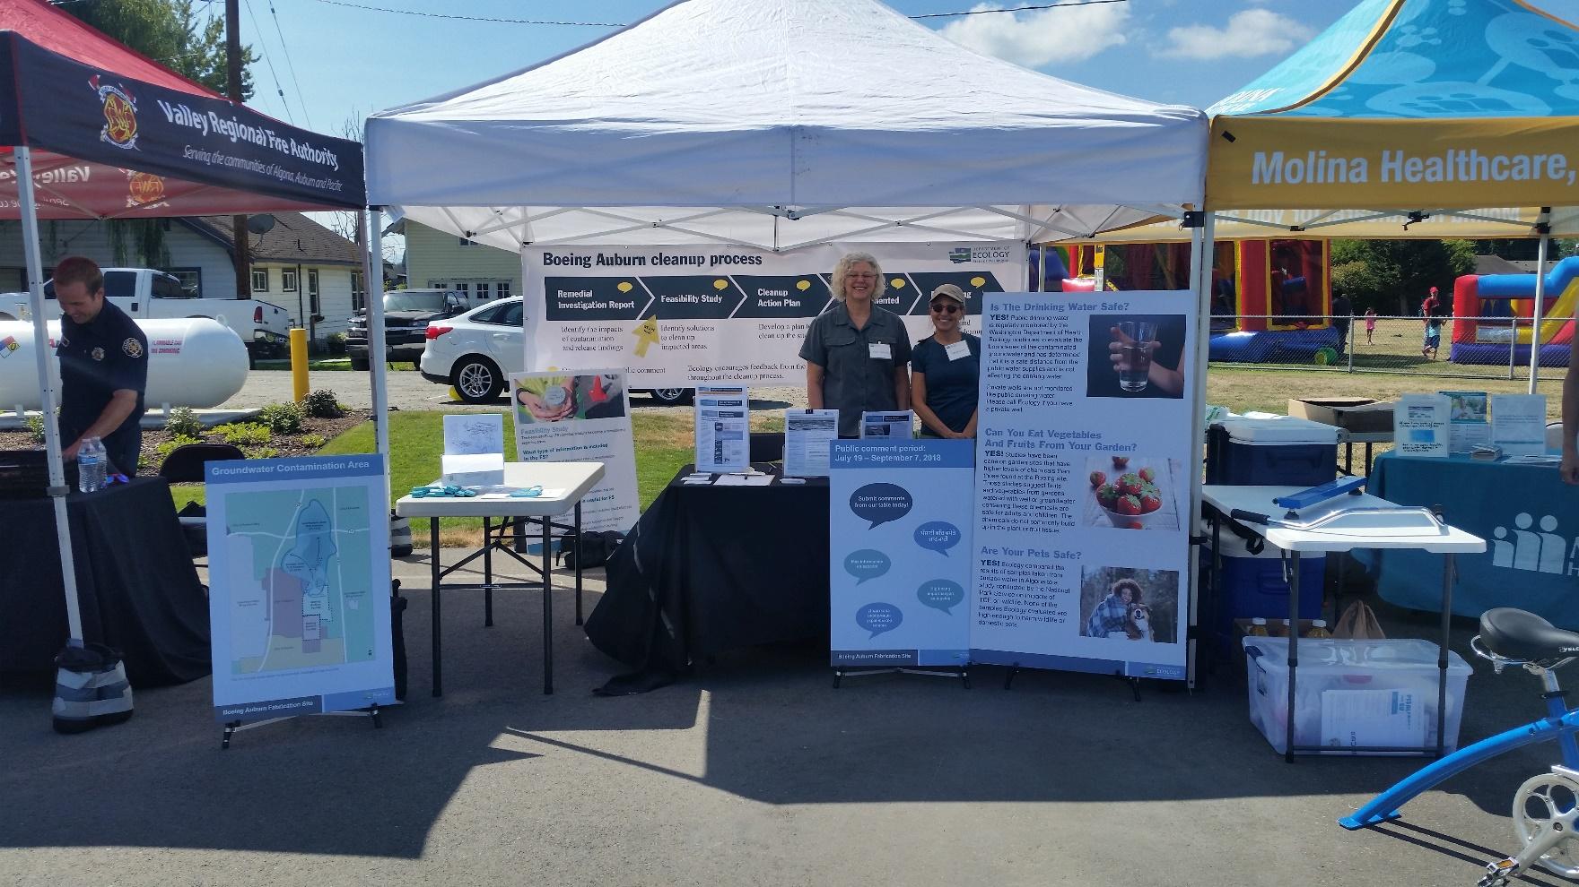
Recent community outreach
Algona Days – Aug 4, 2018

Slide 15
Upcoming community opportunities:
Wetland walk – 10/13, 10 am
  Auburn Environmental Park Boardwalk Trailhead
  Hosted by Futurewise
Technology workshop
  Before Feasibility Study is released and during the public comment period
  Ask questions and understand the different technologies and their processes
Feasibility Study public comment period
  2019
Notes:
We will be attending and hosting a few different opportunities for the public to ask questions and feel prepared for the public comment period of the feasibility study.
Wetland walk:
APAC is hosting a hour long wetland walk in October at the Auburn Environmental Park. We will be there.
Technology Workshop:
We are thinking about how best to explain the different cleanup methods.
One proposal is a technology workshops around the time of the Feasibility study’s release.
Purpose: ensure your community feels prepared to understand the feasibility study and participate in the public comment period.
We would explain technologies and its pros and cons.

Slide 16
Boeing Auburn Fabrication site
Robin Harrover
Site Manager
robin.harrover@ecy.wa.gov
425-649-7232

Slide 17
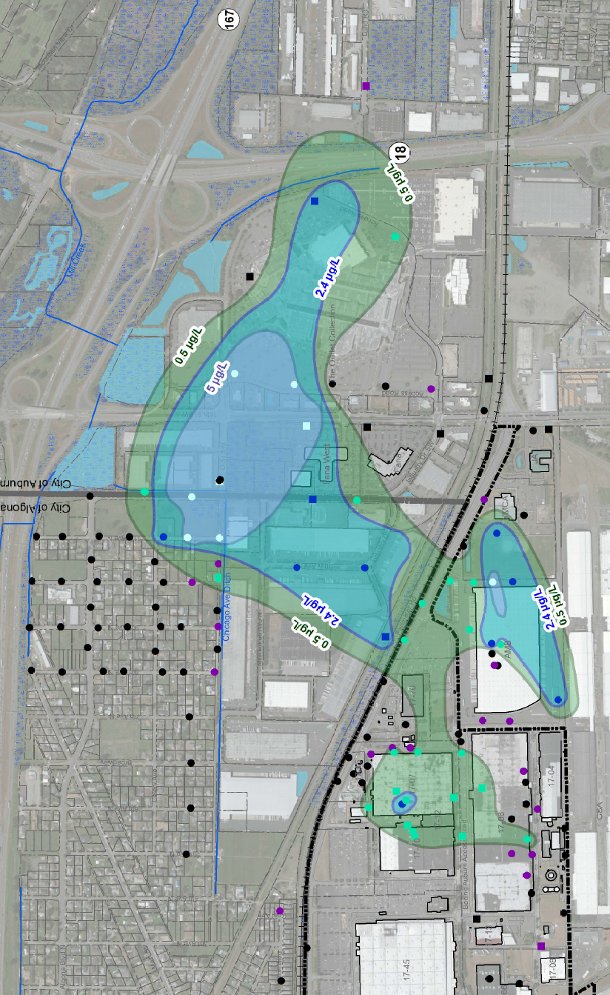
Groundwater Contamination is Stable
TCE in shallow groundwater
0 to 30 ft.
N
Notes:
Contaminated Groundwater Plumes Are Stable
The concentrations of chemicals (TCE and VC) are either the same, decreasing or not detected at most of the site’s wells.
There are nearly 300 wells that monitor the contamination in the groundwater.
That is a lot of wells. Other cleanup sites have far fewer.
That is why we consider the plume to be stable.
Exception: There are 16 wells that have had some detections of TCE and 12 wells that had detections of VC.
We will continue to track the monitoring of the plume.
This slide shows concentrations of TCE at three different depths below the surface.
Green
Blue
Light blue

Slide 18
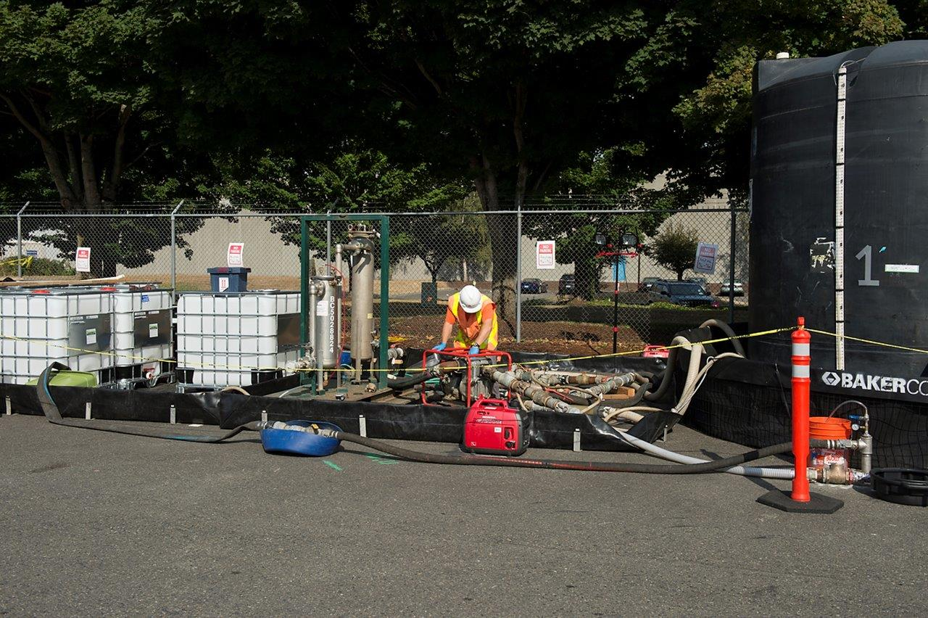
Enhanced Bioremediation
Notes:
Alternative picture

