Slide 1
Circle K Station 1461 Architectural & Engineering Project Support Informational Meeting
Department of Ecology
Toxics Cleanup Program
RFQ 2011 TCP
https://apps.ecology.wa.gov/gsp/Sitepage.aspx?csid=5089
October 3, 2019

Slide 2
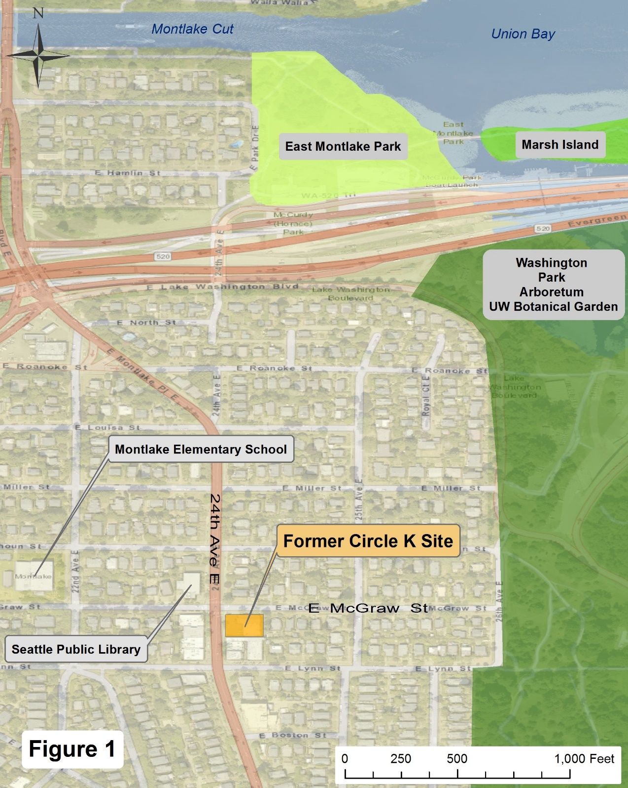
Notes:
Montlake Elementary School located two blocks west on E. McGraw

Slide 3
Site and Area Background
The Property is approximately 0.26 acres, located southeast of the intersection between 24 Ave East (a very busy street) and East McGraw Street, approximately 1800 feet south of Lake Washington. It is in the Montlake neighborhood which consists mainly of residential houses and buildings, with some small commercial business located west of the Site along 24th Ave East.
Notes:
Page 2 in handout

Slide 4
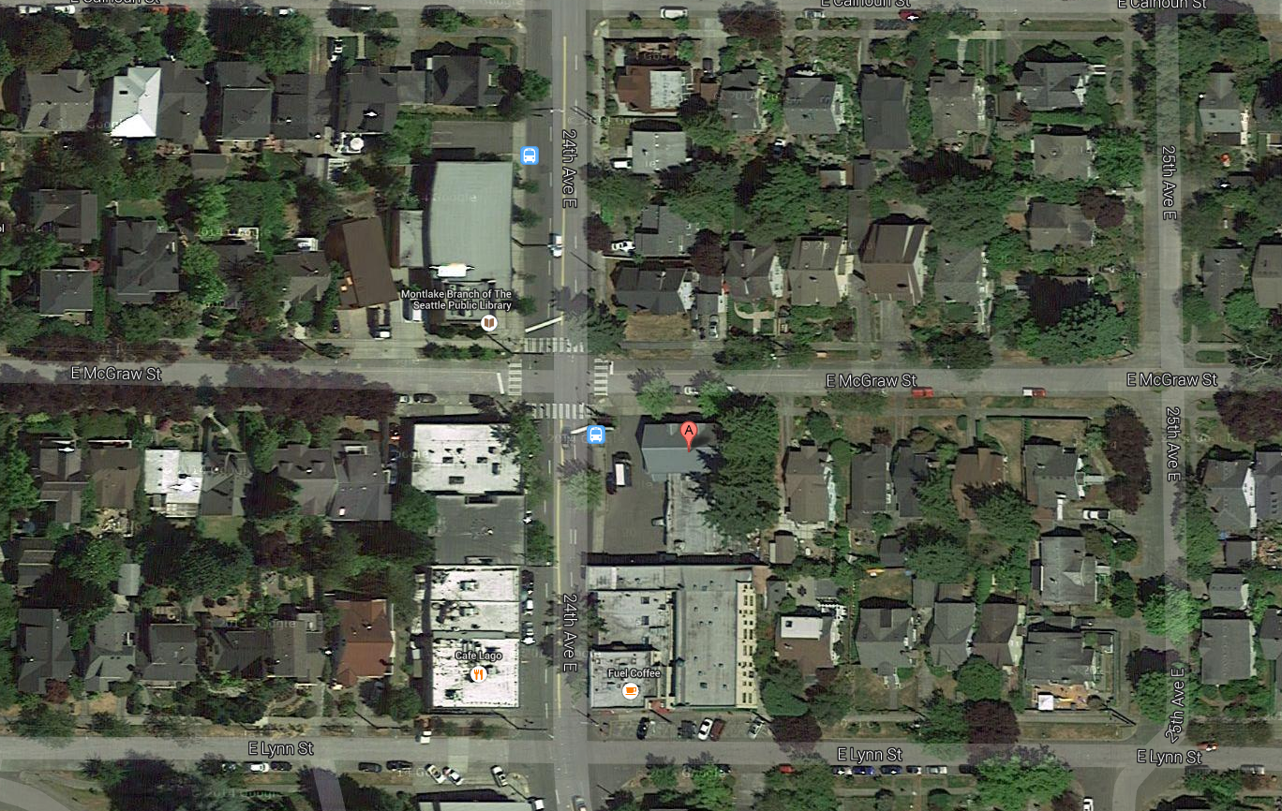
Establish Communication Protocol
Ecology’s Project Team
Nordic Properties Project Team
Chevron’s Project Team
Property Owners Project Team
Identify a primary point of contact
Other project team members
Notes:
Note the proximity to Montlake Library with Elementary School just off the map to the east

Slide 5
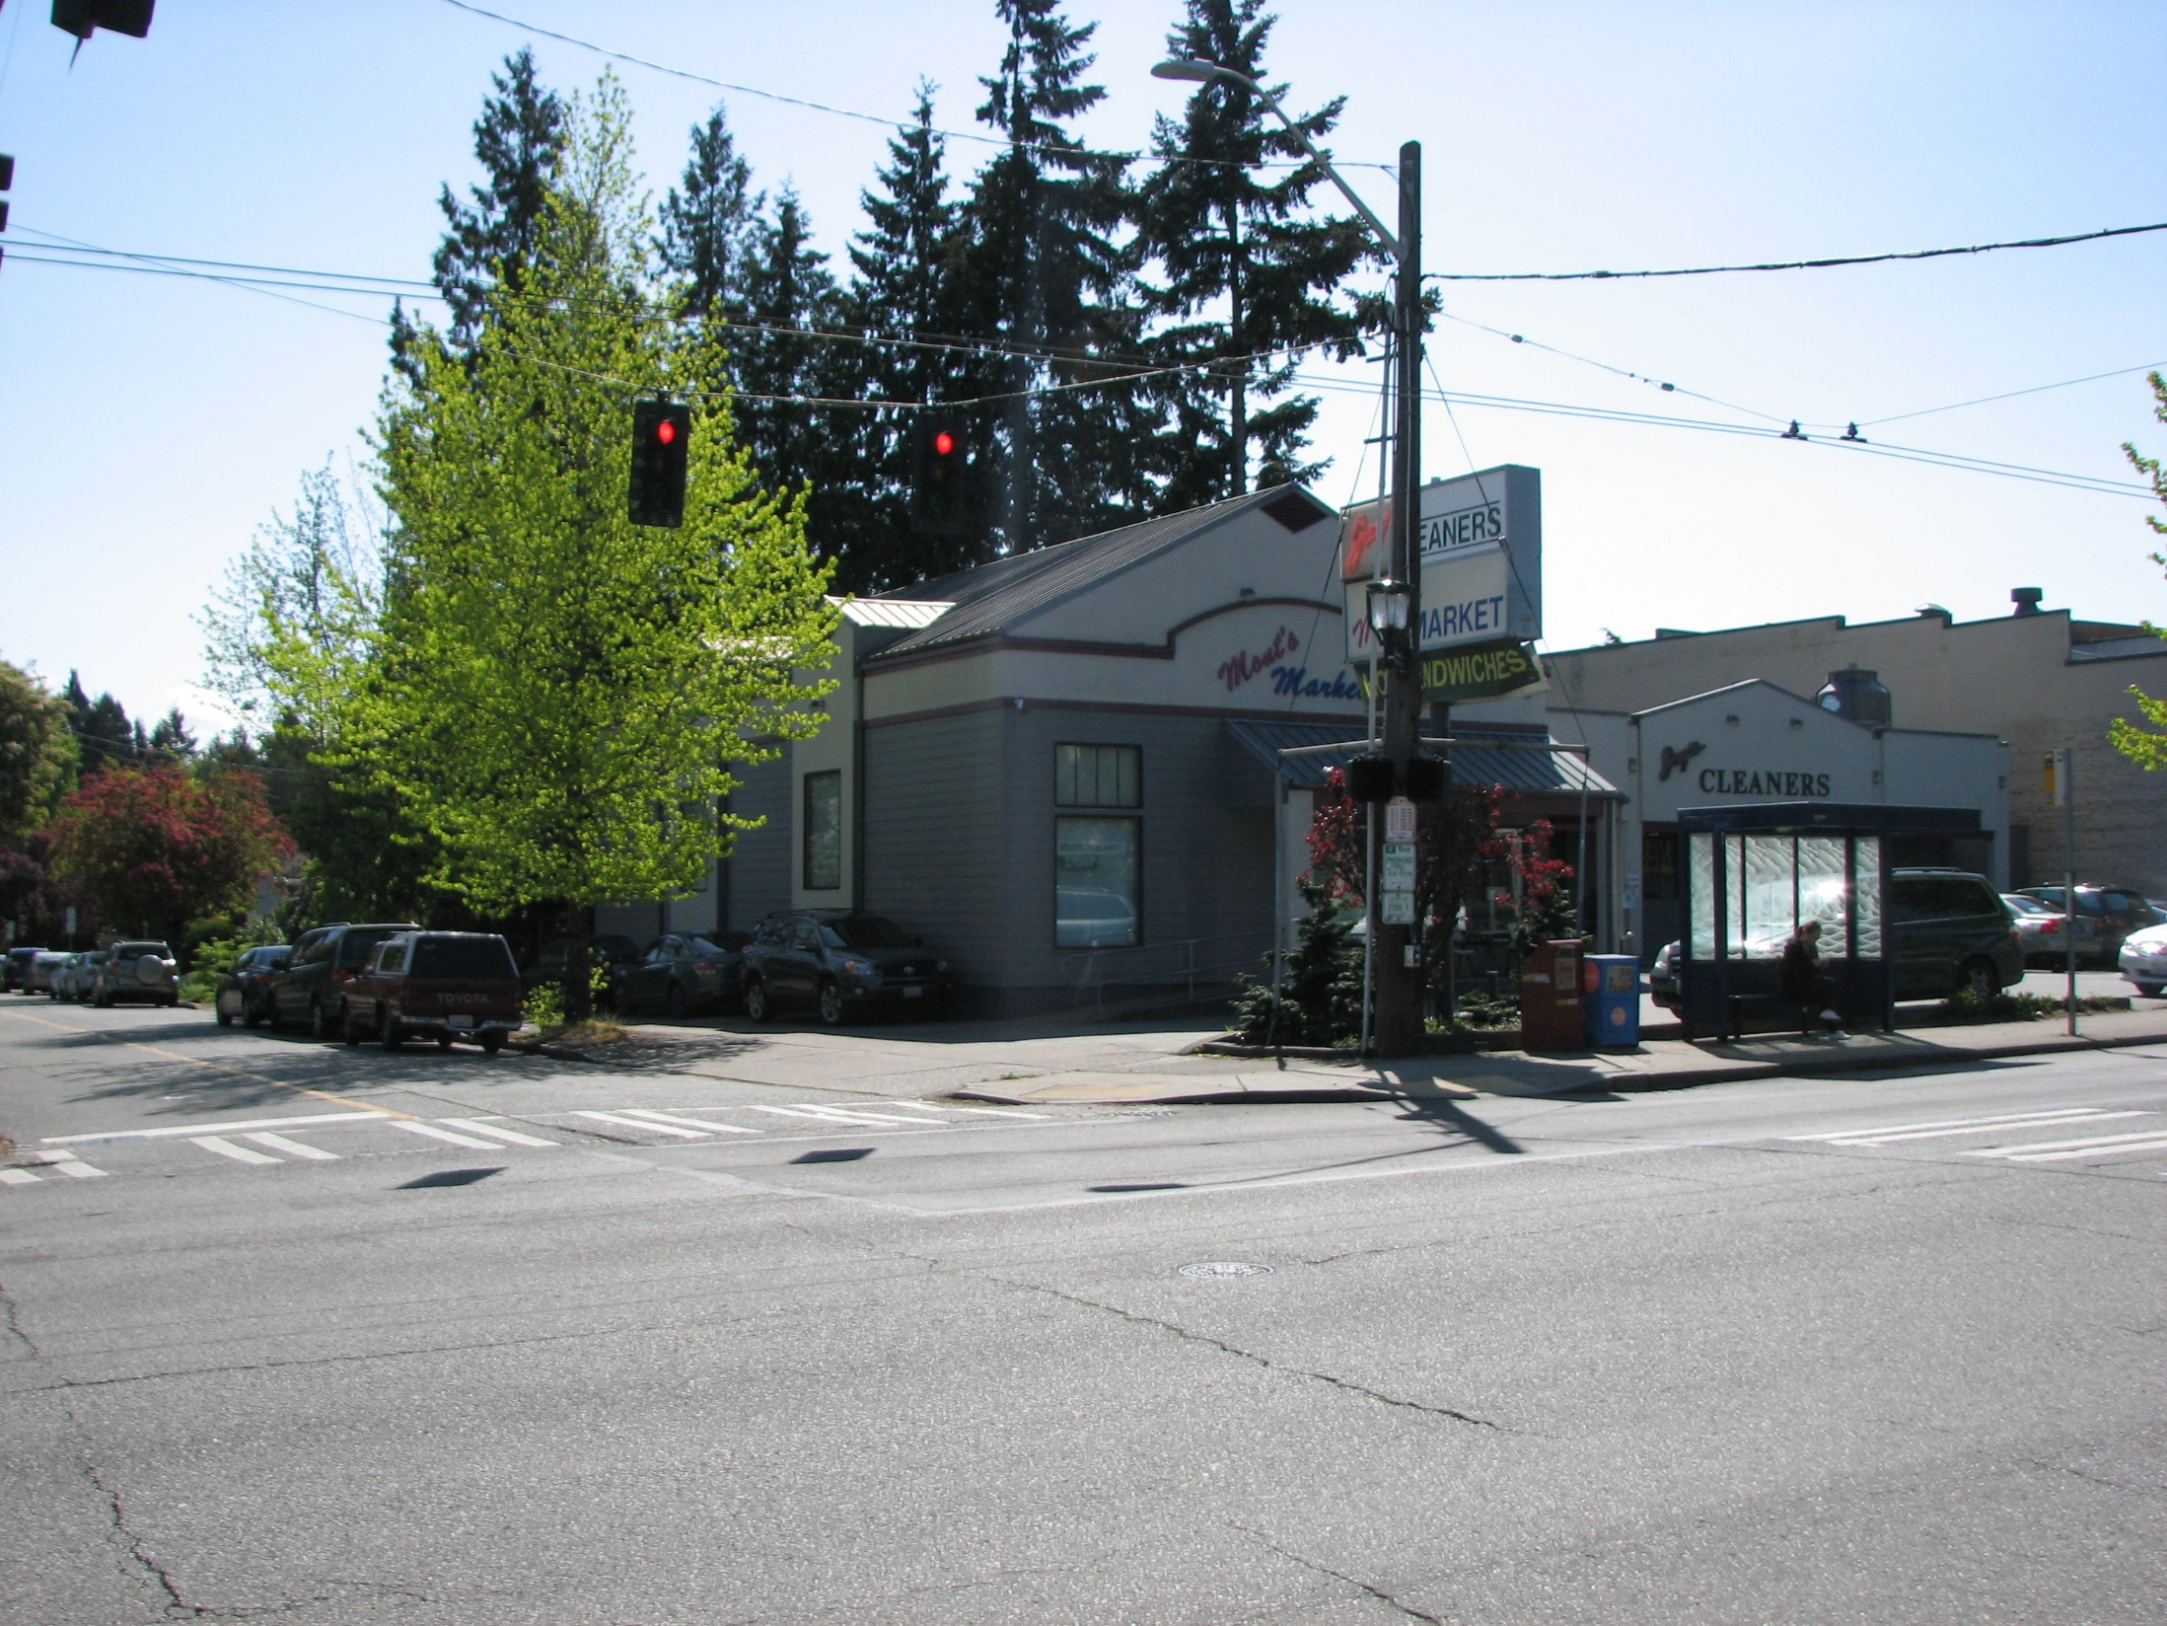
Establish Communication Protocol
Ecology’s Project Team
Nordic Properties Project Team
Chevron’s Project Team
Property Owners Project Team
Identify a primary point of contact
Other project team members
Notes:
Looking NNE E McGraw on left, 24th Ave E goes left to right, bus stop and bus electrical cables visible

Slide 6
Looking South on 24th Ave E
Notes:
24th Ave E has high traffic with people, children, and again note the electric bus cables

Slide 7
Really Tight Working Conditions

Slide 8
Looking South on 24th Ave E
Notes:
24th Ave E has high traffic with people, children, and again note the electric bus cables

Slide 9
Looking North on 24th Ave E
Notes:
Sorry about the rain splatter on the camera lens, this was a rainy morning

Slide 10
Looking west uphill E McGraw
Notes:
Morning School Traffic towards Montlake Elementary School, Children present weekdays 7-9AM & 2-4 PM

Slide 11
Montlake Library located across the Street on 24th Ave
Notes:
Again note the electric bus cables

Slide 12
Old Ecology Pump & Treat Vault
Notes:
Located on the north side of the building

Slide 13
Vault location on North Side of building
Notes:
Manhole cover north side of building

Slide 14
Inside the vault
Notes:
Can see the groundwater, If no longer needed this needs to be decommissioned

Slide 15
Remedial Investigation and Current Site Conditions
From April 2016 to May 2017 Ecology conducted and completed the Circle K 1461 Remedial Investigation (RI), a Feasibility Pilot Study, the Feasibility Study Report (FS), and the preliminary draft Cleanup Action Plan (DCAP).
Notes:
Page 3 of handout

Slide 16
Current Site Conditions
Soil Results
Figure 6 shows the approximate lateral extent of GRO concentrations that exceed the soil CUL.
The GRO concentrations appear to be highest in the western-central portion of the Site and may extend offsite beneath 24th Avenue East.
The lateral extent of impacted soil appears to be limited on the southern side to a short distance south of boring KJB‑13, on the eastern side to the approximate western edge of the building footprint (may extend beneath the building) and on the northern side to a short distance north of boring KJB-4.
Notes:
Page 3 of handout

Slide 17
Figure 6 Soil Sample Results
Notes:
Max GRO 43,000 inKJB-9 at west property line

Slide 18
Current Site Conditions Groundwater
Depth to groundwater at the Site ranges from approximately 9 to 12 feet. The current ground water flow direction at the Site is to the South-Southeast at a gradient of approximately 0.024 ft/ft and is depicted in Figure 11 Groundwater Potentiometric Surface 2016).
Notes:
Page 3-4 of handout

Slide 19
Figure 11 Groundwater Potentiometric Surface 2016
Notes:
GW flow direction South-Southeast, page 3 of handout

Slide 20
Current Site Conditions Groundwater
Analytical results from groundwater monitoring events conducted between 1989 and 2006 indicate the GRO and benzene concentrations exceeded the groundwater CUL on the northern side of East McGraw Street. However, the results from the 2016 events indicate that the petroleum hydrocarbon plume is at least stable and possibly diminishing in size over time.

Slide 21
Current Site Conditions
Gasoline Range Organics in GW
Figure 12 shows the approximate lateral extent of GRO in groundwater.
GRO concentrations reported in groundwater samples collected from the four wells (MW-4, MW-8, MW-9, and MW-13) and the four new wells (MW‑17, MW-19, MW-20, and MW-21) in December 2016 exceeded the MTCA Method A groundwater CUL.
GRO concentrations exceeding the MTCA Method A groundwater CUL were also reported for the reconnaissance groundwater samples collected from borings KJB-4 through KJB-10 and KJB-13, all of which are onsite.
As with soil, the GRO concentrations are highest in the western-central portion of the Site and may extend offsite to the west beneath 24th Avenue East and to the north beneath East McGraw Street.
Notes:
Page 3 of handout

Slide 22
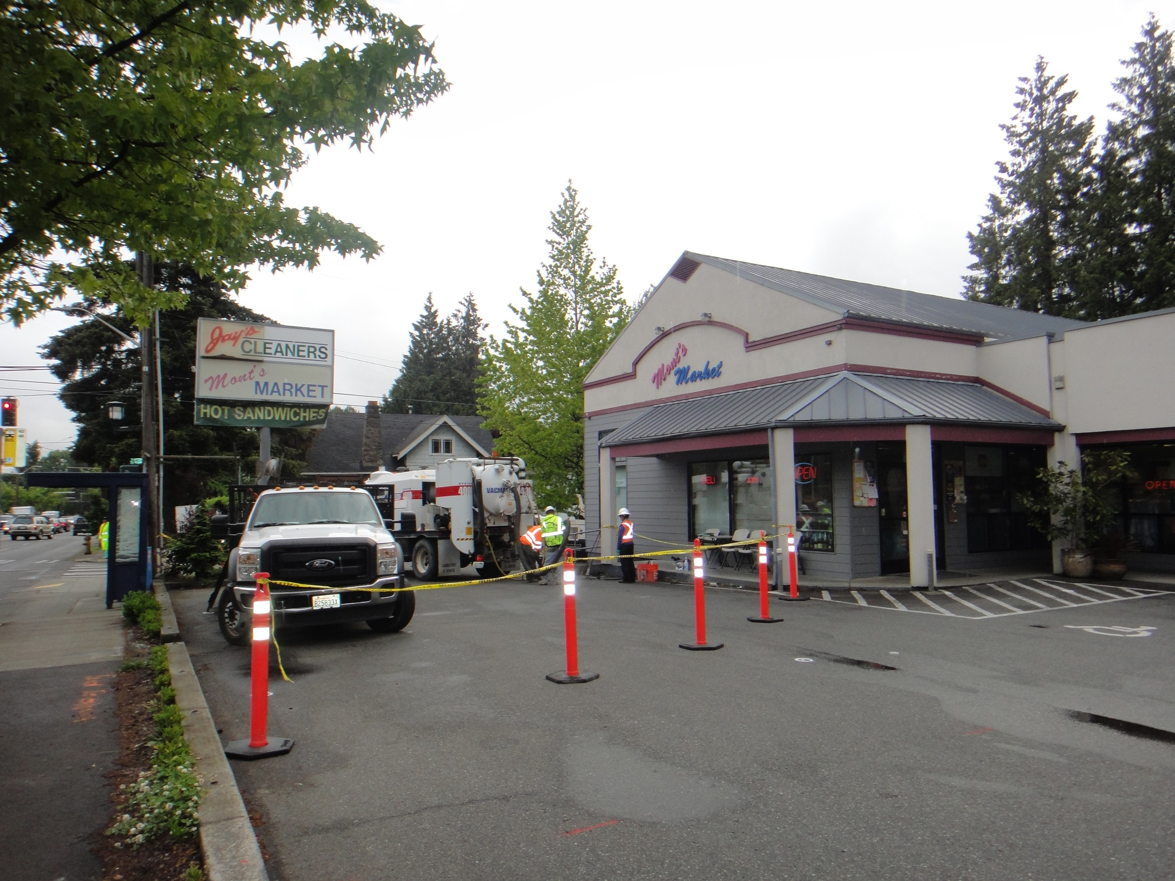
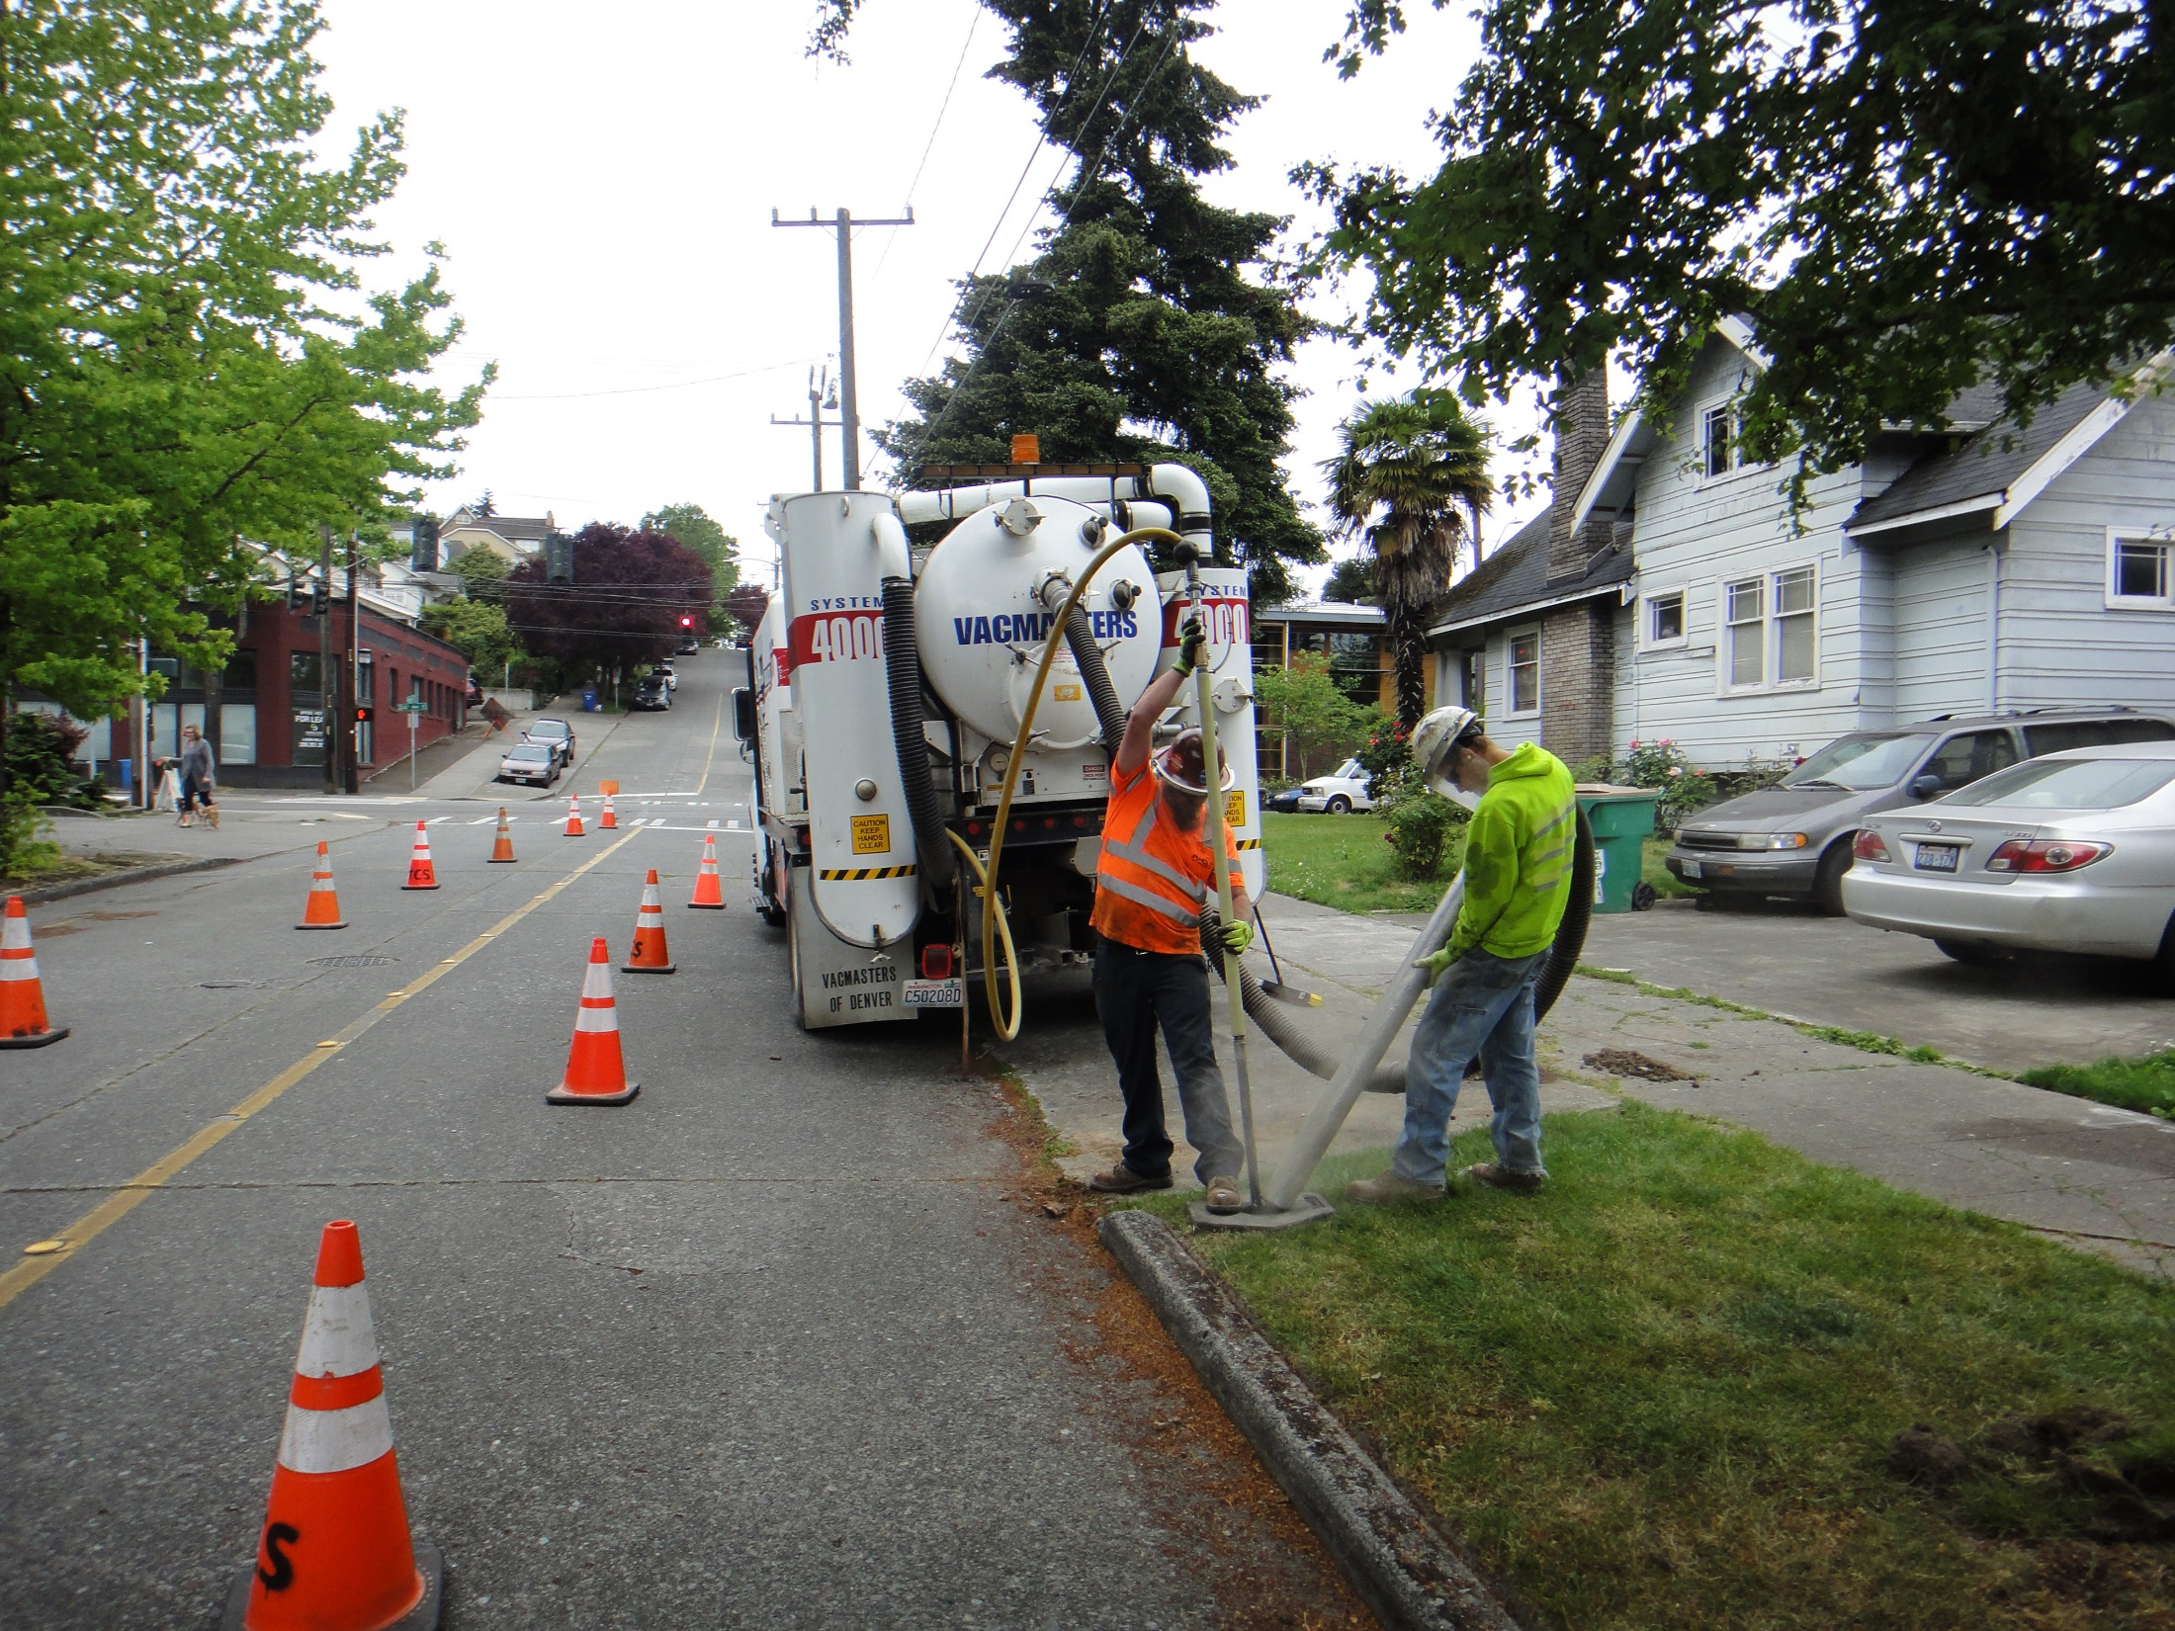
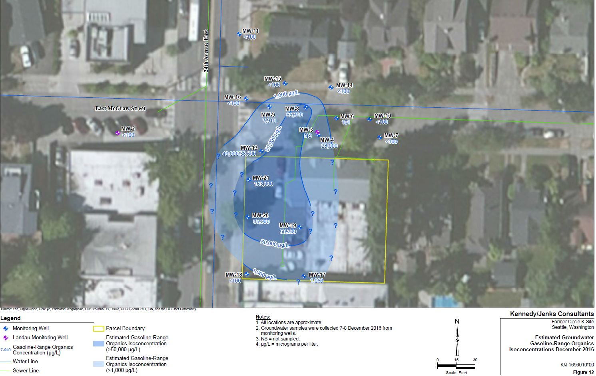
Notes:
Figure 12 GRO in Groundwater, 163,000 ppm in MW-21

Slide 23
Current Site Conditions
Benzene & EDC in GW
Figure 13 shows the approximate lateral extent of Benzene in groundwater.
Benzene concentrations exceed the groundwater CUL in generally the same locations as the GRO concentration exceedances, except as noted.
Benzene was either not detected or detected at a concentration less than the CUL in the groundwater samples collected from wells MW‑7 and MW-9, respectively, in 2016.
Benzene was reported above the CUL in the groundwater samples collected from well MW-6 in 2016. None of the fuel additives were detected in the groundwater samples analyzed for these compounds (samples collected from wells MW-20 and MW-21).
Similar to GRO, BTEX concentrations exceeding the MTCA Method A groundwater CUL were reported for the reconnaissance groundwater samples collected from borings KJB-4 through KJB-10 and KJB-13, all of which are onsite.
The 1-Ethyl-3-(3-dimethylaminopropyl)carbodiimide (EDC) concentration in the reconnaissance sample collected from KJB-8 exceeded the MTCA Method A groundwater CUL.
Notes:
Page 4 of handout.

Slide 24
Notes:
21,000 ppm in MW-21, VIA is discussed on page 4 of handout.

Slide 25
In Situ Bioremediation Pilot Study
To assist in the evaluation of remedial alternatives, a bioremediation pilot test was conducted to assess the efficacy of bioremediation for reducing petroleum hydrocarbon concentrations in groundwater.
The 7-day bioremediation pilot test was performed in March 2017
During the latter portion of the pilot test, traces of the injected surfactant solution were observed in monitoring wells located at least 15 feet away from the injection wells, indicating that the soil permeability in the saturated zone is amenable to injection and recirculation.
May 2017, approximately 2 months following the pilot study.
A preliminary evaluation of these data indicate that in general, constituent concentrations decreased on the western side of the site and increased or were consistent with previous results in the central portion of the site.
Notes:
Page 5 of handout

Slide 26
Notes:
Pilot Study location on Site Looking Northwest

Slide 27
Notes:
Pilot Study location on Site Looking South

Slide 28
Notes:
Pump and inject system for Pilot Study

Slide 29
Notes:
All injection and extraction wells were gaged on an hourly basis

Slide 30
Feasibility Study, Preferred Cleanup Alternative
Recommended Remedial Alternative
The preferred remedial action for the Site includes a combination of Alternative 5 (In Situ Bioremediation) to address impacted site saturated soil and groundwater and Alternative 2 (Soil Vapor Extraction) to support remediation of the vadose zone and to mitigate the VI pathway into on-property buildings.
Of the alternatives evaluated, Alternative 5 provides the shortest estimated timeframe for completion and the highest potential to permanently attain soil and groundwater cleanup levels.
Alternative 5 will not fully address the unsaturated zone and would not mitigate the VI pathway. Consequently, the combination of Alternative 5 and Alternative 2 is the most protective of human health and the environment and best addresses the remedial action objectives.
Notes:
We selected a combination of Alternative 5 and Alternative 2, page 6 of handout.

Slide 31
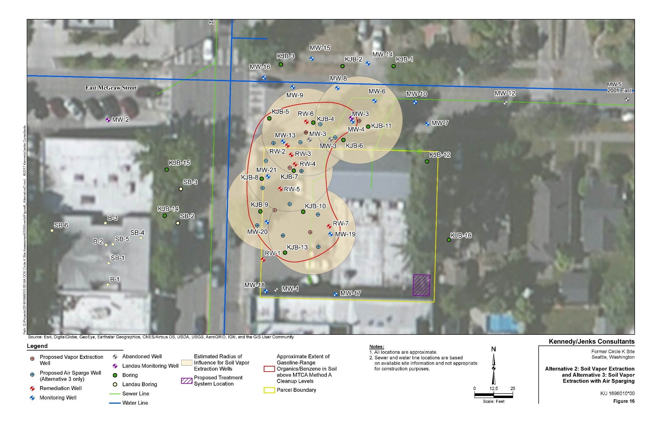
Figure 16 Soil Vapor Extraction
Notes:
Alternative 2, estimated radius of influence for SVE wells

Slide 32
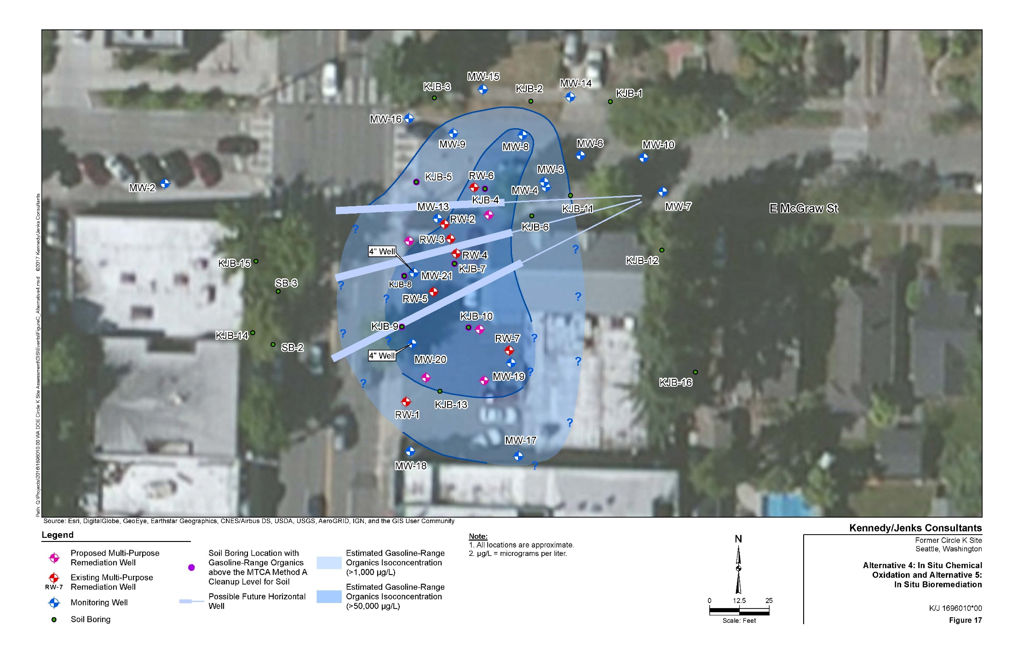
Figure 7 Soil Vapor Extraction & In-Situ Bioremediation
Notes:
Alternative 5, possible location for future horizontal wells

Slide 33
Cleanup Action Plan
Selected Remedial Alternative
The preferred remedial action for the site includes a combination of Alternative 5 (In Situ Bioremediation) to address impacted site saturated soil and groundwater and Alternative 2 (Soil Vapor Extraction (SVE)) to enhance remediation of the vadose zone and mitigate potential VI.
Alternative 5 involves injection of a low-concentration surfactant solution followed by injection and recirculation of a combination of extracted groundwater and amendments into the target cleanup area to stimulate biodegradation of GRO and BTEX in the saturated zone (including smear zone soils).
Alterative 2 involves the construction of several onsite SVE wells and connection of these wells to subsurface piping connected to aboveground blower/vapor treatment equipment.
The system will be operated until evaluation of extracted vapor monitoring results indicates that the concentration of volatile petroleum hydrocarbon in soil gas has declined appreciably and the VI pathway is no longer potentially complete exposure pathway.

Slide 34
Noise Control SVE System
The operation of the SVE will generate a low humming noise for approximately three to six months. A Noise Mitigation Plan must be developed during the design phase of the SVE System
The design must insure that any noise generated by the SVE will not exceed 55 decibels (dB(A)).
Notes:
SVE will not exceed 55 decibels (dB(A)) Residential as prescribed in the City of Seattle – Municipal Code, Title 25 Environmental Protection and Historic Preservation, Chapter 25.08 – Noise Control

Slide 35
Executive Order 05-05
Executive Order 05-05 (Archeological and Cultural Resources) requires Ecology to consult with the Department of Archaeology and Historic Preservation (DAHP) and any affected Tribes to determine potential impacts to cultural resources, and to develop an Inadvertent Discovery Plan if there is found that may be a historic or archaeological artifact or potential human remains.

Slide 36
RI/FS, DCAP, SEPA and Public Comment
Public Comment was held from September 17 to October 16, 2018 for the:
RI/FS,
DCAP,
State Environmental Policy Act (SEPA) Checklist,
Determination of Non‐Significance (DNS),
Executive Order 05-05 required Inadvertent Discovery Plan.
With no significant comments Ecology Finalized the draft Cleanup Action Plan without changes on November 17, 2018.

Slide 37
Questions ?

