Slide 1
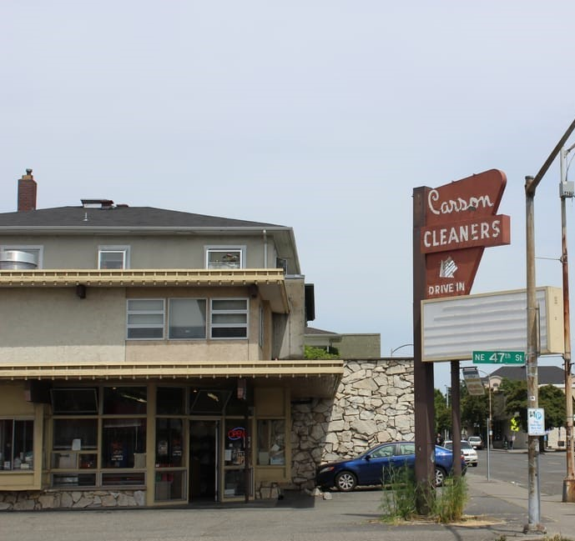
Agreed Order Kick-Off meeting
( Historic Carson Cleaners Store Front)
January 26, 2021 (1:00-3:00pm)
Notes:
Need better picture

Slide 2
Meeting Purpose
Initiate Agreed Order Negotiations.
Establish Communications Protocols.
Establish Expectations Related to Key Project Documents.

Slide 3
Agenda
1
Introduction
Project Teams Introduction & Opening Statements
2
Agreed Order Process
3
Key Project Documents
4
Site History, discovery, data gaps
5
Next Steps and Public Comment

Slide 4
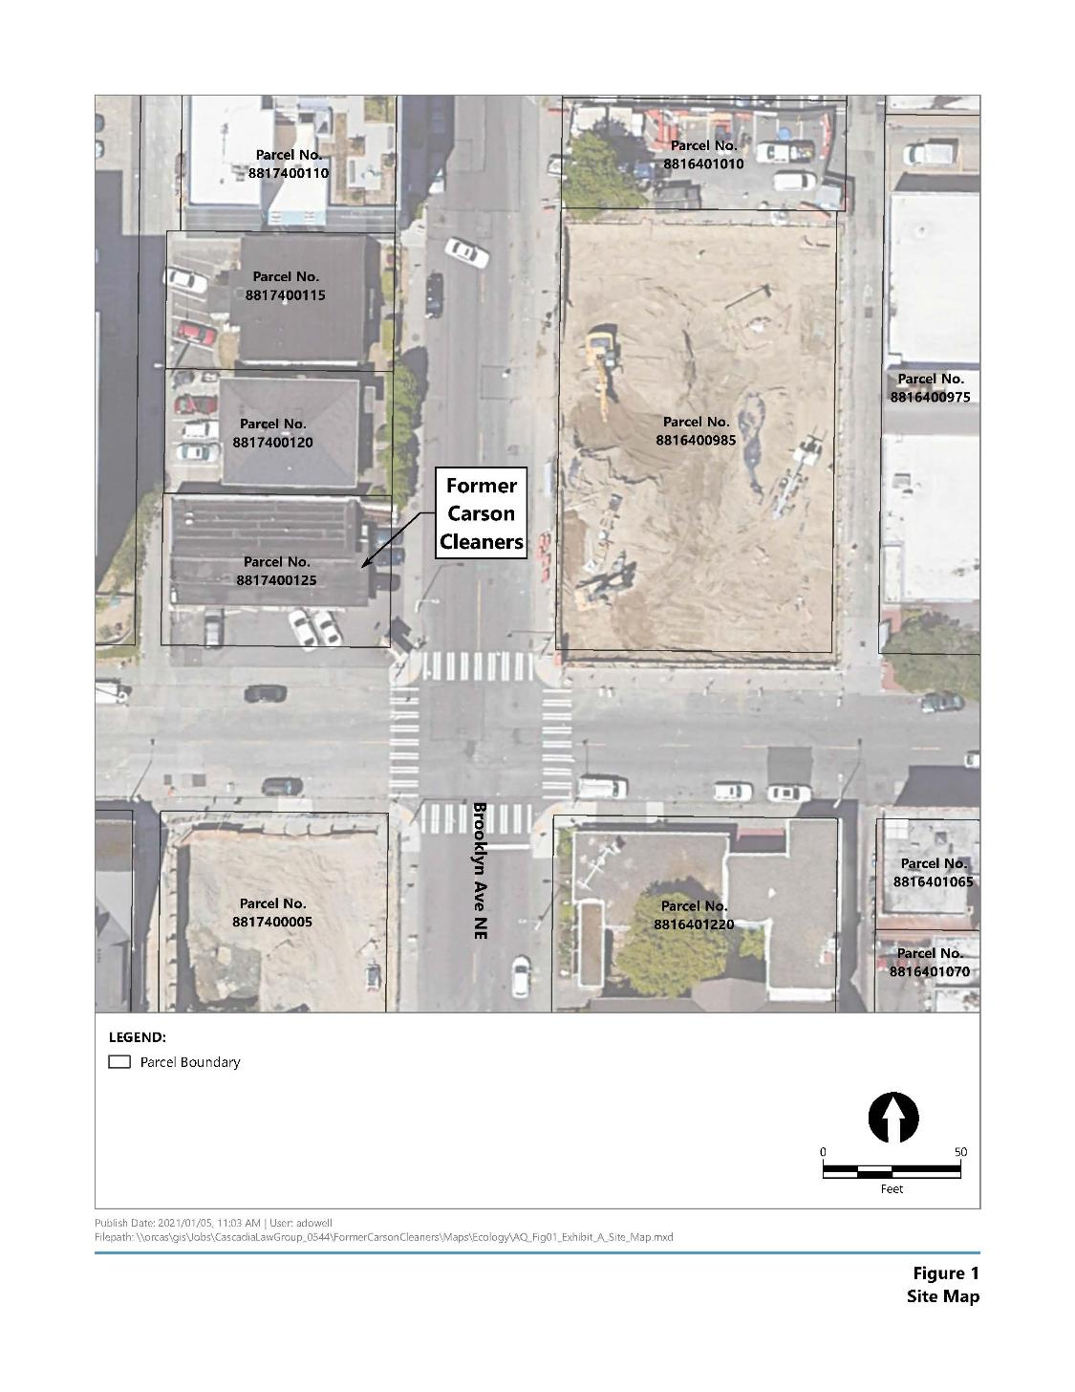
Site Area Map
4701 Brooklyn Ave. NE
Seattle, WA 98105

Slide 5
Why now?
Washington’s Formal Cleanup Process

Slide 6
Key Project Documents
Agency Review Draft RIWP
Remedial Investigation Work Plan (RIWP)
Draft RIWP Due Date
Due no later than 90-days after AO Effective date
Final RIWP due 30-days after receipt of Ecology Comments
Final RIWP Due

Slide 7
Key Project Documents
Agency Review Draft RI Report
60-days after completion of RI Field Work
Remedial investigation validated data uploaded to EIM
Remedial Investigation Report (RI)
Draft RI Due Date
90 days following receipt of remedial investigation validated data
Public Review draft RI Report due 30-days after receipt of Ecology Comments.
Final RI Report 30 days after receipt of Ecology comments, subsequent to public comment
Final RI Report Due

Slide 8
Key Project Documents
Agency Review Draft FS Report
Feasibility Study Report (FS)
Draft FS Report Due Date
90 days following Ecology approval of Public Review Remedial Investigation Report
Public Review draft FS Report due 30-days after receipt of Ecology Comments.
Final FS Report 30 days after receipt of Ecology comments, subsequent to public comment
Final FS Report Due

Slide 9
Key Project Documents
Agency Review Draft DCAP
Draft Cleanup Action Plan (DCAP)
Draft DCAP Due Date
Agency Review Draft DCAP
Due 90 days following approval of Public Review draft FS Report
Public Review draft DCAP due 30-days after receipt of Ecology Comments.
Final FS Report Due

Slide 10
Key Project Meetings
Agreed Order Project Kick-Off Meeting.
Remedial Investigation Planning Meeting
Will be scheduled during Public Comment Period
Remedial Investigation Pre-Report Check-in Meeting
Before the RI Report is submitted to agree on what needs to be included in the report
Feasibility Study Planning Meeting
review the preliminary FS Report, provide comment
Cleanup Action Plan Meeting
After public review of the RI/FS (if RI/FS goes out Public Comment separate)

Slide 11
Project History Timeline
Carson Cleaners, Inc. began dry cleaning operations as a tenant in the early 1960’s until 2014,.
1960’s - 2014
As part of an environmental cleanup of the former Chevron 90129 Site across the street from this former dry cleaners, dry cleaning chemicals in the form of halogenated volatile organic compounds
(HVOCs), were discovered in the southwestern portion of the property and along the perimeter of NE 47th Street.
2018-2019
2019

Slide 12
Project History Timeline
Vapor Intrusion Assessment performed by Anchor
2020

Slide 13
Chemicals of Concern; Halogenated Volatile Organic Compounds (HVOC)
Chemicals of Concern:
Trichloroethylene (TCE)
Tetrachloroethylene (PCE)
1,1-Dichloroethene and 1,2-Dichloroethene, known collectively as Dichloroethene (DCE)
Vinyl Chloride (VC)

Slide 14
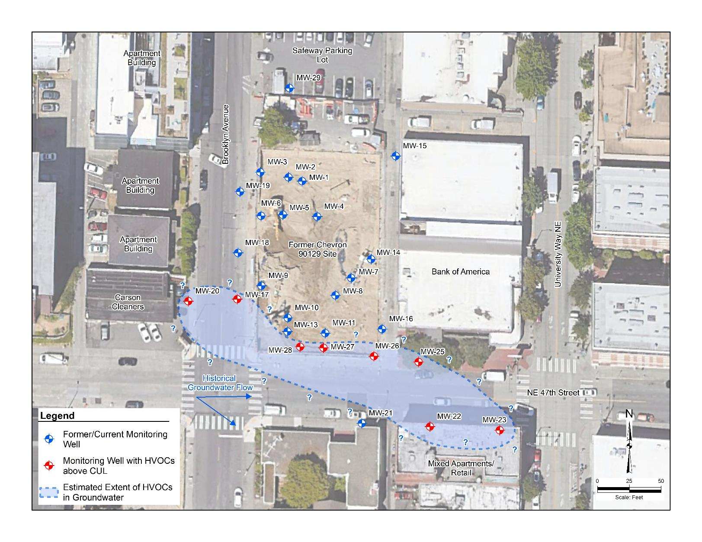
HVOC in Groundwater
Notes:
This figure will be replaced

Slide 15
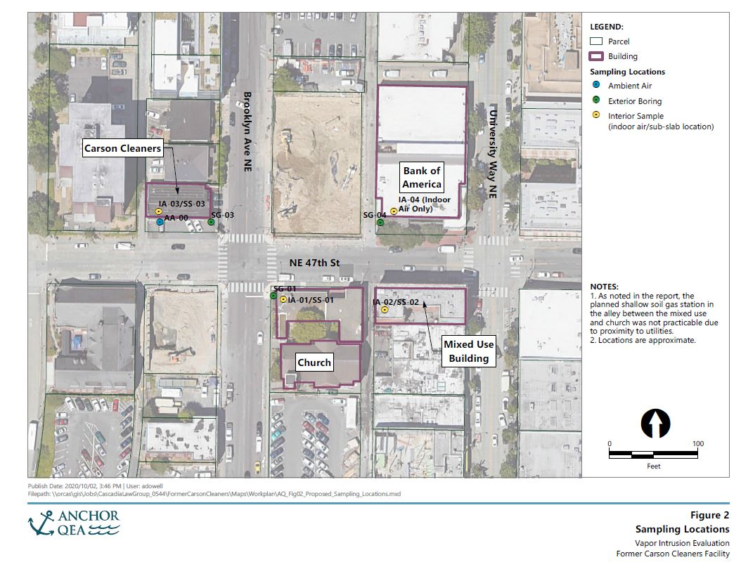
Vapor Intrusion Study Sample Locations

Slide 16
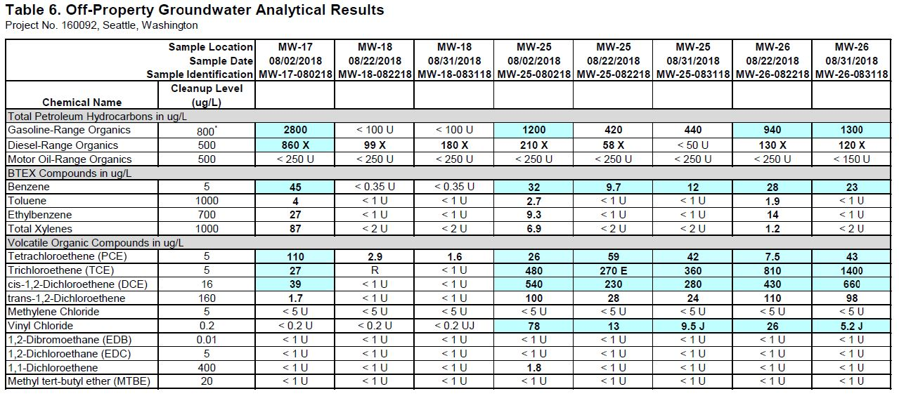
HVOC in Groundwater

Slide 17
Next Steps
3
Cleanup the remaining contamination.
Implement the Cleanup Action Plan
Develop a Cleanup Action Plan
2
Complete a site characterization, select a cleanup remedy, and develop the Cleanup Action Plan.
Agreed Order
1
Ecology and Tahn Associates will enter into a legal agreement, called and Agreed Order, to being the environmental cleanup.

Slide 18
Public Participation
Ecology informs the community by:
Mailing a community information sheet to households in the area.
Holding an online public meeting.
Placing a newspaper ad about the comment period in the Seattle Times.
Drafting a Public Participation Plan that outlines how the public is informed about this cleanup site.
Holding a public comment period.

Slide 19
Out Reach Materials
Ecology prepares Out Reach Documents:
Have drafted Fact Sheet, Display Ad, and Public Participation Plan.
As a courtesy, I will share draft’s for you to review with 30-day response time.
Placing a newspaper ad about the comment period in the Seattle Times.
Holding a public comment period.

Slide 20
Questions?
Dale Myers, Site Manager
Toxics Cleanup Program
3190 160th Ave SE
Bellevue, WA 98008
Email:
Dale.Myers@ecy.wa.gov
Phone #:
425.649.4446

